Slide 1
2015 IECC Commercial Electrical Power and Lighting Systems
PNNL-SA-105485
Notes:
1

Slide 2
Why Care About IECC?
  Energy codes and standards set minimum efficiency requirements for new and renovated buildings, assuring reductions in energy use and emissions over the life of the building. Energy codes are a subset of building codes, which establish baseline requirements and govern building construction.
  Code buildings are more comfortable and cost-effective to operate, assuring energy, economic and environmental benefits.

Slide 3

Commercial Compliance Options
2015 IECC - Prescriptive
2015 IECC - Performance
1
ASHRAE 90.1-2013
2
C402 - Envelope
3
C407 – Total Building Performance
OR
C403 - Mechanical
OR
C404 - SWH
C402.5 – Air Leakage
C405 - Lighting
C403.2 – Provisions applicable to all mechanical systems
AND
Pick One C406:
C404 - SWH
C406.2 – Eff. HVAC Performance
Lighting Mandatory Sections
or
C406.3 – Reduced Lighting Power Density
C405.2
C405.3
C405.4
C405.6
or
C406.4 – Enhanced Lighting Controls
or
C406.5 – On-site Supply of Renewable energy
Building energy cost to be ≤ 85% of standard reference design building
or
C406.6 – Dedicated Outdoor Air System
or
C406.7 – High Eff. Service Water Heating
Notes:
Tenant spaces shall comply with Section C406.1.1

Slide 4
When do the Lighting and Power Requirements Apply?
Original Installed Lighting System in a New Building, Addition, or Tenant Build-out
Existing Lighting System that is Altered
Change in Occupancy that Increases Energy
Change in Occupancy that requires less LPD as shown in the LPD tables
Exceptions:
  Historic buildings
    State or National listing
    Eligible to be listed
  Alterations where less than 10% of the luminaires in a space are replaced and installed interior power lighting is not increased
  Lighting within dwelling units
    Where ≥ 75% of permanently installed fixtures (except low-voltage) are fitted for and include high-efficacy lamps
  Walk-in coolers, walk-in freezers, refrigerated warehouse coolers, and refrigerated warehouse freezers comply with C403.2.15 or C403.2.16
Notes:
C403.2.15 – Lights:
Light sources with an efficacy > 40 lumens/W including ballast losses or use light sources with efficacy > 40 lumens/W including ballast losses in conjunction with a device that turns lights off within 15 minutes of space not occupied
C403.2.16 – Lights:
Light source efficacy > 40 lumens/W including ballast losses or provided with a device that automatically turns off lights within 15 minutes walk-in cooler or freezer was last occupied

Slide 5
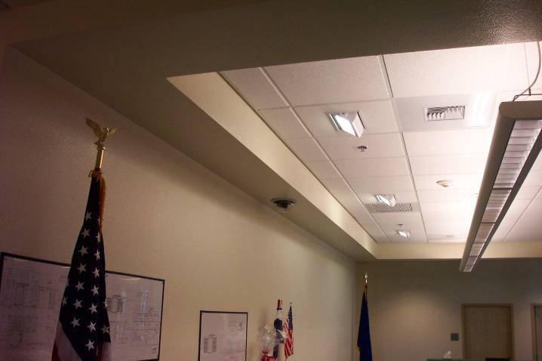
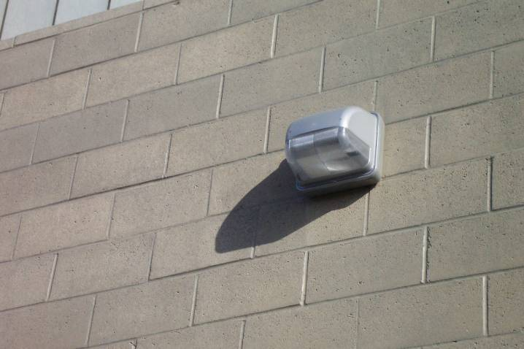
What’s Covered Under Electrical Power and Lighting Systems Requirements?
Mandatory Interior Lighting requirements
  Required Controls
  Wattage/Efficiency Limits
Interior Lighting Power Allowances (watts/ft²)
Exterior Lighting Controls
  Required Controls
  Lamp Efficiency
Exterior Lighting Power Allowances (watts/ft²)
Electric Metering
Electrical Transformers and Motors
Vertical and Horizontal Transportation Systems and Equipment

Slide 6
What’s Covered Under Electrical Power and Lighting Systems Requirements?
Exception:
Dwelling units within commercial building are not required to comply IF they comply with the residential Section R404.1
A minimum of 75 percent of the lamps in permanently installed lighting fixtures are high-efficacy lamps or 75% of permanently installed lighting fixtures contain only high efficacy lamps
  Exception:
Low-voltage lighting

Slide 7
High-Efficacy Lamps - Definition
Compact fluorescent lamps, T-8 or smaller diameter linear fluorescent lamps, or lamps with a minimum efficacy based on lamp wattage
Lamp Wattage | Efficacy
> 40 watts | 60 lumens/watt
15-40 watts | 50 lumens/watt
< 15 watts | 40 lumens/watt

Slide 8
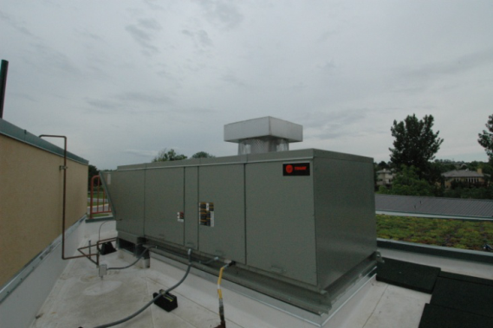
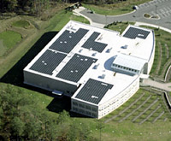
Additional Efficiency Package Options
Section C406
One additional efficiency feature must be selected to comply with the IECC
  More efficient HVAC performance, OR
  Reduced lighting power density system, OR
  Enhanced lighting controls, OR
  On-site supply of renewable energy, OR
  Dedicated outdoor air system, OR
  More efficient SWH
High Efficiency HVAC
More Efficient Lighting System
Onsite Renewables
Notes:
Onsite renewables “regulated energy” = energy used within the building for building mechanical and service water heating equipment and lighting regulated by Chapter C4.

Slide 9
Additional Efficiency Package Options
Section C406
Reduced lighting power per C406.3
  Whole building LPD determined using 90% of values in Table C405.4.2(1) x floor area for the building types OR
  Using 90% by the space-by-space method in Section C405.4.2
  Determine total LPD of building using reduced whole building interior lighting power in Table 406.3 x floor area for the building types

Slide 10
Additional Efficiency Package Options
Section C406 – Cont’d.
Enhanced digital lighting controls per C406.4, controls located and operated in accordance with C405.2.2:
  Luminaires capable of continuous dimming
  Luminaires capable of being addressed individually OR a controlled group of < 4 luminaires
  < 8 luminaires controlled together in a daylight zone
  Fixtures controlled through digital control system that includes the following function:
    Control reconfiguration based on digital addressability
    Load shedding
    Individual user control of overhead general illumination in open offices
    Occupancy sensors capable of being reconfigured through the digital control system
  Construction documents including submittal of Sequence of Operations including specs outlining each function of the fixture requirements above
  Functional testing of controls comply with C408

Slide 11
Interior Lighting Power Allowance
Section C405.4.2
Two methods to determine allowance:
Building Area Method
  Floor area for each building area type x value for the area
  “area” defined as all contiguous spaces that accommodate or are associated with a single building area type as per the table
  When used for an entire building, each building area type to be treated as a separate area
Space-by-Space Method
  Floor area of each space x value for the area
  Then sum the allowances for all the spaces
  Tradeoffs among spaces are allowed
Notes:
The total interior lighting power (watts) equals the sum of all areas interior lighting powers in the building covered within the permit.
Two compliance options: building area method per Table C405.4.2(1) or Space-by-Space Method per Table C405.4.2(2).

Slide 12
Building Area Method
Table C405.4.2(1)
Building Area Type | LPD (w/ft²)
Automotive facility | 0.8
Convention center | 1.01
Courthouse | 1.01
Dining: bar lounge/leisure | 1.01
Dining: cafeteria/fast food | 0.9
Dining: family | 0.95
Dormitory | 0.57
Exercise center | 0.84
Fire station | 0.67
Gymnasium | 0.94
(partial table)
Notes:
Table C405.4.2(1)

Slide 13
Space-By-Space Method
Table C405.4.2(2)
Common Space-by-Space Types | LPD (w/ft²)
Atrium – First 40 feet in height | 0.03 per foot in total height
Atrium – Above 40 feet in height | 0.40+0.02 per foot in total height
Audience/seating area – permanent
In an auditorium | 0.63
In a convention center | 0.82
In a gymnasium | 0.65
In a motion picture theater | 1.14
In a penitentiary | 0.28
In a performing arts theater | 2.43
Classroom/lecture hall/training room
In a penitentiary | 1.34
Otherwise | 1.24
(partial table)
Notes:
Table C405.5.2(2)
Note: the space types are not in the exact order per table

Slide 14
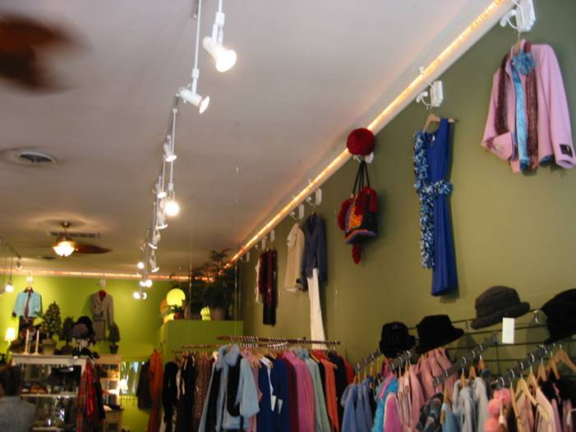
Additional Interior Lighting Power
Section C405.4.2.2.1
Additional Interior Lighting Power Allowance = 500 watts +
(Retail Area 1 x 0.6 W/ft2) +
(Retail Area 2 x 0.6 W/ft2) +
(Retail Area 3 x 1.4 W/ft2) +
(Retail Area 4 x 2.5 W/ft2),
Where:
Retail Area 1 = the floor area for all products not listed in Retail Area 2, 3 or 4.
Retail Area 2 = the floor area used for the sale of vehicles, sporting goods and small electronics.
Retail Area 3 = the floor area used for the sale of furniture, clothing, cosmetics and artwork.
Retail Area 4 = the floor area used for the sale of jewelry, crystal, and china.
Notes:
Where using the space-by-space method, an increase is permitted only where specified lighting is installed and automatically controlled separately from general lighting
Specific accommodation has been made for retail merchandise highlighting in the 2015 IECC. These are IN ADDITION TO general lighting.
Floor area is the specific area to highlight merchandise. For example, track lighting installed to highlight a wall display of shoes – would qualify. Overhead, general lighting not specifically aimed at the wall of shoes would not qualify.

Slide 15
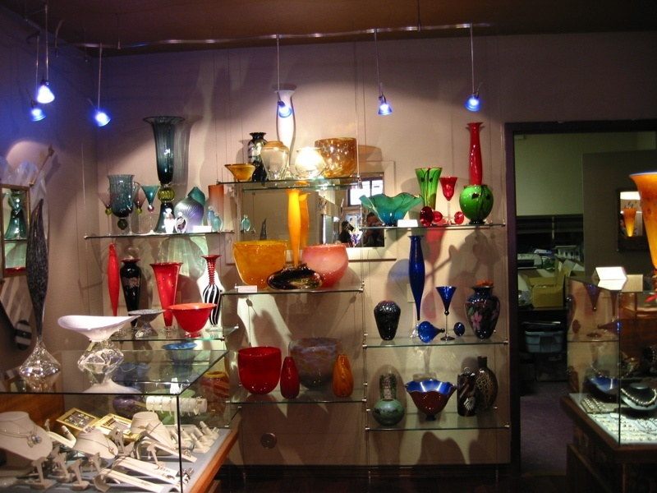
Additional Interior Lighting Power
Section C405.4.2.2.1
Exception:
Other merchandise categories are permitted to be included in Retail Areas 2 through 4 above, provided that justification documenting the need for additional lighting power based on visual inspection, contrast, or other critical display is approved by the code official
For spaces which lighting is specified to be installed in addition to general lighting or purpose of decorative appearance or for highlighting art or exhibits, provided that the add’l lighting power is < 10.7 W/ft² of such spaces
Photo courtesy of Ken Baker, K energy

Slide 16
Proposed Connected Lighting Calculation
Section C405.4.1
Proposed lighting wattage must be calculated in accordance with Equation 4-9
    TCLP = [SL + LV + LTPB + OTHER]
TCLP = total connected lighting power (watts)
SL = labeled wattage of luminaires for screw-in lamps
LV = wattage of the transformer supplying low-voltage lighting
LTPB = wattage of line-voltage lighting tracks and plug-in busways as the specified wattage of the luminaires but at least 30 W/linear feet or wattage limit of the systems circuit breaker, or the wattage limit of other permanent current-limiting devices on the system
OTHER = the wattage of all other luminaires and lighting sources not covered previously and associated with interior lighting verified by data supplied by the manufacturer or other approved sources
Notes:
Screw lamp holders = typical Edison based – this is whatever the factory labeling says is the maximum wattage; not simple wattage of a bulb – must be the max that could be installed in the fixture
Three options for line voltage track.
If you have other types, it’s the manufacturer’s rated wattage of the lamp plus ballast.

Slide 17
Exemptions to Proposed Interior Lighting Power Calculation
Section C405.4.1
Connected power for following not included in calculations:
  Professional sports arena playing field
  Sleeping units provided it complies with R404.1
  Emergency lighting automatically off during normal building operation
  Lighting in spaces specifically designed for use by occupants with special lighting needs including visual impairment and other medical and age related issues
  Lighting in interior spaces specifically designated as a registered interior historic landmark
  Casino gaming areas
  Minor lighting in dressing rooms
  Lighting equipment used for the following exempt if in addition to general lighting and controlled by an independent control device
  Task lighting for medical and dental procedures
  Display lighting for exhibits in galleries, museums and monuments
Notes:
These types of lighting do not have to be counted. These are considered to be IN ADDITION TO general lighting.

Slide 18
Exemptions to Proposed Lighting Power Calculation (cont’d.)
Theatrical, stage, film, and video production
Used for photographic processes
Integral to equipment or instrumentation installed by manufacturer
Plant growth or maintenance
Advertising or directional signage
Food warming and food prep equipment (in restaurant buildings and areas)
Lighting equipment that is for sale
Lighting demonstration equipment in lighting education facilities
Approved because of safety or emergency considerations, exclusive of exit lights
Integral to both open and glass-enclosed refrigerator and freezer cases
In retail display windows when the display is enclosed by ceiling-height partitions
Furniture-mounted supplemental task lighting controlled by automatic shutoff
Exit signs
Notes:
These types of lighting do not have to be counted. These are considered to be IN ADDITION TO general lighting.

Slide 19
Lighting Power Compliance Calculation
Sum the wattage of all proposed connected lighting power
This must include all lighting that is part of the design for the space including:
  Overhead lighting
  Task lighting
  Decorative lighting
Compare values; proposed wattage must be less than or equal to allowed wattage
Notes:
Must include all lighting that is part of the design. If individual task lighting is part of the design it must be included. One example of lighting that would NOT have to be included is if the tenant purchases furniture with under shelf task lighting that wasn’t part of the original design.
The calculation includes the lamp plus ballast values.
Total connected interior lighting power. The total connected interior lighting power (watts) should be determined in accordance with Equation 4-9

Slide 20
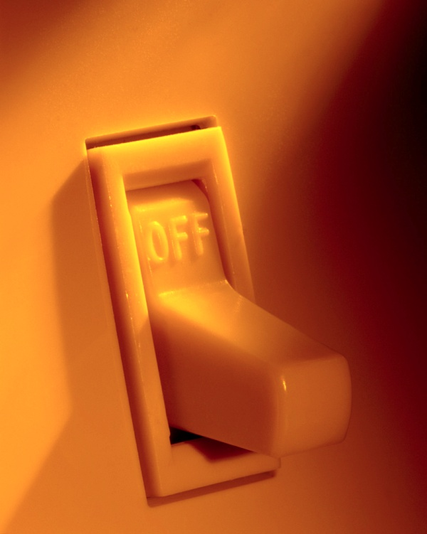
Lighting Controls
Section C405.2 - Mandatory
Lighting systems required to be provided with controls as specified for:
Occupant sensor controls – C405.2.1
Time-switch controls – C405.2.2
Daylight-responsive controls – C405.2.3
Specific application controls – C405.2.4
Exterior lighting controls – C405.2.5
Exemptions:
    Security or emergency areas that must be continuously lighted
    Interior exit stairways, interior exit ramps and exit passageways
    Emergency egress lighting normally off
Notes:
Intent is to allow occupants to control unneeded lighting.

Slide 21
Occupant Sensor Controls
Sections C405.2.1, C405.2.1.1
Occupancy sensors are required in:
  Classrooms/lecture/training rooms
  Conference/meeting/multipurpose rooms
  Lounges
  Employee lunch and break rooms
  Private offices
  Restrooms
  Storage rooms
  Janitorial closets
  Locker rooms
  Other spaces < 300 ft² enclosed by floor-to-ceiling height partitions
  Warehouses
Occupancy sensor function (other than for warehouses):
  Automatically turn lights off within 30 minutes of occupants leaving space
  Either manual-on or controlled to automatically turn lighting on to not more than 50% power
  Incorporate a manual control to allow occupants to turn off the lights

Slide 22
Occupant Sensor Controls
C405.2.1.1 Exemptions
Exemptions:
Full auto-on controls allowed in
  Public corridors
  Stairways
  Restrooms
  Primary building entrance areas and lobbies
  Areas where manual-on operation would endanger safety or security of room or occupants

Slide 23
Occupant Sensor Controls
Section C405.2.1.2 - warehouses
Aisleways and open areas
  Automatically reduce lighting power by > 50% power when areas are unoccupied
  Control lighting in each aisleway independently
  Not control lighting beyond the aisleway being controlled by the sensor

Slide 24
Time-switch Controls
Section C405.2.2
Each area of the building that is NOT provided with occupant sensor control must have a time-switch control to turn lights off automatically.
Exceptions where a manual control can provide the light reduction and automatic control is not required:
  Sleeping units
  Spaces where patient care is directly provided
  Spaces where an automatic shutoff would endanger occupant safety or security
  Lighting intended for continuous operation
  Shop and laboratory classrooms

Slide 25
Time-switch Control Functions
Section C405.2.2.1
Must include an override switching device with the following:
Minimum 7-day clock
Capable of being set for 7 different day types/week
Incorporate holiday “shutoff” feature to turn all controlled lighting loads for 24 hours and resume to normally scheduled operations
Program backup capabilities to prevent loss of program and time setting for 10 hours if power is interrupted
Override switch should include:
  Manual control
  Control lighting to remain on for < 2 hours
  Control lighting for an area < 5,000 ft²

Slide 26
Time-switch Control Functions
Section C405.2.2.1 – Cont’d.
Exceptions:
Malls
Arcades
Auditoriums
Single-tenant retail spaces
Industrial facilities
Arenas
Time limit permitted to be > 2 hours provided override switch is a captive key device
Override switch permitted to control an area > 5,000 ft² but < 20,000 ft²
If area has a manual control:
spaces with 1 luminaire with rated power < 100 watts
spaces that use < 0.6 watts/square foot
corridors, equipment rooms, public lobbies, electrical or mechanical rooms

Slide 27
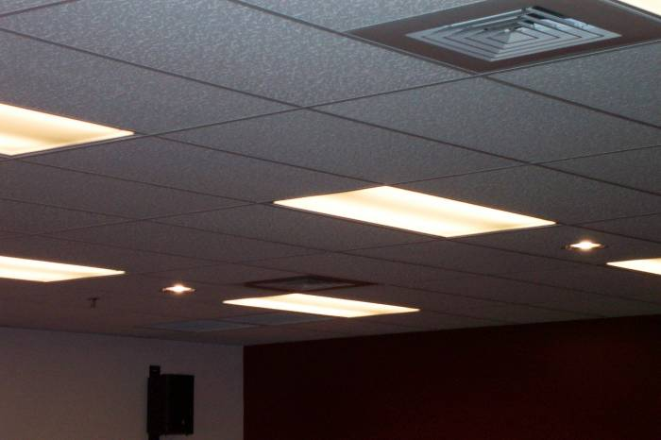
Light-reduction Controls
Section C405.2.2.2
Light Reduction Controls must allow the occupant to reduce connected lighting load
  By at least 50%
  In a reasonably uniform illumination pattern
Notes:
Intent is to allow occupants to moderate light levels to save energy.

Slide 28
Light-reduction Control Options
  Controlling all lamps or luminaires
  Dual switching of alternate rows of luminaires, alternate luminaires or lamps
  Switching middle lamp luminaires independently from the outer lamps
  Switching each luminaire or each lamp
Dimming
Alternating Luminaires
Alternating Lamps
D
S
S
S
S
Dimmer Switch
Notes:
Options are: dimming, dual switching in a uniform patter across the ceiling grid, or, for three-lamp fixtures, switch the middle lamps independently from the outer lamps. You can also do each luminaire or each lamp although this isn’t common due to cost and practicality.
Light reduction controls. Each area that is required to have a manual control must allow the occupant to reduce the connected lighting load in a reasonably uniform illumination pattern by at least 50 percent and have one of the following options OR another approved method.

Slide 29
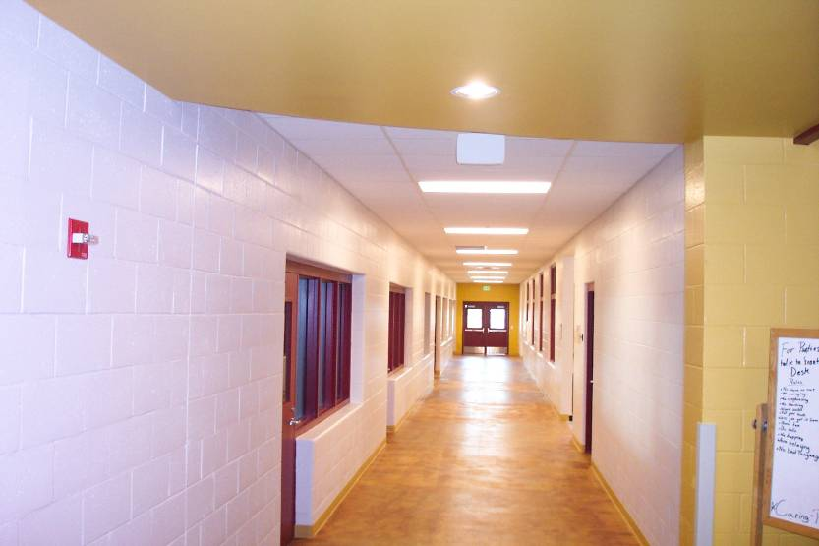
Light-reduction Controls
Section C405.2.2.2 - Exemption
Light Reduction Control Not required in daylight zones with daylight responsive controls complying with C405.2.3

Slide 30
Manual Controls
Section C405.2.2.3
Manual controls comply with the following:
Readily accessible to occupants
Located where the controlled lights are visible OR
Must identify the area served by the lights and indicate their use
Notes:
Basically whenever occupancy sensors are not required a manual control is.

Slide 31
Daylight-responsive Controls
Section C405.2.3
Definition: A device or system that provides automatic control of electric light levels based on the amount of daylight in a space
Required to control lighting in spaces with < 150 watts of general lighting:
  Sidelight daylight zones
  Toplight daylight zones
Exceptions:
  Health care facilities where patient care is directly provided
  Dwelling units and sleeping units
  Lighting required for specific application control per C405.2.4
  Sidelight daylight zones on 1st floor above grade in Group A-2 and Group M occupancies
Notes:
General lighting does not include lighting that is required to have specific application control in accordance with Section C405.2.4

Slide 32
Daylight-responsive Control Functions
Section C405.2.3.1
Toplight daylight zones shall be controlled independently of lights in sidelight daylight zones
Controls shall be configured so that they can be calibrated from within the space by authorized personnel
Calibration mechanisms shall be readily accessible
In offices, classrooms, laboratories, and library reading rooms, controls shall dim lights continuously from full light output to <15%

Slide 33
Daylight-responsive Controls
Section C405.2.3 – Cont’d.
Capable of complete shutoff of all controlled lights
Sidelight daylight zones facing different cardinal orientations (within 45 degrees of due north, east, south, west) controlled independently of each other
Exception:
< 150 watts in each space is permitted to be controlled together with lighting in a daylight zone facing a different cardinal orientation

Slide 34
Sidelight Daylight Zone
Section C405.2.3.2
Definition: floor area adjacent to vertical fenestration which complies with all of the following:
Fenestration located in a wall:
  Daylight zone shall extend laterally to the nearest full-height wall OR
  < 1.0 x height from the floor to the top of the fenestration, and longitudinally from the edge of the fenestration to the nearest full-height wall, or up to 2 ft., whichever is less
Fenestration located in a rooftop monitor:
  Daylight zone shall extend laterally to the nearest obstruction that is (taller) > 0.7 x the ceiling height, or up to 1.0 x the height from the floor to the bottom of the fenestration, whichever is less

Slide 35
Sidelight Daylight Zone
Section C405.2.3.2 – Cont’d.
  And longitudinally from the edge of the fenestration to the nearest obstruction that is (taller) > 0.7 x the ceiling height,< 0.25 x the height from the floor to the bottom of the fenestration, whichever is less
Area of fenestration > 24 ft²
Distance from fenestration to any building or geological information which would block access to daylight is > than the height from bottom of fenestration to top of building or geologic information
Located in existing buildings, the visible transmittance of fenestration > 0.20

Slide 36
Toplight Daylight Zone
Section C405.2.3.3
Definition: the floor area underneath a roof fenestration assembly which complies with all of the following:
Zone shall extend laterally and longitudinally beyond the edge of the roof fenestration assembly to the nearest obstruction that is (taller) > 0.7 x the ceiling height, > 0.7 x the ceiling height, whichever is less
No building or geological information blocks different sunlight from hitting the roof fenestration assembly at the peak solar angle on the summer solstice
Where located in existing buildings, visible transmittance of the roof fenestration assembly and area of the rough opening of the roof fenestration assembly divided by area of daylight zone > 0.008

Slide 37
Specific Application Controls
Section C405.2.4
These types to be controlled by dedicated, independent control
  Display and accent lighting
  Display case lighting
  Hotel and motel sleeping units and guest suites
    Master control device capable of automatically switching off all installed luminaires and switched receptacles within 20 minutes of occupants leaving the room
    Exceptions: lighting and switch receptacles controlled by captive key systems
  Supplemental task lighting, including permanently installed under-shelf or under-cabinet lighting
    Have control device integral to luminaires OR
    Be controlled by readily accessibly, wall-mounted control device
  Nonvisual applications, plant growth and food warming
  Equipment for sale or educational demonstrations

Slide 38

Exit Signs
Section C405.3
Exit Signs
  Internally illuminated exit signs shall not exceed 5 watts per side
Notes:
With the use of LEDs and to the technology today, this is commonly done and not a hard requirement to meet.

Slide 39
Exterior Lighting and Building Lighting Power
Sections C405.5 – Mandatory, C405.5.1
Where power is supplied through the energy service to the building, all exterior lighting to comply with Section C405.5.1
Exception: approved because historical, safety, signage or emergency considerations
Connected Exterior Lighting Power must not exceed Exterior Lighting Power Allowance except where approved because of historical, safety, signage or emergency considerations:
  Calculate exterior lighting power allowance
    Lighting power densities by exterior function and by applicable lighting zone
  Calculate proposed connected lighting power
    Wattage calculation “rules”
    Exempted lighting
  Compare values: proposed wattage must be less than or equal to allowed wattage
Notes:
Similar to interior lighting power limits.
Same steps to calculate as for interior.

Slide 40
Exemptions from Exterior Calculation
Section C405.5.1
The following lighting does not need to be included in the proposed lighting calculation:
Specialized signal, directional, and marker lighting associated with transportation
Advertising signage or directional signage
Lighting integral to equipment or instrumentation and installed by its manufacturer
Lighting for theatrical purposes, including performance, stage, film production, and video production
Lighting for athletic playing areas
Temporary lighting
Lighting for industrial production, material handling, transportation sites, and associated storage areas
Theme elements in theme/amusement parks
Lighting used to highlight features of public monuments and registered historic landmark structures or buildings
Notes:
These do not need to be included when doing your calculation.

Slide 41
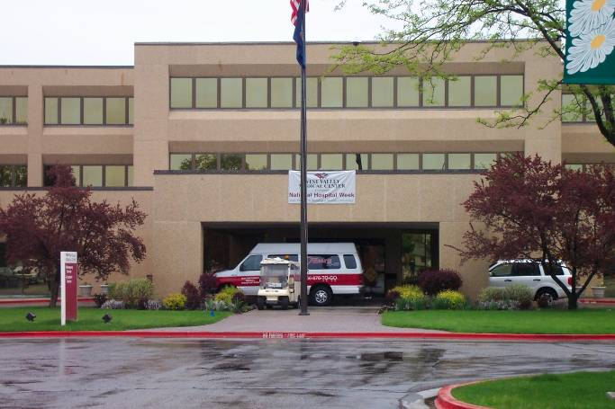
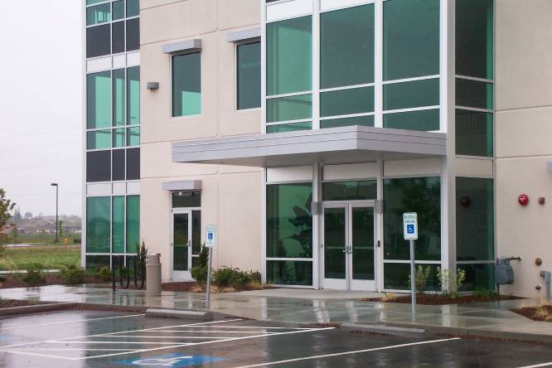
Exterior Lighting Power Limits
Section C405.5.1
What areas are covered under exterior lighting allowances?
  Tradable surfaces
  Common exterior lighted needs that can be traded for other needs
    For example, wattage allowed for parking lot lighting can be “traded” and used for canopy lighting
  Nontradable surfaces
  Less common exterior lighted needs that cannot be traded for other needs
    These applications have more specific security or task illuminance needs
Notes:
Only for lighting powered through the building and associated with the building.
Two sections to the table: tradable and nontradable.
Tradable – when calculating the allowance based on all surfaces; can be used for any fixture you want. Typically, the most common surfaces are included as tradable (example: parking lot lighting). If you don’t use it all, you can use it elsewhere (example: canopy lighting).
Nontradable – typically related to specific security requirements. “Extra” cannot be used for other fixtures.

Slide 42
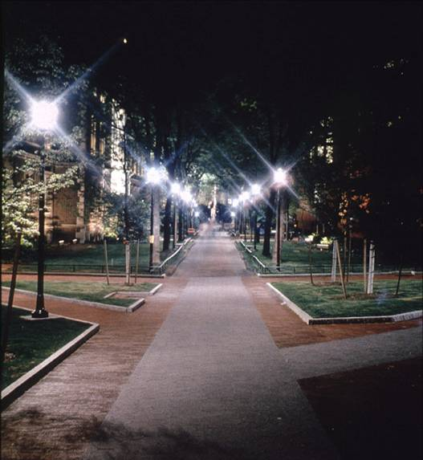
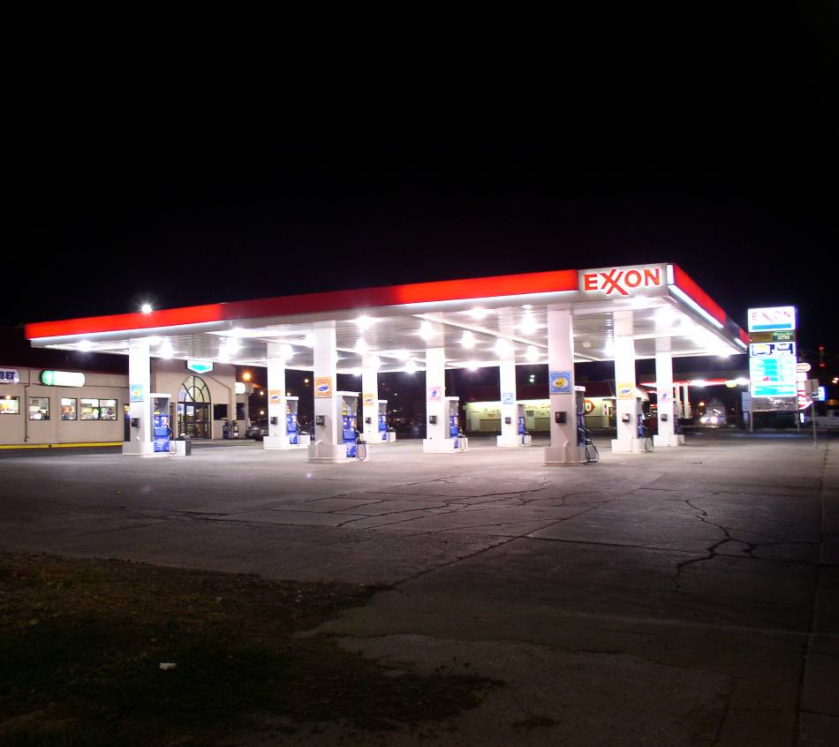
Tradable Surfaces
Uncovered parking lots and areas
Walkways (under and over 10 feet wide)
Stairways
Pedestrian tunnels
Main building entrances and exits
Other doors
Entry canopies
Free-standing and attached sales canopies
Open sales areas
Street frontage sales areas
Notes:
Open sales areas include vehicle sales lots, street frontage for vehicles sales lots in addition to “open area” allowance.

Slide 43
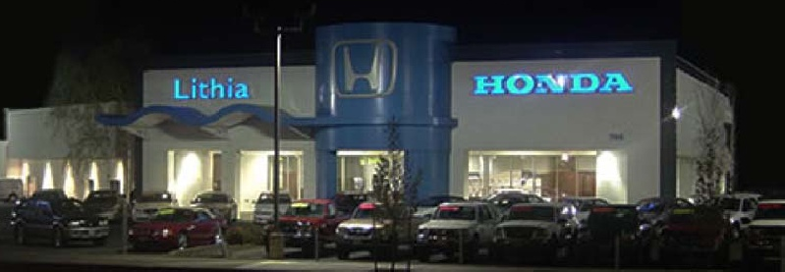
Nontradable Surfaces
Building facades
Automated teller machines and night depositories
Entrances and gatehouse inspection stations at guarded facilities
Loading areas for law enforcement, fire, ambulance and other emergency vehicles
Drive-up windows/doors
Parking near 24-hour retail entrances
Notes:
Although building facades are common, they are included as nontradable surfaces. Cannot use “extra” wattage elsewhere.

Slide 44
Exterior Lighting Zones
Table C405.5.2(1)
Power allowances are listed by lighting zone
Lighting Zone | Description
1 | Developed areas of national parks, state parks, forest land, and rural areas
2 | Areas predominantly consisting of residential zoning, neighborhood business districts, light industrial with limited nighttime use and residential mixed use areas
3 | All other areas no classified as lighting zone 1, 2 or 4
4 | High-activity commercial districts in major metropolitan areas as designated by the local land use planning authority
Notes:
Based on the realization that different areas have different lighting requirements.
If you’re next to a lot of exterior lighting – your lighting needs because of contrast or other visual needs is going to have to be higher.
If there are low ambient conditions, you don’t need as much lighting.
1 = low lit areas
2 = very common for a lot of buildings – basically residential zoned or neighborhood business district
3 = all other
4 = high end of the scale, very high-activity commercial districts. Typically major metropolitan areas, inner cities, etc. with a lot of exterior lighting.

Slide 45
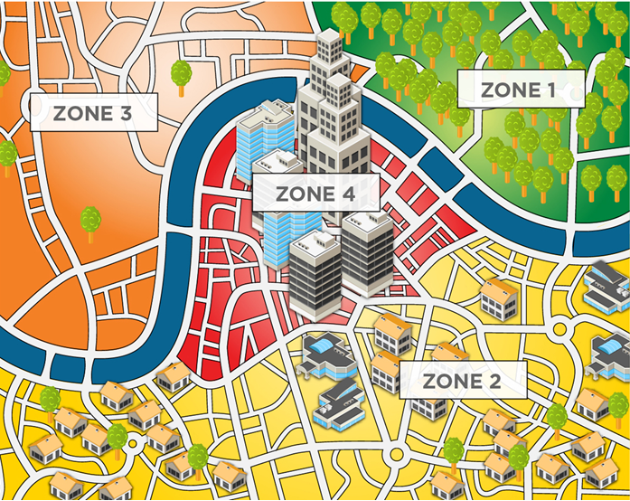
Exterior Lighting Zones
Table C405.5.2(1)
Notes:
Example:
Lighting Zone/Description
1 Developed areas of national parks, state parks, forest land, and rural areas
Areas predominantly consisting of residential zoning, neighborhood business districts, light industrial with limited nighttime use and residential mixed use areas
All other areas not classified as lighting zone 1, 2 or 4
High-activity commercial districts in major metropolitan areas as designated by the local land use planning authority

Slide 46
Exterior Lighting Zones
Table C405.5.2(2)
Allowances include a base allowance plus tradeable allowance
 |  | Zone 1 | Zone 2 | Zone 3 | Zone 4
Base Site Allowance |  | 500 W | 600 W | 750 W | 1300 W
Tradable Surfaces | Uncovered Parking Areas
 | Parking areas and drives | 0.04 W/ft² | 0.06 W/ft² | 0.10 W/ft² | 0.13 W/ft²
 | Building Grounds
 | Walkways less than 10 feet wide | 0.7 W/linear foot | 0.7 W/linear foot | 0.8 W/linear foot | 1.0 W/linear foot
 | Walkways 10 feet wide or greater | 0.14 W/ft² | 0.14 W/ft² | 0.16 W/ft² | 0.2 W/ft²
 | Plaza areas
 | Special Feature Areas
Partial Table | Stairways | 0.75 W/ft² | 1.0 W/ft² | 1.0 W/ft² | 1.0 W/ft²
 | Pedestrian Tunnels | 0.15 W/ft² | 0.15 W/ft² | 0.2 W/ft² | 0.3 W/ft²
Notes:
Base site allowance is given in realization that some smaller buildings may need a little extra help because they won’t have as much square footage to get the wattage they need.
Pick applicable applications for your building and use appropriate zone column to get an allowance for each application.

Slide 47
Exterior Lighting Zones cont’d.
 |  | Zone 1 | Zone 2 | Zone 3 | Zone 4
Nontradable Surfaces | Building facades | No allowance | 0.075 W/ft² of gross above-grade wall area | 0.113 W/ft² of gross above-grade wall area | 0.15 W/ft² of gross above-grade wall area
 | Automated teller machines (ATM) and night depositories | 270 W per location plus 90 W per additional ATM per location | 270 W per location plus 90 W per additional ATM per location | 270 W per location plus 90 W per additional ATM per location | 270 W per location plus 90 W per additional ATM per location
 | Entrances and gatehouse inspection stations at guarded facilities | 0.75 W/ft² of covered and uncovered area | 0.75 W/ft² of covered and uncovered area | 0.75 W/ft² of covered and uncovered area | 0.75 W/ft² of covered and uncovered area
 | Loading areas for law enforcement, fire, ambulance and other emergency service vehicles | 0.5 W/ft² of covered and uncovered area | 0.5 W/ft² of covered and uncovered area | 0.5 W/ft² of covered and uncovered area | 0.5 W/ft² of covered and uncovered area
 | Drive-up window/doors | 400 W per drive-through | 400 W per drive-through | 400 W per drive-through | 400 W per drive-through
 | Parking near 24-hour retail entrances | 800 W per main entry | 800 W per main entry | 800 W per main entry | 800 W per main entry

Slide 48
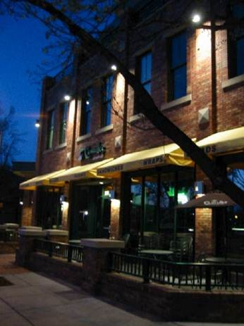
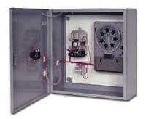
Exterior Lighting Control Requirements
Section C405.2.5
Other than emergency lighting intended to be turned off during building operation, lighting specifically required to meet health and life and safety requirements or decorative gas lighting systems shall:
Turns off as a function of available daylight
Building façade or landscape have controls that automatically shut off as a function of dawn/dusk and set opening and closing time

Slide 49
Exterior Lighting Control Requirements
Section C405.2.5
  Building façade or landscape NOT covered above shall have controls configured to automatically reduce connected lighting power > 30% no later than midnight to 6 am from 1 hour after business closing to 1 hour before opening and any period where activity has not been detected longer than 15 minutes
All time switches should be able to retain programming and the time setting during loss of power for a period of > 10 hours
Exception: Covered vehicle entrances or exits from buildings or parking structures where required for safety, security or eye adaptation

Slide 50




Electrical Energy Consumption
Mandatory Requirement
Section C405.6
Separate metering required for each dwelling unit
Notes:
Specific requirement for buildings with individual dwelling unit to have separate electrical meters.
Intent: Occupant understanding of actual energy use can promote effective energy use!

Slide 51
Electrical Transformers
Section C405.7 - Mandatory
Electric transformers must meet minimum efficiency requirements of Table C405.7 when tested and rated in accordance with test procedure DOE 10 CFR 431
Efficiency to be verified through certification under an approved certification program or when program does not exist, ratings shall be supported by data furnished by transformer manufacturer

Slide 52
Electrical Transformers
Section C405.7 – Mandatory – Cont’d.
Exceptions:
  If meet EPAct 2005 exclusions based on 10CFR431
    Special purpose applications
    Not likely in general purpose applications
    Have multiple voltage taps where highest tap is ≥ 20% more than lowest tap
  Some specific products are listed

Slide 53
Electrical motors
Section C405.8 - Mandatory
Electric motors must meet minimum efficiency requirements of Tables C405.8(1) through C405.8(4) when tested and rated in accordance with test procedure DOE 10 CFR 431
Efficiency to be verified through certification under an approved certification program or when program does not exist, ratings shall be supported by data furnished by motor manufacturer

Slide 54
Vertical and Horizontal Transportation System and Equipment
Section C405.9.1 – Elevator Cabs
The sum of lumens divided by the sum of the watts > 35 lumens/W (not including signal and displays)
Ventilation fans without their own air-conditioning system shall not consume < 0.33 watts/cfm at the max. rated speed of the fan
Controls shall be provided that will de-energize ventilation fans and lighting systems when the elevator is stopped, unoccupied and with its doors closed for > 15 minutes

Slide 55
Vertical and Horizontal Transportation System and Equipment
Section C405.9.1 – Escalators and Moving Walks
Must comply with ASME A17.1/CSA B44
Automatic controls configured to reduce speed to minimum permitted speed in accordance with ASME A17.1/CSA B44 or applicable local code when not conveying passengers
Regenerative drive
  Escalators designed for one-way down operation only or for reversible operation
    Must have a variable frequency regenerative drive that supplies electrical energy to the building electrical system when escalator is loaded with passengers with a combined weight > 750 pounds

Slide 56
Lighting System Functional Testing
Section C408.3.1
Prior to passing final inspection, registered design professional to provide evidence that lighting control systems have been tested to ensure that control hardware and software are calibrated, adjusted, programmed and in proper working order per construction documents and manufacturer’s installation instructions
Notes:
Independent refers to independent from the design or construction of the project

Slide 57
Occupant Sensor Controls
Section C408.3.1.1
  Certify location and aiming per manufacturer recommendation
  Test all sensors if project ≤ 7
  If > 7 sensors, test for each unique combination of sensor type and space geometry
  Where multiples of each unique combination of sensor type and space geometry are provided > 10%, but in no case < 1 of each combination shall be tested unless the code official or design professional requires a higher percentage to be tested
  Where >30% of tested controls fail, all remaining identical combinations must be tested
Verify the following:
    Status indicator, verify correct operation
    Lights turn off or down to permitted level within required time
    Auto-on – lights turn on to permitted level when someone enters the space
    Manual on – lights turn on only when manually activated
    Lights aren’t incorrectly turned on by movement in nearby areas or by HVAC operation

Slide 58
Time-switch Controls
Section C408.3.1.2
  Confirm programmed schedules
  Document schedules for owner
  Verify correct time and date are set
  Verify any battery backup is installed and energized
  Verify override time limit set to ≤ 2 hours
  Simulate occupied condition and verify and document:
    Lights turn on and off with respective switches
    Switch only operates lights in enclosed space where switch is located
  Simulate unoccupied condition and verify and document:
    All nonexempt lights turn off
    Manual override only operates lighting where it is located
  Additional testing as specified by the registered design professional
For daylight responsive controls
  Properly located, field-calibrated, and set to have appropriate setpoints and threshold light levels
  Daylight controlled lighting loads adjust to correct levels with available daylight
  Location where calibration adjustments are made is readily accessible only to authorized personnel

Slide 59


Documentation Requirements
Section C408.3.2
Construction documents specify that documents certifying installed lighting controls meet documented performance criteria of Section C405
Provided to building owner within 90 days from date of receipt of certificate of occupancy

Slide 60
Existing Buildings
Section C502.2.6 Lighting Power and Systems
New lighting systems installed as part of an addition to comply with C405
Total interior lighting power to comply C405.4.2
  Stand alone addition
  Addition + existing building as a single building
Total exterior lighting power to comply C405.5.1
  Stand alone addition
  Addition + existing building as a single building
Repairs – C504.2
  Repairs exempt where only the bulb, ballast or both within the existing luminaires in a space are replaced, provided that the replacement does not increase the installed interior lighting power

