Slide 1
2015 IECC Commercial Mechanical Requirements
PNNL-SA-105486
Notes:
1

Slide 2
Why Care About IECC?
  Energy codes and standards set minimum efficiency requirements for new and renovated buildings, assuring reductions in energy use and emissions over the life of the building. Energy codes are a subset of building codes, which establish baseline requirements and govern building construction.
  Code buildings are more comfortable and cost-effective to operate, assuring energy, economic and environmental benefits.

Slide 3

Commercial Compliance Options
2015 IECC - Prescriptive
2015 IECC - Performance
1
ASHRAE 90.1-2013
2
C402 - Envelope
3
C407 – Total Building Performance
OR
C403 - Mechanical
OR
C404 - SWH
C402.5 – Air Leakage
C405 - Lighting
C403.2 – Provisions applicable to all mechanical systems
AND
Pick One C406:
C404 - SWH
C406.2 – Eff. HVAC Performance
or
Lighting Mandatory Sections
C406.3 – Reduced Lighting Power Density
C405.2
C405.3
C405.4
C405.6
or
C406.4 – Enhanced Lighting Controls
or
C406.5 – On-site Supply of Renewable energy
Building energy cost to be ≤ 85% of standard reference design building
or
C406.6 – Dedicated Outdoor Air System
or
C406.7 – High Eff. Service Water Heating
Notes:
Tenant spaces shall comply with Section C406.1.1

Slide 4
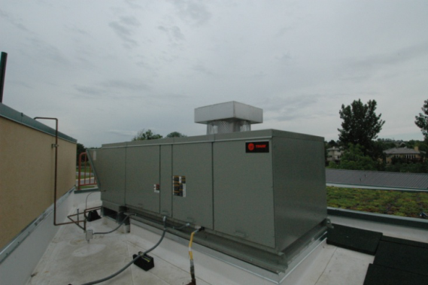
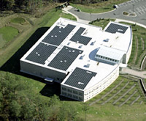
Additional Efficiency Package Options
Section C406
One additional efficiency feature must be selected to comply with the IECC
  More efficient HVAC performance, OR
  Reduced lighting power density system, OR
  Enhanced lighting controls, OR
  On-site supply of renewable energy
  Dedicated outdoor air system, OR
  More efficient SWH
High Efficiency HVAC
More Efficient Lighting System
Onsite Renewables
Notes:
Onsite renewables “regulated energy” = energy used within the building for building mechanical and service water heating equipment and lighting regulated by Chapter C4.

Slide 5
Additional Efficiency Package Options
Section C406
Efficient HVAC performance per C406.2 OR
  Per Tables C403.2.3(1) thru C403.2.3(7)
  Only used when efficiencies in the above tables are greater than 10% in addition to the requirements in C403
  Where multiple performance requirements are provided, the equipment shall exceed all requirements by 10%
  VRF’s exceed energy efficiency provisions of 90.1-2013 by 10%
  Equipment not listed in tables above shall be limited to 10% of total building system capacity

Slide 6
Additional Efficiency Package Options
Section C406 – Cont’d.
On-site renewable energy per C406.5 OR
  Total minimum ratings to comply with
    Provide ≥ 1.75 Btu or ≥ 0.50 watts per ft² of conditioned floor area OR
    Provide ≥ 3% of energy used for mechanical and SWH equipment and lighting
Dedicated outdoor air system per C406.6 OR
  For multi-zone/hydronic HVAC systems covered by C403.4
  Be equipped with an independent ventilation system designed to provide <100% outdoor air to each occupied space
  Ventilation system capable of total energy recovery
  HVAC system include supply-air temperature controls that automatically reset the supply-air temp. in response to building loads or outdoor air temperatures
  Controls reset the supply-air temp. at least 25% of the difference between design supply-air temp. and design room-air temp.

Slide 7
Additional Efficiency Package Options
Section C406 – Cont’d.
Reduced energy use in SWH per C406.7
  Buildings with the following types allowed to use this compliance method:
  Group R-1: Boarding houses, hotels, or motels
  Group I-2: Hospitals, psychiatric hospitals, and nursing homes
  Group A-2: Restaurants and banquet halls or buildings containing food preparation areas
  Group F: Laundries
  Group R-2: Buildings with residential occupancies
  Group A-3: Health clubs and spas
  Buildings showing a SWH load of >10% of total building energy loads as shown with an energy analysis per C407

Slide 8
Additional Efficiency Package Options
Section C406 – Cont’d.
Reduced energy use in SWH (cont’d.)
Load fraction:
  Building SWH has >1 of the following sized to provide > 60% of hot water requirements or sized to provide 100% of hot water requirements if building complies with C403.4.7
  Waste heat recovery from SWH, heat recover chillers, building equipment, process, equipment, or combined heat and power system
  Solar water-heating systems

Slide 9
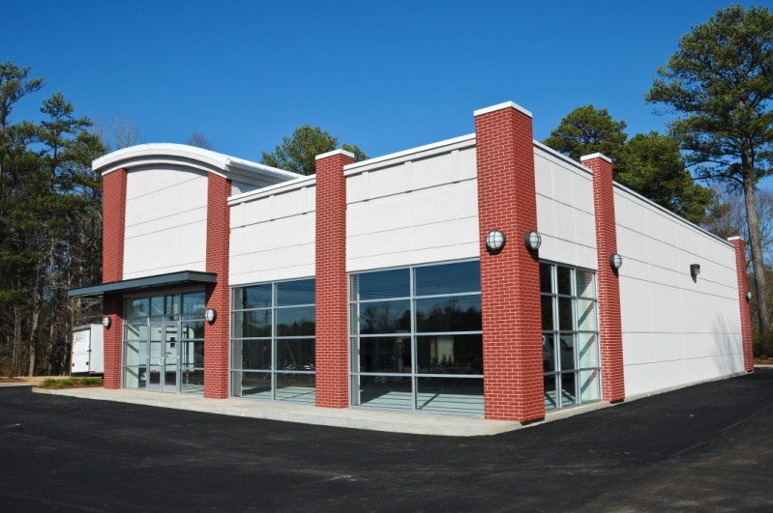
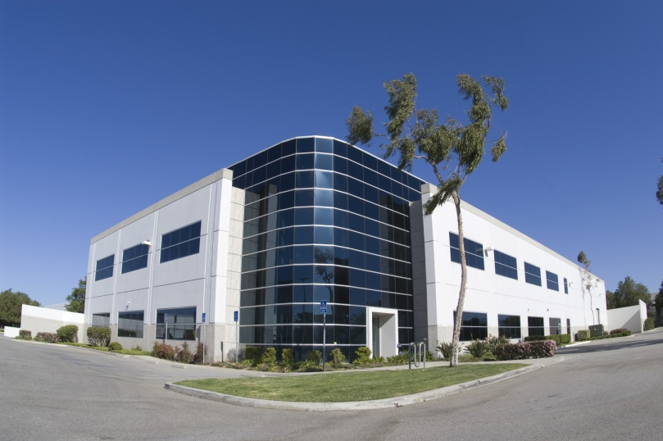
Does My Project Need to Comply with the IECC?
All Buildings Other Than:
One- and two-family residential
R-2, R-3, R-4 three stories or less in height
Notes:
R-2 is occupancies containing more than 2 dwelling units where the occupants are primarily permanent in nature, including apartments, boarding houses, dormitories, etc. (but not hotels/motels).
R-3 includes one- and two-family dwellings.
R-4 includes residential care and assisted living facilities.

Slide 10
Referenced Codes and Standards
Section C106.1
Codes and standards listed in Chapter 6 are considered part of the requirements of this code to the “prescribed extent of each such reference and as further regulated in Sections C106.1.1 and C106.1.2”
Conflicts, C106.1.1 – where differences occur between this code and the referenced codes and standards, provisions of this code apply
Provisions in reference codes and standards, C106.1.2 – “where the extent of the reference to a referenced code or standard includes subject matter that is within the scope of this code, the provisions of this code, as applicable, shall take precedence over the provisions in the referenced code or standard”

Slide 11
Building Mechanical Systems
Systems and equipment serving the building heating, cooling, and ventilation needs to comply with C403.2 and Sections C403.3 and C403.4 based on the equipment and systems provided
Walk-in coolers, walk-in freezers, refrigerated warehouse coolers and refrigerated warehouse freezers shall comply with Section 403.2.15 or 403.2.16

Slide 12
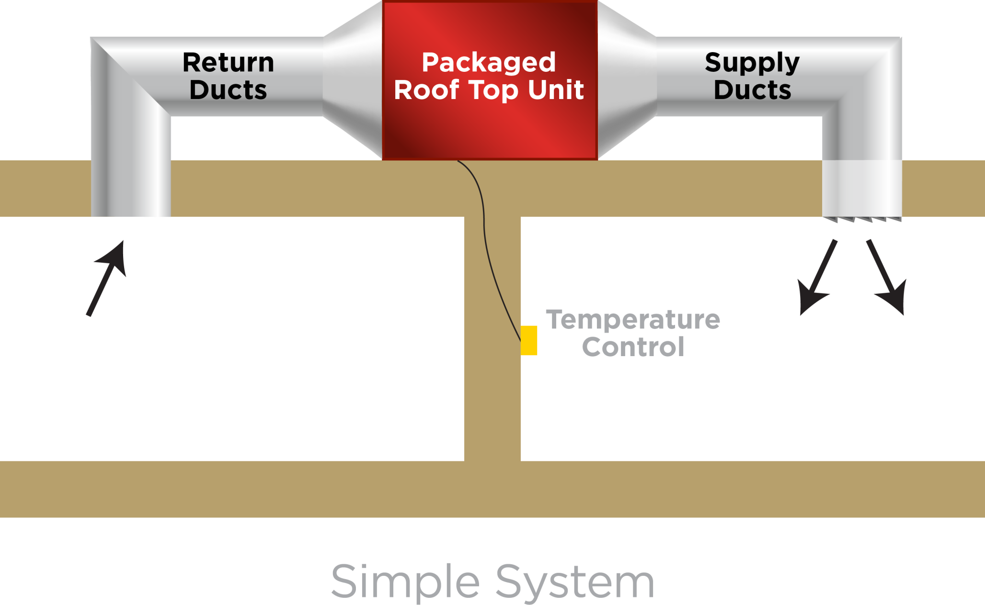
Simple Systems
Notes:
The wording simple and complex have been removed from 2015 but the concept remains the same

Slide 13
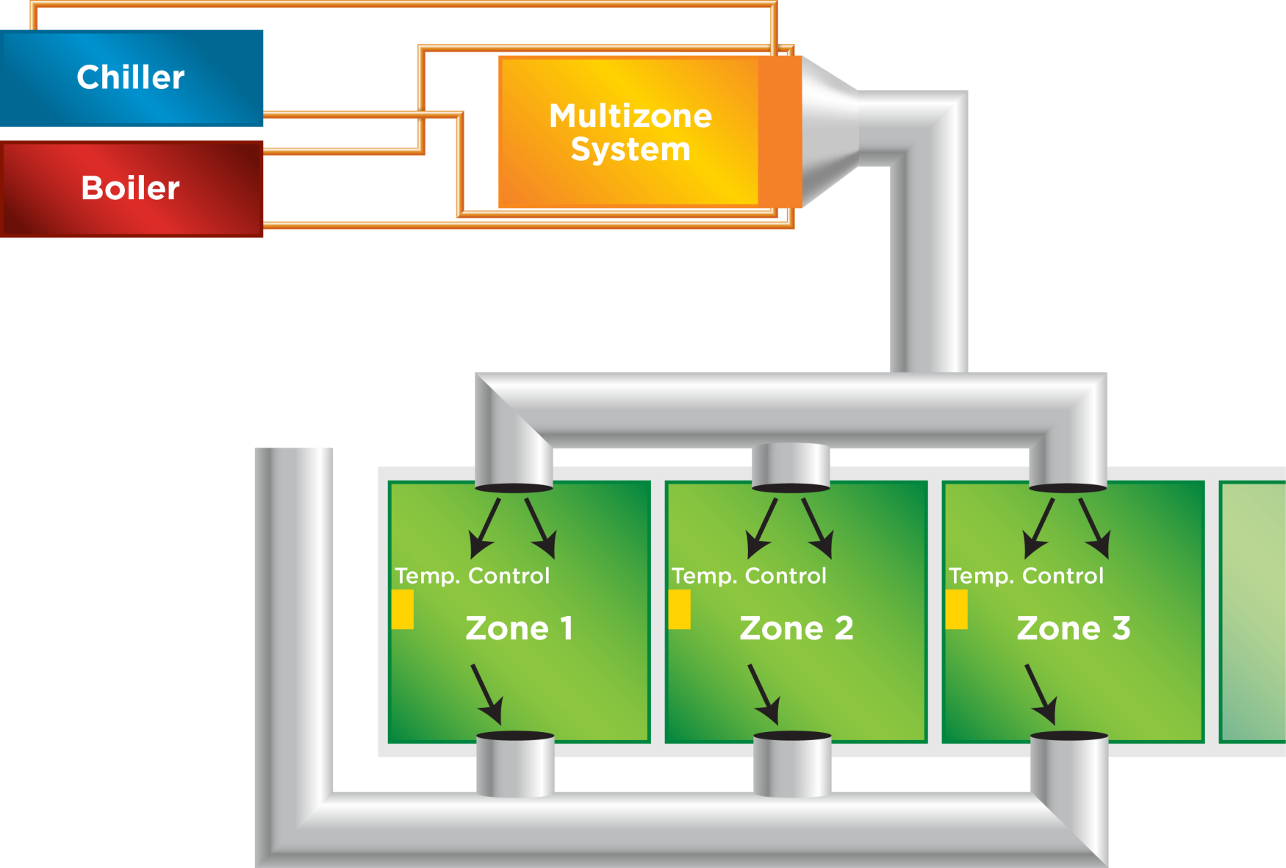
Complex Systems

Slide 14
Mandatory Provisions
Section C403.2
Provisions Applicable to ALL Mechanical Systems
HVAC Load Calculations
Equipment and System Sizing
HVAC Equipment Performance Requirements
HVAC System Controls
Hot Water Boiler Outdoor Temp. Set-back Control
Ventilation
Energy Recovery Ventilation Systems
Kitchen Exhaust Systems
Duct and Plenum Insulation and Sealing
Piping Insulation
HVAC System Commissioning and Completion
Air System Design and Control
Heating Outside a Building
Refrigeration Equipment Performance
Walk-in Coolers and Freezers, Refrigerated Warehouse Coolers and Freezers
Walk-in Coolers and Walk-in Freezers

Slide 15
HVAC Load Calculations
Section C403.2.1 Mandatory
Heating and cooling load sizing calculations required
ASHRAE/ACCA Standard 183 OR
Other approved computation procedures – defined in Chapter 3
  Interior design conditions
    Specified by Section C302 of the IECC
      ≤ 72ºF for heating load
      ≥ 75ºF for cooling load
Loads reduced from energy recovery systems utilized in the HVAC system shall be accounted for in accordance with the ASHRAE HVAC Systems and Equipment Handbook
Notes:
Handbook can be purchased from ASHRAE

Slide 16
Equipment and System Sizing Section C403.2.2 Mandatory
Output capacity of heating and cooling equipment only SHALL NOT be greater than calculated loads
Select the system which serves the greater load, heating or cooling
  Exceptions:
    Standby Equipment with Required Controls
    Multiple Units with Combined Capacities Exceeding Loads
      Sequencing Controls Required
Notes:
A single piece of equipment providing both heating and cooling must satisfy this provision for one function with the capacity for the other function as small as possible, within available equipment options.

Slide 17
HVAC Performance
Section C403.2.3 Mandatory Minimum
Efficiency Requirements
Applies to all equipment used in heating and cooling of buildings
  Where components from different manufacturers are used
    calculations and supporting data demonstrating combined efficiency meets requirements
Must comply with all listed efficiencies
Notes:
There are several tables based on type of equipment. The efficiency to be verified through certification under an approved certification program or, if no certification program exists, the equipment efficiency ratings shall be supported by data furnished by the manufacturer. Where multiple rating conditions or performance requirements are provided, the equipment shall satisfy all stated requirements.

Slide 18
Water-Cooled Centrifugal Chilling Packages
Section C403.2.3.1
Equipment not designed for operation at AHRI Standard 550/590 test conditions of 44°F leaving chilled-water temperature and 2.4 gpm/ton evaporator fluid flow and 85°F entering condenser water temperature with 3 gpm/ton condenser water flow
  To have maximum full-load kW/ton and NPLV ratings adjusted using Equations 4-6 and 4-7
The FLadj and PLVadj values are only applicable for centrifugal chillers meeting all of these full-load design ranges
  Evaporator leaving temperature ≥ 36°F
  Condenser leaving temperature ≤ 115°F
  20°F < LIFT < 80°F

Slide 19
Table C403.2.3(2)
Mandatory
EQUIPMENT TYPE | SIZE CATEGORY | HEATING SECTION TYPE | SUBCATEGORY OR RATING CONDITION | MINIMUM EFFICIENCY |  | TEST PROCEDURE
 |  |  |  | Before 1/1/2016 | As of 1/1/2016
Air cooled (cooling mode) | < 65,000 Btu/h | All | Split system | 13.0 SEER | 14.0 SEER | AHRI 210/240
 |  |  | Single packaged | 13.0 SEER | 14.0 SEER
Through-the-wall air cooled | ≤ 30,000 Btu/h | All | Split system | 12.0 SEER | 12.0 SEER
 |  |  | Single packaged | 12.0 SEER | 12.0 SEER
Single-duct high-velocity air cooled | < 65,000 Btu/h | All | Split system | 11.0 SEER | 11.0 SEER
Notes:
This is only part of Table C403.2.3(2) to give an idea of the information contained in the table.

Slide 20
Positive Displacement (Air- and Water-Cooled Chilling Packages)
Section C403.2.3.2
Equipment with a leaving fluid temperature > 32°F and water-cooled positive displacement chilling packages with a condenser leaving fluid temperature < 115°F to meet Table C403.2.3(7)
  when tested or certified with water at standard rating conditions, in accordance with the referenced test procedure
Notes:
Note: wording is not consistent with previous section “condenser leaving temp” “condenser leaving fluid temp”

Slide 21
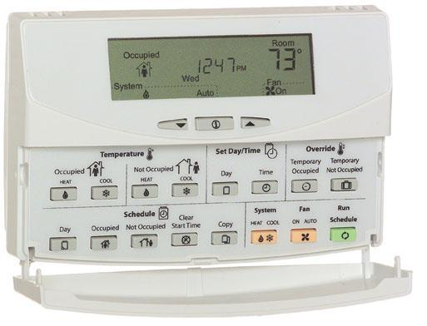
System Controls
Section C403.2.4 (Mandatory)
Control required for each system
if zoned for each zone
Notes:
If humidification/dehumidification, at least one control device provided for each humidity control system.
C 403.2.4.1 Exception: Independent perimeter systems that are designed to offset only building envelope heat losses or gains or both serving one or more perimeter zones also served by an interior system provided:
The perimeter system includes at least one thermostatic control zone for each building exposure having exterior walls facing only one orientation (within +/- 45 degrees) (0.8 rad) for more than 50 contiguous feet (15.2 m); and
2. The perimeter system heating and cooling supply is controlled by a thermostat(s) located within the zone(s) served by the system.

Slide 22
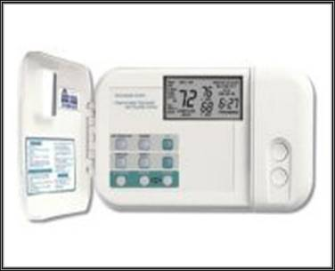
System Controls (Mandatory)
Section C403.2.4.1.1 Heat Pump Supplementary Heat
Heat pump systems
  Heat pump thermostat required when supplying electric resistance heating
  Control must prevent supplemental heat demand when heat pump can meet the heating load.
    Except during defrost

Slide 23
Controls (Mandatory)
Section C403.2.4.1.2 Deadband
Thermostats must have at least a 5°F deadband
  Exception:
    Thermostats requiring manual change over between heating and cooling
    Occupancies or applications requiring precision in indoor temperature control as approved by code official
Notes:
The deadband means that the system will not be on and will not be using energy when the temperature is in that deadband. This also helps reduce the possibility of simultaneous heating and cooling.

Slide 24
Controls (Mandatory)
Section C403.2.4.1.3 Set Point Overlap Restriction
Where separate thermostatic control device for heating and separate cooling in a zone:
  Limit switch
  Mechanical stop OR
  Direct digital control system with software programming shall be provided with capability to prevent heating set point from exceeding cooling set point to maintain deadband

Slide 25
Controls (Mandatory)
Section C403.2.4.2 Off Hour
Automatic time clock or programmable system
  Exceptions:
    Zones operated continually
    Zones with full HVAC load demand <6,800 Btu/h and has a readily accessible shut off switch
Thermostatic setback capabilities
  Capability to maintain zone temps down to 55ºF or up to 85ºF
Automatic setback and shutdown
Seven different daily schedules/week
Retain programming ≥ 10 hrs with loss of power AND
  Manual override up to 2 hours OR
  Manual timer capable of operating up to 2 hours OR
  Occupancy sensor
Notes:
Each zone shall be provided with thermostatic setback controls that are controlled by either an automatic time clock or programmable control system.
Thermostatic setback capabilities.
Thermostatic setback controls shall have the capability to set back or temporarily operate the system to maintain zone temperatures down to 55°F (13°C) or up to 85°F (29°C).
Automatic setback and shutdown capabilities.
Automatic time clock or programmable controls shall be capable of starting and stopping the system for seven different daily schedules per week and retaining their programming and time setting during a loss of power for at least 10 hours. Additionally, the controls shall have a manual override that allows temporary operation of the system for up to 2 hours; a manually operated timer capable of being adjusted to operate the system for up to 2 hours; or an occupancy sensor.

Slide 26
Automatic Start Capabilities (Mandatory)
Section C403.2.4.2.3
Automatic start controls for each HVAC system
Capable of automatically adjusting daily start time to bring each space to desired occupied temperature immediately prior to scheduled occupancy
Notes:
This allows the building to “warm up” or “cool down” in time for occupancy without requiring the occupants to override the setbacks or face a cold or hot building when they arrive.

Slide 27
Controls (Mandatory)
Section C403.2.4.3 Shutoff Dampers
Outdoor air intake and exhaust openings and stairway and shaft vents provided with Class I motorized dampers
Dampers with air leakage rate < 4 cfm ft² of damper surface at 1.0 inch water gauge (249 Pa) and labeled and approved in accordance with AMCA 500D
Outdoor air intake and exhaust dampers with automatic controls configured to close the systems or spaces served when not in use or during unoccupied period warm-up and setback operation
  Unless systems served require outdoor or exhaust air per IMC OR
  Dampers are opened to provide intentional economizer cooling
Notes:
Motorized dampers are more expensive than gravity dampers and are only required where they are most impactful (e.g., taller buildings).

Slide 28
Controls (Mandatory)
Section C403.2.4.3 Shutoff Dampers – Cont’d.
Stairway and shaft vent dampers installed with automatic controls configured to open up on activation of any fire alarm initiating device of the building’s fire alarm system or the interruption of power to the damper
  Exceptions:
    Gravity dampers permitted in buildings < 3 stories
    Gravity dampers permitted for buildings of any height located in Climate Zones 1-3
    Gravity dampers permitted for outside air intake or exhaust airflows of 300 cfm (0.14m3/s) or less

Slide 29
Controls (Mandatory)
Section C403.2.4.3 Shutoff Dampers – Cont’d.
Gravity motorized dampers shall have an air leakage rate:
  < 20 cfm/ft2 where > 24 inches in either dimension
  40 cfm/ft2 where < 24 inches in either dimension
Air leakage rate determined at 1.0 inch water gauge
(249 Pa) when tested in accordance with AMCA 500D
Dampers labeled by an approved agency

Slide 30
Controls (Mandatory)
Section C403.2.4.4 Zone Isolation
Divided into isolation areas:
HVAC systems serving zones > 25,000 ft² in floor area OR
Span > one floor and are designed to operate or be occupied nonsimultaneiously
Isolation areas:
Isolation devices and controls configured to automatically shut off the supply of conditioned air and outdoor air to and exhaust air from the isolation area
Controlled independently meeting C403.2.4.2.2
Central systems and plants provided with controls and devices that will allow system and equipment operation for any length of time while serving the smallest isolation area served by system or plant

Slide 31
Controls (Mandatory)
Section C403.2.4.4 Zone Isolation – Cont’d.
Exceptions:
Exhaust air and outdoor air connections to isolation areas where the fan system to which they connect is < 5,000 cfm
Exhaust airflow from a single isolation area of < 10% of the design airflow of the exhaust system to which it connects
Isolation areas intended to operate continuously or intended to be inoperative only when all other isolation areas in a zone are inoperative

Slide 32
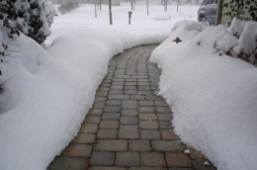
Controls (Mandatory)
Section C403.2.4.5 Snow Melt Systems
Snow- and ice-melting systems, supplied through energy service to the building, shall include
  automatic controls capable of shutting off the system when the pavement temperature is above 50°F (10°C) and no precipitation is falling
  an automatic or manual control that will allow shutoff when the outdoor temperature is above 40°F (4°C)
Photo courtesy of Ken Baker, K energy

Slide 33
Controls (Mandatory)
Section C403.2.4.6 Freeze Protection System
Systems such as heat tracing of outdoor piping and heat exchangers, including self-regulated heat tracing to include:
  Automatic controls configured to shut off the system when outdoor air temperatures are > 40°F (4°C) OR
  When conditions of the protected fluid will prevent freezing

Slide 34
Controls (Mandatory)
Section C403.2.4.7 Economizer Fault Detection and Diagnostics
Air cooled unitary direct-expansion units (listed in Tables C403.2.3(1-3) and variable refrigerant flow (VRF) units that are equipped with an economizer per Section C403.3 to include a fault detection and diagnostics (FDD) system complying with the following:
  Temperature sensors permanently installed to monitor system operation
    Outside air
    Supply air
    Return air
  Temperature sensors have an accuracy of +2°F over the range of 40°F - 80°F
  Refrigerant pressure sensors, where used, have an accuracy of +3% of full scale

Slide 35
Controls (Mandatory)
Section C403.2.4.7 Economizer Fault Detection and Diagnostics – Cont’d.
Unit controller capable of providing system status by indicated the following:
  Free cooling available
  Economizer enabled
  Compressor enabled
  Heating enabled
  Mixed air low limit cycle active
  Current value of each sensor
Unit controller capable of manually initiating each operating mode so that the operation of compressors, economizers, fans and heating system can be independently tested and verified

Slide 36
Controls (Mandatory)
Section C403.2.4.7 Economizer Fault Detection and Diagnostics – Cont’d.
Unit capable of reporting faults to a fault management application accessible by day-to-day operating or service personnel, or annunciated locally on zone thermostats
The FDD system capable of detecting the following faults:
  Air temperature sensor failure/fault
  Not economizing when the unit should be economizing
  Economizing when the unit should not be economizing
  Damper not modulating
  Excess outdoor air

Slide 37
Hot Water Boiler Outdoor Temp.
Set-back Control
Section C403.2.5
Hot water boilers that supply heat to the building through one or two-pipe heating systems shall have an outdoor setback control that lowers the boiler water temperature based on the outdoor temperature

Slide 38
Demand Controlled Ventilation Section C403.2.6.1 (Mandatory)
DCV must be provided for each zone with spaces > 500 ft² and the average occupant load ≥ 25 people/1000 ft² of floor area where the HVAC system has:
  An air-side economizer, or
  Automatic modulating control of the outdoor air damper, or
  A design outdoor airflow > 3,000 cfm
Demand control ventilation (DCV): a ventilation system capability that provides for the automatic reduction of outdoor air intake below design rates when the actual occupancy of spaces served by the system is less than design occupancy.

Slide 39
Demand Controlled Ventilation
Section C403.2.5.1 (Mandatory)
Exceptions:
Systems with energy recovery per C403.2.6
Multiple zone systems without direct digital control of single zones communicating with central control panel
Systems with design outdoor airflow < 1,200 cfm
Spaces where supply airflow rate minus any makeup or outgoing transfer air requirement < 1,200 cfm
Ventilation provided for process loads only

Slide 40
Enclosed Parking Garage Ventilation Controls
Section C403.2.6.2 (Mandatory)
Garages for storing or handling automobiles operating under their own power shall employ contamination-sensing devices and automatic controls configured to stage fans or modulate fan average airflow rates to < 50% of design capacity, or intermittently operate fans < 20% of occupied time or as required to maintain acceptable contaminant levels in accordance with IMC provisions
Failure of these devices shall cause the exhaust fans to operate continuously at design airflow
Exceptions:
  Garages with total exhaust capacity < 22,500 cfm with ventilation systems that do not utilize heating or mechanical cooling
  Garages that have garage area to ventilation system motor nameplate power ratio >1,125 cfm/hp and do not utilize heating or mechanical cooling

Slide 41
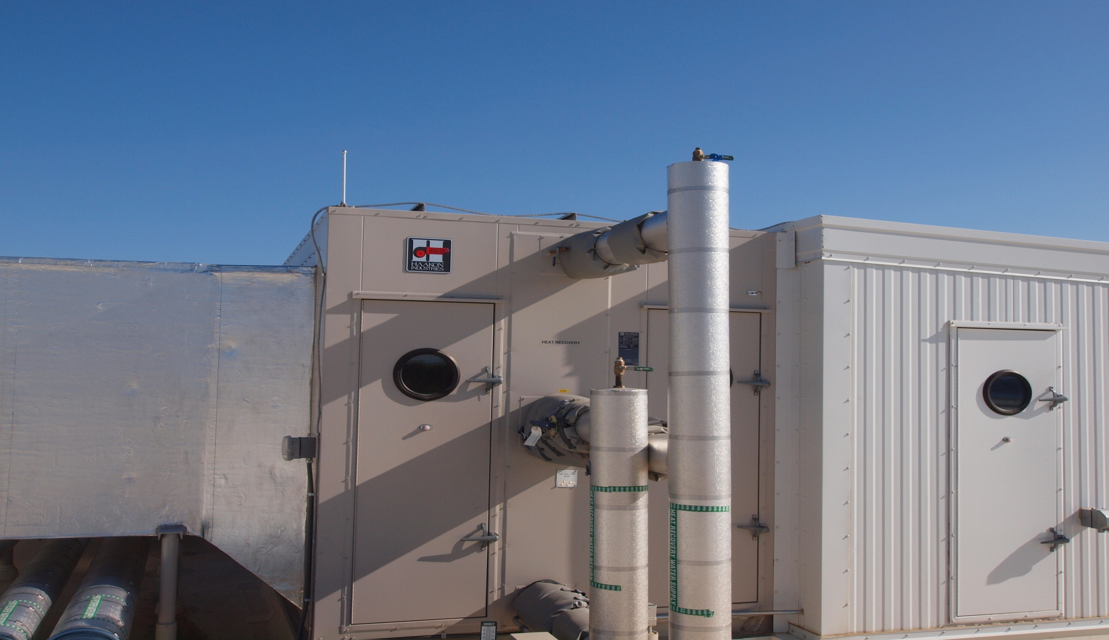
Energy Recovery Ventilation Systems Section C403.2.7 (Mandatory)
Applies to fan systems with supply airflow rates > values in Tables C403.2.7(1-2)
Exhaust air total recovery efficiency must be ≥ 50%
When an air economizer is required
  include a bypass or controls that permit operation of economizer per C403.3
Energy recovery ventilation (ERV) systems: employ air-to-air heat exchangers to recover energy from exhaust air for the purpose of preheating, precooling, humidifying or dehumidifying outdoor ventilation air prior to supplying the air to a space, either directly or as part of an HVAC system.
Notes:
Have an energy recovery system that provides a change in the enthalpy of the outdoor air supply of 50 percent or more of the difference between the outdoor air and return air at design conditions. Provide for bypassing or controlling the energy recovery system to permit cooling with outdoor air where cooling with outdoor air is required.

Slide 42
Energy Recovery Ventilation Systems Section C403.2.6 (Mandatory)
Exceptions:
  Where energy recovery ventilation systems prohibited by the IMC
  Lab fume hood system with at least one of the following:
  VAV hood exhaust and room supply systems capable of reducing exhaust and makeup air volume to ≤ 50% of design values
  Direct makeup (auxiliary) air supply equal to at least 75% of exhaust rate, heated no warmer than 2ºF below room setpoint, cooled to no cooler than 3ºF above room setpoint, no humidification added, and no simultaneous heating and cooling use for dehumidification control
Systems serving uncooled spaces and heated to < 60ºF
Where > 60% of outdoor heating energy is from site-recovered or site solar energy
Heating energy recovery in Climate Zones 1-2
Cooling energy recovery in Climate Zones 3C, 4C, 5B, 5C, 6B, 7, and 8
Systems requiring dehumidification that employ energy recovery in series with the cooling coil
Where largest source of air exhausted at a single location at building exterior is < 75% of design outside air flow rate
Systems expected to operate < 20 hours/week at outdoor air % covered by Table C403.2.7(1)
Systems exhausting toxic, flammable, paint or corrosive fumes or dust
Commercial kitchen hoods used for collecting and removing grease vapors and smoke

Slide 43
Kitchen Exhaust Systems
Section C403.2.8
Replacement air introduced directly into the exhaust hood cavity shall not be > 10% of the hood exhaust airflow rate
Conditioned supply air delivered to any space shall not exceed the greater of the following:
  Ventilation rate required to meet the space heating or cooling load
  Hood exhaust flow minus the available transfer air from adjacent space where available transfer air is considered that portion of outdoor ventilation air not required to satisfy other exhaust needs, such as restrooms, and not required to maintain pressurization of adjacent spaces

Slide 44
Kitchen Exhaust Systems
Section C403.2.8
Total kitchen hood exhaust flow rate >5,000 cfm, each hood be a factory built commercial exhaust hood listed by nationally recognized testing laboratory in compliance with UL 710
Each hood shall have a maximum exhaust rate as specified in Table C403.2.8 and comply with one of the following:
  Not < 50% of all replacement air shall be transfer air that would otherwise be exhausted
  Demand ventilation systems on not < 75% of the exhaust air that are capable of not < 50% reduction in exhaust and replacement air system airflow rates including controls necessary to modulate airflow in response to appliance operation and maintain full capture and containment of smoke, effluent and combustion products during cooking and idle

Slide 45
Kitchen Exhaust Systems
Section C403.2.8 – Cont’d.
Listed energy recovery devices with a sensible heat recovery effectiveness not <40% on not <50% of the total exhaust airflow
  Where a single hood, or hood section, is installed over appliances with different duty ratings, the maximum allowable flow rate for the hood or hood section shall be based on the requirements for the highest appliance duty rating under the hood or hood section
    Exception: where not < 75% of the replacement air is transfer air that would otherwise be exhausted

Slide 46
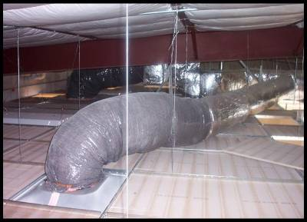
Duct and Plenum Insulation & Sealing
Section C403.2.9 (Mandatory)
Insulation required for supply and return ducts and plenums
    Located in unconditioned space:
      minimum R-6
    Duct located outside the building; duct or plenum within building envelope assembly shall be separated from building exterior or unconditioned or exempt spaces:
      minimum R-8, Climate Zones 1-4
      minimum R-12, Climate Zones 5-8
Exceptions:
  When located within equipment
  When design temperature difference between interior and exterior of the duct or plenum doesn’t exceed 15ºF
Notes:
When located within a building envelope assembly, the duct or plenum shall be separated from the building exterior or unconditioned or exempt spaces by a minimum of R-8 insulation.
Separation from an unconditioned space has a higher requirement than a duct in an unconditioned space because the ductwork insulation is taking the place of the envelope insulation.
All ducts, air handlers and filter boxes shall be sealed. Joints and seams shall comply with Section 603.9 of the International Mechanical Code.
Duct Construction: ductwork shall be constructed and erected in accordance with IMC

Slide 47
Low & Medium Pressure Duct Systems
Sections C403.2.9.1.1 and C403.2.9.1.2 (Mandatory)
Ducts designed to operate at static pressures ≤ 2 in. w.g.
Securely fastened and sealed
  Exceptions:
    When located within equipment
    Design temperature difference between interior and exterior of duct or plenum <15°F
Notes:
Low-pressure duct systems. All longitudinal and transverse joints, seams and connections of supply and return ducts operating at a static pressure less than or equal to 2 inches w.g. (500 Pa) shall be securely fastened and sealed with welds, gaskets, mastics (adhesives), mastic-plus-embedded-fabric systems or tapes installed in accordance with the manufacturer’s installation instructions. Pressure classifications specific to the duct system shall be clearly indicated on the construction documents in accordance with the International Mechanical Code.
Exception:
Locking-type longitudinal joints and seams other than the snap-lock and button-lock types need not be sealed as specified in this section
Medium-pressure duct systems. Insulated and sealed in accordance with Section C403.2.9.
In both cases, pressure classifications specific to the duct system shall be clearly indicated on the construction documents in accordance with the International Mechanical Code.

Slide 48
High Pressure Duct Systems
Section C403.2.9.1.3 (Mandatory)
Ducts and plenums designed to operate at static pressures > 3 in. w.g. to be insulated and sealed and be leak tested in accordance with SMACNA HVAC Air Duct Leakage Test Manual
  Air leakage rate ≤ 4.0
  CL = F/P^{0.65}
    Where
      F = leakage rate cfm per 100 sf of duct surface area
      P = the static pressure of the test
Must test ≥ 25% of the duct area and meet the requirements

Slide 49
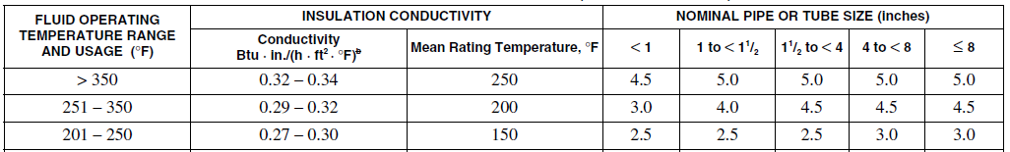
Piping Insulation
Section C403.2.10 (Mandatory)
All piping serving heating or cooling system must be insulated in accordance with Table C403.2.10
Minimum Pipe Insulation
(thickness in inches)
(Partial table)
Notes:
Table Footnotes:
a. For piping smaller than 11/2 inch (38 mm) and located in partitions within conditioned spaces, reduction of these thicknesses by 1 inch (25 mm) shall be permitted (before thickness adjustment required in footnote b) but not to a thickness less than 1 inch (25 mm).
b. For insulation outside the stated conductivity range, the minimum thickness (T) shall be determined as follows:
T = r{(1 + t/r)K/k – 1}
where:
T = minimum insulation thickness,
r = actual outside radius of pipe,
t = insulation thickness listed in the table for applicable fluid temperature and pipe size,
K = conductivity of alternate material at mean rating temperature indicated for the applicable fluid temperature (Btu × in/h × ft2 × °F) and
k = the upper value of the conductivity range listed in the table for the applicable fluid temperature.
c. For direct-buried heating and hot water system piping, reduction of these thicknesses by 11/2 inches (38 mm) shall be permitted (before thickness adjustment
required in footnote b but not to thicknesses less than 1 inch (25 mm).

Slide 50
Piping Insulation
Section C403.2.10
Exceptions:
Piping internal to HVAC equipment (including fan coil units) factory installed and tested
Piping for fluid in temperature range
  60 °F< temp < 105°F
Piping for fluid not heated or cooled by electricity or fossil fuels
Strainers, control valves, and balancing valves associated with piping ≤ 1” in diameter
Direct buried piping for fluids ≤ 60°F

Slide 51
Mechanical Systems Commissioning and Completion
Section C403.2.11 (Mandatory)
Mechanical system to be commissioned and completed per Section C408.2

Slide 52
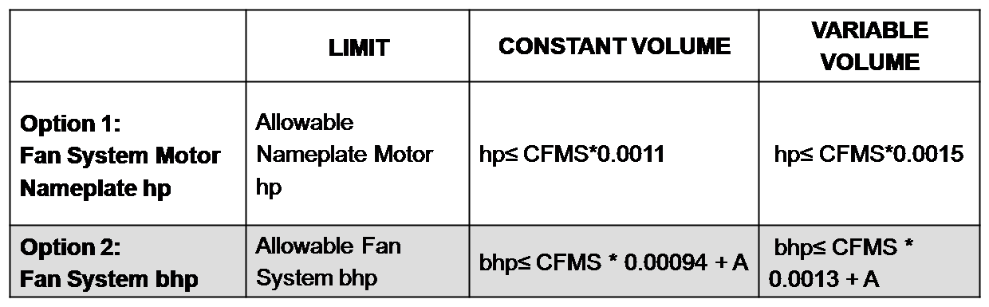
Air System Design and Control Section C403.2.12 (Mandatory)
Maximum fan power requirements
Applies to HVAC systems with total fan system power > 5 hp
Each HVAC system at design conditions can not exceed allowable fan system motor nameplate hp (Option 1) or fan system bhp (Options 2) in Table C403.2.12.1(1)
Single zone VAV systems to comply with constant volume fan power limitations
TABLE C403.2.12.1.1(1) FAN POWER LIMITATION
Notes:
There are two options: Each HVAC system at fan system design conditions to not exceed the allowable fan system motor nameplate hp
(Option 1) or fan system bhp (Option 2) as shown in Table C403.2.12.1(1). This includes supply fans, return/relief fans, and fan-powered terminal units associated with systems providing heating or cooling capability.
Fan system power is the sum of the nominal power demand (nameplate hp) of all fans in a system that are required to operate at design conditions to supply air from the heating or cooling source (such as coils) to the conditioned spaces and return it back to the source or exhaust it to the outdoors.

Slide 53
Allowable Fan Motor Horsepower
Section C403.2.12.1 (Mandatory)
Table C403.1.12.1(2)
Fan Power Limitation Pressure Drop Adjustment
BHP option includes adjustment “adders” and “deducts” for certain devices
Single-zone variable air volume systems shall comply with the constant volume fan power limitation
DEVICE | ADJUSTMENT
Credits
Fully ducted return and/or exhaust air systems | 0.5 in w.c. (2.15 in w.c. for laboratory and vivarium systems)
Return and/or exhaust air flow control devices | 0.5 in w.c.
Exhaust filters, scrubbers, or other exhaust treatment. | The pressure drop of device calculated at fan system design condition.
Particulate Filtration Credit: MERV 9 thru 12 | 0.5 in w.c.
Particulate Filtration Credit: MERV 13 thru 15 | 0.9 in w.c.
Particulate Filtration Credit: MERV 16 and greater and electronically enhanced filters | Pressure drop calculated at 2x clean filter pressure drop at fan system design condition.
Carbon and Other gas-phase air cleaners | Clean filter pressure drop at fan system design condition.
(Partial table)
Notes:
Table changed from 2009 IECC.

Slide 54
Allowable Fan Motor Horsepower
Section C403.2.12.1 (Mandatory)
Exceptions:
  Hospital, vivarium, and laboratory systems using flow control devices on exhaust and/or return for health and safety or environmental control permitted to use variable fan power limitation
  Individual exhaust fans with motor nameplate ≤ 1 hp

Slide 55
Motor Nameplate Horsepower
Section C403.2.12.2 (Mandatory)
Selected fan motor to be no larger than first available motor size greater than bhp
Fan bhp on design documents
Exceptions
  Fans < 6 bhp, where first available motor larger than bhp has nameplate rating within 50% of bhp, next larger nameplate motor size may be selected
  Example: 5.2 Bhp; next size of 7.5 is within 1.5 * Bhp (7.8)
  so may upsize to 10 HP, or next size after 7.5 HP
  Fans ≥ 6 bhp, where first available motor larger than bhp has nameplate rating within 30% of bhp, next larger nameplate motor size may be selected
bhp = brake horsepower

Slide 56
Motor Nameplate Horsepower
Section C403.2.12.3 Fan Efficiency (Mandatory)
Have a fan efficiency grade (FEG) < 67 when determined in accordance with AMCA 205 by an approved independent testing laboratory or labeled by the manufacturer
Total efficiency at the design point of operation be within 15 percentage points of the max. total efficiency of the fan
Exceptions:
  Fans of < 5 hp
    Single fan with a motor nameplate horsepower of <5 hp UNLESS
    Multiple fans in a series or parallel that have a combined motor nameplate horsepower < 5hp and are operated as the functional equivalent of a single fan

Slide 57
Motor Nameplate Horsepower
Section C403.2.12.3 Fan Efficiency (Mandatory)
Exceptions (cont’d)
Fans that are part of the equipment covered under Section C403.2.3
Fans included in an equipment package certified by an approved agency for air or energy performance
Powered wall/roof ventilators
Fans outside the scope of AMCA 205
Fans that are intended to operate only during emergency conditions

Slide 58
Heating Outside a Building
Section C403.2.13 (Mandatory)
Systems are to be radiant systems
Controlled by an occupancy sensing device or timer switch
  So system is automatically deenergized when no occupants are present
Notes:
Examples may be heating loading docks, hotel taxi waiting areas, or patios in restaurants. This is one of the few examples in the code where a specific technology (i.e., radiant heating) is required. Typically the code only mentions performance requirements.

Slide 59
Refrigeration Equipment Performance
Section C403.2.14
Equipment have an energy use in kWh/day ≤ the values of Tables C403.2.14(1-2) when tested and rated in accordance with AHRI Standard 1200
Energy use shall be verified through certification under an approved certification program or where a certification program does not exist, the energy use shall be supported by data furnished by the equipment manufacturer

Slide 60
Walk-in Coolers, Walk-in Freezers, Refrigerated Warehouse Coolers/Freezers
Section C403.2.15
Be equipped with automatic door-closers that firmly close walk-in doors that have been closed to within 1” of full closure
  Exception – automatic closers are not required for doors >45” in width or > 7ft in height
Doorways have strip doors, curtain, spring hinged doors or other approved method of minimizing infiltration when doors are open
Walk-in coolers and refrigerated warehouse coolers shall have wall, ceiling, and door insulation of > R-25 and walk-in freezers and refrigerated warehouse freezers
> R-32
  Exception – glazed portions of doors or structural members need not be insulated

Slide 61
Walk-in Coolers, Walk-in Freezers, Refrigerated Warehouse Coolers/Freezers
Section C403.2.15 – Cont’d
Walk-in freezers contain floor insulation > R-28
Transparent reach-in doors for walk-in freezers and windows in walk-in freezer doors shall be of triple-pane glass, either filled with inert gas or with heat-reflective treated glass
Windows and transparent reach-in doors for walk-in coolers, doors shall be of double-pane or triple pane, inert gas-filled, heat-reflective treated glass
Evaporator fan motors that are < 1hp and < 460 volts use electronically commutated motors, brushless direct-current motors, or 3-phase motors
Condenser fan motors < 1hp use electronically commutated motors, permanent split capacitor-type motors or 3-phase motors

Slide 62
Walk-in Coolers, Walk-in Freezers, Refrigerated Warehouse Coolers/Freezers
Section C403.2.15 – Cont’d
Antisweat heaters without antisweat heater controls:
  limit total door rail, glass and frame heater power draw < 7.1W/ft² of door opening for walk-in freezers and 3.0 W/ft² of door opening for walk-in coolers
Where antisweat heater controls are provided
  reduce the energy use of the antisweat heater as a function of the relative humidity in the air outside the door or of the condensation on the inner glass plane

Slide 63
Walk-in Coolers and Walk-in Freezers
Section C403.2.16
Site assembled or site constructed walk-ins have identical provisions to pre-manufactured walk-ins.
Automatic door closers be provided that fully close walk-in doors that have been closed to within 1” of full closure
  Exception – automatic losers are not required for doors > 45” in width or > 7ft in height
Doorways have strip doors, curtain, spring hinged doors or other approved method of minimizing infiltration when doors are open
Walls shall be provided with insulation having a thermal resistance of > R-25, ceilings with insulation having a thermal resistance and doors > R-25 and doors
  Exception – insulation is not required for glazed portions of doors or at structural members associated with the walls, ceiling or door frame

Slide 64
Walk-in Coolers and Walk-in Freezers
Section C403.2.16
Floor of walk-in freezers provided with insulation having a thermal resistance of > R-28
Transparent reach-in doors for and windows in opaque walk-in freezer doors provided with triple-pane glass having the interstitial spaces filled with inert gas or provided with heat-reflective treated glass
Transparent reach-in doors for and windows in opaque walk-in cooler doors be double-pane heat-reflective treated glass having the interstitial space gas filled
Evaporator fan motors <1 hp and < 460 volts be electronically commutated motors or 3-phase motors
Condenser fan motors <1hp in capacity be of the electronically commutated or permanent split capacitor-type or be 3-phase motors
  Exception – fan motors in walk-in coolers and freezers combined in a single enclosure >3,000 ft² in floor area are exempt

Slide 65
Walk-in Coolers and Walk-in Freezers
Section C403.2.16
Antisweat heaters without antisweat heater controls are provided, have a total door rail, glass and frame heater power draw < 7.1W/ft² of door opening for walk-in freezers and 3.0 W/ft² of door opening for walk-in coolers
Where antisweat heater controls are provided, they shall reduce the energy use of eth antisweat heater as a function of the relative humidity in the air outside the door or to the condensation on the inner glass plane

Slide 66
Refrigerated Display Cases
Section C403.2.17
Site-assembled or site-constructed refrigerated display cases shall comply with the following:
Lighting and glass doors controlled by one of the following:
  Time switch controls to turn off lights during nonbusiness hours. Timed overrides for display case shall turn the lights on for up to 1 hour and automatically time out to turn the lights off
  Motion sensor controls on each display case section that reduce lighting power by at least 50% within 3 minutes after the area within the sensor range is vacated
Low-temp. display cases incorporate temp.-based defrost termination control with a time-limit default. The defrost cycle shall terminate first on an upper temp. limit breach and second upon a time limit breach.
Antisweat heater controls to reduce the energy use of the antisweat heater as a function of the relative humidity in the air outside the door or to the condensation on the inner glass pane

Slide 67
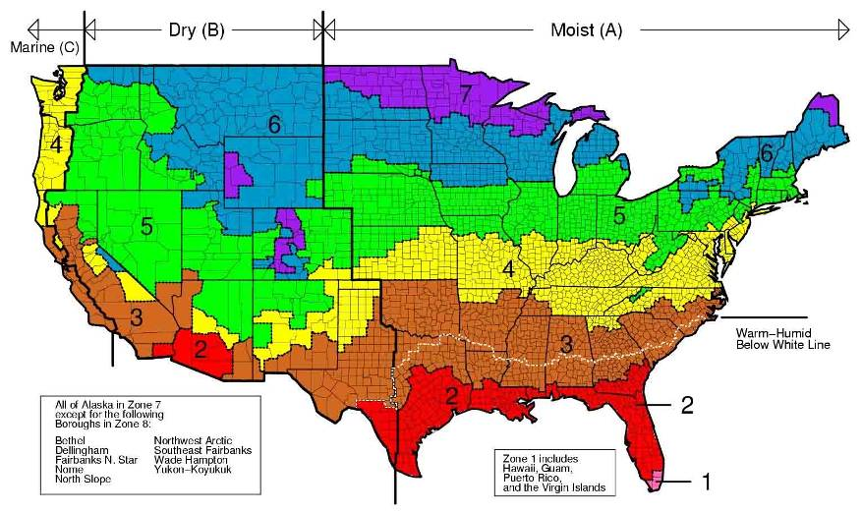
Climate Zones - 2015 IECC
Notes:
The climate zones are unchanged from the 2012 IECC.
U.S. counties are defined entirely by county boundaries; every county is homogenous.
There are 8 temperature oriented zones, crossed with 3 moisture regimes (moist, dry, marine), for a theoretical 24 possible zones.

Slide 68
Economizers
Section C403.3
CLIMATE ZONES | ECONOMIZER REQUIREMENT
1A, 1B | No requirement
2A, 2B, 3A, 3B, 3C, 4A, 4B, 4C, 5A, 5B, 5C, 6A, 6B, 7, 8 | Economizers on individual DX cooling units ≥ 54,000 Btu/hª
 | Economizer (usually central water economizer) on any chilled water cooling unit if total cooling meets table C403.3 limits
Total supply capacity of all fan-cooling units not provided with economizers shall not exceed 20% of the total supply capacity of all fan-cooling units in the building or 300,000 Btu/h, whichever is greater, unless otherwise excepted
Notes:
Changed from the 2009 IECC. Simple and complex systems no longer separated. Individual unit exception increased from 33,000 to 54,000 Btu/h. The limit before shown in a table, now shown in text.
Economizers. Supply air economizers shall be provided on each cooling system as shown in Table C403.3.1(1).

Slide 69
Economizers
Section C303.3
Climate Zones (Cooling) | Total Chilled-Water System Capacity < Capacity of Cooling Units with Air Economizers
 | Local Water-cooled Chilled-water Systems | Air-cooled Chilled-water Systems or District Chilled-water Systems
1a | No economizer requirement | No economizer requirement
1b, 2a, 2b | 960,000 Btu/h | 1,250,000 Btu/h
3a, 3b, 3c, 4a, 4b, 4c | 720,000 Btu/h | 940,000 Btu/h
5a, 5b, 5c, 6a, 6b, 7, 8 | 1,320,000 Btu/h | 1,720,000 Btu/h
Example: Hotel with guest room chilled water fan coil units totaling 1,500 MBH of cooling capacity in climate zone 5A
Central water economizer or individual fan coil air economizers required if a water-cooled chiller
No economizer requirement if all air-cooled chillers or district chilled water source outside of building

Slide 70
Economizers
Section C403.3.1 Exceptions
Exceptions: (economizers not required)
Where > 25% of air designed to be supplied by the system is to spaces that are designed to be humidified
> 35°F dew-point temperature to satisfy process needs
Systems that serve residential spaces where system capacity is < 5 times requirement in Table C403.3.1(1)
Systems expected to operate < 20 hours/week
Where use of outdoor air for cooling will affect supermarket open refrigerated casework systems
Where cooling efficiency meets of exceeds efficiency requirements in Table C403.3(2)

Slide 71
Economizers
Section C403.3.1 Exceptions – Cont’d.
Chilled-water cooling systems that are passive (without a fan) or use induction where the total chilled water system capacity less the capacity of fan units with air economizers is less than the minimum specified in Table C403.3(1)
Systems that include a heat recovery system in accordance with Section 403.4.7

Slide 72
Economizers
Section C403.3
Trade-off high cooling efficiency for economizer
Table C403.3(2)
CLIMATE ZONES | COOLING EQUIPMENT PERFORMANCE IMPROVEMENT (EER OR IPLV)
2B | 10% Efficiency Improvement
3B | 15% Efficiency Improvement
4B | 20% Efficiency Improvement

Slide 73
Economizers
Section C303.3.1 Integrated Economizer Control
Systems to be integrated with the mechanical cooling system and capable of providing partial cooling even where additional mechanical cooling is required to provide the remainder of the cooling load
Controls shall not be capable of creating a false load in the mechanical cooling systems by limiting or disabling the economizer or any other means, such as hot gas bypass, except at the lowest stage of mechanical cooling

Slide 74
Economizers
Section C303.3.1 Integrated Economizer Control – Cont’d
Units that include an air economizer to comply with the following:
Unit controls have the mechanical cooling capacity control interlocked with the air economizer controls such that the outdoor air damper is at the 100% open position when mechanical cooling is on and the outdoor air damper does not begin to close to prevent coil freezing due to minimum compressor run time until the leaving air temp. < 45°F
Direct expansion (DX) units that control >75,000 Btu/h of rated capacity of the capacity of the mechanical cooling directly based on occupied space temp. shall have not fewer than two stages of mechanical cooling capacity
Other DX units including those that control space temp. by modulating the airflow to the space be in accordance with Table C403.3.1

Slide 75
Economizers
Section C403.3.2 Heating System Impact
HVAC system design and economizer controls shall be such that economizer operation does not increase building heating energy use during normal operations
Exception: Economizers on variable air volume (VAV) systems that cause zone level heating to increase due to a reduction in supply air temperature

Slide 76
Air Economizers
Section C403.3.3.1 Design Capacity
Capable of modulating outdoor air and return air dampers to provide up to 100% of design supply air quantity as outdoor air for cooling

Slide 77
Air Economizers
Section C403.3.3.2 Control Signal
Economizer dampers to be capable of being sequenced with mechanical cooling equipment and not be controlled by only mixed air temperature
Exception:
Can use mixed air temperature limit control for systems controlled from space temperature
Example: single-zone systems

Slide 78
Air Economizers
Section C403.3.3.3 High-Limit Shutoff
Air economizers to be capable of automatically reducing outdoor air intake to design minimum outdoor air quantity when outdoor air intake will no longer reduce cooling energy usage
High-limit shutoff control types to be chosen from Table C403.3.1.1.3(1) for specific climates
Specifications for high-limit shutoff control type settings per Table C403.3.1.1.3(2)

Slide 79
Air Economizers
Section C403.3.3.4 Relief of Excess Outdoor Air
Systems to be capable of relieving excess outdoor air during air economizer operation to prevent over-pressurizing the building
Relief air outlet to be located to avoid recirculation into the building

Slide 80
Air Economizers
Section C403.3.3.5 Dampers
Return, exhaust/relief and outdoor air dampers used in economizers shall comply with Section C403.2.4.3 (Shut Off Dampers)

Slide 81
Water-side Economizers
Section C403.3.4.1 Design Capacity
Capable of cooling supply air by indirect evaporation and provide up to 100% of expected system cooling load at outdoor air temperatures < 50ºF dry bulb/45ºF wet bulb
Exceptions:
Systems primarily serving computer rooms in which 100% of expected system cooling load at 40ºF dry bulb/35ºF wet bulb is met with evaporative water economizers
Systems primarily serving computer rooms with dry cooler water economizers which satisfy 100% of the expected system cooling load at 35ºF dry bulb
Systems where dehumidification requirements cannot be met using outdoor air temps of 50ºF dry bulb/45ºF web bulb and where 100% of expected system cooling load at 45ºF dry bulb/40ºF wet bulb is met with evaporative water economizers

Slide 82
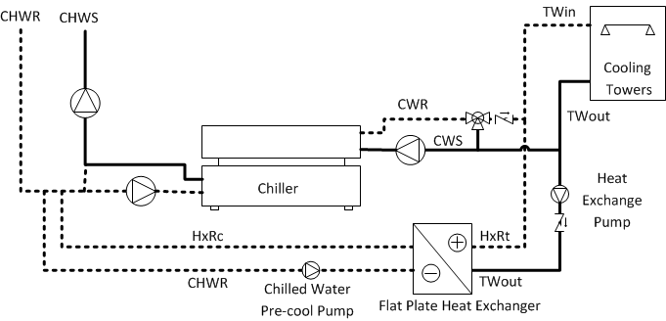
Water-side Economizers
Section C403.3.4.2 Maximum Pressure Drop
Precooling coil and water-to-water heat exchangers used as part of a water economizer system to have either a:
water side pressure drop < 15 feet of water OR
secondary loop created so that the coil or heat exchanger pressure drop is not seen by the circulating pumps when the system is in normal cooling (non-economizer) mode
Notes:
Unlike airside economizers, water economizers have parasitic energy losses that reduce the cooling energy savings. One of these losses comes from possible increases in pumping energy. This requirement attempts to limit those losses. The diagram shows the second option, a secondary loop with a separate pump on the chilled water side.
Save pumping energy

Slide 83
Hydronic and Multiple-zone HVAC Systems Controls & Equipment
Section C403.4 Prescriptive
Systems Include:
Packaged VAV reheat
Built-up VAV reheat
Built-up single-fan, dual-duct VAV
Built-up or packaged dual-fan, dual-duct VAV
Four-pipe fan coil system with central plant
Water Source heat pump with central plant
Any other multiple-zone system
Hydronic space heating and cooling system

Slide 84
Fan Airflow Control
Section C403.4.1.1
Each cooling system listed in Table C403.4.1.1 be designed to vary the indoor fan airflow as a function of load and comply with the following:
Direct expansion (DX) and chilled water cooling units that control capacity of mechanical cooling directly based on space temp to have not fewer than 2 stages of fan control
  Low or minimum speed < 66% full speed
    fan to draw < 40% of fan power at full fan speed
    Used during period of low cooling load and ventilation-only operation
Other units including DX cooling and chilled water that control the space temp. by modulating the airflow to the space have modulation fan control (usually a variable speed drive)
  Minimum speed < 50% of full speed
    Fan to draw < 30% of fan power at full fan speed
  Low or minimum speed used during period of low cooling load and ventilation-only operation

Slide 85
Fan Airflow Control
Section C403.4.1.1 – Cont’d.
Units that include an airside economizer in accordance with Section C403.3 to have not fewer than two speeds of fan control during economizer operation
Exceptions:
  Modulating fan control is not required for chilled water and evaporative cooling units with fan motors < 1 hp where the units are not used to provide ventilation air and the indoor fan cycles with the load
  Where the volume of outdoor air required to comply with the ventilation requirements of IMC at low speed exceeds the air that would be delivered at the speed defined in Section C403.4.1
    Minimum speed to be selected to provide the required ventilation air

Slide 86
Variable Air Volume Fan Control Section C403.4.2
Individual VAV fans with motors ≥ 7.5hp must be:
  Driven by a mechanical or electrical variable speed drive OR
  Driven by a vane-axial fan with variable-pitch blades OR
  Have controls or devices to result in fan motor demand ≤ 30% of their design wattage at 50% of design airflow
*
Notes:
For systems with direct digital control of individual zone boxes reporting to the central control panel, the static pressure set point shall be reset based on the zone requiring the most pressure, i.e., the set point is reset lower until one zone damper is nearly wide open.

Slide 87
Static Pressure Sensor Location
Section C403.4.1.2
Sensors used to control VAV fans
  Placed so that the controller setpoint is ≤ 1.2 inches w.c.
Sensors installed downstream of major duct splits
  At least one sensor to be located on each major branch so that static pressure can be maintained in each branch

Slide 88
Set Points for Direct Digital Control
Section C403.4.1.3
Systems with direct digital control of individual reporting to the central control panel
  Static pressure set point to be reset based on the zone requiring the most pressure (i.e., the set point is reset lower until one zone damper is nearly wide open)
  Direct digital controls capable of monitoring zone damper positions or have an alternative method of indication the need for static pressure capable of all of the following:
    Automatically detecting any zone that excessively drives the reset logic
    Generating an alarm to the system operational location
    Allowing an operator to readily remove > 1 zones from the reset algorithm

Slide 89
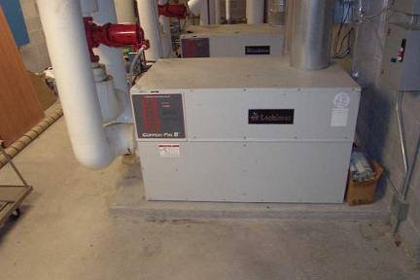
Hydronic System Controls
Section C403.4.2
Limit reheat/recool of fluids
Multiple boiler heating plants must include automatic controls capable of sequencing operation of the boilers
Single boilers > 500,000 Btu/h input design capacity must include multi-staged or modulating burner

Slide 90
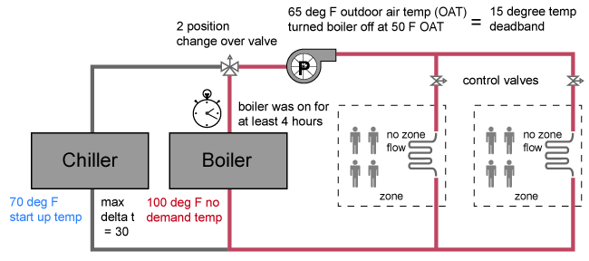
Hydronic Systems
Section C403.4.2
3-Pipe System – not allowed
  Can’t use a common return
2-Pipe Changeover System
  Dead band between changeover ≥ 15ºF outside temperature
Diagram Courtesy of Ken Baker
Notes:
Two-pipe changeover systems use a common distribution system to alternately supply heated or chilled water to fan-coils and air-handlers. One pipe in and one pipe out. Changeover happens at specified times of the year.
To be designed to allow a dead band between changeover from one mode to the other of at least 15°F (8.3°C) outside air temperatures; be designed to and provided with controls that will allow operation in one mode for at least 4 hours before changing over to the other mode; and be provided with controls that allow heating and cooling supply temperatures at the changeover point to be no more than 30°F (16.7°C) apart.

Slide 91
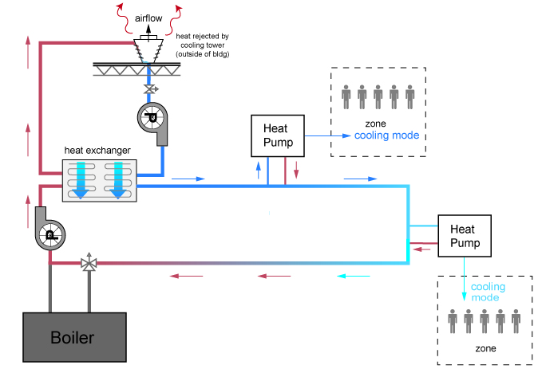
Hydronic Water Loop Heat Pump Systems
Section C403.4.2.3
Temperature dead band of at least 20ºF (C403.4.2.3.1)
  Exception:
    Where system loop temp optimization controller is installed and can determine the most efficient operating temp based on real time conditions of demand and capacity
Example:
Heat rejection off below 75ºF loop temperature.
Boiler off above 55ºF loop temperature
75ºF - 55ºF =
20ºF dead band
Diagram Courtesy of Ken Baker
Notes:
Ex: water loop through building and heat pumps are placed around and use water loop as a heat source for heating and a heat sink for cooling.
Requirements are meant to limit the unnecessary use of the central heating and cooling sources and increase heat recovery in the system.

Slide 92
Hydronic Water Loop Heat Pump Systems
Section C403.4.2.3
Heat rejection equipment in Climate Zones 3 and 4 (C403.4.2.3.2)
  Closed-circuit cooling tower used directly in heat pump loop
    Install either automatic valve to bypass all but a minimal flow of water around tower OR lower leakage positive closure dampers to be provided
  Open-circuit tower used directly in heat pump loop
    Install automatic valve to bypass all heat pump water flow around tower
  Open- or closed-circuit used in conjunction with separate heat exchanger to isolate cooling tower from heat pump loop
    Heat loss controlled by shutting down the circulation pump on cooling tower loop
Heat rejection equipment in Climate Zones 5 - 8
  Open- or closed-circuit cooling tower used
    Must have a separate heat exchanger to isolate cooling tower from heat pump loop
    Heat loss controlled by shutting down circulation pump on cooling tower loop and providing an automatic valve to stop flow of fluid
Notes:
Exception: Where it can be demonstrated that a heat pump system will be required to reject heat throughout the year.
If an open-circuit tower is used directly in the heat pump loop, an automatic valve must be installed to bypass all heat pump water flow around the tower.
If an open-circuit tower is used in conjunction with a separate heat exchanger to isolate the tower from the heat pump loop, then heat loss must be controlled by shutting down the circulation pump on the cooling tower loop.

Slide 93
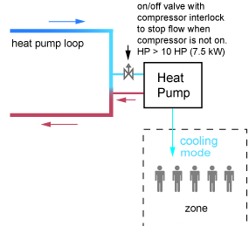

Hydronic Water Loop Heat Pump Systems
Section C403.4.2.3 – cont’d.
Two position valve (C403.4.2.3.3)
  Required on each hydronic heat pump where total system pump power > 10 hp

Slide 94
Hydronic System Part Load Control Section C403.4.2.4
System ≥ 500,000 Btu/h heating or cooling must include
  Temperature reset and variable flow
    Automatic resets for supply water temperature by at least 25% of design supply-to-return temperature differences and
    Automatic vary fluid flow if a combined motor capacity ≥ 10 hp with ≥ 3 control valves or other devices:
      Must reduce system design flow rate by > 50% by
      designed valves or pumps that modulate flow:
      Modulating valves or VSD on pumps,
      Valves that step open and close OR
      Sequencing pumps or valves turn on and of as function of load
    Automatic vary pump flow on chilled-water system and heat rejection loops serving cooled unitary air conditioners with a combined pumping motor capacity ≥ 10 hp by reducing pump design flow > 50%
      Utilizing adjustable speed drives on pump OR
      Multiple-staged pumps ≥ half of total pump hp is capable of being automatically turned off
      Pump flow rate to be controlled to maintain one control valve nearly wide open Or to satisfy the minimum differential pressure
Notes:
The “or” in 2012 has changed to an “and” for 2015

Slide 95
Hydronic System Part Load Control Section C403.4.2.4
Exceptions:
Supply-water temp. reset for chilled-water systems supplied by off-site district chilled water or chilled water from ice storage systems
Minimum flow rates other than 50% as required by the equipment manufacturer for proper operation of equipment where using flow bypass or end-of-line 3-way valves
Variable pump flow on dedicated equipment circulation pumps where configured in primary/secondary design to provide the minimum flow requirements of the equipment manufacturer for proper operation of equipment
Example:
Variable flow secondary pump required if 10 hp or more
No VSD required on primary chiller pump where each chiller has a dedicated pump designed at minimum flow.

Slide 96
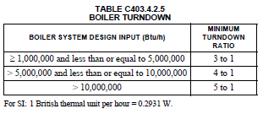
Boiler Turndown
Section 403.4.2.5
Boiler systems with design input ≥ 1,000,000 Btu/h to comply with turndown ratio specified in Table C403.4.2.5
System turndown requirement must be met through the use of
  multiple single input boilers OR
  > 1 modulating boilers OR
  combination of single input and modulating boilers

Slide 97
Pump Isolation
Section C403.4.2.6
Multiple chiller chilled water plants
  Capability to reduce flow through the chiller automatically when chiller is shut down
  Chillers piped in series considered one chiller
Multiple boiler plants
  Capability to reduce flow through the boiler automatically when boiler is shut down
What to look for:
Separate pumps for each boiler or chiller with check valves, OR
A variable flow pump with isolation valves for each boiler or chiller
Notes:
Essentially requires that flow through chillers (or boilers), when piped in parallel, must be shutoff when the chillers (or boilers) are inactive.
When a chilled-water plant includes more than one chiller, provisions shall be made so that the flow in the chiller plant can be automatically reduced, correspondingly, when a chiller is shut down.
When a boiler plant includes more than one boiler, provisions shall be made so that the flow in the boiler plant can be automatically reduced, correspondingly, when a boiler is shut down.

Slide 98
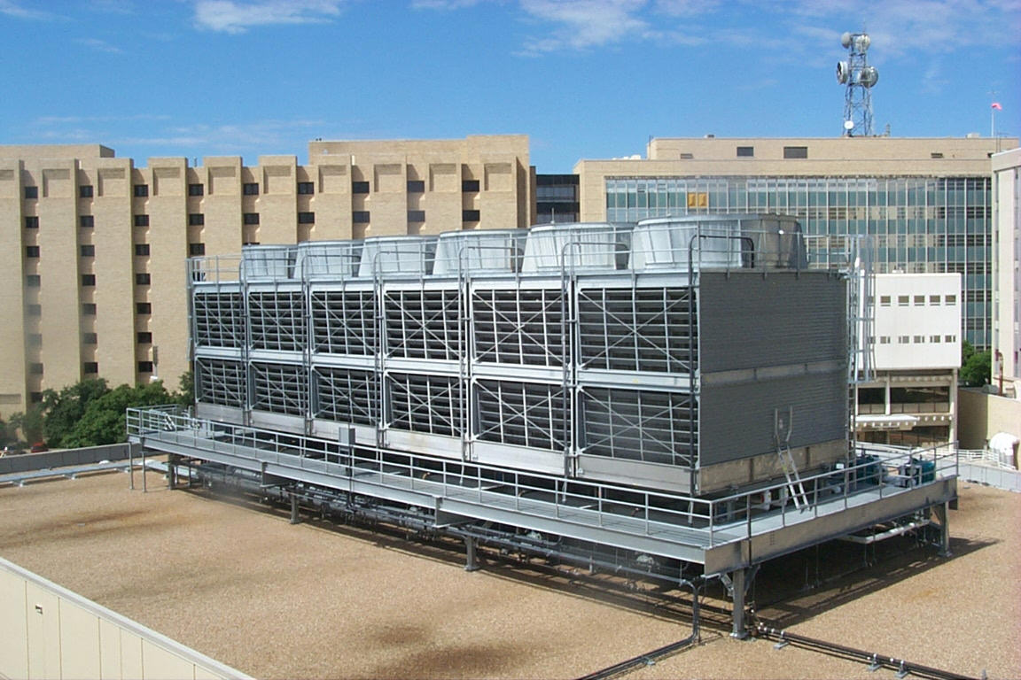
Heat Rejection Equipment
Section C403.4.3
Each tower fan powered by a motor ≥ 7.5 hp must include variable speed or two speed fan
  Have controls to automatically change the fan speed to control the leaving fluid temperature or condensing temperature/pressure of the heat rejection device
  Exception:
    Factory-installed heat rejection devices within condensers and chillers tested and rated in accordance with Tables C403.2.3(6) and C403.2.3(7)
Notes:
Each fan powered by a motor of 7.5 hp (5.6 kW) or larger to have the capability to operate that fan at two-thirds of full speed or less, and shall have controls that automatically change the fan speed to control the leaving fluid temperature or condensing temperature/pressure of the heat rejection device.

Slide 99
Heat Rejection Equipment
Section C403.4.3.1 - General
Air-cooled condensers, dry coolers, open-circuit cooling towers, closes-circuit cooling towers, and evaporative condensers used for comfort cooling applications must comply with Section C403.4.3
  Exception: heat rejection devices where energy usage is included in the equipment efficiency ratings listed in Tables C403.2.3(6) and C403.2.3(7)

Slide 100
Heat Rejection Equipment
Section C403.4.3.2.1 – Fan motors > 7.5 hp
Must have the capability to
Operate at < 2/3 of full speed
Controls that automatically change fan speed to control the leaving fluid temp. or condensing temp./pressure of the heat rejection device
Exception:
Condenser fans serving multiple refrigerant circuits
Condenser fans serving flooded condensers
Installations located in Climate Zones 1 and 2

Slide 101
Heat Rejection Equipment
Section C403.4.3.2.2 – Multiple-cell
Multiple-cell heat rejection equipment with variable speed fan drives to be controlled in both manners:
Operate the maximum number of fans allowed that comply with manufacturer’s requirements for all system components
So all fans can operate at the same fan speed required for the instantaneous cooling duty, as opposed to staged (on/off) operation
Minimum fan speed must be the minimum allowable speed of the fan drive system in accordance with manufacturer’s recommendations

Slide 102
Heat Rejection Equipment
Section C403.4.3.3 – Limitation on
Centrifugal Fan Open-circuit Cooling Towers
Combined rated capacity > 1,100 gpm at 95ºF condenser water return, 85ºF condenser water supply, 75ºF outdoor air wet-bulb temperature must meet the energy efficiency requirement for axial fan open-circuit cooling towers listed in Table C403.2.3(3)
Exception:
Centrifugal open-circuit cooling towers that are designed with inlet or discharge ducts or require or require external sound attenuation

Slide 103
Heat Rejection Equipment
Section C403.4.3.4 – Tower Flow Turndown
Open-circuit cooling towers used on water-cooled chiller system that are configured with multiple or variable-speed condenser water pumps
Designed that all open circuit cooling tower cells can be run in parallel with the larger of
  the flow that is produced by the smallest pump at its minimum expected flow rate OR
  50% of the design flow for the cell

Slide 104
Requirements for Complex Systems Serving Multiple Zones
Section C403.4.4
Must be variable air volume (VAV) systems
VAV systems must be designed and capable of being controlled to reduce the primary air supply to each zone before reheat, recool, or mixing take place
Maximum airflow in reheat, recool, or mixing—one of:
  30% of the maximum supply air to each zone
  ≤ 300 cfm where the maximum flow rate is <10% of total fan system design supply airflow rate
  Minimum ventilation requirements from Chapter 4 of the IMC
  Any higher rate that can be demonstrated to reduce overall system annual energy use by off setting reheat/recool energy losses through reduction in outdoor air intake for the system, as approved by code official
  Airflow rate required to comply with applicable codes or accreditation standards, such as pressure relationships or minimum air change rates

Slide 105
Exceptions
Section C403.4.4
Exceptions from VAV control (individual zones or systems):
Where > 75% of reheat energy comes from site-recovered or site-solar energy source
Zones with special humidity requirements
Zones with ≤ 300 cfm peak supply and flow rate is < 10% of total fan system supply airflow rate
Zones where reheated, recooled or mixed air volume < minimum ventilation requirements (Chapter 4 of IMC)
Systems with controls capable of preventing reheating, recooling, mixing or simultaneous supply of air previously heated or cooled

Slide 106
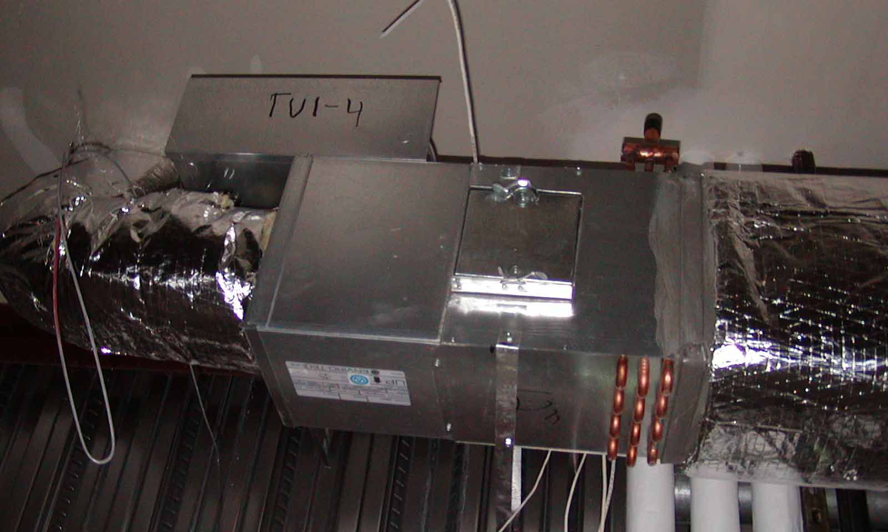
Single Duct VAV Systems, Terminal Devices
Section C403.4.4.1
Single duct VAV systems to use terminal devices capable of reducing the supply of primary supply air before reheating or recooling takes place

Slide 107
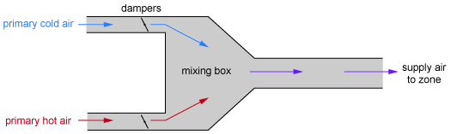

Dual Duct and Mixing VAV Systems, Terminal Devices
Section C403.4.4.2
Systems with one warm air duct and one cool air duct to use terminal devices capable of reducing flow from one duct to a minimum before mixing of air from the other duct takes place
Notes:
These systems are considered older technology

Slide 108
Single Fan Dual Duct and Mixing VAV Systems, Economizers
Section C403.4.4.3
Individual dual duct or mixing reheating and cooling systems with a single fan and with total capacities > 90,000 Btu/h (7.5 tons) should not have economizers
Notes:
Not very common

Slide 109
Fractional hp Fan Motors
Section C403.4.4.4
Motors for fan ≥ 1/12 hp and < 1 hp shall be electronically commutated motors OR have a minimum motor efficiency of 70% rated in accordance with DOE 10 CFR 431
Motors must have the means to adjust motor speed for either balancing or remote control
The use of belt-driven fans with sheave adjustments for airflow balancing instead of a varying motor speed is permitted
Exceptions:
  Motors in the airstream within fan coils and terminal units that only provide heating to the space served
  Motors in space-conditioning equipment that comply with Section C403.2.3 or C403.2.12
  Motors that comply with Section C405.8

Slide 110
Supply-Air Temperature Reset Controls
Section C403.4.4.5
Multiple zone HVAC systems to have controls to automatically reset supply-air temperature in response to building loads or outdoor air temperature
Controls to be capable of resetting supply air temperature at least 25% of difference between design supply-air temperature and design room air temperature
Exceptions:
  Systems that prevent reheating, recooling or mixing of heated and cooled supply air
  75% of energy for reheating is from site-recovered or site solar energy sources
  Zones with peak supply air quantities of ≤ 300 cfm

Slide 111
Multiple-zone VAV System Ventilation Optimization Control
Section C403.4.4.6
Multiple-zone VAV systems with direct digital control of individual zone boxes reporting to central control panel
  Automatic controls configured to reduce outdoor air intake flow below design rates in response to changes in system ventilation efficiency (Ev) as defined by IMC
Exceptions:
  VAV systems with zonal transfer fans that recirculate air from other zones without directly mixing it with outdoor air, dual-duct dual-fan VAV systems, and VAV systems with fan-powered terminal units
  Systems having exhaust air energy recovery complying with Section C403.2.7
  Systems where total design exhaust airflow is > 70% of total design outdoor air intake flow requirements

Slide 112
Heat Recovery for Service Hot Water Heating
Section C403.4.5
Condenser heat recovery required for heating/reheating of SWH provided:
  Facility operates 24 hours/day
  Total installed heat capacity of the heat rejection of water-cooled systems >6,000,000 Btu/hr
  Design SWH load >1,000,000 Btu/hr
Capacity to provide the smaller of
  60% of peak heat rejection load at design conditions OR
  Preheating to raise peak SWH to 85ºF
Exceptions:
  Recovered heat is used for space heating or when SWH is provided by renewables or site recovered energy sources
Notes:
Concept: If there is waste heat in the building, it is to be used for potable water.
Exceptions: 1. Facilities that employ condenser heat recovery for space heating or reheat purposes with a heat recovery design exceeding 30% of the peak water-cooled condenser load at design conditions. 2. Facilities that provide 60% of their service water heating from site solar or site recovered energy or from other sources.

Slide 113
Hot Gas Bypass
Section C403.4.6
Cooling systems can’t use unless system designed with
  multiple steps of unloading OR
  Continuous capacity modulation
Capacity limited per Table C403.4.6 as limited by Section C403.3.1
Rated Capacity | Maximum Hot Gas Bypass Capacity (% of total capacity)
≤ 240,000 Btu/h | 50%
> 240,000 Btu/h | 25%
Notes:
In hot gas bypass systems, hot gas from the compressor discharge is injected into the compressor suction to false load the compressor so it will operate stably at its lowest stage of unloading. This can be the result in increased energy usage at low loads, so it can only be used in certain circumstances.

Slide 114
Refrigeration Systems
Section C403.5
Display cases, walk-in coolers or walk-in freezers served by remote compressors and remote condensers not located in a condensing unit must comply with Sections C403.5.1 and C403.5.2
Exception: Systems where the working fluid in the refrigeration cycle goes through both subcritical and supercritical states (transcritical) or that use ammonia refrigerant

Slide 115
Condensers Serving Refrigeration Systems
Section C403.5.1
Fan-Powered Condensers
Design saturated condensing temperatures for air-cooled condenser not to exceed
  design dry-bulb temp. plus 10ºF for low-temp. refrigeration systems
  Design dry-bulb temp. plus 15ºF for medium temp. refrigeration systems where saturated condensing temp. for blend refrigerants should be determined using the average of liquid vapor temps. as converted from the condenser drain pressure
Condenser fan motors < 1 hp use electronically commutated motors, permanent split-capacitor-type motors or 3-phase motors

Slide 116
Condensers Serving Refrigeration Systems
Section C403.5.1 – Cont’d.
Air-cooled condensers, evaporatively cooled condensers, air- or water-cooled fluid coolers or cooling towers must reduce fan motor demand ≤ 30% of design wattage at 50% of design air volume, and incorporate one of the following continuous variable speed fan control approaches:
  Control for air-cooled condensers must use variable setpoint control logic to reset the condensing temp. setpoint in response to ambient dry-bulb temp.
  Control for evaporatively cooled condensers must use variable setpoint control logic to reset the condensing temp. setpoint in response to ambient wet-bulb temp.
Multiple fan condensers to be controlled in unison
Minimum condensing temp. setpoint ≤ 70ºF

Slide 117
Compressor Systems
Section C403.5.2
Compressors and multiple-compressor system suction groups must include control systems that use floating suction pressure control logic to reset the target suction pressure temp. based on the temp. requirements of the attached refrigeration display cases or walk-ins:
Exception: controls are not required for:
  Single-compressor system that do not have variable capacity capability
  Suction groups that have:
    a design saturated suction temp. of > 30ºF,
    comprise the high stage of a two-stage or cascade system OR
    Primarily serve chillers for secondary cooling fluids

Slide 118
Compressor Systems
Section C403.5.2 – Cont’d.
Liquid subcooling must be provided for all low-temp. compressor systems with a design cooling capacity
> 100,000 Btu/hr with a design-saturated suction temp. < -10ºF
  Sub-cooled liquid temp. to be controlled at max. temp. setpoint of 50ºF at the exit of the subcooler using either compressor economizer ports or a separate compressor suction group operating at a saturated suction temp. >18ºF
    Insulation for liquid lines with a fluid operating temp. < 60ºF must comply with Table C403.2.10
Compressors that incorporate internal or external crankcase heaters must provide a means to cycle the heaters off during compressor operation

Slide 119
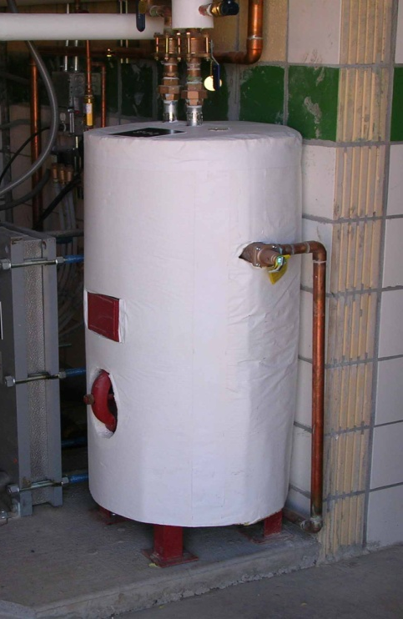
Service Water Heating
Section C404
Table C404.2 Minimum Performance of Water-Heating Equipment
  Water Heater Types Covered
    Electric Storage
    Gas and Oil Storage
    Instantaneous Water Heaters – Gas and Oil
    Hot water boilers – gas and oil
    Pool heaters
    Unfired storage tanks
Heat Traps (C404.3)
Piping Insulation (C404.4)
Efficient Piping(C404.5)
Circulation & Temperature Maintenance (C404.6)
Demand Recirculation (C404.7)
Drain Heat Recovery(C404.8)
Pools and Spas (C404.9)
Portable Spas (C404.10)
SWH Commissioning(C404.11)

Slide 120
Service Water-heating Equipment Performance
Section C404.2
Water-heating equipment and hot water storage tanks must meet Table C404.2
Efficiency verified through data furnished by manufacturer of equipment or through certification under an approved certification program
Water-heating equipment intended to be used to provide space heating must meet Table C404.2

Slide 121
High Input-rated SWH Systems
Section C404.2.1
Gas-fired equipment installed in new buildings
Single piece serves entire building with input rating
≥ 1,000,000 Btu/h
  Thermal efficiency ≥90%
Multiple pieces with combined input rating ≥ 1,000,000 Btu/h
  Combined input-capacity-weighted-average thermal efficiency ≥90%
Exceptions:
25% of annual SWH requirement is provided by site-solar or site-recovered energy
Input rating of water heaters installed in individual dwelling units
Individual units with input rating ≤ 100,000 Btu/h not considered part of building SWH equipment

Slide 122
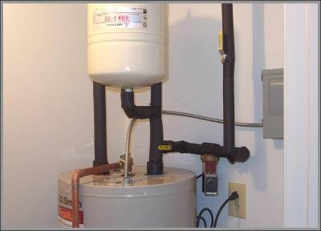
Heat Traps
Section C404.3
Equipment not supplied with integral heat traps and serving noncirculating systems must have heat traps on the supply and discharge piping associated with the equipment

Slide 123
Insulation of Piping
Section C404.4
Piping from water heater to termination of heated water fixture supply pipe (all recirculation piping) to be insulated per Table C403.2.10
Both inlet and outlet piping of storage water heater or heated water storage tank
  Piping to a heat trap or first 8 ft. of piping, whichever is less
Piping that is heat traced per Table C403.2.10 or heat trace manufacturer instructions
Tubular piping insulation installed in accordance with insulation manufacturer’s instructions
Insulation to be continuous
  Except where piping passes through a framing member
Minimum insulation thickness not to supersede any greater insulation thickness requirements necessary for the protection of piping from freezing temps. or personnel against external surface temps. on the insulation

Slide 124
Insulation of Piping
Section C404.4 – Cont’d.
Exceptions:
Tubing from the connection at the termination of the fixture supply piping to a plumbing fixture or plumbing appliance
Valves, pumps, strainers and threaded unions in piping that is ≤1” in nominal diameter
Piping from user-controlled shower and bath mixing valves to the water outlets
Cold-water piping of demand recirculation water system
Tubing form hot drinking-water heating unit to the water outlet
Piping at locations where a vertical support of the piping is installed
Piping surrounded by building insulation with a thermal resistance ≥ R-3

Slide 125
Efficient Heated Water Supply Piping
Section C404.5
For piping from the nearest source of heated water (from the water heater or from the recirculation or trace heated loop) to fixture requires either maximum pipe length (C404.5.1) or maximum pipe volume (C404.5.2) and has maximum flow rated by size
Flow rate through ¼” piping should be ≤ 0.5 gpm
Flow rate through 5/16” piping should be ≤ 1.0 gpm
Flow rate through 3/8” piping should be ≤ 1.5 gpm
Intent is to reduce wasting previously-heated water that has cooled in pipes that do not require insulation

Slide 126
Maximum Allowed Pipe Length Method
Section C404.5.1
Maximum allowed piping length from nearest source of heated water to termination of the fixture supply pipe:
Where piping contains more than one size, the largest size of pipe within the piping shall be used for determining the max. allowable length of piping in Table C404.5.1
Public lavatory faucet, use “Public Lavatory faucets” column in Table C404.5.1
All other plumbing fixtures and plumbing appliances use “Other fixtures and appliances” column in Table C404.5.1

Slide 127
Maximum Allowed Pipe Volume Method
Section C404.5.2
Water heaters, circulating water systems, and heat trace temp. maintenance systems to be considered sources of heated water
Volume from the nearest source of heated water to the termination of the fixture supply pipe as follows:
  Public lavatory facet: ≤ 2 ounces
  Other plumbing fixtures or plumbing appliances: ≤ 0.5 gallon

Slide 128
Water Volume Determination
Section C404.5.2.1
Volume to be the sum of the internal volumes of pipe, fittings, valves, meters and manifolds between the nearest source of heated water and the termination of the fixture supply pipe
Volume determined from the “Volume” column in Table
Volume contained with fixture shutoff valves, within flexible water supply connectors to a fixture fitting and within a fixture fitting should not be included in the water volume determination
Heated water supplied by recirculating system or heat-traced piping, the volume should include the portion of the fitting on the branch pipe that supplies water to the fixture

Slide 129
Heated-water Circulating and Temperature Maintenance Systems
Section C404.6
Circulation Systems
  Controlled pump(s) required
  Demand control required (see C404.7)
  Gravity and thermosyphon not allowed
Heat Trace Systems
  Energy input adjusted to maintain temperature
  Timed or demand automatic controls
Controls for Hot Water Storage Tank Pumps
  Automatic controls limit pump operation to no more than 5 minutes after heater operation
Notes:
Add notes for each section

Slide 130
Demand Recirculation Controls
Section C404.7
Systems with >1 recirculation pumps that pump water from a heated-water supply pipe back to the heated-water source through a cold-water supply pipe must be a demand recirculation water system
Pumps to have controls that:
  Start pump upon receiving a signal from the action of a user of a fixture or sensing the flow of hot or tempered water to a fixture fitting or appliance
  Limit the temp. of water entering the cold-water piping (used as a recirculation return) to 104ºF

Slide 131
Drain Water Heat Recovery Units
Section C404.8
Must comply with CSA B55.2
Potable water-side pressure loss < 10 psi at maximum design flow
Group R occupancies, units must meet efficiency in accordance with CSA B55.1
Note that this provision does not require the use of drain water heat recovery units; it just specifies their performance if used

Slide 132
Energy Consumption of Pools and Permanent Spas
Section C404.9 Mandatory
Heaters (C404.9.1)
  Readily accessible on-off switch, that is an integral part of heater, mounted on the exterior of heater or external to within 3 feet of heater
  Switch should not change the setting of the heater thermostat
  Switches to be in addition to a circuit breaker for the power to the heater
  Natural gas or LPG fired pool heaters will not have continuously burning pilot lights
Time switches or other control method (C404.9.2)
  Automatic controls required to control heaters and pumps on a preset schedule
  Exceptions:
    Where public health standards require 24 hour operation
    Where pumps are required to operate solar and waste heat recovery pool heating systems
  Note: heaters, pumps and motors with built-in timers meet this requirement
Notes:
Pool heater - added LPG

Slide 133
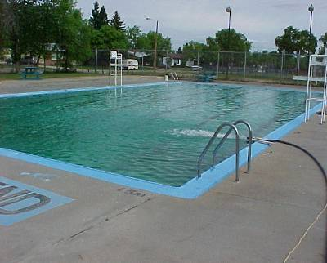
Covers
Section C404.9.3
Outdoor heated pools and outdoor permanent spas required to have a cover
  Cover must be vapor-retardant
  Or other approved vapor-retardant means
Exception:
  Pools deriving > 70% of operating season energy for heating from site-recovered or solar energy

Slide 134
Mechanical Systems and SWH Commissioning and Completion
Section C408.2
Prior to passing final mechanical and plumbing inspection
  Registered design profession to provide evidence of commissioning and completion
Construction document notes to clearly indicate provisions for commissioning and completion requirements
  Permitted to refer to specifications
Copies of all documents to be provided to the owner and made available to code official upon request

Slide 135
Mechanical Systems Commissioning and Completion Requirements
Section C408.2 Exceptions
These systems are exempt from commissioning requirements
  In buildings where total mechanical equipment capacity is
  < 480,000 Btu/h (40 tons) cooling capacity and < 600,000 Btu/h combined service water heating and space-heating capacity
  Included in Section C403.3 that serve individual dwelling units and sleeping units

Slide 136
Commissioning Plan
Section C408.2.1
Developed by registered design professional or agency and include:
  Narrative description of activities to be accomplished during each phase of commissioning
    Including personnel who will do each activity
  Listing of specific equipment, appliances or systems to be tested and description of tests to be performed
  Functions to be tested, including, but not limited to calibrations and economizer controls
  Conditions under which test will be performed
    At a minimum, testing will affirm winter and summer design conditions and full outside air conditions
  Measurable criteria for performance

Slide 137
Systems Adjusting and Balancing
Section C408.2.2
HVAC systems balanced per generally accepted engineering standards
Air and water flow rates measured and adjusted to deliver final flow rates within tolerances in product specifications
Test and balance activities to include air system and hydronic system balancing

Slide 138
Air Systems Balancing
Section C408.2.2.1
Each supply air outlet and zone terminal device equipped with means for air balancing per Chapter 6 of the IMC
No discharge dampers used for air-system balancing on constant volume fans and variable volume fans with motors ≥ 10 hp
Air systems balanced in a manner to first minimize throttling losses, then, for fans with system power > 1hp, fan speed adjusted to meet design flow conditions
Exception – fans with motors ≤ 1hp are not required to have a means for air balancing

Slide 139
Hydronic Systems Balancing
Section C408.2.2.2
Individual hydronic heating and cooling coils equipped with means for balancing and measuring flow
Hydronic systems proportionately balanced in a manner to first minimize throttling losses, then pump impeller to be trimmed or pump speed to be adjusted to meet design flow conditions
Each hydronic system to have either capability to measure pressure across the pump, or test ports at each side of each pump
Exceptions with a means for balancing or measuring flow:
  Pumps with pump motors ≤ 5hp
  Where throttling results in ≤ 5% of nameplate hp draw above that required if the impeller were trimmed

Slide 140
Functional Performance Testing
Section C408.2.3.1 Equipment
To demonstrate the installation and operation of components, systems, and system-to-system interfacing relationships in accordance with approved plans and specifications, such that operation, function, and maintenance serviceability for each of the commissioned systems is confirmed
Testing to include all modes and sequence of operation, including under full-load, part-load and the following emergency conditions:
  All modes as described in the sequence of operation
  Redundant or automatic back-up mode
  Performance of alarms, and
  Mode of operation upon a lost off power and restoration of power
Exception – unitary or packaged HVAC equipment listed in Tables C403.2.3(1) through C403.2.3(3) that don’t require supply air economizers

Slide 141
Functional Performance Testing
Section C408.2.3.2 Controls
HVAC and SWH control systems to be tested to document that control devices, components, equipment, and systems are calibrated, adjusted and operate in accordance with approved plans and specifications
Sequences of operation to be functionally tested to document they operate in accordance with approved plans and specifications

Slide 142
Functional Performance Testing
Section C408.2.3.3 Economizers
Air economizers to undergo a functional test to determine they operate in accordance with manufacturer’s specifications

Slide 143
Preliminary Commissioning Report
Section C408.2.4
Registered design professional or approved agency to complete, certify, and submit to the building owner or owner’s authorized agent
Report to be organized with mechanical and service hot water findings in separate sections to allow independent review. Report to be identified as “Preliminary Commissioning Report” and will identify:
  Itemization of deficiencies found during testing that haven’t been corrected at the time of report preparation
  Deferred tests that can’t be performed at the time of report preparation due to climatic conditions
  Climatic conditions required for performance of deferred tests
Notes:
Organization is to allow mechanical and plumbing inspectors easy separate review of the report

Slide 144
Preliminary Commissioning Report
Sections C408.2.4.1, C408.2.4.2 Acceptance and Copy of Report
Buildings or portions of buildings can’t pass final mechanical inspection until code official has received a letter of transmittal from the building owner acknowledging the building owner or owner’s authorized agent has received the Preliminary Commissioning Report
Code official is permitted to require a copy of the report be made available for review

Slide 145
Documentation Requirements
Section C408.2.5
Construction documents to specify that documents described in C408.2.5 be provided to building owner or owner’s authorized agent within 90 days of receipt of certificate of occupancy
  Drawings
  Manuals
  System balancing report
  Final commissioning report
Drawings
  Include location and performance data on each piece of equipment

Slide 146
Documentation Requirements
Section C408.2.5.2 Manuals
O&M manual to be provided to include all of the following:
  Submittal data stating equipment size and selected options for each piece of equipment requiring maintenance
  Manufacturer’s operation and maintenance manuals for each piece of equipment requiring maintenance (except equipment not furnished as part of the project). Required routine maintenance actions to be clearly identified.
  Name and address of at least one service agency
  HVAC and SWH controls system maintenance and calibration information, including wiring diagrams, schematics, and control sequence descriptions. Desired or field-determined setpoints to be permanently recorded on control drawings at control devices or, for digital control systems, in system programming instructions
  Narrative of how each system is intended to operate, including recommended setpoints

Slide 147
Documentation Requirements
Section C408.2.5.3 System Balancing Report
To include descriptions of the activities and measurements completed per Section C408.2.2 (systems adjusting and balancing)

Slide 148
Documentation Requirements
Section C408.2.5.4 Final Commissioning Report
Delivered to building owner or owner’s authorized agent, report to be organized with mechanical system and service hot water system findings in separate sections to allow independent review and include:
  Results of functional performance tests
  Disposition of deficiencies found during testing, including corrective measure details – used or proposed
  Functional performance test procedures used during commissioning process including measurable criteria for test acceptance
Exception – deferred tests which can’t be performed at time of report preparation due to climatic conditions

