Slide 1
2018 IECC Commercial Scope and Envelope Requirements
PNNL-SA-132967
Notes:
1

Slide 2
Why Care About IECC?
  Energy codes and standards set minimum efficiency requirements for new and renovated buildings, assuring reductions in energy use and emissions over the life of the building. Energy codes are a subset of building codes, which establish baseline requirements and govern building construction.
  Code buildings are more comfortable and cost-effective to operate, assuring energy, economic and environmental benefits.

Slide 3
Structure of the 2018 IECC
Commercial
Section
Residential
Section
Ch. 1 Scope and Application / Administrative and
Enforcement
Ch. 2 Definitions
Ch. 3 General Requirements
Ch. 4 Commercial Energy Efficiency
Ch. 5 Existing Buildings
Ch. 6 Referenced Standards
Index
Ch. 1 Scope and Application / Administrative and
Enforcement
Ch. 2 Definitions
Ch. 3 General Requirements
Ch. 4 Residential Energy Efficiency
Ch. 5 Existing Buildings
Ch. 6 Referenced Standards
Index

Slide 4
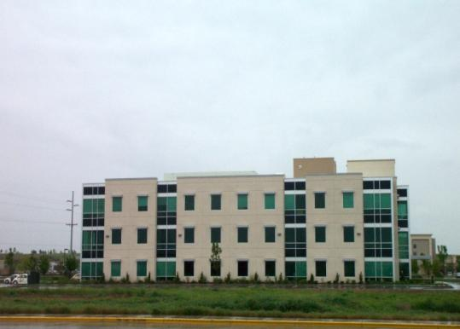

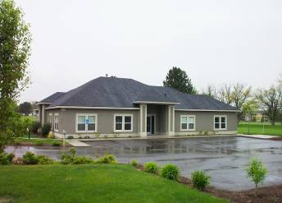
Does My Project Need to Comply with the Commercial Provisions in the IECC?
All Buildings Other Than:
One- and two-family residential
R-2, R-3, R-4 three stories or less in height
Notes:
R-2 is occupancies containing more than 2 dwelling units where the occupants are primarily permanent in nature, including apartments, boarding houses, dormitories, etc. (but not hotels/motels).
R-3 includes one- and two-family dwellings.
R-4 includes residential care and assisted living facilities.

Slide 5
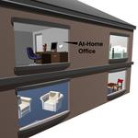
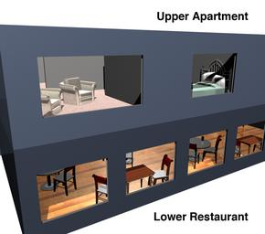
Scope
Section C101.4.1 – Mixed Residential and
Commercial Buildings
Section C101.5 - Compliance
Treat the residential building portion under the applicable residential code
Treat the commercial building portion under the commercial code
Code Official has final authority
  Compliance materials, Software, worksheets
Notes:
The residential and commercial occupancies fall under two different scopes. Thus, two compliance submittals must be prepared using the appropriate calculations and forms from the respective codes for each.
Case-by-case basis.

Slide 6
Scope
Section C102.1 – Alternative Materials, Design, and Methods of Construction and Equipment
The code is not intended to prevent installation of any material or prohibit design of construction that is not specifically prescribed in this code if alternative is approved
Approved where
  Code official finds proposed design is satisfactory and complies with the intent of the provisions and material, method, or work is for the purpose intended, not less than equivalent prescribed in the code in quality, strength, effectiveness, fire resistance, durability and safety
Where not approved
  Code official to respond in writing stating the reasons why

Slide 7

Scope/Construction Documents
Section C103
Documentation shall be prepared by a registered design professional
Electronic media can be used
Information required:
  Insulation materials and R-values
  Fenestration U-factors, SHGC
  Area-weighted U-factor and SHGC calculations
  Mechanical system design criteria
  Mechanical, SWH, equipment types, sizes, and efficiencies
  Economizer description
  Equipment and system controls
  Duct sealing, duct and pipe insulation and location
  Lighting fixture schedule with wattage and control narrative
  Location of daylight zones
  Air sealing details
The building thermal envelope shall be represented on the construction drawings.
Notes:
No work shall be done on any part of the building beyond the point indicated in each successive inspection without first obtaining written approval of the code official.
No construction work shall be concealed without being inspected and approved.

Slide 8
Scope/Construction Documents
Section C103
Examination of documents
Amended construction documents
Retention of construction documents
Building documentation and closeout submittal requirements

Slide 9
Scope
Section C104-C109
Fees, C104
Inspections, C105
  Work remains visible and accessible for inspection
Code Validity, C106
  Code deemed to be illegal or void shall not affect the remainder of the code
Referenced standards, C107
  Provisions take precedence and considered part of the requirements of the code
Stop Work Order, C108
  Authority of code official
  Failure to comply
Board of Appeals, C109
Notes:
Life and safety take precedence. A couple of these will go into more detail in further slides, the next two slides touch a little bit more on two of these.
2018 - Fees section was previously C107 and now moved to C104 and then renumbered of other sections occurred as needed

Slide 10
Inspections
Section C104
Construction work for which a permit is
required is subject to inspection by code official, his or her designated agent or an approved agency
Required inspections include:
  Footing and foundation insulation
  Thermal envelope
  Plumbing system
  Mechanical system
  Electrical system
  Final

Slide 11
Referenced Codes and Standards
Section C107.1
Codes and standards listed in Chapter 6 are considered part of the requirements of this code to the “prescribed extent of each such reference and as further regulated in Sections C107.1.1 and C107.1.2”
Conflicts, C107.1.1 – where differences occur between this code and the referenced codes and standards, provisions of this code apply
Provisions in reference codes and standards, C107.1.2 – “where the extent of the reference to a referenced code or standard includes subject matter that is within the scope of this code, the provisions of this code, as applicable, shall take precedence over the provisions in the referenced code or standard”

Slide 12
Low-energy Buildings
Section C402.1.1
Buildings or portions of buildings that are separated from remainder of building by building thermal envelope assemblies complying with C402 are exempt from the Envelope provisions if:
  Peak design rate of energy < 3.4 Btu/h/ft² or 1.0 watt/ft² of floor area for space conditioning purposes, OR
  Those portions or building that do not contain conditioned space, OR
  Greenhouses
Notes:
Definition of Greenhouse: a structure or a thermally isolated area of a building that maintains a specialized sunlit environment exclusively used for, and essential to, the cultivation, protection or maintenance of plants

Slide 13
Equipment Buildings
Section C402.1.2
Buildings that comply with the following are exempt from the building thermal envelope provisions:
Separate building with floor area < 500 ft² (50 m²)
Intended to house electronic equipment with installed equipment power totaling > 7 watts/ft² (75W/m²)
Heating system capacity < 17,000 Btu/hr (5 kW) and a heating thermostat set point that is restricted to < 50ºF
Average wall and roof U-factor < 0.200 in Climate Zones 1-5 and < 0.120 in Climate Zones 6-8
Comply with the roof solar reflectance and thermal emittance provisions for Climate Zone 1

Slide 14
Commercial Compliance Options
2018 IECC - Prescriptive
2018 IECC - Performance
1
ASHRAE 90.1-2016
2
C402 - Envelope
3
C407 – Total Building Performance
OR
C403 - Mechanical
OR
C404 - SWH
C402.5 – Air Leakage
C405 - Lighting
C403.2 – Provisions applicable to all mechanical systems
AND
Pick At Least One C406:
C404 - SWH
C406.2 – Eff. HVAC Performance
Lighting Mandatory Sections
C406.3 – Reduced Lighting Power
C405.2
C405.3
C405.4
C405.6
C406.4 – Enhanced Lighting Controls
C406.5 – On-site Supply of Renewable energy
C406.6 – Dedicated Outdoor Air System
Building energy cost to be ≤ 85% of standard reference design building
C406.7 – High Eff. Service Water Heating
C406.8 – Enhanced Envelope Performance
C406.9 – Reduced Air Infiltration
Notes:
Tenant spaces shall comply with Section C406.1.1

Slide 15
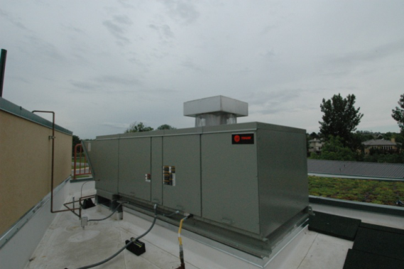
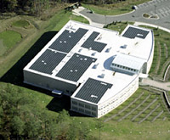
Additional Efficiency Package Options
Section C406
One additional efficiency feature must be selected to comply with the IECC
  More efficient HVAC performance, OR
  Reduced lighting power density system, OR
  Enhanced lighting controls, OR
  On-site supply of renewable energy
  Dedicated outdoor air system, OR
  More efficient SWH
High Efficiency HVAC
More Efficient Lighting System
Onsite Renewables
Notes:
Onsite renewables “regulated energy” = energy used within the building for building mechanical and service water heating equipment and lighting regulated by Chapter C4.

Slide 16
Additional Efficiency Package Options
Section C406
Efficient HVAC performance per C406.2 OR
  Per Tables C403.2.3(1) thru C403.2.3(7)
  Only used when efficiencies in the above tables are greater than 10% in addition to the requirements in C403
  Where multiple performance requirements are provided, the equipment shall exceed all requirements by 10%
  Variable refrigerant flow systems exceed energy efficiency provisions of 90.1-2013 by 10%
  Equipment not listed in tables above shall be limited to 10% of total building system capacity
Reduced lighting power per C406.3 OR
  Whole building LPD determined using 90% of values in Table C405.4.2(1) x floor area for the building types OR
  Using 90% by the space-by-space method in Section C405.4.2
  Determine total LPD of building using reduced whole building interior lighting power in Table 406.3 x floor area for the building types

Slide 17
Additional Efficiency Package Options
Section C406 – Cont’d.
Enhanced digital lighting controls per C406.4, controls located and operated in accordance with C405.2.2:
  Luminaires capable of continuous dimming
  Luminaires capable of being addressed individually OR a controlled group of < 4 luminaires
  < 8 luminaires controlled together in a daylight zone
  Fixtures controlled through digital control system that includes the following function:
    Control reconfiguration based on digital addressability
    Load shedding
    Individual user control of overhead general illumination in open offices
    Occupancy sensors capable of being reconfigured through the digital control system
  Construction documents including submittal of Sequence of Operations including specs outlining each function of the fixture requirements above
  Functional testing of controls comply with C408

Slide 18
Additional Efficiency Package Options
Section C406 – Cont’d.
On-site renewable energy per C406.5 OR
  Total minimum ratings to
    Provide ≥ 1.75 Btu or ≥ 0.50 watts per ft² of conditioned floor area OR
    Provide ≥ 3% of energy used for mechanical and SWH equipment and lighting
Dedicated outdoor air system per C406.6 OR
  Be equipped with an independent ventilation system designed to provide <100% outdoor air to each occupied space
  Ventilation system capable of total energy recovery
  HVAC system include supply-air temperature controls that automatically reset the supply-air temp. in response to building loads or outdoor air temperatures
  Controls reset the supply-air temp. at least 25% of the difference between design supply-air temp. and design room-air temp.

Slide 19
Additional Efficiency Package Options
Section C406 – Cont’d.
Reduced energy use in SWH per C406.7
  Buildings with the following types allowed to use this compliance method:
  Group R-1: Boarding houses, hotels, or motels
  Group I-2: Hospitals, psychiatric hospitals, and nursing homes
  Group A-2: Restaurants and banquet halls or buildings containing food preparation areas
  Group F: Laundries
  Group R-2: Buildings with residential occupancies
  Group A-3: Health clubs and spas
  Buildings showing a service hot water load of >10% of total building energy loads as shown with an energy analysis per C407

Slide 20
Additional Efficiency Package Options
Section C406 – Cont’d.
Reduced energy use in SWH (cont’d)
Load fraction:
  Building SWH system has >1 of the following sized to provide > 60% of hot water requirements or sized to provide 100% of hot water requirements if building complies with C403.4.7
  Waste heat recovery from service hot water, heat recover chillers, building equipment, process, equipment, or combined heat and power system
  Solar water-heating systems
Enhanced Envelope Performance
  Total UA of building thermal envelope as designed to be not less than 15% below total UA of building thermal envelope per Section C402.1.5

Slide 21
Additional Efficiency Package Options
Section C406 – Cont’d.
Reduced Air Infiltration
  Air infiltration verified by whole-building pressurization test
    Per ASTM E779 or ASTM E1827
    By independent third party
  Measured air-leakage rate not to exceed 0.25 cfm/ft² under pressure differential of 0.3 inches w.c. (75 Pa), with calculated surface area the sum of above- and below-grade building envelope
  Submit report to code official and building owner
    Including: tested surface area, floor area, air by volume, stories above grade, and leakage rates
Exception: Buildings over 250,000 ft² of conditioned floor area don’t need testing on whole building, can test representative above-grade sections. Tested areas to total not less than 25% of conditioned floor area and tested per C406.9

Slide 22
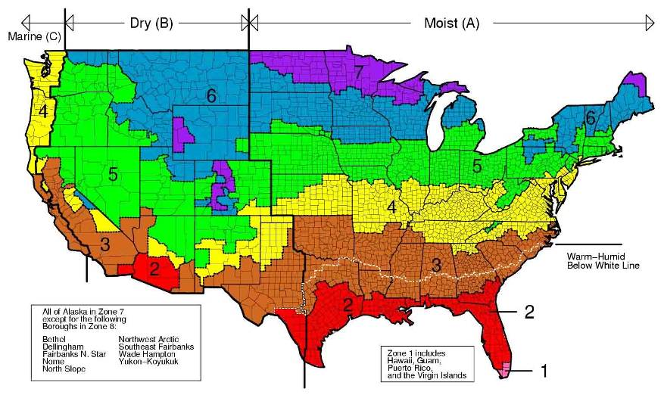
Climate Zones
2015 IECC - Chapter 3
Determining Your Climate Zone is the First Step in the Process
Notes:
The climate zones are unchanged from the 2015 IECC. There are exceptions in C303.1.1 and C303.2.2.
U.S. counties are defined entirely by county boundaries; every county is homogenous.
There are 8 temperature oriented zones, crossed with 3 moisture regimes (moist, dry, marine), for a theoretical 24 possible zones.
Hawaii, Puerto Rico, Guam, American Samoa, U.S. Virgin Island, and Island in the area between the Tropic of Cancer and Tropic of Capricorn are now designated as Climate Zone 1

Slide 23
What is the Building Thermal Envelope?
Roof/Ceiling Assembly
Wall Assembly
Vertical Fenestration and Skylights
Floor Assembly
Slab Edge
Below Grade Wall Assembly
Notes:
These assemblies can comprise the building thermal envelope if they separate conditioned from unconditioned space or outside air.
BUILDING THERMAL ENVELOPE. The basement walls, exterior walls, floor, roof, and any other building element that enclose conditioned space. This boundary also includes the boundary between conditioned space and any exempt or unconditioned space.

Slide 24
Building Envelope Requirements
Section C402.1 - General
Building thermal envelope to comply with the following:
Specific insulation requirements of Section C402.2
Thermal requirements of either:
  R-value-based method of Section C402.1.3
  U-, C-, and F-factor-based method of Section C402.1.4 OR
  Component performance alternative of Section C402.1.5
Roof solar reflectance and thermal emittance
Fenestration in building envelope assemblies
Air Leakage of building envelope assemblies

Slide 25
Building Envelope Compliance Options
3 Methods for compliance of building components:
C402.1.3 – Insulation component R-value based method
C402.1.4 – Assembly U-factor, C-factor or F-factor based method
C402.1.5 – Component Performance Alternative

Slide 26
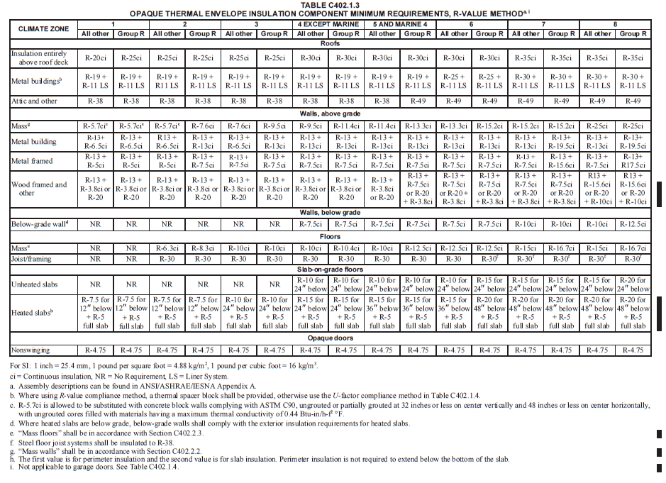
Chapter 5 Prescriptive Approach
Compliance
Notes:
Table C402.1.3 – examples from each component section in the table follow
Specific building thermal envelope insulation – insulation in these opaque assemblies to comply with Section C402.2.1 – C402.2.6 and Table C402.1.3

Slide 27
Chapter 5 Prescriptive Approach
Compliance
ROOFS
Climate Zone | 1 |  | 2 |  | 3 |  | 4 Except Marine |  | 5 And Marine 4 |  | 6 |  | 7 |  | 8
Insulation entirely above deck | R-20ci | R-25ci | R-25ci | R-25ci | R-25ci | R-25ci | R-30ci | R-30ci | R-30ci | R-30ci | R-30ci | R-30ci | R-35ci | R-35ci | R-35ci | R-35ci
Metal buildings ^{a, b} | R-19+ R-11 LS | R-19+ R-11 LS | R-19+ R-11 LS | R-19+ R-11 LS | R-19+ R-11 LS | R-19+ R-11 LS | R-19+ R-11 LS | R-19+ R-11 LS | R-19+ R-11 LS | R-19+ R-11 LS | R-25+ R-11 LS | R-25+ R-11 LS | R-30+ R-11 LS | R-30+ R-11 LS | R-30+ R-11 LS | R-30+ R-11 LS
Attic and other | R-38 | R-38 | R-38 | R-38 | R-38 | R-38 | R-38 | R-38 | R-38 | R-49 | R-49 | R-49 | R-49 | R-49 | R-49 | R-49
Notes:
The minimum thermal resistance (R-value) of the insulating material(s) installed either between the roof framing or continuously on the roof assembly is to be as specified in Table C402.1.3, based on the construction materials used in the roof assembly.

Slide 28
Chapter 5 Prescriptive Approach
Compliance
WALLS, ABOVE GRADE
Climate Zone | 1 |  | 2 |  | 3 |  | 4 Except Marine |  | 5 And Marine 4 |  | 6 |  | 7 |  | 8
Mass | R-5.7ci | R-5.7ci^{c} | R-5.7ci^{c} | R-7.6ci | R-7.6ci | R-9.5ci | R-9.5ci | R-11.4ci | R-11.4ci | R-13.3ci | R-13.3ci | R-15.2ci | R-15.2ci | R-15.2ci | R-25ci | R-25ci
Metal building | R-13+ 6.5ci | R-13+ 6.5ci | R-13+ 6.5ci | R-13+R-13 ci | R-13+R-13 ci | R-13+R-13 ci | R-13+R-13 ci | R-13+R-13 ci | R-13+R-13 ci i | R-13+R-13 ci | R-13+R-13 ci | R-13+R-13 ci | R-13+R-13 ci | R-13+R-19.5 ci | R-13+R-13 ci | R-13+R-19.5 ci
Metal Framed | R-13= R-5 ci | R-13= R-5 ci | R-13= R-5 ci | R-13+ 7.5ci | R-13+ 7.5ci | R-13+ 7.5ci | R-13+ 7.5ci | R-13+ 7.5ci | R-13+ 7.5ci | R-13+ 7.5ci | R-13+ 7.5ci | R-13+ 7.;5ci | R-13+ 7.5cfi | R-13+ 15.6ci | R-13+ 7.5ci | R-13+ 17.5ci
Wood Framed & Other | R-13+R-3.8ci or R-20 | R-13+R-3.8ci or R-20 | R-13+R-3.8ci or R-20 | R-13+R-3.8ci or R-20 | R-13+R-3.8ci or R-20 | R-13+R-3.8ci or R-20 | R-13+R-3.8ci or R-20 3 | R-13+R-3.8ci or R-20 | R-13+R-3.8ci or R-20 | R-13+R-7.5ci or R-20+R-3.8 ci | R-13+R-7.5ci or R-20+R-3.8 ci | R-13+R-7.5ci or R-20+R-3.8 ci | R-13+R-7.5ci or R-20+R-3.8 ci | R-13+R-7.5ci or R-20+R-3.8 ci | R-13+R-15.6ci or R-20+R-10ci | R-13+R-15.6ci or R-20+R-10 ci
Notes:
Above-grade walls are those walls covered by Section C402.2.3 on the exterior of the building and completely above grade or walls that are more than 15 percent above grade.
The minimum thermal resistance (R-value) of the insulating material(s) installed in the wall cavity between the framing members and continuously on the walls are to be as specified in Table C402.1.3, based on the type of framing and construction materials used in the wall assembly. The R-value of integral insulation installed in concrete masonry units should not be used to determine compliance with Table C402.1.3. “Mass walls” include walls weighing at least (1) 35 pounds per square foot (170 kg/m2) of wall surface area or (2) weighing not less than 25 pounds per square foot (120 kg/m2) of wall surface area given that the material weight is no more than 120 pounds per cubic foot (pcf)(1900 kg/m3), (3) having a heat capacity exceeding 7 Btu/ft2/ºF, (4) having a heat capacity exceeding 5 Btu/ft2/ºF where the material weight is not more than 120 pcf

Slide 29
Chapter 5 Prescriptive Approach
Compliance
WALLS, BELOW GRADE
Climate Zone | 1 |  | 2 |  | 3 |  | 4 Except Marine |  | 5 And Marine 4 |  | 6 |  | 7 |  | 8
Below grade wall | NR | NR | NR | NR | NR | NR | NR | R-7.5ci | R-7.5ci | R-7.5ci | R-7.5ci | R-7.5ci | R-10ci | R-10ci | R-10ci | R-12.5ci
Notes:
Where heated slabs are below grade, below grade walls, must comply with the exterior insulation for heated slabs.
New definition for Wall, below grade: a wall associated with the basement or first story of the building that is part of the building thermal envelope is less than 15% above grade (> 85% below grade wall) and is on the exterior of the building

Slide 30
Chapter 5 Prescriptive Approach
Compliance
FLOORS
Climate Zone | 1 |  | 2 |  | 3 |  | 4 Except Marine |  | 5 And Marine 4 |  | 6 |  | 7 |  | 8
Mass^{e} | NR | NR | R-6.3ci | R-8.3ci | R-10ci | R-10ci | R-10ci | R-10.4ci | R-10ci | R-12.5ci | R-12.5ci | R-12.5ci | R-15ci | R-16.7ci | R-15ci | R-16.7ci
Joist/ Framing | NR | NR | R-30 | R-30 | R-30 | R-30 | R-30 | R-30 | R-30 | R-30 | R-30 | R-30^{f} | R-30^{f} | R-30^{f} | R-30^{f} | R-30^{f}
Notes:
Floors over outdoor air or unconditioned space.
Footnote e: “Mass floors” include floors weighing not less than (1) 35 pounds per square foot of floor surface area or (2) 25 pounds per square foot of floor surface area if the material weight is not more than 120 pounds per cubic foot
Footnote f: Steel floor joist systems shall be insulated to R-38

Slide 31
Chapter 5 Prescriptive Approach
Compliance
SLAB-ON GRADE FLOORS
Climate Zone | 1 |  | 2 |  | 3 |  | 4 Except Marine |  | 5 And Marine 4 |  | 6 |  | 7 |  | 8
Unheated Slabs | NR | NR | NR | NR | NR | NR | R-10 for 24 in. below | R-10 for 24 in. below | R-10 for 24 in. below | R-10 for 24 in. below | R-10 for 24 in. below | R-15 for 24 in. below | R-15 for 24. in. below | R-15 for 24 in. below | R-15 for 24 in. below | R-20 for 24 in. below
Heated Slabs | R-7.5 for 12 in. below + R-5 full slab | R-7.5 for 12 in. below + R-5 full slab | R-7.5 for 12 in. below + R-5 full slab | R-7.5 for 12 in. below + R-5 full slab | R-10 for 24 in below + R-5 full slab | R-10 for 24 in. below + R-5 full slab | R-15 for 24 in. below + R-5 full slab | R-15 for 24 in. below + R-5 full slab | R-15 for 36 in. below + R-5 full slab | R-15 for 36 in. below + R-5 full slab | R-15 for 36 in. below + R-5 full slab | R-20 for 48 in. below + R-5 full slab | R-20 for 48 in. below + R-5 full slab | R-20 for 48 in. below + R-5 full slab | R-20 for 48 in. below + R-5 full slab | R-20 for 48 in. below + R-5 full slab
Notes:
Slabs on grade. Where the slab on grade is in contact with the ground, the minimum R-value of the insulation around the perimeter of unheated or heated slab-on-grade floors designed in accordance with the R-value method of Section C402.1.3 shall be as specified in Table C402.1.3. The insulation needs to be placed on the outside of the foundation or on the inside of a foundation wall. The insulation should extend downward from the top of the slab for a minimum distance as shown in the table or to the top of the footing, whichever is less, or downward to at least the bottom of the slab and then horizontally to the interior or exterior for the total distance shown in the table. Insulation extending away from the building to be protected by pavement or a minimum of 10 inches of soil.
Exception: where slab is greater than 24 inches below finished exterior grade, perimeter insulation isn’t required.

Slide 32
Chapter 5 Prescriptive Approach
Compliance
OPAQUE DOORS
Climate Zone | 1 |  | 2 |  | 3 |  | 4 Except Marine |  | 5 And Marine 4 |  | 6 |  | 7 |  | 8
Nonswinging | R-4.75 | R-4.75 | R-4.75 | R-4.75 | R-4.75 | R-4.75 | R-4.75 | R-4.75 | R-4.75 | R-4.75 | R-4.75 | R-4.75 | R-4.75 | R-4.75 | R-4.75 | R-4.75
Notes:
Opaque doors. By definition: opaque door is a door > 50% opaque in surface area.

Slide 33
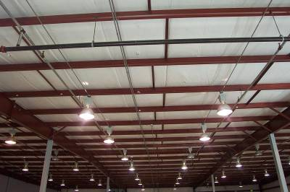
Roof Assembly
Section C402.2.1
Roof R-values and U-factor requirements are based on assembly type / insulation placement
Insulation entirely above deck
Metal buildings
Attic and other
Insulation on suspended ceiling with removable ceiling tiles not considered for code compliance.
Continuous insulation board to have > 2 layers and the edge joints between each layer should be staggered.
Skylight curbs to be insulated to the level of roofs with insulation entirely above deck or R-5, whichever is less (exception: unit skylight curbs included as a component of a skylight listed and labeled per NRC 100)
Notes:
Each type discussed in follow-on slides.

Slide 34
Roof Assembly
Section C402.2.1 - Exceptions
Continuously insulated roof assemblies where the thickness of insulation varies by < 1” and area-weighted U-factor is equivalent to the same assembly with the
R-value specified in Table C402.1.3
Tapered insulation is used with insulation entirely above deck, the R-value where the insulation thickness varies
< 1” from the minimum thickness of tapered insulation must comply with the R-value specified in Table C402.1.3
Two layers of insulation aren’t required where insulation tapers to the roof deck (e.g., at roof drains)

Slide 35
Roof Solar Reflectance and
Thermal Emittance
Section C402.3
Required in Climate Zones 1-3 for low-sloped roofs (less than 2 units vertical in 12 horizontal), directly above cooled conditioned spaces
Comply with one or more options:
1) Minimum three-year aged solar reflectance of 0.55 and minimum three-year aged thermal emittance of 0.75
OR
2) Three-year aged solar reflectance index of 64
Where aged solar reflectance required by Section C402.3 is not available, it should be determined with Equation 4-3
R_{aged} = [0.2+0.7(R_{initial} -0.2)]

Slide 36
Roof Solar Reflectance and
Thermal Emittance
Section C402.3 - Exceptions
Portions of roofs that include or are covered by:
  PV systems or components
  Solar air or water heating systems or components
  Roof gardens or landscaped roofs
  Above-roof decks or walkways
  Skylights
  HVAC systems, components, and other opaque objects mounted above the roof
Portions of roofs shaded during peak sun angle on June 21 by permanent features of the building or permanent features of adjacent buildings
Ballasted roofs with minimum stone ballast of 17 lbs/ft² or 23 lbs/ft² pavers
Roofs, where a minimum of 75% of the roof area meets one or more of the above exceptions

Slide 37
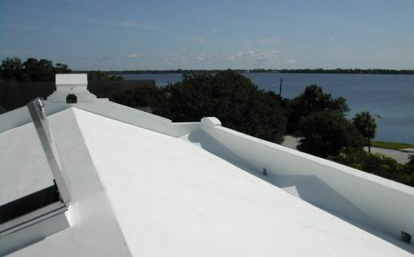
High Albedo Roof - Example

Slide 38
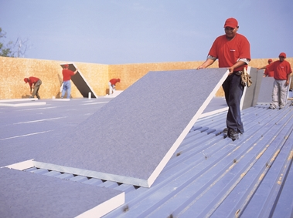
Roof R-Value
Insulation Completely Above Deck
Insulation considered continuous (CI)
Insulation thickness can vary ≤ 1” and area weighted U-factor meets the requirements of Table C402.1.3
Notes:
Roof assembly. The minimum thermal resistance (R-value) of the insulating material installed either between
the roof framing or continuously on the roof assembly shall be as specified in Table C402.1.3, based on construction
materials used in the roof assembly.
Exception: Continuously insulated roof assemblies where the thickness of insulation varies by < 1” and area-weighted U-factor is equivalent to the same assembly with the R-value specified in Table C402.1.3
Tapered insulation is used with insulation entirely above deck, the R-value where the insulation thickness varies < 1” from the minimum thickness of tapered insulation must comply with the R-value specified in Table C402.1.3

Slide 39
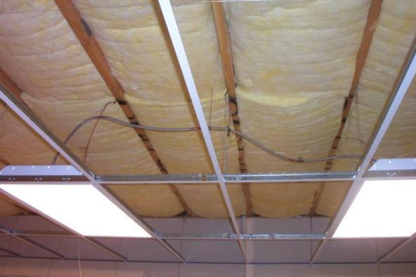
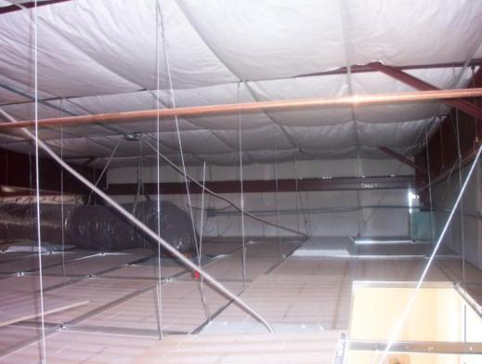
Roof Assembly
Insulation Placed on Ceiling with Removable Ceiling Tiles
Will not count for code compliance
Not considered part of the minimum thermal resistance of the roof insulation
Notes:
For buildings with suspended ceilings, the roof insulation is installed either directly under the roof sheathing, on-top of the roof deck or on a sealed sheetrock ceiling with the suspended ceiling located below it.

Slide 40
Roof R-Value
Metal Buildings
Thermal spacer block required on all metal buildings or must use U-factor Compliance Method
Two layers of insulation required
  CZ 1-5 and marine 4: R-19+R-11 LS
  CZ 6: R-25+R-11 LS
  CZ 7-8: R-30+R-11 LS
Liner System includes the following:
Continuous vapor barrier liner membrane that is installed below
the purlins and that is uninterrupted by framing members
An uncompressed, unfaced insulation resting on top of the liner
membrane and located between purlins
Multilayer installations, the last rated R-value of insulation is for
unfaced insulation draped over purlins and compressed when the
metal roof panes are attached
Notes:
LS = liner system

Slide 41
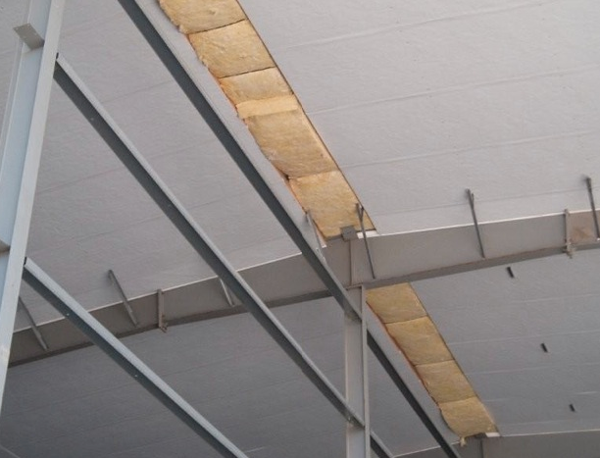
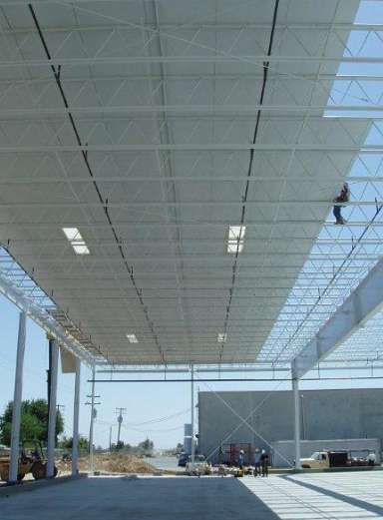
Metal Building Roofs
Photos courtesy of MBMA

Slide 42
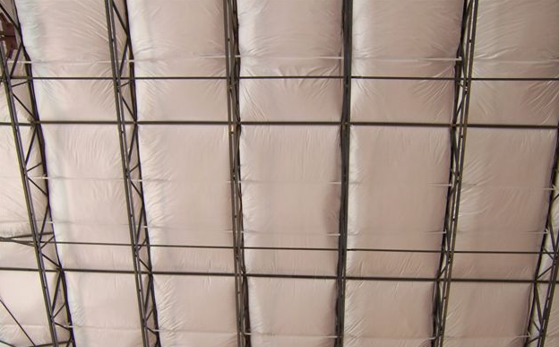
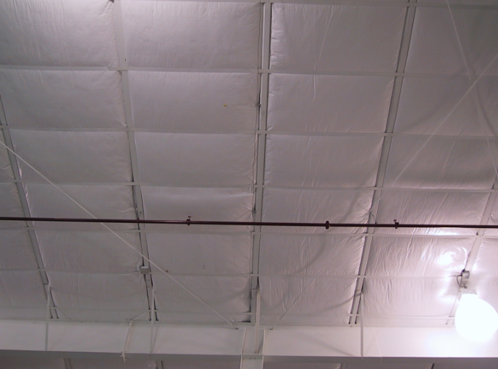
Metal Building Roofs
Photos courtesy of MBMA

Slide 43
Roof R-Value
Ceilings with Attic Spaces
Install insulation between framing
R-38 in Climate Zones 1-5 and marine 4 “All Other”
R-49 in Climate Zones 5-8 and marine 4 “Group R”

Slide 44
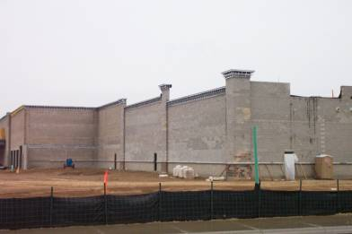
Wall R-Value
Mass Walls
Mass walls must comply with one of the following:
Walls weigh at least 35 lbs/ft² of wall surface area
25 lbs/ft² of wall surface area if material weight is
≤ 120 lb/ft³
Heat capacity > 7 Btu/ft²
Heat capacity > 5 Btu/ft² if the material weight is < 120 pcf
Notes:
Concrete masonry unit, tilt-up concrete, etc.

Slide 45
Mass Walls
Concrete Masonry Units
Climate Zones 1 and 2 (all other) and Climate Zone 1 (Group R) – Can use integral insulation instead of R-5.7 ci
  Concrete block walls must comply with ASTM C 90, and
  Ungrouted or partially grouted @ 32 inch. o.c. or less vertically or 48 inch. o.c. or less horizontally, and
  Ungrouted cells must be filled with insulation material ≤ of 0.44 Btu-in./h-ft² F

Slide 46
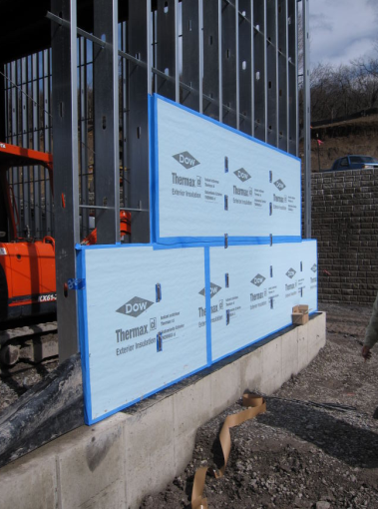
Wall R-Value
Wood, Metal Frame, and Other
Cavity insulation or cavity plus continuous (ci)
Continuous insulation not broken up by framing members e.g., rigid board insulation
Photo courtesy of Dow Building Solutions

Slide 47
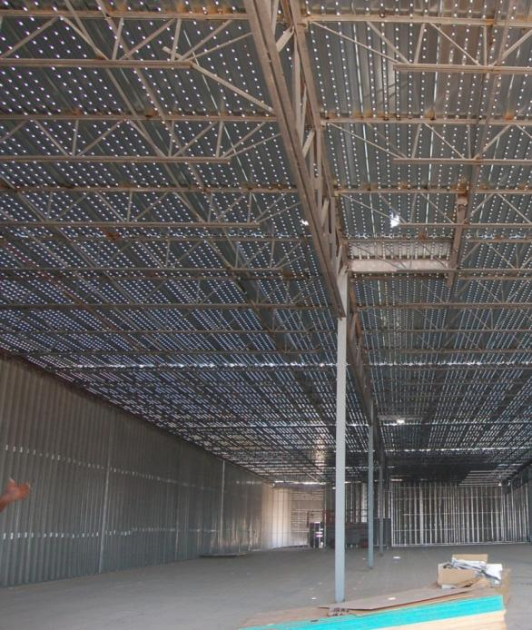
Metal Building Walls
Table C402.1.3
Photo courtesy of Ken Baker, K energy

Slide 48
Below Grade Walls
Table C402.1.3 or Table C402.1.4
What is a below grade wall?
  Basement or first-story walls ≥ 85% below grade
Insulation must extend down 10 ft from the outside finished grade level or to the level of the lowest floor, whichever is less
Heated slabs installed below grade (footnoted to Tables C402.1.3 and C402.2.14)
  Below grade walls must meet exterior insulation requirements for heated slabs
Notes:
No insulation is required for CZ 1-3 group R and all other.

Slide 49
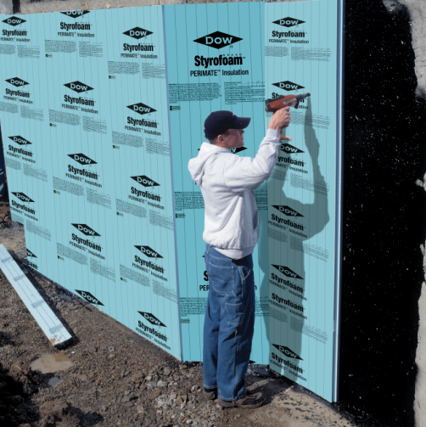
Below-Grade Wall Insulation
Photo courtesy of Dow Building Solutions

Slide 50
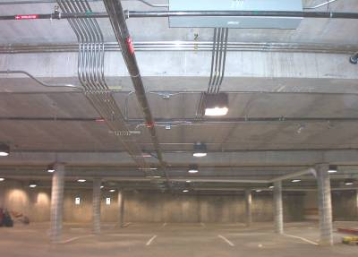
Floors Over Outdoor Air or
Unconditioned Space
Section C402.2.3
Joist/Framing (Steel/Wood)
  Insulation installed between framing
Mass Floors
  Materials weighing (of floor surface area)
  35 lbs/ft², or
  25 lbs/ft² if material weight is ≤ 120 lbs/ft³
  Insulation installed continuously
Steel Floor Joist Systems (footnoted to Table C402.1.3)
  R-38 in Climate Zones 6 Group R) and 7-8 (Group R and All other)
Notes:
Photo: this is a parking garage under conditioned space.
Steel floor joist system R-38 is footnote f to Table C402.1.3.

Slide 51
Floors
Section C402.2.3
Floor framing cavity insulation or structural slab insulation should be installed to maintain permanent contact with underside of subfloor decking or structural slabs
Exceptions:
Framing cavity insulation or structural slab insulation is permitted to be in contact with top side of sheathing or ci installed on the bottom side of floor where combined with insulation that meets or exceeds R-value in Table C402.1.3 for “Metal framed” or “Wood framed and other” values for “Walls, Above Grade” and extends from the bottom to the top of all perimeter floor framing or floor assembly members
Insulation applied to underside of concrete floor slabs is permitted an airspace of < 1” where it turns up and is in contact with underside of floor under walls associated with the building thermal envelope

Slide 52
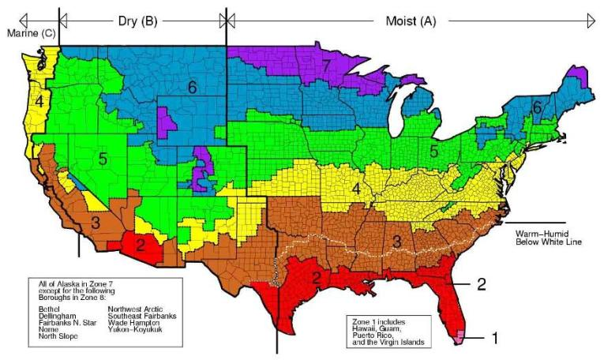
Slab-on-Grade Floors
Section C402.2.4
Unheated slab – insulation required:
  Climate Zones 4-8
Heated slabs – insulation required in all Climate Zones
Exception: where slab-on-grade floor is > 24” below finished exterior grade
Notes:
Perimeter insulation to be placed on the outside of the foundation or on the inside of a foundation wall.
Perimeter insulation to extend downward from the top of the slab for the minimum distance shown in the table or to the top of the footing, whichever is less, or downward to not less than the bottom of the slab and then horizontally to the interior or exterior for the total distance shown in the table.

Slide 53
Below-grade Walls
Section C402.2.5
C-factor to be in accordance with Table C402.1.4
R-value of continuous insulation within or on below-grade exterior walls to be per C402.1.3
C-factor or R-value required to extend to a depth of not less than 10 feet below outside finished ground level or level of lowest floor in conditioned space enclosed by the below-grade wall, whichever is less

Slide 54
Insulation of Radiant Heating Systems
Section C402.2.6
Radiant heating system panels and their associated components:
Installed in interior or exterior assemblies to be insulated with > R-3.5 on all surfaces not facing the space being heated
Installed in the building thermal envelope should be separated from the exterior of the building or unconditioned or exempt spaces by not less than the
R-value installed in the opaque assembly in which they are installed or assembly comply with Section C402.1.4
Exception: heated slabs-on-grade insulated in accordance with Section C402.2.4

Slide 55
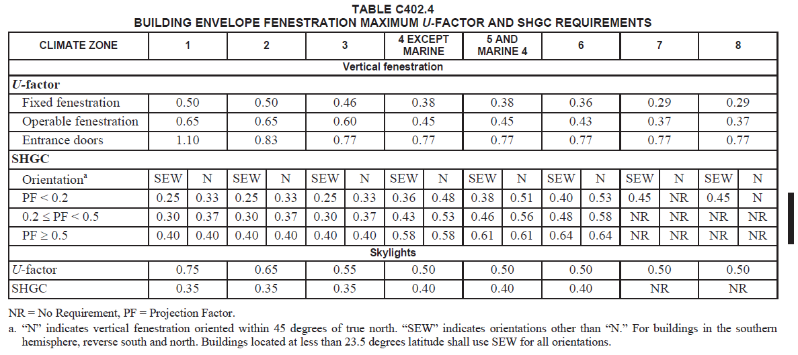
Fenestration
Chapter 5 Prescriptive Approach
Notes:
U-factor requirements by: fixed fenestration, operable fenestration, entrance doors

Slide 56
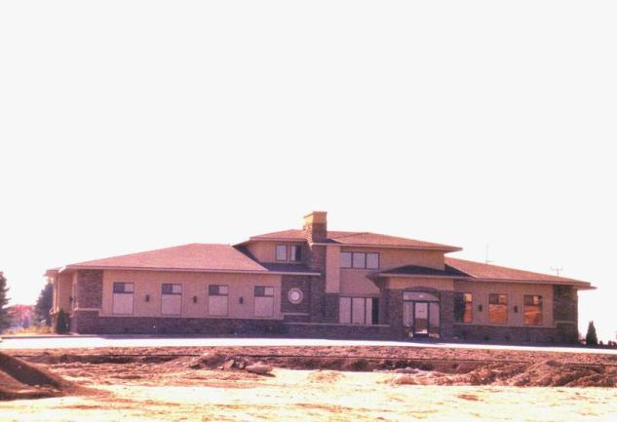
Vertical Fenestration Requirement
Section C402.4.1 – Prescriptive (Max area)
Percentage of Vertical Fenestration Area to Gross Wall Area
Allowed up to 30% maximum of above grade wall
  In Climate Zones 1-6, up to 40% maximum of above grade wall with daylighting controls
Notes:
This threshold also applies when showing compliance using COMcheck.

Slide 57
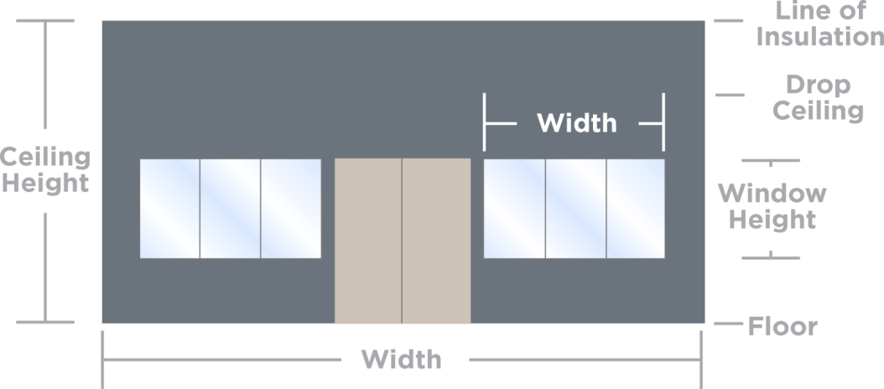
Vertical Fenestration Requirement
Section C402.4.1
Based on above-grade wall area (gross)
  Includes walls between conditioned space and unconditioned space or the great outdoors
    Includes walls that are > 15% above grade
Total fenestration area (includes frame and glazing)
  Does not include opaque door area

Slide 58
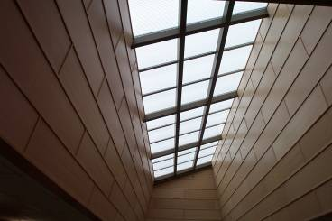
Skylight Minimum Fenestration Area
Section C402.4.1 Prescriptive
Limited to ≤ 3% of Roof Area
Up to 6% allowed if automatic daylighting controls installed in toplit zones

Slide 59
Increased Vertical Fenestration with Daylight Responsive Controls
Section C402.4.1.1
Up to 40% vertical fenestration area allowed in Climate Zones 1-6, provided
  No less than 50% of the conditioned floor area is within a daylight zone in buildings < 2 stories above grade
  No less than 25% of the net floor area is within a daylight zone in building > 3 stories above grade
  Daylight responsive controls complying with C405.2.3.1 are installed in daylight zones
  VT of vertical fenestration is ≥ 1.1 times SHGC
Exception:
Fenestration that is outside the scope of NFRC 200 isn’t required to comply with VT

Slide 60
Increased Skylight Area with Daylighting Controls
Section C402.4.1.2
Up to 6% of the roof area provided daylight responsive controls are installed in toplit zones
Notes:
In certain spaces, both skylights and automatic controls are required.

Slide 61
Minimum Skylight Fenestration Area
Section C402.4.2
In certain types of enclosed spaces > 2,500 ft² in floor area directly under a roof with > 75% of ceiling area with ceiling height > 15 ft.
  total toplit daylight zone to not be < ½ the floor area and provide one of the following
    Minimum of 3% of skylight area to toplit daylight zone where all skylights have a VT not less than 0.40 OR
    Provide a minimum skylight effective aperture of not less than 1%
Exceptions:
Climate Zones 6-8
Spaces with LPDs < 0.5 W/ft²
Documented shaded spaces
Daylight area under rooftop monitors is > 50% of floor area
Spaces where total area minus area of daylight zones adjacent to vertical fenestration is < 2,500 ft² and lighting is controlled per C405.2.5 (Exterior Lighting Controls)
Notes:
Applicable space types: office, lobby, atrium, concourse, corridor, storage space, gymnasium/exercise center, convention center, automotive service area , manufacturing, non-refrigerated warehouse, retail store, distribution/sorting area, transportation depot, or workshop
Documented shaded space = documented that existing structures or natural objects block direct beam sunlight on at least half of the roof over the enclosed area for more than 1,500 daytime hours per year between 8am and 4pm

Slide 62
Lighting Controls in Toplit Daylight Zones
Section C402.4.2.1
Daylight responsive controls complying with C405.2.3.1 should be provided to control all lights with toplit zones
Notes:
Documented shaded space = documented that existing structures or natural objects block direct beam sunlight on at least half of the roof over the enclosed area for more than 1,500 daytime hours per year between 8am and 4pm

Slide 63
Haze Factor
Section C402.4.2.2
Skylights in certain space types to have a glazing material or diffuser with a measured haze factor > 90% per ASTM D 1003
  Office, storage, automotive service, manufacturing, nonrefrigerated warehouse, retail store, and distribution/sorting area
Exception:
  Skylights designed and installed to exclude direct sunlight entering the occupied space by use of fixed or automated baffles, or the geometry of skylight and light well

Slide 64
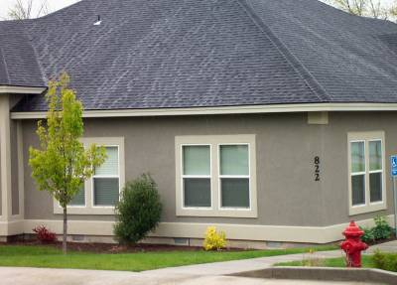
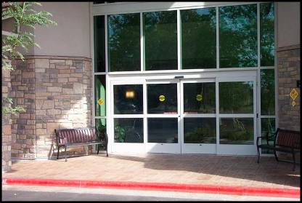
Fenestration U-Factor
Section C402.4.3
Table C402.4 requirements by these categories:
Fixed fenestration
Operable fenestration
Entrance doors

Slide 65
Skylight U-Factor / SHGC
U-factor and SHGC Based
NFRC 100 Rating or ANSI/DASMA 105 for U-factor or Default Table
NFRC 200 Rating for SHGC and VT or Default Table

Slide 66
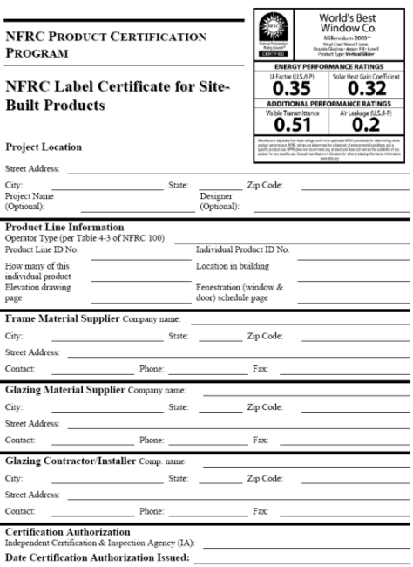
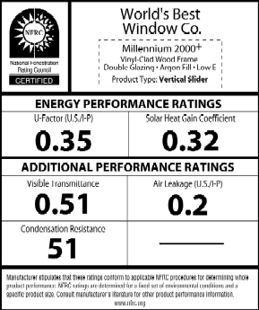
Fenestration Product Rating
Section C303.1.3
How Do You Meet the Requirement?
Fenestration product rating in accordance to NFRC 100 (Windows, Doors, Skylights)
Labeled and certified by the manufacturer
Non-NFRC 100 rated fenestration
  Default Glazed Fenestration U-factor Table C303.1.3(1)
Notes:
Fenestration product rating. U-factors of fenestration products (windows, doors and skylights) shall be determined in accordance with NFRC 100 by an accredited, independent laboratory, and labeled and certified by the manufacturer. Products lacking such a labeled U-factor shall be assigned a default U-factor from Table C303.1.3(1) or C303.1.3(2). The solar heat gain coefficient (SHGC) and visible transmittance (VT) of glazed fenestration products (windows, glazed doors and skylights) shall be determined in accordance with NFRC 200 by an accredited, independent laboratory, and labeled and certified by the manufacturer. Products lacking such a labeled SHGC or VT shall be assigned a default SHGC or VT from Table C303.1.3(3).

Slide 67
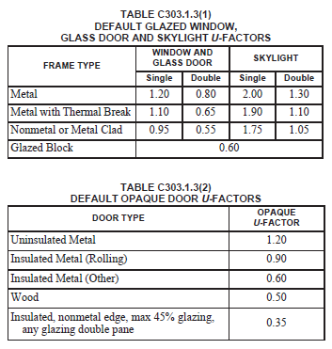
Default U-Factors
Tables C303.1.3(1) and (2)
Notes:
Use of defaults is not recommended as these values may not meet the requirements.

Slide 68
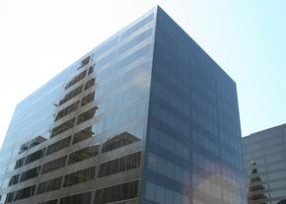


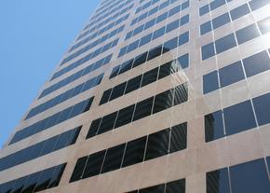
Glazed Fenestration SHGC
What is Solar Heat Gain Coefficient?
  “The ratio of the solar heat gain entering the space through the fenestration assembly to the incident solar radiation.”

Slide 69
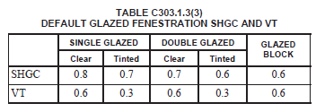
Fenestration SHGC and VT Product
Rating Requirements
Table C303.1.3(3)
Two Options for Meeting the SHGC and VT Requirements
  Fenestration product rated and labeled to NFRC 200, or
  Select default from Table C303.1.3(3)
Notes:
Use of defaults is not recommended as these values may not meet the requirements.

Slide 70
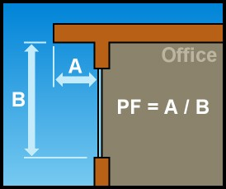
Fenestration SHGC Requirements
The Effect of Overhangs on Fenestration SHGC
Overhangs allow a higher SHGC product to be installed
Projection factor must be calculated
When different windows or glass doors have different PFs
    Evaluate separately
Notes:
Where different windows or glass doors have different projection factors, they are to be evaluated separately
PF = A/B (Equation 4-5)
where:
PF = Projection factor (decimal).
A = Distance measured horizontally from the furthest continuous extremity of any overhang, eave, or permanently
attached shading device to the vertical surface of the glazing.
B = Distance measured vertically from the bottom of the glazing to the underside of the overhang, eave, or permanently
attached shading device.
Where different windows or glass doors have different PF values, they shall each be evaluated separately, or an
area-weighted PF value shall be calculated and used for all windows and glass doors.

Slide 71
Increased Skylight SHGC and U-factor
Sections C402.4.3.1, C402.4.3.2
Skylights installed above daylight zones with daylight responsive controls:
Climate Zones 1-6, permitted maximum SHGC 0.60
Climate Zones 1-3, permitted maximum U-factor 0.90
Climate Zones 4-8, permitted maximum U-factor 0.75

Slide 72
Dynamic Glazing
Section C402.4.3.3
SHGC determined using manufacturer’s ratio of the higher to lower labeled SHGC
SHGC ratio > 2.4
Automatically controlled to modulate amount of solar gain into the space in multiple steps
Considered separately from other fenestration
Area-weighted averaging isn’t allowed
Exception: not required to comply where both the lower and higher labeled SHGC already comply with Table C402.3
Notes:
Dynamic glazing has a range of SHGC values, so it was necessary to define which value in the range gets compared to the code.
Intended to satisfy the SHGC and VT requirements of Table C402.4

Slide 73
Area-Weighted U-Factor
Section C402.4.3.4
Allowed to meet requirements in Table C402.4
Can’t combine products from different categories when calculating the area-weighted average U-factor

Slide 74
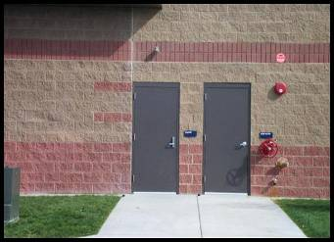
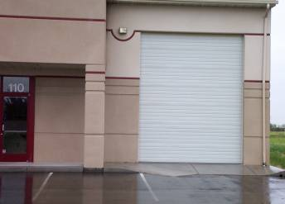
Doors
Section C402.4.5
Opaque swinging doors having < 50% glass area
Comply with Table C402.1.4
Opaque nonswinging doors
  Comply with Table C402.1.3
All other doors to comply with vertical fenestration requirements (Section C402.4.3)

Slide 75
Mandatory Requirements
Air Leakage
Air barriers
Fenestration air leakage
Rooms Containing Fuel-burning Appliances
Air intakes, exhaust openings, stairways and shafts
Loading dock weatherseals
Vestibules
Recessed lighting
Notes:
The next section covers mandatory requirements.

Slide 76
Air Leakage
Section C402.5
Tested in accordance with ASTM E 779 at pressure differential of 0.3 inch water gauge or an equivalent method approved by code official when tested air leakage rate
< 0.40 cfm/ft²
Notes:
This is really one option. The other option is complying with Sections C402.5.1 through 5.8.

Slide 77
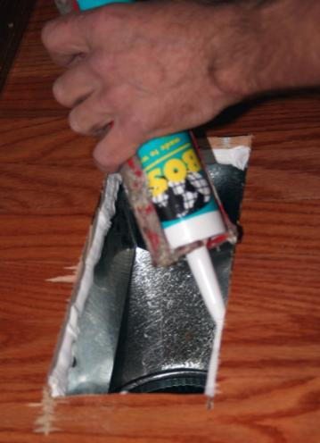
Air Barrier Construction
Section C402.5.1.1
Continuous air barrier required except in:
    Climate Zone 2B
Air barrier placement allowed:
  Inside of building envelope
  Outside of building envelope
  Located within assemblies composing envelope OR
  Any combination thereof
Continuous for all assemblies part of the thermal envelope and across joints and assemblies
Joints and seams sealed including sealing transitions in places and changes in materials, securely installed in or on the joint for its entire length to not dislodge, loosen or otherwise impair its ability to resist positive and negative pressure from wind, stack effect and mechanical ventilation

Slide 78
Air Barrier Construction
Section C402.5.1.1
Penetrations of air barrier and air leakage paths to be caulked, gasketed or otherwise sealed in a manner compatible with construction materials and location (sealing to allow for expansion, contraction and mechanical vibration)
Joints and seals
  Sealed in same manner or taped
Sealing of concealed fire sprinklers where required in a manner recommended by manufacturer
  Caulking or other adhesive sealants should not be used to fill voids between fire sprinkler cover plates and walls, or ceilings
Recessed lighting to comply with C402.5.8
Where similar objects are installed that penetrate the air barrier, make provisions to maintain the air barrier’s integrity

Slide 79
Air Barrier Compliance Options
Section C402.5.1.2
Two ways to comply with air barrier requirements:
Materials – C402.5.1.2.1 OR
Assemblies – C402.5.1.2.2

Slide 80
Air Barrier Materials (Compliance)
Section C402.5.1.2.1
Materials with air permeance ≤ 0.004 cfm/ft² under pressure differential of 0.3 in. w.g. tested in accordance with ASTM E 2178
These materials
meet this requirement:
Material | Thickness (minimum)
Plywood | 3/8 in.
Oriented strand board | 3/8 in.
Extruded polystyrene insulation board | ½ in.
Foil-faced urethane insulation board | ½ in.
Closed cell spray foam minimum density of 1.5 pcf | 1-1/2 in.
Open cell spray foam density between 0.4 and 1.5 pcf | 4.5 in.
Exterior gypsum sheathing or interior gypsum board | ½ in.
Cement board | ½ in.
Built up roofing membrane
Modified bituminous roof membrane
Fully adhered single-ply roof membrane
A Portland cement/sand parge, stucco, or gypsum plaster | 5/8 in.
Cast-in-place and precast concrete
Sheet metal or aluminum
Solid or hollow masonry constructed of clay or shale masonry units
Notes:
The listed materials are deemed to comply with this section provided joints are sealed and materials are installed as air barriers in accordance with manufacturers instructions

Slide 81
Air Barrier Assemblies (Compliance)
Section C402.5.1.2.2
OR
Assemblies of materials and components (sealants, tapes, etc.) with average air leakage ≤ 0.04 cfm/ft² under pressure differential of 0.3 in. w.g. tested in accordance with ASTM E 2357, 1677 or 283
The following assemblies are deemed to comply provided that joints are sealed and Section C402.5.1.1 (Air Barrier Construction) is met:
    Concrete masonry walls coated with either one application either of block filler or two applications of a paint or sealer coating OR
    Masonry walls constructed of clay or shale masonry units with a nominal width of > 4” OR
    Portland cement/sand parge, stucco or plaster > ½” thick

Slide 82
Air Leakage of Fenestration
Section C402.5.2
Fenestration Assembly | cfm/ft² | Test Procedure
Windows, sliding glass doors, and swinging doors | 0.20 | AAMA/WDMA/CSA 101/I.S.2/A440 or NFRC 400
Skylights - with condensation weepage openings | 0.30
Skylights – all other | 0.20
Curtain walls and storefront glazing | 0.06 | NFRC 400 or ASTM E 283 at 1.57 psf
Commercial glazed swinging entrance doors | 1.00
Power-operated sliding doors and power operated folding doors | 1.00
Revolving doors | 1.00
Garage doors | 0.4 | ANSI/DASMA 105, NFRC 400, or ASTM E 283 at 1.57 psf
Rolling doors | 1.00
High-speed doors | 1.30
Exceptions:
  Field-fabricated fenestration assemblies
  Fenestration in buildings that meet the building test for air barrier compliance option

Slide 83
Rooms Containing Fuel-burning Appliances
Section C402.5.3
Appliances and combustion air openings to be located outside the building thermal envelope or enclosed in a room isolated from inside the thermal envelope in Climate Zones 3-8, one of the following to comply:
  Rooms to be sealed and insulated per envelope requirements
  Doors into the rooms fully gasketed
  Water lines and ducts insulated
  Combustion air ducts that pass through conditioned space, insulated to > R-8

Slide 84
Rooms Containing Fuel-burning Appliances
Section C402.5.3 – Cont’d.
Exceptions:
Fireplaces and stoves complying with 901-905 IMC and Section 2111.14 IBC

Slide 85
Doors and Access Openings to
Section C402.5.4 Shafts, Chutes, Stairways, and Elevator Lobbies
Doors and access openings from conditioned space to shafts, chutes, stairways, and elevator lobbies not within the scope of the fenestration assemblies in Section C402.5.2 to be gasketed, weatherstripped, or sealed
Exceptions:
  Door openings required to comply with 716 IBC
  Doors or door openings required to comply with UL 1784 IBC

Slide 86
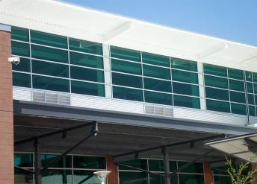

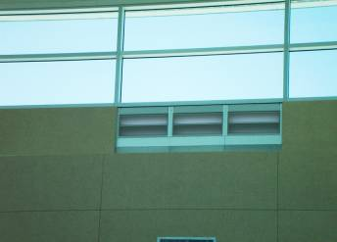
Air Intakes, Exhaust Openings, Stairways, and Shafts
Section C402.5.5
Openings integral to the building envelope to have dampers per Section C403.7.7 (Shutoff Dampers)
Notes:
C403.7.7 Requirements Below:
Outdoor air intake and exhaust openings and stairway and shaft vents provided with Class I motorized dampers
Dampers with air leakage rate < 4 cfm ft² of damper surface at 1.0 inch water gauge (249 Pa) and labeled and approved in accordance with AMCA 500D
Outdoor air intake and exhaust dampers with automatic controls configured to close the systems or spaces served when not in use or during unoccupied period warm-up and setback operation
Unless systems served require outdoor or exhaust air per IMC OR
Dampers are opened to provide intentional economizer cooling
Stairway and shaft vent dampers installed with automatic controls configured to open up on activation of any fire alarm initiating device of the building’s fire alarm system or the interruption of power to the damper
Exceptions
Gravity dampers permitted in buildings < 3 stories
Gravity dampers permitted for buildings of any height located in Climate Zones 1-3
Gravity dampers permitted for outside air intake or exhaust airflows of 300 cfm (0.14m3/s) or less.
Gravity motorized dampers shall have an air leakage rate:
< 20 cfm/ft2 where > 24 inches in either dimension
40 cfm/ft2 where < 24 inches in either dimension
Air leakage rate determined at 1.0 inch water gauge (249 Pa) when tested in accordance with AMCA 500D.
Dampers labeled by an approved agency

Slide 87
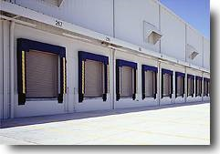
Loading Dock Weatherseals
Section C402.5.6
Equip cargo door openings and loading door openings with weatherseals
Goal is to restrict infiltration and provide direct contact with vehicles along top and sides
Notes:
No exceptions for warmer climates in the IECC.
Loading dock weatherseals - restrict infiltration when vehicles are parked in the doorway. No set requirement for the seals themselves; just required to have them.

Slide 88
Vestibules
Section C402.5.7
Required to reduce infiltration into spaces
Required on entrance doors leading into spaces ≥ 3,000 ft²
Doors must have self-closing devices
Exceptions:
  Buildings in Climate Zones 1 and 2
  Doors from a sleeping unit or dwelling unit
  Revolving doors
  Doors that have an air curtain with velocity > 6.56 ft/second at the floor tested in accordance with ANSI/AMCA 220 installed in accordance with manufacturer’s instructions. Manual or automatic controls provided that will operate the air curtain with opening and closing. Air curtain and their controls to comply with Section C408.2.3.
Notes:
Exceptions:
Doors not intended for public use includes doors to mechanical or electrical equipment rooms

Slide 89
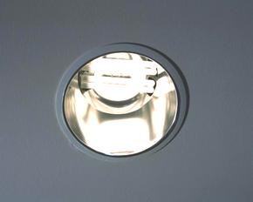
Recessed Lighting
Section C402.5.8
All recessed luminaires installed in the building thermal envelope
Type IC rated to have all of the following:
Sealed with gasket or caulk between housing and interior wall or ceiling covering AND
Labeled in accordance with ASTM E 283 to allow ≤ 2.0 cfm of air movement between conditioned and unconditioned spaces
Notes:
Heat loss can be significant if not done properly – they act as chimneys, transferring heat loss and moisture through the building envelope into attics.

Slide 90

Existing Buildings Chapter 5
Section C501 - General
Additions, alterations, or repairs
Existing buildings
Maintenance
Compliance
New and replacement materials
Buildings designated as historic
Notes:
Buildings designated as historic
National/state/local historical register
Some jurisdictions may still require additions to these structures to comply with the energy code.

Slide 91
Existing Buildings
Section C502 - Additions
Any nonconditioned space that is altered to become conditioned space shall be required to be brought into full compliance with this code
Examples:
Converting part of an unconditioned warehouse to office space
Shell building tenant build-out

Slide 92
Existing Buildings
Section C502 - Additions
Vertical fenestration: new fenestration that results in a total building fenestration area < 30% must comply with C402.4.1.5, C402.4.3 or C407
If > 30% for total building or addition alone, must comply with C402.4.1.1 Increased Vertical Fenestration Area with Daylight Responsive Controls for the addition only
Additions that result in total building vertical fenestration >40% must comply with C402.1.5 Component Performance Alternative or C407 Total Building Performance
Skylight Area: new skylight area that is < 3% complies with C402.4.1
If > 3% for total building or addition alone, must comply with C402.4.1.2 Increased Skylight Area with Daylight Responsive Controls for addition only
Additions that result in total building skylight area >6% must comply with C402.1.5 Component Performance Alternative or C407 Total Building Performance

Slide 93
Existing Buildings
Section C502 - Additions
Mechanical Systems comply with C403
SWH – C404
Pools and inground permanently installed spas – C404.10
Lighting power and systems – C405
  Interior comply with addition alone or addition plus existing building
  Exterior comply with addition alone or addition plus existing

Slide 94

Existing Buildings
Section C503 - Alterations
Code applies to any new construction
Unaltered portion(s) do not need to comply
Alterations complying with ASHRAE 90.1-2016 do not need to comply with C402-C405
Vertical Fenestration and Skylight Area similar to requirements for additions
Envelope – where existing building exceeds fenestration area limitations of Section C402.4.1 prior to alteration, building is exempt from C402.4.1 provided there is no increase in fenestration area

Slide 95
Existing Buildings
Section C503 - Alterations
Exceptions:
  Storm windows over existing fenestration
  Surface-applied window film installed on existing single pane
  Exposed, existing ceiling, wall or floor cavities if already filled with insulation
  Where existing roof, wall or floor cavity isn’t exposed
  Roof recover
  Reroofing for roofs where neither sheathing nor insulation exposed
      Insulate above or below the sheathing
        Roofs without insulation in the cavity
              Sheathing or insulation is exposed
Notes:
The code states that additions, alterations, renovations or repairs can’t create an unsafe or hazardous condition or overload existing building systems.
Surface applied window film installed on existing single pane fenestration assemblies to reduce solar heat gain provided the code does not require the glazing or fenestration assembly to be replaced

Slide 96
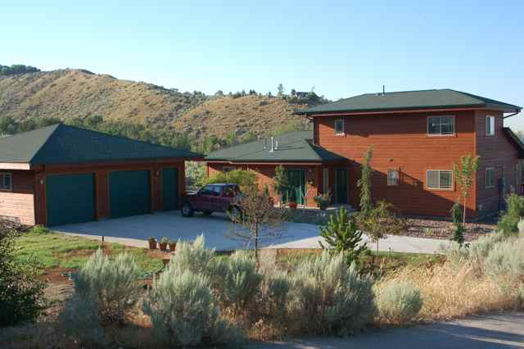
Change in Space Conditioning
Section C503.2
Any non-conditioned or low energy space that is altered to become conditioned space shall be required to be brought into full compliance with this code
Image courtesy of Ken Baker, K energy
Exceptions:
Where component performance alternative in Section C402.1.5 is used, proposed UA to be not greater than 110% of the target UA
Where total building performance option in Section C407 is used to comply, annual energy cost of proposed design to be not greater than 110% of annual energy cost otherwise permitted by Section C407.3

Slide 97
Existing Buildings
Section C503 - Alterations
Heating and Cooling
  New HVAC systems and duct systems that are part of the alteration to comply with Section C403
    Economizers – new cooling systems that are part of the alteration to comply with Section C403.5
Service hot water systems
  New SWH systems that are part of the alteration to comply with C404
Lighting Systems
  New Lighting systems that are part of the alteration to comply with C404
    Exception – alteration that replace <10% of the luminaires in a space provided such alteration does not increase the installed interior lighting power

Slide 98
Existing Buildings
Section C504 - Repairs
Work on nondamaged components necessary for the required repair or damaged components shall be considered to be part of the report and subject to the alterations requirements
Repairs considered part of the code
  Glass-only replacements in an existing sash and frame
  Roof repairs
  Replacement of existing doors that separate conditioned space from the exterior do not require the installation of a vestibule or revolving door, provided that an existing vestibule that separate a conditioned space from the exterior shall not be removed
  Repairs where only the bulb and/or ballast within the existing luminaires in a space are replaced provided the replacement does not increase the installed interior lighting power

Slide 99
Change of Occupancy or Use
Section C505.1
Spaces undergoing a change in occupancy that would result in an increase in demand for either fossil fuel or electrical energy shall comply with this code
Where the use in a space changes from one to another in Tables C405.3.2(1) or C405.3.2(2), the installed lighting wattage shall comply with Section 405
Where in a building with a fenestration area exceeding C402.4.1, space is exempt from C402.4.1 provided there is no increase in fenestration area

Slide 100
Change of Occupancy or Use
Section C505.1 - Exceptions
Exceptions
  Where Section 402.1.5 is used for compliance, proposed UA not to be > 10% of target UA
  Where Section C407 is used for compliance, annual energy cost of proposed design not to be > 110% of that permitted by Section C407.3

