Slide 1
2018 IECC Commercial Electrical Power and Lighting Systems
PNNL-SA-132937
Notes:
1

Slide 2
Why Care About IECC?
  Energy codes and standards set minimum efficiency requirements for new and renovated buildings, assuring reductions in energy use and emissions over the life of the building. Energy codes are a subset of building codes, which establish baseline requirements and govern building construction.
  Code buildings are more comfortable and cost-effective to operate, assuring energy, economic and environmental benefits.

Slide 3
Commercial Compliance Options
2018 IECC - Prescriptive
2018 IECC - Performance
1
ASHRAE 90.1-2016
2
C402 - Envelope
3
C407 – Total Building Performance
OR
C403 - Mechanical
OR
C404 - SWH
C402.5 – Air Leakage
C405 - Lighting
C403.2 – Provisions applicable to all mechanical systems
AND
Pick At Least One C406:
C404 - SWH
C406.2 – Eff. HVAC Performance
Lighting Mandatory Sections
C406.3 – Reduced Lighting Power
C405.2
C405.3
C405.4
C405.6
C406.4 – Enhanced Lighting Controls
C406.5 – On-site Supply of Renewable energy
C406.6 – Dedicated Outdoor Air System
Building energy cost to be ≤ 85% of standard reference design building
C406.7 – High Eff. Service Water Heating
C406.8 – Enhanced Envelope Performance
C406.9 – Reduced Air Infiltration
Notes:
Tenant spaces shall comply with Section C406.1.1

Slide 4
When do the Lighting and Power Requirements Apply?
Original Installed Lighting System in a New Building, Addition, or Tenant Build-out
Existing Lighting System that is Altered
Change in Occupancy that Increases Energy
Change in Occupancy that requires less LPD as shown in the LPD tables
Exceptions:
  Historic buildings
    State or National listing
    Eligible to be listed
  Alterations where less than 10% of the luminaires in a space are replaced and installed interior power lighting is not increased
  Lighting within dwelling units
    Where ≥ 75% of permanently installed fixtures (except low-voltage) are fitted for and include high-efficacy lamps
  Walk-in coolers, walk-in freezers, refrigerated warehouse coolers, and refrigerated warehouse freezers comply with C403.2.15 or C403.2.16
Notes:
C403.2.15 – Lights:
Light sources with an efficacy > 40 lumens/W including ballast losses or use light sources with efficacy > 40 lumens/W including ballast losses in conjunction with a device that turns lights off within 15 minutes of space not occupied
C403.2.16 – Lights:
Light source efficacy > 40 lumens/W including ballast losses or provided with a device that automatically turns off lights within 15 minutes walk-in cooler or freezer was last occupied

Slide 5
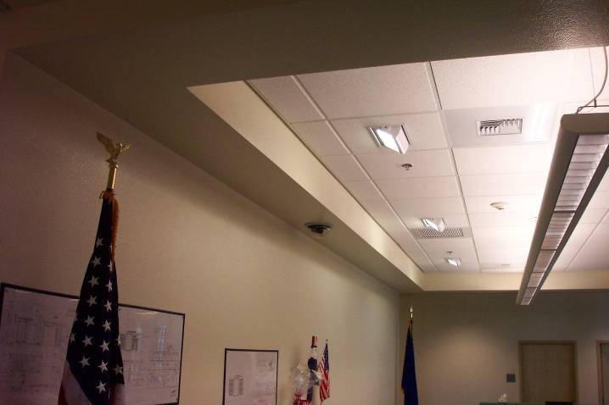
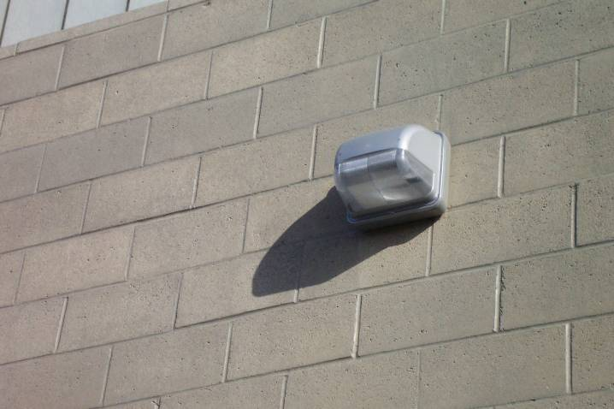
What’s Covered Under Electrical Power and Lighting Systems Requirements?
Mandatory Interior Lighting requirements
  Required Controls
  Wattage/Efficiency Limits
Interior Lighting Power Allowances (watts/ft²)
Exterior Lighting Controls
  Required Controls
  Lamp Efficiency
Exterior Lighting Power Allowances (watts/ft²)
Dwelling Electric Meters
Electrical Transformers and Motors
Vertical and Horizontal Transportation Systems and Equipment

Slide 6
What’s Covered Under Electrical Power and Lighting Systems Requirements?
Exception:
Dwelling units within commercial buildings are not required to comply IF they comply with the residential Section R404.1
A minimum of 75 percent of the lamps in permanently installed lighting fixtures are high-efficacy lamps or 75% of permanently installed lighting fixtures contain only high efficacy lamps
  Exception:
Low-voltage lighting

Slide 7
High-Efficacy Lamps - Definition
Compact fluorescent lamps, LED lamps, T8 or smaller diameter linear fluorescent lamps, or other lamps with an efficacy based on lamp wattage
Lamp Wattage | Efficacy
> 40 watts | 60 lumens/watt
15-40 watts | 50 lumens/watt
< 15 watts | 40 lumens/watt

Slide 8
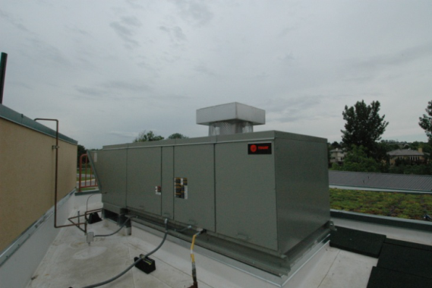
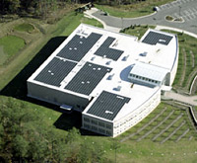
Additional Efficiency Package Options
Section C406
One or more additional efficiency features must be selected to comply with the IECC
  More efficient HVAC performance, OR
  Reduced lighting power system, OR
  Enhanced lighting controls, OR
  On-site supply of renewable energy, OR
  Dedicated outdoor air system, OR
  More efficient SWH, OR
  Enhanced envelope performance, OR
  Reduced air infiltration
High Efficiency HVAC
More Efficient Lighting System
Onsite Renewables
Notes:
Onsite renewables “regulated energy” = energy used within the building for building mechanical and service water heating equipment and lighting regulated by Chapter C4.

Slide 9
Interior Lighting Power Allowance
Section C405.3.2
Two methods to determine allowance:
Building Area Method
  Floor area for each building area type x value for the area
  “area” defined as all contiguous spaces that accommodate or are associated with a single building area type as per the table
  When used for an entire building, each building area type to be treated as a separate area
Space-by-Space Method
  Floor area of each space x value for the area
  Then sum the allowances for all the spaces
  Tradeoffs among spaces are allowed
Notes:
The total interior lighting power (watts) equals the sum of all areas interior lighting powers in the building covered within the permit.
Two compliance options: building area method per Table C405.32(1) or Space-by-Space Method per Table C405.3.2(2).

Slide 10
Building Area Method
Table C405.3.2(1)
Building Area Type | LPD (w/ft²)
Automotive facility | 0.71
Convention center | 0.76
Courthouse | 0.90
Dining: bar lounge/leisure | 0.90
Dining: cafeteria/fast food | 0.79
Dining: family | 0.78
Dormitory | 0.61
Exercise center | 0.65
Fire station | 0.53
Gymnasium | 0.68
(partial table)
Notes:
Table C405.4.2(1)

Slide 11
Space-By-Space Method
Table C405.3.2(2)
Common Space Types | LPD (w/ft²)
Locker room | 0.48
Lounge/breakroom
In a healthcare facility | 0.78
Otherwise | 0.62
Office
Enclosed | 0.93
Open plan | 0.81
Parking area, interior | 0.14
Pharmacy area | 1.34
(partial table)
Notes:
Table C405.5.2(2)
Note: the space types are not in the exact order per table

Slide 12
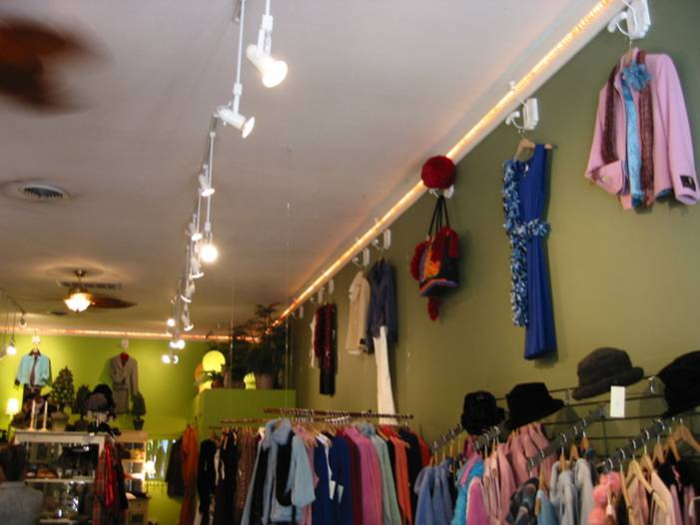
Additional Interior Lighting Power
Section C405.3.2.2.1
Additional Interior Lighting Power Allowance = 1000 watts +
(Retail Area 1 x 0.45 W/ft²) +
(Retail Area 2 x 0.45 W/ft²) +
(Retail Area 3 x 1.05 W/ft²) +
(Retail Area 4 x 1.87 W/ft²),
Where:
Retail Area 1 = the floor area for all products not listed in Retail Area 2, 3 or 4.
Retail Area 2 = the floor area used for the sale of vehicles, sporting goods and small electronics.
Retail Area 3 = the floor area used for the sale of furniture, clothing, cosmetics and artwork.
Retail Area 4 = the floor area used for the sale of jewelry, crystal, and china.
Notes:
Where using the space-by-space method, an increase is permitted only where specified lighting is installed and automatically controlled separately from general lighting
Specific accommodation has been made for retail merchandise highlighting in the 2015 IECC. These are IN ADDITION TO general lighting.
Floor area is the specific area to highlight merchandise. For example, track lighting installed to highlight a wall display of shoes – would qualify. Overhead, general lighting not specifically aimed at the wall of shoes would not qualify.

Slide 13
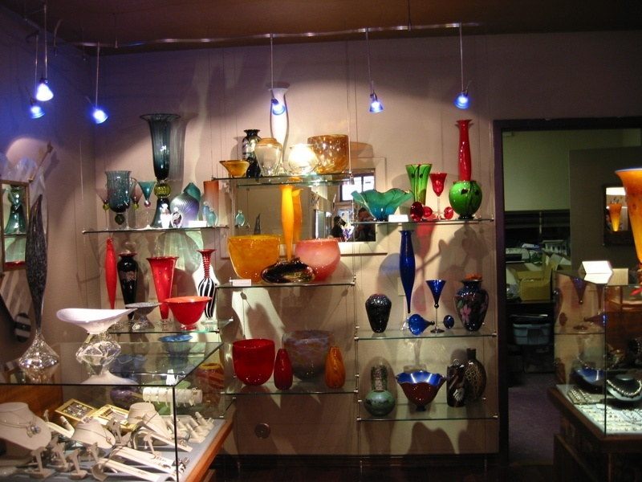
Additional Interior Lighting Power
Section C405.3.2.2.1
Exception:
Other merchandise categories are permitted to be included in Retail Areas 2 through 4 above, provided that justification documenting the need for additional lighting power based on visual inspection, contrast, or other critical display is approved by the code official
For spaces which lighting is specified to be installed in addition to general lighting or purpose of decorative appearance or for highlighting art or exhibits, provided that the add’l lighting power is < 0.9 W/ft² in lobbies and < 0.75 W/ft² in other spaces
Photo courtesy of Ken Baker, K energy

Slide 14
Proposed Connected Lighting Calculation
Section C405.3.1
Proposed lighting wattage must be calculated in accordance with Equation 4-10
    TCLP = [LVL + BLL + LED + TRK + OTHER]
TCLP = total connected lighting power (watts)
LVL = labeled wattage of luminaires connected directly to building power
BLL = wattage of the ballast or transformer
LED = wattage of LEDs with either integral or remote drivers
TRK = wattage of lighting tracks, cable conductors, rail conductors, and plug-in busways specified wattage of the luminaires but not less than 8 W per linear foot OR the wattage limit of other permanent current-limiting devices on the system OR wattage limit of the transformer
OTHER = the wattage of all other luminaires and lighting sources not covered previously and associated with interior lighting verified by data supplied by the manufacturer or other approved sources
Notes:
Screw lamp holders = typical Edison based – this is whatever the factory labeling says is the maximum wattage; not simple wattage of a bulb – must be the max that could be installed in the fixture
If you have other types, it’s the manufacturer’s rated wattage of the lamp plus ballast.

Slide 15
Exemptions to Proposed Interior Lighting Power Calculation
Section C405.3.1
Television broadcast lighting for playing areas in sports arenas
Emergency lighting automatically off during normal business operation
Lighting for occupants with special needs (visual impairment and other medical and age-related issues)
Casino gaming areas
Mirror lighting in dressing rooms
Task lighting for medical and dental purposes (in addition to general lighting and controlled independently)
Display lighting for exhibits in galleries, museums and monuments (in addition to general lighting and controlled independently)
Theatrical, stage, film, and video production
Used for photographic processes
Integral to equipment or instrumentation installed by manufacturer
Plant growth or maintenance
Advertising or directional signage
Food warming
Lighting equipment that is for sale
Lighting demonstration equipment in lighting education facilities
Approved because of safety considerations
In retail display windows when the display is enclosed by ceiling-height partitions
Furniture-mounted supplemental task lighting controlled by automatic shutoff
Exit signs
Notes:
These types of lighting do not have to be counted. These are considered to be IN ADDITION TO general lighting.

Slide 16
Lighting Power Compliance Calculation
Sum the wattage of all proposed connected lighting power
This must include all lighting that is part of the design for the space including:
  Overhead lighting
  Task lighting
  Decorative lighting
Compare values; proposed wattage must be less than or equal to allowed wattage
Notes:
Must include all lighting that is part of the design. If individual task lighting is part of the design it must be included. One example of lighting that would NOT have to be included is if the tenant purchases furniture with under shelf task lighting that wasn’t part of the original design.
The calculation includes the lamp plus ballast values.
Total connected interior lighting power. The total connected interior lighting power (watts) should be determined in accordance with Equation 4-9

Slide 17
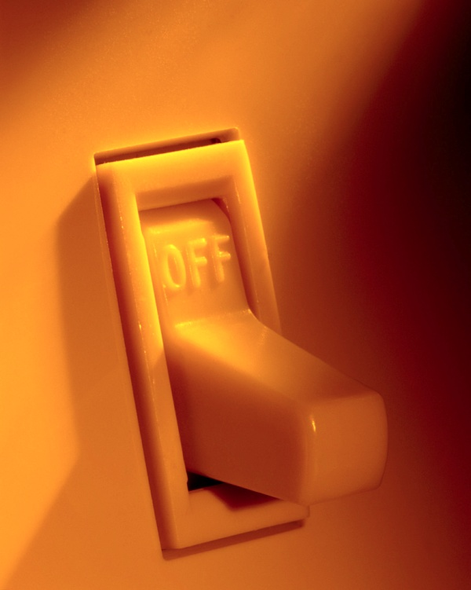
Lighting Controls
Section C405.2 - Mandatory
Lighting systems required to be provided with controls as specified for:
Occupant sensor controls – C405.2.1
Time-switch controls – C405.2.2
Daylight-responsive controls – C405.2.3
Specific application controls – C405.2.4
Manual controls – C405.2.5
Exterior lighting controls – C405.2.6
Notes:
Intent is to allow occupants to control unneeded lighting.

Slide 18
Occupant Sensor Controls
Sections C405.2.1, C405.2.1.1
Occupancy sensors are required in:
  Classrooms/lecture/training rooms
  Conference/meeting/multipurpose rooms
  Copy/print rooms
  Lounges/breakrooms
  Enclosed offices
  Open plan office areas
  Restrooms
  Storage rooms
  Locker rooms
  Other spaces < 300 ft² enclosed by floor-to-ceiling height partitions
  Warehouse storage areas
Occupancy sensor function (other than for warehouses):
  Automatically turn lights off within 20 minutes after occupants have left space
  Either manual-on or controlled to automatically turn on lighting to not more than 50% power
  Incorporate a manual control to allow occupants to turn off lights

Slide 19
Occupant Sensor Controls
C405.2.1.1 Exemptions
Exemptions:
Full auto-on controls allowed in
  Public corridors
  Stairways
  Restrooms
  Primary building entrance areas and lobbies
  Areas where manual-on operation would endanger safety or security of room or occupants

Slide 20
Occupant Sensor Controls
Section C405.2.1.2 - Warehouses
Aisleways and open areas
  Automatically reduce lighting power by > 50% when areas are unoccupied
  Control lighting in each aisleway independently
  Not control lighting beyond the aisleway being controlled by the sensor

Slide 21
Occupant Sensor Controls
Section C405.2.1.3 – Open Plan Office Areas
Spaces less than 300 ft² to comply with C405.2.1.1
All other spaces to comply with:
  General lighting controlled separately in zones with floor areas not greater than 600 ft²
  Automatically turn off general lighting in all control zones within 20 minutes after occupants have left
  General lighting power in each control zone reduced by not less than 80% of full zone general lighting power, in reasonable uniform illumination pattern within 20 minutes of all occupants leaving
    Control functions that switch control zone lights completely off when zone is vacant meet this requirement
  Any daylight responsive control to active general lighting or control zone general lighting only when occupancy for the same area is detected

Slide 22
Time-switch Controls
Section C405.2.2
Each area of the building that is NOT provided with occupant sensor control must have a time-switch control to turn lights off automatically.
Exceptions where a manual control can provide the light reduction and time-switch control is not required:
  Spaces where patient care is directly provided
  Spaces where an automatic shutoff would endanger occupant safety or security
  Lighting intended for continuous operation
  Shop and laboratory classrooms

Slide 23
Time-switch Control Functions
Section C405.2.2.1
Must include an override switching device with the following:
Minimum 7-day clock
Capable of being set for 7 different day types/week
Incorporate holiday “shutoff” feature to turn all controlled lighting loads for ≥ 24 hours and resume to normally scheduled operations
Program backup capabilities to prevent loss of program and time setting for ≥ 10 hours if power is interrupted
Override switch should include:
  Manual control
  Control lighting to remain on for < 2 hours
  Control lighting for an area < 5,000 ft²

Slide 24
Time-switch Control Functions
Section C405.2.2.1 – Cont’d.
Exceptions:
Mall concourses
Auditoriums
Sales areas
Manufacturing facilities
Sports arenas
Time limit permitted to be > 2 hours provided switch is a captive key device
Override switch not limited to an area 5,000 ft² provided area is < 20,000 ft²
If area has a manual control:
spaces with 1 luminaire with rated power < 100 watts
spaces that use < 0.6 watts/ft²
corridors, lobbies, electrical rooms and or mechanical rooms

Slide 25
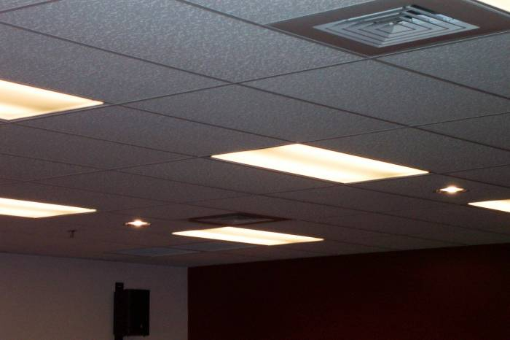
Light-reduction Controls
Section C405.2.2.2
Light Reduction Controls must allow the occupant to reduce connected lighting load
  By not less than 50%
  In a reasonably uniform illumination pattern
Notes:
Intent is to allow occupants to moderate light levels to save energy.

Slide 26
Light-reduction Control Options
  Controlling all lamps or luminaires
  Dual switching of alternate rows of luminaires, alternate luminaires or lamps
  Switching middle lamp luminaires independently from the outer lamps
  Switching each luminaire or each lamp
Dimming
Alternating Luminaires
Alternating Lamps
D
S
S
S
Dimmer Switch
S
Notes:
Options are: dimming, dual switching in a uniform patter across the ceiling grid, or, for three-lamp fixtures, switch the middle lamps independently from the outer lamps. You can also do each luminaire or each lamp although this isn’t common due to cost and practicality.
Light reduction controls. Each area that is required to have a manual control must allow the occupant to reduce the connected lighting load in a reasonably uniform illumination pattern by at least 50 percent and have one of the following options OR another approved method.

Slide 27
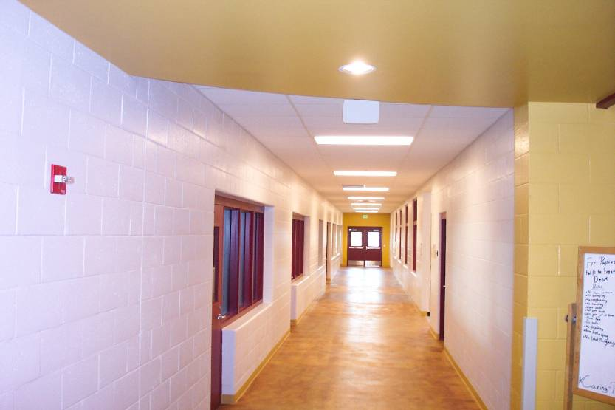
Light-reduction Controls
Section C405.2.2.2 - Exemption
Light Reduction Control Not required in daylight zones with daylight responsive controls complying with C405.2.3

Slide 28
Daylight-responsive Controls
Section C405.2.3
Definition: A device or system that provides automatic control of electric light levels based on the amount of daylight in a space
Required to control lighting in spaces with < 150 watts of general lighting:
  Sidelit zones
  Toplit zones
Exceptions:
  Health care facilities where patient care is directly provided
  Lighting required for specific application control per C405.2.4
  Sidelight daylight zones on 1st floor above grade in Group A-2 and Group M occupancies
Notes:
General lighting does not include lighting that is required to have specific application control in accordance with Section C405.2.4

Slide 29
Daylight-responsive Control Functions
Section C405.2.3.1
Toplit zones shall be controlled independently of lights in sidelit zones
Controls shall be configured so that they can be calibrated from within the space by authorized personnel
Calibration mechanisms shall be in a location with ready access
In offices, classrooms, laboratories, and library reading rooms, controls shall dim lights continuously from full light output to <15%

Slide 30
Daylight-responsive Controls
Section C405.2.3 – Cont’d.
Configured to completely shut off all controlled lights
Sidelit zones facing different cardinal orientations (within 45 degrees of due north, east, south, west) controlled independently of each other
Exception:
< 150 watts in each space is permitted to be controlled together with lighting in a daylight zone facing a different cardinal orientation

Slide 31
Sidelit Zone
Section C405.2.3.2
Definition: floor area adjacent to vertical fenestration which that complies with all of the following:
Fenestration located in a wall:
  Sidelit zone shall extend laterally to the nearest full-height wall OR
  < 1.0 x height from the floor to the top of the fenestration, and longitudinally from the edge of the fenestration to the nearest full-height wall, or up to 2 ft., whichever is less

Slide 32
Sidelit Daylight Zone
Section C405.2.3.2 – Cont’d.
Area of fenestration > 24 ft²
Distance from fenestration to any building or geological information that would block access to daylight is > than the height from bottom of fenestration to top of building or geologic information
The visible transmittance of fenestration > 0.20

Slide 33
Toplit Daylight Zone
Section C405.2.3.3
Definition: the floor area underneath a roof fenestration assembly that complies with all of the following:
Zone shall extend laterally and longitudinally beyond the edge of the roof fenestration assembly to the nearest obstruction that is (taller) > 0.7 x the ceiling height, > 0.7 x the ceiling height, whichever is less
Where located in rooftop monitor, toplit zone to extend laterally to nearest obstruction taller than 0.7 x the ceiling height, or up to 1.0 times the height from floor to bottom of fenestration, whichever is less, and longitudinally from the edge of the fenestration to the nearest obstruction taller than 0.7 x ceiling height, or up to 0.25 times the height from the floor to bottom of fenestration, whichever is less
No building or geological formation blocks different sunlight from hitting the roof fenestration assembly at the peak solar angle on the summer solstice
Where located in existing buildings, visible transmittance of the roof fenestration assembly times the area of the rough opening of the roof fenestration assembly divided by area of daylight zone > 0.008

Slide 34
Specific Application Controls
Section C405.2.4
These types to be controlled by occupant sensor or time-switch control, and a manual control provided to control separately from general lighting
  Display and accent lighting
  Display case lighting
  Supplemental task lighting, including permanently installed under-shelf or under-cabinet lighting
  Equipment for sale or educational demonstrations
Hotel and motel sleeping units
  Master control device capable of automatically switching off all installed luminaires and switched receptacles within 20 minutes of occupants leaving the room
  Exceptions: lighting and switch receptacles controlled by captive key systems and spaces where patient care is provided
Permanently installed luminaires within dwelling units to have controls complying with C405.2.1.1 or C405.2.2.2
Nonvisual applications, plant growth and food warming shall be controlled via time-switch control

Slide 35
Manual Controls
Section C405.2.5
In a location where
  occupants have ready access
  controlled lights are visible (or identify the area served by the lights and indicate status)

Slide 36
Exterior Lighting and Building Lighting Power
Sections C405.4 – Mandatory, C405.4.1
Total exterior connected lighting power to be the maximum rated wattage of all lighting powered through the energy service to the building
Exception: approved because of safety considerations
Connected Exterior Lighting Power must not exceed Exterior Lighting Power Allowance except where approved because of historical, safety, signage or emergency considerations:
  Calculate exterior lighting power allowance
    Lighting power densities by exterior function and by applicable lighting zone
  Calculate proposed connected lighting power
    Wattage calculation “rules”
    Exempted lighting
  Compare values: proposed wattage must be less than or equal to allowed wattage
Notes:
Similar to interior lighting power limits.
Same steps to calculate as for interior.

Slide 37
Exemptions from Exterior Calculation
Section C405.4.1
The following lighting does not need to be included in the proposed lighting calculation:
Emergency lighting automatically off during normal business operation
Exit signs
Specialized signal, directional, and marker lighting associated with transportation
Advertising signage or directional signage
Lighting integral to equipment or instrumentation and installed by its manufacturer
Lighting for theatrical purposes, including performance, stage, film production, and video production
Lighting for athletic playing areas
Temporary lighting
Lighting for industrial production, material handling, transportation sites, and associated storage areas
Theme elements in theme/amusement parks
Lighting used to highlight features of art, public monuments, and the national flag
Lighting used for water features and swimming pools
Lighting controlled from within dwelling units and complying with R404.1
Notes:
These do not need to be included when doing your calculation.

Slide 38
Exterior Lighting Zones
Table C405.4.2(1)
Power allowances are listed by lighting zone
Lighting Zone | Description
1 | Developed areas of national parks, state parks, forest land, and rural areas
2 | Areas predominantly consisting of residential zoning, neighborhood business districts, light industrial with limited nighttime use and residential mixed use areas
3 | All other areas not classified as lighting zone 1, 2 or 4
4 | High-activity commercial districts in major metropolitan areas as designated by the local land use planning authority
Notes:
Based on the realization that different areas have different lighting requirements.
If you’re next to a lot of exterior lighting – your lighting needs because of contrast or other visual needs is going to have to be higher.
If there are low ambient conditions, you don’t need as much lighting.
1 = low lit areas
2 = very common for a lot of buildings – basically residential zoned or neighborhood business district
3 = all other
4 = high end of the scale, very high-activity commercial districts. Typically major metropolitan areas, inner cities, etc. with a lot of exterior lighting.

Slide 39
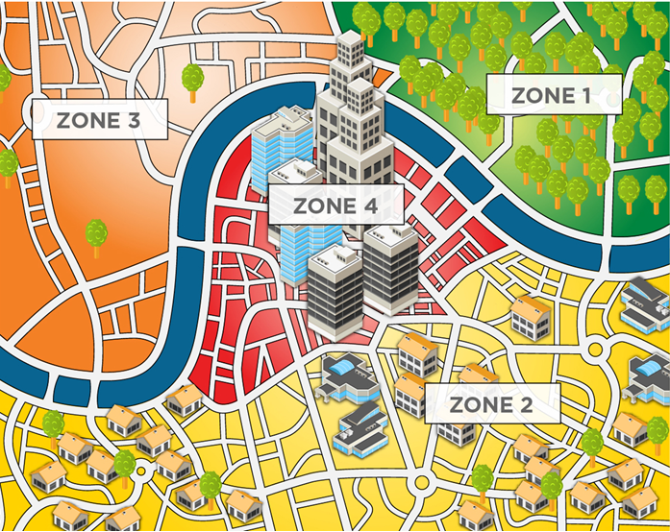
Exterior Lighting Zones
Table C405.4.2(1)
Notes:
Example:
Lighting Zone/Description
1 Developed areas of national parks, state parks, forest land, and rural areas
Areas predominantly consisting of residential zoning, neighborhood business districts, light industrial with limited nighttime use and residential mixed use areas
All other areas not classified as lighting zone 1, 2 or 4
High-activity commercial districts in major metropolitan areas as designated by the local land use planning authority

Slide 40
Exterior Lighting Zones
Table C405.4.2(2)
Allowances include a base allowance plus tradeable allowance
 |  | Zone 1 | Zone 2 | Zone 3 | Zone 4
Base Site Allowance |  | 350 W | 400 W | 500 W | 900 W
 | Uncovered Parking Areas
 | Parking areas and drives | 0.03 W/ft² | 0.04 W/ft² | 0.06 W/ft² | 0.08 W/ft²
 | Building Grounds
 | Walkways and ramps less than 10 feet wide | 0.5 W/linear foot | 0.5 W/linear foot | 0.6 W/linear foot | 0.7 W/linear foot
 | Walkways and ramps 10 feet wide or greater | 0.10 W/ft² | 0.10 W/ft² | 0.11 W/ft² | 0.14 W/ft²
 | Plaza areas
 | Special Feature Areas
Partial Table
Notes:
Base site allowance is given in realization that some smaller buildings may need a little extra help because they won’t have as much square footage to get the wattage they need.
Pick applicable applications for your building and use appropriate zone column to get an allowance for each application.

Slide 41
Exterior Lighting Zones cont’d.
 |  | Zone 1 | Zone 2 | Zone 3 | Zone 4
 | Building facades | No allowance | 0.075 W/ft² of gross above-grade wall area | 0.113 W/ft² of gross above-grade wall area | 0.15 W/ft² of gross above-grade wall area
 | Automated teller machines (ATM) and night depositories | 135 W per location plus 45 W per additional ATM per location
 | Uncovered entrances and gatehouse inspection stations at guarded facilities | 0.5 W/ft² of area
 | Uncovered loading areas for law enforcement, fire, ambulance and other emergency service vehicles | 0.35 W/ft² of area
 | Drive-up window and doors | 200 W per drive-through
 | Parking near 24-hour retail entrances | 400 W per main entry

Slide 42
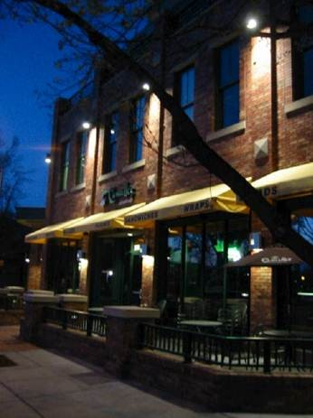
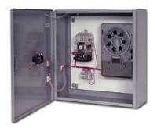
Exterior Lighting Control Requirements
Section C405.2.6
Exterior lighting systems provided with controls complying with C405.2.6.1 through C405.2.6.4
Decorative lighting systems comply with Sections C405.2.6.1, C405.2.6.2, and C405.2.6.4
Exceptions: Covered vehicle entrances or exits from buildings and parking structures where required for safety, security or eye adaptation; and lighting controlled from within dwelling units

Slide 43
Daylight Shutoff
Section C405.2.6.1
Lighting to be automatically off if sufficient daylight is present satisfying needs in the space

Slide 44
Decorative Lighting Shutoff
Section C405.2.6.2
Lighting for building façade and landscape automatically off from not later than 1 hour after business closing to not earlier than 1 hour before opening

Slide 45
Lighting Setback
Section C405.2.6.3
Building façade or landscape NOT covered in Section C405.2.6.2 shall have controls configured to automatically reduce connected lighting power > 30%
  no later than midnight to not earlier than 6 am
  from not later than 1 hour after business closing to not earlier than 1 hour before opening
  any period where activity has not been detected for at least15 minutes

Slide 46
Exterior Time-Switch Control Function
Section C405.2.6.4
All time switch controls
  have a clock capable of being programmed for not fewer than 7 days
  capable of being set for 7 different day types per week
  incorporate automatic holiday setback feature
  be able to retain programming and the time setting during loss of power for a period of > 10 hours

Slide 47




Dwelling Electrical Meter
Section C405.5 - Mandatory
Separate metering required for each dwelling unit
Notes:
Specific requirement for buildings with individual dwelling unit to have separate electrical meters.
Intent: Occupant understanding of actual energy use can promote effective energy use!

Slide 48
Electrical Transformers
Section C405.7 - Mandatory
Low-voltage dry-type distribution electric transformers must meet minimum efficiency requirements of Table C405.6 when tested and rated in accordance with test procedure 10 CFR 431
Efficiency to be verified through certification under an approved certification program or when program does not exist, ratings shall be supported by data furnished by transformer manufacturer

Slide 49
Electrical Transformers
Section C405.6 – Mandatory – Cont’d.
Exceptions:
  If meet EPAct 2005 exclusions based on 10 CFR 431
    Special purpose applications
    Not likely in general purpose applications
    Have multiple voltage taps where highest tap is ≥ 20% more than lowest tap
  Some specific products are listed

Slide 50
Electric motors
Section C405.7 - Mandatory
Electric motors must meet minimum efficiency requirements of Tables C405.7(1) through C405.7(4) when tested and rated in accordance with test procedure 10 CFR 431
Efficiency to be verified through certification under an approved certification program or when program does not exist, ratings shall be supported by data furnished by motor manufacturer

Slide 51
Vertical and Horizontal Transportation System and Equipment
Section C405.8.1 – Elevator Cabs
The sum of lumens divided by the sum of the watts > 35 lumens/W (not including signal and displays)
Ventilation fans without their own air-conditioning system shall not consume < 0.33 watts/cfm at the max. rated speed of the fan
Controls shall be provided that will de-energize ventilation fans and lighting systems when the elevator is stopped, unoccupied and with its doors closed for > 15 minutes

Slide 52
Vertical and Horizontal Transportation System and Equipment
Section C405.8.2 – Escalators and Moving Walks
Must comply with ASME A17.1/CSA B44
Automatic controls configured to reduce speed to minimum permitted speed in accordance with ASME A17.1/CSA B44 or applicable local code when not conveying passengers
Exception: variable voltage drive systems that reduce operating voltage in response to light loading conditions is an alternative to reduced speed function
Regenerative drive
  Escalators designed for one-way down operation only or for reversible operation
    Must have a variable frequency regenerative drive that supplies electrical energy to the building electrical system when escalator is loaded with passengers with a combined weight > 750 pounds

Slide 53
Functional Testing of Lighting Controls
Section C408.3.1
Prior to passing final inspection, registered design professional to provide evidence that lighting control systems have been tested to ensure that control hardware and software are calibrated, adjusted, programmed and in proper working order per construction documents and manufacturer’s installation instructions
Notes:
Independent refers to independent from the design or construction of the project

Slide 54
Occupant Sensor Controls
Section C408.3.1.1
  Certify location and aiming per manufacturer recommendation
  Test all sensors if project ≤ 7
  If > 7 sensors, test for each unique combination of sensor type and space geometry
  Where multiples of each unique combination of sensor type and space geometry are provided > 10%, but in no case < 1 of each combination shall be tested unless the code official or design professional requires a higher percentage to be tested
  Where >30% of tested controls fail, all remaining identical combinations must be tested
Verify the following:
    Status indicator, verify correct operation
    Lights turn off or down to permitted level within required time
    Auto-on – lights turn on to permitted level when someone enters the space
    Manual on – lights turn on only when manually activated
    Lights aren’t incorrectly turned on by movement in nearby areas or by HVAC operation

Slide 55
Time-switch Controls
Section C408.3.1.2
  Confirm programmed schedules
  Document schedules for owner
  Verify correct time and date are set
  Verify any battery backup is installed and energized
  Verify override time limit set to ≤ 2 hours
  Simulate occupied condition and verify and document:
    Lights turn on and off with respective switches
    Switch only operates lights in enclosed space where switch is located
  Simulate unoccupied condition and verify and document:
    All nonexempt lights turn off
    Manual override only operates lighting where it is located
  Additional testing as specified by the registered design professional

Slide 56
Daylight Responsive Controls
Section C408.3.1.3
For daylight responsive controls
  Properly located, field-calibrated, and set to have appropriate setpoints and threshold light levels
  Daylight controlled lighting loads adjust to correct levels with available daylight
  Authorized personnel have ready access to calibration adjustment equipment

Slide 57


Documentation Requirements
Section C408.3.2
Construction documents specify that documents in this section be provided to building owner or owner’s authorized agent within 90 days of date of receipt of certificate of occupancy

Slide 58
Existing Buildings
Section C502.2.6 Lighting Power and Systems
New lighting systems installed as part of an addition to comply with C405
Total interior lighting power to comply C405.3.2
  Stand alone addition
  Addition + existing building as a single building
Total exterior lighting power to comply C405.4.2
  Stand alone addition
  Addition + existing building as a single building
Repairs – C504.2
  Repairs exempt where only the bulb, ballast or both within the existing luminaires in a space are replaced, provided that the replacement does not increase the installed interior lighting power

