Slide 1
Residential Provisions of the 2018 International Energy Conservation Code
PNNL-SA-132655

Slide 2
Why care about IECC?
Energy codes and standards set minimum efficiency requirements for new and renovated buildings, assuring reductions in energy use and emissions over the life of the building. Energy codes are a subset of building codes, which establish baseline requirements and govern building construction.
Code buildings are more comfortable and cost-effective to operate, assuring energy, economic and environmental benefits.

Slide 3
The Family of I-Codes
International Building Code
International Mechanical Code
International Fuel Gas Code
International Property Maintenance Code
International Fire Code
International Zoning Code
International Plumbing Code
International Existing Building Code
International Private Sewage Disposal Code
International Performance Code
International Residential Code
International Energy Conservation Code
International Wildlife-Urban Interface Code
Notes:
The IECC is one of the International Codes. This code establishes minimum regulations for energy efficient buildings using prescriptive and performance related provisions.
The IECC contains energy provisions for both residential and commercial buildings.
Building Envelope - focuses on air sealing, minimum insulation levels, and efficient glazing.
Mechanical Systems - addresses equipment efficiency, HVAC controls and heating and cooling distribution.
Electrical Systems - focuses on interior and exterior lighting wattage limits and controls for efficient lighting usage.
Service Water Heating Systems - addresses water heating efficiency and hot water distribution.
Health and life safety take precedence.

Slide 4
Relationship Between IRC & IECC
IECC addresses only energy
IRC addresses all topics (structural, plumbing, etc.)
Allows builder to carry only one code book
Chapter 11 covers energy efficiency
As of 2015, IECC consolidated with IRC energy chapter (actually a change to the IRC, not the IECC).
IECC addresses both residential and commercial; IRC addresses subset of residential, detached one- and two-family dwellings and townhouses 3 stories or fewer
VS

Slide 5
Structure of the 2018 IECC
Commercial
Section
Residential
Section
Ch. 1 Scope and Application / Administrative and Enforcement
Ch. 2 Definitions
Ch. 3 General Requirements
Ch. 4 Commercial Energy Efficiency
Ch. 5 Existing Buildings
Ch. 6 Referenced Standards
Index
Ch. 1 Scope and Application / Administrative and Enforcement
Ch. 2 Definitions
Ch. 3 General Requirements
Ch. 4 Residential Energy Efficiency
Ch. 5 Existing Buildings
Ch. 6 Referenced Standards
Index

Slide 6
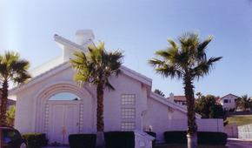
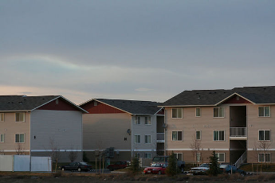
Scope Section R101
Residential Buildings:
One- and two-family dwellings, townhouses of any size and R-2, R-3, R-4 ≤ 3 stories
All buildings that are not “residential” by definition are “commercial”
Notes:
Residential buildings defined by IECC includes R-2, R-3, and R-4 buildings three stories or less in height above grade:
R-2 is occupancies containing more than 2 dwelling units where the occupants are primarily permanent in nature, including apartments, boarding houses, dormitories, etc (including hotels/motels, but those are commercial buildings holding residential occupancies).
R-3 includes one- and two-family dwellings. Most buildings covered by this code are single family with one occupancy type
R-4 includes residential care and assisted living facilities.

Slide 7
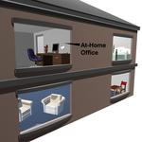
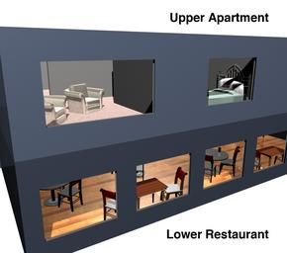
Scope Section R101.4.1 - Mixed Residential and Commercial Buildings Section R101.5 - Compliance
Treat the residential building portion under the applicable residential code
Treat the commercial building portion under the commercial code
Code Official has final authority
Compliance materials, software, worksheets
Notes:
The residential and commercial building portions fall under two different scopes. Thus, two compliance submittals must be prepared using the appropriate calculations and forms from the respective codes for each.
Case by case basis.

Slide 8
Scope Section R102.1 – Alternative Materials, Design, and Methods of Construction and Equipment
The code is not intended to prevent installation of any material or prohibit design or method of construction that is not specifically prescribed in this code
Such material, equipment, or design shall be approved by the code official
If code official doesn’t approve, will state reasons in writing

Slide 9
Scope/Construction Documents Section R103
Documentation shall be prepared by a registered design professional (where required)
Electronic media can be used
Information required:
Insulation materials and R-values
Fenestration U-factors, SHGC
Area-weighted U-factor and SHGC calculations
Mechanical, SWH, equipment types, sizes, and efficiencies
Equipment and system controls
Duct sealing, duct and pipe insulation and location
Air sealing details
The building thermal envelope shall be represented
Notes:
Documentation shall be prepared by a registered design professional (where required by statute by the code official)
No work shall be done on any part of the building beyond the point indicated in each successive inspection without first obtaining written approval of the code official.
No construction work shall be concealed without being inspected and approved.

Slide 10
Scope Section R104-R109
Fees, R104
Inspections, R105
Work remains visible and accessible for inspection
Code Validity, R106
Portions of code deemed to be illegal or void shall not affect the remainder of the code
Referenced codes and standards, R107
Considered part of the requirements of the code, but IECC provisions take precedence
Stop Work Order, R108
Authority of code official
Failure to Comply subject to fine
Board of Appeals, R109
Notes:
Life and safety take precedence. A couple of these will go into more detail in further slides, the next two slides touch a little bit more on two of these. The Fees section from 2015 was removed.

Slide 11
Inspections Section R105
Construction work for which a permit is required is subject to inspection by code official or designated agent
Required inspections include:
Footing and foundation
Framing and rough-in
Plumbing rough-in
Mechanical rough-in
Final

Slide 12
Referenced Codes and Standards Section R107.1
Codes and standards listed in Chapter 5 are considered part of the requirements of this code to the “prescribed extent of each such reference and as further regulated in Sections R107.1.1 and R107.1.2”
Conflicts, R107.1.1 – where differences occur between this code and the referenced codes and standards, provisions of this code apply
Provisions in reference codes and standards, R107.1.2 – “where the extent of the reference to a referenced code or standard includes subject matter that is within the scope of this code, the provisions of this code, as applicable, shall take precedence over the provisions in the referenced code or standard”

Slide 13
Certificate Section R401.3
Permanently posted on a wall in the space where the furnace is located, a utility room or an approved location inside the building
Don’t cover or obstruct the visibility of other required labels
Includes the following:
R-values of insulation installed for the thermal building envelope, including ducts outside conditioned spaces
U-factors and SHGC for fenestration
Area-weighted U-factor and SHGC calculations
Results from any required duct system and building envelope air leakage testing
HVAC efficiencies and types
SWH equipment
Duct sealing, duct and pipe insulation and location
Air sealing details
Notes:
The 2018 IECC requires a permanent certificate posted. The certificate shall be completed by the builder or other approved party. It should indicate the R-values of insulation installed for the building envelope, U-factors and SHGC for fenestration, results from any required duct system and building envelope air leakage testing, HVAC efficiencies, and service water heating equipment.

Slide 14
Certificate (cont’d)
Certificate indicates “gas-fired unvented room heater”, “electric furnace”, or “baseboard electric heater”, rather than indicating an efficiency for those heating types

Slide 15
Overview of Structure
Climate-Specific Requirements:
Roofs
Above grade walls
Foundations
Basements
Slabs
Crawlspaces
Skylights, windows, and doors
Solar Heat Gain Coefficient in warm climates
Mandatory Requirements (apply everywhere):
Infiltration control
Duct insulation, sealing & testing, no use of building cavities
HVAC controls
Piping Insulation and circulating service hot water requirements
Equipment sizing
Dampers
Lighting
Notes:
There are mandatory envelope requirements (design must meet these requirements regardless of location) which include moisture and infiltration control and duct insulation. Other envelope requirements such as insulation values and window efficiency are based on the climate of the project location.
There are many others not mentioned here (Mandatory Requirements): Mechanical ventilation, systems serving multiple dwelling units, snow melt and ice system controls, pools and spas...etc., the presentation will touch on all of these.

Slide 16
Compliance
IECC Terminology
Prescriptive
Required but can be lessened or eliminated in trade for compensating improvements elsewhere
Mandatory
Required and cannot be traded down, even in the simulated performance path or Energy Rating Index path
Note: Unlike simulated performance path, ERI path is not directly based on the prescriptive requirements
Some elements have “hard limits”
aka, “trade-off limits” or "backstops"
a prescriptive requirement that can only be traded so far
components can only be traded so far when complying with the performance requirements or ERI path
Notes:
Prescriptive Trade Off Example: If the code requires R-20 walls, you can trade that down and put in R-13 if you improve another component like ceilings or windows.
Mandatory cannot be traded down or away, even in simulated performance path.
Hard limits aka trade-off limits can only be traded so far.

Slide 17
Climate Zones
IECC Terminology
"Climate Zone" has two components
Eight temperature-oriented zones (1-8)
Three named moisture regimes (moist, dry, marine)
Theoretically 8x3=24 distinct zones, but only 15 occur in U.S.
Two additional climate specifications influence requirements
Warm-Humid line delineates counties that are warm-humid as defined by ASHRAE, with exceptions (affects only bsmt reqm'ts)
The "Tropical Climate Zone" (not a separate zone) defines areas in which simplified/relaxed requirements apply under some conditions
Climate Zones in the U.S. are entirely geographical
Defined along state/county lines
International locations defined by local climate data (mean Temp, precipitation, humidity, etc.)
Notes:
Prescriptive Trade Off Example: If the code requires R-20 walls, you can trade that down and put in R-13 if you improve another component like ceilings or windows.
Mandatory cannot be traded down or away, even in simulated performance path.
Hard limits aka trade-off limits can only be traded so far.

Slide 18
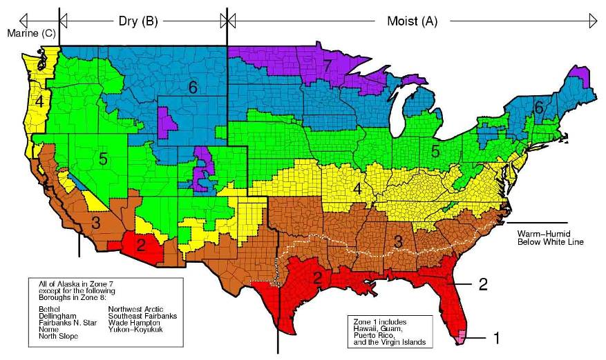
Climate Zones for the 2018 IECC
Notes:
Climate zones are unchanged from 2015 IECC.
Tropical climate zone: Hawaii, Puerto Rico, Guam, American Samoa, U.S. Virgin Islands, Commonwealth of Northern Mariana Islands and islands in the area between the Tropic of Cancer and the Tropic of Capricorn
U.S. counties are defined entirely by county boundaries; every county is homogenous. This means that you don’t have any two buildings in a county subject to different requirements.
There are 8 temperature oriented zones, crossed with 3 moisture regimes (moist, dry, marine), for a theoretical 24 possible zones. As climate zone numbers increase, generally the colder the climate.
Moisture regimes aren’t used in residential requirements. Only one place the warm-humid line is used is in basement requirements in Climate Zone 3 where there aren’t any requirements for basement insulation.

Slide 19
Overview of Residential Code Requirements
Focus is on building envelope
Ceilings, walls, windows, floors, foundations
Sets insulation and fenestration levels, and solar heat gain coefficients
Infiltration control - caulk and seal to prevent air leaks, and test
Ducts, air handlers, filter boxes – seal, insulate, and test
Limited space heating, air conditioning, and water heating requirements
Federal law sets most equipment efficiency requirements, not the I-codes
No appliance requirements
Lighting equipment – 90% of lamps to be high-efficacy lamps or 90% of lighting fixtures to have only high-efficacy lamps
Notes:
Limited HVAC requirements because Federal law preemptively regulates equipment efficiency itself, so it’s only the systems and related machinery that the code impacts.
A high-efficacy lamp is something like a compact fluorescent bulb. Note that this is a simple count of bulbs, not fixtures – so one fixture with a large number of lamps can have a big influence on the fraction of lighting that’s high or not high-efficacy (e.g., a chandelier with a large number of lamps).

Slide 20
IECC Compliance – Three (or Four or Five) Options
PRESCRIPTIVE
SIMULATED PERFORMANCE
ENERGY RATING INDEX (ERI)
R-value (no tradeoffs)
U-factor (tradeoffs within individual components)
UA (tradeoffs between envelope components)
Simulated Performance Alternative
R405 (keyed to Prescriptive requirements)
ERI
Compliance Alternative
R406 (largely independent of prescriptive requirements)
Notes:
Compliance tools that can be used:
Prescriptive R-value – no software needed
Prescriptive UA tradeoffs – REScheck
Simulated Performance – REMrate, Energygauge, REMdesign
ERI – REMrate

Slide 21
IECC Compliance – Three (or Four or Five or Six) Options
PRESCRIPTIVE
SIMULATED PERFORMANCE
ENERGY RATING INDEX (ERI)
R-value (no tradeoffs)
U-factor (tradeoffs within individual components)
UA (tradeoffs between envelope components)
Simulated Performance Alternative
R405 (keyed to Prescriptive requirements)
ERI
Compliance Alternative
R406 (largely independent of prescriptive requirements)
Log homes comply if envelope designed in accordance with ICC 400
Notes:
Compliance tools that can be used:
Prescriptive R-value – no software needed
Prescriptive UA tradeoffs – REScheck
Simulated Performance – REMrate, Energygauge, REMdesign
ERI – REMrate

Slide 22
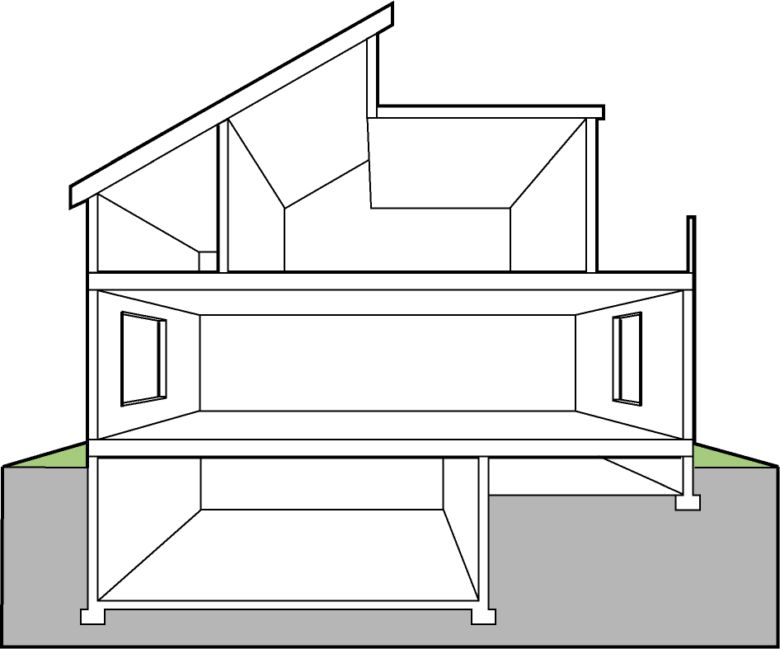
Building Envelope Specific Requirements
Building Thermal Envelope consists of:
Fenestration
Ceilings
Walls
Above grade
Below grade
Mass walls
Floors
Slabs
Crawlspaces
Exceptions:
Low energy usage
< 3.4 Btu/h/sq.ft. OR
1 watt/sq.ft. of floor area OR
unconditioned spaces OR
log homes designed in accordance with ICC 400
attic
Conditioned Space
Notes:
Most IECC requirements for residential buildings are for the Building Thermal Envelope as highlighted in orange on the diagram
The Building Thermal Envelope separates conditioned space from the outdoors and unconditioned spaces such as attics and garages
Fenestration is covered in this section.

Slide 23
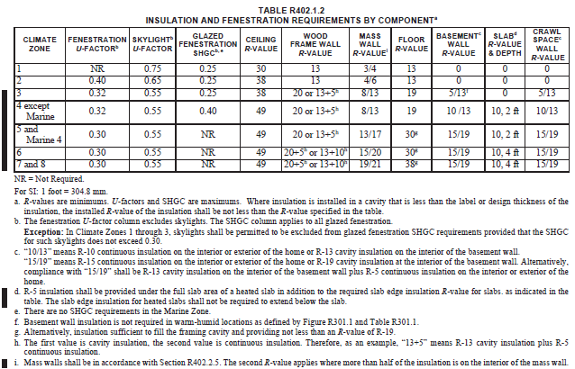
Insulation and Fenestration Requirements by Climate Zone
Notes:
Referred to as “R-value Table”, but note that there are more than “R-values” in the table (e.g., U-factors, SHGC).
Climate Zones 7 and 8 are combined in the table. Each column is a building component.
Note: Most of the tables have footnotes which can also contain requirements.

Slide 24
Tropical Zone Section R401.2.1
Buildings deemed to comply at elevation < 2,400 feet above sea level where the following conditions are met:
< ½ space is air conditioned
Occupied space is not heated
> 80% solar, wind, or other renewable energy source supplies service water heating
SHGC on fenestration < 0.40 or overhang projection factor > 0.30
Lighting in accordance with R404
Exterior roof complies with Table C402.2.11 (commercial cool roof) or insulation of > R-15, if present, attics above insulation are vented and attics below insulation unvented
Roof surface slope of not less than ¼ unit vertical in 12 units horizontal (i.e., 1/48 or 2.1% [code says 21%])
Notes:
Minimum roof slope requirement did not change between 2015 and 2018, but the text was "clarified," and in the process an error/ambiguity inserted.

Slide 25
Tropical Zone Section R401.2.1 Continued
Operable fenestration provides ventilation of not less than 14% of floor area for each room or equivalent ventilation is provided by a ventilation fan
Bedrooms with 2 exterior walls facing different directions have operable fenestration
Interior doors to bedrooms capable of being secured open
Ceiling fan or rough-in provided for bedrooms and the largest space that is not used as a bedroom

Slide 26
Fenestration Sections R303.1.3/R402.3
Doors and windows
NFRC rating or default table
If no labeled U-factor and SHGC, use default table
No glass area limits
Exemptions
Not greater than15 ft² of glazing per dwelling unit (Section R402.3.3)
One side-hinged opaque door assembly not greater than 24 ft² (Section R402.3.4)
Notes:
Default values are very conservative and should only be used if absolutely necessary.
These exemptions relate to U-factors, not R-values, but they are specifically excluded from applying to the U and UA paths (both of which are "prescriptive"). Here's how it is:
1) The exceptions apply to R402.1.2.
2) The exceptions DO NOT apply to R402.1.4 and R402.1.5.
3) The only thing left is R402.1.3, which is titled "R-value computation".

Slide 27
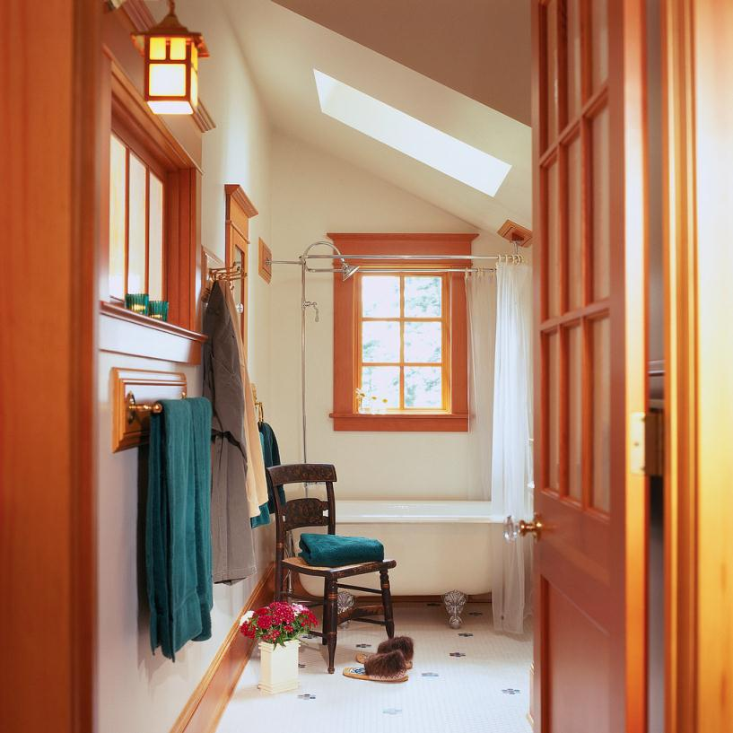
Skylights Section R402.3
Meet U-factor
Meet SHGC
Notes:
Skylights have to meet U and SHGC requirements, but those are different from other fenestration requirements. Maybe should point that out? (Per footnote 'b' of Table R402.1.2., the fenestration u-factor does exclude skylights, there is a stand alone skylight U-factor column, and the SHGC column applies to all fenestration, the exception for skylights is they may be excluded from the glazed fenestration SHGC requirements in climate zones 1-3 if the SHGC does not exceed 0.30)

Slide 28
Fenestration Sections R402.3.1/R402.3.2 - Area-weighted Average
Can be used to satisfy U-factor and SHGC requirements
Subject to hard limits, even in trade-offs
Notes:
SHGC: An area-weighted average of fenestration products > 50% glazed is permitted to satisfy the SHGC requirements
U-factor. An area-weighted average of fenestration products is permitted to satisfy the U-factor requirements.
Ex: if the requirement is 0.5, you could either have all windows be 0.5 or you could have half of them be 0.6 and half be 0.4 and they’d average out to 0.5 and would comply. Multiply each window’s U-factor by its particular area, sum up all the products, divide by total glazing area and get area-weighted average U-factor.

Slide 29
Fenestration Section R402.3.2 – Dynamic Glazing
Dynamic glazing
Ratio of higher to lower labeled SHGC > 2.4
Automatically controlled to modulate amount of solar gain into space in multiple steps
Shall be considered separately from other fenestration (area weighted average)
Exception – not required to comply when both high and low rated SHGC meet Table R402.1.2

Slide 30
Building Envelope Specific Requirements
Building Envelope consists of:
Fenestration
Ceilings
Walls
Above grade
Below grade
Mass walls
Floors
Slabs
Crawlspaces
attic
Conditioned Space
Notes:
Ceilings are covered in this section.

Slide 31
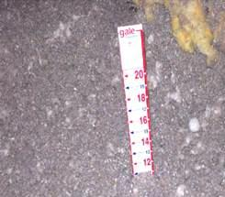
Ceilings Section R303.1
R-values are to be printed on the batt insulation or rigid foam board.
Blown-in insulation must have an insulation certificate at or near the opening of the attic.
The certificate should include:
R-value of installed thickness
Initial installed thickness
Installed density
Settled thickness/settled R-value
Coverage area
Number of bags installed
Insulation markers must be installed every 300 square feet and be marked with the minimum installed thickness and affixed to the trusses or joists.

Slide 32
Ceilings
Requirements based on
Assembly type
Continuous insulation
Insulation between framing (cavity insulation)
Meet or exceed R-values
Notes:
R-values for roofs represent either cavity insulation (between framing) or insulating sheathing (continuous insulation).

Slide 33
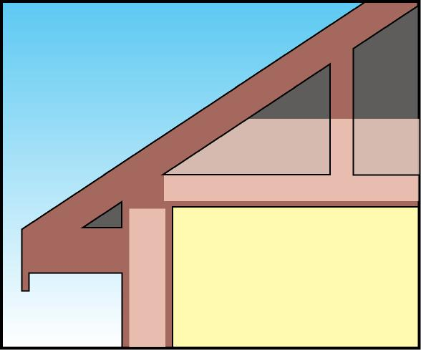
Ceilings with Attics Section R402.2.1
Ceiling insulation requirements in R-value table assume standard truss systems
Possibility of ice dam formations
Insulation
Cold corners contribute to condensation and mold growth in some locations
Insulation
Notes:
Roof insulation in buildings with attics must be installed to allow for free circulation of air through the attic eave vents.
Typically, when blowing in insulation into a standard roof truss system, the insulation will taper as it reaches the exterior wall plate lines. This is due to the slope of the truss and also the baffle that directs ventilation air up and over the insulation from the eave vents. The R-value listed in the Prescriptive Building Envelope table assumes a standard roof truss system, but credit can be taken if insulation is allowed to be installed full height over the exterior wall plate line. The credit is in a reduced insulation R-value.
The use of standard truss systems can cause cold corners and also contribute to ice dam formations. As heat from the house melts snow on the roof right at the corner, melted snow runs down onto the eave where it refreezes and builds up a dam that can push water back underneath the shingles.

Slide 34
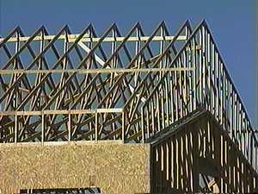
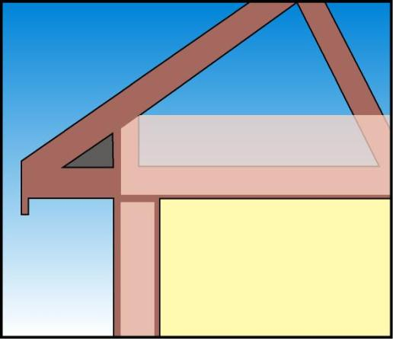
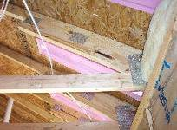
Ceilings with Attics, Cont’d. Section R402.2.1
Insulation at full thickness over
exterior
walls
Insulation
Insulation
Prescriptive R-value path encourages
raised heel truss (aka, energy truss)
If insulation is full height uncompressed over exterior wall top plate, covering 100% of ceiling area
R-30 complies where R-38 is required
R-38 complies where R-49 is required
Note: This reduction ONLY applies to the R-value prescriptive path, not the U-factor or Total UA alternatives
Notes:
Anywhere the prescriptive requirement is R-38, R-30 can be used if using a raised heel truss that gives you full thickness all the way out over the wall.
If prescriptive requirement is R-49, R-38 can be used in a raised heel truss system.
This can also be accomplished by using either an oversized truss or by installing insulation with a higher R-value per inch thickness, such as rigid board insulation. Typically fiberglass batt insulation can be installed over the exterior wall plate line to the desired R-value, and the remaining attic can utilize blown-in insulation.
This only applies to the R-value prescriptive path because the U-factor table accounts for lack of insulation at those corners automatically.

Slide 35
Ceilings without Attic Spaces Section R402.2.2 - (e.g., vaulted)
If insulation is full height uncompressed over exterior wall top plate
R-30 allowed for up to 500 ft² or 20% total insulated ceiling area, whichever is less, where
Required insulation levels exceed R-30
Design of roof/ceiling assembly does not provide sufficient amount of space to meet higher levels
Note: This reduction ONLY applies to the R-value prescriptive path, not the U-factor or Total UA alternatives
Notes:
Typically vaulted ceiling or cathedral ceiling
If vaulted ceiling has a requirement of > R-30, but rafters or trusses can’t accommodate that, you can comply with not more than R-30 up to 500 sf or 20% of total insulated ceiling area, whichever is less.
Ex: If you have a small vaulted ceiling area over the entryway and because it’s small, it has relatively small framing members above and you’re in the North where R-38 is required, code will allow R-30. So, you don’t have to redesign the structure just to accommodate R-38 as long as the area is < 500 sf or 20% of ceiling area.

Slide 36
Eave Baffle Section R402.2.3
For air permeable insulations in vented attics, a baffle shall be installed
Adjacent to soffit and eave vents
To maintain an opening ≥ size of vent
To extend over top of attic insulation
May be of any solid material
Notes:
Note: the code doesn't say how far the baffle must extend over the top of the insulation.

Slide 37
Steel-Frame Ceilings Section R402.2.6
Table R402.2.6 Steel-Frame Ceiling, Wall and Floor Insulation
(R-Value)
Table keys on the wood-frame requirement for the corresponding building component
Wood Frame R-value Requirement
Cold-Formed Steel
Equivalent R-valueª
Steel Truss Ceilings^{b}
R-30
R-38 or R-30 + 3 or R-26 + 5
R-38
R-49 or R-38 + 3
“R-X + R-Y” means R-X cavity plus R-Y continuous
In ceilings, insulation that exceeds the height of the framing must cover the framing
R-49
R-38 + 5
Steel Joist Ceilings^{b}
R-30
R-38 in 2x4, or 2x6, or 2x8
R-49 in any framing
R-38
R-49 2x4, or 2x6, or 2x8, or 2x10
Steel Framed Wall, 16 inches on center
R-13
R-13 + 4.2 or R-21 +2.8, or R-0+9.3 or R-15+R-3.8 or R-21 + 3.1
R-13+3
R-0 + 11.2 or R-13 +6.1, or R-15 +5.7 or R-19+5.0 or R-21+4.7

Slide 38
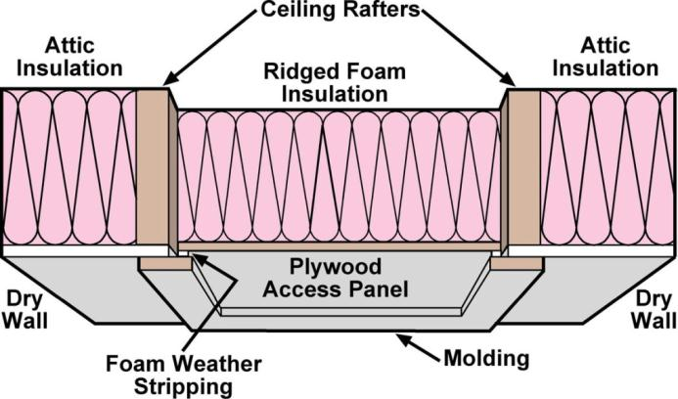
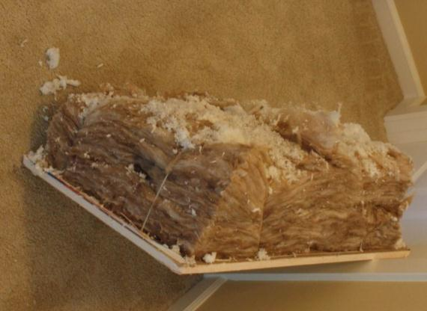
Access Hatches and Doors Section R402.2.4 - Prescriptive
Weatherstrip and insulate doors from conditioned spaces to unconditioned spaces (e.g., attics and crawl spaces)
Insulate to level equivalent to surrounding surfaces
e.g., required ceiling insulation = R-38, then attic hatch must be insulated to R-38
Provide access to all equipment that prevents damaging or compressing the insulation
Install a wood framed or equivalent baffle or retainer when loose fill insulation is installed
Exception:
Vertical doors
that provide access
can meet
Table R402.1.2
Notes:
The baffle prevents the loose fill insulation from spilling into the living space when the attic access is opened and provides a permanent means of maintaining the installed R-value of the loose fill insulation. Foam board works well.
Ex: if you have an access hatch into an attic with R-38, the hatch itself has to be insulated to R-38 with a baffle or wall retainer to hold the loose fill insulation away from that opening when it’s opened.
Access to equipment example - You can’t just blow insulation all around the air handler, you have to build a platform up to the air handler that’s over the insulation.

Slide 39
Building Envelope Specific Requirements
Building Envelope consists of:
Fenestration
Ceilings
Walls
Above grade
Below grade
Mass walls
Fenestration
Floors
Slabs
Crawlspaces
attic
Conditioned Space
Notes:
Walls are covered in this section.

Slide 40
Walls Covered by IECC
Exterior above-grade walls
Attic kneewalls
Skylight shaft walls
Perimeter joists
Basement walls
Garage walls (shared with conditioned space)

Slide 41
Above Grade Walls
Insulate walls including those
next to unconditioned spaces
Don’t forget to insulate rim joists
Notes:
Insulation should not be compressed behind the wiring or plumbing; this reduces the R-value of insulation.
Be sure the insulation has filled the entire cavity; batts that are cut too short will leave voids.
For continuous insulation make sure there are no voids and the insulation is well bonded to the outside framing.
Perimeter joists between floors must be insulated. Ex: 8 ft wall becomes a 9 ft wall.
While not a requirement, in some climates it is important to insulate exterior corners and on or in headers over doors and windows to eliminate heat transfer through the surfaces.

Slide 42
Wood-Frame Walls Section R402
Table R402.1.2 INSULATION AND FENESTRATION REQUIREMENTS BY COMPONENT
CLIMATE ZONE | … | WOOD FRAME WALL R-VALUE
1 |  | 13
2 |  | 13
3 |  | 20 or 13+5^{h}
4 except Marine |  | 20 or 13+5^{h}
5 and Marine 4 |  | 20 or 13+5^{h}
6 |  | 20+5 or 13+10^{h}
7 and 8 |  | 20+5 or 13+10^{h}
h. First value is cavity insulation, second is continuous insulation so. Therefore, as an example, “13+5” means R-13 cavity insulation plus R-5 continuous insulation
Notes:
Partial table shown

Slide 43
Walls – Insulated Siding Section R303.1
R-value labeled on product package
Indicated on certification
Installer signature and date
Posted on site in conspicuous location
Thermal resistance (R-value) determined in accordance with ASTM C 1363

Slide 44
Steel-Frame Walls Section R402.2.6
Table R402.2.6 Steel-Frame Ceiling, Wall and Floor Insulation
(R-Value)
Wood Frame R-value Requirement
Cold-Formed Steel
Equivalent R-valueª
“R-X + R-Y” means R-X cavity plus R-Y continuous
Steel Truss Ceilings^{b}
R-30
R-38 or R-30 + 3 or R-26 + 5
R-38
R-49 or R-38 + 3
R-49
R-38 + 5
Table keys on the wood-frame requirement for the corresponding building component
Steel Joist Ceilings^{b}
R-30
R-38 in 2x4, or 2x6, or 2x8
R-49 any framing
R-38
R-49 2x4, or 2x6, or 2x8, or 2x10
Steel Framed Wall
R-13
R-13 + 4.2 or R-19 +2.1, or R-21 +2.8 or R-0+9.3 or R-15+R-3.8 or R-21 + 3.1
R-13+R-3
R-0 + 11.2 or R-13 +6.1, or R-15 +5.7 or R-19+5.0 or R-21+4.7
Notes:
Metal framing provides a more effective path for heat transmission than wood stud wall construction.
R-X+Y means RX cavity insulation plus R-Y continuous insulation (example R-26+5).
In ceilings, insulation that exceeds the height of the framing must cover the framing.
Steel framed assemblies shall meet the insulation requirements in Table R402.2.6 OR
the U-factor requirements in the U-factor Table R402.1.4 for Frame Walls and use a series-parallel path calculation method.

Slide 45
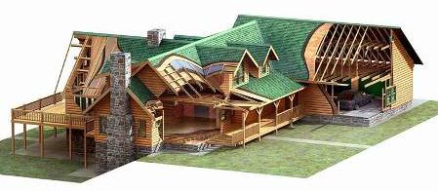
Mass Walls Section R402.2.5
What type
Concrete block, concrete, insulated concrete form (ICF), masonry cavity, brick (other than brick veneer), adobe, compressed earth block, rammed earth, and solid timber/logs
Any other walls having a heat capacity >6 Btu/ft.²/ºF
Provisions
Are assumed to be above grade walls
Notes:
“Earth” includes adobe, compressed earth block, and rammed earth.
Mass walls have sufficient mass that they’re able to store a significant amount of heat in the all itself. Special requirements acknowledge that storage ability can improve the performance of the wall in terms of energy, especially in southern locations for cooling purposes.

Slide 46
Mass Wall Requirements Section R402.2.5
Table R402.1.2 INSULATION AND FENESTRATION REQUIREMENTS BY COMPONENT
CLIMATE ZONE | … | MASS WALL R-VALUE^{i}
1 |  | 3/4
2 |  | 4/6
3 |  | 8/13
4 except Marine |  | 8/13
5 and Marine 4 |  | 13/17
6 |  | 15/20
7 and 8 |  | 19/21
Second (higher) number applies when more than half the R-value is on the interior of the mass (i.e., when the thermal mass is insulated from the conditioned space)
Notes:
Partial table shown
Means that thermally massive walls lose a lot of their advantage when you insulate the building from them.
So, it’s much better from an energy standpoint to have insulation on the outside of a thermally massive wall than it is to have it on the inside. If you have most of the insulation on the inside, you have to have a little more of it.

Slide 47
Walls with Partial Structural Sheathing Section R402.2.7
If structural sheathing covers <40% of gross wall area
The continuous insulation R-value can be reduced by as much as R-3 if necessary to result in a consistent total sheathing thickness on areas of walls covered by structural sheathing
This reduction does not apply to the U-factor alternative or Total UA alternative
Notes:
In other words,
*If* structural sheathing covers not more than 40% of the gross wall area
Then it is permitted that
The >60% has the full required insulating sheathing R-value
The ≤40% has “sandwiched” structural and insulating sheathing with summed thickness equal to that of the full insulating sheathing
*Provided* that the R-value of the insulating sheathing sandwiched over the structural sheathing is not reduced by any more than R-3 compared to the full-thickness insulating sheathing.

Slide 48
Building Envelope Specific Requirements
Building Envelope consists of:
Fenestration
Ceilings
Walls
Above grade
Below grade
Mass walls
Floors
Slabs
Crawlspaces
attic
Conditioned Space
Notes:
Floors are covered in this section.

Slide 49
Floors Over Unconditioned Space Section R402.2.8
Table R402.1.2 INSULATION AND FENESTRATION REQUIREMENTS BY COMPONENT
CLIMATE ZONE | … | FLOOR R-VALUE
1 |  | 13
2 |  | 13
3 |  | 19
4 except Marine |  | 19
5 and Marine 4 |  | 30^{g}
6 |  | 30^{g}
7 and 8 |  | 38^{g}
Exception: If framing members are too small to accommodate R-30, insulation that fills the framing cavity, not less than R-19, complies
Notes:
Partial table shown
Ex: R-19 fits in a 8” framing member; R-30 requires a 10” framing member. Insulation cannot be compressed and must be installed according to manufacturer’s installation instructions.

Slide 50
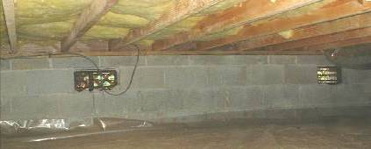
Floors (Over Unconditioned Space) Section 402.2.8
Unconditioned space includes unheated basement, vented crawlspace, or outdoor air
Climate Zones | R-Value
1-2 | 13
3-4ab | 19
4c-6 | 30*
7-8 | 38*
Exception: cavity insulation in contact with the topside of sheathing or continuous insulation installed on the bottom of floor framing where combined with insulation that meets or exceeds Table R402.1.2 requirements for wood frame walls and that extends from bottom to the top of all perimeter floor framing members
Insulation must maintain permanent contact with underside of subfloor
* Exception
Climate Zones 4c-8 R-19 permitted if cavity completely filled
Notes:
Building Thermal Envelope: the basement walls, exterior walls, floor, roof, and any other building element that enclose conditioned space. This boundary also includes the boundary between conditioned space and any exempt or unconditioned space.
If insulation in the floor framing members doesn’t fill the cavity, the gap can’t be against the underside of the sub floor. Insulation must be pushed up to be in substantial contact with the sub floor and held by some means. This is to prevent airflow up above the insulation, which could short circuit its insulating ability. HOWEVER, the exception above allows an alternative if there is sheathing or rigid insulation under the floor and (…see the exception on the slide)

Slide 51
Steel-Frame Floors Section R402.2.6
Table R402.2.6 Steel-Frame Ceiling, Wall and Floor Insulation
(R-Value)
Wood Frame R-value Requirement
Cold-Formed Steel-Frame
Equivalent R-valueª
Table keys on the wood-frame requirement for the corresponding building component
Steel Joist Floor^{b}
R-13
R-19 in 2x6, or R-19 + 6 in 2x8 or 2x10
R-19
R-19 + 6 in 2x6, or R-19 + 12 in 2x8 or 2x10
“R-X + R-Y” means R-X cavity plus R-Y continuous
Notes:
Metal framing provides a more effective path for heat transmission than wood stud wall construction.
R-X+Y means R-X cavity insulation plus R-Y continuous insulation (example R-26+5).
Steel framed assemblies shall meet the insulation requirements in Table R402.2.6 OR
the U-factor requirements in the U-factor Table R402.1.4 for Frame Walls and use a series-parallel path calculation method.

Slide 52
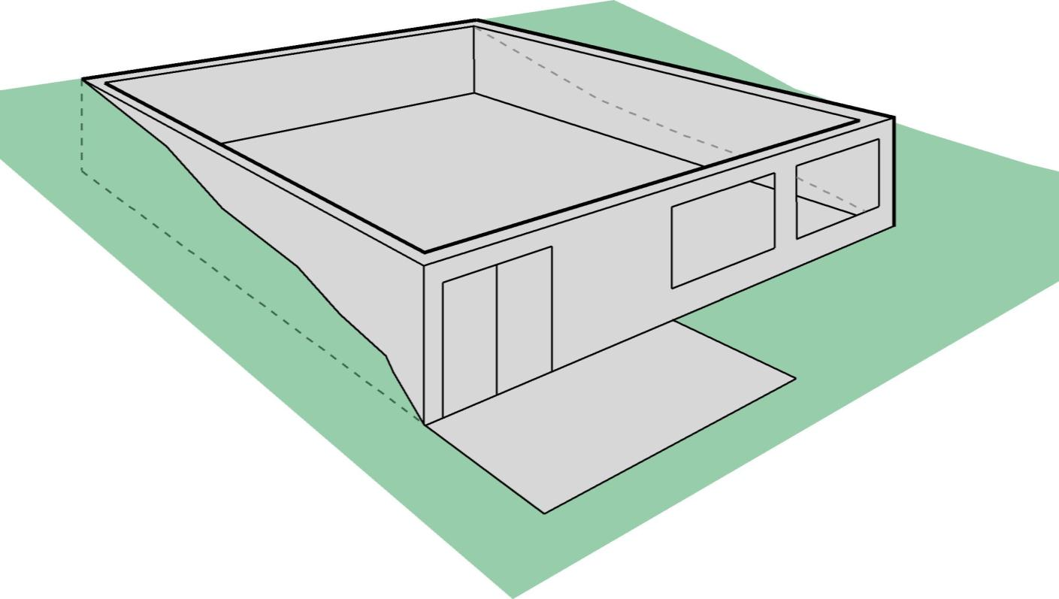
Defining Below-Grade Walls
Basement Wall – >50% below grade
Below grade
Basement wall
Exterior Wall –
<50% below grade
Notes:
Define each wall individually.
If the grade is sloping, the average height of the grade of the wall should be used to determine whether it’s a below-grade or above-grade wall.
Back wall = below grade requirements
Front wall = above grade requirements
Side walls = could be either; best if plans specify where the backfill will go and how much of the wall will be buried.

Slide 53
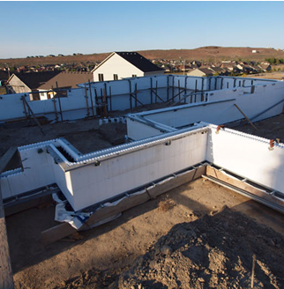
Below-Grade Walls
≥ 50% below grade
Otherwise treat as above-grade wall
Climate Zones | R-Value
1-2 | 0
3 | 5/13
4ab | 10/13
4c-8 | 15/19
Insulated from top of basement wall down to 10 ft below grade or basement floor, whichever is less
Notes:
Where 50% or more of a wall assembly is below grade (based on exterior surface area), the below-grade wall requirement from the Envelope Requirements may be used for the entire assembly. Insulation R-values from Table R402 1.2 are considered full height of the basement wall.
Below-grade wall insulation must extend from the top of the basement down to 10 feet below grade or to the basement floor, whichever is less.
Walls associated with unconditioned basements must meet the requirements unless the floor above the basement is insulated accordingly.

Slide 54
Basement Walls Section R402.2.9
Table R402.1.2 INSULATION AND FENESTRATION REQUIREMENTS BY COMPONENT
CLIMATE ZONE | … | FLOOR R-VALUE | BASEMENT^{c} WALL R-VALUE
1 |  | 13 | 0
2 |  | 13 | 0
3 |  | 19 | 5/13^{f}
4 except Marine |  | 19 | 10/13
5 and Marine 4 |  | 30^{g} | 15/19
6 |  | 30^{g} | 15/19
7 and 8 |  | 38^{g} | 15/19
“X/Y” means R-X continuous or R-Y cavity
15/19 requirement can be met with R-13 cavity (interior) plus R-5 continuous (exterior)
In zone 3, no insulation required in warm-humid counties (footnote f)
Notes:
Partial table shown
Ex: R-5/13 means R-5 continuous – typically foam board mounted on the outside of the foundation wall against the dirt. 13 refers to cavity if you’ve furred and finished the inside of the basement wall and put insulation between framing members.

Slide 55
Building Envelope Specific Requirements
Building Envelope consists of:
Fenestration
Ceilings
Walls
Above grade
Below grade
Mass walls
Floors
Slabs
Crawlspaces
attic
Conditioned Space
Notes:
Slabs are covered in this section.

Slide 56
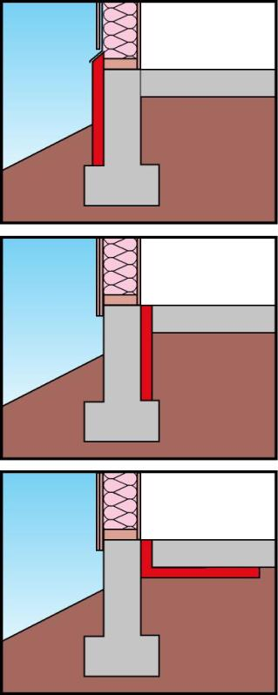
Slab Edge Insulation Section R402.2.10
Applies to slabs with a floor surface < 12 inches below grade
R-10 (typically 2 inches) insulation in Zones 4 and above
Must extend downward from top of slab a minimum of 24” (Zones 4 and 5) or 48” (Zones 6, 7, and 8)
Insulation can be vertical or extend horizontally under the slab or out from the building
Insulation extending outward must be under 10 inches of soil or pavement
An additional R-5 is required for heated slabs
Insulation to depth of the footing or 2 feet, whichever is less in Zones 1-3 for heated slabs
Flashing
Figure 2
Protection
Board
Slab
Rigid Insulation
Figure 3
Slab
Rigid Insulation
Figure 4
Slab
Rigid Insulation
Notes:
Slab-edge insulation may be installed vertically or horizontally on the inside or outside of foundation walls. If installed vertically, it must extend downward from the top of the slab to the top of the footing. If installed horizontally, it must cover the slab edge and then extend horizontally (to the interior or exterior). Insulation extending outward must be under 10 inches of soil or protected by pavement.
Southern zones (1-3) = No requirement
CZ 4 and 5 – need 2 feet of R-10
Northern zones (6-8) – need 4 feet of R-10
A slab more than 12” below grade doesn’t require slab edge insulation, but the wall would be considered a below-grade wall.

Slide 57
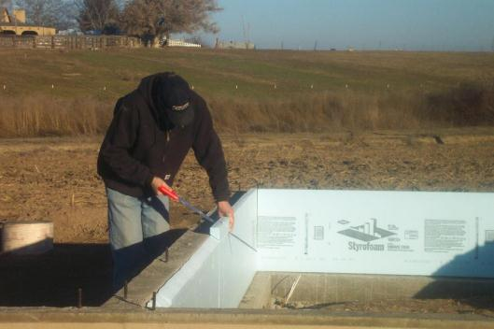
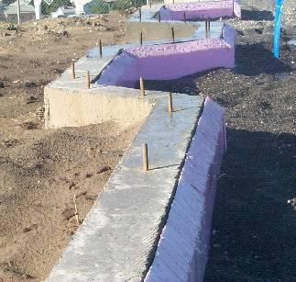
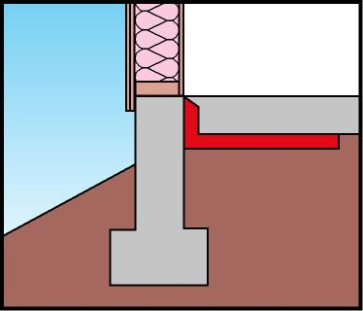
Slab Edge Insulation
Section R402.2.10
Bevel Cut
Slab
Rigid Insulation
Notes:
The top edge of the insulation installed between the exterior wall and the edge of the interior slab can be cut at a 45 degree angle away from the exterior wall.
This is an example of insulation cut at a 45-degree bevel cut this is a way to avoid bringing the insulation to the top of the slab edge so a carpet tack strip can be attached.
Insulation is not required where the code official deems termite infestation to be very heavy.

Slide 58
Building Envelope Specific Requirements
Building Envelope consists of:
Fenestration
Ceilings
Walls
Above grade
Below grade
Mass walls
Floors
Slabs
Crawlspaces
attic
Conditioned Space
Notes:
Crawlspaces are covered in this section.

Slide 59
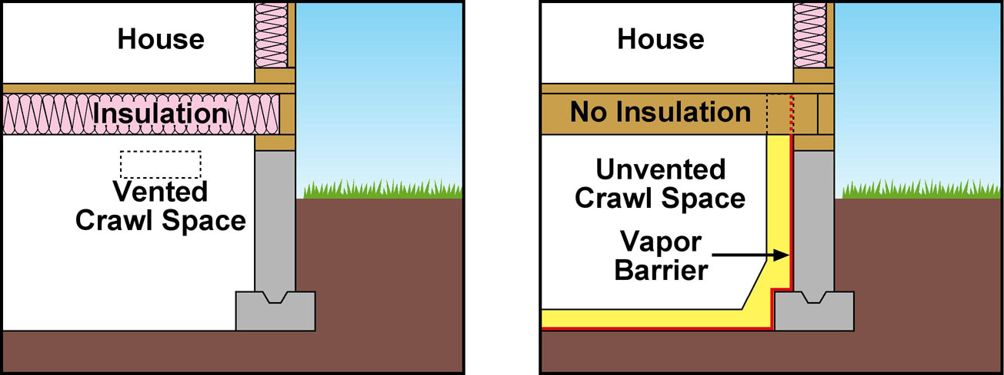
Crawlspace Wall Insulation Section R402.2.11
Implies an unvented crawlspace (aka, conditioned crawlspace)
Space must be mechanically vented or receive minimal supply air (Refer to IRC)
Exposed earth must be covered with a continuous Class I vapor retarder
Notes:
The code requires the crawl space wall insulation be permanently fastened to the wall and extend downward from the floor to the finished grade level and then vertically and/or horizontally for not less than an additional 24”.
However, there are some criteria that must be met in order to use this insulation method:
The crawlspace may not have ventilation openings that communicate directly with outside air
The crawlspace floors must be covered with vapor retarder, the joints must overlap 6” and be sealed or taped. The edges should extend at least 6” up the stem wall and be attached to the stem wall.
The crawlspace must have openings back to conditioned space.
The crawlspace floor must be covered with an approved vapor retarder material, the joints must overlap 6” and be sealed, the edges should extend at least 6” up the stem wall and attached to the stem wall.
The IRC allows the construction of unventilated crawlspaces. To meet the requirements the crawlspace walls must be insulated to the R-value specified in the energy code. The crawlspace must either be provided with conditioned air or with mechanical ventilation. The code does not specify the quantity of conditioned air to supply the crawlspace.
If mechanical ventilation is selected, the crawlspace must be ventilated at 1 CFM per 50 square feet. The ground surface must also be covered with an approved vapor retarder material. To eliminate moisture from the crawlspace the sill plate and perimeter joist must be sealed. Also, while not a code requirement, all joints in the vapor retarder should be overlapped and taped. This includes the connection between the vapor retarder and crawlspace wall.

Slide 60
Vented & Unvented Crawlspaces Section R402.2.11
Vented Crawlspace Requirements:
The raised floor over the crawlspace must be insulated.
A vapor retarder may be required as part of the floor assembly.
Ventilation openings must exist that are equal to at least 1 square foot for each 150 square feet of crawlspace area and be placed to provide cross-flow (IRC 408.1, may be less if ground vapor retarder is installed).
Ducts in crawlspace must be sealed and have R-6 insulation.
Unvented Crawlspace Requirements:
The crawlspace ground surface must be covered with an approved vapor retarder (e.g., plastic sheeting).
Crawlspace walls must be insulated to the R-value requirements specific for crawlspace walls (IECC Table R402.1.2).
Crawlspace wall insulation must extend from the top of the wall to the inside finished grade and then 24” vertically or horizontally.
Crawlspaces must be mechanically vented (1 cfm exhaust per 50 square feet) or conditioned (heated and cooled as part of the building envelope).
Ducts are inside conditioned space and therefore don’t need to be insulated.
Notes:
These are some other requirements that might pertain to the crawlspace whether it is vented or unvented. Not all of these requirements are addressed in the IECC and come from other codes such as the IRC.
Typical vented CS will have insulation on the floor over the CS, whereas unvented CS will have insulation on CS walls.
Vented CS may be required to have vapor retarder as part of floor assembly, whereas unvented will be required to have vapor retarder on ground surface underneath.
Vented CS has requirements for the openings; unvented CS must be mechanically vented one way or other, either with pure exhaust or actually bringing conditioned air in.
Ducts in vented CS must be insulated to R-6 because they’re in unconditioned space.

Slide 61
U-Factor and Total UA Alternatives Section R402.1
U-factor Alternative
Similar to Prescriptive R-Value but uses U-factors instead
Allows for innovative or less common construction techniques such as structural insulated panels or advanced framing
Allows no trade-offs between building components
Total UA Alternative
Also uses U-factors in lieu of R-values, but allows trade-offs across all envelope components
Primary approach used in REScheck software
UA – U-factor x area of assembly
Notes:
As a refresher…
U-factor table is for the entire assembly.
R-value table is only for the insulation.
UA Alternative – if the total bldg. thermal envelope UA (sum of U-factor x assembly area) is less than or equal to the total UA resulting from using the U-factor Table R402.1.4 (multiplied by the same area as in the proposed bldg.) the bldg. would be considered in compliance.
The SHGC requirements must be met in addition to UA compliance.

Slide 62
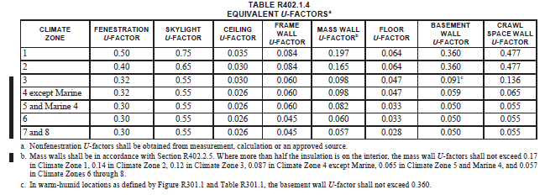
Requirements by Climate Zone U-Factor Table
Notes:
Note: SHGC values are in Table R402.1.2 and must be met regardless of this table.
Note that this table applies to assemblies whereas the previous (R-value) table applies to insulation only.

Slide 63
Mass Walls Section R402.2.5 - U-Factor
Provisions
Apply when wall heat capacity > 6 Btu/ft²/ºF
When more than half the insulation is on the interior, the mass wall U-factors
Climate Zones | U-Factor Maximum
1 | 0.197 / 0.170
2 | 0.165 / 0.140
3 | 0.098 / 0.120
4 except Marine | 0.098 / 0.087
4 Marine and 5 | 0.082 / 0.065
6 | 0.060 / 0.057
7 and 8 | 0.057 / 0.057
Notes:
The second set of values in the table on this slide come from footnote b in Table R402.1.4.
The second U-factor in the table is for interior insulated walls

Slide 64
Fenestration Trade-off Limits Section R402.5
Hard limits on U-factor in northern U.S. (cannot be exceeded, even in trade-offs or ERI path)
U-0.75 for skylights in Zones 4-8
U-factors of individual windows or skylights can be higher if area-weighted average is below these limits.
Climate Zones | U-Factor Maximum
4-5 | 0.48
6-8 | 0.40
Notes:
U-Factor is a measure of how well the assembly conducts heat. The lower the number, the better the assembly acts as an insulator.
A window U-factor is based on the interior surface area of the entire assembly, including glazing, sash, curbing, and other framing elements. Center-of-glass U-factors cannot be used.
The code requires windows, glass doors, and skylights to be rated by the National Fenestration Rating Council and to have labels that show the rated U-factor and SHGC values for the glazing unit, but allows default values from Table R303.1.3).

Slide 65
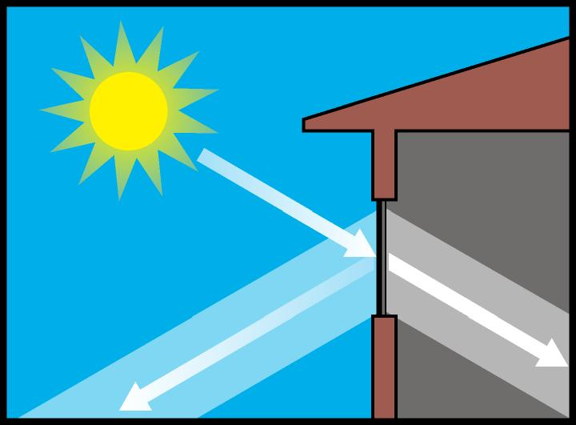
Fenestration Trade-off Limits, cont’d.
Hard limit on Solar Heat Gain Coefficient in southern U.S. (Zones 1-3)
SHGC cannot exceed 0.50, even in performance trade-offs or ERI path
SHGCs of individual windows or skylights can be higher if area-weighted average is below this limit.
Solar Heat Gain Coefficient
Notes:
SHGC is a measure of how much solar gain is transmitted through the window by solar radiation.
The lower the SHGC value of a window the less sunlight and heat can pass through the glazing.
These are based on building average; SHGC of individual windows or skylights can be higher if area-weighted average is below this limit.
In locations in climate zones 1-3, the combined SHGC (the area weighted average) of all glazed fenestration products in the building shall not exceed .50. Under no circumstances can the area-weighted average SHGC exceed 0.50 in zones 1-3, regardless of what trade-offs are used.

Slide 66
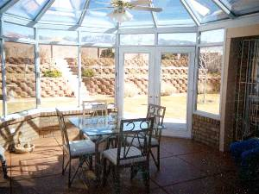
Sunrooms
Less stringent insulation
R-value and glazing
U-factor requirements
Sunroom definition:
One story structure
Glazing area >40% glazing of gross exterior wall and roof area
Separate heating or cooling system or zone
Must be thermally isolated (both HVAC and physical separation—closeable doors or windows between sunroom and rest of the house)
Can always meet Table R402.1.2 requirements with unlimited glass
Notes:
Sunroom: a one-story structure attached to a dwelling with a glazing area in excess of 40 percent of the gross area of the structure’s exterior walls and roof.
REScheck cannot be used for Sunroom compliance.
Patio and enclosure folks came up with this because cannot meet the R-value requirements. Code has “relaxed” requirements for sunrooms if certain things are true: must have separate heating or cooling system or be zoned as a separate zone and must be thermally isolated (needs to have closeable doors on windows or doors between it and the rest of the house).

Slide 67
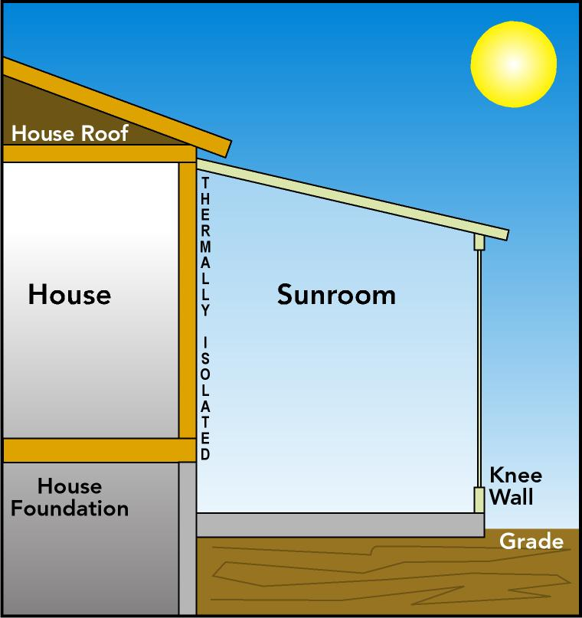
Sunroom Requirements Section R402.2.13
Ceiling Insulation
Zones 1-4 R-19
Zones 5-8 R-24
Wall Insulation
All zones R-13
Fenestration U-Factor
Zones 2-8 0.45
Skylight U-Factor
Zones 2-8 0.70
Notes:
New wall(s), windows and doors separating a sunroom from conditioned space to meet the building thermal envelope requirements.
These are prescriptive requirements and the SHGC requirements are still applicable and not less stringent, regardless of whether it is a sunroom or not.

Slide 68
Simulated Performance Alternative Section R405
Proposed design to be shown to have an annual energy cost that is less than or equal to the annual energy cost of the standard reference design
Specifications for standard reference and proposed design are in Table R504.5.2(1)
New in 2018: Allowance for batch sampling of stacked multifamily units

Slide 69
Simulated Performance Alternative
Requires computer software with specified capabilities (local official may approve other tools)
Includes both envelope and some systems
Equipment treated equally in standard and proposed design
Allows greatest flexibility
Can trade off tight duct systems
Defines compliance based on equivalency of calculated energy cost or source energy
Section R405 specifies “ground rules”
These will generally be “hidden” in compliance software calculation algorithms
Similar ground rules are used in home federal tax credits and ENERGY STAR Home guidelines
Notes:
The simulated performance alternative can be used for building designs that do not comply with all the prescriptive requirements in Chapter 4 [RE] of the IECC. Under the simulated performance alternative, a “Proposed design” will comply with the code if the calculated annual energy cost is not greater than a similar building (the “Standard design”) designed in accordance with Chapter 4 [RE].
The Proposed design uses the same energy sources, floor area, geometry, design conditions, occupancy, climate data, and usage schedule as the Standard design. Some energy-conserving strategies to improve the performance of the Proposed design include exterior shading of windows, passive solar design, thermal mass heat storage, improved thermal envelope, improved duct systems, reduced air infiltration, and high-efficiency heating, cooling, and water heating equipment.
Some cost associated with this as specialized software must be used. Code officials and others must be able to read resulting reports.

Slide 70
Energy Rating Index Section R406
First included in the 2015 IECC, ERI path differs from the traditional prescriptive and performance paths
Unlike the performance path, is not based on the prescriptive requirements
Fundamental requirement is a single rating (ERI) based on ANSI/RESNET/ICC 301-2014
Mandatory provisions of the code must be met
Exception: Ducts not completely inside the building thermal envelope must be insulated to R-6 or greater
Hard limit: Envelope must meet minimum requirements of the 2009 IECC
Notes:
ANSI/RESNET/ICC 301-2014 has ventilation rate based on ASHRAE 62.2. This rate is replaced in the IECC by a value consistent with the IRC (M1507.3.3).

Slide 71
Energy Rating Index (Compliance Alternative) Section R406
Compliance with this method must be completed by an approved third party and documentation including compliance reports must be reviewed by the code official
Compliance is demonstrated if the calculated ERI is ≤ a defined threshold for the zone in which the building is located
Notes:
ERI -

Slide 72
Energy Rating Index Section R406
Table R406.4
Maximum Energy Rating Index
Climate Zone | ERIª
1 | 57
2 | 57
3 | 57
4 | 62
5 | 61
6 | 61
7 | 58
8 | 58
Notes:
Footnote: Where on-site renewable energy is included for compliance using the ERI analysis of Section R406.4, building to meet mandatory requirements in R406.2, and the building envelope is to be greater than or equal to the efficiency levels and SHGC in Table R402.1.2 or Table R402.1.4 of the 2015 IECC.

Slide 73
Energy Rating Index Section R406
ERI is determined in accordance with ANSI/RESNET/ICC 301-2014
Except for buildings covered by IRC, the ERI Reference Design Ventilation rate is changed from 301's spec:
Equation 4-1
Ventilation rate, CFM = (0.01 x total square foot area of house) + [7.5 x (number of bedrooms + 1)]
Energy used to recharge or refuel a vehicle used for transportation on roads not on the building site not included in ERI reference design or rated design

Slide 74
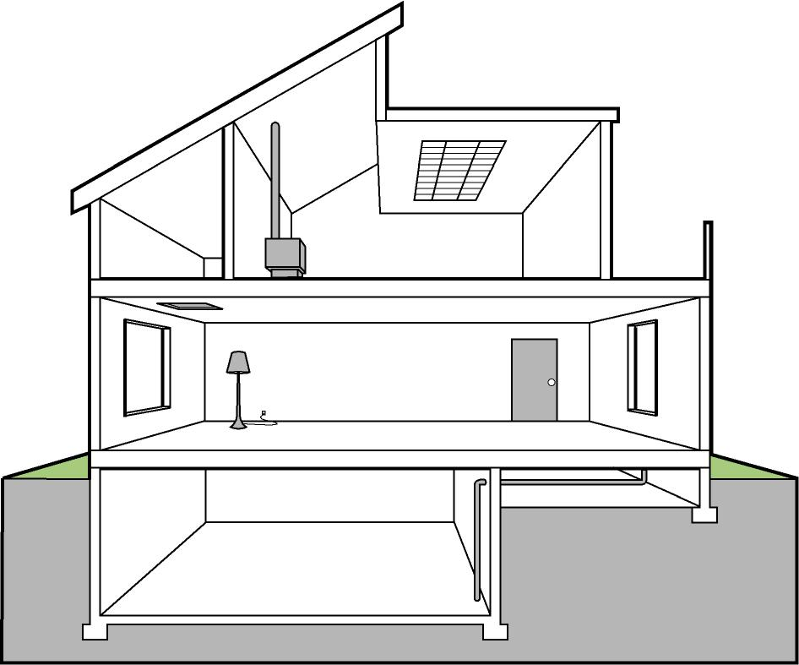
Mandatory Requirements Section R402.4 - Air Leakage
Building thermal envelope (Section R402.4.1)
Recessed lighting
Fenestration
Fireplaces
Rooms with
fuel burning
appliances
Ceiling
Chimney
Lights
Penetrations
Attic Hatch
Window
Exterior
Door
Floor
Wiring
Foundation
Plumbing

Slide 75
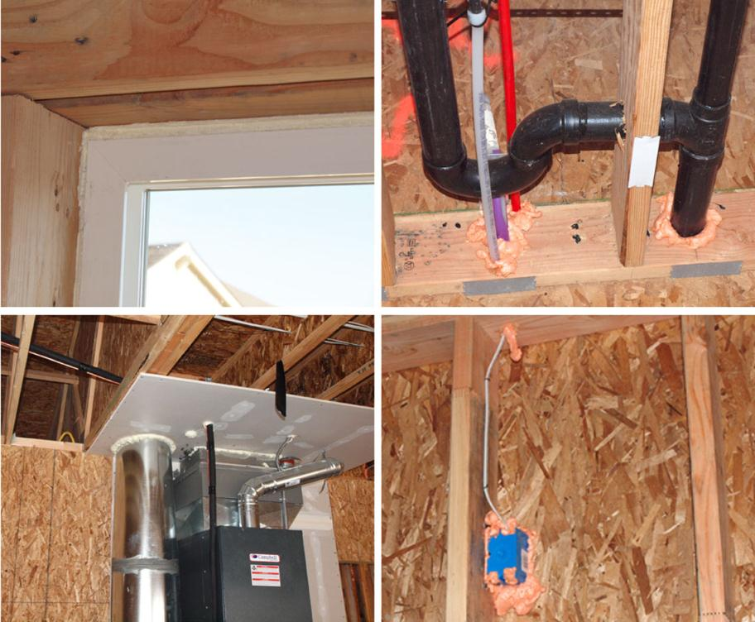
Air Leakage Control Section R402.4.1
Building thermal envelope
Notes:
The sealing methods between dissimilar materials shall allow for differential expansion and contraction.

Slide 76
Building Thermal Envelope Section R402.4.1 – Air Leakage
Requires BOTH:
Whole-house pressure test
Testing may occur any time after creation of all building envelope penetrations
Field verification of items listed in Table R402.5.1.1
Air Leakage Rate | Climate Zone | Test Pressure
≤ 5 ACH | 1-2 | 50 Pascals
≤ 3 ACH | 3-8 | 50 Pascals
Notes:
Two options: whole house pressure test with a blower door system to make sure that the envelope leakage isn’t more than what’s expected OR use a fairly thorough checklist from the code
Whole-house pressure test section includes instructions for setting up. For example: Exterior windows and doors, fireplace and stove doors to be closed but not sealed.
Field verification states that the code official can require an approved party, independent from the insulation installer, inspect the air barrier and insulation.

Slide 77
Table R402.4.1.1
Component | Air Barrier Criteria | Insulation Installation Criteria
General requirements | A continuous air barrier shall be installed in the building envelope. The exterior thermal envelope contains a continuous air barrier. Breaks or joints in the air barrier shall be sealed. | Air-permeable insulation shall not be used as a sealing material.
Ceiling/attic | The air barrier in any dropped ceiling or soffit shall be aligned with the insulation and any gaps in the air barrier sealed. Access openings, drop down stair or knee wall doors to unconditioned attic spaces shall be sealed. | The insulation in any dropped ceiling/soffit shall be aligned with the air barrier.
Walls | The junction of the foundation and sill plate shall be sealed. The junction of the top plate and the top of exterior walls shall be sealed. Knee walls shall be sealed. | Cavities within corners and headers of frame walls shall be insulated by completely filling the cavity with a material having a thermal resistance R-value of not less than R-3 per inch. Exterior thermal envelope insulation for framed walls shall be installed in substantial contact and continuous alignment with the air barrier.
Windows, skylights and doors | The space between framing and skylights and the jambs of windows and doors shall be sealed.
(partial table)
Notes:
This is only a part of Table R402.4.1.1

Slide 78
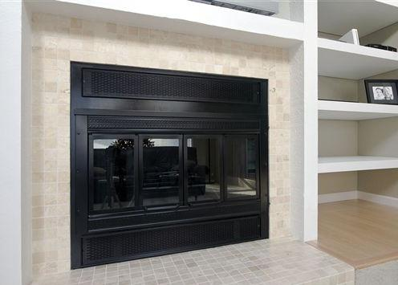
Fireplaces Section R402.4.2
New wood-burning fireplaces shall have tight fitting flue dampers or doors, and outdoor combustion air
Tight fitting doors on fireplaces that are:
Factory built – listed and labeled per UL 127

Slide 79
Fenestration Air Leakage Section R402.4.3
TYPE | AIR INFILTRATION RATE
Windows, sliding glass doors, and skylights | 0.3 cfm/ft²
Swinging doors | 0.5 cfm/ft²
Exceptions
Site-built windows, skylights, and doors
Notes:
Tested to NFRC 400 or AAMA/WDMA/CSA 101/ 1.S.2/A440

Slide 80
Rooms with fuel burning appliances Section R402.4.4
Climate Zones 3-8
Open combustion fuel burning appliances where open combustion air ducts provide combustion air
The appliances and combustion air opening shall be located outside the building thermal envelope OR
Enclosed in a room isolated from inside the thermal envelope
Sealed and insulated per Table R402.1.2
Door gasketed and sealed
Any ducts or water lines insulated per R403
Combustion air duct insulated to an R-value of not less than R-8 where it passes through conditioned space
Exceptions:
Direct vent appliances with both intake and exhaust pipes installed continuous to outside
Fireplaces and stoves complying with R402.4.2 and Section R1006-IRC
Notes:
Rooms insulated per Table R402.1.2 where the walls, floors, and ceilings shall meet not less than the basement wall R-value requirement

Slide 81
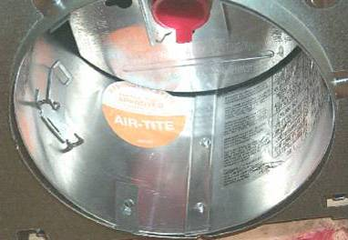
Recessed Lighting Fixtures Section R402.4.5
Type IC rated and labeled as meeting ASTM E 283 when tested at 1.57 psf (75 Pa) pressure differential with no more than 2.0 cfm of air movement
Sealed with a gasket or caulk between the housing and interior wall or ceiling covering
Notes:
When installed in the building envelope, recessed lighting fixtures shall meet one of these requirements.
IC means “insulation contact.” Another designation label you might encounter is Air-Lok.
Type IC rated in accordance with ASTM E 283 admitting no more than 2.0 cfm of air movement from the conditioned space to the ceiling cavity.

Slide 82
Mechanical Systems & Equipment
Equipment efficiency set by Federal law, not the I-Codes
Notes:
Not really dealt with directly in the IECC because Federal law establishes minimum efficiencies and those Federal requirements preempt any state or local building codes.

Slide 83
Requirements for Systems Section R403
Controls
Heat pump supplementary heat
Hot water boiler outdoor temperature setback
Ducts
Sealing (Mandatory)
Insulation (Prescriptive)
HVAC piping insulation
Hot water systems
Ventilation
Dampers
Equipment sizing
Systems serving multiple dwelling units
Snow melt controls
Pools and in-ground permanently installed spas

Slide 84
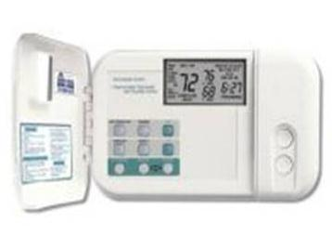
Programmable Thermostat Section R403.1.1 - Controls
At least one programmable thermostat controlling the primary heating/cooling per dwelling unit
Capability to set back or temporarily operate the system to maintain zone temperatures
Not less than 55ºF (13ºC) or
Not greater than 85ºF (29ºC)
Initially programmed
by manufacturer with:
heating temperature set point not greater than 70ºF (21ºC) and
cooling temperature set point not less than 78ºF (26ºC)
Notes:
Programmable thermostat capable of controlling the heating and cooling system on a daily schedule to maintain different set points at different times of the day.

Slide 85
Heat Pump Supplementary Heat Section R403.1.2 - Controls
Prevent supplementary electric-resistance heat when heat pump can meet the heating load
Exception
During defrost
Notes:
Heat pumps having supplementary electric resistance heat to have controls that except during defrost, prevent supplemental heat operation when the heat pump compressor can meet the heating load.

Slide 86
Hot Water Boiler Outdoor Temp. Setback Section R403.2
One- or two-pipe heating systems must have an outdoor setback control to decrease boiler temperature based on outdoor temperature
Notes:
Might be worth noting that the code doesn’t say how the boiler setpoint varies with outdoor temperature, just that it does.
The point of this code requirement is that the boiler setpoint must be controlled in response to outdoor temperature.

Slide 87
Duct Insulation Section R403.3.1 - Prescriptive
Supply and return ducts in attics: R-8 where > 3” diameter, R-6 if < 3”
Other areas: R-6 where > 3” diameter, R-4.2 if < 3”
Examples
Location | Duct Diameter >3” or <3”
Attic | R-8 or R-6
Conditioned Space | NR
Vented Crawlspace | R-6 or R-4.2
Conditioned Crawlspace | NR
Basement – Conditioned | NR
Basement – Unconditioned | R-6 or R-4.2
Exterior Walls | R-6 or R-4.2
Notes:
No trade-offs allowed for duct insulation.
Exception: - ducts completely inside the building envelope
NR = no requirement

Slide 88
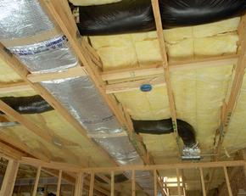
Duct Sealing Section R403.3.2 - Mandatory
Sealing (Mandatory)
Joints and seams to comply with IMC or IRC
All ducts, air handlers, and filter boxes to be sealed (Section R403.3.2.1)

Slide 89
Duct Testing Section R403.3.3 - Mandatory
Ducts shall be pressure tested to determine air leakage by either of the following:
Rough-in test
Total leakage measured with a pressure differential of 0.1 inch w.g. (25 Pa) across the system including manufacturer’s air handler enclosure
All registers taped or otherwise sealed
Postconstruction test
Total leakage measured with a pressure differential of 0.1 inch w.g. (25 Pa) across the entire system including manufacturer’s air handler enclosure
All registers taped or otherwise sealed
Exceptions
Duct air leakage test not required where ducts and air handlers are entirely within the building thermal envelope
Test not required for ducts serving heat or energy recovery ventilators not integrated with ducts serving heating or cooling systems
A written report of results of test signed by the party conducting test and provided to code official

Slide 90
Duct Leakage Section R403.3.4 - Prescriptive
Total leakage of ducts, where measured in accordance with Section 403.3.3 shall be as follows:
Rough-in test
Total leakage ≤4 cfm/per 100 ft² of conditioned floor area
if air handler not installed at time of test
Total air leakage ≤3 cfm/per 100 ft²
Postconstruction test
Total leakage ≤4 cfm/per 100 ft² of conditioned floor area
Notes:
These tests apply only if the ducts are located in unconditioned space and exist to verify the sealing has been done correctly.
Don’t have to be tested if within building envelope.

Slide 91
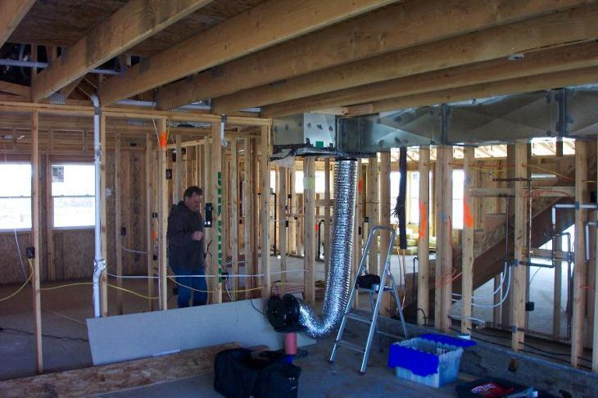
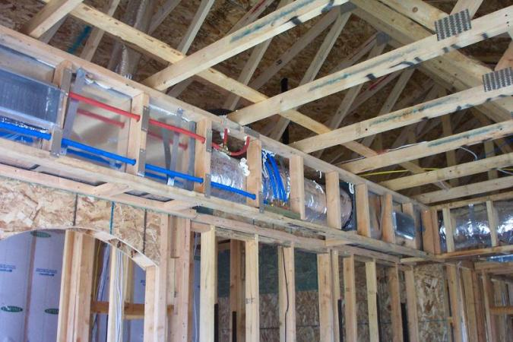
Duct Tightness Tests Section R403.3.3

Slide 92
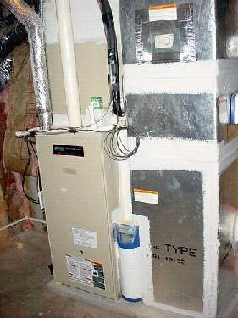
Sealed Air Handler Section R403.3.2.1 - Mandatory
Air handlers to have a manufacturer’s designation for an air leakage of ≤ 2% of design air flow rate per ASHRAE 193

Slide 93
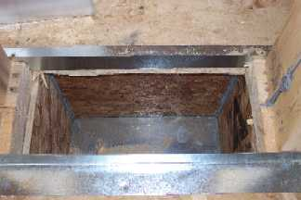
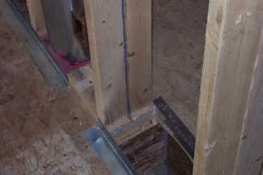
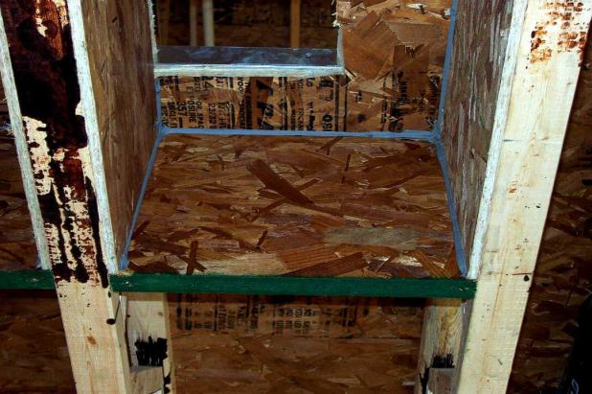
Building Cavities Section R403.3.5 - Mandatory
Framing cavities cannot be used as ducts or plenums

Slide 94
Ducts Buried within Ceiling Insulation
Prior to 2018, the IECC did not prohibit buried ducts, but neither did it define the practice or make specific allowance for it. The new provisions:
Define buried-duct practices that are explicitly allowed
Provide a means to characterize the performance of a buried duct system as an equivalent duct insulation R-value
Allow simplified credit for buried ducts in the performance path
Buried duct system may be considered inside conditioned space if certain requirements are met

Slide 95
Ducts Buried within Ceiling Insulation Section R403.3.6
Where supply and return air ducts are partially or completely buried in ceiling insulation, such ducts shall comply with all of the following:
1. The supply and return ducts shall have an insulation R-value not less than R-8.
2. At all points along each duct, the sum of the ceiling insulation R-value against and above the top of the duct, and against and below the bottom of the duct, shall be not less than R-19, excluding the R-value of the duct insulation.
3. In Climate Zones 1A, 2A and 3A, the supply ducts shall be completely buried within ceiling insulation, insulated to an R-value of not less than R-13 and in compliance with the vapor retarder requirements of Section 604.11 of the International Mechanical Code or Section M1601.4.6 of the International Residential Code, as applicable.
Exception: Sections of the supply duct that are less than 3 feet (914 mm) from the supply outlet shall not be required to comply with these requirements.

Slide 96
Effective R-value of Deeply Buried Ducts Section R403.3.6.1
Where using a simulated energy performance analysis, sections of ducts that are:
installed in accordance with Section R403.3.6
located directly on, or within 5.5 inches (140 mm) of the ceiling
surrounded with blown-in attic insulation having an R-value of R-30 or greater
located such that the top of the duct is not less than 3.5 inches (89 mm) below the top of the insulation
shall be considered as having an effective duct insulation R-value of R-25

Slide 97
Ducts Located in Conditioned Space Section R403.3.7
For simulated performance path, buried ducts may be considered inside conditioned space if:
The duct system is actually located completely within the continuous air barrier and within the building thermal envelope, OR
The ducts are buried within ceiling insulation in accordance with Section R403.3.6 and all of the following conditions exist:
2.1. The air handler is located completely within the continuous air barrier and within the building thermal envelope.
2.2. The duct leakage, as measured either by a rough-in test of the ducts or a post-construction total system leakage test to outside the building thermal envelope in accordance with Section R403.3.4, is less than or equal to 1.5 cubic feet per minute (42.5 L/min) per 100 square feet (9.29 m2) of conditioned floor area served by the duct system.
2.3. The ceiling insulation R-value installed against and above the insulated duct is greater than or equal to the proposed ceiling insulation R-value, less the R-value of the insulation on the duct.

Slide 98
Mechanical System Piping Insulation Section R403.4 - Mandatory
R-3 required on
HVAC systems
Exception: Piping that conveys fluids between 55 and 105°F
If exposed to weather,
protect from damage, including
Sunlight
Moisture
Equipment maintenance
Wind
Provide shielding from solar radiation that can cause degradation of material
Adhesive tape is not allowed
Notes:
Mandatory – no trade-offs.

Slide 99
Service Hot Water Systems Section R403.5
Heated water circulation systems
Heat trace systems
Demand recirculation water systems

Slide 100
Heated Water Circulation and Temp. Maintenance Systems Section R403.5.1 - Mandatory
Heated water circulation systems
provided with circulation pump
return pipe must be a dedicated return pipe or a cold water supply pipe
gravity and thermosyphon circulation systems are prohibited
Controls shall
start the pump based on identification of the demand for hot water within the occupancy
automatically turn off pump when water in the loop is at desired temperature and there is no demand for hot water
Automatic controls, temperature sensors, and pumps shall be accessible
Manual controls shall be readily accessible

Slide 101
Heat Trace Systems Section R403.5.1.2
Electric heat trace systems shall comply with IEEE 515.1 or UL 515
Controls shall automatically adjust the energy input to the heat tracing to maintain the desired water temperature in the piping in accordance with the times when heated water is used in the occupancy

Slide 102
Demand Recirculation Water Systems Section R403.5.2
Demand recirculation water system to have controls that
start pump upon:
receiving a signal from action of user of a fixture or appliance
sensing the presence of a user of a fixture or
sensing the flow of hot or tempered water to a fixture fitting or appliance
limit the temperature of water entering cold water pipe to not greater than 104ºF

Slide 103
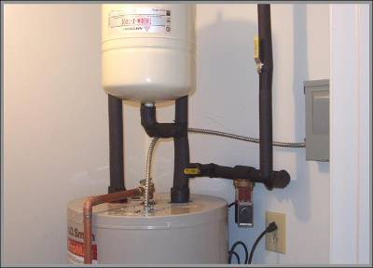
Hot Water Pipe Insulation Section R403.5.3 - Prescriptive
R-3 required on
Piping ≥ ¾ in. nominal diameter
Piping serving more than one dwelling unit
Piping located outside the conditioned space
Piping from the water heater to a distribution manifold
Piping under a floor slab
Buried piping
Supply and return piping in recirculating systems other than demand recirculation systems
Image courtesy of Ken Baker, K energy
Notes:
Note that all > or equal to ¾-inch piping must be insulated. This is a substantial change from the previous code, where only those larger than ¾-inch required insulation.

Slide 104
Drain Water Heat Recovery Units Section R403.5.4
Comply with CSA B55.2 and tested in accordance with CSA B55.1
Portable water-side pressure loss of drain water hat recovery units shall be < 3 psi for individual units connected to 1 or 2 showers
< 2 psi if connected to > 3 showers

Slide 105
Mechanical Ventilation Section R403.6
Ventilation
Building to have ventilation complying with IRC or IMC or with other approved means
Outdoor air intakes and exhausts shall have automatic or gravity dampers that close when the ventilation system is not operating
Whole-house mechanical ventilation system fans to meet efficacy in Table R403.6.1
Exception
When an air handler integral to tested and listed HVAC equipment is used to provide whole-house mechanical ventilation, the air handler shall be powered by an electronically commutated motor
Notes:
No requirement for whether these intakes or exhausts be present or how many, simply what they have to be like if they’re there.

Slide 106
Equipment Sizing and Efficiency Rating Section R403.7
Equipment Sizing
Load calculations determine the proper capacity (size) of equipment
Goal is big enough to ensure comfort but no bigger
Sizing shall be performed in accordance with ACCA Manual S based on loads calculated in accordance with ACCA Manual J (other approved methods)
Efficiency Rating
New or replacement heating/cooling equipment shall have an efficacy rating equal to or greater than minimum required by federal law for geographic location of installation
Notes:
Equipment sizing is a direct reference to the IRC. Intent is to get the HVAC system sized correctly so it operates as efficiently as possible.
Oversized equipment has a higher initial cost, a higher operating cost, may provide less comfort, and the short-cycling reduces the equipment life expectancy. Any one of these is a good reason not to oversize.
Heating and cooling system design loads for the purpose of sizing systems and equipment shall be determined in accordance with the procedures described in the ACCA Manual J or an equivalent computation procedure.

Slide 107
Snow Melt System Controls Section R403.9
Snow- and ice-melting system controls
Automatic shutoff when pavement temperature is > 50°F and precipitation is not falling
Automatic or manual shutoff when outdoor temperature is > 40°F
Notes:
Requirements apply when systems are supplied through energy service to the building.

Slide 108
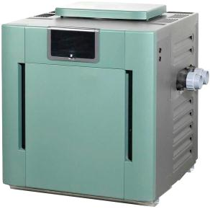
Pools and Permanent Spa Energy Consumption Section R403.10 - Mandatory
Pools and spas in accordance with APSP-145
Heaters
with a readily accessible on-off switch that is integral
part of heater mounted on the exterior of heater or
external to within 3 feet of heater
Switch shall not change the setting of heater thermostat
Switches shall be in addition to the circuit breaker for the power to the heater
fired by natural gas not allowed to have continuously burning pilot lights
Time switches (or other control method) to automatically turn off and on heaters and pumps according to a preset schedule installed on all heaters and pump motors
Note: heaters, pumps, and motors with built-in timers meet the requirement
Exceptions
Public health standards requiring 24-hour pump operation
Pumps operating pools with solar and waste-heat recovery heating systems

Slide 109
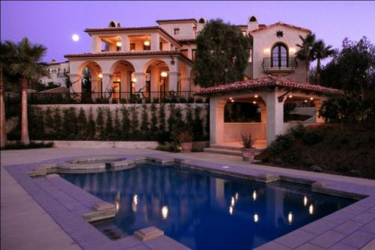
Covers Section R403.10.3
On outdoor heated pools and outdoor permanently installed spas
Vapor-retardant cover OR
Other approved vapor retarder means
Exception:
If >75% of energy from on-site renewable energy system
Notes:
Requirement for cover to be left with the pool at time of construction. Covers required for all heated pools and inground permanently installed spas.
Limiting the evaporation of water is very important in terms of avoiding energy loss.
Exception is computed over an operation season of not less than three calendar months.

Slide 110
Portable Spas Section R403.11 - Mandatory
Energy consumption of electric-powered portable spas shall be controlled by the requirements of APSP14

Slide 111
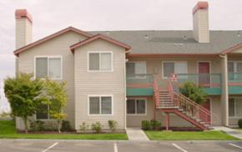
Systems Section R403.8
Systems serving multiple dwelling units shall comply with Sections C403 and C404 instead of Section R403
Notes:
Section C403: Building Mechanical Systems
Section C404: Service Water Heating
Metering – separate metering

Slide 112
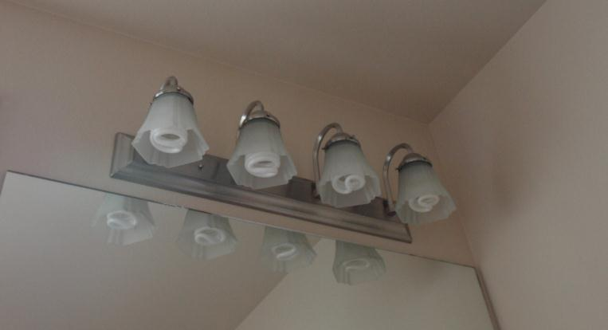
Lighting Equipment Section R404.1 - Mandatory
A minimum of 90 percent of the permanently installed lighting fixtures shall contain only high efficacy lamps
Notes:
High efficacy lamps: compact fluorescent lamps, LED lamps, T-8 or smaller diameter linear fluorescent lamps, or other lamps with a minimum efficacy of:
60 lumens per watt for lamps > 40 watts
50 lumens per watt for lamps > 15 watts, but < 40 watts
40 lumens per watt for lamps < 15 watts

Slide 113
Lighting Equipment Section R404.1.1 - Mandatory
Fuel gas lighting systems may not have continuously burning pilot lights

Slide 114
Existing Buildings Section R501 - General
Additions, alterations, or repairs
Existing buildings
Maintenance
Compliance
New and replacement materials
Buildings designated as historic
Notes:
Buildings designated as historic
National/state/local historical register
Some jurisdictions may still require additions to these structures to comply with the energy code.

Slide 115
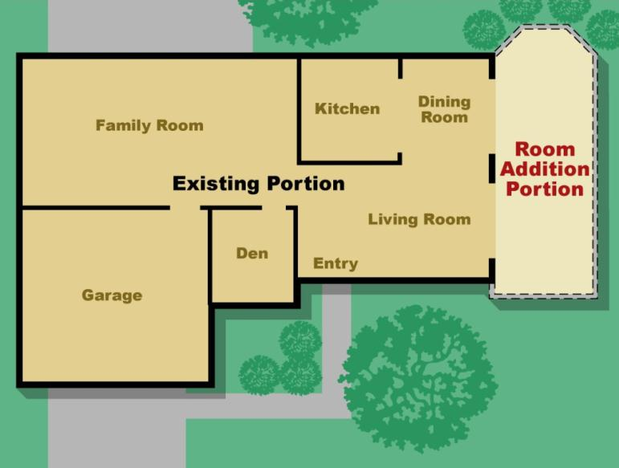
Existing Buildings Section R502 - Additions
Additions must meet the prescriptive requirements in Table R402.1.2 or R402.1.4 (R-value computation or U-factor or total UA alternatives)
N
Notes:
1. Treat the addition as a stand-alone building and ignore the common walls between the existing building and the addition.
Combine the existing building with the addition and bring the whole building to compliance. Compliance can be harder to achieve if the existing building is quite old.

Slide 116
Existing Buildings Section R502 - Additions
Additions comply if any of the following is demonstrated
The addition alone complies with the provisions of this code
The existing building and addition together comply as a single building
The existing building and addition together use no more energy than the existing building

Slide 117
Existing Buildings Section R503 - Alterations
Code applies to any new construction
Unaltered portion(s) do not need to comply
(R503.1.1.1) Replacement fenestration that includes both glazing and sash must meet
0.25 SHGC in Climate Zones 1-3
0.40 SHGC in Climate Zone 4 except Marine
U-factors in all Climate Zones 1-8
Where more than 1 replacement fenestration unit is to be installed, an area-weighted average U-factor, SHGC or both of all replacement fenestration units can be an alternative compliance approach.
Notes:
The section refers to the R-value table and should also refer to the U-factor table.
When installing more than one replacement fenestration unit, an alternative is to show an area-weighted average of the U-factor, SHGC, or both

Slide 118
Existing Buildings Section R503 - Alterations
Building Envelope
Exceptions:
Storm windows over existing fenestration
Surface-applied window film installed on existing single pane
Exposed, existing ceiling, wall or floor cavities if already filled with insulation
Where existing roof, wall or floor cavity isn’t exposed
Roof recover
Roofs without cavity insulation and neither sheathing nor insulation is exposed during the reroofing
Insulate either above or below the sheathing
Lighting
Exceptions:
<50% of luminaries in a space are replaced
Only bulbs and ballasts within existing luminaries are replaced (provided installed interior lighting power isn’t increased)
Notes:
The code states that additions, alterations, renovations or repairs can’t create an unsafe or hazardous condition or overload existing building systems.
Surface applied window film installed on existing single pane fenestration assemblies to reduce solar heat gain provided the code does not require the glazing or fenestration assembly to be replaced.

Slide 119
Existing Buildings Section R503 - Alterations
Heating and Cooling
New HVAC systems and duct systems that are part of the alteration to comply with Section 403
Exception: Where duct from on existing HVAC system are extended, duct systems with < 40 linear feet in unconditioned spaces are not required to be tested in accordance with Section R403.3.3
Service hot water (SHW) systems
New SHW systems that are part of the alteration to comply with R403.5

Slide 120
Existing Buildings Section R504 - Repairs
Work on nondamaged components necessary for the required repair or damaged components shall be considered part of the repair and are not subject to the alterations requirements
Repairs considered part of the code
Glass-only replacements in an existing sash and frame
Roof repairs
Repairs where only the bulb, ballast or both within the existing luminaires in a space are replaced provided the replacement does not increase the installed interior lighting power

