Slide 1
ANSI/ASHRAE/IES Standard 90.1-2016: Envelope
Prepared by Pacific Northwest National Laboratory for the U.S. Department of Energy
March 2017 – PNNL-SA-124574

Slide 2
Acknowledgements
PNNL and DOE would like to thank ASHRAE Standing Standard Project Committee 90.1 for their contributions to the development of this presentation and their technical review of the content.

Slide 3
Summary of Changes
Comprehensive update to the fenestration prescriptive requirements in Tables 5-5-0 through 5-5-8
Orientation requirements for vertical fenestration were tightened
SHGC credit for shading by permanent projections was modified to correct how it addressed north-facing fenestration
Whole building air leakage testing added as an option
Thresholds for conditioned space were lowered

Slide 4
Compliance Paths Building Envelope
Building System
Compliance Options
Envelope
Prescriptive Option
HVAC
Mandatory
Provisions
(required for all compliance options)
Energy Code Compliance
Trade Off Option
SWH
Power
Energy Cost Budget
Lighting
Other
Performance Rating Method
Notes:
Under “Compliance Paths”, Simplified is not available for Envelope
Prescriptive Option = no trade offs; 8 criteria sets (certain rules to being able to use this option)
Trade Off Option = trade offs permitted among envelope components; area take offs must be calculated; ENVSTD, COMcheck
ECB = trade offs can be made between envelope, lighting, and/or mechanical (building as a whole)
Simplified = not an option for Envelope

Slide 5
Section 5 Building Envelope Overview 5.1 – 5.4
Section 5.1 General
Scope
Space-Conditioning Categories
Envelope Alterations
Climate
Section 5.2 Definition of Compliance Paths
Section 5.3 Simplified Building (Not Used)
Section 5.4 Mandatory Provisions
Insulation
Fenestration and Doors
Air Leakage
Loading Dock Weatherseals
Vestibules

Slide 6
Section 5 Building Envelope Overview (cont’d)
Prescriptive Building Envelope Option (Section 5.5)
Opaque Areas
Fenestration
Building Envelope Trade-Off Option (Section 5.6)
Submittals (Section 5.7)
Product Information and Installation Requirements (Section 5.8)
Inspection and Verification (Section 5.9)

Slide 7
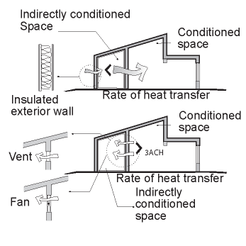
Section 5 – 5.1.2 Space-Conditioning Categories
Separate envelope component requirements apply to three types of conditioned spaces
Nonresidential
Residential
Semiheated
Semiheated spaces are heated, but not to comfort levels, and not cooled
Figure 5-A
Examples of Indirectly Conditioned Spaces
(User’s Manual – 90.1.-2013)
Notes:
Defining characteristic of nonresidential is that no one is sleeping there at night and whether it is a dwelling unit (cook, eat, wash, sleep).
Unconditioned spaces are enclosed spaces within a building that are not conditioned or semiheated; must be completely enclosed by walls, roofs, floors, and/or other envelope components and space must qualify as a cooled space, heated space, or an indirectly conditioned space.
Indirectly heated spaces don’t have heating or cooling directly (ex: storage room adjacent to conditioned space)
Nonresidential examples: retail, offices (not continuously conditioned)
Residential examples: dwelling units, hotel/motel guest rooms, dormitories (more or less continuously conditioned)
Semiheated example: warehouse (building official must approve semiheated spaces)

Slide 8
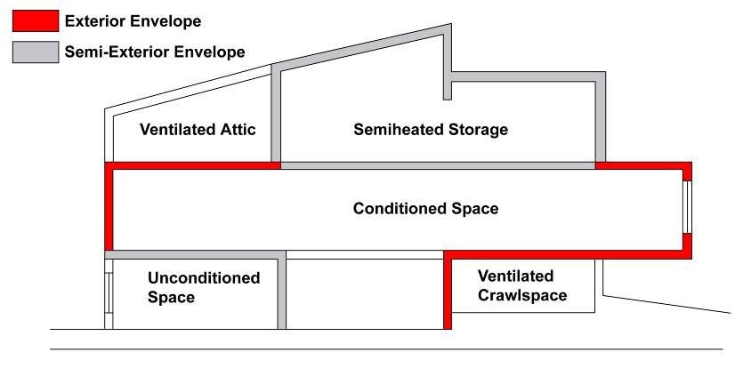
Section 5 Building Envelope
Notes:
The gray areas represent the semi-exterior envelope, and the red areas represent exterior envelope.
Semi-exterior envelope is defined under “building envelope” in Section 3: the elements of a building that separate conditioned space from unconditioned space or that enclose semiheated spaces through which thermal energy may be transferred to or from the exterior, or to or from unconditioned spaces, or to or from conditioned spaces.
Note that “unconditioned spaces” such as the ventilated attic or the ventilated crawlspace do not have any envelope requirements between these spaces and the exterior BUT there are requirements for the envelope between these spaces and any conditioned or “semi-conditioned” spaces. The presence of unconditioned spaces or “semi-conditioned” spaces greatly complicates the definition of the building envelope.
IECC does not have definition for semiheated = conditioned

Slide 9
Section 5 – 5.1.2 Space Conditioning Categories & Basis
Envelope Requirements Are Specified by Space-Conditioning Categories
Conditioned space must be
a cooled space with a cooling system sensible cooling output capacity larger than 3.4 Btu/h∙ft² of floor area
a heated space with a heating system output capacity larger than that specified in table below
Or, an indirectly conditioned space
Heating Output, Btu/h∙ft² | Climate Zone
>5 | 0, 1, 2
>9 | 3A, 3B
>7 | 3C
>10 | 4A, 4B
>8 | 4C
>12 | 5
>14 | 6
>16 | 7
>19 | 8
Notes:
By SPACE, not BUILDING
Word in italic have a definition in Section 3 Definitions

Slide 10
Section 5 – 5.1.2 Space Conditioning Categories & Basis
Semiheated space
has a heating system with a capacity ≥ 3.4 Btu/h.ft² of floor area but is not conditioned space
Space is not cooled at all
Spaces are assumed to be conditioned space and comply with requirements of conditioned space at time of construction regardless of whether the mechanical or electrical equipment is included in the building permit application or installed at that time
Exceptions:
Space is designated as semiheated or unconditioned and
Approved as such by the building official
Notes:
Semiheated is heated, but not to comfort levels like conditioned space.
Additional information in the User’s Manual
Must be approved by building official and must be labeled on plans

Slide 11
Section 5
Envelope Alteration Exceptions
Allowed if they don’t increase energy usage of building
Installation of storm windows or glazing panels with low-emissivity coating
Replacement of glazing in existing sash and frame provided U-factor and SHGC < than previous glass
Alterations to envelope cavities provided they are insulated to full depth with a nominal R-3.0 per in.
Wall and floor alterations where no new cavities are created
Roof recovering
Removal and replacement of roof membranes
Replacement of existing doors that separate conditioned space from exterior do not require a vestibule provided existing vestibule is not removed
Replacement of existing fenestration, provided area of replacement is no more than 25% of total fenestration area provided U-factor and SHGC < than previous fenestration
Notes:
Altered portions of buildings must comply with section 5 for insulation, air leakage, and fenestration. Alterations listed here don’t have to comply if they don’t increase energy use of building.
Roof membranes – if the roof is stripped down to the level of sheathing or insulation, then the roof must be insulated to the Standard (unless there is insulation below the sheathing).
Replacing exterior doors doesn’t trigger requirement for vestibule or revolving door, however, if a vestibule or revolving door exists, it can’t be removed.
Use COMcheck for alterations

Slide 12
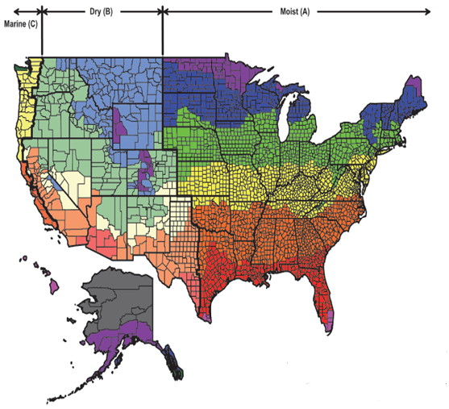
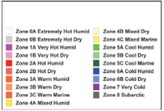
Section 5 – 5.1.4
Climate – Climate Zone Update
More accurately represents recent climate, better data
Aligns with ASHRAE Standard 169-2013
Retains same climate zone definitions (based on HDDs)
Some U.S. counties have shifted zones
Reflects weather over the most recent 30 years
Adds new Climate Zone 0 (extremely hot)
Approximately 10% of U.S. counties reassigned to a different climate zone with a majority reassigned to a warmer climate zone

Slide 13
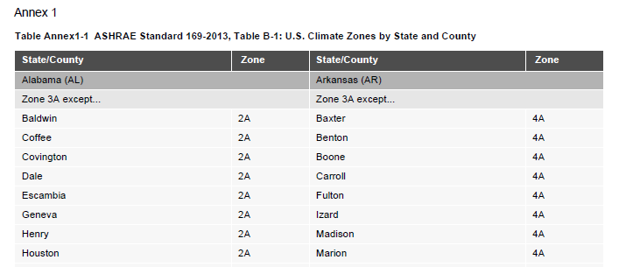
Section 5 – 5.1.4
Climate
United States Locations – Use ASHRAE Standard 169 Table Annex 1-1
Notes:
United States Locations. Appendix B no longer has climate data, refer to Annex 1 for climate locations in Table Annex 1-1
Exception:
If there are recorded historical climatic data available for a construction site, they may be used to determine compliance if approved by the building official.

Slide 14
Compliance Approach
Building Envelope
Building System
Compliance Options
Envelope
Prescriptive Option
HVAC
Mandatory
Provisions
(required for all compliance options)
Energy Code Compliance
Trade Off Option
SWH
Power
Energy Cost Budget
Lighting
Other
Performance Rating Method
Notes:
Compliance. For the appropriate climate, space-conditioning category, and class of construction, the building envelope to comply with
5.1 General
5.4 Mandatory
5.7 Submittals
5.8 Product Information
AND
Either 5.5 Prescriptive if
The vertical fenestration area does not exceed 40% of the gross wall area for each space-conditioning category and
The skylight fenestration area does not exceed 3% of the gross roof area for each space-conditioning category, or
5.6 Building Envelope Trade-Off Options
Mandatory requirements will be discussed next.

Slide 15
Section 5 – 5.4
Mandatory Provisions
Insulation (Section 5.4.1 refers to 5.8.1. through 5.8.1.10)
Labeling (Section 5.8.1.1)
Compliance with Manufacturers’ Requirements (Section 5.8.1.2)
Loose-Fill Insulation Limitation (Section 5.8.1.3)
Baffles (Section 5.8.1.4)
Substantial Contact (Section 5.8.1.5)
Recessed Equipment (Section 5.8.1.6)
Insulation Protection (Section 5.8.1.7)
Location of roof insulation (Section 5.8.1.8)
Extent of Insulation (Section 5.8.1.9)
Joints in Rigid Insulation (Section 5.8.1.10)
Notes:
All mandatory provisions must be satisfied regardless of which compliance path (prescriptive, building envelope trade-off, or energy cost budget) is used.
The amount of insulation required is specified in the prescriptive Section (5.5) or will be determined through the envelope trade-off option (5.6). The insulation requirements for labeling, contact, protection, staggering of rigid insulation, and so on, are specified in Section 5.8. Section 5.8 is referenced in Section 5.4.1 and is part of the mandatory requirements. Note also that Section 5.7 Submittals is “mandatory” as well.

Slide 16
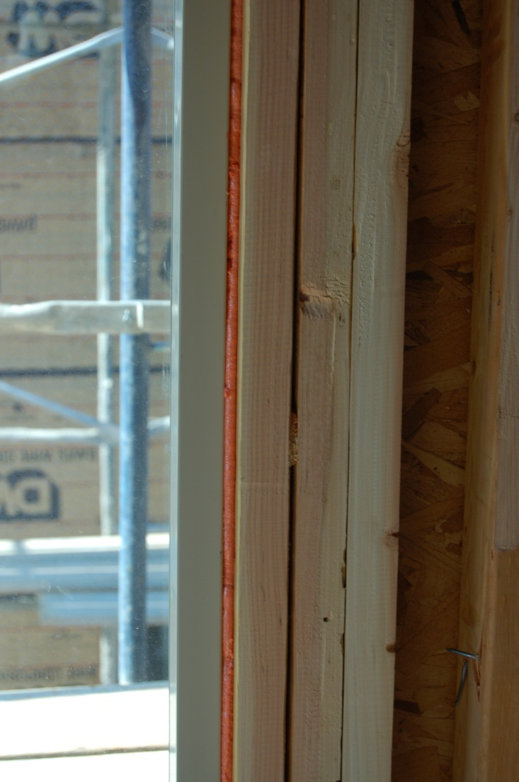
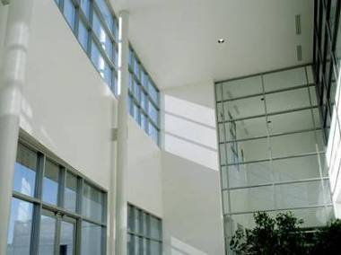
Section 5 – 5.4
Mandatory Provisions
Fenestration and Doors (Section 5.4.2 that refers to 5.8.2)
Air Leakage (Section 5.4.3)
Photo courtesy of Ken Baker, K energy
Notes:
Requirements are described in detail in subsequent slides.

Slide 17
Section 5 – 5.4.3
Air Leakage
Continuous air barrier
Fenestration and doors
Loading dock weather seals
Vestibules
Notes:
Goal is to not let uncontrolled air leak into or out of the building.

Slide 18
Section 5 – 5.4.3.1
Air Leakage – Continuous Air Barrier
Continuous air barrier required except in:
Semiheated spaces in climate zones 0-6
Single wythe concrete masonry buildings in climate zone 2B
Plans
Air barrier components identified or noted in construction documents
Joints, intersections, and penetrations of air barrier components (incl. lighting fixtures) detailed
To extend over all surfaces of building envelope at lowest floor, exterior walls, and ceiling or roof
Designed to resist positive and negative pressures from wind, stack effect, and mechanical ventilation
Notes:
Single wythe in CZ 2B is a result of the public review process, and the subcommittee believes that only CZ 2B is cost effective and fits the need where these walls are the most common.

Slide 19
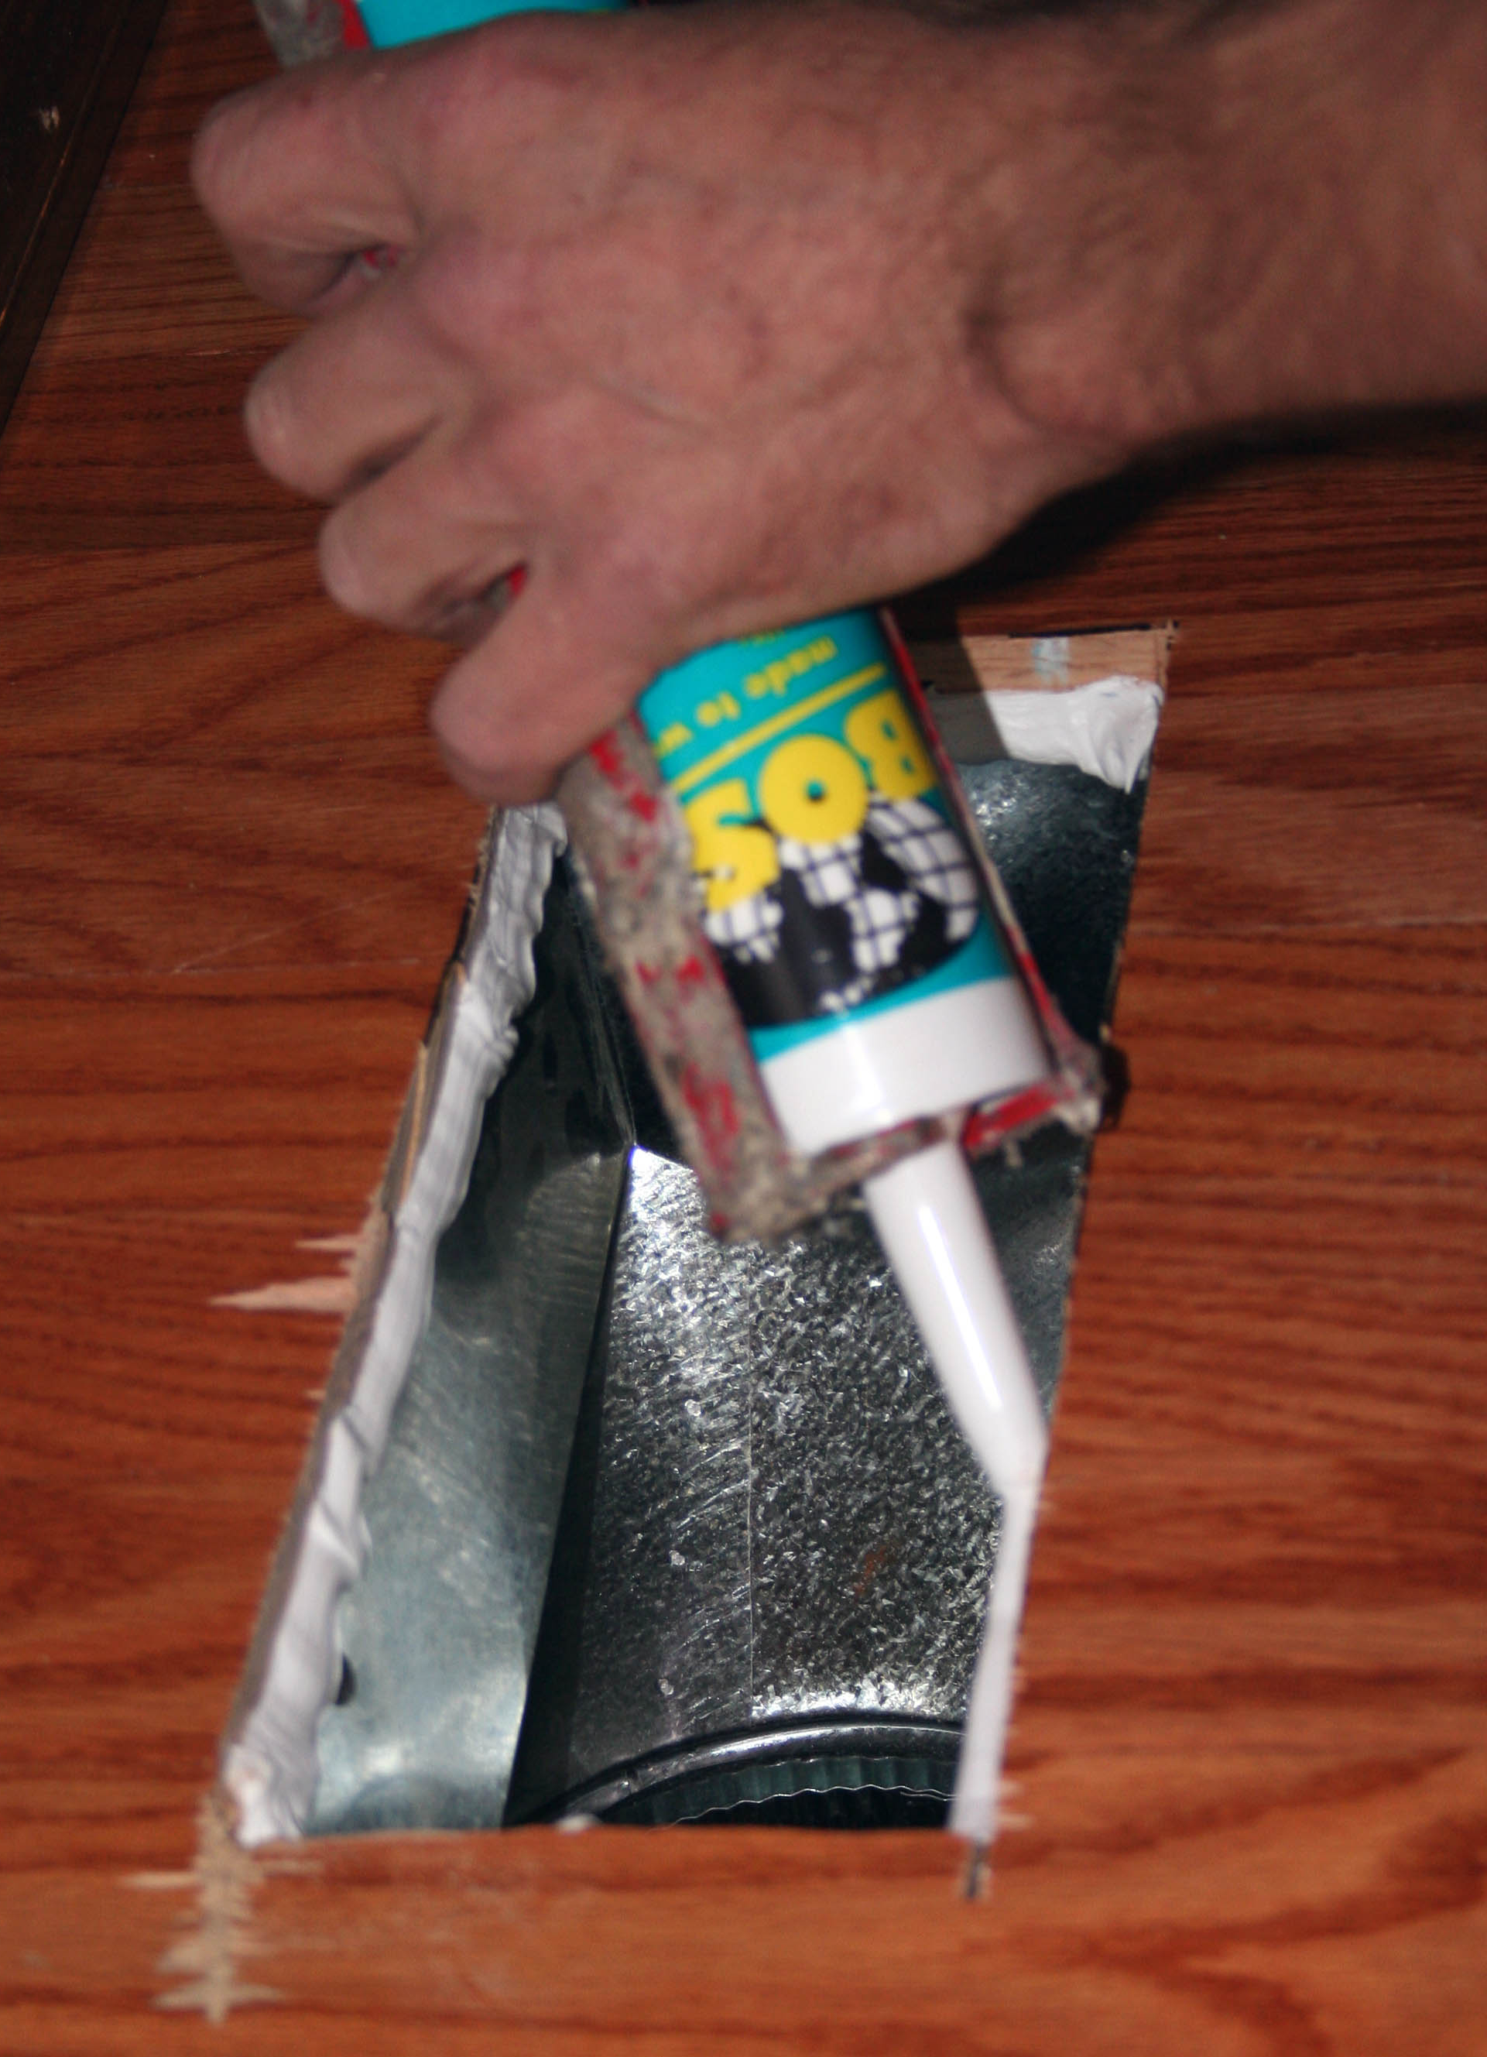
Section 5 – 5.4.3.1.2
Air Leakage – Air Barrier Installation
The following areas are to be wrapped, sealed, caulked, gasketed, or taped
Joints around fenestration and door frames (both manufactured and site-built)
Junctions between walls
And foundations
At building corners
And roofs or ceilings
Penetrations for roofs, walls, and floors
Building assemblies used as ducts or plenums
Joints, seams, connections between planes, and other changes in continuous air barrier materials

Slide 20
Section 5 – 5.4.3.1.3
Air Leakage – Testing, Acceptable Materials, and Assemblies
New Whole-Building Testing Option
3 Options to Comply (a, b, or c):
Whole-Building Testing
Materials Testing
Assemblies of Materials Testing

Slide 21
Section 5 – 5.4.3.1.3
Air Leakage – Testing, Acceptable Materials, and Assemblies (cont’d)
Option 1: Whole-Building Testing [5.4.3.1.3(a) Whole-building pressurization testing]
Buildings > 50,000 sf
Buildings < 50,000 sf
Can comply by testing only (and all) the following portions and area-weighting measured air leakage:
Floor areas under roof or with building entrances
Representative above-grade wall sections totaling at least 25% of wall area, not including floor area in (a)
Must comply by testing entire building
Building complies if measured air leakage rate is less than 0.40 cfm/ft² at 0.30 in. of water
If measured air leakage rate is greater than 0.40 cfm/ft² but less than 0.60 cfm/ft²
Perform diagnostic evaluation (smoke tracer, infrared imaging, etc.) and seal identified leaks
Perform visual inspection of air barrier and seal identified leaks
Submit report to code official and building owner identifying corrective actions taken to seal leaks

Slide 22
Section 5 – 5.4.3.1.3
Air Leakage – Testing, Acceptable Materials, and Assemblies (cont’d)
Option 2: Materials Testing [5.4.3.1 (b)]
Materials with an air permeance of < 0.004 cfm/ft² under pressure differential of 0.3 in. of H₂O when tested in accordance with ATM E 2178
These materials meet these requirements
Material | Thickness (minimum)
Plywood | 3/8 in.
Oriented strand board | 3/8 in.
Extruded polystyrene insulation board | ½ in.
Foil-faced urethane insulation board | ½ in.
Exterior gypsum sheathing or interior gypsum board | ½ in.
Cement board | ½ in.
Built up roofing membrane
Modified bituminous roof membrane
Single-ply roof membrane
A Portland cement/sand parge, stucco, or gypsum plaster | ½ in.
Cast-in-place and precast concrete
Sheet metal
Closed cell 2 lb/ft³ nominal density spray polyurethane foam | 1 in.

Slide 23
Section 5 – 5.4.3.1.3
Air Leakage – Testing, Acceptable Materials, and Assemblies (cont’d)
Option 3: Assemblies of Materials Testing [5.4.3.1 (c)]
Assemblies of materials and components (sealants, tapes, etc.) that have an average air leakage < 0.04 cfm/ft² under a pressure differential of 0.3 in. of H₂O when tested in accordance with ASTM E 2357, 1677, 1680, or 283.
The following assemblies meet these requirements:
Concrete masonry walls that are
Fully grouted, or
Painted to fill the pores.

Slide 24
Section 5 – 5.4.3.2
Air Leakage – Fenestration and Doors
Product | cfm/ft² | Procedure | psf
Glazed swinging entrance doors, glazed power-operated sliding entrance doors, glazed power-operated folding entrance doors, and revolving doors | 1.0 | AAMA/WDMA/CSA 101/I.S.2/A440, NFRC 400, or ASTM E283 | 1.57
Curtainwall and storefront glazing | 0.06 | NFRC 400 or ASTM E283 | 1.57
Unit skylights with condensation weepage openings | 0.3 | AAMA/WDMA/CSA 101/I.S.2/A440 or NFRC 400 | 1.57
Unit skylights with condensation weepage openings | 0.5 | AAMA/WDMA/CSA 101/I.S.2/A440 | 6.24
Nonswinging doors for vehicular access and material transportation (min. opening of 32 in/s) | 1.3 | ANSI/DASMA 105, NFRC 400, or ASTM E283 | 1.57
Opaque nonswinging doors, glazed sectional garage doors, and upward acting glazed nonswinging doors | 0.4 | ANSI/DASMA 105, NFRC 400, or ASTM E283 | 1.57
All other products | 0.2 | AAMA/WDMA/CSA 101/I.S.2/A440 or NFRC 400 | 1.57
All other products | 0.3 | AAMA/WDMA/CSA 101/I.S/A440 | 6.24
Exceptions
Field-fabricated fenestration and doors
Metal coiling doors in semiheated spaces in climate zones 0-6 not to exceed 1.0 cfm/ft² when tested at 1.57 psf in accordance with same procedures as revolving doors
Products in buildings that comply with a whole building air leakage rate of 0.4 cfm/ft² under pressure differential of 0.3 in. H₂O, 1.57 psf per ASTM E779

Slide 25
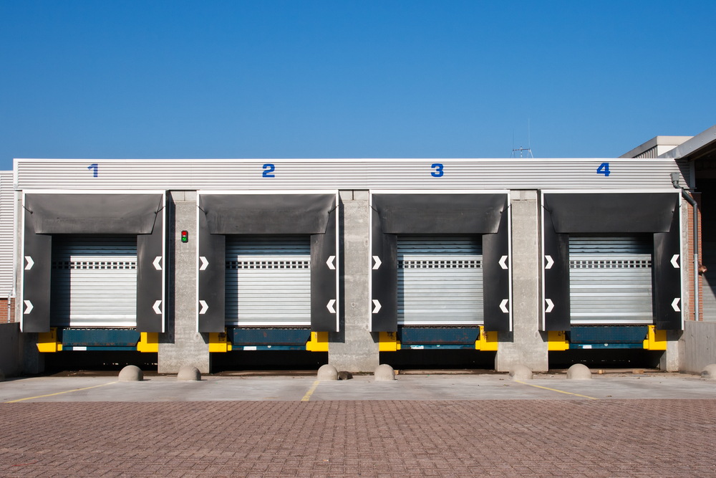
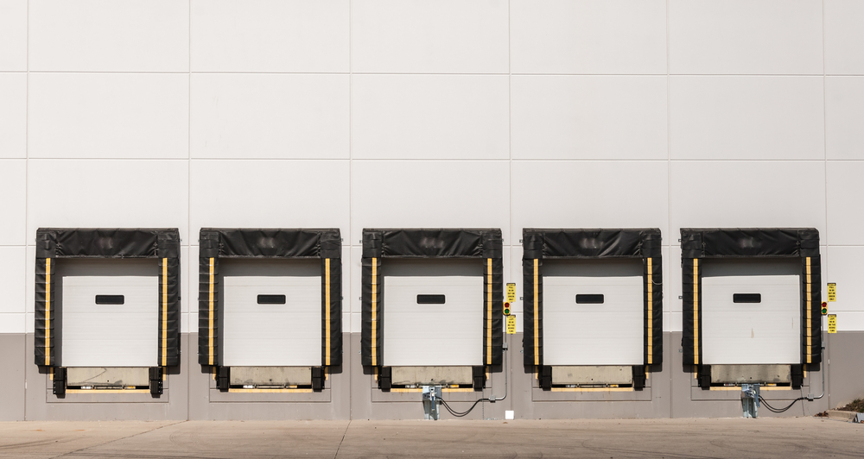
Section 5 – 5.4.3.3
Air Leakage – Loading Dock Weatherseals
In climate zones 0 and 4-8
Cargo doors and loading dock doors equipped with weatherseals
To restrict infiltration when vehicles are parked in the loading dock/doorway
Notes:
Climate dependent requirements shown in green font
Usually consists of a vinyl-wrapped compressible foam block that’s mounted around the perimeter of the door and forms a seal between the truck and the dock when the truck is parked at the dock.
Typically offered by manufacturers as an option

Slide 26
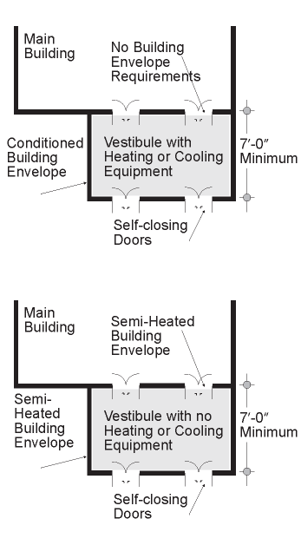
Section 5 – 5.4.3.4
Air Leakage – Vestibules
Vestibules must have
Self-closing doors
Interior and exterior doors not open at the same time
Distance between interior and exterior doors not < 7 ft when in closed position
Floor area of each vestibule to not exceed the greater of 50 ft² or 2% of the gross conditioned floor area for that level of the building
Exterior envelope of conditioned vestibule comply with conditioned space requirements
Interior/exterior envelope of unconditioned vestibule comply with semiheated space requirements
Notes:
Climate dependent requirements shown in green font
building entrance: any doorway, set of doors, turnstile, vestibule, or other form of portal that is ordinarily used to gain access to the building by its users and occupants.
Conditioned Vestibules – exterior envelope to meet requirements for a conditioned space.
Unconditioned Vestibules – interior and exterior envelope to meet requirements for a semiheated space.
Big difference between IECC and 90.1 requirements is number of stories specified in 90.1

Slide 27
Section 5
Air Leakage – Vestibules Exceptions
Non-entrance doors or doors opening from dwelling unit
Building entrances with revolving doors
All building entrances in climate zones 1 and 2 OR in buildings < 4 stories and < 10,000 ft² in gross conditioned floor area in climate zone 3 OR in buildings < 1000 ft² in gross conditioned floor area in climate zones 0 and 4-8
All doors that open from spaces < 3000 ft² and separate from building entrance
Semiheated spaces
Enclosed elevator lobbies for building entrances directly from parking garages
Notes:
Climate dependent requirements shown in green font
Not required < 4 stories because stack effect is smaller and stack effect (along with wind effects) is one of the main drivers of infiltration. Also, low-rise buildings are generally smaller and there is less traffic through the door. However, large, low-rise buildings have more foot traffic so they are not exempt.
Doesn’t include hot and humid climates even though they could use vestibules too (less temperature gradient usually between indoor and outdoor temperatures).
If meet one, exempt from all? Yes.

Slide 28
Section 5 – 5.4.3.4
Air Leakage – Vestibules
Vestibules opening into large conditioned spaces (large retail)
spaces having a gross conditioned floor area for that level of the building of 40,000 ft² and greater,
and when the doors opening into and out of the vestibule are equipped with automatic, electrically driven, self-closing devices, the interior and exterior doors shall have a minimum distance between them of not less than 16 ft.
Notes:
Sometimes, vestibules may have a unit heater to heat the space but not all the way to comfort conditions. Such a vestibule would be considered a semiheated space.

Slide 29
Compliance Approach
Building Envelope
Building System
Compliance Options
Envelope
Prescriptive Option
HVAC
Mandatory
Provisions
(required for all compliance options)
Energy Code Compliance
Trade Off Option
SWH
Power
Energy Cost Budget
Lighting
Other
Performance Rating Method
Notes:
The following section details the prescriptive envelope requirements.

Slide 30
Section 5 – 5.5 Prescriptive Building Envelope Option
Each envelope component must separately meet designated space conditioning requirements:
(Nonresidential, Residential, and/or Semiheated)
Opaque Areas (5.5.3)
Fenestration (5.5.4)
WWR ≤ 40% of gross wall area
Skylight-roof ratio ≤ 3% of roof area
Prescriptive requirements for each component specified by climate zone and space conditioning category (Tables 5.5-0 through 5.5-8)
Insulation levels for roofs, walls, floors and doors
Fenestration criteria for windows, glazed doors and skylights

Slide 31
Section 5 – 5.5.3 Opaque Areas
Compliance
Meet or exceed minimum R-values in table
Only R-value of insulation, not to include air films, etc.
OR
Meet maximum U-factor, C-factor, or F-factor for the entire assembly (typical construction assemblies described in Appendix A)
OR
Perform area-weighted average U-factor, C-factor, or F-factor
Only if there are multiple assemblies within a single class of construction for a single space-conditioning category
Notes:
C-factor (thermal conductance) = time rate of steady-state heat flow through unit area of a material or construction, induced by a unit temperature difference between the body surfaces. Units of C-factor are Btu/h-ft2-F. Note that C-factor doesn’t include soil or air films.
F-factor – the perimeter heat loss factor for slab-on-grade floors, expressed in Btu/h-ft-F
Rule #3 indicates that area-weighted averages across multiple classes of construction or multiple space-conditioning categories are not allowed.

Slide 32
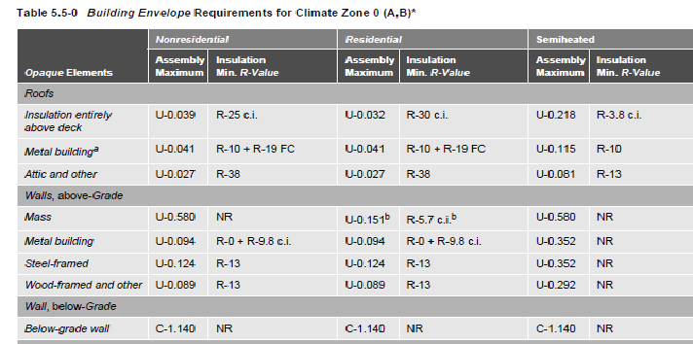
Section 5 – 5.5.1 Opaque
Opaque Elements | Nonresidential |  | Residential |  | Semiheated
 | Assembly Maximum | Insulation Min. R-Value | Assembly Maximum | Insulation Min. R-Value | Assembly Maximum | Insulation Min. R-Value
Roofs Insulation Entirely above Deck Metal Building Attic and Other | U-0.039 U-0.041 U-0.027 | R-25 c.i. R-10 + 19 FC R-38 | U-0.032 U-0.041 U-0.027 | R-30 c.i. R-10 + 19 FC R-38 | U-0.218 U-0.115 U-0.081 | R-3.8 c.i. R-10 R-13
FC = filled cavity
Reference Table 5.5-0 on page 51 in 90.1-2016
Notes:
There is a table for each climate zone. Requirements are separated by Nonresidential, Residential, and Semiheated columns. Both U-factor and R-value requirements are given. Requirements for residential spaces are a little more stringent than nonresidential because residential spaces are assumed to have continuous heating and cooling.
PRESENTERS: All of the tables are provided; use only the tables representing climate zones applicable to your training sessions.
“ci” stands for continuous insulation (uninterrupted by framing members). “ci” applies to all Insulation Entirely Above Deck and to most of mass walls, mass floors, and below-grade walls.
“fc” = filled cavity

Slide 33
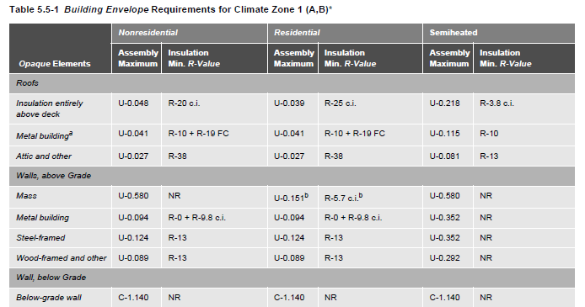
Section 5 – 5.5.1 Opaque
Opaque Elements | Nonresidential |  | Residential |  | Semiheated
 | Assembly Maximum | Insulation Min. R-Value | Assembly Maximum | Insulation Min. R-Value | Assembly Maximum | Insulation Min. R-Value
Roofs Insulation Entirely above Deck Metal Building Attic and Other | U-0.048 U-0.041 U-0.027 | R-20 c.i. R-10 + 19 FC R-38 | U-0.039 U-0.041 U-0.027 | R-25 c.i. R-10 + 19 FC R-38 | U-0.218 U-0.115 U-0.081 | R-3.8 c.i. R-10 R-13
FC = filled cavity
Reference Table 5.5-1 on page 52 in 90.1-2016
Notes:
There is a table for each climate zone. Requirements are separated by Nonresidential, Residential, and Semiheated columns. Both U-factor and R-value requirements are given. Requirements for residential spaces are a little more stringent than nonresidential because residential spaces are assumed to have continuous heating and cooling.
PRESENTERS: All of the tables are provided; use only the tables representing climate zones applicable to your training sessions.
“ci” stands for continuous insulation (uninterrupted by framing members). “ci” applies to all Insulation Entirely Above Deck and to most of mass walls, mass floors, and below-grade walls.
“fc” = filled cavity

Slide 34
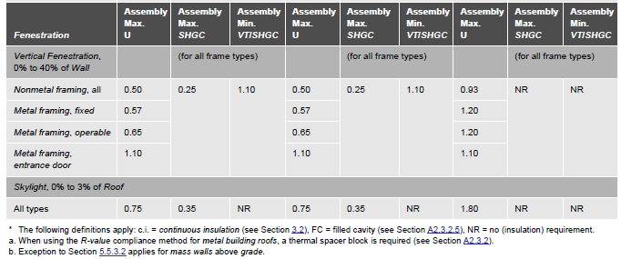
Section 5 – 5.5-1 (cont’d) Fenestration
TABLE 5.5-1 (Cont’d)
Notes:
Maximum of 40% WWR and Skylight maximum of 3% to be able to use these tables; otherwise must use Envelope Trade Off Option or ECB.
Compliance with U-factors and SHGC shall be demonstrated for the overall fenestration product. Gross wall areas and gross roof areas shall be calculated separately for each space-conditioning category for the purposes of determining compliance.
If there are multiple assemblies within a single class of construction for a single space-conditioning category, compliance shall be based on an area-weighted average U-factor or SHGC. It is not acceptable to do an area-weighted average across multiple classes of construction or multiple space-conditioning categories.

Slide 35
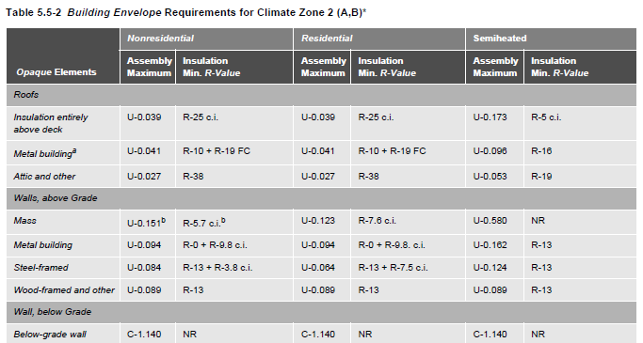
Section 5 – 5.5.1 Opaque
Opaque Elements | Nonresidential |  | Residential |  | Semiheated
 | Assembly Maximum | Insulation Min. R-Value | Assembly Maximum | Insulation Min. R-Value | Assembly Maximum | Insulation Min. R-Value
Roofs Insulation Entirely above Deck Metal Building Attic and Other | U-0.039 U-0.041 U-0.027 | R-25 c.i. R-10+R-19 FC R-38 | U-0.039 U-0.041 U-0.027 | R-25 c.i. R-10+R-19 FC R-38 | U-0.173 U-0.096 U-0.053 | R-5 c.i. R-16 R-19
Reference Table 5.5-2 on page 53 in 90.1-2016
Notes:
PRESENTERS: All of the tables are provided; use only the tables representing climate zones applicable to your training sessions.

Slide 36
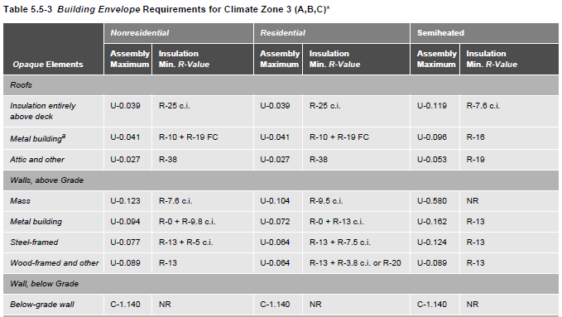
Section 5 – 5.5.1 Opaque
Opaque Elements | Nonresidential |  | Residential |  | Semiheated
 | Assembly Maximum | Insulation Min. R-Value | Assembly Maximum | Insulation Min. R-Value | Assembly Maximum | Insulation Min. R-Value
Roofs Insulation Entirely above Deck Metal Building Attic and Other | U-0.039 U-0.041 U-0.027 | R-25 c.i. R-10+R-19 FC R-38 | U-0.039 U-0.041 U-0.027 | R-25 c.i. R-10+R-19 FC R-38 | U-0.119 U-0.096 U-0.053 | R-7.6 c.i. R-16 R-19
Reference Table 5.5-3 on page 54 in 90.1-2016
Notes:
PRESENTERS: All of the tables are provided; use only the tables representing climate zones applicable to your training sessions.

Slide 37
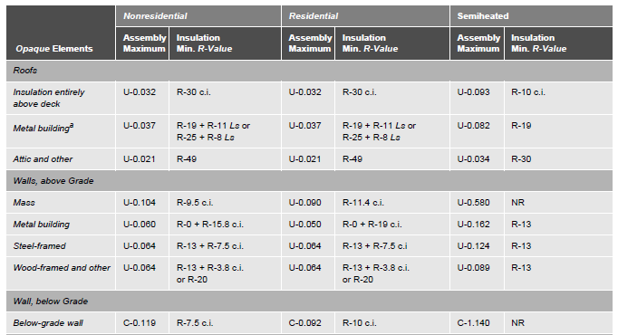
Section 5 – 5.5.1 Opaque
Opaque Elements | Nonresidential |  | Residential |  | Semiheated
 | Assembly Maximum | Insulation Min. R-Value | Assembly Maximum | Insulation Min. R-Value | Assembly Maximum | Insulation Min. R-Value
Roofs Insulation Entirely above Deck Metal Building Attic and Other | U-0.032 U-0.037 U-0.021 | R-30 c.i. R-19+R-11 Ls or R-25+R-8 Ls R-49 | U-0.032 U-0.037 U-0.021 | R-30 c.i. R-19+R-11 Ls or R-25+R-8 Ls R-49 | U-0.093 U-0.082 U-0.034 | R-10 c.i. R-19 R-30
Reference Table 5.5-4 on page 55 in 90.1-2016
Notes:
PRESENTERS: All of the tables are provided; use only the tables representing climate zones applicable to your training sessions.

Slide 38
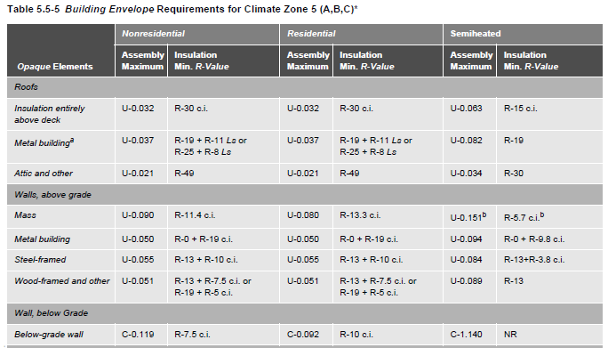
Section 5 – 5.5.1 Opaque
Opaque Elements | Nonresidential |  | Residential |  | Semiheated
 | Assembly Maximum | Insulation Min. R-Value | Assembly Maximum | Insulation Min. R-Value | Assembly Maximum | Insulation Min. R-Value
Roofs Insulation Entirely above Deck Metal Building Attic and Other | U-0.032 U-0.037 U-0.021 | R-30 c.i. R-19+R-11 Ls or R-25+R-8 Ls R-49 | U-0.032 U-0.037 U-0.021 | R-30 c.i. R-19+R-11 Ls or R-25+R-8 Ls R-49 | U-0.063 U-0.082 U-0.034 | R-15 c.i. R-19 R-30
Reference Table 5.5-5 on page 56 in 90.1-2016
Notes:
PRESENTERS: All of the tables are provided; use only the tables representing climate zones applicable to your training sessions.

Slide 39
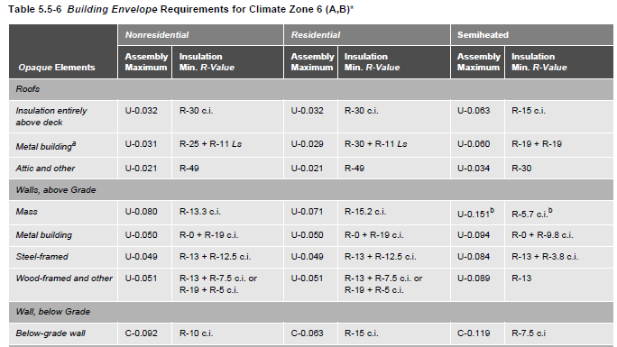
Section 5 – 5.5.1 Opaque
Opaque Elements | Nonresidential |  | Residential |  | Semiheated
 | Assembly Maximum | Insulation Min. R-Value | Assembly Maximum | Insulation Min. R-Value | Assembly Maximum | Insulation Min. R-Value
Roofs Insulation Entirely above Deck Metal Building Attic and Other | U-0.032 U-0.031 U-0.021 | R-30 c.i. R-25+R-11 Ls R-49 | U-0.032 U-0.029 U-0.021 | R-30 c.i. R-30+R-11 Ls R-49 | U-0.063 U-0.060 U-0.034 | R-15 c.i. R-19+R-19 R-30
Reference Table 5.5-6 on page 57 in 90.1-2016
Notes:
PRESENTERS: All of the tables are provided; use only the tables representing climate zones applicable to your training sessions.

Slide 40
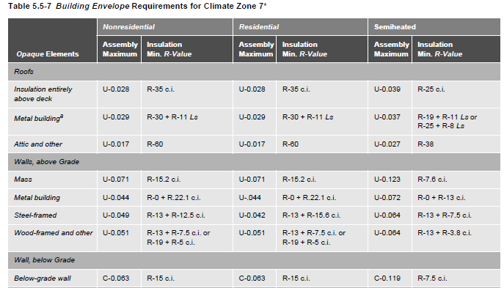
Section 5 – 5.5.1 Opaque
Opaque Elements | Nonresidential |  | Residential |  | Semiheated
 | Assembly Maximum | Insulation Min. R-Value | Assembly Maximum | Insulation Min. R-Value | Assembly Maximum | Insulation Min. R-Value
Roofs Insulation Entirely above Deck Metal Building Attic and Other | U-0.028 U-0.029 U-0.017 | R-35 c.i. R-30+R-11 Ls R-60 | U-0.028 U-0.029 U-0.017 | R-35 c.i. R-30+R-11 Ls R-60 | U-0.039 U-0.037 U-0.027 | R-25 c.i. R-19+R-11 Ls or R-25+R-8 Ls R-38
Reference Table 5.5-7 on page 58 in 90.1-2016
Notes:
PRESENTERS: All of the tables are provided; use only the tables representing climate zones applicable to your training sessions.

Slide 41
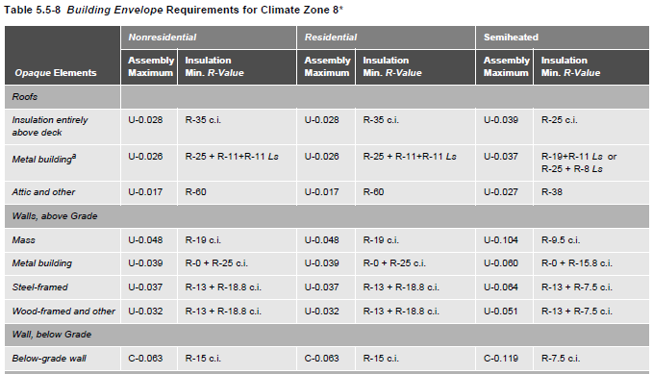
Section 5 – 5.5.1 Opaque
Opaque Elements | Nonresidential |  | Residential |  | Semiheated
 | Assembly Maximum | Insulation Min. R-Value | Assembly Maximum | Insulation Min. R-Value | Assembly Maximum | Insulation Min. R-Value
Roofs Insulation Entirely above Deck Metal Building Attic and Other | U-0.028 U-0.026 U-0.017 | R-35 c.i. R-25+R-11+ R-11 Ls R-60 | U-0.028 U-0.026 U-0.017 | R-35 c.i. R-25+R-11+ R-11 Ls R-60 | U-0.039 U-0.037 U-0.027 | R-25 c.i. R-19+R-11 Ls or R-25+R-8 Ls R-38
Reference Table 5.5-8 on page 59 in 90.1-2016
Notes:
PRESENTERS: All of the tables are provided; use only the tables representing climate zones applicable to your training sessions.

Slide 42
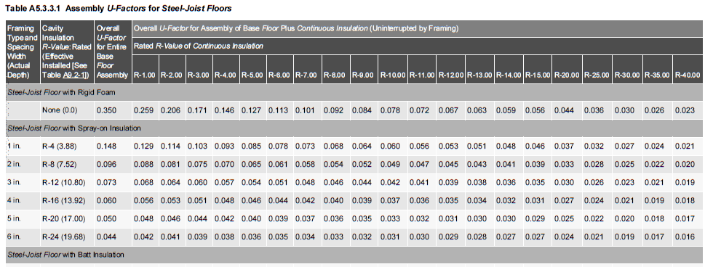
Section 5 – A5.3 Opaque Areas
Framing Type and Spacing Width (Actual Depth) | Cavity Insulation R-Value: Rated (Effective Installed [See Table A9.2A]) | Overall U-Factor For Entire Base Floor Assembly | Overall U-Factor for Assembly of Base Floor Plus Continuous Insulation (Uninterrupted by Framing) Rated R-Value of Continuous Insulation
 |  |  | R- 1.00 | R- 2.00 | R- 3.00 | R- 4:00 | R- 5.00 | R- 6.00 | R- 7.00 | R- 8.00 | R- 9.00 | R- 10.00 | R- 11.00 | R- 12.00 | R- 13.00 | R- 14.00 | R- 15.00 | R- 20.00 | R- 25.00 | R- 30.00 | R- 35.00 | R- 40.00
Steel Joist Floor with Rigid Foam None (0.0) 0.350 |  |  | 0.259 | 0.206 | 0.171 | 0.146 | 0.127 | 0.113 | 0.101 | 0.092 | 0.084 | 0.078 | 0.072 | 0.067 | 0.063 | 0.059 | 0.056 | 0.044 | 0.036 | 0.030 | 0.026 | 0.023
Notes:
Section 5.5.3 refers to Appendix A.
Appendix A has specifications listed for each class of construction and values for typical construction assemblies that can be used to determine compliance.
This is an example of one of the tables in Appendix A – Assembly U-factors for steel-joist floors.

Slide 43
Section 5 – 5.5.3.1 Roof Insulation
Meet or exceed minimum R-value in table for climate zone
Skylight curbs insulated to level of roofs with insulation entirely above deck or R-5, whichever is less
Notes:
Some interruptions are inevitable and permitted up to 1%. Interruptions are typically required to provide structural supports for mechanical or other roof-mounted equipment.

Slide 44
Section 5 – 5.5.3.1 Roof Insulation (cont’d)
Three types of roofs are defined
Roofs with insulation entirely above deck
R-value is for continuous insulation
Exception: Interruptions for framing and pads for mechanical equipment ≤ 1% of surface of the total roof area
Metal building roofs
First value is for insulation
draped over purlins and then compressed when metal spanning members attached or
hung between purlins provided there’s a min. of 1” thermal break between purlins and metal spanning members
Second value is for double-layer installations with insulation installed parallel to the purlins
Attics and other roofs
R-value is for insulation installed both inside and outside the roof or entirely inside the roof cavity
Notes:
Double-layer – continuous insulation – it is assumed that the insulation boards are installed below the purlins and are uninterrupted by framing members. Insulation exposed to the conditioned space or semiheated space shall have a facing and all insulation seams shall be continuously sealed to provide a continuous air barrier.
Attics and Other Roofs – all roofs that aren’t metal building roofs or don’t have insulation installed above the structural deck.
For attics – the Standard permits the insulation depth to be reduced near the eaves since this was accounted for in developing the requirements.
Single-rafter roofs – when insulation required by the Standard has a thickness too large to fit in the cavity, it’s only necessary to install insulation at a depth that will fill the cavity and still leave an inch or so for ventilation.

Slide 45
Section 5 – 5.8.1 Insulation Installation
Rated R-value clearly identified by an identification mark applied by manufacturer to each piece of building envelope insulation
Exception- provide documentation
Per manufacturer’s instructions
Achieve rated R-value
No open-blown or poured loose-fill insulation when ceiling slope is > 3/12
If eave vents installed
Provide baffling of air vents to deflect incoming air above the surface of the insulation
Metal buildings Exception
if roof and wall insulation is compressed between roof or wall skin and the structure
Notes:
Exception: when insulation does not have an identification mark, the installer of such insulation shall provide a signed and dated certification for the installed insulation listing the type of insulation, the manufacturer, the rated R-vale of insulation, and where appropriate, the initial installed thickness, the settled thickness, and the coverage area
Exception: where metal building roof and metal building wall insulation is compressed between the roof or wall skin and the structure

Slide 46
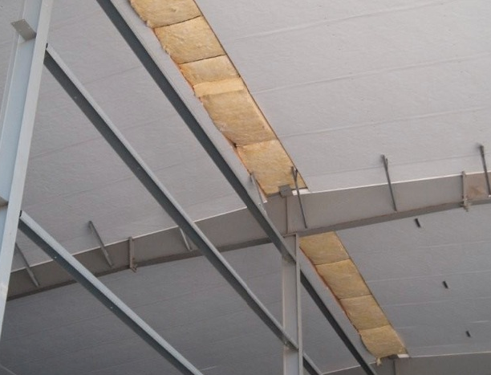
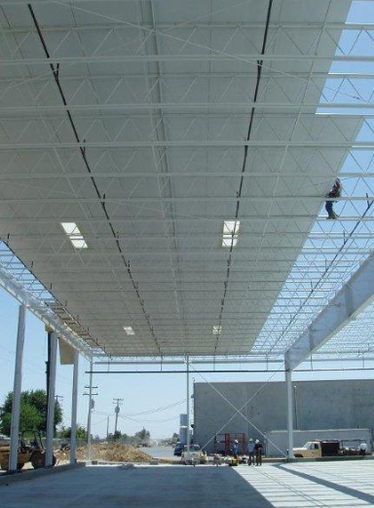
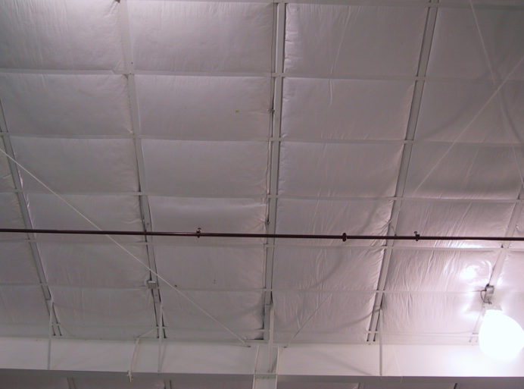
Section 5
Roof Insulation Examples
Photos courtesy of MBMA
Notes:
Verify that the installed insulation R-value meets or exceeds the R-value shown on the plans or energy code compliance documentation.
Applies if only time you can check insulation before final roof covering is installed (e.g., roof deck).

Slide 47
Section 5 – 5.5.3.1.1 High Albedo Roofs
Required in climate zones 0-3
Minimum three-year aged solar reflectance of 0.55 and minimum three-year aged thermal emittance of 0.75 (tested in accordance with CRRC-1 Standard)
OR
Minimum Solar Reflectance Index of 64, based on
Three-year aged solar reflectance
Three-year aged thermal emittance
Tested in accordance with CRRC-1 Standard
OR
Increase roof insulation levels in Table 5.5.3.1.1
Notes:
Qualifying products shall be tested and labeled by the Cool Roof Rating Council.
Solar Reflectance Index must be as calculated by the ASTM E1980 procedure.
Cool roof can be achieved by applying a coating to the roof’s outside surface or using a material that has both a high reflectance (light color) and a high emittance.

Slide 48
Section 5 – 5.5.3.1 High Albedo Roofs – Exceptions
Ballasted roofs with minimum stone ballast of 17 lb/ft² or 23 lb/ft² pavers
Vegetated roof systems containing minimum thickness of 2.5 in. of growing medium that covers minimum of 75% of roof area with durable plantings
Roofs, where a minimum of 75% of the roof area is:
shaded during peak sun angle on June 21 by permanent components or features of the building
covered by off-set PV arrays, building-integrated PV arrays, or solar air or water collectors OR
permitted to be interpolated using a combination of 1 and 2 above
Steep-sloped roofs
Low-sloped metal building roofs in climate zones 2-3
Roofs over: ventilated attics, semiheated spaces, or conditioned spaces that aren’t cooled spaces
Asphaltic membranes in climate zones 2-3
Notes:
Qualifying products shall be tested and labeled by a nationally recognized accreditation organization, such as the Cool Roof Rating Council CRRC-1.
Cool roof can be achieved by applying a coating to the roof’s outside surface or using a material that has both a high reflectance (light color) and a high emittance.

Slide 49
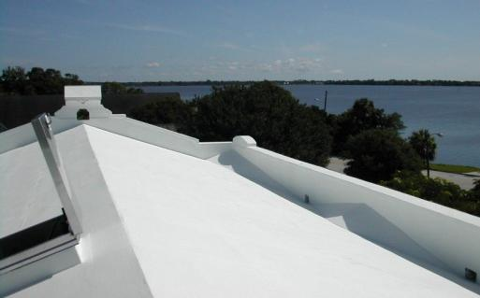
Section 5 High Albedo Roof – Example

Slide 50
Section 5 – 5.5.3.2 Above-Grade Wall Insulation
Meet or exceed R-value specified for climate zone in appropriate table
When wall consists of both above-grade and below-grade portion, entire wall to be insulated on either exterior or interior or be integral
If insulated on interior
above-grade wall insulation requirements apply
If insulated on exterior or integral
below-grade wall portion to be insulated to the below-grade wall requirements and
above-grade to above-grade wall requirements
Notes:
A mass wall is a heavyweight wall, with a heat capacity larger than 5 Btu/ft2-F.
Comply with R-value criteria or U-factor requirement for the overall assembly, including thermal bridges.
If insulated on the interior, the wall is insulated to the above-grade wall requirements.
If insulated on the exterior or integral, the below-grade wall portion is insulated to the below-grade wall requirements, and the above-grade wall portion shall be insulated to the above-grade wall requirements.
Exception example – perlite-filled cores on concrete block; applies only when the concrete masonry units are ungrouted or partly grouted.
Sub-bullets under “Mass Walls” come from Appendix A. Exception itself is unchanged, but language was moved from the Appendix to Section 5 in 90.1-2013.

Slide 51
Section 5 – 5.5.3.2 Above-Grade Wall Insulation (cont’d)
Above-grade wall in Climate Zone 0 to meet one of the following:
A. East and west walls, minimum of 75% of the opaque wall area to have a minimum SRI 29
glass sprandrel areas a minimum solar reflectance of 29% determined in accordance with NFRC 300 or ISO 9050 is permitted
Each wall is allowed to be considered separately
East and west walls, minimum of 30% of the above-grade wall area be shaded through the use of shade-providing plants, manmade structures, existing buildings, hillsides, permanent building projections, on-site renewable energy systems, or combination
Shade coverage calculated at 10 a.m. for east walls and 3 p.m. for west walls on summer solstice
The building is allowed to be rotated up to 45 degrees to the nearest cardinal orientation for compliance calculation purposes

Slide 52
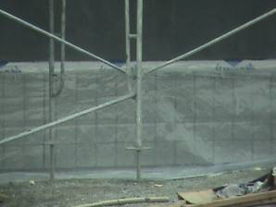
Section 5 – 5.5.3.2 Above-Grade Wall Insulation (cont’d)
Four types of walls are defined
Mass walls
heat capacity (HC) determined from Table A3.1-2 or A3.1-3
Rated R-value is for continuous insulation or when uninterrupted by framing other than metal clips no closer than 24 in. o.c. horizontally and 16 in. o.c. vertically
Exception
Requirement of U-0.151

Slide 53
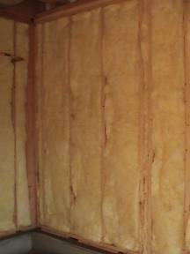
Section 5 Above-Grade Wall Insulation (cont’d)
Four types of walls are defined (cont’d)
Metal building wall R-value
for insulation compressed between metal wall panels and the steel structure
Steel-framed wall R-value
for uncompressed insulation installed in the cavity between steel studs; also acceptable to be continuous insulation uninterrupted by studs
Wood-framed and other R-value
for uncompressed insulation installed in the cavity between wood studs; also acceptable to be continuous insulation uninterrupted by studs

Slide 54
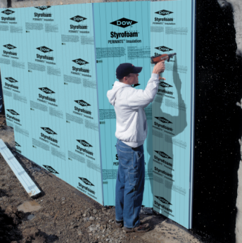
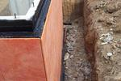
Section 5 – 5.5.3.3 Below-Grade Wall Insulation
Meet or exceed values in appropriate table for climate zone
R-value is for continuous insulation
Exception
If framing is used, compliance is based on maximum assembly C-factor
Photo courtesy of Dow Building Solutions
Notes:
C-factor includes all layers in the construction assembly but excludes exterior air film and soil effect.
Continuous insulation can be either on the outside or inside.

Slide 55
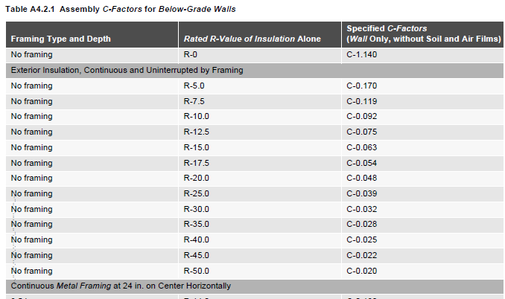
Section 5 – 5.5.3.3 Below-Grade Wall Insulation
Framing Type and Depth | Rated R-Value of Insulation Alone | Specified C-Factors (Wall Only, without Soil and Air Films)
No Framing | R-0 | C-1.140
Exterior Insulation, Continuous and Uninterrupted by Framing
No Framing No Framing No Framing | R-5.0 R-7.5 R-10.0 | C-0.170 C-0.119 C-0.092
Notes:
C-factors for below-grade walls are taken from Table A4.2.1; excerpt shown above

Slide 56
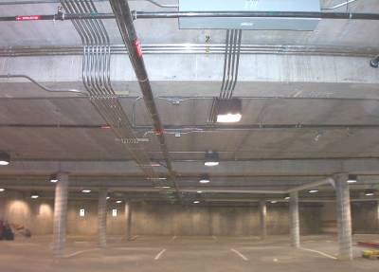
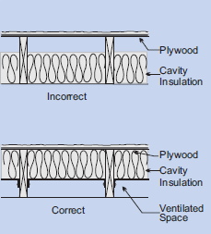
Section 5 – 5.5.3.4 Floor Insulation
Meet or exceed values in appropriate table for climate zone
3 classes of floors over unconditioned space are defined:
Mass floors
R-value is for continuous insulation
If framing is used, compliance is based on maximum assembly U-factor
Steel-joist floors
R-value is for uncompressed insulation or spray-on insulation, but is also acceptable for continuous insulation
Wood-framed and others
R-value is for uncompressed insulation, but is also acceptable for continuous insulation
Notes:
Waffle slab floors – floor is insulated either on interior above the slab or on all exposed surfaces of the waffle
Insulation in floor cavity must be in contact with inside surface.

Slide 57
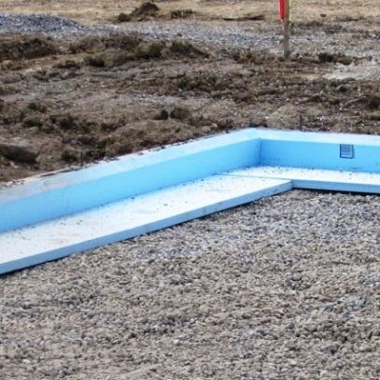
Section 5 – 5.5.3.5 Slab-on-Grade Floor Insulation
For the rated R-value of insulation to be installed around the perimeter of the slab-on-grade floor to the distance specified or exceed the values in the appropriate table for climate zone.
Be installed around the perimeter to the distance specified
Inside foundation wall – extend downward from top of slab a minimum distance specified or to the top of the footing, whichever is less
Outside foundation wall – extend from top of the slab or downward to at least the bottom of the slab and then horizontally to a minimum distance specified
In all climate zones, the horizontal insulation extending outside of the foundation to be covered by pavement or by soil a minimum of 10 in. thick
Exception: monolithic slab-on-grade floor, insulation to extend from the top of the slab-on-grade to the bottom of the footing.
Notes:
For unheated slabs, insulation is required from climate zones 3 and up.

Slide 58
Section 5 – 5.5.3.6 Opaque Doors
U-factor not greater than specified for climate zone in appropriate table
Notes:
Table 5.5-4 (partial table)

Slide 59
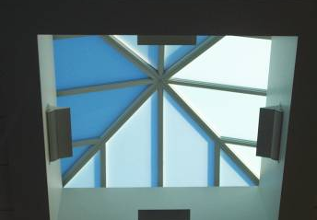
Section 5 – 5.5.4 Fenestration
Criteria apply to fenestration, including windows, glass doors, glass block, plastic panels, and skylights
specified by fenestration type, space-conditioning category and by climate zone
Compliance with values in Tables 5.5-0 through 5.5-8
U-factor not greater than specified
SHGC not greater than specified
Meet or exceed minimum VT/SHGC
Use NFRC ratings or default values in Appendix A
Exceptions:
Area weighting allowed within same class of
construction and space-conditioning category
Area weighting for vertical fenestration allowed across multiple classes of construction for a single space-conditioning category, but not across multiple space-conditioning categories
Notes:
Use default values with caution as the defaults are chosen to be the worst examples of products that might be used. They may not comply with 90.1-2013.

Slide 60
Section 5 – 5.5.4.2 Fenestration Area
Total vertical fenestration area to be smaller than specified values in Tables 5.5-0 through 5.5-8 (40% for all climate zones)
Including both fixed and operable vertical fenestration
Exception: street-level vertical fenestration (5.5.4.4.1)
Total skylight area smaller than specified in Tables 5.5-0 through 5.5-8 (3% of roof area for all climate zones)
Permitted to be no greater than 6% of gross roof area provided criteria in exception 1 to skylight SHGC requirements are met (5.5.4.4.2) and daylight area under skylights is more than or equal to half the floor area of the space
Notes:
Buildings with vertical fenestration > 40% must use the Trade-Off Method or ECB.
For both windows and skylights, there is a maximum U-factor and a maximum SHGC.
= vertical if slope is greater than or equal to 60 degrees from horizontal.
= skylight if slope is less than 60 degrees from horizontal.
Ex: clerestories, roof monitors = vertical

Slide 61
Section 5 – 5.5.4.2.3 Minimum Skylight Fenestration Area
Minimum skylight area must be provided in enclosed spaces that are
≥ 2,500 ft²
In spaces with ceiling height > 15 ft and
Space types
Office
Lobby
Atrium
Concourse
Corridor
Storage (incl. nonrefrigerated warehouse)
Gymnasium/fitness/exercise area
Playing area
Gymnasium seating area
Convention exhibit/event space
Courtroom
Automotive service
Fire station engine room
Manufacturing
Corridor/transition and bay areas
Retail
Library reading and stack areas
Distribution/sorting area
Transportation
Baggage and seating areas
Workshop
Notes:
Requirements for skylights in large spaces

Slide 62
Section 5 – 5.5.4.2.3 Minimum Skylight Fenestration Area
The skylight area must daylight a minimum of half the floor area and provided
Minimum ratio of 3% of skylight area to daylight area with a skylight VLT at least 0.40
OR
a minimum skylight effective aperture of at least 1%
Exceptions
Enclosed spaces in Climate Zones 6-8
Enclosed spaces under shaded roofs (beam sunlight blocked for more than 1500 daytime hours between 8 a.m. and 4 p.m.)
Daylight area under rooftop monitors is > 50% of floor area
Documented that 90% of skylight area is shaded on June 21 (Northern Hemisphere)/December 21 (Southern Hemisphere) at noon by permanent features
Where total space area minus the primary and secondary sidelighted area(s) is < 2,500 ft and where lighting is controlled according to sidelighting requirements of Section 9.4.1

Slide 63
Section 5 – 5.5.4.3 and 5.8.2.3 Fenestration U-Factor
U-factor not greater than specified in Tables 5.5-0 through 5.5-8
Exception: U-factor for skylights allowed to be increased no greater than
0.90 Btu/h•ft² °F in Climate Zone 0-3
0.75 Btu/h•ft² °F in Climate Zone 4-8
Provided they have a glazing material or diffuser with a measured haze value greater than 90% when tested in accordance with ASTM D1003
Have a skylight VT greater than 0.40 and
All general lighting in the daylight area under skylights controlled by multi-level photocontrols in accordance with Section 9.4.1.1 (f)
Determined in accordance with NFRC 100
Skylights – determine for a slope of 20° above the horizontal
Exceptions
A8.1 acceptable for skylights, A8.2 acceptable for other vertical fenestration, and A7 acceptable for opaque doors
ANSI/DASMA 105 acceptable for sectional garage doors and metal coiling doors
Notes:
NFRC’s certification program shifted the basis for skylight ratings to a 20 degree slope in 2001.

Slide 64
Section 5 – 5.5.4.4 Fenestration SHGC
Vertical fenestration (5.5.4.4.1)
SHGC values < Table value for appropriate total vertical fenestration area
Exceptions
For south, east, or west-oriented vertical fenestration only, the SHGC in the proposed building can be reduced by using the multipliers in Table 5.5.4.4.1 for fenestration shaded by permanent projections that will last as long as the building itself
For south, east, or west-oriented vertical fenestration shaded by partially opaque permanent projections that will last as long as the building itself, can reduce the PF by multiplying by values in Table 5.5.4.4.1
Street-level exception only applies when using the prescriptive compliance option
Dynamic glazing cannot be area-weighted with other fenestration and minimum SHGC of dynamic glazing shall be used to show compliance for dynamic glazing
North-oriented vertical fenestration allowed to have SHGC equal to or less than the area-weighted average SHGC of the south, east, and west-oriented vertical fenestration before any reductions made for permanent projections in Exception 1 and 2 of Section 5.5.4.4.1
Notes:
Street-level fenestration if:
Street side of the street-level story is < 20 ft in height
Fenestration has a continuous overhang with weighted average PF > 0.5 and
Street-level fenestration area is < 75% of the gross wall area.

Slide 65
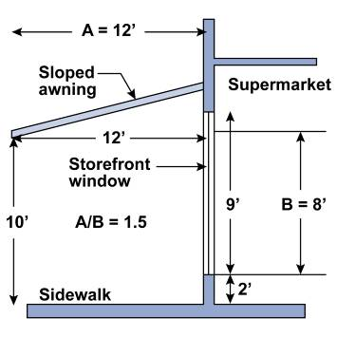
Information – Overhangs
Standard credits permanent overhangs by adjustment to SHGC
Size of overhang is determined by projection factor
Notes:
Conventional overhangs are solid, however, the Standard also offers credit for louvered overhangs and overhangs made of transparent or translucent materials such as tinted or fretted glass.
Credit is offered for louvered overhangs only when the louvers are angled and spaced such that no direct sunlight passes through the louvers at solar noon on the summer solstice (June 21 in the northern hemisphere).

Slide 66
Section 5 – 5.8.2.4 Solar Heat Gain Coefficient (SHGC)
Determined in accordance with NFRC 200
Exceptions
Shading Coefficient (SC) x 0.86 is acceptable for overall fenestration area (NFRC 300)
SHGC of center-of-glass is acceptable (NFRC 300) for overall fenestration area
SHGC from A8.1 for skylights is an acceptable alternative for determining compliance
SHGC from A8.2 for vertical fenestration is an acceptable alternative for determining compliance
Notes:
The glazing’s effectiveness in rejecting solar heat gain
SHGC must be determined in accordance with NFRC 200 and product must be labeled and certified by manufacturer.

Slide 67
Section 5 – 5.5.4.4.2 Skylight SHGC
Skylights
SHGC values < Table value for appropriate total skylight area
Exceptions:
1. If skylights
Have a glazing material or diffuser with measured haze value > 90% when tested according to ASTM D1003, and
Have a skylight VT > 0.40, and
Have all general lighting in daylight area under skylights controlled by multilevel photocontrols per Section 9.4.1.1 (f)
2. Dynamic Glazing
Minimum SHGC is used to demonstrate compliance
Considered separately from other vertical fenestration
Area-weighted averaging with other vertical fenestration that isn’t dynamic glazing isn’t allowed

Slide 68
Section 5 – 5.5.4.5 Fenestration Orientation
Two options to comply for vertical fenestration:
(a) For Climate Zones 0 - 8
A_{W} ≤ (A_{T})/4 and A_{E} ≤ (A_{t})/4
OR
For Climate Zones 0 – 3
A_{W} x SHGC_{W} ≤ (A_{T} x SHGC_{C})/4 and
A_{E} x SHGC_{E} ≤ (A_{T} x SHGC_{C})/4
For Climate Zones 4 – 8
A_{W} x SHGC_{W} ≤ (A_{T} x SHGC_{C})/5 and
A_{E} x SHGC_{E} ≤ (A_{T} x SHGC_{C})/5
Where,
A_{W} and SHGC_{W} = west-oriented vertical fenestration area and SHGC
A_{E} and SHGC_{E} = east-oriented vertical fenestration area and SHGC
A_{T} = total vertical fenestration area
SHGC_{C} = SHGC criteria in Tables 5.5-0 through 5.5-8
Exceptions
Complies with Exception 3 of Section 5.5.4.4.1
Buildings with shade on 75% of the west and east
Alterations and additions that don’t increase vertical fenestration area
Buildings where west- and east-oriented vertical fenestration area < 20% of gross wall area for each of those facades and SHGC on those facades < 90% of SHGC_{c}
Buildings in Climate Zone 8
No!
N
Yes!
Notes:
SHGC trade-off new in 2013 edition. Allows more flexibility in complying prescriptively.
SHGC of east- and west-oriented fenestration used in formula can include effect of overhangs.
Exception for 75% shading applies when shading provided from permanent projections, existing buildings, existing permanent infrastructure, or topography at 9am and 3pm on June 21

Slide 69
Section 5 – 5.5.4.6 Visible Transmittance/SHGC Ratio
When automatic daylighting controls are required per 9.4.1.1 (e) or (f)
fenestration to have a ratio of VT/SHGC not less than listed in Tables 5.5-0 through 5.5-8 (>1.1 for all climate zones)
Exceptions
Can have a light-to-solar-gain ratio (LSG) of not less than 1.25
center-of-glass SHGC and VT determined per NFRC 300 and NFRC 301 by independent lab or included in a database published by a government agency and certified by a manufacturer
Fenestration not covered in scope of NFRC 200
Enclosed spaces
where daylight area under rooftop monitors is > 50% of enclosed space floor area
with skylights complying with 5.5.4.2.3
where sidelighting effective aperture is ≥ 0.15
Dynamic glazing
VT/SHGC ratio and LSG determined using maximum VT and maximum SHGC
Considered separately from other fenestration; cannot include dynamic glazing with other fenestration for area-weighted averaging

Slide 70
Compliance Approaches
Building System
Compliance Options
Envelope
Prescriptive Option
HVAC
Mandatory
Provisions
(required for all compliance options)
Energy Code Compliance
Trade Off Option
SWH
Power
Energy Cost Budget
Lighting
Other
Performance Rating Method
Notes:
The following section details the envelope trade-off option.
Building Envelope Trade-Off Option cannot be used to make trade offs between the building envelope and the lighting or mechanical systems
All mandatory provisions must be satisfied regardless of which compliance path (prescriptive, building envelope trade-off, or energy cost budget) is used.

Slide 71
Section 5 – 5.6.1 Building Envelope Trade-Off Option “Rules”
Proposed design must comply with Sections 5.1, 5.4, 5.7, 5.8, and 5.9
Proposed envelope performance factor (EPF) of proposed design is less than or equal to the proposed envelope performance factor of the base design
All building envelope components shown on drawings or installed in existing buildings to be included in proposed building design
Fenestration and opaque envelope types and area used in simulation model to be consistent with design documents
Don’t need to separately describe any envelope assembly covering < 5% of total area of that assembly
as long as it’s similar to an assembly being modeled
if not separately described, add the area of that assembly to an assembly with same orientation and thermal properties

Slide 72
Section 5 – 5.6.1.2 Trade-Offs Limited to Building Permit
If building permit will apply to less than the whole building
Parameters relating to unmodified existing conditions or future building components to be identical for both proposed EPF and base EPF
Future components meet prescriptive requirements of Section 5.5

Slide 73
Section 5 – 5.7 Submittal Document Labeling of
Space-Conditioning Categories
General – AHJ can require compliance documentation and supplemental information per 4.2.2
Space Conditioning Categories – if building has semiheated or unconditioned spaces and compliance is sought using semiheated criteria, spaces to be clearly indicated on floor plans
Visible Transmittance – include test results for skylight glazing or diffusers (per 5.8.2.5)
Daylight Areas – documentation to identify daylight areas on floor plans, including
Primary sidelighted areas
Secondary sidelighted areas
Daylight area under skylights
Daylight areas under roof monitor

Slide 74
Section 5 – 5.8 Product Information and Installation Requirements
Labeling of Building Envelope Insulation (Section 5.8.1.1)
Compliance with Manufacturers’ Requirements (Section 5.8.1.2)
Loose-Fill Insulation Limitation (Section 5.8.1.3)
Baffles (Section 5.8.1.4)
Substantial Contact (Section 5.8.1.5)
Recessed Equipment (Section 5.8.1.6)
Insulation Protection (Section 5.8.1.7)
Location of Roof Insulation (Section 5.8.1.8)
Extent of Insulation (Section 5.8.1.9)
Joints in Rigid Insulation (Section 5.8.1.10)
Notes:
Labeling of Building Envelope Insulation - The rated R-value to be clearly identified
Exception: If no identification mark, need a signed and dated certification for the installed insulation listing the type of insulation, the manufacturer, the rated R-value, and, where appropriate, the initial installed thickness, the settled thickness, and the coverage area.
Compliance with Manufacturers’ Requirements - Insulation to be installed in accordance with manufacturers’ recommendations and in such a manner as to achieve rated R-value of insulation.
Exception: Where metal building roof and metal building wall insulation is compressed between the roof or wall skin and the structure.
Loose-fill Insulation Limitation - Open-blown or poured loose-fill insulation not used in attic roof spaces when the slope of the ceiling is >3/12.
Baffles - When eave vents are installed baffles provided to deflect the incoming air above the surface of the insulation.

Slide 75
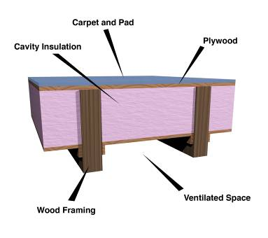
Section 5 – 5.8.1.5 Insulation – Substantial Contact
Install insulation in a permanent manner in substantial contact with inside surface
Flexible batt insulation in floor cavities
Supported in a permanent manner by supports no more than 24 in. on center (o.c.)
Notes:
There is an exception for assemblies that use reflective materials and rely on an air gap next to the interior surface.

Slide 76
Section 5 – 5.8.1.6 Recessed Equipment
Recessed equipment should not affect insulation thickness
Lighting fixtures
HVAC equipment (includes wall heaters, ducts, and plenums)
Other
Except when
Total combined area affected (include necessary clearances) is < 1% of opaque area of the assembly, OR
Entire roof, wall, or floor is covered with insulation to the full depth required, OR
Effects of reduced insulation are included in area-weighted calculations and compressed insulation values from Table A9.4.3
In all cases, air leakage to be limited through or around recessed equipment to the conditioned space in accordance with Section 5.4.3 (Air leakage)
Notes:
Penetration to the roof/ceiling area
Even with these exceptions, the infiltration barrier must be maintained – this generally prohibits drop-in ceilings from being used as the exterior envelope element.
Examples of recessed equipment:
Lighting fixtures
Wall heaters
HVAC ducts
Diffusers
VAV boxes
Electrical panels
Exception examples:
Lighting fixtures can penetrate insulated ceiling if area of opening is <1% of total ceiling area.
Could be achieved if Type IC lighting fixtures are used and additional insulation is placed on top of them.
In all cases, air leakage through or around the recessed equipment to the conditioned space is limited in accordance with Section 5.4.3 (Air Leakage).

Slide 77
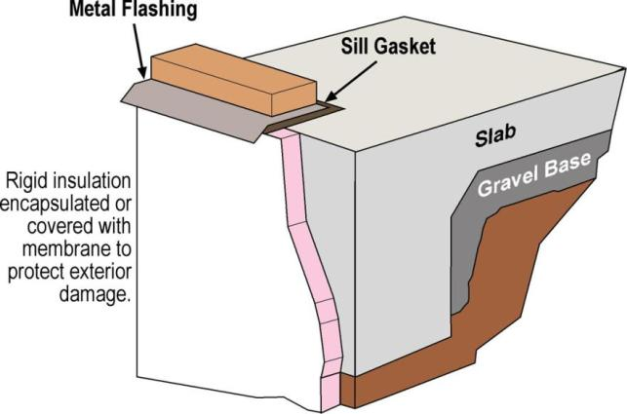
Section 5 – 5.8.1.7 Insulation Protection
Insulation Protection
Cover exterior insulation with protective material
Sunlight
Moisture
Landscaping operations
Equipment maintenance
Wind
Access to attics and mechanical rooms without damaging or compressing insulation
Insulation materials in ground contact to have a water absorption rate ≤ 0.3% (ASTM C272)
Example
Notes:
Rigid insulation used at the slab perimeter shall be covered.
If equipment is installed in attics, access must be provided in a way that won’t cause compression or damage to the insulation. This may mean using walking boards, access panels, and other techniques.
Foundation vents to not interfere with the insulation.

Slide 78
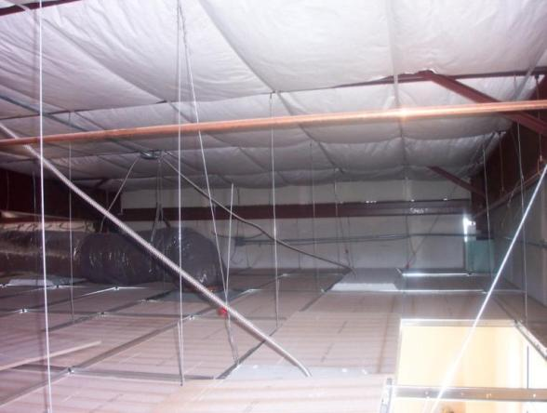
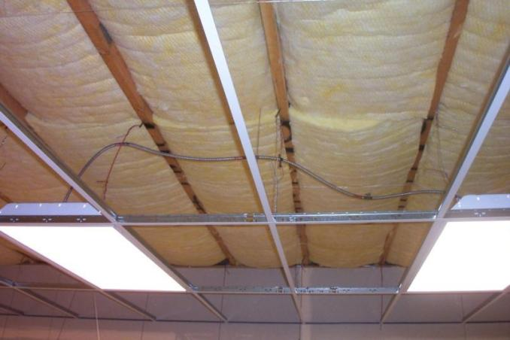
Section 5 – 5.8.1.8 Location of Roof Insulation
Roof Insulation
Not installed on a suspended ceiling with removable ceiling panels
Non-compliant
Notes:
Prohibited because the insulation’s continuity is likely to be disturbed by maintenance workers.
Also, suspended ceilings don’t meet the infiltration requirements unless they’re properly sealed.
If not totally sealed not part of your thermal envelope

Slide 79
Section 5 – 5.8.1.9 Extent of Insulation
Insulation should extend over the full component area to the required rated R-value of insulation
U-factor
C-factor OR
F-factor
Unless otherwise allowed in Section 5.8.1

Slide 80
Section 5 – 5.8.1.10 Joints in Rigid Insulation
Where 2 or more layers of rigid insulation board are used in a construction assembly
the edge joints between each layer of boards to be staggered

Slide 81
Section 5 – 5.9 Inspection
Required Inspections:
Fenestration and doors
Air leakage testing where applicable conducted by independent third party
Operation of door and closer or operating mechanism inspected for conformance with the manufacturer’s instructions
Seals or gaskets installed per manufacturer’s instructions
Loading dock weatherseals
Ensure that the seals are in good condition

Slide 82
Section 5 – 5.9 Inspection (cont’d)
Opaque building envelope air tightness
Opaque roof, above-grade walls, and below-grade walls, and floors subject to the following inspections:
Use of compliant materials and assemblies per Section 5.4.3.1.3
Integration with adjoining fenestration and continuous air barrier elements
Fenestration
Skylights size and location in relation to designed primary sidelighted area and secondary lighted area below
Roof monitor size and location in relation to designed primary sidelighted area and secondary lighted area below
Dynamic glazing with SHGC and U-factor per Section 5.5.4.4.1 and 5.5.4.4.2 and testing of the operation of conformance per manufacturer’s instructions.
Permanent fenestration projections installation and performance per Section 5.5.4.4.1 and construction documents.

Slide 83
Section 5 – 5.9 Verification
Building Envelope Performance
Verified per Section 4.2.5
Air Leakage
In accordance with one of the following methods:
An air barrier design and installation program implemented to include:
Design review conducted to assess compliance with requirements in Sections 5.4.3.1.1, 5.4.3.1.2 and applicable portions of 5.4.3.1.3
Periodic field inspection of continuous air barrier components and assemblies conducted during construction while the air barrier is still accessible for inspection and repair to verify compliance with Sections 5.4.3.1.1, 5.4.3.1.2 and applicable portions of 5.4.3.1.3
Reporting in compliance with Section 4.2.5

Slide 84
Section 5 – 5.9 Verification (cont’d)
Air Leakage cont’d
b. A whole-building air leakage verification program implemented to include the following elements:
1. whole-building pressurization testing performed in accordance with Section 5.4.3.1.3(a) and use of any exceptions documented
2. Reporting in compliance with Section 4.2.5

