Slide 1
ANSI/ASHRAE/IES
Standard 90.1-2016: HVAC
Prepared by Pacific Northwest National Laboratory for the
U.S. Department of Energy
March 2017 – PNNL-SA-124554

Slide 2
Acknowledgements
PNNL and DOE would like to thank ASHRAE Standing Standard Project Committee 90.1 for their contributions to the development of this presentation and their technical review of the content.

Slide 3
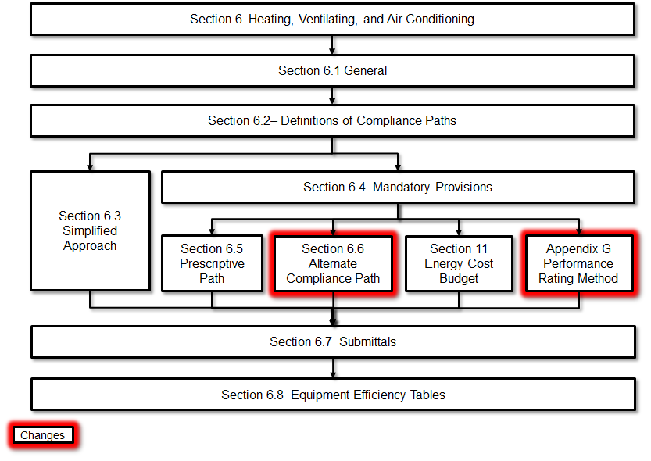
Section 6 Compliance Flowchart
Flowchart shows the overall structure and compliance paths for the requirements
Updates shown in red
Notes:
Section 6.6 was in the prior version of the standard but was missing. With the new PUE for data centers this path is now an option
Appendix G is also now a compliance path and will be covered later in this presentation.

Slide 4
Summary of Changes
Updated climate zone map
Increased HVAC equipment efficiency requirements
Requirements for replacement equipment
Several others

Slide 5
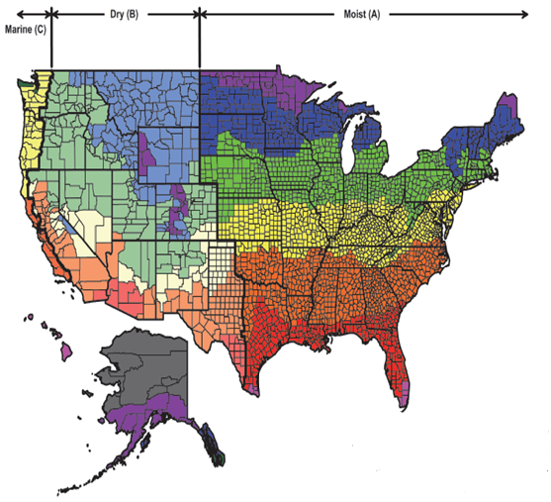
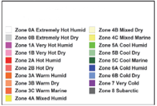
Updated Climate Zone Map
Aligns with new ASHRAE Standard 169-2013
Reflects global warming trends over the most recent 30 years
Adds new Climate Zone 0 (extremely hot)
Approximately 10% of U.S. counties reassigned to a warmer climate zone

Slide 6
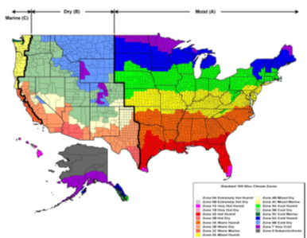
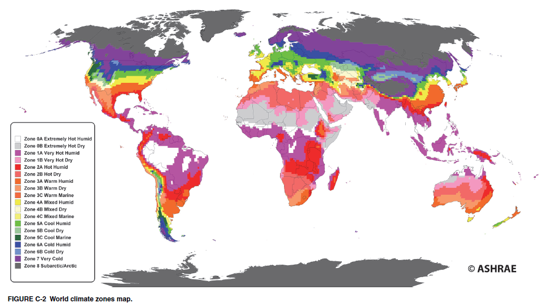
Climate Zone Requirements
With the ASHRAE 169 redefinition of climate zones and the addition of new climate zone 0A and 0B changes were made to the climate specific Section 6 requirements Climate zones are referenced to Section 5.1.4
Changes were made in the following tables and sections
Table 6.4.3.4.3 Damper leakage
Economizer requirements in 6.5.1
Table 6.5.1-1 Minimum Fan Cooling Unit Size for which economizers are Required
Table 6.5.1.1.3 High-Limit Shutoff Control Settings for Air Economizers
Table 6.5.1.2.1 Fluid Economizer Sizing Dry-Bulb and Wet-Bulb Requirements for Computer Rooms (new table)
Supply air temperature reset in section 6.5.3.5
Table 6.5.4.2 Pump Flow Control Requirements (new table)
Exhaust Air Energy Recovery in 6.5.6.1 and tables 6.5.6.1-1 & 2
Table 6.6.1 Power Usage Effectiveness (PUE) Maximum
Table 6.8.2 Minimum Duct Insulation R-Value
Table 6.8.3-1 Minimum Piping Insulation Thickness Heating and Hot Water Systems
Notes:
These climate zone changes represent more recent climatic data.
In general, counties are warmer, and the lines between zones have mostly moved northerly.
As a result, some building insulation requirements may have gotten less stringent in certain counties.

Slide 7
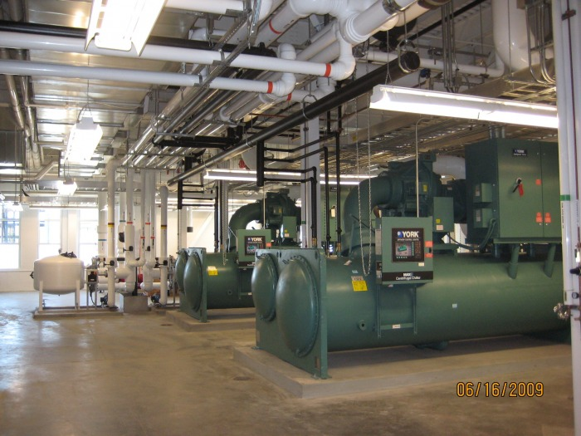
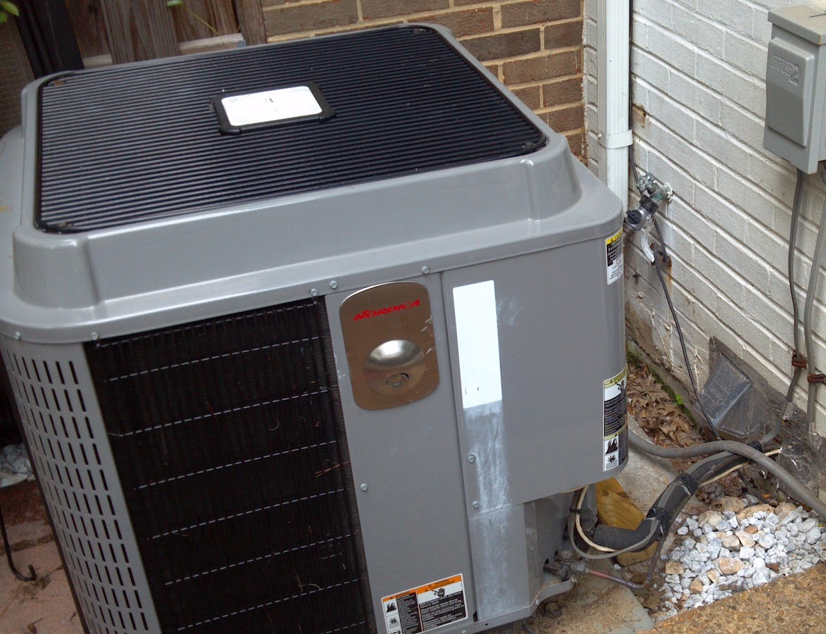
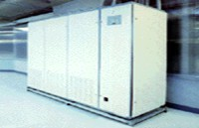
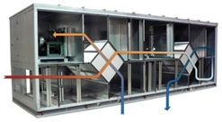
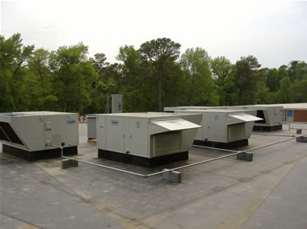
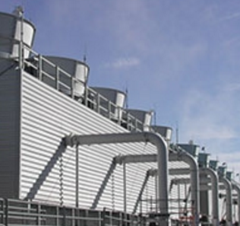
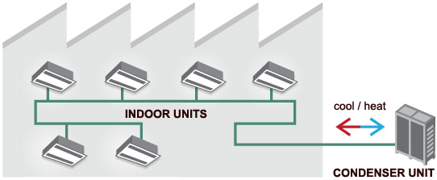




Summary (cont’d)
Increased HVAC Equipment Efficiency Requirements
Chillers
(kW/Ton)
Heat Pumps
(IEER)
Computer Room AC
(SCOP)
Dedicated Outdoor Air* (ISMRE, ISCOP)
Rooftop AC Units
(IEER)
Cooling Towers
(gpm/hp)
Variable Refrigerant Flow
(EER, IEER)
* Newly regulated equipment

Slide 8
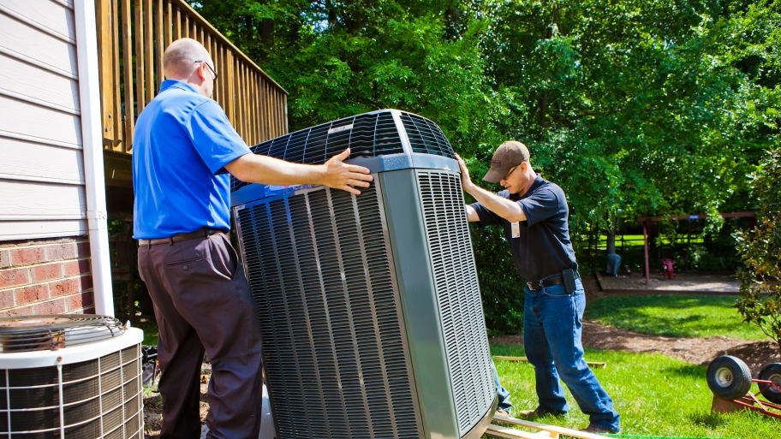
Summary (cont’d)
Replacement equipment now needs to meet many of the requirements formerly for new equipment only. For example:
  Various controls requirements
  Economizer requirements
  Fan efficiency
  Boiler turndown

Slide 9
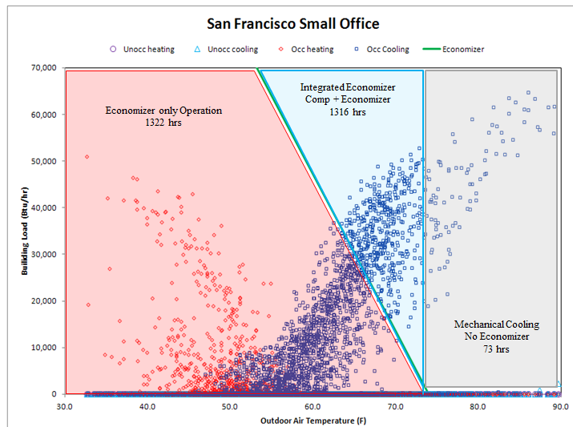
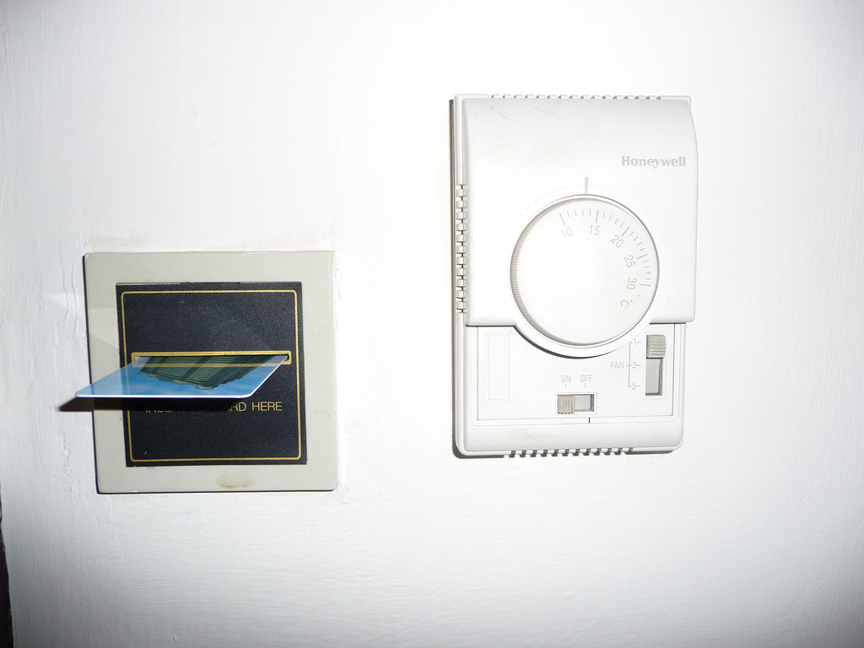
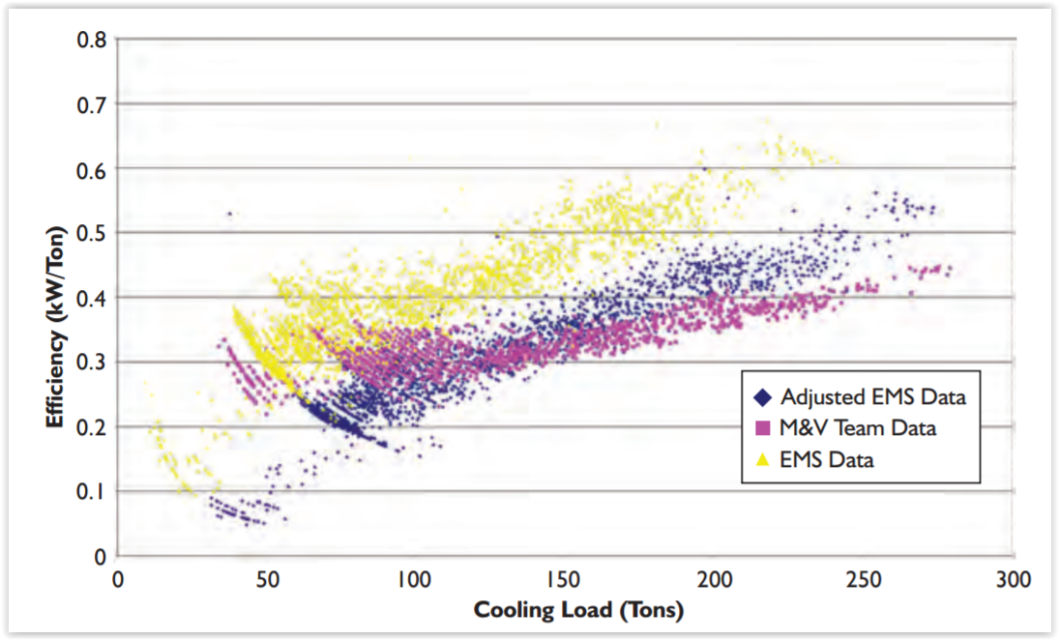
Summary (cont’d)
Hotel/Motel Guest Room Controls
  Heating, cooling, & ventilation automatically reduced when unoccupied
Chilled Water Plant Metering
  Large plants required to meter for electricity and efficiency
Economizer Fault Detection and Diagnostics
  Ensures that economizers using outdoor air for free cooling are configured and working correctly
Miscellaneous Control Requirements

Slide 10
Miscellaneous Controls Requirement
Control Setpoint Configuration Requirements
In many of the controls requirements it was stated that controls must be capable of some configuration. This has been changed to not only require that they are capable but they shall be configured to the defined requirement.
Example in 6.4.3.4 Ventilation outdoor air and exhaust/relief dampers shall be capable of and configured to automatically…

Slide 11
HVAC Compliance
Building System
Compliance Options
Envelope
Prescriptive Option
HVAC
Mandatory
Provisions
(required for most compliance options)
Trade Off Option
Energy Code Compliance
SWH
Energy Cost Budget
Power
Simplified
Lighting
Performance Rating
Method
Other
Notes:
There are four compliance options for HVAC: Simplified, Prescriptive Path, ECB, and Appendix G.. When the simplified approach is used, the Mandatory Provisions do not apply. Grayed out option under Compliance Options is not available for HVAC.
Pick IECC OR ASHRAE for entire code application

Slide 12
Section 6 – 6.1.1
HVAC Scope
New Buildings
Additions to Existing Buildings
Alterations in Existing Buildings
Throughout Section 6, when referring to controls requirements, replaces the words “capable of” with “capable of and configured to” so that controls will be set up at time of inspection.
Notes:
Exceptions: When HVAC to an addition is provided by existing HVAC systems and equipment, existing systems and equipment aren’t required to comply. However, any new systems or equipment installed must comply with specific requirements applicable to those systems and equipment.

Slide 13
Section 6 – 6.1.1.3
HVAC Alterations Scope
Equipment
  New equipment shall meet the minimum efficiency requirements
Cooling systems
  New cooling systems installed to serve previously uncooled spaces shall comply with this section
  Alterations to existing cooling systems shall not decrease economizer capacity (unless economizer tradeoff is used)
Ductwork
  New and replacement ductwork shall comply with applicable requirements
Piping
  New and replacement piping shall comply with applicable requirements
Notes:
New HVAC equipment as a direct replacement of existing HVAC equipment must comply with the specific minimum efficiency requirements applicable to that equipment.
New cooling systems installed to serve previously uncooled spaces must comply with this section as described in Section 6.2.
Alterations to existing cooling systems must not decrease economizer capability unless the system complies with Section 6.5.1.
New and replacement ductwork must comply with Sections 6.4.4.1 and 6.4.4.2.
New and replacement piping must comply with Section 6.4.4.1.

Slide 14
Section 6 – 6.1.1.3
HVAC Alterations
Alterations to the building HVACR system shall comply with the requirements of Section 6
  Exceptions that are allowed:
    Equipment being modified or repaired (not replaced)
      provided such modifications will not result in an increase in the annual energy consumption
    Equipment being replaced or altered which requires extensive revisions to other systems and such replaced or altered equipment is a like-for-like replacement
    Refrigerant change of existing equipment
    Relocation of existing equipment
    Ducts and pipes where there is insufficient space or access to meet these requirements

Slide 15
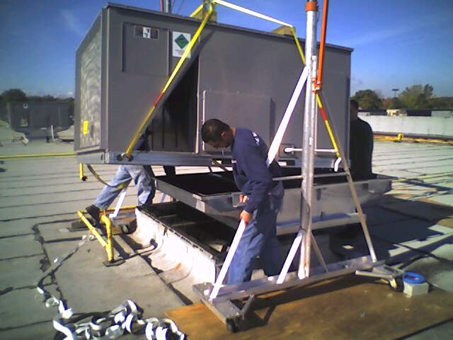
Replacement Equipment
Section 6.1.1.3 defines requirements for replacement equipment which in prior versions of 90.1 were only required on new construction
6.1.1.3.1 New HVACR equipment as a direct replacement of existing HVACR equipment shall comply with the following sections as applicable for the equipment being replaced:
6.3, “Simplified Approach Option for HVAC Systems”
6.4.1, “Equipment Efficiencies, Verification, and Labeling Requirements”
6.4.3.1, “Zone Thermostatic Controls”
6.4.3.2, “Set-Point Overlap Restrictions”
6.4.3.3, “Off-Hour Controls” except for Section 6.4.3.3.4, “Zone Isolation”
6.4.3.4, “Ventilation System Controls”
g. 6.4.3.7, “Freeze Protection and Snow/Ice Melting Systems”
6.4.3.8, “Ventilation Controls for High-Occupancy Areas” only for single-zone equipment
6.4.3.9, “Heated or Cooled Vestibules”
6.4.5, “Walk-In Coolers and Walk-In Freezers”
6.5.1.1, “Air Economizers” for units located outdoors
6.5.1.3, “Integrated Economizer Control”
6.5.1.4, “Economizer Heating System Impact”
6.5.3.1.3, “Fan Efficiency”
6.5.3.2.1, “Supply Fan Airflow Control”
6.5.3.6, “Fractional Horsepower Fan Motors”
6.5.4.1, “Boiler Turndown”
6.5.4.3, “Chiller and Boiler Isolation”
6.5.5.2, “Fan Speed Control”

Slide 16
Section 6 – 6.2
HVAC Compliance Paths
You have to follow Sections
  6.1 General,
  6.7 Submittals, and
  6.8 Minimum Equipment Efficiency
And then you can follow either
  Section 6.3 Simplified Approach
  Sections 6.4 Mandatory Provisions and 6.5 Prescriptive Path
  Sections 6.4 Mandatory Provisions and 6.6 Alternative Compliance Path (for Computer Rooms)
Alternatively, you can follow Section 11 (ECB), in which case Section 6.4 is mandatory
Notes:
Section 11 - simulation

Slide 17
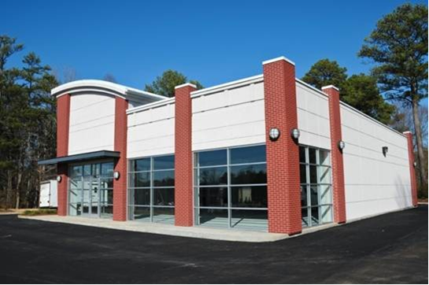
Section 6 – 6.3
Simplified Approach Option
The simplified approach is an optional path for compliance when the following are met:
  Buildings with 1 or 2 stories
  Buildings with gross floor area < 25,000 ft²
  System serving single HVAC zone
  Each system complies with 6.3.2
Notes:
Buildings must meet ALL of these requirements before the simplified approach option may be used.
The Simplified Approach was included so that small buildings could comply with the standard with minimal effort, but be subjected to the same stringency as is in the rest of the standard. Since the requirements fit on two pages it is ideal for a small commercial building. The committee included this simplified approach because 80 to 85% of the building stock is this type of building.

Slide 18
Section 6 – 6.3
Simplified Approach Criteria
Single HVAC zone
Variable flow requirements (6.5.3.2.1)
Cooling equipment efficiency (6.8.1)
Air economizers (6.5.1 and 6.4.3.12)
Heating equipment efficiency (6.8.1)
Exhaust air energy recovery (6.5.6.1)
Dual setpoint thermostat or manual changeover
Heat pump auxiliary heat control
No reheat or simultaneous cooling and heating for humidity control
Off-hour shutoff and temperature setback/setup
Systems serving hotel/motel guest rooms comply with Section 6.4.3.3.5
Piping insulation (Tables 6.8.3-1 and 6.8.3-2)
Ductwork insulation and sealing (6.4.4.2.1)
Air balancing of ducted system
Outdoor air intake and exhaust systems (6.4.3.4)
Zone thermostatic controls to prevent simultaneous heating and cooling
Optimum start controls
Demand control ventilation (6.4.3.8 and 6.5.3.7)
Door switch requirements (6.5.10)
Notes:
Item r is new in 90.1-2013
Note: the section numbers following the items refer to the sections where the detailed requirements exist. For ease of presentation, the slides representing those detailed requirements have been moved into this Simplified Approach section and may not appear later in the presentation.

Slide 19
Section 6 – 6.5.3.2 (6.3.2b)
Fan Control
Air-handling and fan coil unit supply fans controlled by two-speed motors or variable speed drives
  Chilled-water cooling coils where the supply fans have motors ≥ 1/4 hp
  Direct expansion units ≥ 65,000 Btu/h cooling capacity
  Two speeds of fan control required during economizer operation
  * or volume of outdoor air required
  to meet Standard 62.1
Temperature Control | Typical Zones | Minimum fan speed | Fan power at min speed | Fan control
Supply Air | Multiple | ≤ 50% * | ≤ 30% | Modulating
Room Temperature | Single | ≤ 66% * | ≤ 40% | Two-speed, Multi-speed or Modulating
Notes:
Requirements referenced in 6.3.2b
The effective dates in the 90.1-2013 table are now in the past so a DX units ≥65,000 Btu/h and chilled water units greater than ¼ hp require a minimum of 2 stages of fan control

Slide 20
Section 6 – 6.8.1 (6.3.2c)
Equipment Efficiency
Reference 90.1-2016 Tables:
6.8.1-1, 6.8.1-2, 6.8.1-4
Notes:
6.8.1-1 – air conditioners
6.8.1-2– heat pumps
6.8.1-4 – packaged terminal and room air conditioners and heat pumps

Slide 21
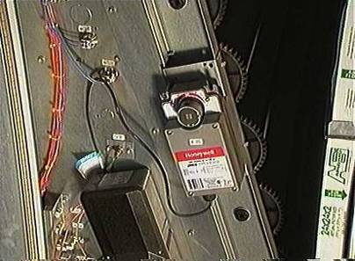
Section 6 – 6.5.1 (6.3.2.d)
Economizers
The system shall either have an economizer,
Or use the economizer Trade-off Option
  Limited to unitary systems
  Requires higher minimum cooling efficiency (EER)
  Trade-off EER by
    System size
    Climate zone
Eliminated separate table for computer rooms. They must follow the same thresholds as other spaces.
Notes:
Table 6.5.1-2 is the table to review for eliminating the required Economizer

Slide 22
Section 6 – 6.3.2
Economizers
Reference Table 6.5.1-2 on page 88 in 90.1-2016
Notes:
Table 6.5.1-2 is the table to review for eliminating the required Economizer
No trade-offs

Slide 23
Section 6 – 6.5.1 (6.3.2d)
Economizers
Climate and size dependent (Tables 6.5.1-1 and -2)
There are LOTS of exceptions
Can use air economizers
  100% of design supply air
  Sequenced with mechanical cooling equipment
  High limit shutoff
  Dampers
  Relief of excess outdoor air
  Sensor accuracy
Notes:
Most systems have to have an economizer.
Economizers are not required in all climates. In fact, the requirement is both size- and climate-dependent.
Remember that climates go from hot (1) to cold (8), and are moist (A), dry (B), or marine (C).
When an economizer is required, it may be either an air or water economizer – at the discretion of the building owner and design team
Control of the economizers must be integrated so that mechanical and economizer cooling can take place simultaneously.
In all cases, the economizer must not increase the heating energy in the system. In effect, this disallows systems, such as single-fan double-duct, because they can greatly increase the heating energy usage. However, these systems could be used in locations that do not require economizers.

Slide 24
Section 6 – 6.5.1
Economizer Exceptions
Exceptions
  Small individual fan units: < Table 6.5.1-1
  Chilled-water cooling systems without a fan or that use induced airflow with certain capacity in certain climate zones
  Systems with nonparticulate air treatment per Standard 62.1
  Hospitals where >75% of the air must be humidified >35°Fdp
  Processes where >25% of the air must be humidified >35°Fdp
  Systems with condenser heat recovery per 6.5.6.2.2
  Residential systems <5X limits in Table 6.5.1-1
  Systems with a balance point <=60°F
  Systems expected to operate < 20hrs/wk
  Systems serving zones with open refrigerated casework
  Where comfort cooling efficiency meets or exceeds Table 6.5.1-2
  Systems serving computer rooms under certain conditions
  Dedicated systems for computer rooms where a minimum of 75% of the design load serves various conditions
Notes:
There are numerous exceptions including:
Systems with condenser heat recovery
Systems that operate less than 20 hours per week
Supermarket systems
Where equipment efficiency has been increased to a level listed in the standard. This increased efficiency is intended to offset the reduced cost of cooling by the economizer.

Slide 25
Section 6 – 6.5.6.1 (6.3.2f)
Exhaust Air Energy Recovery
Required if:
  Supply air capacity ≥ value listed in Tables 6.5.6.1-1 and 6.5.6.1-2
    Values are based on climate zone and % of outdoor air flow rate at design conditions
  Table 6.5.6.1-1 used for all ventilation systems operating < 8,000 hrs/yr
  Table 6.5.6.1-2 used for all ventilation systems operating ≥ 8,000 hrs/yr
Recovery system effectiveness ≥ 50%
  required thresholds have changed to account for minimum size availability of small energy recovery products
A new definition was added for energy recovery efficiency
  enthalpy recovery ratio: change in the enthalpy of the outdoor air supply divided by the difference between the outdoor air and entering exhaust air enthalpy, expressed as a percentage
  sensible energy recovery ratio: change in the dry-bulb temperature of the outdoor air supply divided by the difference between the outdoor air and entering exhaust air dry-bulb temperatures, expressed as a percentage.
Notes:
Heat recovery with 50% effectiveness (enthalpy change) is required on the airside when individual fan systems have capacities of 5,000 cfm, of which 70% or more is outdoor air. Must be able to bypass or control air as required by 6.5.1.1 for systems with air economizer
This effectiveness can be calculated at either heating or cooling design. For cooling design, it must represent total energy transfer—not just sensible. For heating design, effectiveness can be based on sensible heat.
There are several exceptions, including the fact that if there are many small exhaust air ducts, it isn’t cost-effective to recover the heat.

Slide 26
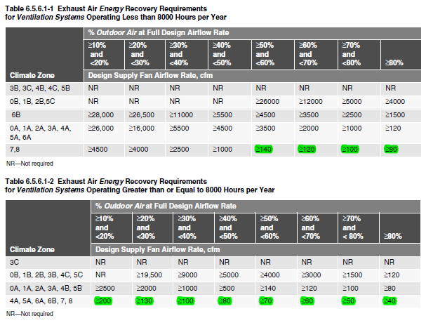
Revised Exhaust Air Energy Recovery Tables

Slide 27
Section 6 – 6.5.6.1 (6.3.2f)
Exhaust Air Energy Recovery Exceptions
Lab systems meeting 6.5.7.3
Systems serving uncooled spaces that are heated to < 60°F
Where > 60% of outdoor heating energy is provided from site-recovered or site solar energy
Heating energy recovery in climate zones 0, 1 and 2
Cooling energy recovery in climate zones 3c, 4c, 5b, 5c, 6b, 7, and 8
Where sum of airflow rates exhausted and relieved within 20 ft of each other is < 75% of the design outdoor airflow
Systems requiring dehumidification that employ energy recovery in series with the cooling coil
Systems operating < 20 hrs/week at outdoor air % in Table 6.5.6.1-1
Notes:
The next to last exception refers to systems like wrap around heat pipes providing reheat after the cooling coil, or systems that reject cooling condensing energy as reheat.
Some of the exemptions for toxic, flammable, point and corrosive fumes and for commercial kitchen hoods were eliminated.

Slide 28
Section 6 – 6.3
Simplified Approach Option (cont’d)
Manual changeover or dual set-point thermostat
Heat pump supplementary heat lockout
No reheat or simultaneous heating and cooling for humidity control
Time clocks (except hotel/motel guest rooms and systems requiring continuous operation)
Systems serving hotel/motel guest rooms to comply with automatic control of HVAC (Section 6.4.3.3.5)
Notes:
It is important to remember that the simplified approach has the same stringency as the rest of the standard; they have just been put on two pages for single-zone air- or evaporatively-cooled systems. In doing this the committee had to balance simplicity (fewer pages) with which requirements to include. Therefore some systems, such as those requiring heat recovery or water cooled systems are not included in the simplified approach.
Systems serving spaces other than hotel/motel guest rooms, and other than those requiring continuous operation, which have both a cooling or heating capacity greater than 15,000 Btu/h and a supply fan motor power greater than 3/4 hp, shall be provided with a time clock that (1) can start and stop the system under different schedules for seven different day-types per week, (2) is capable of retaining programming and time setting during a loss of power for a period of at least ten hours, (3) includes an accessible manual override that allows temporary operation of the system for up to two hours, (4) is capable of temperature setback down to 55°F during off hours, and (5) is capable of temperature setup to 90°F during off hours.
Need to be able to control the system – 24/7 schedule

Slide 29
Section 6 – 6.3
Simplified Approach Option (cont’d)
Ductwork and plenum insulation
Air balancing of ducted systems required
Outdoor air intake and exhaust systems meet 6.4.3.4
Interlocked thermostats for separate heating and cooling
System > 10,000 cfm:
  optimum start controls
Demand control ventilation per 6.4.3.8
Door switch requirements

Slide 30
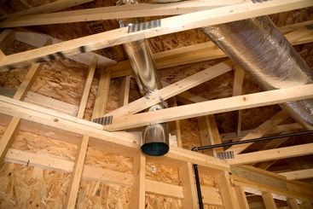
Section 6 – 6.3 (6.3.2.m)
Simplified Approach Option (cont’d)
Piping and ductwork/plenum insulated
Piping Insulation - Reference Tables 6.8.3-1 and 6.8.3-2 on pages 127 and 128 in 90.1-2016
Duct Insulation - Reference Table 6.8.2 on page 127 in 90.1-2016
Notes:
Except for piping within manufacturers’ units, HVAC piping shall be insulated in accordance with Table 6.8.3-1/3-2. Insulation exposed to weather shall be suitable for outdoor service, e.g., protected by aluminum, sheet metal, painted canvas, or plastic cover. Cellular foam insulation shall be protected as above or painted with a coating that is water retardant and provides shielding from solar radiation.
Ductwork and plenums shall be insulated in accordance with Tables 6.8.2-1 and 6.8.2-2 and shall be sealed in accordance with 6.4.4.2.

Slide 31
Section 6 – 6.4.4.1.3 (6.3.2l)
Piping Insulation
Tables 6.8.3-1 and 6.8.3-2
Exceptions
  Factory-installed
  Piping conveying fluids
    design operating temperature range between 60°F-105°F, inclusive
    that haven’t been heated or cooled through the use of fossil fuels or electricity
  Where heat gain or loss won’t increase energy use
  For piping ≤ 1 in, No insulation required for strainers, control values, and balancing values
Notes:
The values in the table are minimum thicknesses of insulation having a conductivity falling in the range listed, when tested at the mean rating temperature listed, for each fluid design temperature range category.

Slide 32

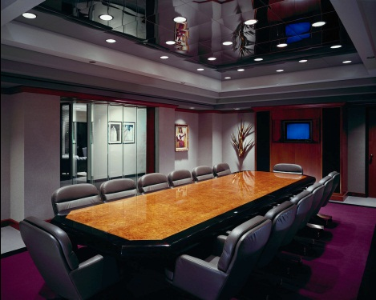
Section 6 – 6.4.3.8 (6.3.2q)
Demand Control Ventilation
DCV must be provided for each zone with an area > 500 ft² and the design occupancy > 25 people/1000 ft² where the HVAC system has:
  air-side economizer,
  automatic modulating control of OSA dampers
  design outdoor airflow > 3,000 cfm
Demand control ventilation (DCV): a ventilation system capability that provides for the automatic reduction of outdoor air intake below design rates when the actual occupancy of spaces served by the system is less than design occupancy.
Notes:
Typically applies to assembly spaces such as theaters, meeting rooms, ballrooms, school auditoriums, cafeterias, and other high occupancy areas.
In 2013 extended to classrooms, break rooms, and conference rooms.

Slide 33
Section 6 – 6.4.3.8 (6.3.2q)
Demand Control Ventilation
Exceptions to DCV:
Systems with exhaust air energy recovery meeting 6.5.6.1
Multiple-zone systems without DDC of individual zones communicating with central control panel
Systems with design outdoor air flow < 750 cfm
Spaces where > 75% of space design outdoor airflow is required for makeup air exhausted from space or transfer air exhausted from other spaces
Spaces with one of the following occupancy categories per ASHRAE 62.1
  Correctional cells
  Daycare sickrooms
  Science labs
  Barbers, beauty, and nail salons
  Bowling alley seating
Notes:
Typically applies to assembly spaces such as theaters, meeting rooms, ballrooms, school auditoriums, cafeterias, and other high occupancy areas.

Slide 34
HVAC Compliance
Building System
Compliance Options
Envelope
Prescriptive Option
HVAC
Mandatory
Provisions
(required for most compliance options)
Trade Off Option
Energy Code Compliance
SWH
Energy Cost Budget
Power
Simplified
Lighting
Performance Rating
Method
Other
Notes:
There are three compliance options for HVAC: Simplified, Prescriptive Path, and ECB. When the simplified approach is used, the Mandatory Provisions do not apply. Grayed out option under Compliance Options is not available for HVAC.
Pick IECC OR ASHRAE for entire code application

Slide 35
Section 6 – 6.4
HVAC Mandatory Provisions
Minimum Equipment Efficiency (Section 6.4.1)
Calculations (Section 6.4.2)
Controls and Diagnostics (Section 6.4.3)
HVAC System Construction and Insulation (Section 6.4.4)
Walk-in Coolers and Walk in Freezers (Section 6.4.5.)
Refrigerated Display Case (Section 6.4.6)
Notes:
All mandatory provisions must be met regardless of whether the Prescriptive or ECB compliance path is used.
The mandatory requirements that apply to the Simplified Approach were previously discussed in the presentation.
The remaining requirements discussed in this section more likely apply to complex systems.

Slide 36
Section 6 – 6.4.1.1
Minimum Equipment Efficiency
HVAC Equipment Covered
  Electrically operated unitary air conditioners and condensing units
  Electrically operated unitary and applied heat pumps (air, water, and ground source)
  Water-chilling packages (chillers)
  Electrically operated packaged terminal air conditioners and heat pumps, single-package vertical air conditioners, single-package heat pumps, room air conditioners, and room air conditioner heat pumps
  Warm-air furnaces, warm-air furnaces/AC units, warm-air duct furnaces and unit heaters
  Gas-and oil-fired boilers
  Performance requirements for heat rejection equipment (cooling towers)
  Heat transfer equipment (heat exchangers)
  Electrically operated variable refrigerant flow (VRF) air conditioners
  Electrically operated VRF air-to-air and applied heat pumps
  Air conditioners and condensing units serving computer rooms
  Commercial refrigerators and freezers
  Commercial refrigeration
  Vapor-Compression-Based Indoor Pool Dehumidifiers
  Electrically Operated DX-DOAS Units, Single-Package and Remote Condenser, without Energy Recovery
  Electrically Operated DX-DOAS Units, Single-Package and Remote Condenser with Energy Recovery
Notes:
Tables 6.8.1A – 6.8.1P

Slide 37
Section 6 – 6.4.1.4
Verification of Equipment Efficiencies
Equipment efficiency information from manufacturers verified by one of the following
EPACT equipment – to comply with federal certification requirements
If certification program exists for covered product and includes provisions for verification and challenge of equipment efficiency ratings, product listed in program
If product not listed in program, ratings verified by an independent laboratory test report
If no certification program exists, equipment efficiency ratings supported by data furnished by manufacturer
Where components from different manufacturers are used, system designer specifies components whose combined efficiency meets Section 6.4.1
Requirements for plate type liquid-to-liquid heat exchangers listed in Table 6.8.1-8

Slide 38
Section 6 – 6.4.1.5
Labeling
Mechanical equipment (6.4.1.5.1) – equipment not covered by NAECA to have a permanent label stating equipment complies with 90.1
Packaged terminal air conditioners (6.4.1.5.2) – packaged terminal air conditioners and heat pumps with sleeve sizes < 16 in. high and 42 in. wide with a cross-sectional area < 670 in² to be factory labeled as follows:
  Manufactured for nonstandard size applications only: not to be installed in new construction projects

Slide 39

Section 6 – 6.4.2.1
Load Calculations
Must calculate heating and cooling system design loads
Must determine calculations with ANSI/ASHRAE/ACCA Standard 183
Notes:
Load calculations required, but there’s no corresponding requirement to use the calculations for equipment sizing.
Enforcement agencies should request a summary of the load calculations (don’t need to require the entire detailed calculation package).
ANSI/ASHRAE/ACCA Standard 183-2007 Peak Cooling and Heating Load Calculations in Buildings Except Low-Rise Residential Buildings

Slide 40
Section 6 – 6.4.2.2
Pump Head
When sizing pumps, head to be determined in accordance with generally accepted engineering standards/handbooks acceptable to the authority having jurisdiction
Must calculate the pressure drop through each device and pipe segment in the critical circuit at design conditions

Slide 41
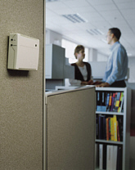
Section 6 – 6.4.3.1
Controls – Zone Thermostatic & Dead Band
Required for each zone
  Perimeter can be treated differently
Dead band controls
  Thermostats must have at least a 5°F dead band
  Exceptions
    Thermostats that require manual changeover between heating and cooling modes
    Special occupancy or applications where wide temperature ranges aren’t acceptable (e.g., retirement homes) and approved by AHJ
Notes:
A dwelling unit can be considered a single zone
Whole idea is to maintain control of energy use; keep thermal control; shut off stuff when it’s not needed.
Exception: Independent perimeter systems that are designed to offset only building envelope loads shall be permitted to serve one or more zones also served by an interior system provided
the perimeter system includes at least one thermostatic control zone for each building exposure having exterior walls facing only one orientation for 50 contiguous feet or more, and
the perimeter system heating and cooling supply is controlled by a thermostatic control(s) located within the zones(s) served by the system.
Exterior walls are considered to have different orientations if the directions they face differ by more than 45 degrees.

Slide 42
Section 6 – 6.4.3.2
Controls – Setpoint Overlap Restriction
If heating and cooling for the same zone are controlled by separate thermostats or sensors:
  Means will be provided to prevent the heating setpoint from exceeding the cooling setpoint minus any applicable proportional band
  Means can include limit switches, mechanical stops, or software programming for DDC systems
Notes:
Requirement because one control zone could fight with the others if their setpoints are close to each other.

Slide 43
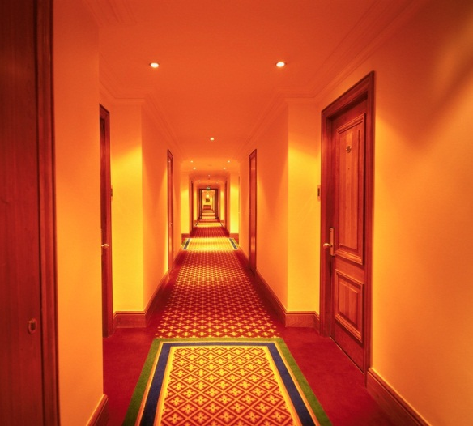
Section 6 – 6.4.3.3
Controls – Off-Hour
Temperature Control off-hour requirements
Automatic shutdown
Setback controls
Optimum start
Zone isolation
Automatic control of HVAC in hotel/motel guest rooms
Exceptions, HVAC systems
  with heating and cooling capacity < 15,000 Btu/h
  intended to operate continuously
Notes:
Whole idea is to maintain control of energy use; keep thermal control; shut off stuff when it’s not needed. These only cover presence of controls – nothing in the Standard says how you use them.

Slide 44
Section 6 – 6.4.3.3.1
Controls – Automatic Shutdown
Each HVAC system needs one of the following:
  Automatic time clock or programmable thermostat with 7-day/week schedule and 10-hour battery backup with two-hour manual override, OR
  Occupant sensor, OR
  Manually-operated timer with maximum two hour duration, OR
  Security system interlock
Exception
  Residential occupancies allowed to operate with only 2 different time schedules/wk
Notes:
Occupancy sensor to shut off system if no occupancy for up to 30 minutes
Interlock to security system that shuts off system when security system is activated
Controls to keep the information because people likely wouldn’t reprogram them if they didn’t and programmed settings were lost

Slide 45
Section 6 – 6.4.3.3.2
Controls – Setback
Heating systems
  Maintain unoccupied zone temperatures at an adjustable setpoint at least 10°F below occupied heating setpoint
Cooling systems
  Temporarily operate during unoccupied periods to
    Maintain unoccupied zone temperatures at an adjustable setpoint at least 5°F above the occupied cooling setpoint
    May operate cooling as needed to prevent high space humidity levels
Exception
  Radiant heating systems with setback heating setpoint at least 4°F below occupied heating setpoint
Notes:
Note that these are capabilities, not settings
Setback controls prevent spaces from becoming so cold or so hot during off-hours that the HVAC system can’t bring them back up to a comfortable range in a reasonable period of time.
Exception:
Radiant floor and ceiling heating systems.

Slide 46
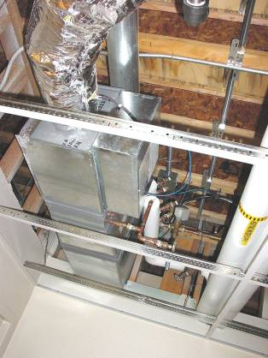
Section 6 – 6.4.3.3.3
Controls – Optimum Start
Individual heating and cooling air distribution systems with setback controls and DDC
Control algorithm to be at least be a function of
  Difference between space temperature and occupied setpoint, OA temp, and amount of time prior to scheduled occupancy
  Mass radiant floor slab systems to incorporate floor temperature into the optimum start algorithm
Notes:
Ideally, optimum start controls will start the system to provide just enough warm-up or cool-down time to bring the spaces served by the system to occupied setpoint temperatures at exactly the occupied hour, no sooner and no later.
Adding the outside air input will start early enough in extreme conditions so that temperature is adequate when the space becomes occupied, avoiding disabling the optimum start feature.
Regulates the mechanical systems in the morning (starting later for energy savings)

Slide 47
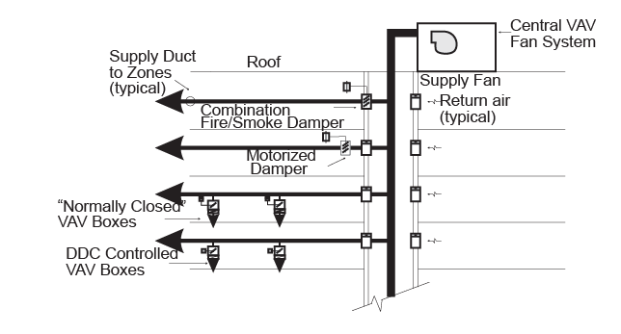
Section 6 – 6.4.3.3.4
Controls – Zone Isolation
Applies to
  Each floor in a multistory building
  Maximum 25,000 ft² zones
Requirements
  Central systems shall have devices and controls to ensure stable operation with only the smallest isolation zone being supplied
  Capable of separate time schedules for each isolation zone
Figure 6-E
Isolation Methods for a Central VAV System
(User’s Manual – 90.1.-2007)
Exceptions
  OSA and exhaust isolation when system supply air is < 5,000 cfm
  Exhaust isolation where single zone exhaust airflow less than 10% of system exhaust airflow
  Zones with continuous operation
Notes:
HVAC systems serving zones intended to operate or be occupied nonsimultaneously to be divided into isolation areas
Zones can be grouped into a single isolation area provided it does not exceed 25,000 ft² of conditioned floor area nor include more than one floor.
Each isolation area to be equipped with isolation devices capable of automatically shutting off the supply of conditioned air and outdoor air to and exhaust air from the area.
For central systems and plants, controls and devices to be provided to allow stable system and equipment operation for any length of time while serving only the smallest isolation area served by the system or plant.
Exceptions:
Isolation devices and controls are not required for the following:
Exhaust air and outdoor air connections to isolation zones when the fan system to which they connect is 5000 cfm and smaller.
Exhaust airflow from a single isolation zone of less than 10% of the design airflow of the exhaust system to which it connects.
Zones intended to operate continuously or intended to be inoperative only when all other zones are inoperative.

Slide 48
Section 6 – 6.4.3.3.5
Automatic Control of HVAC in Hotel/Motel Guest
Rooms
Hotels and motels with > 50 guest rooms to have automatic HVAC controls to apply the following requirements within 30 minutes of all occupants leaving the room:
  Guest Room HVAC Setpoint Control
  Automatically raised by ≥ 4°F from the occupant set point (cooling).
  Automatically lowered ≥ 4°F from the occupant set point (heating).
  Specific conditions for unrented and unoccupied rooms.
  Guest Room Ventilation Control
  Ventilation and exhaust fans automatically be turned off, or isolation devices serving each guest room shall automatically shut off the supply of outdoor air to the guest room and shut off exhaust air from the guest room.
Captive key cards are permitted to be used for compliance
There are some exceptions so see the standard for further details
Notes:
New requirements were added for hotel and motel guest room control
When unrented and unoccupied, HVAC set points automatically reset to 80°F or higher (cooling) and to 60°F or lower (heating).
Unrented and unoccupied guest rooms are indicated by:
Continuously unoccupied for up to 16 hours
A networked guest room control system indicates the guest room is unrented and the guest room is unoccupied for up to 30 minutes.

Slide 49
Section 6 – 6.4.3.4
Controls – Ventilation System
Stair and Shaft Vent dampers (6.4.3.4.1)
Motorized dampers automatically closed during normal building operation
Interlocked to open as required by fire and smoke detection systems
Shutoff Damper Controls (6.4.3.4.2)
  All outdoor air intake and exhaust systems require motorized damper
  Ventilation outdoor air and exhaust/relief dampers capable of automatically shutting off during
    Preoccupancy building warm-up, cool down, and setback
    (Except when ventilation reduces energy costs or when ventilation must be supplied due to code requirements)
Exceptions
    Backdraft gravity dampers are allowed
      For exhaust and relief in buildings < 3 stories in height above grade
      Of any height in climate zones 0 – 3
      Design intake or exhaust capacity of 300 cfm or less
    Ventilation systems serving unconditioned spaces
    Exhaust systems serving type 1 kitchen exhaust hoods
    300 CFM
Notes:
Shut off air leakage to outdoors; don’t use heat you don’t need; don’t waste energy you don’t need to.

Slide 50
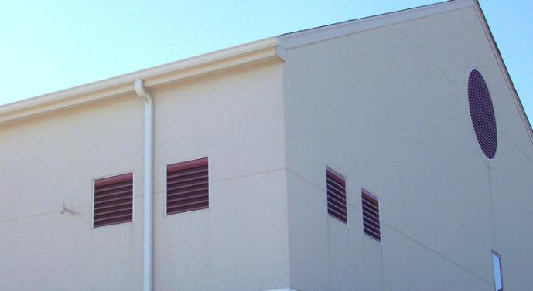
Section 6 – 6.4.3.4.3
Controls – Damper Leakage
Table 6.4.3.4.3 provides maximum leakage rates for outdoor air supply and exhaust dampers
Where OA supply and exhaust air dampers are required by Section 6.4.3.4.1
  They shall have a maximum leakage rate when tested in accordance with AMCA Standard 500D as indicated in Table 6.4.3.4.3
Notes:
Motorized dampers for outdoor air supply and exhaust systems to automatically shut when systems aren’t in use

Slide 51
Section 6 – 6.4.3.4.3
Controls – Damper Leakage
Reference Table 6.4.3.4.3 on page 80 in 90.1-2016

Slide 52
Section 6 – 6.4.3.4.4
Ventilation Fan Controls
Fans with motors > 0.75 hp shall have automatic controls complying with Section 6.4.3.3.1 that are capable of shutting off fans when not required
Exception
  HVAC systems intended to operate continuously

Slide 53
Section 6 – 6.4.3.4.5
Enclosed Parking Garage Ventilation
Ventilation systems in enclosed parking garages
automatically detect contaminant levels and stage fans or
modulate fan airflow rates to ≤ 50%, provided acceptable contaminant levels are maintained
Exception
  Garages < 30,000 ft² with ventilation systems that do not use mechanical cooling or heating
  Garages with a garage area to ventilation system motor nameplate hp ratio > 1500 ft²/hp and don’t use mechanical cooling or heating
  Where permitted by AHJ

Slide 54
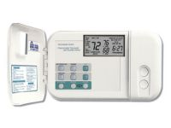
Section 6 – 6.4.3.5
Heat Pump Auxiliary Heat Control
Controls to prevent supplemental heat when heat pump can handle the load both during operation and during setback recovery.
OK to operate supplemental heat during defrost.
Exception
Heat pumps
    With minimum efficiency regulated by NAECA, AND
    With HSPF rating meeting Table 6.8.1-2 (and the rating Includes all usage of internal electric resistance heating)
Notes:
Heat Pump Auxiliary Heat Control. Heat pumps equipped with internal electric resistance heaters shall have controls that prevent supplemental heater operation when the heating load can be met by the heat pump alone during both steady-state operation and setback recovery. Supplemental heater operation is permitted during outdoor coil defrost cycles.

Slide 55


Section 6 – 6.4.3.6
Controls - Humidification and Dehumidification
General humidity control is limited:
Prevent use of fossil fuel or electricity to produce RH > 30% in warmest zone
Reduce RH < 60% in coldest zone
Provide means to prevent simultaneous operation of humidification and dehumidification equipment
  Limit switches, mechanical stops, or software programming (DDC systems)
Exceptions
  Zones served by desiccant systems, used with direct evaporative cooling in series
  Systems serving zones (museums and hospitals) where
    specific humidity levels are required by accreditation or approved by AHJ, and
    configured to maintain a deadband of at least 10% RH with no active humidification or dehumidification
  Humidity levels are required by accreditation or approved by AHJ to be maintained with precision of not more than ± 5% RH
Notes:
Exception 1 – provided because technically, this process both dehumidifies and humidifies the air
Warmest/coldest zone latitude needed to allow for multi-zone systems
When humidity control within 30% to 60% deadband is required by accreditation, a 10% deadband must be maintained.
In very special cases (process or high value archival storage) ± 5% RH needs to be maintained, and a deadband is typically not possible for that tight of control.

Slide 56
Section 6 – 6.4.3.7
Controls – Freeze Protection and Snow/Ice
Automatic controls to shut off for
  Freeze protection systems
    outside air temperatures > 40°F or
    when conditions of protected fluid will prevent freezing;
    e.g, a glycol loop would have a lower shutoff setpoint
  Snow- and ice-melting systems
    pavement temperature > 50°F and no precipitation is falling
    Also shutoff if outdoor temperature > 40°F
  Note that the setpoints shown are conservative upper limits, and a freeze protection system may be set to lower settings that are more energy efficient.

Slide 57
Section 6 – 6.4.3.9
Heating and Cooling in Vestibules
Include automatic controls to
shut off heating system when
  OA temps are > 45°F
  Also controlled by a thermostat in the vestibule with setpoint limited to maximum of 60°F
  Note: a single heating thermostat in the vestibule limited to 45°F would meet the requirements
Shut off vestibule cooling system when
  Controlled by a thermostat in the vestibule with setpoint limited to minimum of 85°F
Exceptions, vestibules:
  heated or cooled by site-recovered energy
  tempered with transfer air that would otherwise be exhausted
Notes:
Note: requirements of 6.4.3.8 Ventilation Controls for High-Occupancy Areas are described in slides 25-26

Slide 58
Section 6 – 6.4.3.10
DDC Requirements
DDC provided in applications and for qualifications listed in Table 6.4.3.10.1
Where required in the table, the DDC system must be capable to provide control logic per section 6.5:
Monitoring zone and system demand for fan pressure, pump pressure, heating, and cooling
Transferring zone and system demand information from zones to air distribution system controllers and from air distribution systems to heating and cooling plant controllers
Automatically detecting those zones and systems that may be excessively driving the reset logic and generate an alarm or other indication to the system operator
Readily allowing operator removal of zone(s) from the reset algorithm
DDC Display: Where required in new buildings, DDC system to be capable of trending and graphically displaying input and output points
Notes:
Part of the table is shown for illustrative purposes

Slide 59
Section 6 – 6.4.3.11
Chilled-Water Plant Monitoring
For electric-motor-driven chilled-water plants in new buildings, or for new plants in existing buildings, measurement devices shall be installed and shall measure the electric energy use and efficiency of the chilled-water plant for:
  water-cooled chilled-water plants larger than 1500 tons peak cooling capacity for Climate Zones 5 through 8, 3C, and 4C, and larger than 1000 tons peak cooling capacity for all other zones; and
  air-cooled chilled-water plants larger than 860 tons peak cooling capacity for Climate Zones 5 through 8, 3C, and 4C, and larger than 570 tons peak cooling capacity for all other zones.
The efficiency shall be calculated in kW/ton or COP of cooling operating efficiency

Slide 60
Section 6 – 6.4.3.12
Economizer Fault Detection and Diagnostics (FDD)
Air-cooled direct-expansion cooling units in
Tables 6.8.1-1 and 6.8.1-2 (if an air economizer is
installed per Section 6.5.1) to include an FDD system
complying with the following:
Outdoor air, supply air, and return temperature
sensors permanently installed to monitor
system operation and the control to include a
means to display values
Economizer control to provide system status indication for:
  Free cooling available
  Economizer enabled
  Compressor enabled
  Heating enabled
  Mixed-air low-limit cycle active
Control system capable of and configured to display the following faults:
  Air temperature sensor failure/fault
  Not economizing when the unit should be economizing
  Economizing when the unit should not be economizing
  Damper not modulating
  Excess outdoor air

Slide 61
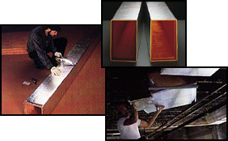
Section 6 – 6.4.4
HVAC System Construction and Insulation
Insulation installed in accordance with industry-accepted standards
Insulation protection
Duct and plenum insulation
Piping insulation
Sensible heating panel insulation
Radiant floor heating
Duct sealing
Duct leakage tests
Notes:
Each of these is discussed in subsequent slides.
3rd bullet – already discussed in ASHRAE simple system

Slide 62
Section 6 – 6.4.4.1.1
General
Insulation installed in accordance with industry-accepted standards
Insulation
  Protected from damage due to sunlight, moisture, equipment maintenance, and wind
  Exposed to weather to be suitable for outdoor service
  Covering chilled water piping, refrigerant suction piping, or cooling ducts located outside the conditioned space to include a vapor retardant located outside the insulation, all penetrations and joints of which to be sealed
Notes:
An example – insulation that may be damaged by workers maintaining equipment (if it has to be walked on or over to access equipment) must be protected from damage, such as by enclosing it in plastic or metal jacket (piping) or canvas wrap (ductwork).

Slide 63
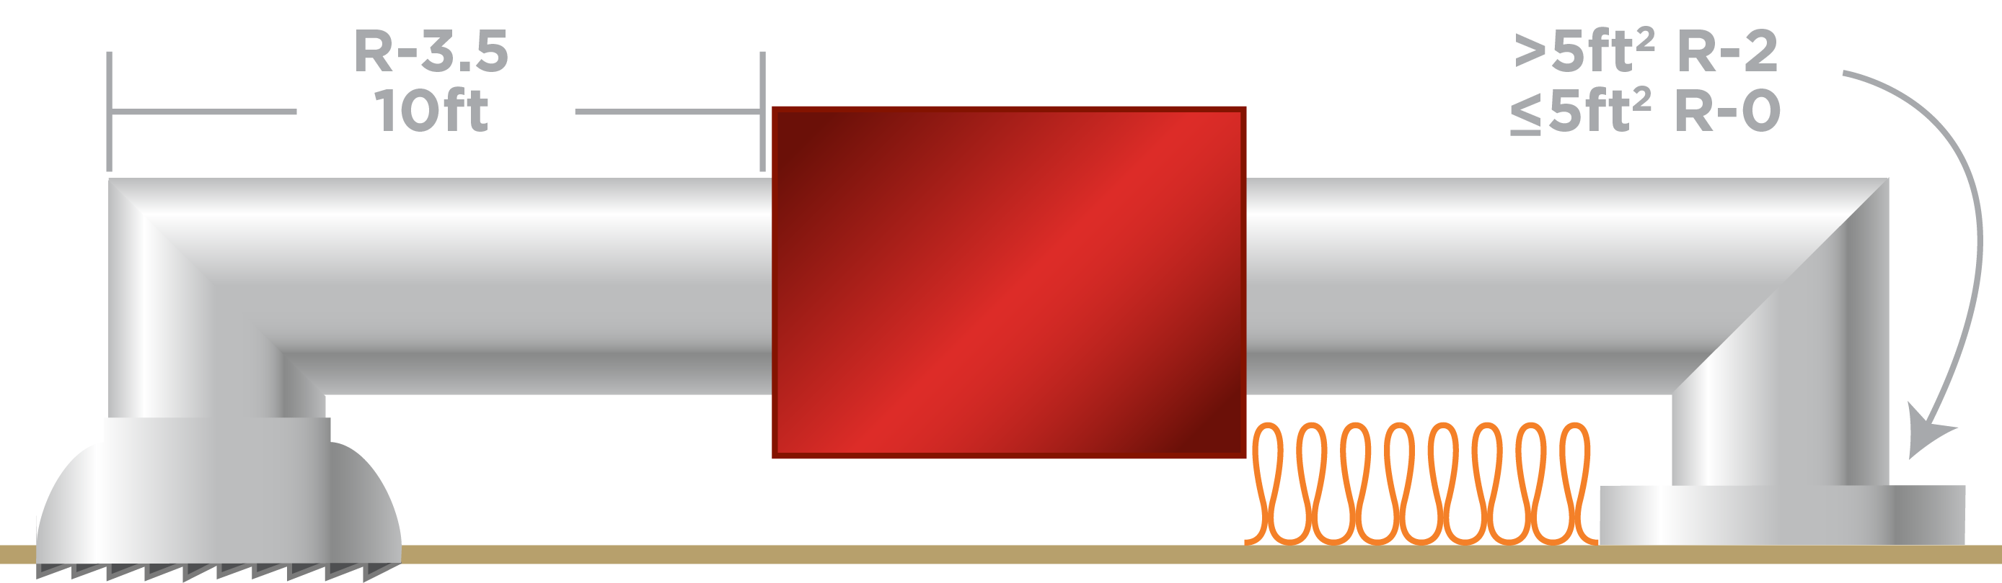
Section 6 – 6.4.4.1.2
Duct and Plenum Insulation
All supply and return ducts and plenums to be insulated per Table 6.8.2
Duct insulation requirement table was simplified with some increases.
Exceptions
  Factory-installed plenums, casings, or ductwork furnished as part of HVAC equipment
  Ducts located in heated, semiheated, or cooled spaces
  For runouts < 10 ft in length to air terminals or air outlets, the R-value need not exceed R-3.5
  Backs of air outlets and outlet plenums exposed to unconditioned or indirectly conditioned spaces with face areas > 5 ft² need not exceed R-2; those ≤ 5 ft² need not be insulated
Notes:
Tables list duct insulation requirements as a function of the duct application (e.g., cooling-only supply duct); climate; and duct or plenum location (e.g., ventilated attic).
Last bullet – IECC does not have

Slide 64
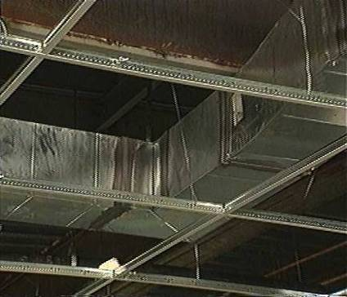
Section 6 – 6.4.4.2.2
Duct Leakage Tests
Designed > 3 in. w.c.
  Leak tested
  Representative sections ≥ 25% of the total installed duct area shall be tested
  Ratings > 3 in. w.c. to be identified on drawings
  Maximum permitted duct leakage
    L_{max} = C_{L}P^{0.65}
      Where L_{max} = maximum permitted leakage in cfm/100 ft² duct surface area
Notes:
Goes beyond SMACNA standards.
Testing is only required for duct sections of high pressure systems with a design duct pressure class rating in excess of 3 in. w.c.
Sections to be selected by building owner or representative. Positive pressure leakage testing is acceptable for negative pressure ductwork.

Slide 65
Section 6 – 6.4.5
Walk-in Coolers and Freezers
Site assembled or site constructed walk-ins ≤ 3000 sq ft
  Automatic door closers that close doors within 1 inch of full closure for doors ≤ 3 ft 9 in. wide or ≤ 7 ft tall
  Strip doors (curtains), spring-hinged doors, or other way to minimize infiltration when doors are open
  Wall, ceiling and door insulation
    Walk-in coolers ≥ R-25
    Walk-in freezers ≥ R-32
    Exception: glazed portions of doors or structural members
  Floor insulation
    Walk-in freezers ≥ R-28

Slide 66
Section 6 – 6.4.5
Walk-in Coolers and Freezers (cont’d)
  Use electronically commutated motors or three-phase motors for evaporator fan motors < 1 hp and < 460 V
  Use light sources with efficacy ≥ 40 lm/W (including any ballast losses)
    May use light sources with efficacy < 40 lm/W in conjunction with a timer or device to turn off the lights within 15 minutes of last occupation
  transparent reach-in doors and windows in walk-in doors either filled with inert gas or heat-reflective treated glass
    freezers: triple-pane glass
    coolers: double-pane glass
  for antisweat heaters without antisweat heater controls to have a total door rail, glass, and frame heater power draw
    ≤7.1 W/ft² of door opening for walk-in freezers
    ≤3.0 W/ft² of door opening for walk-in coolers
  Antisweat heater controls to reduce the energy use of the antisweat heater as a function of the RH in the air outside the door or condensation on the inner glass plane
  Use electronically commutated motors, permanent split capacitor-type motors, or three-phase motors for condenser fan motors < 1 hp
  Walk-in freezers to incorporate primary temperature-based defrost termination control with a secondary time limit

Slide 67
Section 6 – 6.4.6
Refrigerated Display Case
Meet equipment efficiency requirements
Lighting to be controlled by one of these:
  automatic time-switch to turn off lights during non-business hours with timed overrides to turn lights on for ≤ 1 hr
  Motion sensors that reduce lighting power by ≥ 50% within 3 minutes after sensor area is vacated
Low-temperature cases to have primary temperature-based defrost termination control with secondary time-limit termination.
Antisweat heater controls to reduce energy use of antisweat heater as function of RH in air outside the door or to condensation on inner class pane

Slide 68
HVAC Compliance
Building System
Compliance Options
Envelope
Prescriptive Option
HVAC
Mandatory
Provisions
(required for most compliance options)
Trade Off Option
Energy Code Compliance
SWH
Energy Cost Budget
Power
Simplified
Lighting
Performance Rating
Method
Other
Notes:
There are four compliance options for HVAC: Simplified, Prescriptive Path, ECB, and Appendix G. When the simplified approach is used, the Mandatory Provisions do not apply. Grayed out option under Compliance Options is not available for HVAC.
Pick IECC OR ASHRAE for entire code application

Slide 69
Section 6 – 6.5
HVAC Prescriptive Path
Economizers (Section 6.5.1)
Simultaneous Heating and Cooling Limitation
(Section 6.5.2)
Air System Design and Control (Section 6.5.3)
Hydronic System Design and Control (Section 6.5.4)
Heat Rejection Equipment (Section 6.5.5)
Energy Recovery (Section 6.5.6)
Exhaust Systems (Section 6.5.7)
Radiant Heating Systems (Section 6.5.8)
Hot Gas Bypass Limitation (Section 6.5.9)
Door Switches (Section 6.5.10)
Refrigeration Systems (Section 6.5.11)
Notes:
Each section will be discussed in subsequent sections.

Slide 70
Section 6 – 6.5.1 & 6.5.1.1.2
Water Economizer & Control Signal
Large non-fan cooling systems now require a water economizer:
Exception 2 to 6.5.1: Chilled-water cooling systems without a fan or that use induced airflow, where the total capacity of these systems is less than 1,000,000 Btu/h in Climate Zones 0, 1B, and 2 through 4; less than 1,400,000 Btu/h in Climate Zones 5 through 8; or any size in Climate Zone 1A.
Dampers capable of being sequenced with the mechanical cooling equipment and shall not be controlled by only mixed air temperature
This prevents the economizer from operating when heating is required or only partial cooling is required
Exception
  Systems controlled from space temperature (such as single-zone systems)
  Single zone systems should still interlock the economizer operation with a call for cooling
Notes:
Not an IECC requirement

Slide 71
Section 6 – 6.5.1.1.3
High Limit Shutoff
Automatically reduce outdoor air intake to minimum outdoor air quantity when outdoor air intake will no longer reduce cooling energy usage
High limit control types for specific climate zones from Table 6.5.1.1.3
  Allowed:
      Fixed dry bulb temperature
      Differential dry bulb temperature
      Fixed or differential enthalpy requires dry-bulb high limit in combination
  Not allowed:
    Electronic hybrid enthalpy
    Dew point and dry-bulb
Notes:
There are several common high limit controllers:
Fixed Dry-Bulb Temperature High Limit
Differential Dry-Bulb Temperature High Limit
Fixed Enthalpy High Limit now requires dry-bulb in combination
Differential Enthalpy High Limit now requires dry-bulb in combination
No longer allowed
Electronic Hybrid Enthalpy/Temperature Controllers
Dew Point and Dry-Bulb Temperature High Limit
Bring in 100% air – need to exhaust 100% of the air

Slide 72
Section 6 – 6.5.1.1.3
High-limit Shutoff Control Settings
Reference Table 6.5.1.1.3 on page 89 in 90.1-2016

Slide 73
Section 6 – 6.5.1.1.4
Dampers
Return, exhaust/relief and outdoor air dampers to meet the requirements in 6.4.3.4.3
Notes:
Section 6.5.1.1.4 references the requirements in 6.4.3.3.4, making this section both mandatory and prescriptive!
When the system is in the 100% OA mode, leakage through the return damper will increase supply air temperatures, forcing the mechanical cooling system to operate at colder OA temperatures and increases the cooling load once the mechanical cooling is on.

Slide 74
Section 6 – 6.5.1.1.5
Relief of Excess Outdoor Air
Means to relieve excess outdoor air during economizer operation to prevent over pressurizing the building
Outlet located to avoid recirculation into the building
Notes:
With economizer systems, without the relief, the building can become overpressurized, causing exterior doors to stand open and causing whistling at elevator and stair doors. When these problems occur, operators are apt to disable the economizer.

Slide 75
Section 6 – 6.5.1.1.6
Sensor Accuracy
Outdoor air, return air, mixed air, and supply sensors calibrated
Certification of factory calibration is acceptable, field calibration is not required
 | Accuracy | Range
Dry-bulb and wet-bulb temperatures | ± 2°F | 40°F-80°F
Enthalpy and value of differential enthalpy sensors | ±3 Btu/lb | 20-30 Btu/lb
Relative humidity | ± 5% | 20%-80% RH

Slide 76
Section 6 – 6.5.1.2.1
Design Capacity – Water Economizers
System capable of cooling supply air by indirect evaporation and providing up to 100% of expected system cooling load at outside air temperatures of 50°F dry bulb/45°F wet bulb and below
Exceptions
  Systems primarily serving computer rooms
    Where 100% of expected system cooling load at dry bulb and wet bulb in Table 6.5.1.2.1 is met with evaporative water economizers
    With systems that satisfy 100% of expected system cooling load at the dry bulb in Table 6.5.1.2.1 is met with dry cooler water economizers
  If required for dehumidification, design can meet 100% of expected cooling load at 45°F dry bulb/40°F wet bulb with water-cooled fluid economizers

Slide 77
Section 6 – 6.5.1.2.2
Maximum Pressure Drop – Water Economizers
Precooling coils and water-to-water heat exchangers to have either
  Water-side pressure drop of <15 ft of water OR
  Bypassed when not in use
Figure 6-O from
90.1 User’s Manual
Notes:
Unlike airside economizers, water economizers have parasitic energy losses that reduce the cooling energy savings. One of these losses comes from possible increases in pumping energy. This requirement attempts to limit those losses.
Save pumping energy

Slide 78
Section 6 – 6.5.1.3
Integrated Economizer Control
Economizers must be integrated with mechanical cooling systems and be capable of providing partial cooling even when additional mechanical cooling is required
Controls to not false load the mechanical cooling systems by limiting or disabling the economizer or any other means (e.g., hot gas bypass) except at lowest cooling stage

Slide 79
Section 6 – 6.5.1.3
Integrated Economizer Control (cont’d)
Units with air economizers
Unit controls
  Mechanical cooling capability interlocked with air economizer controls so outdoor air damper is at 100% open when mechanical cooling is on and outdoor air damper doesn’t begin to close to prevent coil freezing due to minimum compressor run time until leaving air temperature is < 45°F
DX units that control capacity of mechanical cooling based on occupied space temperature to have a minimum of 2 stages of mechanical cooling capacity if unit cooling capacity is ≥ 65,000 Btu/h

Slide 80
Section 6 – 6.5.1.3 cont’d
All other DX units, including those that control space temperature by modulating air flow to the space, to comply with Table 6.5.1.3
Rating Capacity, Btu/h | Min. # of Mechanical Cooling Stages | Min. Compressor Displacement
≥ 65,000 and < 240,000 | 3 | ≤ 35% of full load
≥ 240,000 | 4 | ≤ 25% full load

Slide 81
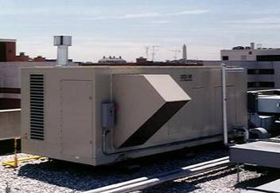
Section 6 – 6.5.1.4
Economizer Heating System Impact
Designed so economizer operation doesn’t increase the building heating energy use during normal operation
Exception
  Economizers on VAV systems that cause zone level heating to increase due to a reduction in supply air temperature
Notes:
This simply requires that heating and economizer controls be coordinated so they are mutually exclusive

Slide 82
Section 6 – 6.5.1.5
Economizer Humidification System Impact
Systems with hydronic cooling and dehumidification systems designed to maintain inside humidity at a dewpoint > 35°F to use a fluid economizer (if 6.5.1 requires an economizer)

Slide 83
Section 6 – 6.5.2.1
Zone Thermostatic Controls
Capable of operating in sequence the supply of heating and cooling energy to the zone
Controls prevent
  Reheating
  Recooling
  Mixing or simultaneously supplying air previously heated or cooled
  Other simultaneous operation of heating and cooling systems to the same zone
Notes:
Single-zone systems will inherently meet these requirements, provided their controls are capable of sequencing typical heating and cooling.
Discourages cooling air then reheating

Slide 84
Section 6 – 6.5.2.1
Zone Thermostatic Controls – Exceptions
Simultaneous heating and cooling is allowed for the following 4 cases:
1. Zones for which volume of air that is reheated, recooled, or mixed is less than the larger of the following
  20% of zone design peak supply for DDC and 30% for other systems
  Outside air flow rate to meet Standard 62.1 for the zone
  Any higher rate that can be demonstrated to jurisdiction to reduce overall system annual energy usage
  Air flow rate required to meet applicable codes or accreditation standards (pressure relationships or minimum air change rates)
2. Zones with DDC that comply with all of these
  Air flow rate in dead band that doesn’t exceed larger of these
    20% of zone design peak supply
    Outdoor air flow rate to meet Standard 62.1 for the zone
    Any higher rate that can be demonstrated to jurisdiction to reduce overall system annual energy usage
    Air flow rate required to comply with applicable codes or accreditation standards, such as pressure relationships or minimum air change rates
  Air flow rate that’s reheated, recooled, or mixed in peak heating demand < 50% of zone design peak supply
  First stage of heating consists of modulating zone supply air temperature setpoint up to a maximum while air flow is maintained at deadband flow rate
  Second stage of heating consists of modulating air flow rate from deadband flow rate up to heating maximum flow rate while maintaining the maximum supply air temperature
3. Lab exhaust systems complying with 6.5.7.3
4. Zones where ≥ 75% of energy for reheating or providing warm air in mixing systems is from site-recovered or site-solar source

Slide 85
Section 6 – 6.5.2.1.1
Supply Air Temperature Reheat Limit
Zones with both supply and return/exhaust air openings > 6 ft above floor to not supply heating air > 20°F above space temperature
  Applies where reheating is allowed in other parts of the Standard
Exceptions
  Laboratory exhaust systems complying with 6.5.7.3
  During preoccupancy building warm-up and setback
Notes:
Single-zone systems will inherently meet these requirements, provided their controls are capable of sequencing typical heating and cooling.
Discourages cooling air then reheating

Slide 86
Section 6 – 6.5.2.2
Hydronic System Controls
To prevent the simultaneous heating and cooling in hydronic systems

Slide 87
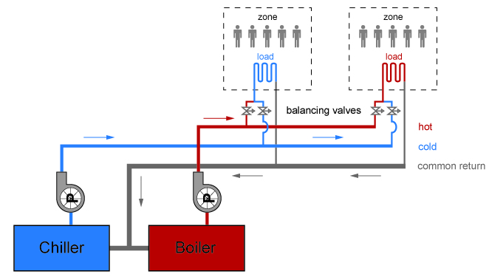
Section 6 – 6.5.2.2.1
Three-Pipe System
No common return system for both hot and chilled water
Notes:
Three-pipe systems use a common return for both hot water and chilled water and cause heated water and cooled water to be mixed with each other, increasing both heating and cooling energy usage.

Slide 88
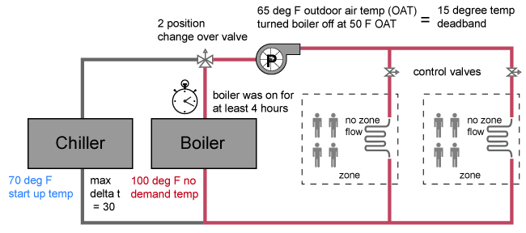
Section 6 – 6.5.2.2.2
Two-Pipe Changeover System
Two-pipe changeover system is allowed if it meets the following requirements:
  Dead band from one mode to another is ≥ 15°F outdoor air temperature
  Controls to allow operation of ≥ 4 hours in one mode before changing to another mode
  Reset controls so heating and cooling supply temperatures at changeover point no more than 30°F apart
Diagram Courtesy of Ken Baker
Notes:
Two-pipe changeover systems use a common distribution system to alternately supply heated or chilled water to fan-coils and air-handlers. One pipe in and one pipe out. Changeover happens at specified times of the year.

Slide 89
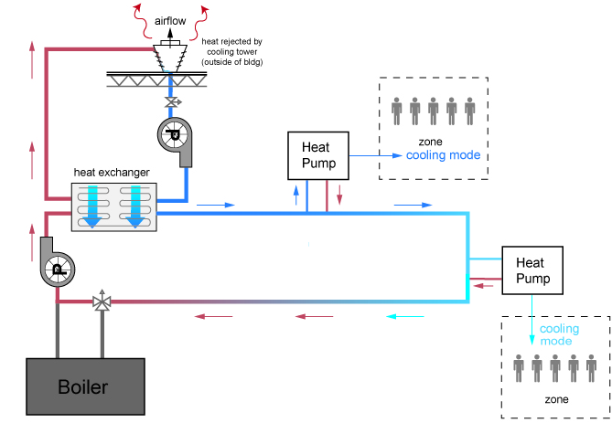
Section 6 – 6.5.2.2.3
Hydronic (Water Loop) Heat Pump Systems
Controls to provide heat pump water supply temperature deadband of at least 20°F between initiation of heat rejection and heat addition by central devices
Exception
If system loop temperature optimization controller is used, deadband < 20°F is allowed
A two-position valve at each
hydronic heat pump for hydronic
systems having a total pump system
power > 10 hp
Diagram Courtesy of Ken Baker
In CZ 3-8, limit heat rejection during heating:
Fluid cooler: provide automatic bypass or low leakage air dampers
Open cooling tower: provide automatic bypass
Open tower with heat exchanger (shown): automatic shutdown of tower pump
Notes:
Ex: water loop through building and heat pumps are placed around and use water loop as a heat source for heating and a heat sink for cooling.
Requirements are meant to limit the unnecessary use of the central heating and cooling sources.
For climate zones 3 through 8, if a closed-circuit tower (fluid cooler) is used, either an automatic valve must be installed to bypass all but a minimal flow of water around the tower (for freeze protection) or low-leakage positive closure dampers shall be provided.
If an open-circuit tower is used directly in the heat pump loop, an automatic valve must be installed to bypass all heat pump water flow around the tower.
If an open-circuit tower is used in conjunction with a separate heat exchanger to isolate the tower from the heat pump loop, then heat loss must be controlled by shutting down the circulation pump on the cooling tower loop.

Slide 90
Section 6 – 6.5.2.3
Dehumidification
Humidistatic controls to prevent
  Reheating
  Mixing of hot and cold air streams
  Heating and cooling of same air stream

Slide 91
Section 6 – 6.5.2.3
Dehumidification Exceptions
Systems reduces supply air flow to 50%, or to minimum ventilation
Systems ≤ 65,000 Btu/h that can unload at least 50%
Systems smaller than 40,000 Btu/h
Process applications where building includes site-recovered or site solar energy source that provides energy equal to ≥ 75% of annual energy for reheating or providing war air in mixing systems (exception does NOT apply to computer rooms)
90% of reheat or re-cool annual energy is recovered or solar
Systems where heat added to airstream is result of use of desiccant system and 75% of heat added by desiccant system is removed by a heat exchanger (either before or after desiccant system with energy recovery)

Slide 92
Section 6 – 6.5.2.4
Humidification
Automatic valve to shut off preheat in humidifiers with preheating jackets mounted in airstream
Insulate dispersion tube hot surfaces in airstreams of ducts or AHUs ≥ R-0.5
  Except where mechanical cooling, including economizer operation, doesn’t occur simultaneously with humidification

Slide 93
Section 6 – 6.5.2.5 & 6.5.2.6
Preheat Coils
Controls to stop heat output whenever mechanical cooling, including economizer operation, is occurring
Ventilation Air (DOAS) Heating Control
Units that provide ventilation air to multiple zones and operate in conjunction with zone heating and cooling systems
shall not use heating or heat recovery to warm supply air above 60°F when
  representative building loads or
  outdoor air temperature
  indicate that the majority of zones require cooling
Saves energy use by taking advantage of “free cooling”
  uses cool outside air when there is a benefit to many zones in the building
  avoids mechanically cooling air that was preheated at the DOAS unit
Notes:
A DOAS unit separates the ventilation air from systems or air used for heating or cooling.
Generally this improves energy efficiency, as it reduces techniques like reheat.
However, some control strategies will preheat the air delivered by the DOAS to the space temperature setpoint (usually 70 to 75 degrees F).
This “neutral temperature” control strategy results in heating air that would provide beneficial cooling inside the building.
So this restriction maintains less preheating of separately processed ventilation air
That saves both heating the air at the ventilation unit and recooling the air in the space with mechanical cooling.

Slide 94
Section 6 – 6.5.3
Air System Design and Control
Each HVAC system with total fan system power > 5 hp to meet 6.5.3.1
  Fan System Power and Efficiency
Appropriate fan systems to meet 6.5.3.2 through 6.5.3.7
  Fan Control
    Fan Airflow Control
    VAV Static Pressure Sensor location
    VAV Set Point Reset
Notes:
Fan system power is the sum of the nominal power demand (nameplate hp) of all fans in a system that are required to operate at design conditions to supply air from the heating or cooling source (such as coils) to the conditioned spaces and return it back to the source or exhaust it to the outdoors.
Subsequent slides discuss each of these.

Slide 95
Section 6 – 6.5.3.1
Fan System Power and Efficiency
Table 6.5.3.1-1
Two options:
nameplate hp (Option 1)
fan system bhp (Option 2)
Exceptions
Hospital, vivarium, and laboratory systems that utilize flow control devices on exhaust and/or return to maintain space pressure relationships necessary for occupant health and safety or environmental control may use variable-volume fan power limitation
Individual exhaust fans with motor nameplate hp ≤ 1 hp

Slide 96
Section 6 – 6.5.3.1
Fan Power Limitation
Reference Table 6.5.3.1-1 on page 95 in 90.1-2016

Slide 97
Section 6 – 6.5.3.1
Fan Power Limitation
Reference Table 6.5.3.1-2 on page 95 in 90.1-2016
Changes:
Energy recovery credit referenced to Enthalpy Recovery Ratio
Fully ducted return air credit now only allowed for return or exhaust systems required by code or accreditation standards to be fully ducted, or systems required to maintain air pressure differentials between adjacent rooms.
Notes:
The fully ducted return credit increases the allowable fan size.
A larger fan would use more energy.
This change only allows the credit where those return ducts are required by other codes or accreditation standards.
You could still use fully ducted air return in other situations, but you would need to have a more efficient fan system.
That can be achieved with larger ducts or a more efficient fan or fan motor.

Slide 98
Section 6 – 6.5.3.1.2
Motor Nameplate Horsepower
Selected fan motor to be no larger than first available motor size greater than bhp
Fan bhp on design documents
Exceptions
  Fans < 6 bhp, where first available motor larger than bhp has nameplate rating within 50% of bhp, next larger nameplate motor size may be selected
  Fans ≥ 6 bhp, where first available motor larger than bhp has nameplate rating within 30% of bhp, next larger nameplate motor size may be selected
  Systems complying with 6.5.3.1.1 Option 1
  Fans with motor nameplate hp < 1hp

Slide 99
Section 6 – 6.5.3.1.3
Fan Efficiency
Fan efficiency grade (FEG) of ≥ 67 based on manufacturer’s certified data as defined by AMCA 205
Total efficiency of fan at design point of operation to be within 15 percentage points of maximum total efficiency of the fan
Exceptions
  Single fans with motor nameplate hp ≤ 5 hp
  Multiple fans (e.g., fan arrays) with combined motor nameplate hp ≤ 5 hp and operated as functional equivalent of a single fan
  Fans
    Part of equipment listed in 6.4.1.1
    Included in equipment bearing third-party certified seal for air or energy performance of equipment package
    Outside scope of AMCA 205
    Intended to only operate during emergency conditions
  Powered wall/roof ventilators (PRV)

Slide 100
Section 6 – 6.5.3.2.1
Fan Control
DX cooling, chilled water, and evaporative cooling systems to be designed to vary indoor fan airflow as a function of load
Cooling units that control capacity of mechanical cooling directly based on space temperature to have at least 2 stages of fan control
  Low or minimum
    Speed ≤ 66 % of full speed
    Draw ≤ 40% of fan power at full fan speed
    Used during periods of low cooling load and ventilation-only operation
All other units, including DX cooling and chilled-water units that control space temperature by modulating airflow to have modulating fan control
  Minimum speed
    ≤ 50% of full speed
    Draw ≤ 30% of power at full fan speed
  Low or minimum speed
    Used during periods of low cooling load and ventilation-only operation
Exceptions for cycling fans without ventilation or fans that need a higher speed to meet 62.1 ventilation requirements

Slide 101
Section 6 – 6.5.3.2.2
VAV Static Pressure Sensor Location
Located so controller set point is ≤ 1.2 in. wc
  Except for systems complying with VAV setpoint reset requirements
Install multiple sensors in each major branch if sensor would be located downstream of a major duct split

Slide 102
Section 6 – 6.5.3.2.3
VAV Setpoint Reset
For systems with direct digital control of individual zone reporting to the central control panel
  Static pressure set point reset based on zone requiring the most pressure
  Controls to:
    Monitor zone damper positions or other indicator of need for static pressure
    Automatically detect zones that may be excessively driving reset logic and generate alarm
    Readily allow operator removal of zone(s) from reset algorithm
Notes:
i.e., set point is reset lower until one zone damper is nearly wide open

Slide 103
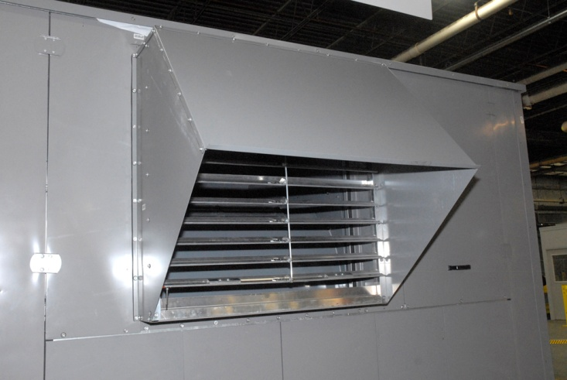
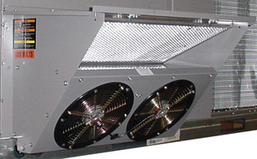
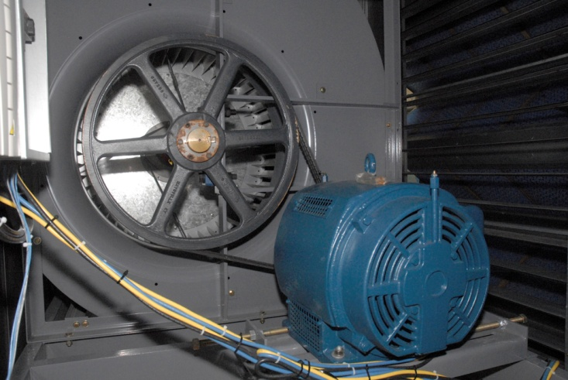
Section 6 – 6.5.3.2.4
Return and Relief Fan Control
Return and relief fans used to meet Section 6.5.1.1.5 shall comply with all of the following:
Relief air rate shall be controlled to maintain building pressure either directly, or indirectly through differential supply-return airflow tracking.
Systems with constant speed or multispeed supply fans shall also be allowed to control the relief system based on outdoor air damper position.
Fans shall have variable-speed control or other devices that will result in total return/relief fan system demand of no more than 30% of total design power at 50% of total design fan flow.
Exceptions
Return or relief fans with total motor size less than or equal to 0.5 hp.
Staged relief fans with a minimum of four stages.
Notes:
An important part of effective use of an air economizer is building exhaust
control during the economizer operation.
A new requirement has been added to section 6.5.3.2 for Fan Control
This will allow the space pressurization to be better controlled, resulting in more effective use of economizer air.
If the relief fan is simply on/off it can result in pressure variations that reduce the amount of economizer air used, resulting in more cooling.

Slide 104
Section 6 – 6.5.3.3
Multiple-zone VAV System Ventilation Optimization
Control
In multiple-zone VAV systems with DDC of individual zone boxes reporting to central control panel
  Include means to automatically reduce outdoor air intake flow below design rates in response to changes in system ventilation efficiency as per Standard 62.1, Appendix A
Exceptions
  VAV systems with zonal transfer fans that recirculate air from other zones without directly mixing it with outdoor air, dual-duct dual-fan VAV systems, and VAV systems with fan-powered terminal units
  Systems where total design exhaust airflow is > 70% of total outdoor air intake flow requirements
  Removed exception when there is ERV
Notes:
This control sequence does not require full calculation of multi-space equation in real time.
It does require that the critical zone primary ventilation requirements be re-evaluated in real time, based on the ratio of actual airflow to design minimum airflow.
There is significant savings from this strategy.
Further evaluation of the interaction of ventilation optimization and energy recovery ventilation showed that
both of these strategies together saved more energy than either of them alone.

Slide 105
Section 6 – 6.5.3.4
Parallel-Flow Fan-Powered VAV Air Terminal Control
Parallel-flow fan-powered VAV air terminals shall have automatic controls configured to:
turn off the terminal fan except when space heating is required or if required for ventilation;
turn on the terminal fan as the first stage of heating before the heating coil is activated; and
during heating for warmup or setback temperature control, either
  operate the terminal fan and heating coil without primary air or
  reverse the terminal damper logic and provide heating from the central air handler through primary air.
This control strategy reduces fan energy use while maintaining effective comfort control for the space. It will also reduce heating energy use, by recovering heat from return air.
Notes:
Each component provides some energy savings:
a. turn off the terminal fan except when space heating is required or if required for ventilation;
Fan energy is saved during most hours when heating is not required
b. turn on the terminal fan as the first stage of heating before the heating coil is activated; and
Turning on the terminal fan will use warmer return air, possibly avoiding, and reducing the need for heating in the space.
c. during heating for warmup or setback temperature control, either
operate the terminal fan and heating coil without primary air or
Turning off primary air during when unoccupied and ventilation is not needed reduces reheat of primary air.
2. reverse the terminal damper logic and provide heating from the central air handler through primary air.
With electric reheat systems, it may be better to use a central gas furnace for warm up, and this provision allows that.

Slide 106
Section 6 – 6.5.3.5
Supply Air Temperature Reset Controls
Multiple zone HVAC systems to have controls to automatically reset supply-air temperature in response to building loads or outdoor air temperature
Controls to reset supply air temperature at least 25% of difference between design supply-air temperature and design room air temperature
Controls that adjust the reset based on zone humidity are okay
Zones expected to experience relatively constant loads to be designed for fully reset supply temperature
Exceptions
  Climate zones 0a, 1a, 2a, and 3a
  Systems that prevent reheating, recooling or mixing of heated and cooled supply air
  75% of energy for reheating is from site-recovered or site solar energy sources
Notes:
i.e., set point is reset lower until one zone damper is nearly wide open

Slide 107
Section 6 – 6.5.3.6
Fractional Horsepower Fan Motors
Motors for fans ≥ 1/12 hp and < 1hp:
  Electronically-commutate motors or have minimum motor efficiency of 70% when rated per 10 CFR 431
  Have means to adjust motor speed for either balancing or remote control
    Belt-driven fans may use sheave adjustments for airflow balancing in lieu of varying motor speed
Exceptions, motors
In airstream within fan-coils and terminal units that operate only when providing heat
Installed in space conditioning equipment certified under 6.4.1
Covered by Table 10.8-4 or 10.8-5

Slide 108
Section 6 – 6.5.4
Hydronic System Design and Control
Boiler turndown for systems with design input of ≥ 1,000,000 Btu/h per Table 6.5.4.1; requirement can be met by using:
  multiple single-input boilers,
  one or more modulating boilers, or a
  combination of single-input and modulating boilers
HVAC hydronic systems with three or more control valves to have variable flow control
Chiller and boiler isolation
Chilled and Hot Water Temperature Reset
Hydronic (water-loop) Heat Pumps and Water-Cooled Unitary Air-Conditioners
Pipe Sizing minimum limits
Chilled-Water Coil Selection
Notes:
Total pump system power is the sum of the motor nameplate hp of all pumps that are required to operate at design conditions to supply fluid from the heating or cooling source to all heat transfer devices (e.g., coils, heat exchanger) and return it to the source.

Slide 109
Section 6 – 6.5.3.7
Ventilation Design
The required minimum outdoor air rate is the larger of the minimum outdoor air rate or the minimum exhaust air rate required by Standard 62.1, Standard 170, or applicable codes or accreditation standards. Outdoor air ventilation systems shall comply with one of the following:
Design minimum system outdoor air provided shall not exceed 135% of the required minimum outdoor air rate.
Dampers, ductwork, and controls shall be provided that allow the system to supply no more than the required minimum outdoor air rate with a single set-point adjustment.
The system includes exhaust air energy recovery complying with Section 6.5.6.1.
Notes:
This provision simply limits ventilation to an amount reasonably close to the minimums required by the mechanical code of 62.1.
Excess ventilation results in excessive heating and cooling of outside air.

Slide 110
Section 6 – 6.5.4.2
Hydronic Variable Flow
HVAC pumping systems with three or more control valves to be
  Designed to modulate or step open and close as a function of load
  Designed for variable fluid flow
  Capable of reducing flow rates to ≤ 25% of design flow rate
Individual pumps serving variable flow systems with a motor hp at least the power in Table 6.5.4.2
Threshold reduced in some climate zones, raised in others.
  Have controls and/or devices resulting in pump motor demand
  ≤ 30% of design wattage at 50% of design water flow
Differential pressure setpoint to be ≤ 110% of that required to achieve design flow through the heat exchanger
If differential pressure control and DDC controls are used
  Reset setpoint downward based on valve positions until one valve is nearly wide open
Exceptions added to clarify variable flow not required for primary pumps, preheat coils, or run around heat recovery coils
Notes:
Controlled as a function of desired flow or to maintain a minimum required differential pressure
Differential pressure measured at or near the most remote heat exchanger or heat exchanger requiring greatest differential pressure
No specific type of pump flow or pressure control is required.
Pumps that ride their pump curves will still use less energy at low flows than at design flow.
In 2016, the requirements
modified to clarify that apply to both heating and cooling pumping systems
used to be based on a requirement for variable flow with motors larger than 10 HP - changed to require variable flow on systems with more than 3 control valves and with motor HP or combined motor horsepower for parallel systems exceeds the values shown table 6.5.4.2
also require turndown to 25% flow or the limits of required flow for heat and cooling
There are some exceptions for primary pumps, electric heat heating systems, when there are freeze protection issues and for heat recovery runaround loops

Slide 111
Section 6 – 6.5.4.3
Chiller and Boiler Isolation
If chilled water plant has more than one chiller or boiler plant has more than one boiler
  Provide for all fluid to be automatically shut off when chiller or boiler is shut down
  Pumps
    Number of pumps ≥ number of chillers or boilers
    Staged on and off with chillers and boilers
Notes:
Essentially requires that flow through chillers (or boilers), when piped in parallel, must be shutoff when the chillers (or boilers) are inactive.
When a chilled-water plant includes more than one chiller, provisions shall be made so that the flow in the chiller plant can be automatically reduced, correspondingly, when a chiller is shut down. Chillers referred to in this section, piped in series for the purpose of increased temperature differential, shall be considered as one chiller.
When a boiler plant includes more than one boiler, provisions shall be made so that the flow in the boiler plant can be automatically reduced, correspondingly, when a boiler is shut down.
Recommendation – go into 90.1 Users Manual

Slide 112
Section 6 – 6.5.4.4
Chilled and Hot Water Temperature Reset Controls
Affects systems with design capacity > 300,000 Btu/h
  To include controls to automatically reset supply water temperatures by representative building loads (including return water temperature) or by outside air temperature
  Where DDC is used to control valves, the set point shall be reset based on valve positions until one valve is nearly wide open or setpoint limits of the system equipment or application have been reached
Exceptions
  Where chilled-water supply is already cold such that blending would be required to achieve the rest chilled-water supply temperature
  Where a specific temperature is required for a process
  Water temperature reset is not required where valve position is used to comply with Section 6.5.4.1
Notes:
Resetting primary chilled water or hot water temperatures at part load improves the efficiency of primary equipment and reduces energy losses through piping.

Slide 113
Section 6 – 6.5.4.5
Hydronic Heat Pumps and Water-Cooled Unitary
Air-Conditioners
Two-position valves at each hydronic heat pump must be provided and interlocked to shut off water flow to the heat pump when the compressor is off
Exceptions
  Units using fluid economizers
For hydronic heat pumps and water-cooled unitary ACs with total pump power > 5 hp
  Controls or devices must be provided to have pump motor demand ≤ 30% of design wattage at 50% of design water flow

Slide 114
Section 6 – 6.5.4.6
Pipe Sizing
Chilled-water and condenser-water piping so design flow rate in each segment doesn’t exceed values in Table 6.5.4.6
This table presents the maximum allowed flow rates per section of pipe as a function of the following three criteria:
  Pipe size
  Annual hours of operation
  System flow and control
Exceptions
Rates exceeding the Table are allowed if the specific section of pipe in question isn’t in the critical circuit > 30% of operating hours
Piping systems with equivalent or lower total pressure drop than the same system with standard weight steel pipe with piping and fittings sized per the Table

Slide 115
Section 6 – 6.5.4.7
Chilled-Water Coil Selection
Chilled-water cooling coils provide a
15°F or higher temperature difference between leaving and entering water temperatures and
minimum of 57°F leaving water temperature at design conditions
Exceptions
Coils with an air-side pressure drop exceeding 0.70 in. of water when rated at 500 fpm face velocity and dry conditions (no condensation).
Individual fan-cooling units with a design supply airflow rate 5000 cfm and less.
Constant-air-volume systems.
Coils selected at the maximum temperature difference allowed by the chiller.
Passive coils (no mechanically supplied airflow).
Coils with design entering chilled-water temperatures of 50°F and higher.
Coils with design entering air dry-bulb temperatures of 65°F and lower.
Energy is saved by delivering the same cooling with less water flow. In some cases chiller efficiency may be enhanced as well.
Notes:
Energy is saved by delivering the same cooling with less water flow.
A bigger temperature difference across the coil reduces water flow.
Less water flow means less pumping.
In some cases chiller efficiency may be enhanced as well.
Some chiller types operate more efficiently with a higher temperature difference at the chiller.
Increasing the coil temperature difference is necessary to increase the system temperature difference.

Slide 116
Section 6 – 6.5.5
Heat Rejection Equipment
Applies to heat rejection equipment used in comfort cooling systems such as
  Air-cooled condensers
  Dry coolers
  Open-circuit cooling towers
  Closed-circuit cooling towers
  Evaporative condensers
Exceptions
  Heat rejection devices included as an integral part of equipment listed devices whose energy usage is included in Tables 6.8.1-1 through 6.8.1-4

Slide 117
Section 6 – 6.5.5.2
Fan Speed Control
Fan Speed Control
Each fan powered by a motor ≥ 5 hp, including the motor service factor
  Result in fan motor demand of no more than 30% of design wattage at 50% of design airflow
  Have controls to automatically change the fan speed to control the leaving fluid temperature or condensing temperature/pressure of the heat rejection device
Exceptions
  Condenser fans serving multiple refrigerant circuits or fluid cooling circuits
  Condenser fans serving flooded condensers
Multicell heat rejection equipment with variable-speed fan drives
  Operate maximum number of fans allowed that comply with manufacturer’s requirements for all fan system components
  Control all fans to same fan speed required for instantaneous cooling duty, as opposed to staged (on/off) operation, minimum fan speed to comply with minimum allowable fan drive system speed per manufacturer’s recommendations
Notes:
When cooling tower fans are 5 hp and above, you must have the capability to reduce fan speed. Today, usually people use variable-speed drives on their tower fans.
Including the service factor may mean that for some motors or fan arrays, the total horsepower may exceed 5, even though the motor nameplate is less than 5 hp
There are several exceptions.

Slide 118
Section 6 – 6.5.5.3
Limitation on Centrifugal Fan Open-Circuit
Cooling Towers
If towers have a combined rated capacity ≥ 1100 gpm at 95°F condenser water return, 85°F condenser water supply, and 75°F outdoor air wet-bulb temperature
  Must meet requirement for axial fan open-circuit cooling towers in Table 6.8.1-7
Exceptions
  Ducted (inlet or discharge)
  Require external sound attenuation

Slide 119
Section 6 – 6.5.5.4
Tower Flow Turndown
Open-circuit cooling towers used on water-cooled chiller systems configured with multiple- or variable-speed condenser water pumps designed so all open-circuit cooling tower cells can be run in parallel with larger of
  Flow produced by smallest pump at its maximum expected flow rate or
  50% of design flow for the cell
Notes:
Saves energy by using larger tower area with lower fan speeds

Slide 120
Section 6 – 6.5.6.2
Heat Recovery for Service Water Heating
Condenser heat recovery for SWH required if
  Facility operates 24 hrs per day and
  Heat rejection > 6,000,000 Btu/h and
  SWH load > 1,000,000 Btu/h
The required heat recovery system shall have the capacity to provide the smaller of
  60% of the peak heat rejection load at design conditions or
  preheat of the peak service hot water draw to 85°F
Exceptions
If condenser heat recovery is used for space heating with a heat recovery design > 30% of peak water-cooled condenser load at design conditions
If 60% of service water heating is provided from site-solar or site-recovered energy or other sources
Notes:
Note: probably only a very small percentage of buildings meet all three situations
Hospitals
Hotels
Correctional facilities
Dormitories
Exceptions:
Facilities that employ condenser heat recovery for space heating with a heat recovery design exceeding 30% of the peak water-cooled condenser load at design conditions.
Facilities that provide 60% of their service water heating from site-solar or site-recovered energy or from other sources.
A lot of waste heat; collect waste heat to heat water
Ex: 1000 bed nursing home or 75 room hotel (SWH load >1M btu/h)

Slide 121
Section 6 – 6.5.7.1
Transfer Air
Conditioned supply air delivered to any space with mechanical exhaust to not exceed the greater of
supply flow required to meet the space heating or cooling load;
ventilation rate required by the AHJ, the facility Environmental Health and Safety department, or ASHRAE Standard 62.1; or
mechanical exhaust flow minus the available transfer air from conditioned spaces or return air plenums on the same floor, not in different smoke or fire compartments, and that at their closest point are within 15 ft. of each other.
Available transfer air is that portion of outdoor ventilation air that
  is not required to satisfy other exhaust needs,
  is not required to maintain pressurization of other spaces, and
  is transferable according to applicable codes and standards and to the class of air recirculation limitations in ASHRAE Standard 62.1.
When transfer air is used instead of supply air, it means less fan energy and less heating and cooling of supply air.
Notes:
Transfer air can supply many areas with large exhaust requirements, such as restrooms, locker rooms, and kitchens.
Kitchens already had transfer air requirements.
This adds other areas with exhaust air needs.
When transfer air is used instead of supply air, it means
less fan energy and
less heating and cooling of supply air.

Slide 122
Section 6 – 6.5.7.1
Transfer Air – Exceptions
Exceptions
Biosafety level classified laboratories 3 or higher.
Vivarium spaces.
Spaces required by applicable codes and standards to be maintained at positive pressure relative to adjacent spaces.
Spaces where demand for transfer air may exceed the available transfer airflow rate and where the spaces have a required negative pressure relationship.
NOTE: if exception 3 or 4 is used: any transferable air not directly transferred to be made available to the associated AHU and be used whenever economizer or other options do not save more energy.
Notes:
This allows transfer air not to be used where it is not appropriate.

Slide 123
Section 6 – 6.5.7.2
Kitchen Exhaust Systems
Replacement air introduced directly into hood cavity to be ≤ 10% of hood exhaust airflow rate
If kitchen/dining facility has total kitchen hood exhaust airflow rate > 5,000 cfm, each hood’s exhaust rate must not exceed the rate shown in Table 6.5.7.2.2
  If a single hood or hood section is over appliances with different duty ratings, then the max. airflow rate for that can’t exceed the Table values for highest appliance duty rating under that hood or hood section
Exception
If at least 75% of all replacement air is transfer air that would otherwise be exhausted

Slide 124
Section 6 – 6.5.7.2
Kitchen Exhaust Systems (cont’d)
Kitchens/dining facilities with total kitchen hood exhaust airflow rate > 5,000 cfm must have one of these:
  At least 50% of all replacement air is transfer air that would otherwise be exhausted
  Demand ventilation systems on at least 75% of exhaust air (capable of at least 50% reduction in exhaust and replacement air system airflow rates)
  Listed energy recovery devices with sensible heat recovery effectiveness of not less than 40% on at least 50% of the total exhaust airflow

Slide 125
Section 6 – 6.5.7.2
Kitchen Exhaust Systems (cont’d)
Performance testing of design airflow rates and proper capture and containment must be done using an approved field test method
  If demand control ventilation systems are used, additional testing is required at minimum airflows
  Note: see Kitchen Exhaust Code Notes at
  http://www.energycodes.gov/kitchen-exhaust-code-notes

Slide 126
Section 6 – 6.5.7.3
Laboratory Exhaust Systems
Laboratory exhaust systems with total exhaust rate > 5,000 cfm to have one of the following
  VAV lab exhaust and room supply system capable of reducing exhaust and makeup air flow rates and/or incorporate a heat recovery system
  VAV lab exhaust and room supply systems required to have minimum circulation rates to comply with code to be capable of reducing zone exhaust and makeup air flow rates to the regulated minimum circulation values or minimum required to maintain pressurization relationship requirements
    Non-regulated zones capable of reducing exhaust and makeup air flow rates to 50% of zone design values or minimum required to maintain pressurization relationship requirements
  Direct makeup air supply to equal at least 75% of exhaust air flow rate, heated no warmer than 2°F below room setpoint, cooled to no cooler than 3°F above room setpoint, no humidification added, and no simultaneous heating and cooling used for dehumidification control

Slide 127

Section 6 – 6.5.8
Radiant Heating Systems
Required for unenclosed spaces exception: loading docks with air curtains
Radiant heating systems that are used as primary or supplemental enclosed space heating must be in conformance with the governing provisions of the standard
Radiant hydronic ceiling or floor panels
Combination or hybrid systems with radiant heating (or cooling) panels
Radiant heating (or cooling) panels used in conjunction with other systems such as VAV or thermal storage systems
Notes:
Basically means that you have to treat radiant heating systems used indoors in the same way that you treat other heating systems. This affects which buildings are within the scope of the Standard, the semiheated building vs. conditioned building spaces, zone thermostat controls, reheat, and a host of other controls related to simultaneous heating and cooling. In all of these, radiant heating is to be considered just like any other heating system, and the requirements of 6.5.8.2 are there purely to emphasize this.

Slide 128
Section 6 – 6.5.9
Hot Gas Bypass Limitation
  Applied in systems with stepped or continuous unloading
  Limitation also pertains to chillers
  Hot gas bypass not to be used on constant-volume units
Rated capacity
of system
Maximum HGBP,
% of total capacity
≤ 240,000 Btu/h 15%
> 240,000 Btu/h 10%
Notes:
With hot-gas bypass systems, hot gas from the compressor discharge is injected into the compressor suction to false load the compressor so that it will operate stably at its lowest stage of unloading.
There’s also a limitation on hot gas bypass (NOT hot gas reheat but hot gas BYPASS.) Hot gas bypass is generally used to keep a compressor from cycling … and is very energy IN-efficient. The hot gas bypass limitation applies to systems over 7.5 tons and the limits are noted above. It’s important to understand that this limit also applies to chillers.
Hot Gas Bypass Limitation. Cooling systems shall not use hot gas bypass or other evaporator pressure control systems unless the system is designed with multiple steps of unloading or continuous capacity modulation. The capacity of the hot gas bypass shall be limited as indicated in Table 6.5.9.

Slide 129
Section 6 – 6.5.10
Door Switches
Doors that open to the outdoors from a conditioned space must have controls to do the following when the doors are open:
  Disable mechanical heating or reset heating setpoint to ≤ 55°F within 5 minutes of door opening
  Disable mechanical cooling or reset cooling setpoint to ≥ 90°F within 5 minutes of door opening
    Mechanical cooling can remain if outdoor air temperature is < space temperature
    Exceptions
      Building entries with automatic closing devices
      Spaces without thermostats
      Alterations to existing buildings
      Loading docks

Slide 130
Section 6 – 6.5.11
Refrigeration Systems
When connected to remote compressors, condensers, or condensing units, these systems must meet 6.5.11.1 and 6.5.11.2
  Refrigerated display cases
  Walk-in coolers
  Walk-in freezers
Exception
  systems with transcritical refrigeration cycle or ammonia refrigerant

Slide 131
Section 6 – 6.5.11.1
Condensers Serving Refrigeration Systems
Fan-powered condensers
Design saturated condensing temperatures for air-cooled condensers ≤ design dry bulb temperature
  + 10°F for low-temperature systems
  + 15°F for medium-temperature systems
  Saturated condensing temperature for blend refrigerants TBD using average of liquid and vapor temperatures as converted from condenser drain pressure
Condenser fan motors < 1 hp to use
  Electronically commutated motors
  Permanent split capacitor-type motors, or
  Three-phase motors
Notes:
The required motors are much more efficient than older shaded pole motors

Slide 132
Section 6 – 6.5.11.1
Condensers Serving Refrigeration Systems (cont’d)
Condenser fans for air-cooled, evaporatively cooled and air- or water-cooled fluid coolers or cooling towers
  Reduce fan motor demand to ≤ 30% of design wattage at 50% of design air volume, and
  Use either continuous variable-speed fan-control approach:
    Air-cooled condensers – use variable setpoint control logic to reset condensing temperature setpoint in response to ambient dry-bulb temperature
    Evaporatively-cooled condensers – use variable setpoint control logic to reset condensing temperature setpoint in response to ambient wet-bulb temperature
Control multiple fan condensers in unison
Minimum condensing temperature setpoint to be ≤ 70°F

Slide 133
Section 6 – 6.5.11.2
Compressor Systems
Compressors and multiple-compressor systems suction groups
  Include control systems using floating suction pressure control logic to reset target suction pressure temperature based on temperature requirements of attached refrigeration display cases or walk-ins
  Exceptions
  Single-compressor systems without variable capacity capability
  Systems serving suction groups
    With design saturated suction temperature ≥ 30°F
    Comprise the high stage of a two-stage or cascade system, or
    Primarily serve chillers for secondary cooling fluids

Slide 134
Section 6 – 6.5.11.2
Compressor Systems (cont’d)
Liquid subcooling provided for all low-temperature compressor systems with design cooling capacity ≥ 100,000 Btu/h with design saturated suction temperature ≤ -10°F
Subcooled liquid temperature controlled at maximum temperature setpoint of 50°F at exit of subcooler using either compressor economizer (inter stage) or as a separate compressor suction group operating at a saturated suction temperature ≥ 18°F
  Subcooled liquid lines subject to insulation requirements in Table 6.8.3-2
If internal or external crankcase heaters, provide a means to cycle the heaters off during compressor operation

Slide 135
Section 6 – 6.6.1
Alternative Compliance Path – Computer
Rooms Systems
HVAC systems serving the heating, cooling, or ventilating needs of a computer room shall comply with Sections 6.1, 6.4, 6.6.1.1 or 6.6.1.2, 6.6.1.3, 6.7, and 6.8.
Annual Energy: PUE₁ ≤ the values listed in Table 6.6.1. Hourly simulation for calculating PUE₁, based on Appendix G simulation methodology.
Exceptions: This compliance path is not allowed for a proposed computer room design utilizing a combined heat and power system.
Peak Power: PUE₀ ≤ the values listed in Table 6.6.1. Limited to systems only utilizing electricity. PUE₀ = the highest value determined at outdoor cooling design temperatures, calculated for two conditions: 100% design IT equipment energy and 50% design IT equipment energy.
Documentation required: energy consumption or demand of IT equipment, power distribution losses, HVAC systems, and lighting.

Slide 136
Section 6 – 6.7
Submittals
Record drawings
Operating and maintenance manuals
System balancing
System commissioning
Notes:
Note: Completion Requirements in section 6.7 are referenced by section 6.4.5.
Each described in subsequent sections.

Slide 137
Section 6 – 6.7.2.1
Drawings
Record drawings of actual installation to building owner within 90 days of system acceptance and include, as a minimum
  Location and performance data on each piece of equipment
  General configuration of duct and pipe distribution system including sizes
  Terminal air or water design flow rates

Slide 138
Section 6 – 6.7.2.2
Manuals
Operating and maintenance manuals to building owner within 90 days of system acceptance and include several items
Notes:
To include submittal data stating equipment size and selected options for each piece of equipment requiring maintenance operation manuals and maintenance manuals for each piece of equipment requiring maintenance, except equipment not furnished as part of the project. Required routine maintenance actions shall be clearly identified
Names and addresses of at least one service agency
HVAC controls system maintenance and calibration information, including wiring diagrams, schematics, and control sequence descriptions. Desired or field determined set points shall be permanently recorded on control drawings at control devices or, for digital control systems, in programming comments.
A complete narrative of how each system is intended to operate, including suggested set points

Slide 139
Section 6 - 6.7.2.3
System Balancing
Systems shall be balanced in accordance with accepted engineering standards
Written report for conditioned spaces > 5000 ft²
Minimize throttling losses
For fans with system power > 1 hp
  Adjust fan speed to meet design flow conditions
Notes:
In accordance with generally accepted engineering standards

Slide 140
Section 6 – 6.7.2.3.3
Hydronic System Balancing
Proportionately balanced to minimize throttling losses
Pump impeller trimmed or pump speed adjusted to meet design flow conditions
Each system to have either the ability to measure differential pressure increase across the pump or have test ports at each side of the pump
Exceptions
  Pumps with pump motors ≤ 10 hp
  When throttling results in < 5% of the nameplate hp draw, or 3 hp, whichever is greater, above that required if the impeller was trimmed

Slide 141
Section 6 – 6.7.2.4
System Commissioning
Control elements are calibrated, adjusted, and in proper working condition
> 50,000 ft² conditioned area
  Except warehouses and semiheated spaces
  Requires commissioning instructions
Notes:
Commissioning helps to ensure that building systems are designed, installed and operating as intended.
Can range from simple start-up procedure t at projects and to a formal process conducted by an independent “commissioning agent” that carries through the entire design and construction process.
For most projects, some level in between is probably the most cost effective.

Slide 142
Section 6 – 6.8.1
Minimum Efficiency Requirement Listed
Equipment – Standard Rating and Operating Conditions
Several changes were made to the equipment efficiency requirements defined in section 6.4.1.1 and in the tables 6.8.1-1 to 6.8.1-16
Table | Name | Change
6.8.1-1 | Electrically Operated Unitary Air Conditioners and Condensing Units | Effective Dates
6.8.1-2 | Electrically Operated Unitary and Applied Heat Pumps | Effective Dates
6.8.1-3 | Water-Chilling Packages—Minimum Efficiency Requirements | Effective Dates
6.8.1-4 | Electrically Operated Packaged Terminal Air Conditioners, Packaged Terminal Heat Pumps, Single-Package Vertical Air Conditioners, Single-Package Vertical Heat Pumps, Room Air Conditioners, and Room Air Conditioner Heat Pumps | No change
6.8.1-5 | Warm-Air Furnaces and Combination Warm-Air Furnaces/Air-Conditioning Units, Warm-Air Duct Furnaces, and Unit Heaters | No change
6.8.1-6 | Gas- and Oil-Fired Boilers | No change
6.8.1-7 | Performance Requirements for Heat Rejection Equipment | Higher levels
6.8.1-8 | Heat Transfer Equipment | No change
Notes:
Commissioning helps to ensure that building systems are designed, installed and operating as intended.
Can range from simple start-up procedure t at projects and to a formal process conducted by an independent “commissioning agent” that carries through the entire design and construction process.
For most projects, some level in between is probably the most cost effective.

Slide 143
Section 6 – 6.8.1
Minimum Efficiency Requirement Listed
Equipment – Standard Rating and Operating Conditions
Table | Name | Change
6.8.1-9 | Electrically Operated Variable-Refrigerant-Flow Air Conditioners | New levels effective 1/1/2017
6.8.1-10 | Electrically Operated Variable-Refrigerant-Flow and Applied Heat Pumps | New levels effective 1/1/2017 & 1//2018
6.8.1-11 | Air Conditioners and Condensing Units Serving Computer Rooms | New categories and levels
6.8.1-12 | Commercial Refrigerator and Freezers | No change
6.8.1-13 | Commercial Refrigeration | No change
6.8.1-14 | Vapor Compression Based Indoor Pool Dehumidifiers | New Table
6.8.1-15 | Electrically Operated DX-DOAS Units, Single-Package and Remote Condenser, without Energy Recovery | New Table
6.8.1-16 | Electrically Operated DX-DOAS Units, Single Package and Remote Condenser, with Energy Recovery | New Table
Notes:
Commissioning helps to ensure that building systems are designed, installed and operating as intended.
Can range from simple start-up procedure t at projects and to a formal process conducted by an independent “commissioning agent” that carries through the entire design and construction process.
For most projects, some level in between is probably the most cost effective.

Slide 144
Table 6.8.1-1 & 2 – Unitary Equipment, Minimum Efficiency Requirements
Table 6.8.1-1 - Electrically Operated Unitary Air Conditioners and Condensing
Table 6.8.1-2 - Heat Pumps
IEER values in 90.1-2013 were increased, but the EER levels remained the same
Final rule released (under EPACT) for the federally covered products from 65,000 Btu/h to 760,000 Btu/h
  Efficiency metric switched from EER to IEER (federal law allows only one required efficiency metric)
  Rule aligns with the 90.1 levels effective as early as 1/1/2016 but with a federal preemptive effective date of 1/1/2018
  Rule also defined higher levels that will be effective 1/1/2023
The efficiency level (SEER and HSPF) for <65,000
3-phase products also increased efficiency in 90.1-2013
Notes:
Note that as defined in EPACT federal requirements override and preempt any state or city implemented efficiency, but if the values are approved by DOE then states can implement the ASHRAE 90.1 requirements on new construction, but not on replacement units.

Slide 145
Packaged AC & HP, Furnaces
A/C & HP ≥ 65,000 TO 760,000 Btu/h, Gas Heat ≥ 225K Btu/h
January 1, 2018
January 1, 2023
January 1, 2023 all gas-fired commercial warm air furnaces ≥ 225K BTU/h input capacity minimum thermal efficiency at the maximum rated capacity (rated maximum input) is 81%

Slide 146
Table 6.8.1-3 Chillers
In 90.1-2013 the efficiency levels for chillers were revised, including new levels for full load and part load with an effective date of 1/1/2015
Because the effective date is now in the past (before 1/1/2015 levels were eliminated) there is an error in the table
  The dates were removed but the effective 1/1/2015 values were not. This will be corrected with an Errata so the first two columns should be ignored as shown in the next slide.
AHRI 550/590 (IP) standard and AHRI 551/591 (SI) standards have revised rating conditions to an entering and leaving temperature instead of a temperature and a flow rate.
AHRI standard now uses different conditions for IP and SI so this is reflected in the ratings and a direct conversion of efficiency metrics can not be used. To reflect this IPLV values are now labeled IPLV.IP and IPLV.SI.
In addition to these changes, the Kadj equations used for centrifugal minimum efficiency adjustments have been changed in Section 6.4.1.2.1. A new spreadsheet tool will be provided with the Users Manual to be released in 2017, but the tool will also be available on the AHRI website.

Slide 147
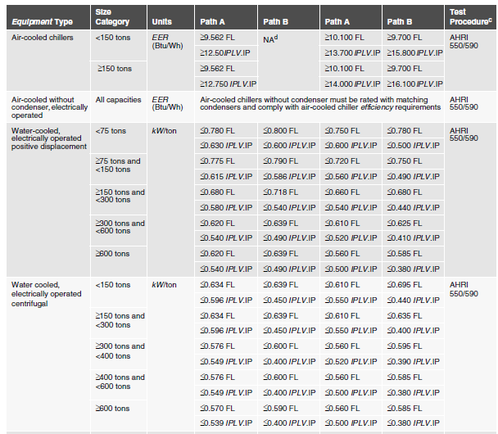
Table 6.8.1-3 Errata Change
These values are the old effective 1/1/2010 values and should be ignored

Slide 148
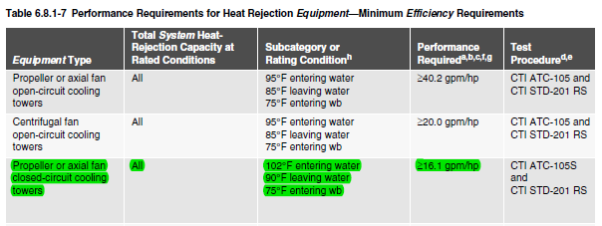
Table 6.8.1-7 Heat Rejection Equipment
One change was made to the table to increase the efficiency requirement for Propeller or axial fan closed-circuit cooling towers from 14.0 gpm/hp to 16.1 gpm/hp
Also note in Section 6.5.5.2 there are new requirements for cooling tower fan control

Slide 149
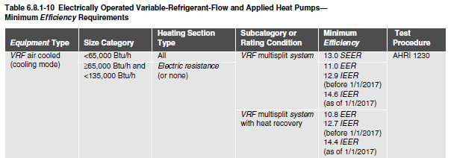
Table 6.8.1-9 &10 – VRF Equipment
New higher IEER values were defined for air cooled cooling only and heat pump Variable Refrigerant Flow (VRF) equipment with an effective date of 1/1/2017
EER values were not changed
The IEER, EER and heating COP levels for water source heat pump VRFs were also changed and go into effect on 1/1/2018
See standard for additional product categories
Notes:
Higher IEER values mean less energy use on a year-round basis.

Slide 150
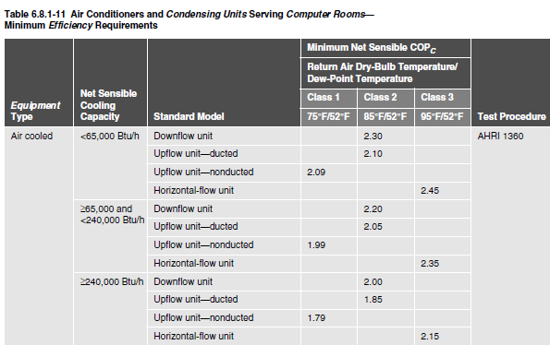
Table 6.8.1-11 Computer Room Units
Table 6.8.1-11 was totally revised to add 3 classifications of computer units
  Class 1 – 75 F DB/52 F WB
  Class 2 – 85 F DB/52 F WB
  Class 3 – 95 F DB/52 F WB
New COP_{C} values were then
defined for the various products
and new categories
This goes along with revisions
to the AHRI 1360 rating
standard
Notes:
Classifications added to reflect the trend in the industry to higher computer room operating temperatures

Slide 151
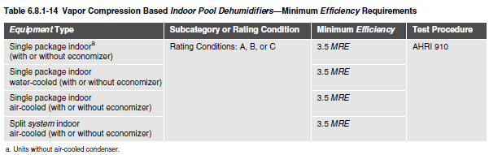
Table 6.8.1-14 Indoor Pool Dehumidifiers
New table
AHRI has developed a new standard for these products called AHRI 920 and this table now defines the minimum efficiency requirements
A new metric – Moisture Removal Efficiency (MRE)
  A ratio of the Moisture Removal Capacity expressed in kg/h to the total power input in kW at any given set of Rating Conditions expressed in kg of moisture/kWh. So a unit shown can remove 3.5 kg of moisture per 1 kWh of electricity used.
Notes:
This is a brand new efficiency table and prior to this there were no efficiency requirements for pool dehumidifiers

Slide 152
Table 6.8.1-15 & 16 DX-DOAS Equipment
Table 6.8.1-15 covers efficiency requirements for DX-DOAS Equipment based on the new AHRI 920 standard
This is a new table and prior to this there were no efficiency requirements for DOAS equipment
Similar to the Pool Dehumidifiers, this table uses a new metric base on moisture removal and this metric is an annual part load metric similar to IEER and IPLV
  Integrated Seasonal Moisture Removal Efficiency (ISMRE). This seasonal efficiency number is a combined value based on the formula listed in AHRI Standard 920 of the four (4) dehumidification Moisture Removal Efficiency (MRE) ratings required for DX-DOAS Units expressed in lb. of moisture/kWh
There are two tables, with table 15 covering units without energy recovery and table 16 covering units with energy recovery

Slide 153
Section 7 Compliance Flowchart
Flowchart revised to clarify the compliance paths for service water heating

Slide 154
Compliance
Service Water Heating (SWH)
Building System
Compliance Options
Envelope
Prescriptive Option
HVAC
Mandatory
Provisions
(required for most compliance options)
Trade Off Option
Energy Code Compliance
SWH
Energy Cost Budget
Power
Simplified
Lighting
Performance Rating
Method
Other
Notes:
Grayed out options under Compliance Options are not available for SWH.
There are now three compliance approaches available for SWH: Prescriptive, ECB, and Appendix G. The Simplified Mechanical Approach does not require that the Mandatory Provisions be met.

Slide 155
Service Water Heating Changes
Section 7.4.3 - Service hot water piping insulation
  new requirement added to require the first 8 ft. of branch piping connecting to recirculated, heat-traced, or impedance heated piping to be insulated
Table 7.8 which defines the minimum efficiency for water heating equipment the requirements for the following products was moved to an Informative Appendix and referenced to the federal requirements and applicable test procedures found in the Code of Federal Regulations 10 CFR Part 430
  Electric table top water heaters with a storage capacity ≥ 20 gal
  Electric water heaters < 12 kW and with a storage capacity ≥ 20 gal
  Heat pump water heaters with ≤ 24 amps power and ≤ 250 volts power supply
  Gas storage water heaters < 75,000 Btu/h and > 20 gallons
  Oil storage water heaters < 105,000 Btu/h and > 20 gallons

Slide 156
Section 7
SWH Compliance Paths
Section 7.2
You have to follow Sections
  7.1,
  7.4,
  7.5,
  7.7, and
  7.8
Alternatively, you can follow Section 11 (ECB), in which case Section 7.4 is mandatory

Slide 157
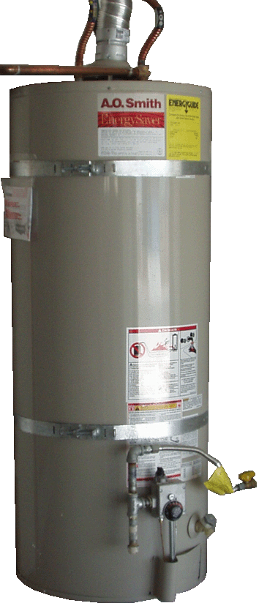
Section 7
Service Water Heating
General (Section 7.1)
Compliance Path(s) (Section 7.2)
Mandatory Provisions (Section 7.4)
  Load calculations
  Equipment efficiency
  Service hot water piping insulation
  Service water-heating system controls
  Pools
  Heat traps
Prescriptive Path (Section 7.5)
  Space heating and water heating
  Service water-heating equipment
  Buildings with high-capacity service water-heating systems
Submittals (Section 7.7)
Product Information (Section 7.8)

Slide 158
Section 7 – 7.1.1
SWH Scope
New buildings
Additions to existing buildings
Alterations to existing buildings
Notes:
Minor alterations to SWH systems, such as extending the pipes to new fixtures or installing valves, wouldn’t trigger requirements.
Exception:
Compliance isn’t required where there is insufficient space or access to meet these requirements.

Slide 159
Section 7 – 7.1.1.3
SWH Alterations
SWH equipment installed as a direct replacement shall meet these requirements
Exception
Not sufficient space or access to meet requirements
Notes:
Minor alterations to SWH systems, such as extending the pipes to new fixtures or installing valves, wouldn’t trigger requirements.
Exception:
Compliance isn’t required where there is insufficient space or access to meet these requirements.

Slide 160
Section 7 – 7.4.1
Load Calculations
In accordance with manufacturer’s published sizing guidelines or generally accepted engineering standards and handbooks
Notes:
The appropriate method depends on the type of application (food service, laundry, etc.) and the type of system (instantaneous or storage).

Slide 161
Section 7 – 7.4.2
Equipment Efficiency
Section 7.4.2 refers to Table 7.8 for equipment efficiencies
Equipment not listed in Table 7.8 has no minimum performance requirements, for example:
  Electric or oil water heaters < 20 gallons
  Gas instantaneous water heaters ≤ 50,000 Btu/h
Exception
  Water heaters and hot water supply boilers > 140 gal storage capacity don’t have to meet standby loss requirements when
    Tank surface is thermally insulated to R-12.5, and
    A standing pilot light isn’t installed, and
    Gas- or oil-fired water heaters have a flue damper or fan-assisted combustion

Slide 162
Section 7 – 7.8
Equipment Efficiency
Reference Table 7.8 on page 133 in 90.1-2016

Slide 163
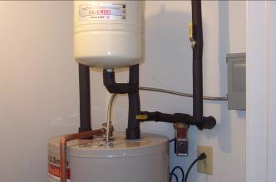
Section 7 – 7.4.3
Service Hot Water Piping Insulation
Insulate the following per Table 6.8.3-1
Circulating water heater
  Recirculating system piping,
  including supply and return piping
Nonrecirculating storage system
  First 8 ft of outlet piping
  First 8 ft of branch piping connecting to
  recirculated, heat-traced, or impedance
  heated piping
  Inlet pipe between storage tank and
  heat trap
Externally-heated pipes (heat trace or impedance heating)
Notes:
Previously, branch piping connected to a recirculation or heat-trace pipe where temperature was maintained could be uninsulated.
Uninsulated piping loses heat quickly, meaning, that the water would be cold and likely dumped by the user until hot water was available at the fixture.
Insulating the run-out branch piping slows the heat loss and means that when the next user shows up at the fixture several minutes later, the water is more likely to be at an acceptable temperature and not dumped.

Slide 164
Section 7 – Table 6.8.3-1
Piping Insulation
Reference Table 6.8.3-1 on page 127 in 90.1-2016

Slide 165
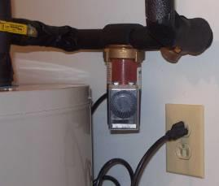
Section 7 – 7.4.4
Service Water Heating System Controls
Temperature Controls
Temperature Maintenance Controls
Outlet Temperature Controls
Circulating Pump Controls
Notes:
Each discussed in subsequent slides.

Slide 166
Section 7 – 7.4.4.1
Temperature Controls
To allow for storage temperature adjustment from 120°F or lower to a maximum temperature compatible with the intended use
Exception
  If manufacturer’s installation instructions specify a higher minimum thermostat setting to minimize condensation and resulting corrosion
Notes:
In addition to the potential energy savings, maintaining water temperature as low as possible reduces corrosion and scaling of water heaters and components.
Another important benefit is improved safety with respect to scalding.

Slide 167
Section 7 – 7.4.4.2
Temperature Maintenance Controls
Automatic time switches or other controls
  Set to switch off usage temperature maintenance system during extended periods when hot water is not required
Notes:
Applies to systems designed to maintain usage temperatures in hot-water pipes, such as recirculating hot-water systems or heat trace.

Slide 168
Section 7 – 7.4.4.3
Outlet Temperature Controls
Controls provided
  To limit maximum temperature of water delivered from lavatory faucets in public facility restrooms to 110°F

Slide 169
Section 7 – 7.4.4.4
Circulating Pump Controls
To limit operation to a period from the start of the heating cycle to a maximum of five minutes after the end of the heating cycle

Slide 170
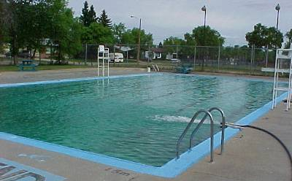
Section 7 – 7.4.5
Pools
Pool heaters to have readily accessible on-off switch
Pool heaters fired by natural gas can NOT have continuously burning pilot lights
Vapor retardant pool covers required (unless recovered or solar heat)
Time switches required
for both heaters and pumps
Notes:
Pools heated to > 90°F to have pool cover with a minimum insulation value of R-12
Exception from covers
Pools deriving > 60% of energy for heating from site-recovered energy or solar energy source
Time Switch Exceptions
Where public health standards require 24-hr pump operation
Where pumps are required to operate solar and waste heat recovery pool heating systems

Slide 171
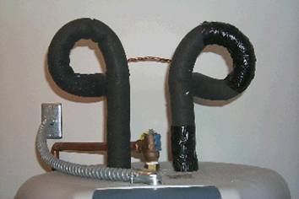
Section 7 – 7.4.6
Heat Traps
Noncirculating systems to have heat traps on both the inlet and outlet piping as close as practical to storage tank (if no integral heat traps)
  Either a device specifically designed for this purpose or
  Arrangement of tubing that forms a loop of 360° or piping that from the point of connection to the water heater includes a length of piping directed downward before connection to the vertical piping of the supply water or hot water distribution system, as applicable
Notes:
Storage heaters with integral heat traps on both inlet and outlet piping satisfy this requirement.
A heat trap is a means to counteract the natural convection of heated water in a vertical pipe run.

Slide 172
Section 7 – 7.5.1
Space Heating and Water Heating
Gas- or oil-fired space heating boiler system (complying with Section 6) is allowed to provide total space heating and water heating when ONE of the following conditions is met:
  Single boiler or component that is heating the service water has a standby loss in Btu/h not exceeding
    (13.3 x pmd + 400) / n; where pmd is probable maximum demand in gal/h and n is the fraction of the year when outdoor daily mean temperature is > 64.9°F
  Jurisdiction agrees use of a single heat source will consume less energy than separate units
  Energy input of the combined boiler and water heater system is
  < 150,000 Btu/h
Instructions for determining standby loss are included in this Section

Slide 173
Section 7 – 7.5.2
Service Water Heating Equipment
Equipment used to provide the additional function of space heating as part of a combination (integrated) system shall satisfy all requirements for service water heating equipment

Slide 174
Section 7 – 7.5.3
Buildings with High-Capacity Service Water
Heating Systems
New buildings with total installed gas water heating input capacity ≥ 1,000,000 Btu/h
  Minimal thermal efficiency of 90%
    Multiple units are allowed to meet this requirement if water-heating input with thermal efficiency above and below 90% provides an input capacity-weighted average thermal efficiency of ≥ 90%
Exceptions
  Where 25% of annual SWH requirement is provided by site-solar or site-recovered energy
  Water heaters in individual dwelling units
  Individual gas water heaters with input capacity ≤ 100,000 Btu/h

Slide 175
Section 7 – 7.7
Service Water Heating Submittals
AHJ may require submittal of compliance documentation and supplemental information in accordance with Section 4.2.2

