Slide 1
ANSI/ASHRAE/IES Standard 90.1-2016: Power and Lighting
Prepared by Pacific Northwest National Laboratory for the
U.S. Department of Energy
March 2017– PNNL-SA-124553

Slide 2
Acknowledgements
PNNL and DOE would like to thank ASHRAE Standing Standard Project Committee 90.1 for their contributions to the development of this presentation and their technical review of the content.

Slide 3
Summary of Changes
Interior Lighting Power Density (LPD)
Limits
Interior Power Density limits (LPD) were revised for 90.1-2016 primarily because of improved efficacy of LED lighting. All space type models used for LPD development were reviewed and where applicable, LED technology was included as part of the technology mix.
Space-by-Space LPDs – Most were reduced from previous 90.1-2013 levels with an average reduction of 26% but a few went up based on revised design criteria and current practice for that space type
Building area LPDs – Almost all were reduced as much as 34% with an overall average reduction across all building types of 12% from the 90.1-2013 allowances.
Notes:
Where do LPD values come from?
Space type LPDs
For 90.1 - Developed within the ASHRAE/IESNA 90.1 Lighting subcommittee with Illuminating Engineering Society (IES) committee support.
Generated from building space type models with design and lighting technology inputs
Whole building LPDs
Developed from detailed room data for commercial buildings and the space type LPDs
Weighted average for building type

Slide 4
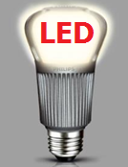
Summary of Changes
Energy Code LPDs and LED Lighting
Energy codes do limit the installed lighting power for interior and exterior (LPD) but…….
Energy codes (including 90.1) do not specify or require the use of specific lighting technologies.
However….
90.1-2016 does include partial or complete LED efficacy in many space type models in recognition of:
  Proven LED efficacy and energy savings capability
  Continued reduced cost of LEDs
  Product maturity and reasonable applicability
It is very likely that the future 90.1-2019 standard will include additional LED technology further reducing some space type and building LPD values.

Slide 5
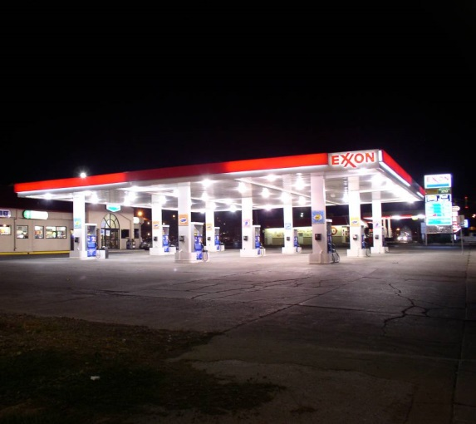
Summary of Changes
Exterior Lighting Power Density (LPD) Limits
Exterior Power Density limits (LPD) were reduced for 90.1-2016 based on improved efficacy of LED lighting that is currently effectively applied in exterior environments.
All area, linear, and application limits were reduced an average of 30% reflecting efficacy data collected on current efficient LED products.

Slide 6
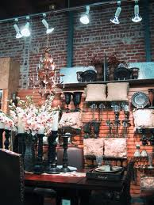




Summary of Changes
Retail Display and Decorative Allowances
Additional allowances for retail display lighting were reduced ~ 25% to reflect LED technology
Additional Lighting Power Allowance:
  1000 watts
    + (Retail Area 1 × 0.45 W/ft²)
    + (Retail Area 2 × 0.45 W/ft²)
    + (Retail Area 3 × 1.05 W/ft²)
    + (Retail Area 4 × 1.88 W/ft²)
Allowances for decorative lighting were also reduced ~ 25% from 1.0 W/ft² to 0.75 W/ft² to reflect LED technology

Slide 7
Summary of Changes
Partial Auto-On Restriction
An exception was added to the requirement for manual on OR partial auto on to accommodate advanced lighting controls for added energy savings
Lighting in open-plan office spaces will be allowed to turn on automatically to more than 50% (i.e. full auto-on)
The exception limits control zones to 600 square feet to preserve savings

Slide 8
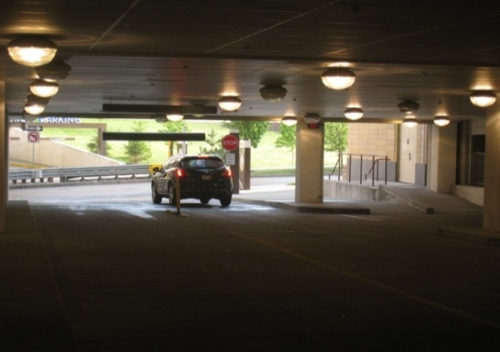
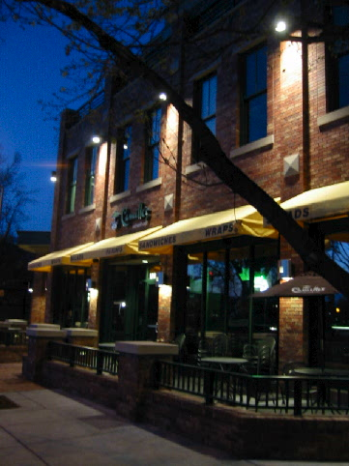
Summary of Changes
Exterior Lighting Control
Requirements to reduce lighting power by 30% during periods of non-occupancy or after business hours in exterior applications AND parking garages has been increased to 50%

Slide 9
Summary of Changes
Alterations
Lighting alterations (retrofits) section revised to add interior and exterior controls
  Interior retrofits must now also comply with occupancy and scheduled full and partial shutoff and bi-level switching where specified.
  Exterior retrofits must now also comply with astronomical control and/or scheduled shutoff control where specified for each application.
Application threshold changed to 20% of lighting load before requirements are applied. This acknowledges the added controls savings and practicality of applying controls in retrofits.
Lamp plus ballast retrofits and one-for-one fixture replacements need only comply with LPD limits.

Slide 10
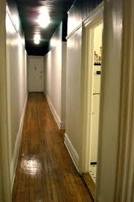
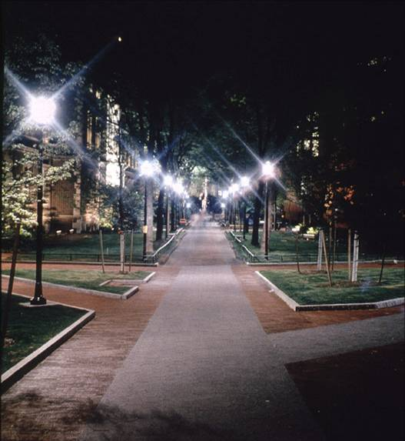
Summary of Changes
Other Changes
New specific parking lighting control
New requirement for dwelling unit lighting

Slide 11
Summary of Changes
Power Requirements
Low Voltage Dry Transformer efficiency
  Values were revised to meet federal efficiency minimums
Voltage Drop for efficiency
  Value combined/changed to maximum 5% of design load for combined feeder plus branch circuits

Slide 12
Compliance
Power
Building System
Compliance Options
Envelope
Prescriptive Option
HVAC
Mandatory
Provisions
(required for most compliance options)
Energy Code Compliance
Trade Off Option
SWH
Energy Cost Budget
Power
Lighting
Simplified
Other
Performance Rating
Method
Notes:
Grayed out options under Compliance Options do not exist for this chapter. For Power, there are only Mandatory Provisions and the option to use the Energy Cost Budget Method or Appendix G.
Power section is only in 90.1, not IECC.

Slide 13
Section 8
Power – Scope
New Buildings
Additions
Alterations
Mandatory Provisions
  Voltage drop
  Automatic receptacle control
  Electrical Energy Monitoring
  Low-Voltage Dry Type Distribution Transformers
Submittals
Notes:
Section 8 covers voltage drop and completion requirements (both of these requirements are mandatory).

Slide 14
Section 8 – 8.1.2 – 8.1.4
New Buildings, Additions, and Alterations to
Existing Buildings
Equipment installed in new buildings or additions to existing buildings must comply
Alterations to equipment or systems must comply with requirements applicable to those specific portions of the building and systems being altered
  New equipment installed as a direct replacement of existing equipment must comply with requirements for that equipment
  Exception - Compliance not required for relocation or reuse of existing equipment at the same site

Slide 15
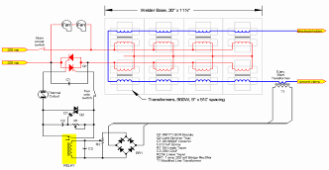
Section 8 – 8.4.1
Voltage Drop
Two types of conductors
  Feeder conductors
    Connect service equipment to the branch circuit breaker panels
  Branch circuit conductors
    Run from the final circuit breaker to the outlet or load
Feeder conductors and branch circuits combined to be sized for a maximum of 5% voltage drop total

Slide 16
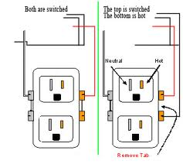
Section 8 – 8.4.2
Automatic Receptacle Control
Automatically controlled
≥ 50% of all 125 volt 15- and 20-amp receptacles in:
Private offices
Conference rooms
Rooms used primarily for printing and/or
copying functions
Break rooms
Classrooms
Individual workstations
≥ 25% of branch circuit feeders installed for modular furniture not shown on construction documents

Slide 17
Section 8 – 8.4.2
Automatic Receptacle Control (cont’d)
Automatic control devices must function on:
  Time-of-day controller provided to control ≤ 5,000 ft² and not more than one floor (occupant able to manually override up to 2 hours) OR
  Occupant sensor(s) to turn off receptacles within 20 minutes of occupant leaving the space, OR
  Automated signal from another control or alarm that turns receptacles off within 20 minutes after determining the area is unoccupied
Controlled receptacles must be
visually marked to differentiate from uncontrolled receptacles
uniformly distributed throughout the space
Plug-in type devices may not be used to comply with this requirement
Exceptions
Receptacles designated for equipment requiring 24 hr/day 365 days/yr operation
Spaces where automatic lighting shutoff would cause security or safety concerns

Slide 18
Section 8 – 8.4.3
Electrical Energy Monitoring
Measurement devices in new building to monitor electrical energy use for each of these separately:
Total electrical energy
HVAC systems
Interior lighting
Exterior lighting
Receptacle circuits
For buildings with multiple tenants, the above must be separately monitored for total building and for each tenant (excluding shared systems)
Exception:
up to 10% of each separate load (other than total) can be from other electrical loads

Slide 19
Section 8 – 8.4.3
Electrical Energy Monitoring – Recording and
Reporting
Energy use must be automatically recorded a minimum of every 15 minutes
Use must be reported at least hourly, daily, monthly, and annually
Data for tenants must be made available to that tenant
The system must be capable of retaining data for at least 36 months

Slide 20
Section 8 – 8.4.4
Low Voltage Dry-Type Distribution Transformers
Comply with the Energy Policy Act of 2005
  If not included in scope of EPAct 2005, then no requirements
Exceptions
  If meet EPAct 2005 exclusions based on 10CFR431
    Special purpose applications
    Not likely in general purpose applications
    Have multiple voltage taps where highest tap is ≥ 20% more than lowest tap
  Some specific products are listed
Notes:
Products that meet the exception criteria and are exempt from 8.1.2 include these types of transformers: drive, rectifier, auto-transformer, uninterruptible power system, impedance, regulating, sealed and nonventilating, machine tool, welding, grounding, or testing.

Slide 21


Section 8 – 8.7
Power Submittals
Owner gets information about the building’s electrical system
  Record drawings of actual installation within 30 days
    Single-line diagram of electrical distribution system
    Floor plans showing location and areas served for all distribution
  Manuals
    Submittal data stating equipment rating
    O&M manuals for equipment
    Qualified service agency contact
    Complete narrative of system as it’s normally intended to
    operate

Slide 22
Compliance
Lighting
Building System
Compliance Options
Envelope
Prescriptive Option
HVAC
Mandatory
Provisions
(required for most compliance options)
Energy Code Compliance
Trade Off Option
SWH
Energy Cost Budget
Power
Lighting
Simplified
Performance Rating
Method
Notes:
For Lighting, Prescriptive Option is really either Building Area Method or Space-by-Space Method. Grayed out options under Compliance Options are not used.

Slide 23
Basic Lighting Requirements
Mandatory Requirements (Interior and Exterior)
Interior Lighting Power Limits
Exterior Lighting Power Limits
+
+
Tradable
Total Connected Power
Interior Lighting Power Allowance
<
Exemptions
Controls
Non-Tradable
Switching
Exemptions
Building Area
Efficiency
Exterior Lighting Power Allowance
OR
Total Connected Power
<
Space-by-Space
Additional Allowances
Notes:
Interior lighting requirements are divided into a set of mandatory requirements, provisions that must be complied with regardless of the quantity of lighting that is installed, and two methods for determining the allowed wattage for the building.
The Prescriptive approach contains a look up table to determine allowed wattage for each occupancy type and is divided into two categories.
The Building Area approach can be used for a single occupancy building or separate business entities within a building.
The Space-by-Space approach is used flexibility and for non-standard building types or space configurations.

Slide 24
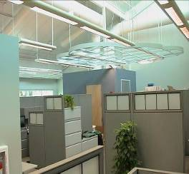
Section 9
Lighting
General Application (Section 9.1)
  Scope
  Lighting Alterations
  Installed Lighting Power
  Interior and Exterior Luminaire Wattage
Compliance (Section 9.2)
Mandatory Provisions (Section 9.4)
  Lighting control
  Exterior lighting power
  Functional testing
  Dwelling units
  Climate zone exception for daylighting control
Building Area Method Compliance Path (Section 9.5)
Alternative Compliance Path: Space-by-Space Method (Section 9.6)

Slide 25
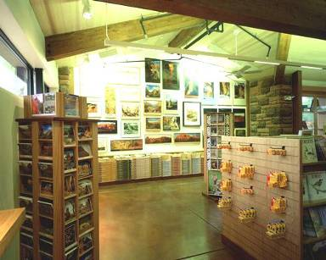
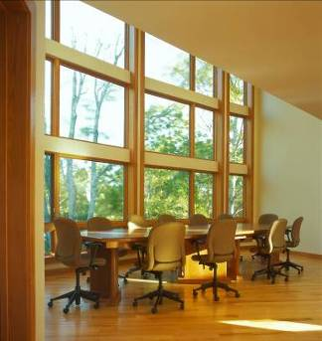
Section 9
Lighting General Scope
  Interior spaces of buildings
  Exterior lighting powered through building
  Exceptions
Emergency lighting
Lighting required by life safety statute
Decorative gas lighting
Notes:
This section applies to the following: interior spaces of buildings
exterior building features, including facades, illuminated roofs, architectural features, entrances, exits, loading docks, and illuminated canopies
exterior building grounds lighting provided through the building’s electrical service

Slide 26
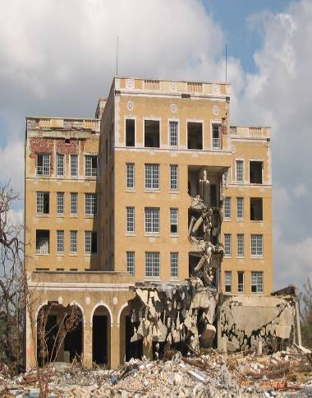
Section 9
Lighting General – Alterations
  Applies to these retrofits:
    where luminaires are added, replaced, or removed
    Replacement of lamp plus ballast in luminaires
  Requires BOTH interior and exterior alterations to comply with Lighting Power Density (LPD) limits and basic after hours automatic shutoff requirements
  Exception
  Spaces where alterations involve
  < 20% of connected lighting load and the LPD for the space is not increased
  Alterations that only involve replacement of lamps plus ballasts/drivers or only involve one-for-one luminaire replacement to only comply with LPD requirement and Section 9.4.1.1(h) and 9.4.1.1(i)
  Routine maintenance or repair situations

Slide 27
Section 9
Interior Lighting Power
Installed interior lighting power must be ≤ lighting power allowance
  Installed interior lighting power calculation method
  Calculation requirements
  Lots of exemptions (next page)
  Power allowance calculation methods
  Building area compliance path
  Alternative Compliance Path: Space-by-space method

Slide 28
Section 9 – 9.1.3
Installed Lighting Power Calculation Requirements
– INTERIOR and EXTERIOR
These requirements apply to both interior and exterior
Installed Lighting Power shall include all power used by the luminaires, including lamps, ballasts/drivers, transformers, and controls
  Exception: where two independent lighting systems exist in the same space or area and are controlled to prevent simultaneous operation, only the system with the highest total wattage must be included
Luminaire Wattage for various systems shall be determined in accordance with details in Section 9.1.4

Slide 29
Section 9 – 9.1.4
Luminaire Wattage Calculation Requirements
These requirements apply to both interior and exterior
Line voltage luminaires without ballasts or transformers = max. labeled wattage of the luminaire
Luminaires with ballasts/drivers or transformers = wattage of the maximum lamp/auxiliary combination OR max. labeled wattage of the luminaire. For luminaires with factory adjustable ballast factors (not user changeable), apply the ballast factor to be used in the space)
Line voltage track = actual wattage with a min. 30 W per foot OR wattage limit of system’s circuit breaker OR wattage limit of other permanent-current-limiting device(s) on the system
Low voltage track = transformer wattage
All others as specified on equipment

Slide 30
Section 9
Installed Interior Lighting Power Calculation
Exemptions
Lighting that does not have to be included in the installed lighting power calculation:
Theatrical, stage, film, and video production
Medical and dental procedures
Exhibit displays for museums, monuments, and galleries
Integral to equipment or instrumentation installed by manufacturer
Integral to both open and glass-enclosed refrigerator and freezer cases
Retail display windows, provided the display is enclosed by ceiling-height partitions
Food warming and food preparation equipment
Interior spaces specifically designated as registered interior historic landmarks
Integral part of advertising or directional signage
Exit signs
Sale or lighting educational demonstration systems
Lighting for television broadcasting in sporting activity areas
Casino gaming areas
Furniture-mounted supplemental task lighting controlled by automatic shutoff and complying with 9.4.1.4(d)
For use in areas specifically designed for life support of nonhuman life forms
Mirror lighting in dressing rooms and accent lighting in religious pulpit and choir areas
Parking garage transition lighting

Slide 31
Section 9
Building Area Method of Calculating Interior Lighting
Power Allowance
Can be used for entire building or separate building type occupancies
Advantages
  Fewer calculations
Limitations
  Limited building area type selection - use reasonably equivalent type
  Insensitive to specific space functions and room configurations
  Generally more restrictive that space-by-space method
Calculation Process
  Determine gross lighted area for each building type area using:
    Exterior faces of exterior walls
    Centerline of interior walls
  Calculate the area power allowance by multiplying the gross lighted area by the applicable building type allowance from Table 9.5.1
  Sum all the allowances (if more than one building type area)
Notes:
The building area method is the easiest to use but has limitations as discussed above.

Slide 32
Section 9 – Table 9.5.1
Building Types
Part of Table 9.5.1 shown below.
Complete table in the Standard has 32 different building types
Building Type
Lighting Power Density (W/ft²)
Automotive Facility
0.71
Convention Center
0.76
Court House
0.90
Dining: Bar Lounge/Leisure
0.90
Dining: Cafeteria/Fast Food
0.79
Dining: Family
0.78
Dormitory
0.61
Exercise Center
0.65
Notes:
A partial view of the Building Area table.

Slide 33
Section 9 – 9.6.1
Space-by-Space Method of Calculating Interior
Lighting Power Allowance
Applies to any building configuration by calculating allowances for individual spaces
Advantages
  More flexible than building area method
  More accurately accounts for actual room lighting power needs
  Provides additional allowances for:
    Difficult room configurations
    Decorative and retail needs
    Use of advanced controls not already required in the standard
Limitations
  More calculations needed (individual spaces)
Calculation Process
  Determine the gross lighted area of each space type
    include balconies and mezzanines
    Use centerline of walls between spaces
  Calculate the space power allowance by multiplying the space type area by the applicable allowance from Table 9.6.1
  Sum all the allowances
Notes:
Multi-occupancy building – if both space-by-space and building area methods are used, trade-offs are not permitted between the two building occupancies; each building occupancy must comply separately.
For each space enclosed by partitions 80% or greater than ceiling height, determine the gross interior floor area by measuring to the center of the partition wall. Include the floor area of balconies or other projections. Retail spaces do not have to comply with the 80% partition height requirements.
The interior lighting power allowance is the sum of lighting power allowances of all spaces. Trade-offs among spaces are permitted provided that the total installed interior lighting power does not exceed the interior lighting power allowance.

Slide 34
Section 9 – 9.6.1
Space-by-Space Method of Calculating Subspaces
If a physical space has multiple functions such that more than one space type from Table 9.6.1 applies
  Break the space into smaller subspaces
  Use the centerline of interior walls and dividing line between subspaces to determine subspace areas
  Calculate the allowance separately for each subspace
  Exception
  Subspaces with areas less than 20% of the original space and less than 1000 ft² do not need to be broken out separately
Notes:
Multi-occupancy building – if both space-by-space and building area methods are used, trade-offs are not permitted between the two building occupancies; each building occupancy must comply separately.
For each space enclosed by partitions 80% or greater than ceiling height, determine the gross interior floor area by measuring to the center of the partition wall. Include the floor area of balconies or other projections. Retail spaces do not have to comply with the 80% partition height requirements.
The interior lighting power allowance is the sum of lighting power allowances of all spaces. Trade-offs among spaces are permitted provided that the total installed interior lighting power does not exceed the interior lighting power allowance.

Slide 35
Section 9 – Table 9.6.1
Space-by-Space Allowances
Small part of Table 9.6.1 shown below
Notes:
Partial look at Table 9.6.1.

Slide 36
Room Geometry Adjustment – 9.6.4
Room Cavity Ratio Adjustment for relief in unusual space configurations
Used only when applying the space by space method
Calculate the Room Cavity Ratio (RCR) for the empty room:
RCR = 2.5 x Room Cavity Height x room perimeter length room area
(Room Cavity Height = Luminaire mounting height – Workplane height)
If RCR is greater than the RCR threshold for that space type from Table 9.6.1, a 20% increase is allowed
For corridor/transition spaces, a 20% adjustment is allowed when less than 8 feet wide, regardless of the RCR

Slide 37
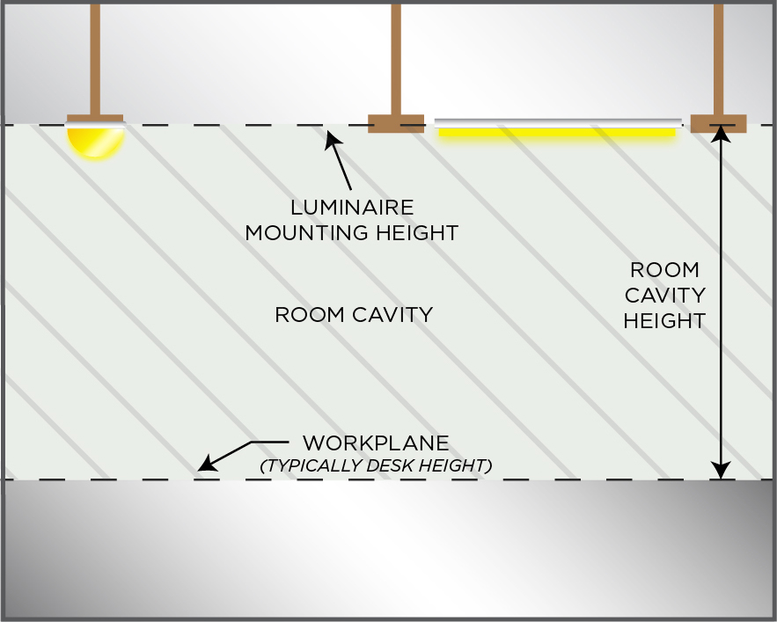
Room Geometry Adjustment

Slide 38
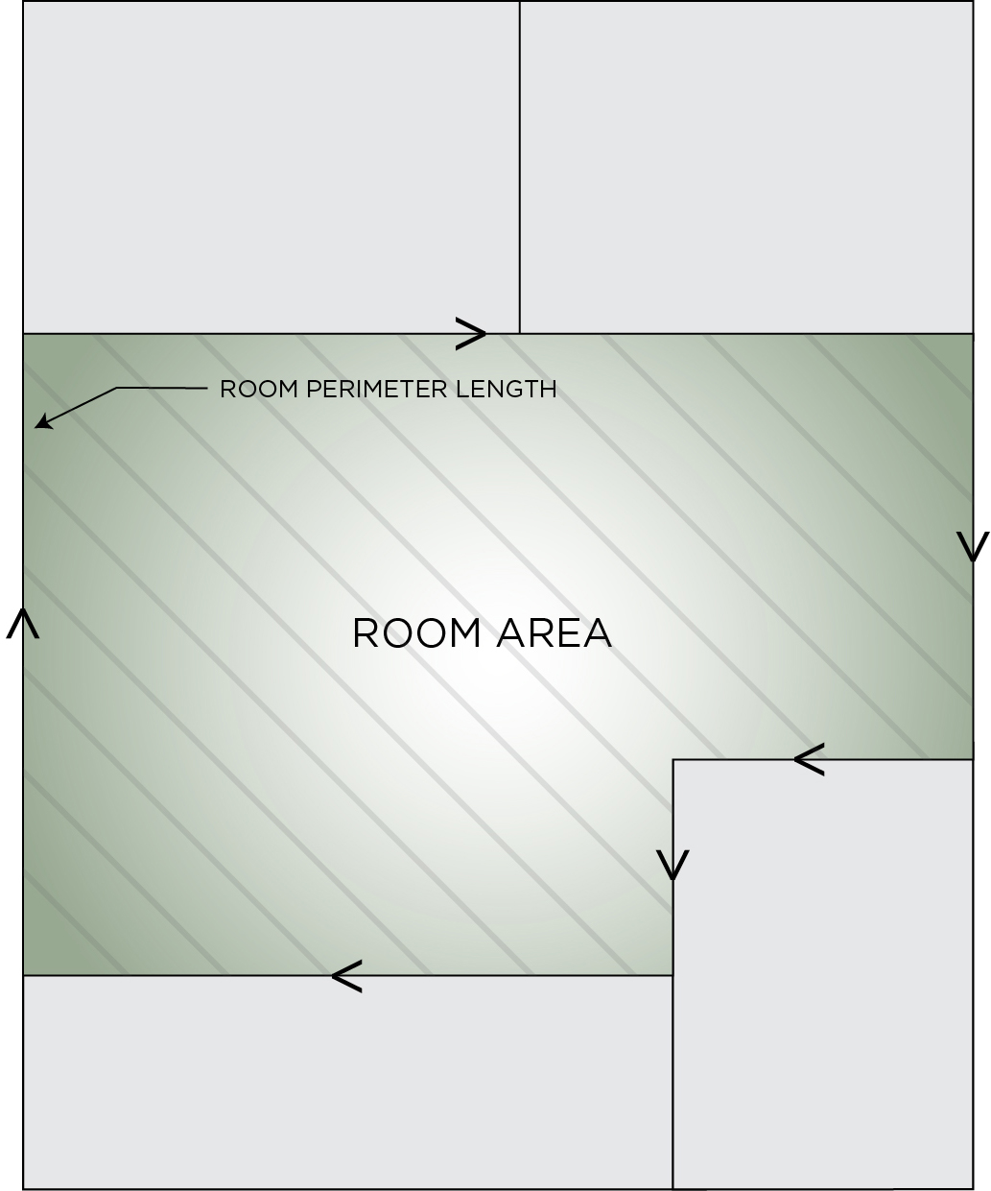
Room Geometry Adjustment

Slide 39
Section 9 – 9.6.2 – 9.6.3
Additional Interior Lighting Power
Decorative and Retail display highlighting
An increase in the lighting power allowance is allowed for specific decorative and retail applications when using the space-by-space method.
Applications must be automatically controlled, separately from the general lighting, to be turned off during non-business hours. The additional allowances can only be used for the additional lighting equipment – and not general lighting
  Decorative luminaires in addition to the general lighting = 0.75 W/ft²
  Retail display lighting = varies by retail type
Advanced Controls
An increase in the allowance is also allowed for the use of specified advanced controls that are installed in addition to those already required
Notes:
Retail display lighting covered on the next slide.
Decorative lighting is use-it-or-lose-it and can only be applied up to the amount of decorative lighting wattage installed.
Additional power is allowed only if the specified lighting is installed and automatically controlled, separately from the general lighting, to be turned off during nonbusiness hours. This additional power can be used only for the specified luminaires and not used for any other purpose.

Slide 40
Section 9 – 9.6.2
Additional Retail Display Lighting Allowance
Additional Interior Lighting Power Allowance = 1000 watts +
(Retail Area 1 x 0.45 W/ft²) +
(Retail Area 2 x 0.45 W/ft²) +
(Retail Area 3 x 1.05 W/ft²) +
(Retail Area 4 x 1.88 W/ft²),
Where:
Retail Area 1 = the floor area for all products not listed in Retail Area 2, 3 or 4
Retail Area 2 = the floor area used for the sale of vehicles, sporting goods and small electronics
Retail Area 3 = the floor area used for the sale of furniture, clothing, cosmetics and artwork
Retail Area 4 = the floor area used for the sale of jewelry, crystal, and china.
Other merchandise categories not listed may be included in Retail Areas 2 through 4, provided that justification documenting the need for additional lighting power based on visual inspection, contrast, or other critical display is approved by the authority having jurisdiction.
Notes:
Retail highlighting allowance is use-it-or-lose-it.
This additional display lighting must be separately circuited, switched, and automatically controlled.
Additional allowance depends on type of retail display area.
Doesn’t apply to entire store – only sales floor area.

Slide 41
Section 9 – 9.6.3
Advanced Controls Incentive
If all mandatory control requirements are met for a space AND advanced controls are installed in that space, THEN additional limited lighting power is allowed:
Additional power can be used anywhere in the building
Additional Interior Lighting Power Allowance is calculated as
  Lighting Power Under Control x Control Factor
Notes:
Table 9.6.3 is used; only a partial table is shown.

Slide 42
Section 9.4.1.1
Interior Lighting Controls
For each space type, apply the lighting control functions listed.
If using the Space-by-Space method for LPD requirements, use same space type for control requirements. For space types not listed, use a reasonable equivalent
“REQ” = mandatory
“ADD1” = at least one of these must be implemented
“ADD2” = at least one of these must be implemented

Slide 43
Section 9.4.1.1
Control Functions
Local control
Restricted to manual ON
Restricted to partial automatic ON
Bilevel lighting control
Automatic daylight responsive controls for sidelighting
Automatic daylight responsive controls for toplighting
Automatic partial OFF (full OFF complies)
Automatic full OFF
Scheduled shutoff

Slide 44
Section 9 – 9.4.1.1 (a)
Local Control
At least one control that controls all the lighting in the space
  In spaces ≤ 10,000 ft², each control serves 2,500 ft² maximum and in spaces > 10,000 ft², serves 10,000 ft² maximum

Slide 45
Section 9 – 9.4.1.1 (b)
Restricted to Manual ON
No lighting automatically turned on
Exception
Where manual ON would endanger safety or security
Typically, users are allowed to choose to implement this control or Partial On

Slide 46
Section 9 – 9.4.1.1 (c)
Restricted to Partial ON
< 50% of general lighting power allowed to be automatically turned on, and none of remaining lighting automatically turned on
Exception
Lighting in open-plan offices allowed to turn on automatically to > 50% if control zone is ≤ 600 ft²
Typically, users are allowed to choose to implement this control or Manual On

Slide 47
Section 9 – 9.4.1.1 (d)
Bilevel Lighting Control
General lighting to provide at least one intermediate step in lighting power or continuous dimming in addition to full ON and full OFF
  To have at least one control step between 30% and 70% (inclusive) of full lighting power in addition to all off

Slide 48
Section 9 – 9.4.1.1 (e)
Automatic Daylight Responsive Controls for
Sidelighting
Apply photocontrols if the combined input power of all general lighting completely or partially within:
  primary sidelighted areas is ≥ 150 W
  primary and secondary sidelighted areas is ≥ 300 W
  general lighting in secondary sidelighted area controlled independently of general lighting in primary sidelighted area
Control system must have following characteristics
  Calibration adjustment located ≤ 11ft above finished floor
  Photocontrol to reduce electric lighting in response to available daylight using
    Continuous dimming or
    At least one control point between 50% and 70% of design light power
    Second control point between 20% and 40% of design light power or
    Lowest dimming level technology allows
    Third control point that turns off all controlled lighting
    Calibration doesn’t require physical presence of a person at sensor while calibration is processing

Slide 49
Section 9 – 9.4.1.1 (e)
Automatic Daylight Responsive Controls for
Sidelighting (cont’d)
Exceptions
Primary sidelighted areas where top of any existing adjacent structure is twice as high above the windows as its distance away from the windows
Sidelighted areas where total glazing area is
< 20 ft²
Retail spaces

Slide 50
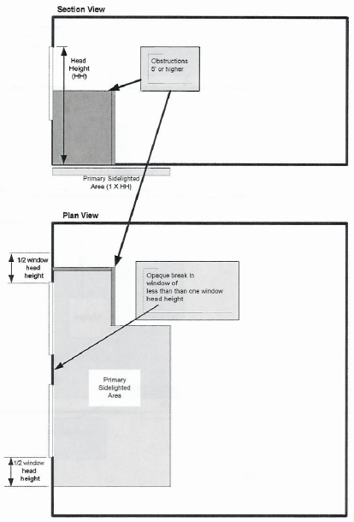
Section 9 – 9.4.1.4
Daylight Zone Definition – Primary Sidelighted Area
© 2013, ASHRAE, ANSI/ASHRAE/IES Standard 90.1-2013, Figure 3.2-3
Notes:
Primary sidelighted area: the total primary sidelighted area is the combined primary sidelighted area without double counting overlapping areas. The floor area for each primary sidelighted area is directly adjacent to vertical glazing below the ceiling with an area equal to the product of the primary sidelighted area width and the primary sidelighted area depth.
The primary sidelighted area width is the width of the vertical fenestration plus, on each side, the smaller of:
1. One half of the vertical fenestration head height (where head height is the distrance from the floor to the top of the glazing) or
2. the distance to any 5 ft or higher opaque vertical obstruction.
The primary sidelighted area depth is the horizontal distance perpendicular to the vertical fenestration which is the smaller of:
1. one vertical fenestration head height or
2. the distance to any 5 ft or higher opaque vertical obstruction.

Slide 51
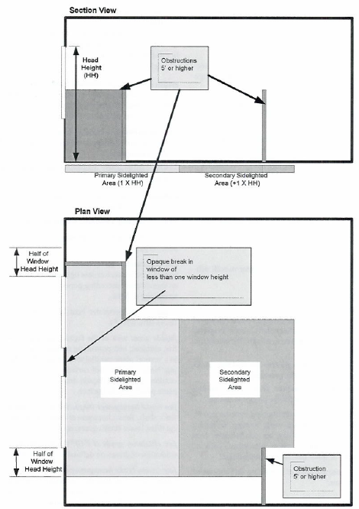
Section 9 – 9.4.1.4
Daylight Zone Definition – Secondary
Sidelighted Area
© 2013, ASHRAE, ANSI/ASHRAE/IES Standard 90.1-2013, Figure 3.2-4
Notes:
Secondary sidelighted area: the total secondary sidelighted area is the combined secondary sidelighted area within a space. Each secondary sidelighted area is directly adjacent to a primary sidelighted area.
The secondary sidelighted area width is the width of the vertical fenestration plus, on each side, the smaller of:
1. One half of the vertical fenestration head height or
2. the distance to any 5 ft or higher vertical obstruction.
The secondary sidelighted area depth is the horizontal distance perpendicular to the vertical fenestration, which begins at the edge of the primary sidelighted area depth and ends at the smaller of:
1. one vertical fenestration head height (head height is the distance from the floor to the top of the glazing), or
2. the distance to any 5 ft or higher opaque vertical obstruction.

Slide 52
Section 9 – 9.4.1.1 (f)
Automatic Daylight Responsive Controls for
Toplighting (cont’d)
Apply photocontrols if the combined input power of all general lighting completely or partially under daylight areas under skylights and daylight areas under roof monitors is ≥ 150 W. Photocontrols must:
  Reduce electric lighting in response to available daylight using
    Continuous dimming or
    At least one control point between 50% and 70% of design light power
    Second control point between 20% and 40% of design light power or
    Lowest dimming level technology allows
    Third control point that turns off all controlled lighting
  Calibration doesn’t require physical presence of a person at sensor while calibration is processing
  Control overlapping toplighted and sidelighted daylight areas together with general lighting in the daylight area under skylights or daylight areas under roof monitors

Slide 53
Section 9 – 9.4.1.1 (f)
Automatic Daylight Responsive Controls for
Toplighting
Exceptions
Daylight area under skylights where documented that existing adjacent structures or natural objects block direct sunlight fore > 1500 daytime hours per year between 8am and 4pm
Daylight area under skylights where overall skylight effective aperture for enclosed space is < 0.006
In each space within buildings in Climate Zone 8 where input power of general lighting within daylight areas is < 200 W

Slide 54
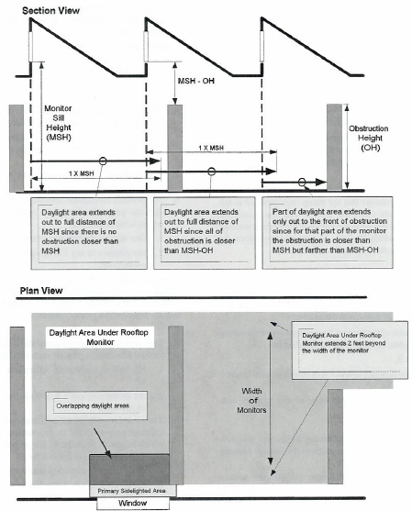
Section 9 – 9.4.1.4
Daylight Zone Definition – Under Rooftop Monitors
© 2013, ASHRAE, ANSI/ASHRAE/IES Standard 90.1-2013, Figure 3.2-1
Notes:
The daylight area under rooftop monitors is the combined daylight area under each rooftop monitor without double counting over-lapping areas. The daylight area under each rooftop monitor is the product of the width of the vertical glazing above the ceiling level and the smallest of the
following horizontal distances inward from the bottom edge of the glazing, (See Figure 3.2-1):
1. the monitor sill height, MSH, (the vertical distance from the floor to the bottom edge of the monitor glazing), or
2. the distance to the edge of any primary sidelighted area or
3. the distance to the front face of any vertical obstruction where any part of the obstruction is farther away than the difference between the
height of the obstruction and the monitor sill height (MSH-OH).

Slide 55
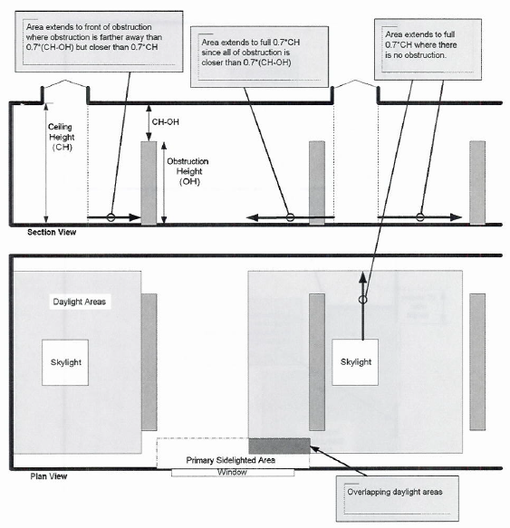
Section 9 – 9.4.1.4
Daylight Zone Definition – Under Skylights
© 2013, ASHRAE, ANSI/ASHRAE/IES Standard 90.1-2013, Figure 3..2-2
Notes:
The daylight area under skylights is the combined daylight area under each skylight without double counting overlapping areas. The daylight
area under each skylight is bounded by the opening beneath the skylight, plus horizontally in each direction, the smallest of (See Figure 3.2-2):
1. 70% of the ceiling height (0.7 × CH), or
2. the distance to the nearest face of any opaque vertical obstruction where any part of the obstruction is farther away than 70% of the distance between the
top of the obstruction and the ceiling (0.7 × [CH–OH]), where CH = the height of the ceiling at the lowest edge of the skylight, and OH = the height to the top of the obstruction.

Slide 56
Section 9 – 9.4.1.1 (g)
Automatic Partial OFF (Full OFF Complies)
Automatically reduce general lighting power by at least 50% within 20 minutes of all occupants leaving the space
Exceptions
Space has LPD < 0.80 W/ft²
Space is lighted by High Intensity Discharge technology
General lighting power in space is automatically reduced by ≥ 30% within 20 minutes of all occupants leaving the space
Lighting load ≤ 0.02 W/ft² multiplied by gross lighted area of the building

Slide 57
Section 9 – 9.4.1.1 (h)
Automatic Full OFF
All lighting automatically shut off within 20 minutes of all occupants leaving the space
Control device to control < 5,000 ft²
Exceptions
Shop and lab classrooms
Areas where auto shutoff causes safety or security concerns
Lighting for 24/7 operation
Typically, users are allowed to choose to implement this control or Scheduled Shutoff

Slide 58
Section 9 – 9.4.1.1 (i)
Scheduled Shutoff
Control lights on a scheduled basis (automatic time switch)
    Time-of-day controller or
    Signal from another control or alarm
Controller or system provide independent control sequences that
    Controls ≤ 25,000 ft²
    Not more than one floor
    Accounts for weekend and holidays
  Manual override control
    < 2 hours during scheduled off
    Control ≤ 5,000 ft²
Exceptions
    Lighting for 24/7 operation
    Patient care spaces
    Areas where auto shutoff causes safety or security concerns
    Lighting load ≤ 0.02 W/ft² multiplied by gross lighted area of the building
Typically, users are allowed to choose to implement this control or Automatic Full Off
Notes:
Intent:
Eliminate after hours lighting waste
Casinos (exception)
Areas with safety – always an issue

Slide 59
Section 9 – 9.4.1.2
Parking Garage Lighting Control
Automatic lighting shutoff per 9.4.1.1(i)
Must reduce lighting power by minimum of 30% when no activity is detected for 20 minutes within a lighting zone ≤ 3,600 ft²
Automatically reduce power at least 50% in response to daylight for luminaires within 20 ft of any perimeter wall that has
  a net opening to wall ratio of ≥ 40% and
  no exterior obstructions within 20 ft
Exception
Daylight transition zones and ramps without parking are exempt from 30% reduction and daylight control
Notes:
Graphics on next two slides illustrate these requirements

Slide 60
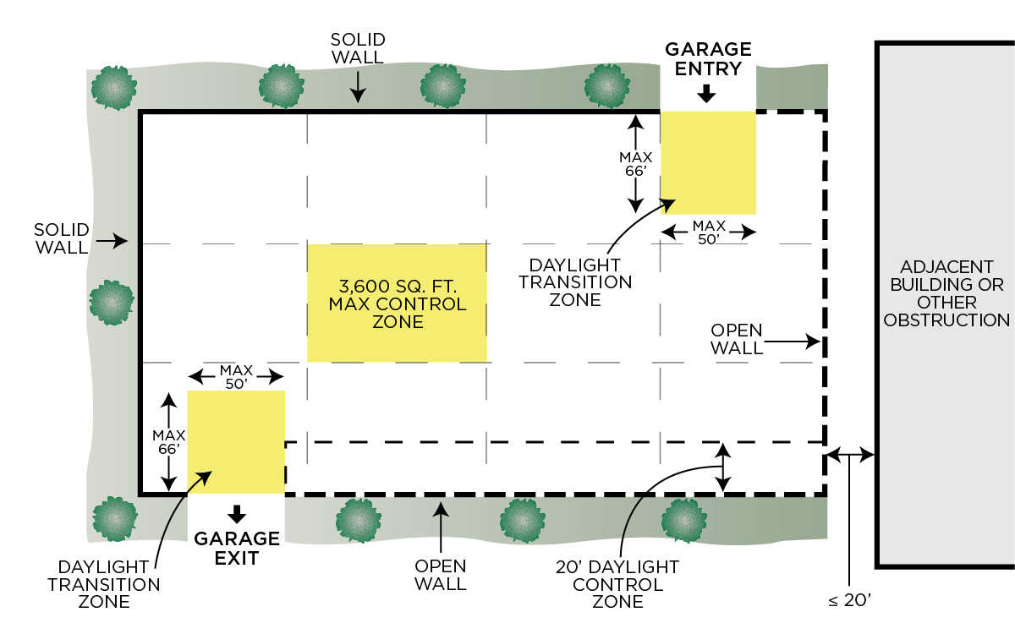
Section 9 – 9.4.1.2
Parking Garage Lighting Control

Slide 61
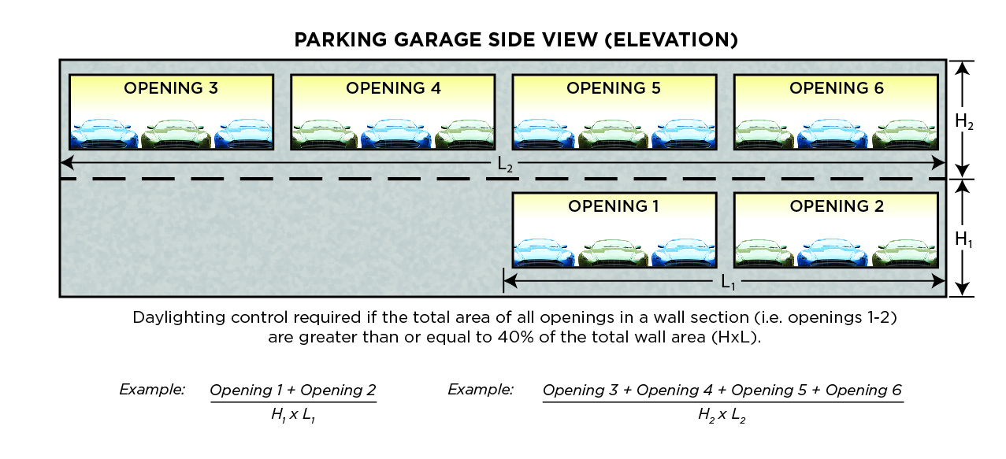
Section 9 – 9.4.1.2
Parking Garage Lighting Control – Opening to
Wall Ratio
Notes:
Daylighting control required if the total area of all openings in a wall section (i.e., openings 1-2 in the graphic) are greater than or equal to 40% of the total wall area.

Slide 62
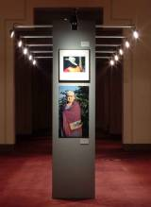
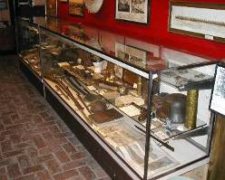
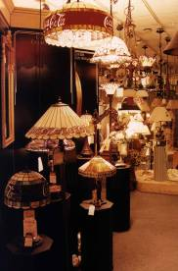
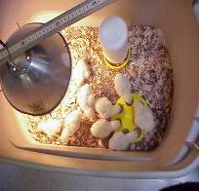
Section 9 – 9.4.1.3
Control of Special Applications
Special applications separately controlled from
general lighting
    Display or accent lighting
    Case lighting
    Nonvisual lighting
    Demonstration lighting
Notes:
Intent:
Provide opportunity to turn off special application lighting

Slide 63
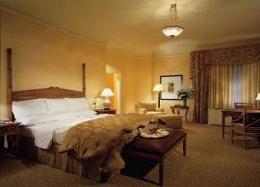
Section 9 – 9.4.1.3
Control of Special Applications
Guestroom lighting and switched receptacles to be turned off within 20 minutes of occupants leaving the space
  Exception: where captive key systems used
Bathrooms controlled to automatically turn off lighting within 30 minutes of occupants leaving space
  Exception: night lighting not > 5W
Supplemental task lighting controlled by
  Controller integral to the luminaires OR
  Wall-mounted controller-readily accessible and located so occupant can see controlled lighting

Slide 64
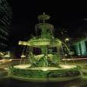

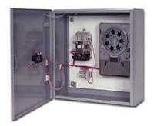
Section 9 – 9.4.1.4
Mandatory Exterior Lighting Control
Lighting must turn off when there is sufficient daylight
Building façade and landscape lighting must be shut off between
  midnight or business closing (whichever is later) and
  6am or business opening (whichever comes first) OR
  times established by AHJ
Power for other lighting and lighting for signage to be automatically reduced by at least 50%
  From midnight or within 1 hour of end of business operations (whichever is later) and until 6am or business opening (whichever is earlier) OR
  During any period when no activity has been detected for a time no longer than 15 minutes
Luminaires serving outdoor parking areas with rated input wattage > 78 W and mounting height of ≤ 24 ft above ground
  Lights must automatically reduce power of each luminaire by > 50% when no activity is detected in the area for 15 minutes or less
  Limited to 1500 W of lighting controlled together
Exceptions
  Covered vehicle entrances
  Exits from buildings or parking structures
  (where required for safety, security, or eye adaptation)
  Lighting integral to signage and installed by manufacturer

Slide 65
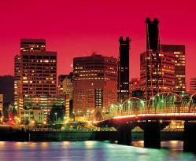
Section 9.4.2
Exterior Lighting Power
Exterior Building Lighting Power must meet prescribed power limits.
The total exterior lighting power allowance is the sum of the base site allowance plus individual lighting power densities (LPD) for the applicable “lighting power zone”
Trade-offs are allowed only among “Tradable Surfaces” applications
Some exemptions apply
Notes:
Building grounds lighting – unless controlled by a motion sensor or qualifies for one of the exceptions under Section 9.1.1 or 9.4.5.
Pedestrian walkways, gardens, other landscape areas associated with a building.
Eliminates the use all incandescent and mercury vapor discharge sources over 100W.

Slide 66
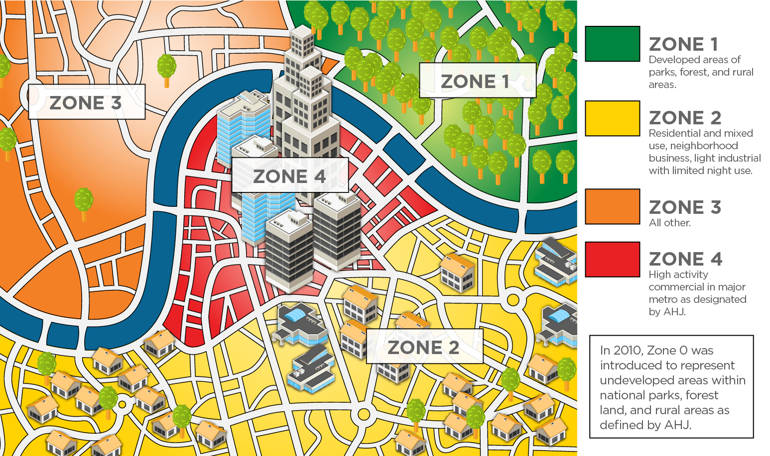
Exterior Lighting Power Zones

Slide 67
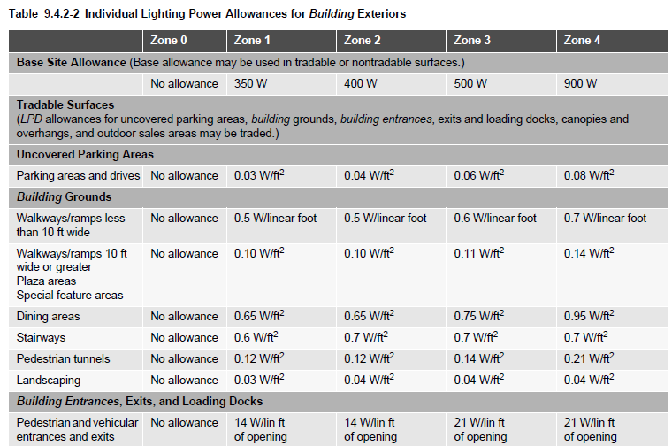
Section 9
Tradable Exterior LPDs
Exterior applications are divided into 2 categories:
Tradable: allowed wattage may be traded
among these applications
Non-Tradable: allowed wattage cannot
be traded between surfaces or with other exterior lighting
Notes:
These are the more common applications in most building exteriors.
Tradable means if you don’t use all the wattage you’re allowed for a parking lot, you could apply some of that to another tradable application, like a canopy, for example.

Slide 68
Section 9 – 9.4.2
Exterior Lighting Power Exemptions
The following are exempt when equipped with separate controls:
  lighting that is integral to signage and installed by its manufacturer;
  lighting for athletic playing areas;
  lighting for industrial production, material handling, transportation sites, and associated storage areas;
  theme elements in theme/amusement parks;
  lighting used to highlight features of public monuments, public art displays, and registered historic landmark structures or buildings;
  lighting for water features;
  specialized signal, directional, and marker lighting associated with transportation;
  lighting that is integral to equipment or instrumentation and is installed by its manufacturer;
  lighting for theatrical purposes, including performance, stage, film, and video production;
  temporary lighting;
  lighting for hazardous locations;
  lighting for swimming pools;
  searchlights.
Notes:
The key is these are exempt but must have separate controls.

Slide 69
Section 9 – 9.4.3
Functional Testing
Functional testing (calibrated/adjusted/programmed) of lighting control devices and systems required within 90 days of occupancy
  Must be performed by individuals NOT involved in design, manufacture, or installation
  For occupant sensors:
    Certify location and aiming per manufacturer recommendation
    Test all sensors if project ≤ 7
    If > 7 sensors, test for each unique combination of sensor type and space geometry and verify
      Status indicator
      Lights turn off or down to permitted level within required time
      Auto-on – lights turn on to permitted level when someone enters the space
      Manual on – lights turn on only when manually activated
      Lights aren’t incorrectly turned on by movement in nearby areas or by HVAC operation

Slide 70
Section 9 – 9.4.3
Functional Testing (cont’d)
  For automatic time switches:
    Confirm programmed schedules
    Document schedules for owner
    Verify correct time and date are set
    Verify any battery backup is installed and energized
    Verify override time limit set to ≤ 2 hours
    Simulate occupied condition and verify and document:
      Lights turn on and off with respective switches
      Switch only operates lights in enclosed space where switch is located
    Simulate unoccupied condition and verify and document:
      All nonexempt lights turn off
      Manual override only operates lighting where it is located
  For daylighting controls
    Properly located, field-calibrated, and set to have appropriate setpoints and threshold light levels
    Daylight controlled lighting loads adjust to correct levels with available daylight
    Location where calibration adjustments are made is readily accessible only to authorized personnel

Slide 71
Section 9 – 9.4.4
Dwelling Units
Dwelling units (apartment, condo, living space, etc.) must be built so that at least 75 percent of the permanently installed lighting fixtures utilize lamps with an efficacy of at least 55 lm/W, or have a total luminaire (fixture) efficacy of at least 45 lm/W.
  Exception: Lighting that is controlled with dimmers or automatic control devices.
Applies to 4 story above grade multi-family (3 story and below not in scope of 90.1)
Other common spaces in the building must follow standard 90.1 Requirements.

Slide 72
Section 9 – 9.7
Submittals
Record drawings, to include for each piece of lighting equipment:
  Location
  Luminaire identifier
  Control
  Circuiting
Operation and maintenance manuals
Daylighting documentation
  Identify all general lighting located within daylight areas under skylights, daylight areas under roof monitors as well as primary sidelighted areas and secondary sidelighted areas

