Slide 1
ANSI/ASHRAE/IES Standard 90.1-2016: Overview
Prepared by Pacific Northwest National Laboratory for the U.S. Department of Energy
March 2017

Slide 2
Acknowledgements
PNNL and DOE would like to thank ASHRAE Standing Standard Project Committee 90.1 for their contributions to the development of the 90.1-2016 presentations and their technical review of the content.

Slide 3
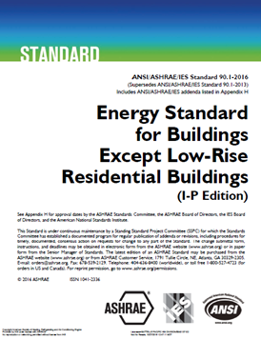
Structure of Standard 90.1-2016
1 Purpose
2 Scope
3 Definitions, Abbreviations, and Acronyms
4 Administration and Enforcement
5 Building Envelope
6 Heating, Ventilating, and Air Conditioning
7 Service Water Heating
8 Power
9 Lighting
10 Other Equipment
11 Energy Cost Budget Method
12 Normative References
Normative Appendices A-H

Slide 4
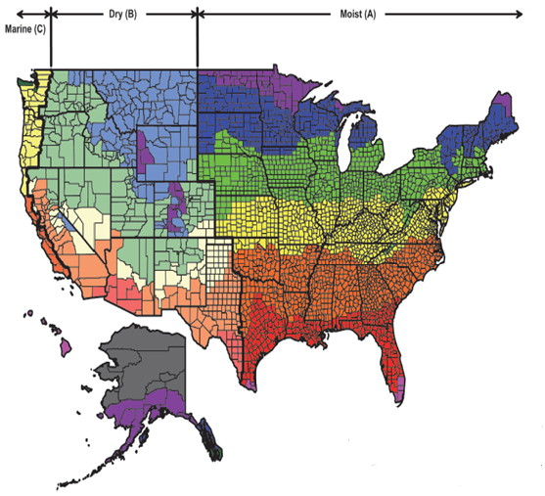
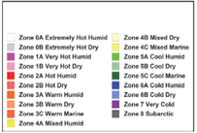
Summary of Changes
Total of 121 addenda
Major format changes for ease of use
New climate maps aligning with ASHRAE Standard 169
New performance-based compliance path
Significant whole building energy savings

Slide 5
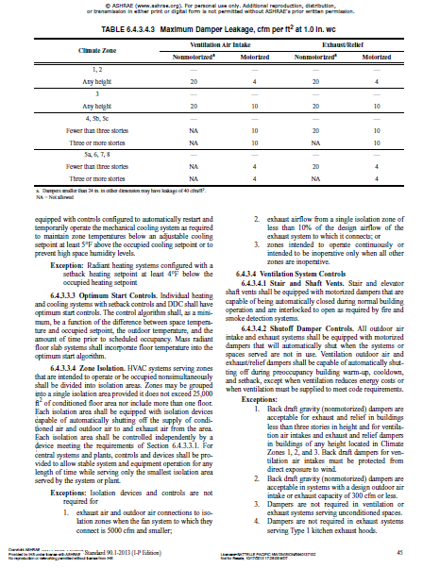
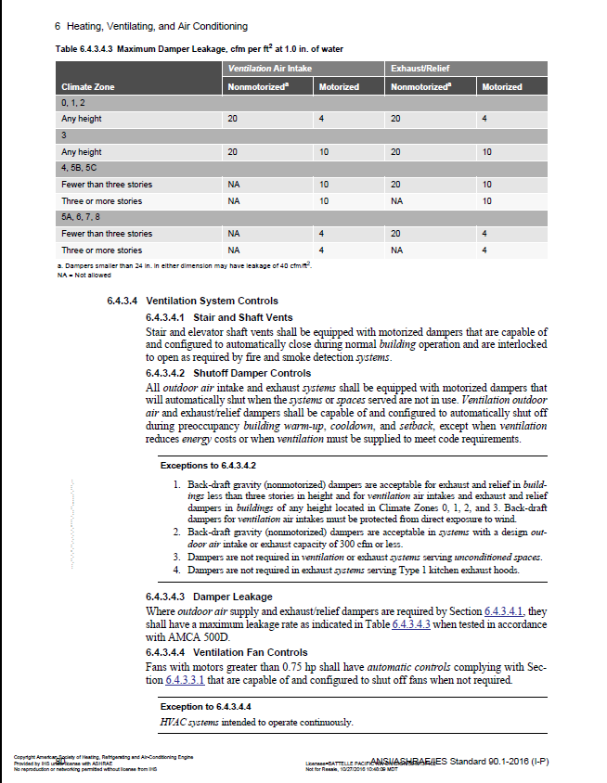
New Format
2013 2016
278 total pages 388 total pages
Two-column format Single-column format
No shading for table rows Alternate shading for table rows
Defined terms normal font Defined terms italicized

Slide 6
Section 2 – Scope 2.1 – 2.4
Applies to:
New buildings and their systems
New portions of buildings and their systems
New systems and equipment in existing buildings, and
New equipment or building systems specifically identified in the standard that are part of industrial or manufacturing processes
Criteria for determining compliance with requirements
Does not apply to:
Single-family houses, low-rise multi-family < 3 stories above grade, manufactured houses (mobile or modular)
Buildings that use neither electricity nor fossil fuel
Certain other buildings or elements may be exempt
Does not circumvent any safety, health, or environmental requirements

Slide 7
Section 4 Administration and Enforcement
General (Section 4.1)
Scope
New Buildings
Additions to Existing Buildings
Alterations to Existing Buildings
Replacement of Portions of Existing Buildings
Changes in Space Conditioning
Administrative Requirements
Alternative Materials, Methods of Construction, or Design
Validity
Other Laws
Reference Standards
Normative Appendices
Informative Appendices
Reference Standard Reproduction Annexes
Compliance Paths and Documentation (Section 4.2)
Notes:
Each of these sections are covered in detail.
Section 5.4 ties back to Sections 5.7 and 5.8.

Slide 8
Compliance Paths
Building System
Compliance Options
Envelope
Prescriptive Option
HVAC
Mandatory
Provisions
(required for all compliance options)
Energy Code Compliance
Trade Off Option
SWH
Power
Energy Cost Budget
Lighting
Other
Performance Rating Method
Notes:
This slide is used as an outline throughout the presentation to help keep track of where we are.

Slide 9
Compliance Path
Compliance Paths for 2016
Prescriptive
Energy Cost Budget
Appendix G (New)
4.2 Compliance
4.2.1 Compliance Paths
4.2.1.1 New Buildings
New buildings shall comply with either the provisions of a. Section 5, “Building Envelope”; Section 6, Heating, Ventilating, and Air Conditioning”; Section 7, “Service Water Heating”; Section 8, “Power”; Section 9, “Lighting”; and Section 10, “Other Equipment,” or
b. Section 11, “Energy Cost Budget Method,” or
c. Appendix G, “Performance Rating Method.”

Slide 10
Compliance Path
Requires a Performance Cost Index (PCI) specific to building type and climate zone
$PCI =\frac{Proposed Building Performance}{Baseline Building Performance}$
PCI of 1.0 = baseline building
PCI of 0.0 = zero net energy
For compliance, PCI < PCI_{t}
PCI_{t} specified in Standard, and varies by building type, climate zone, and proportion of regulated to unregulated load
1.0
Baseline
0.75
0.50
0.25
0
Net Zero

Slide 11
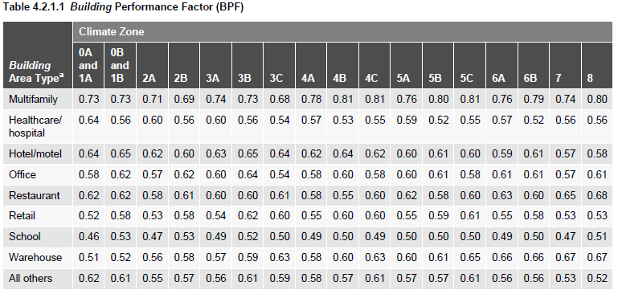
Compliance Path
Building type and climate zone adjustment by Building Performance Factor

Slide 12
Additional Training Materials
Slide decks are also available detailing the Envelope, HVAC, and Power and Lighting requirements of Standard 90.1-2016, accessible at
https://www.energycodes.gov/training

