Slide 1

U.S. Department of Energy
Building Energy Codes Program
2018 National Energy Codes Conference
Pre-Conference, July 15, 2018
Austin, TX
Energy Codes 101 / What’s New in Codes?
Rosemarie Bartlett
Bob Schultz
AIA Provider # 1014
AIA Course # PRECDS1
ICC Preferred Education Provider

Slide 2

AIA and ICC Continuing Education Provider
AIA and ICC Continuing Education Provider
Continuing Education Credits Earned on Completion of this Live Session:
1.0 LU/HSWs will be reported to AIA CES for AIA members.
0.10 ICC CEUs for ICC members must self-report to ICC with the Certificate of Completion.
Certificates of Completion for self-reporting to your professional organization for non-AIA and non-ICC members are available upon request.
This course is registered with AIA CES and ICC PP for continuing professional education. As such, it does not include content that may be deemed or construed to be an approval or endorsement by the AIA or ICC of any material of construction or any method or manner of handling, using, distributing, or dealing in any material or product.
________________________________________

Slide 3
RESNET Professional Development Credits
Raters can earn a maximum of 12 PDHs if they attend:
  all pre-conference and
  full conference sessions
  Exception – commercial buildings sessions
Certificates of Completion for self-reporting are available upon request.

Slide 4
Course
Description
Discuss what has changed from the previous editions of ASHRAE 90.1 and IECC, compliance paths and how the requirements of the commercial chapter of the IECC and ASHRAE 90.1 differ. Also covered will be the IECC development process and an analysis of the voting that occurred.

Slide 5
Learning
Objectives
At the end of the this course, participants will be able to:
Identify changes in the new residential model energy code.
Identify changes in the new commercial model energy code.
Understand different compliance paths in the 2018 IECC and Standard 90.1-2016 commercial requirements.
Understand the code development process.
Learn the basics of the ICC code development process and summary of last code cycle.

Slide 6
Energy Codes 101
Rose Bartlett
bob schultz
2018 Department of Energy National Energy Codes Conference
Building Energy Codes Program
July 15, 2018
Notes:
PNNL develops and supports the CheckTools suite of software
Residential projects – REScheck
Commercial projects - COMcheck
Why do we do this?
Compliance: Provide technical assistance to states to implement building energy codes including increasing and verifying compliance to ensure consumer benefits (42 USC 6833), develop software to support a streamlined compliance process, provide objective information resources and technical guidance to states and localities to increase code compliance.

Slide 7
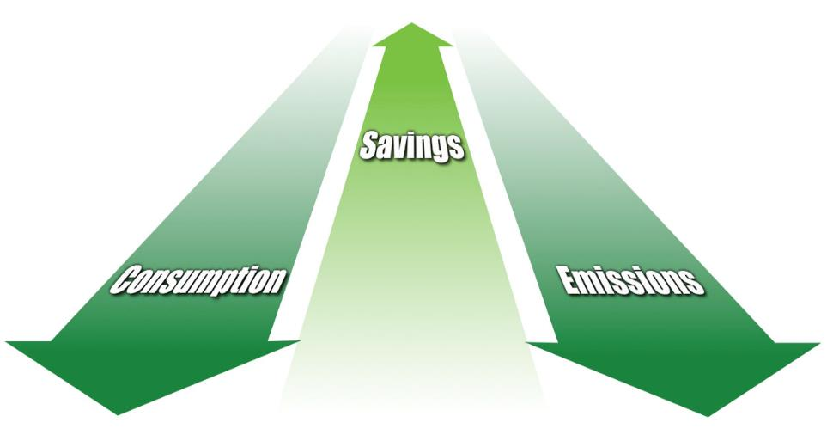
Code Benefits
Cumulative 2010-2040
Reduced energy consumption
Reduced CO₂ emissions
12.82 quads primary energy
841 MMT
Rising cost savings
$126B
www.energycodes.gov/sites/default/files/documents/Impacts_Of_Model_Energy_Codes.pdf
Notes:
Building energy codes set minimum efficiency boundaries that bring about vital, tangible benefits.
Not surprisingly, better codes mean better benefits. Recent research shows that if building energy codes* were upgraded to be 30 to 50 percent more stringent, adopted among states, and effectively implemented, excellent progress would be made in the areas of energy consumption, cost savings, and CO₂ emissions reduction:
Reduced energy consumption—by approximately 0.5-quadrillion Btu per year by 2015, and 3.5-quadrillion Btu per year by 2030. This is equivalent to the power generated by 260 medium power plants.
Rising cost savings—more than $4 billion per year back in homeowners’ pockets by 2015, a figure that could rise to over $30 billion per year by 2030. Even accounting for increased up-front efficiency investment costs, net benefits are quite significant.
Reduced CO₂ emissions—by roughly 3 percent in terms of the projected national CO₂ emissions in 2030.
*2006 International Energy Conservation Code® (IECC) and ANSI/ASHRAE/IESNA5 Standard 90.1-2004

Slide 8
Major Players
ASHRAE
ICC
Jurisdictions
From DOE’s perspective, the model / baseline codes are
  ASHRAE 90.1 for Commercial
  ICC IECC for Residential

Slide 9
DOE’s Role
DOE is directed by statute to participate in industry processes to
  Develop model building energy codes
  Issue determinations as to whether updated codes result in energy savings
  Provide technical assistance to states to implement and comply with the codes
For specific statutory language, visit
  https://www.energycodes.gov/about/statutory-requirements

Slide 10

DOE’s Support
Code development and adoption
  Research
  Technical analyses
  Supporting industry processes which review and update model codes
Implementation and compliance
  Customized technical analyses
  Software tools
  Education and training materials
  Technical support through a help desk

Slide 11
DOE Determinations
DOE is required by law (the Energy Conservation and Production Act, as amended (ECPA)) to issue a determination as to whether
    the latest edition of ASHRAE Standard 90.1 (for commercial and multi-family high-rise residential buildings) or
    the latest version of the International Energy Conservation Code (for low-rise residential buildings)
  will improve energy efficiency compared to the previous edition of the corresponding standard or code.
  DOE has one year to publish a determination in the Federal Register after each new edition of the standard/code is published

Slide 12


Building Energy Codes
ASHRAE Standard 90.1
International Energy
Conservation Code
State and Locally
Adopted Codes
Notes:
When people speak in general about Building Energy Codes, they may be referring to:
ASHRAE Standard 90.1 Standards
The International Energy Conservations Code, or IECC
State and locally adopted codes.

Slide 13
IECC
Two sets of provisions
  Commercial
  Residential (three stories or less in height above grade)
Each set of provisions is treated separately
References 90.1 as an alternate approach for
commercial
  Must be used in its entirety

Slide 14

What Do Building Energy Codes and Standards Cover?
For both residential and commercial:
  Building Envelope
  Mechanical
  Service Water Heating
  Lighting
  Electrical Power
Notes:
Building energy codes are minimum requirements for energy-efficient design and construction for new and renovated residential and commercial buildings. Using them doesn’t necessarily equal (what some refer to as) “green” building. Building energy codes are a solid baseline of requirements—but they do set the standard by which “above-code” efforts are defined.
So, what specific parts of buildings do they cover?
Simply put, they apply to a building’s envelope (the materials that make up its outer shell) as well as its systems and built-in equipment. These will be described in more detail later in this presentation.
The life cycle of a building is decades or even centuries long. As minimum requirements in these vital areas are improved, future generations will receive more efficient and less costly living and working environments.

Slide 15
Residential vs. Commercial
Residential codes are typically less complex than commercial
Commercial buildings usually have more systems
  More requirements for lighting, including daylighting and controls
  Detailed control requirements for mechanical systems
  Etc.

Slide 16




Energy Codes & Standards History – Ancient
Residential Codes
86 MEC
93 MEC
98 IECC
77 MCEC
83 MEC
89 MEC
92 MEC
95 MEC
00 IECC
90-
1975
90A-
1980
90.1-
1989
Codified 90.1-1989
Commercial Standards
Federal
10 CFR 435 (FEDCOM)
10 CFR 435 Subpart E (COSTSAFR)
FEDRES
Notes:
16
Legend: boxes highlighted in yellow are residential only; boxes highlighted in maroon are commercial only
The 92 MEC allowed 90.1-1989 for commercial.
The 93 MEC specifically references 90.1-1989.
The 95 MEC changes the ASHRAE reference to the 1993 codified version.
In 1998, the change is made to the IECC, and a new commercial chapter is added as a simplified approach limited to low-rise commercial buildings with “simple” mechanical systems.
90.1-1999 is a complete revision to the previous version and is written in mandatory, enforceable language.
The 2000 IECC commercial chapter was broadened to include ALL commercial buildings.
The 2001 IECC changes the ASHRAE reference to 90.1-1999.
90.1-2001 includes addenda
2003 IECC changes the ASHRAE reference to 90.1-2001.
90-1975 “Energy Conservation in New Building Design” was the first to comprehensively address the design and construction of new buildings from an energy standpoint.
The 83, 86, and 89 MEC are based largely on 90A-1980.
90.2-1993 is a complete revision of 90A-1980 for low-rise residential buildings.
The 2000 IECC added a residential prescriptive compliance approach.
90.2-2001 revises 90.2-1993 and includes a number of addenda.

Slide 17
Energy Codes & Standards History – Modern
Residential Codes
2012
IECC
2015
IECC
2003
IECC
2006
IECC
2009
IECC
2018
IECC
90.1-
1999
90.1-
2001
90.1-
2004
90.1-
2007
90.1-
2010
90.1-
2013
90.1-
2016
Commercial Standards
Federal
10 CFR 433 – Commercial and High-Rise Multi-Family Residential (all versions of Standard 90.1 starting with 2004)
10 CFR 434
10 CFR 435 Subpart A – Low Rise Residential (all versions of the IECC starting with 2004)
Notes:
17
Legend: boxes highlighted in yellow are residential only; boxes highlighted in maroon are commercial only
Note that 10 CFR 435 started with the 2004 Supplement to the 2003 IECC. The 2004 is not a typo. Note also that the slide does not show linkage between the IECC or Standard 90.1 and the Federal standards as the connection is much more complex that can be shown in this slide.
The 92 MEC allowed 90.1-1989 for commercial.
The 93 MEC specifically references 90.1-1989.
The 95 MEC changes the ASHRAE reference to the 1993 codified version.
In 1998, the change is made to the IECC, and a new commercial chapter is added as a simplified approach limited to low-rise commercial buildings with “simple” mechanical systems.
90.1-1999 is a complete revision to the previous version and is written in mandatory, enforceable language.
The 2000 IECC commercial chapter was broadened to include ALL commercial buildings.
The 2001 IECC changes the ASHRAE reference to 90.1-1999.
90.1-2001 includes addenda
2003 IECC changes the ASHRAE reference to 90.1-2001.
90-1975 “Energy Conservation in New Building Design” was the first to comprehensively address the design and construction of new buildings from an energy standpoint.
The 83, 86, and 89 MEC are based largely on 90A-1980.
90.2-1993 is a complete revision of 90A-1980 for low-rise residential buildings.
The 2000 IECC added a residential prescriptive compliance approach.
90.2-2001 revises 90.2-1993 and includes a number of addenda.

Slide 18
Three Main Aspects
Development
Adoption
Compliance

Slide 19
Code Development
ASHRAE 90.1
  Uses the American National Standards Institute (ANSI) consensus process
  90.1 project committee and subcommittees
  All interested parties can participate
  Final vote of the project committee
    Includes members from a balance of all interests
ICC IECC
  Uses a government consensus process
    All interested parties can participate
    Final vote is online governmental consensus vote
  https://www.iccsafe.org/codes-tech-support/code-development-process/

Slide 20

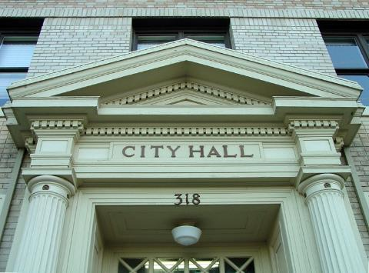
Energy Code Adoption
Can occur at the state or
local level in one of two ways:
directly through legislative
action (state level)
by regulatory action through
state or local agencies.
https://cdn-web.iccsafe.org/wp-content/uploads/Code-Adoption-Process-by-State-NOV.pdf
Notes:
Once building energy codes are developed, they are merely books on the shelf until governing bodies adopt (and sometimes adapt) them into laws.
Adoption of energy codes can occur in one of two ways:
Directly through legislative action
By regulatory action through agencies authorized by the legislative body to oversee the development and adoption of codes.
When adoption is accomplished through legislation, a committee may be appointed to provide recommendations and/or draft the legislation.
When adoption occurs through a regulatory process, states and local governments often appoint an advisory body comprising representatives of the design, building construction, and enforcement communities. This advisory panel recommends revisions that should be considered for adoption. In basing their recommendations on model energy codes, the advisory panel considers modifications to the model codes to account for local preferences and construction practices. The panel also may serve as a source of information during the adoption process. Their recommendations then enter a public review process.

Slide 21
Adoption Date vs. Effective Date
Usually these dates are different
Sometimes a grace period is allowed where the predecessor code can be used
  Because buildings may be in different stages of design or construction
  Stakeholders need time to learn the new code
  Manufacturers may need time to provide products
Effective date is sometime tied to publication date of a model energy code.

Slide 22
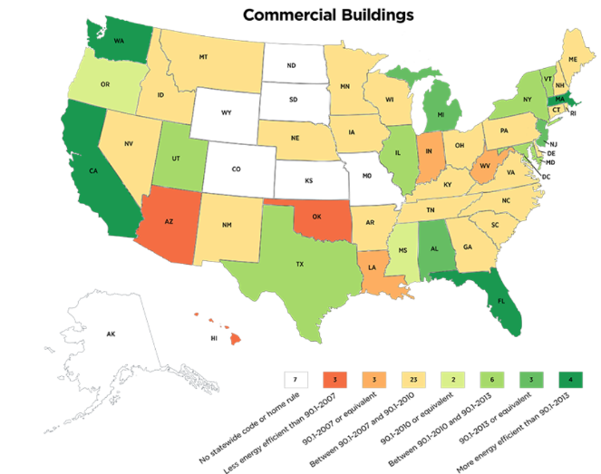
Current State Adoption Status - Commercial

Slide 23
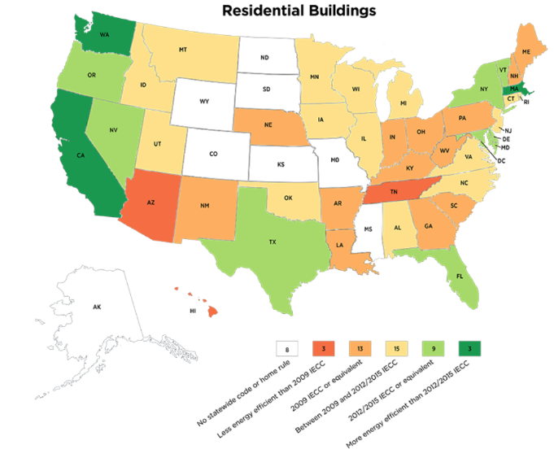
Current State Adoption Status - Residential

Slide 24

Energy Code Enforcement and Compliance
Enforcement, or making sure that a building is in compliance
with an energy code, is the last step in the building process.
Notes:
In this training, we’ve followed the basic life cycle of building energy codes, from their very inception in public forums to their adoption by jurisdictions and application in the building industry. The final stage—implementation by designers and the building industry, and enforcement by the adopters —is absolutely vital.
After all, if energy codes don’t truly guide on-the-ground practices, their corresponding energy savings and environmental benefits are not realized.
‘Enforcement’ simply means ‘making sure that a building is in compliance with an energy code’ and is the last step in the building process.
The responsibility to enforce building energy codes falls upon states or jurisdictions, and the responsibility to comply with the building energy code falls on developers, designers, and contractors. Education and communication regarding energy codes are vital to the effective delivery of both enforcement and compliance.
Let’s examine the basics of energy code enforcement strategies.

Slide 25
Energy Code Compliance
The key to realizing the full benefits associated with building energy codes is through compliance verification.
Materials and tools to help the building industry achieve, document and verify compliance with energy codes.
Methodologies and tools (and funding) to help state and local jurisdictions measure and report energy code compliance.
  http://www.energycodes.gov/compliance

Slide 26


REScheck™
DOE’s residential compliance software
Desktop Software Tools
Web-Based Tools
No-cost, easy-to-use software
that will demonstrate compliance.
https://www.energycodes.gov/software-and-web-tools
Notes:
DOE’s easy-to-use code residential compliance software, REScheck, along with associated training and support resources, is available for download at no cost at www.energycodes.gov/
Software programs such as REScheck™ and COMcheck™ are helpful tools for end-users of codes to determine whether a building or renovation is in compliance. The user inputs building component areas, efficiencies, and other specifications to generate a compliance report. The software allows flexibility and trade-offs between components. For example, a designer may choose to include a greater glass area on a particular wall for a view corridor, and compensate by increasing insulation levels elsewhere.

Slide 27


COMcheck™
DOE’s commercial compliance software
Desktop Software Tools
Web-Based Tools
No-cost, easy-to-use software
that will demonstrate compliance.
https://www.energycodes.gov/software-and-web-tools
Notes:
DOE’s easy-to-use code commercial compliance software, COMcheck, along with associated training and support resources, is also available for download at no cost at www.energycodes.gov/

Slide 28
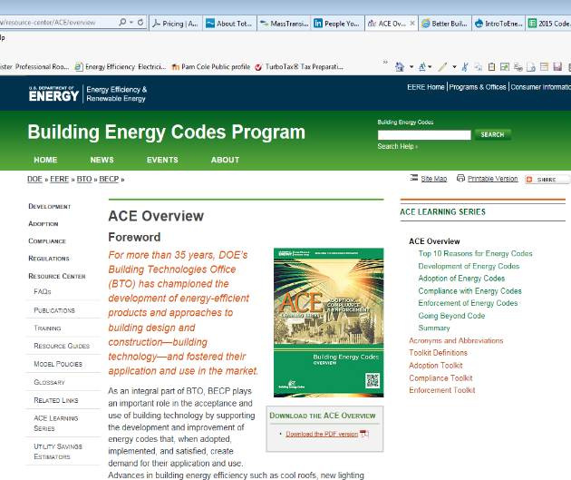
Energy Codes Website
Additional resources, including:
ACE Learning Series
Software Compliance tools
Code Notes
Technical Assistance to Users
Training Materials
www.energycodes.gov
PNNL-SA-72577
Notes:
Thank you for learning the basics of building energy codes!
Please don’t hesitate to present this information to interested parties. For more resources, continue to visit BECP’s website at www.energycodes.gov.

Slide 29
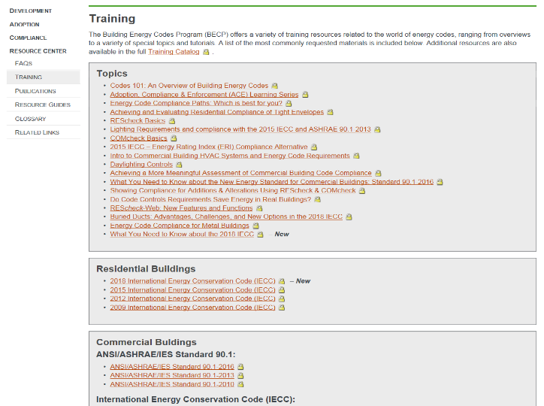
Energy Codes Website: Training materials

Slide 30
What’s New In Codes?

Slide 31
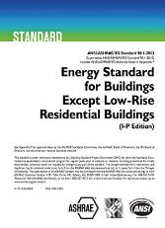
Current status of the IECC and Standard 90.1
2018 IECC completed in August 2017, process has begun for 2021 IECC
90.1-2016 on continuous maintenance, addenda expected and next edition published in 2019
Notes:
ICC Code Development
Public Comment Hearings were held in Kansas City, MO, October 19-25, 2016
The OGCV is open on Nov. 8 through Nov. 22. The Public Comment Hearings did not utilize electronic voting, therefore there is no vote tally from the Public Comment Hearings to be combined with the vote tally from the Online Governmental Consensus Vote to determine the Final Action. The vote tally from only the votes cast on the Online Governmental Consensus Vote will determine the Final Action on the code changes. As was done in the 2014 and 2015 Cycles, a quorum will be required for the Online Governmental Consensus Vote. The quorum is 20 votes. If the number of votes cast does not exceed 19 votes, the action taken at the Public Comment Hearings will be the Final Action on the code change.
If a proposal at the first CAH is AS and gets no public comment before the FAH, it goes on the Consent Agenda with all the other proposals that got no comments and gets voted on en masse, so the AS would prevail.
If a proposal goes on the Consent Agenda it is not subject to the online vote. A single motion at the FAH with the results from the CAH and the motion has been seconded, the vote shall be taken with no testimony being allowed A simple majority (50% plus one) based on the number of eligible voters decides the motion.

Slide 32


Slide 33
Summary of Major Changes –
2018 IECC Residential
Log Homes can use Standard ICC-400
  Adds exception to the residential thermal envelope requirements for log homes complying with ICC-400.
High efficacy lighting to 90%
Low-rise multi-family - certain types of small multifamily buildings to be tested for compliance with the code in batches, rather than testing each individual unit.
  The rationale was that these units should be built identically, but this opens up the possibility of not every unit complying with the code.
Notes:
Exempts log homes from meeting the IECC’s requirements if they are designed to meet ICC 400. Although the latter is similar in many respects to the IECC, its wall requirements are less efficient

Slide 34
Summary of Major Changes –
2018 IECC Residential Cont’d
Windows: approximately 0.6 to 1.1% improvement in the prescriptive path
  U-factors in CZ 3 & 4 from 0.35 to 0.32 and CZ 5-8 from 0.32 to 0.30
Heated slab-on-grade required to have R-5 insulation under the entire slab (in addition to perimeter insulation requirements)
Vapor diffusion port(s) required where unvented attics with air-permeable insulation in zones 1-3 exist
New provisions for ducts depending upon insulation and placement
  Ducts buried with ceiling insulation
  Deeply buried ducts
  Ducts to be considered within the conditioned space

Slide 35
Summary of Major Changes –
2018 IECC Residential Cont’d
Clarifies that new HVAC and duct systems in additions and alterations must meet all the mechanical requirements.
  Prior wording arguably exempted such new systems from mechanical system piping insulation for additions, and from both piping insulation and duct insulation/sealing in alterations.
HRV/ERV ventilation systems have new fan efficacy requirement
ERI trade offs can incorporate on-site renewable energy into the ERI calculation
ERI scores from 51-55 to 57-62
Notes:
Ducts buried within ceiling insulation must comply with:
R-value not less than R-8
Sum of ceiling insulation above and below duct shall be a minimum of R-18 excluding the duct R-value
Climate Zones 1a, 2a, and 3a, where ducts are completely covered with ceiling insulation, supply ducts shall be insulated to a minimum R-18 and meet vapor retarder requirements in IRC, Chapter 16 or IMC, Chapter 6
New provisions for ducts to be considered inside conditioned space
Ducts buried within ceiling insulation must meet following requirements:
Air handler completely within continuous air barrier and within building thermal envelope.
Duct leakage, measured by rough-in test or post-construction total system leakage test to outside building envelope, leakage < 1.5 cubic feet per minute per 100 square feet of conditioned floor area.
Ceiling insulation R-value above insulated duct > proposed ceiling insulation R-value less the R-value of the duct.

Slide 36
Summary of Major Changes –
2018 IECC Commercial
2018 IECC Commercial: Total of 129 approved proposals
  Expanded efficiency measure choices
    Enhanced Envelope Performance (+15%)
    Reduced Air Infiltration
  Increased allowable skylight area when daylighting
  Modest SHGC reductions in zones 4-5 to match 90.1-2016
  Daylighting control trade off
  Heated slabs required to have R-5 under-slab insulation
  Section 4 (mechanical) completely reorganized
  Additional lighting controls for certain spaces
  Reduced lighting power allowances
  Lighting space exemptions modified

Slide 37
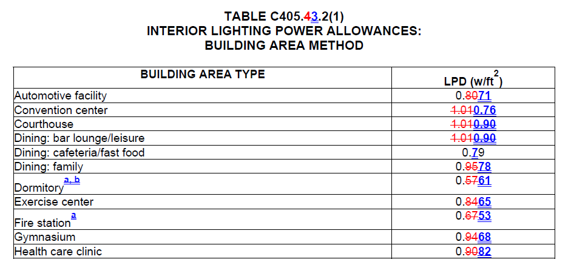
2018 IECC Changes: How to learn more
Procure and review the “redline” version
  Identifies changes more clearly across code versions
  Final published version is still the ‘authoritative’ version

Slide 38
Summary of Major Changes –
ASHRAE 90.1-2016
ASHRAE 90.1-2016 : Total of 121 revisions and enhancements
  Major format changes for ease of use
  New climate maps aligning with ASHRAE Standard 169
  New performance-based compliance path
  Significant whole building energy savings
Notes:
Major format changes include:
1. 1 column format for easier reading
Exceptions separated, indented and set apart with a smaller font size
Defined terms are Italicized
Alternating coloring scheme for table rows

Slide 39
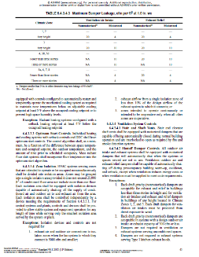
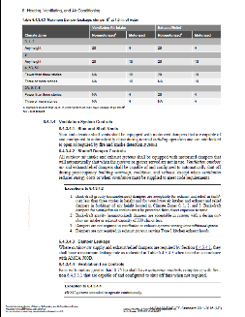
New Format
2013 2016
278 total pages 388 total pages
Two-column format Single-column format
No shading for table rows Alternate shading for table rows
Defined terms normal font Defined terms italicized

Slide 40
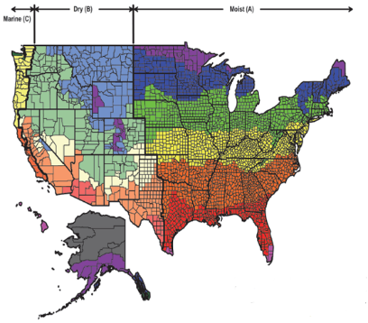
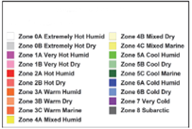
New Climate Zone Map
Aligns with new ASHRAE Standard 169
Reflects global warming trends over the most recent 30 years
Adds new Climate Zone 0 (extremely hot)
Approximately 10% of US counties reassigned to a warmer climate zone

Slide 41
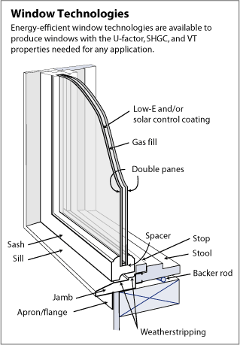
Summary of Changes –
ASHRAE 90.1-2016 – Cont’d
  Extensive update to fenestration prescriptive requirements
    U-factor reduced by as much as 22% in some climate zones
    SHGC reduced by as much as 12%

Slide 42
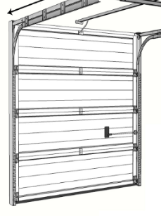
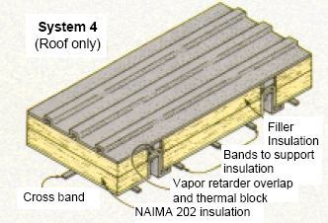
Summary of Changes –
ASHRAE 90.1-2016 – Cont’d
Walls and Doors
  Metal building wall thermal properties better defined to enhance compliance
  U-factors and air leakage limits for doors are improved

Slide 43
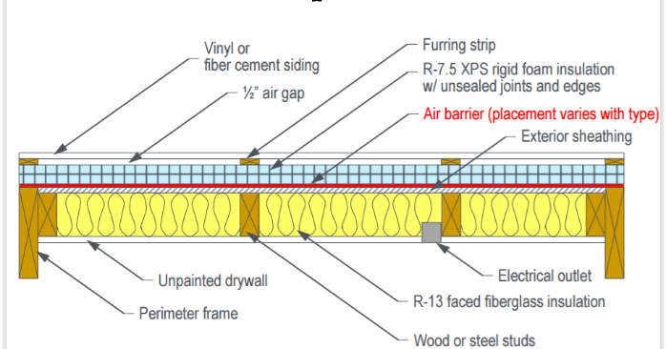
Summary of Changes –
ASHRAE 90.1-2016 – Cont’d
Building Air Leakage
  Whole building air leakage testing added as a compliance option
  Air barrier design and installation verification required

Slide 44
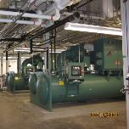
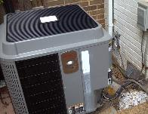
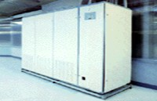
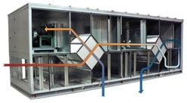
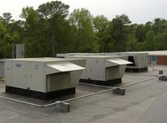

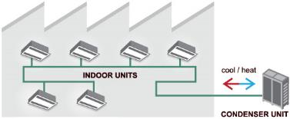
Summary of Changes –
ASHRAE 90.1-2016 – Cont’d
Increased HVAC Equipment Efficiency Requirements
Chillers
Heat Pumps
Computer Room AC
Dedicated Outdoor Air*
Rooftop AC Units
Cooling Towers
Variable Refrigerant Flow
* Newly regulated equipment

Slide 45
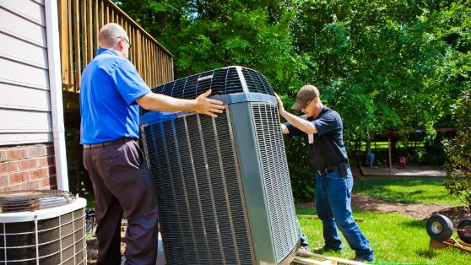
Summary of Changes –
ASHRAE 90.1-2016 – Cont’d
Replacement equipment now needs to meet many of the requirements formerly for new equipment only. For example:
  Various controls requirements
  Economizer requirements
  Fan efficiency
  Boiler turndown

Slide 46
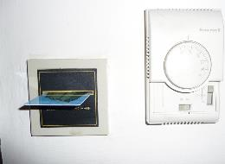
Summary of Changes –
ASHRAE 90.1-2016 – Cont’d
Hotel/Motel Guest Room Controls
  Heating, cooling, & ventilation automatically reduced when unoccupied
Chilled Water Plant Metering
  Large plants required to meter for electricity and efficiency
Economizer Fault Detection and Diagnostics
  Ensures that economizers using outdoor air for free cooling are configured and working correctly

Slide 47

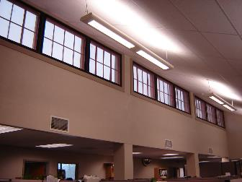

Summary of Changes –
ASHRAE 90.1-2016- Cont’d
Reduced Lighting Power Allowance – Exterior, Interior, Retail Display
  Primarily based on improved efficacy of LED lighting
  Exterior lighting power reduced an average of 30%
  Interior space-by-space reduced an average of 26%
  Retail display reduced ~25%

Slide 48
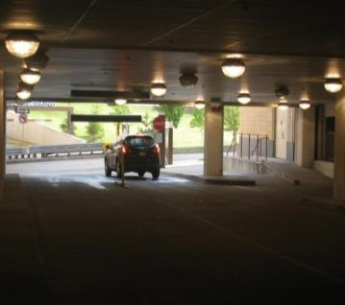
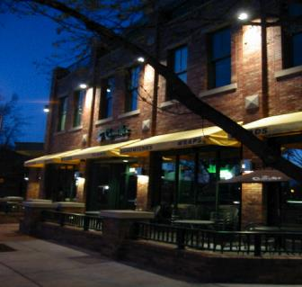
Summary of Changes –
ASHRAE 90.1-2016- Cont’d
Exterior lighting and parking garage lighting requirements to reduce power by 50% during unoccupied periods or after business hours
  Increased from 30%

Slide 49
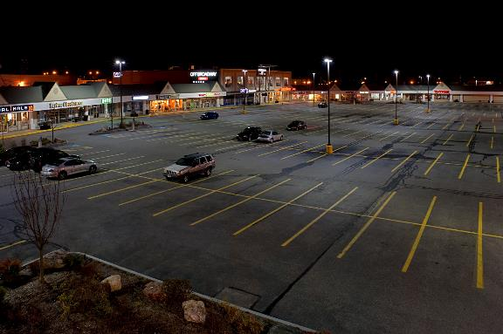
Summary of Changes –
ASHRAE 90.1-2016- Cont’d
Parking areas with shorter poles (24 ft or less) & > 78W
  Lights automatically reduce by at least 50% as detected by occupancy sensors

Slide 50
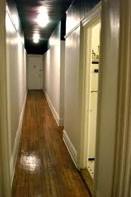
Summary of Changes –
ASHRAE 90.1-2016- Cont’d
Dwelling Unit Lighting
  Apartments, condos, living space must have at least 75% of permanently installed fixtures with minimum lamp efficacy of 55 lumens/Watt
  Likely requires LED or fluorescent

Slide 51
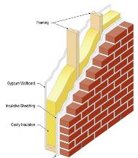
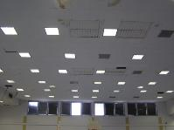

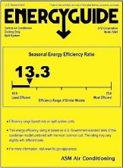
Compliance Paths
90.1-2013 Includes Two Paths for Compliance:
Prescriptive
Performance – Energy Cost Budget (ECB)
$
Proposed Design
$
Baseline Design

Slide 52
New Compliance Path
90.1-2016 Introduces a Third Path for Compliance
  Appendix G – Performance Rating Method
    Previously only allowed for “beyond code” programs like LEED
    Provides increased flexibility
    Saves time and money dedicated to energy modeling by allowing a single modeling approach to be used for multiple functions
    Encourages the creation of tools that automate the simulation process as the market is increased
    Provides credit for good design practices that were previously not recognized for code compliance

Slide 53
Key Takeaways for Designers
Residential ERI path new rating index and backstop
Consideration and use of renewable energy sources
Increased emphasis on building modeling in larger commercial buildings
More rigorous thermal envelope criteria that are increasingly recognizing the value of daylighting
Decreased lighting power limits, more automatic lighting controls and increased consideration of how fenestration impacts daylighting and building energy use
More opportunities for architects to look at the total building and lead as the project design professional
The advent of a new compliance path for energy based on the actual performance of a building over time

Slide 54
THANK YOU!
Rose Bartlett
rose.bartlett@pnnl.gov
Bob Schultz
robert.schultz@pnnl.gov
Building Energy Codes Program
www.energycodes.gov
PNNL-SA-xxxxxx

