Slide 1

U.S. Department of Energy
Building Energy Codes Program
2018 National Energy Codes Conference
Pre-Conference, July 15, 2018
Austin, TX
REScheck Basics
Bob Schultz
AIA Provider # 1014
AIA Course # PRECDS2
ICC Preferred Education Provider

Slide 2

AIA and ICC Continuing Education Provider
AIA and ICC Continuing Education Provider
Continuing Education Credits Earned on Completion of this Live Session:
1.0 LU/HSWs will be reported to AIA CES for AIA members.
0.1 ICC CEUs for ICC members must self-report to ICC with the Certificate of Completion.
Certificates of Completion for self-reporting to your professional organization for non-AIA and non-ICC members are available upon request.
This course is registered with AIA CES and ICC PP for continuing professional education. As such, it does not include content that may be deemed or construed to be an approval or endorsement by the AIA or ICC of any material of construction or any method or manner of handling, using, distributing, or dealing in any material or product.
________________________________________

Slide 3
RESNET Professional Development Credits
Raters can earn a maximum of 12 PDHs if they attend:
  all pre-conference and
  full conference sessions
  Exception – commercial buildings sessions
Certificates of Completion for self-reporting are available upon request.

Slide 4
Course
Description
Basics of using the REScheck software, reviewing generated compliance reports, and the latest and greatest new features.

Slide 5
Learning
Objectives
At the end of the this course, participants will be able to:
Obtain an overview of the basic functions and how REScheck calculates compliance for the building envelope.
Be able to identify the construction specifications needed to complete a compliance calculation in the software.
Learn how to enter the building envelope components into the software.
Understand how the compliance reports are created and what they entail.

Slide 6
REScheck Basics
bob schultz
2018 Department of Energy National Energy Codes Conference
Building Energy Codes Program
July 15, 2018
Notes:
PNNL develops and supports the CheckTools suite of software
Residential projects – REScheck
Commercial projects - COMcheck
Why do we do this?
Compliance: Provide technical assistance to states to implement building energy codes including increasing and verifying compliance to ensure consumer benefits (42 USC 6833), develop software to support a streamlined compliance process, provide objective information resources and technical guidance to states and localities to increase code compliance.

Slide 7





CheckTools Current Use Scenario
Demonstrate Compliance
Collect Data
Check Compliance
Plan Review
Review Software Input
Review Mandatory Requirements
Field Inspection
Verify compliance of inspection checklist items
Prepare Input
Generate Compliance Report
Check Compliance Results
Approve compliance
Paper/PDF
Paper/PDF
Builder
Architect Designer
Plan Reviewer
Field Inspector
BECP Tools used only during “Demonstrate Compliance” Stage

Slide 8
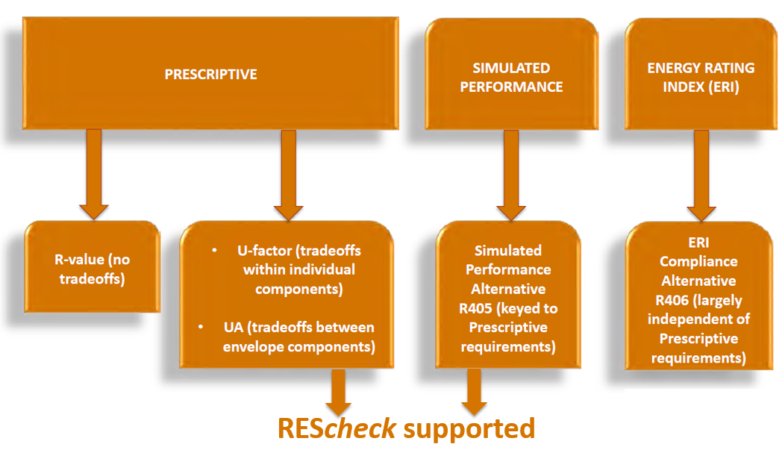
Energy Code Compliance
Notes:
REScheck also supports a limited performance alternative: Envelope trade-offs only.

Slide 9
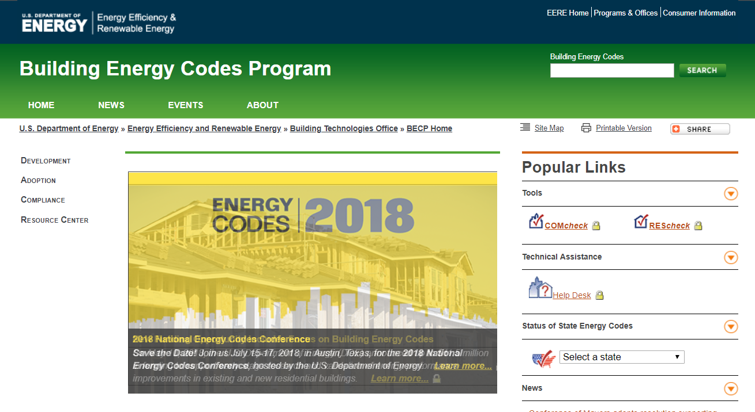
www.energycodes.gov

Slide 10
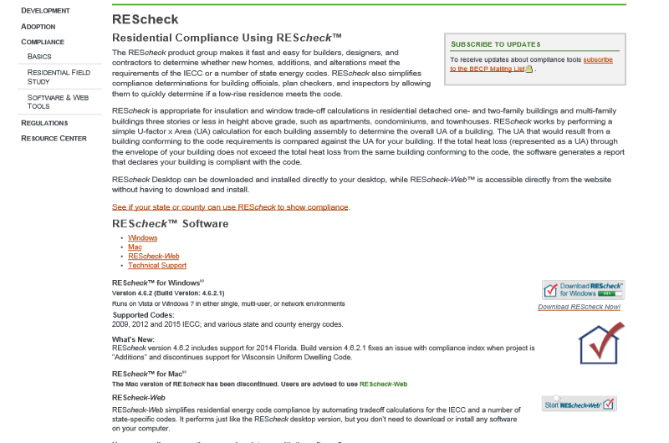
REScheck Page
https://www.energycodes.gov/rescheck

Slide 11
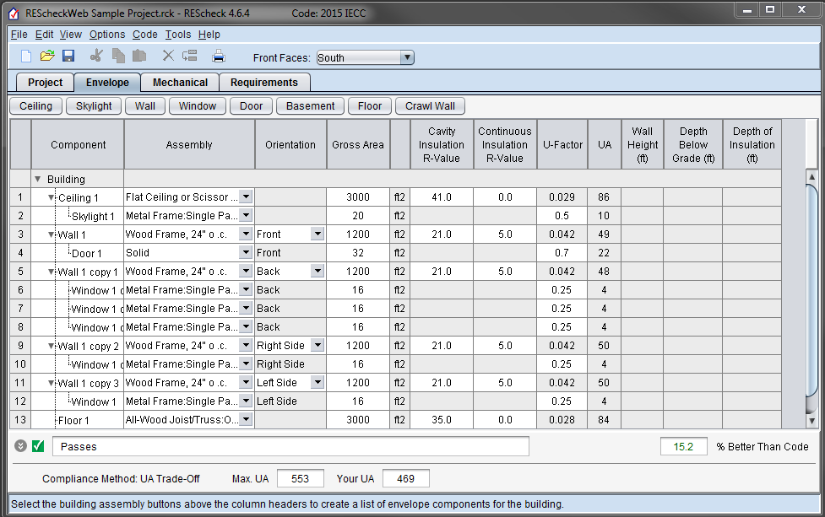
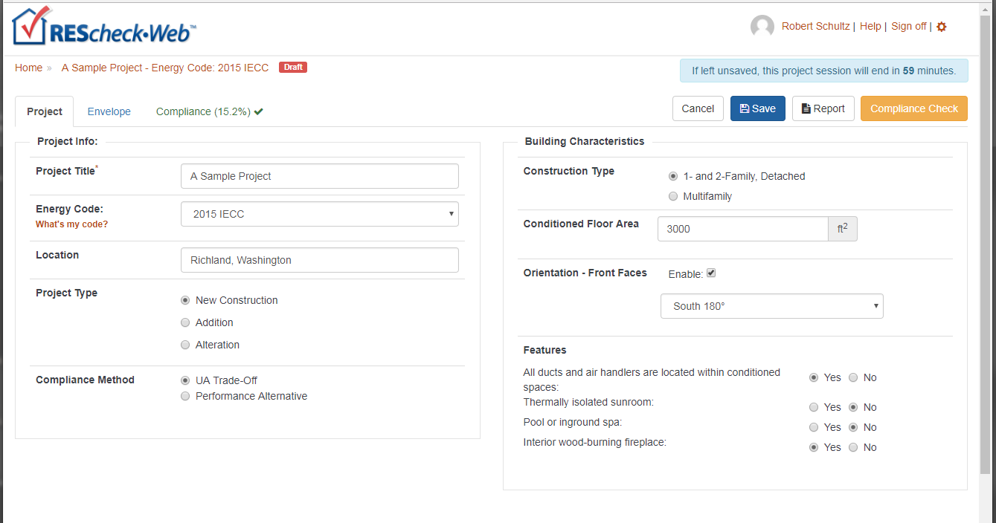
REScheck
“Desktop”
Web

Slide 12
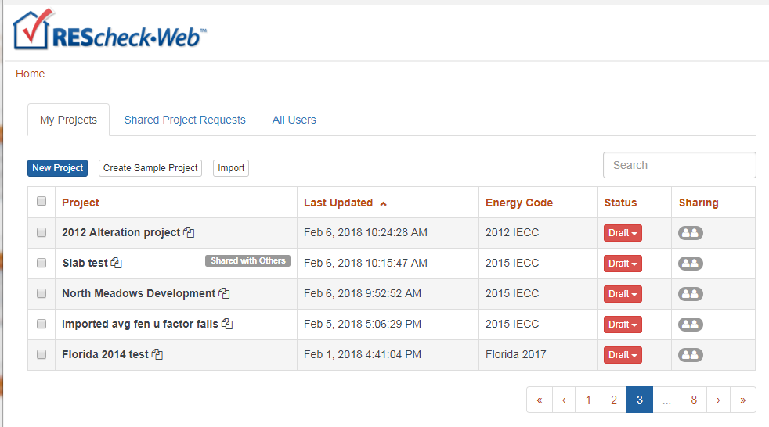
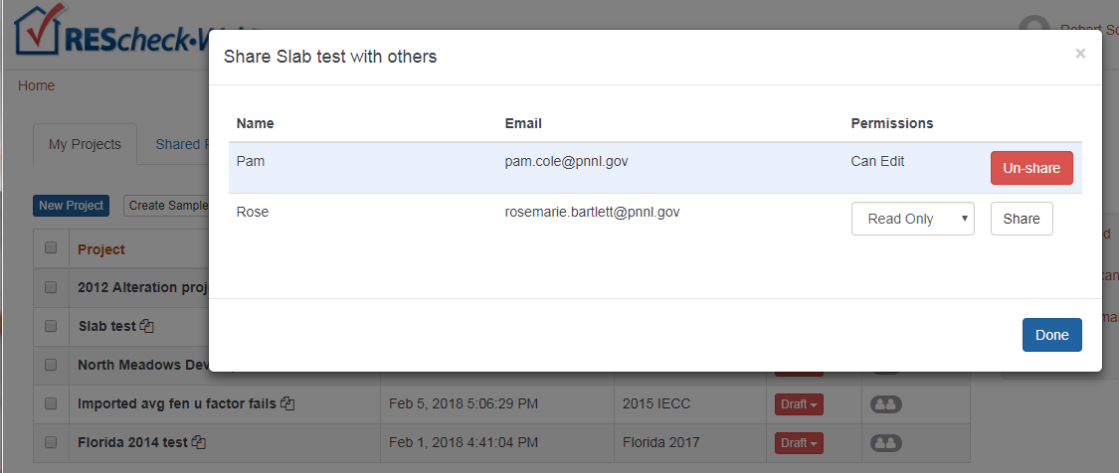
REScheck-Web Projects and Sharing
Can exchange files between desktop and web
  Log in to web
  My Projects

Slide 13
Walkthrough REScheck Steps
Select the appropriate code
Enter project information
Enter building components
Enter mechanical equipment (optional)
Review Mandatory Requirements
Reports
View/print/save

Slide 14
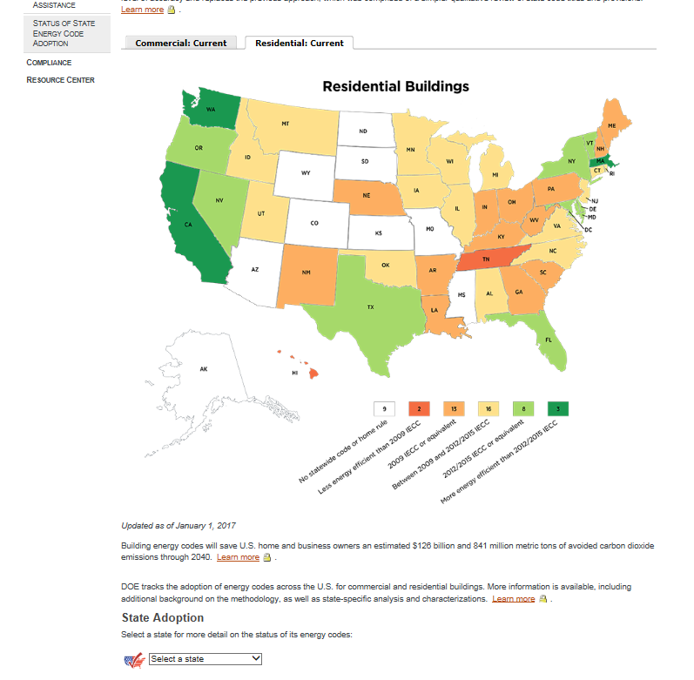
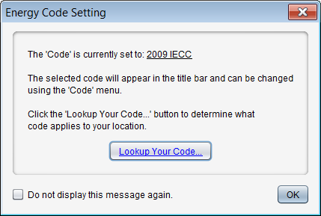
Select the Appropriate Code
Applicable to your state/ jurisdiction (Code menu)

Slide 15
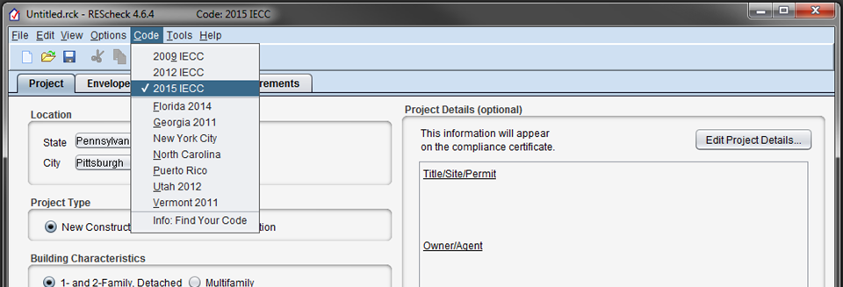
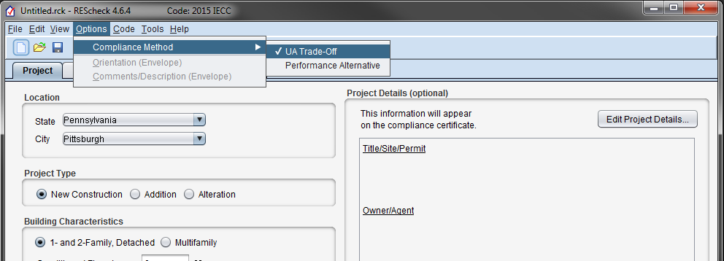
Energy Code and Compliance Method
Notes:
Select Energy Code and Compliance Method from the menu Code and Options, respectively.
Last used selections will be used next time you start REScheck.

Slide 16
Compliance – Methods
Total UA
  U-factor x Area for each building assembly
  UA from building conforming to code compared against your building UA
Performance alternative
  Based on simulated performance of your building compared to an equivalent code building
  Requires additional inputs (over UA approach): building orientation, minimum of four walls having unique orientations, and a minimum of one roof and floor
  Envelope trade-off only, no mechanical equipment trade-off
  Check Compliance button
Performance alternative considers the whole building energy performance, whereas UA trade-off method considers only the thermal conductance of envelope components
Notes:
Mandatory requirements apply regardless of compliance method.

Slide 17
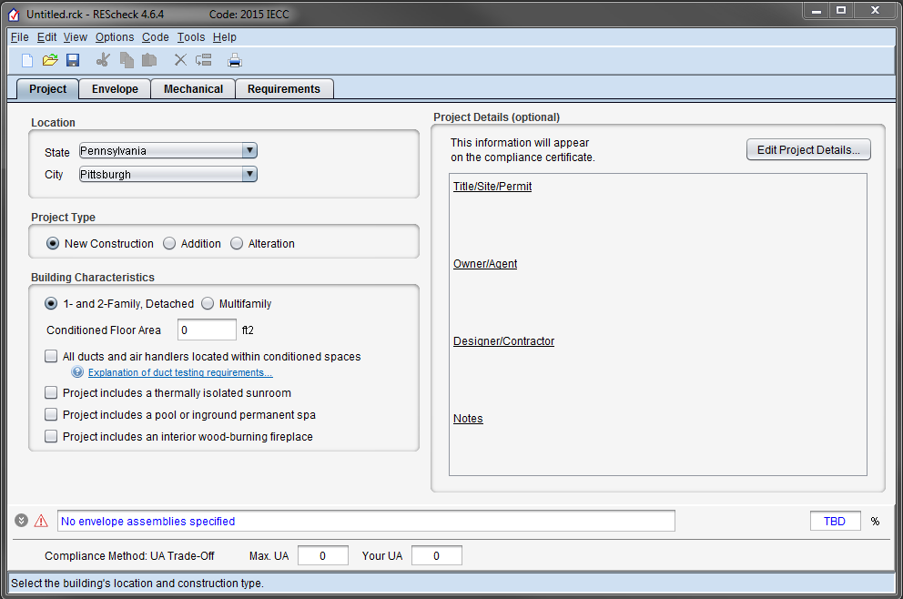
Project Tab: Location
Notes:
Not all cities will be included. Select one closest in to your physical project location.

Slide 18
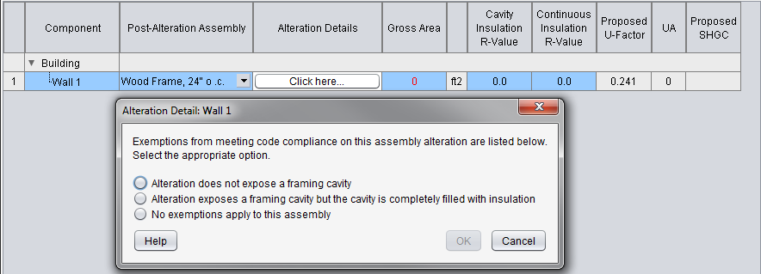
Project Tab: Project Type
Select New Construction, Addition or Alteration on Project screen
  Additions
  User choice:
    Addition only
    Addition plus existing home
  Alterations
    Only include those assemblies being altered
    Exemptions may apply (“Alteration Details”)
Notes:
New = Addition is now separated from Alteration

Slide 19
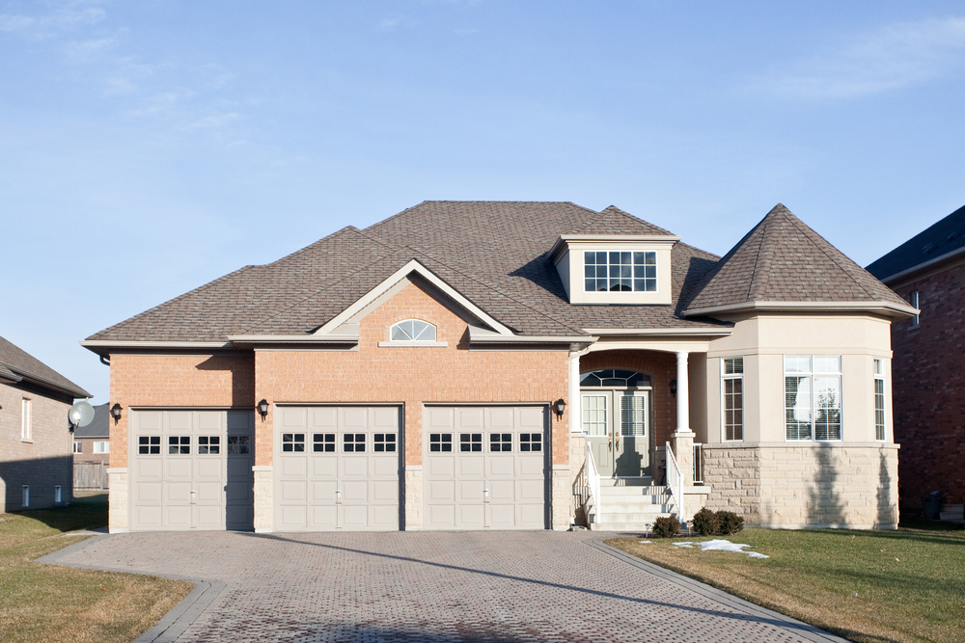
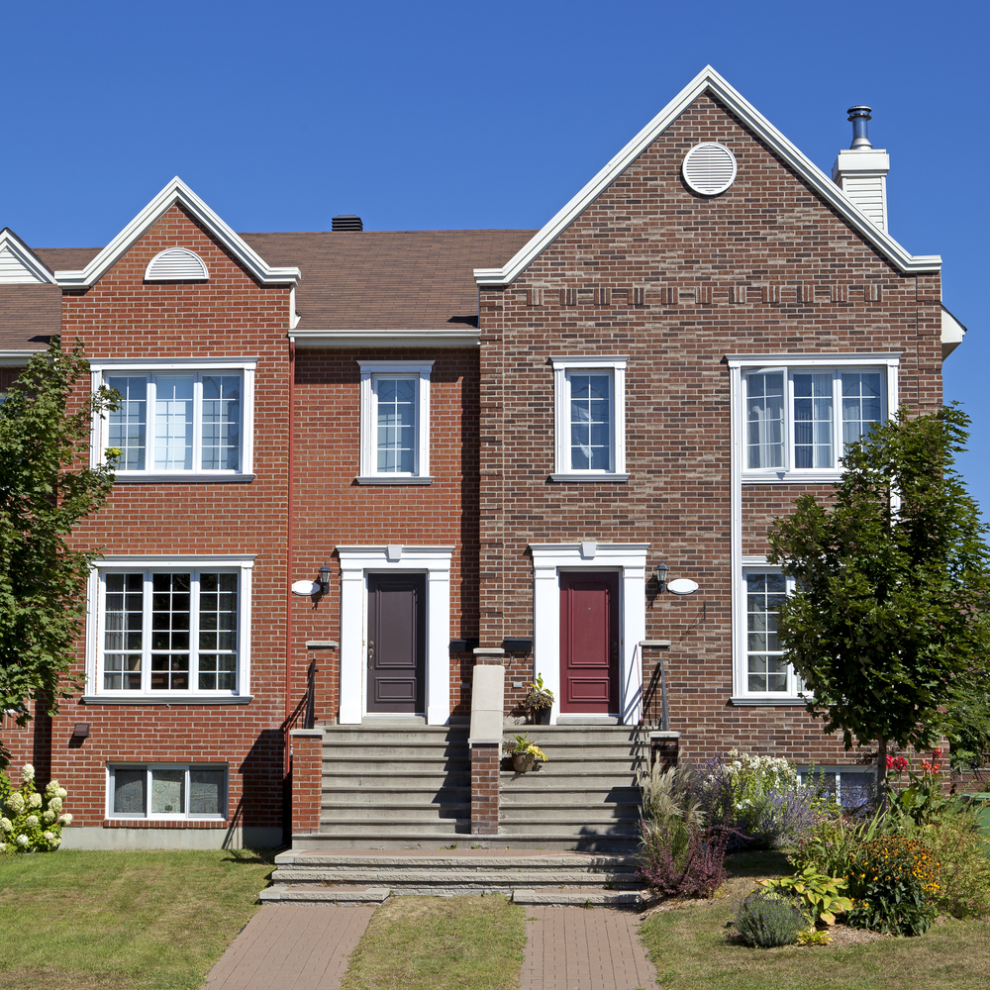
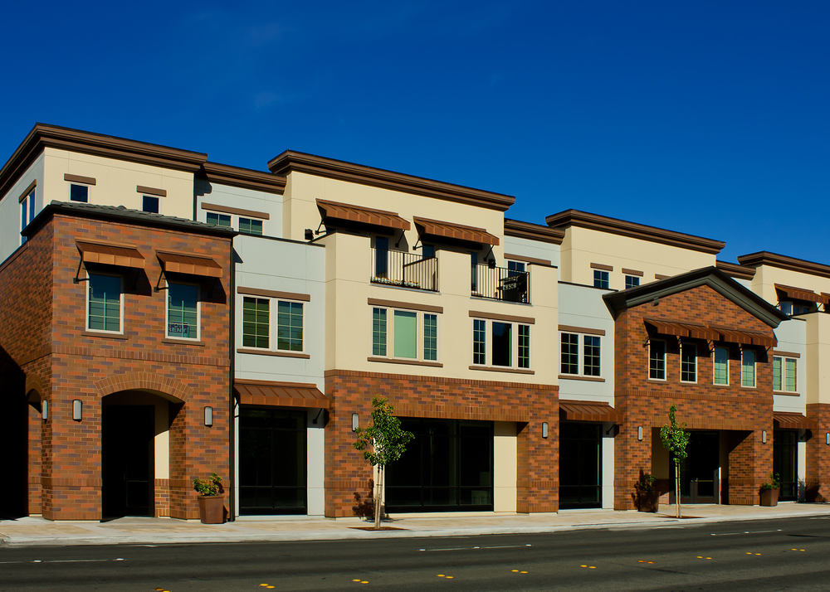
Building Characteristics
1- and 2-Family, Detached
Multi Family

Slide 20

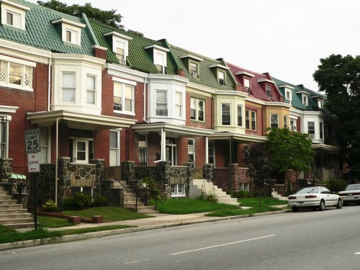
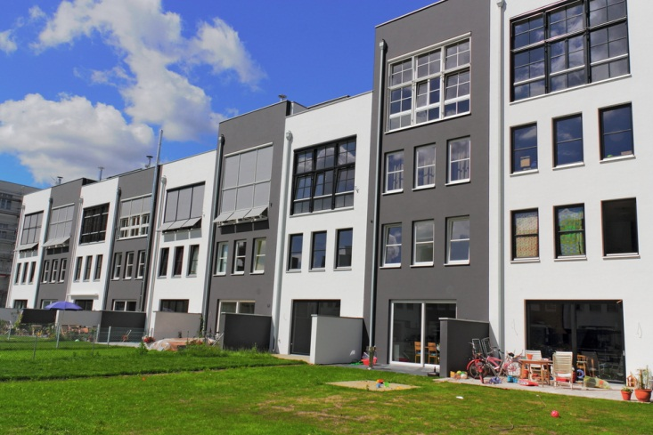
Building Characteristics: Multifamily
Multifamily if
  All multifamily buildings three stories or less in height above grade and
  Contain three or more attached dwelling units
  Examples
    Apartments
    Condominiums
    Townhouses
    Dormitories
    Rowhouses
Notes:
Multifamily buildings can be considered as a whole or separate reports can be generated for each dwelling unit. If compliance is being shown for an individual unit, typically you would not include the shared components that do NOT separate conditioned space from unconditioned space. Where individual units are identical, one report may be submitted as representative of the others. Contact the authority having jurisdiction to determine which approach to take.

Slide 21
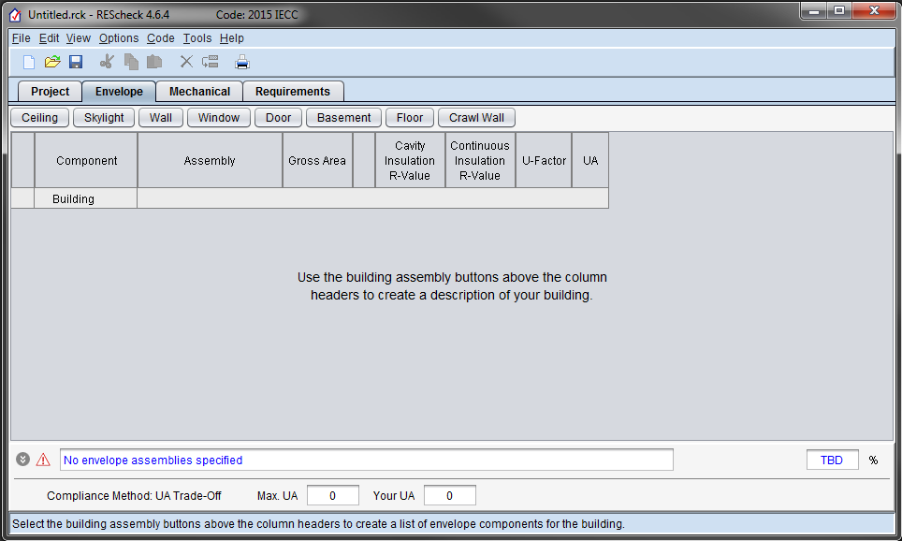
Envelope Tab

Slide 22
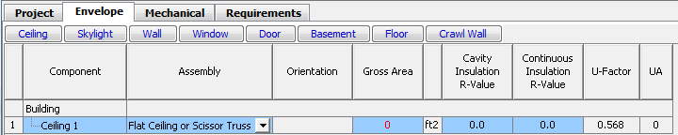
Color Clues
Red
Green
Blue
Notes:
Colors – red usually indicates missing information, errors, or failing compliance;
Colors –green on the screen means a passing condition, in help it means a glossary term;
Colors –blue refers to a lack of data (blue TBD in compliance bar means not enough data has been entered to render a compliance result

Slide 23
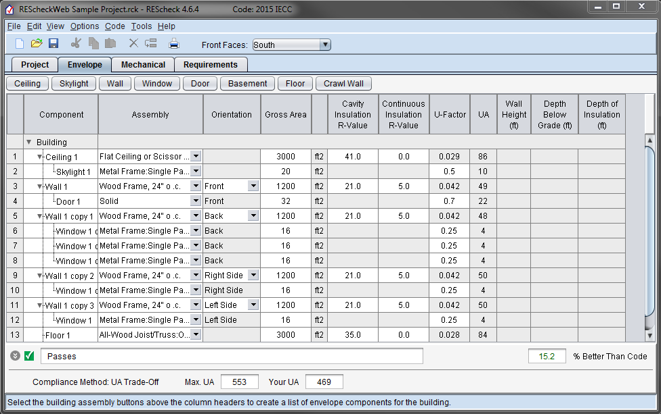
Screen Information
Compliance Bar
Status Bar
Notes:
Status bar explains what type of information goes into the active screen and/or active cell.
Compliance bar shows the compliance results.

Slide 24
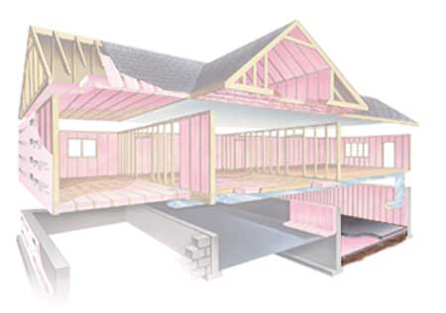
What is the Building Thermal Envelope?
Notes:
Consists of ceiling, walls (above grade and below grade), fenestration, foundation

Slide 25

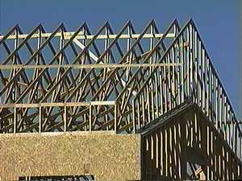
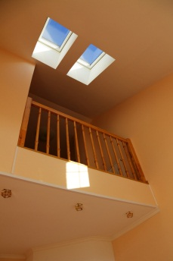
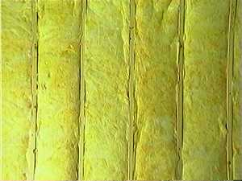
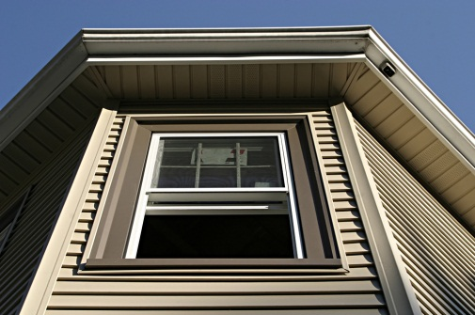
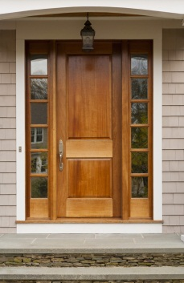
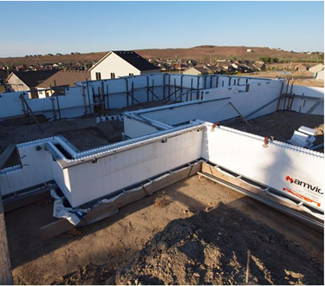
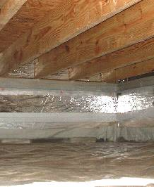
Entering Building Components
Enter only applicable
building components

Slide 26
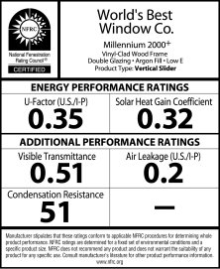
Fenestration: U-Factors and SHGCs

Slide 27
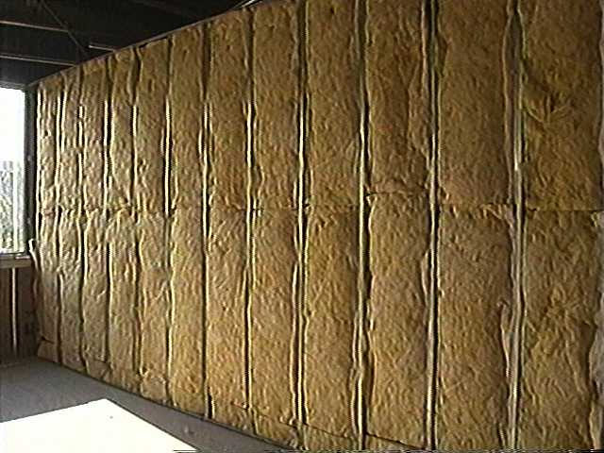
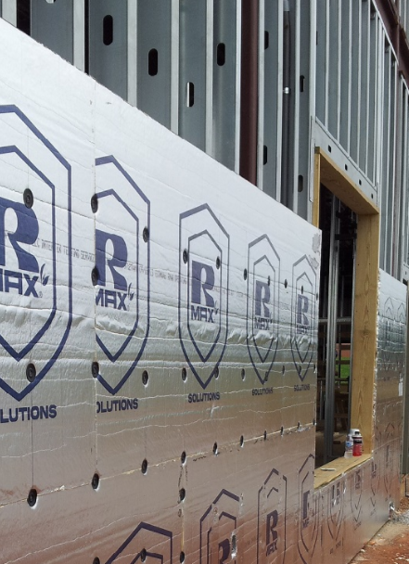
Cavity vs. Continuous
Cavity R-value – used for insulation placed between structural members
Continuous R-value – used for insulation that is continuous across the structure (e.g., rigid insulation)
Notes:
Find better continuous picture

Slide 28
Foundations – what button to use
Basement
Basement is conditioned
Floor
Separates conditioned from
unconditioned space
Crawl Wall
Crawl space is not vented to the outside and floor above is NOT insulated
Notes:
You may have multiple types of foundations in the project, if so, use the applicable buttons
If you have a slab, you will enter the perimeter of the slab component in linear feet. You will also select whether it is heated or unheated. A heated slab (e.g., a radiant slab) is one designed as part of a space-conditioning system. Heated slabs have higher insulation requirements than unheated slabs. You’ll also specify the slab insulation used and its position and depth.
Slabs include all slab edges that are part of the building envelope and are less than 12” below grade. Edges of slab floors over 12” below grade (such as basement floors) aren’t subject to code requirements and shouldn’t be entered into the software.

Slide 29
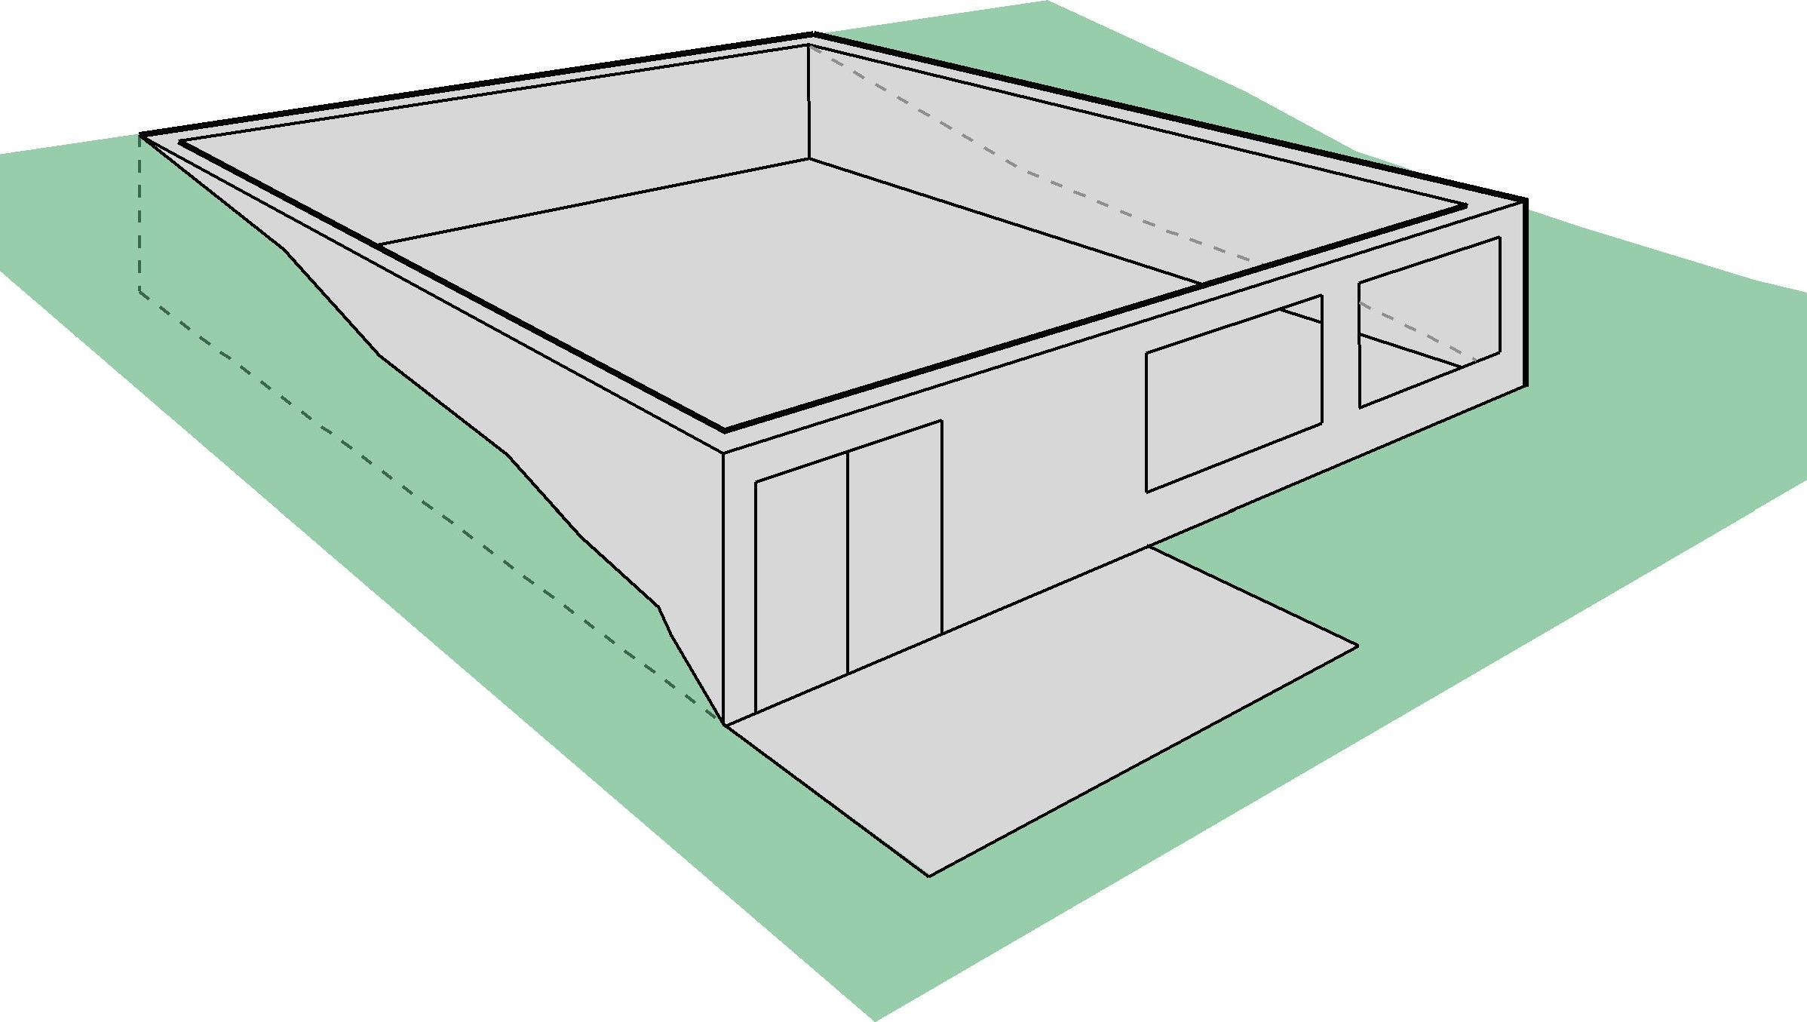
What’s a Basement Wall?
Basement Wall –
>50% below grade
Below grade
Basement wall
Below grade
Basement wall
Exterior Wall –
<50% below grade

Slide 30
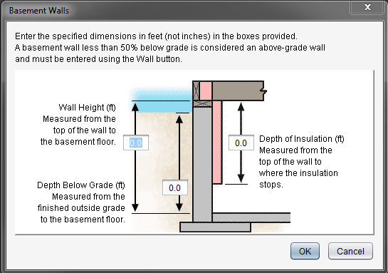
Basements Wall
Wall Height: If not uniform, provide an average height
Depth Below Grade: If sloped or uneven, provide an average depth below grade
Depth of Insulation
  Requirements are for full depth of basement wall (to 10 ft); REScheck allows trade offs
  If you enter insulation depth of 0, program assumes no insulation, regardless of values in the insulation fields
Continuous Insulation: Software assumes it’s exterior rigid
Cavity Insulation: Software assumes you’re furring out on the interior

Slide 31
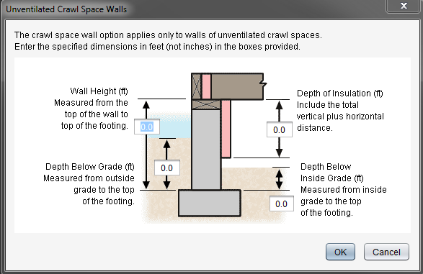
Crawl Wall

Slide 32
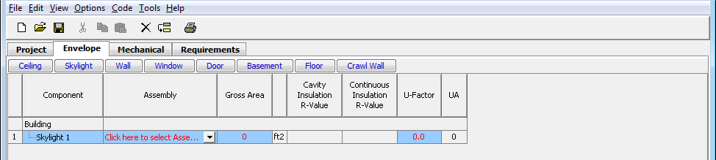
Envelope Helpful Hints
Don’t have to use every button
Can group “like” components
Gross area (except slab-on-grade)
  Gross wall area to include peripheral edges of floors (area of band joist and subfloor between floors)
Use “Other” assembly as needed
Notes:
Use of “other” requires a U-factor of the entire assembly, not just the insulation R-value. Documentation of the calculated assembly U-factor must be provided to the local jurisdiction.

Slide 33
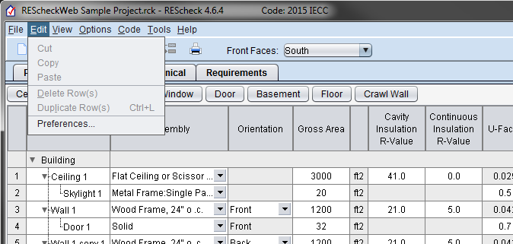
Preferences
General
File options
Version update check
Project
Code/location
Envelope
Applicant
Project details
Reports
Signatures
Upload usage data
Email reports
Notes:
Will demo this slide in realtime.

Slide 34

Compliance Failing – Helpful Hints
Review building plans to ensure all components are entered correctly
Confirm takeoffs (areas) are correct
Confirm insulation values
  Double check cavity vs. continuous entries
Confirm fenestration values
  Double check ratings on windows and doors (U-factor and SHGC)
Look at UA column (next slide)

Slide 35
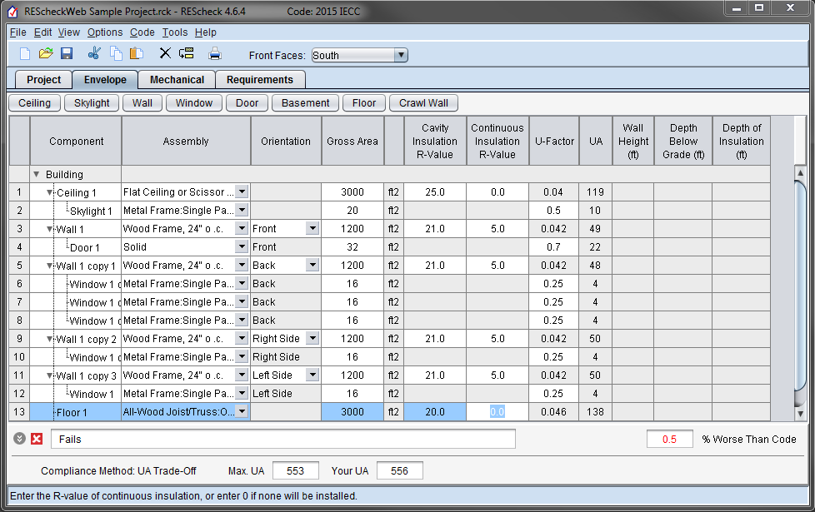

Compliance Failing – Helpful Hints, con’t
Notes:
Look for “heavy hitters” by reviewing “UA” column.

Slide 36
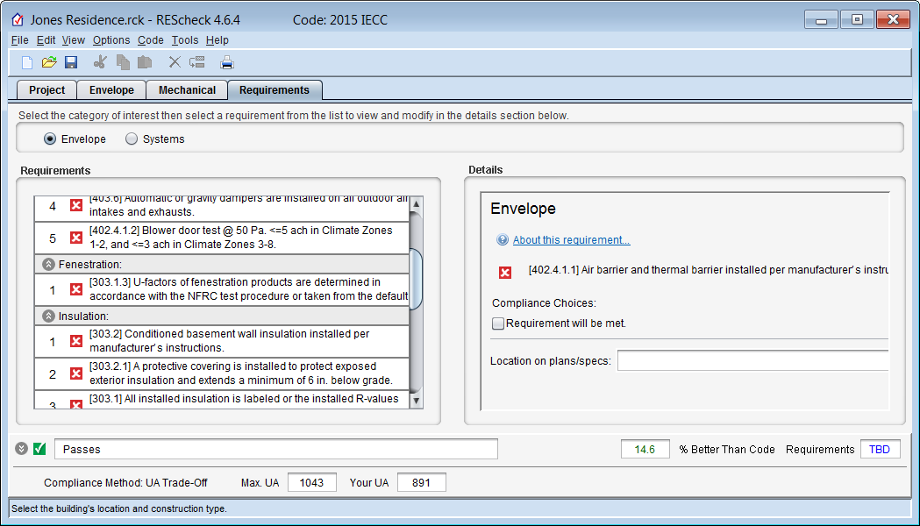
Requirements Tab
Mandatory requirements
  Air leakage
  Building mechanical systems and equipment
  Service water heating
  Duct construction, insulation, testing
For each requirement, the user
  Chooses a “compliance option”
    Requirement will be Met
    Exempt or Exceptions
    Requirement is Not Applicable
  Notes how compliance for applicable requirements are documented
This information is shown on the report in the “Comments/ Assumptions” column of the Inspection Checklist

Slide 37
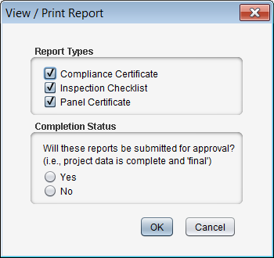
Reports
File View / Print Report
Choices, choose any or all
  Compliance Certificate
  Inspection Checklist
  Panel Certificate

Slide 38
Reports
Implement Requirements tab
Inspection checklists set up by phase of construction
  Plan Review
  Footing/Foundation
  Rough-in
  Final

Slide 39
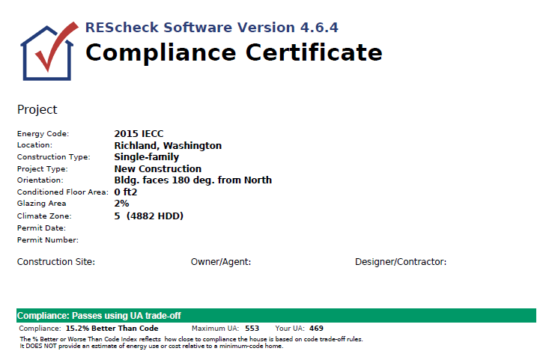
Reports – Sample Compliance Certificate, con’t
Verify energy code, location, construction type, and conditioned floor area

Slide 40
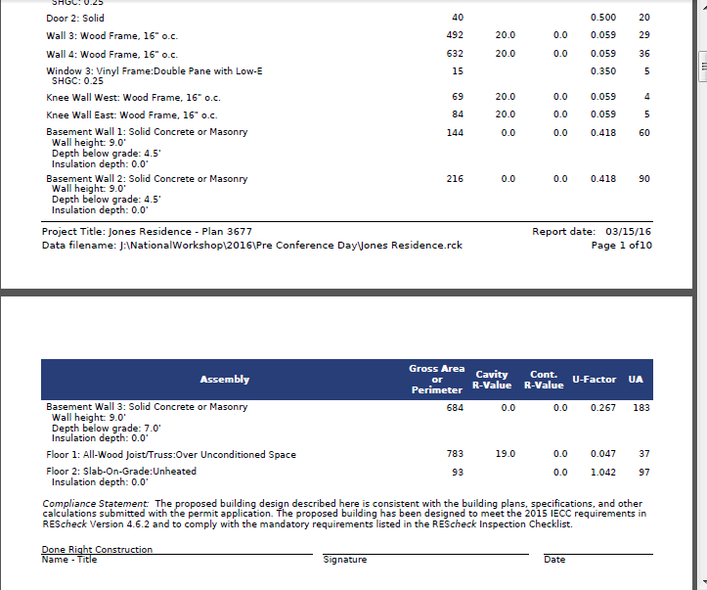
Reports – Sample Compliance Certificate, con’t
Verify Values are Consistent with Plans
Verify Compliance Statement is Signed

Slide 41
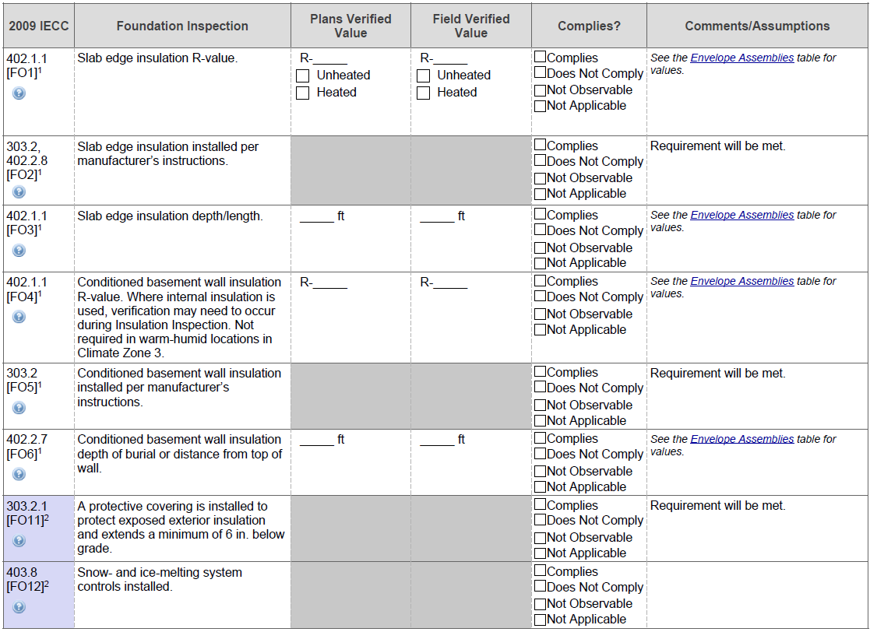
Envelope Sample Inspection Checklist
Notes:
Foundation Inspection

Slide 42
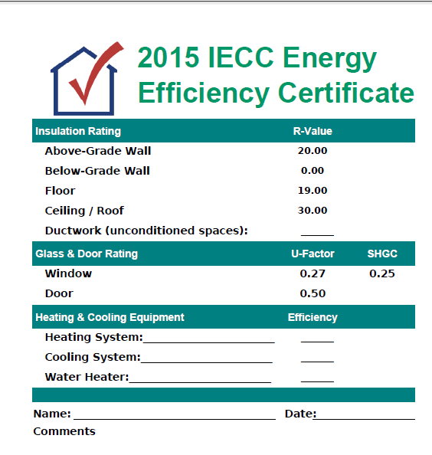
Panel Certificate

Slide 43
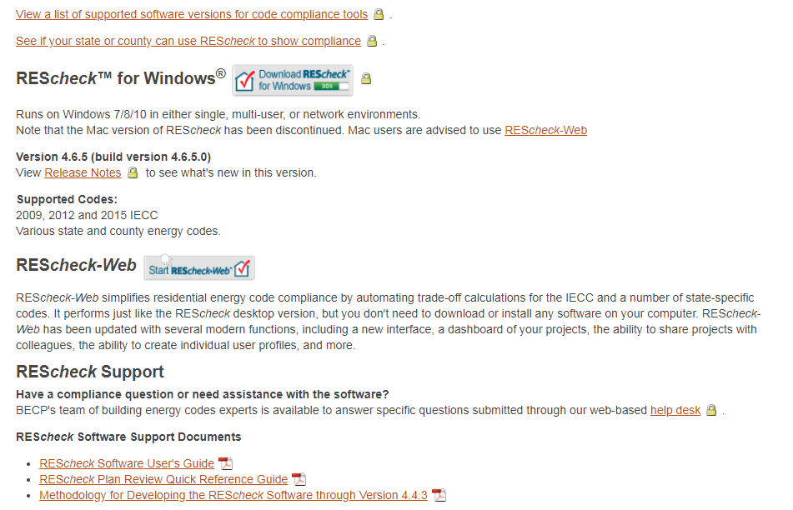
REScheck-Web
https://www.energycodes.gov/rescheck:
Notes:
Users will be required to register from now on.
Once registration is complete, log in credentials can be saved depending on browser and company policy.
All previously saved REScheckWeb projects will be available in the new REScheckWeb.

Slide 44
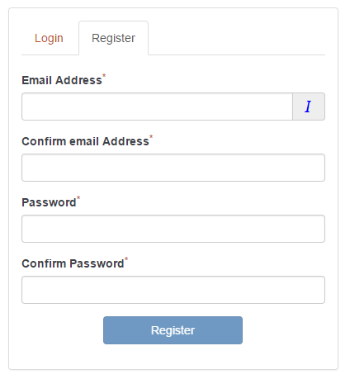
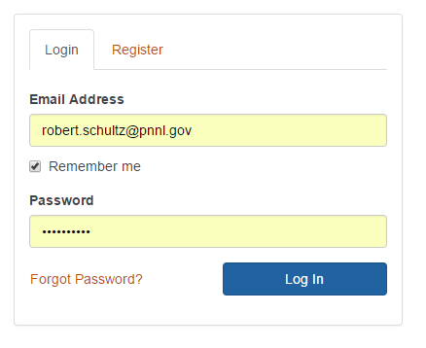
REScheck-Web: Registration and Account Log-In
Notes:
Users will be required to register from now on.
Once registration is complete, log in credentials can be saved depending on browser and company policy.
All previously saved REScheckWeb projects will be available in the new REScheckWeb.

Slide 45
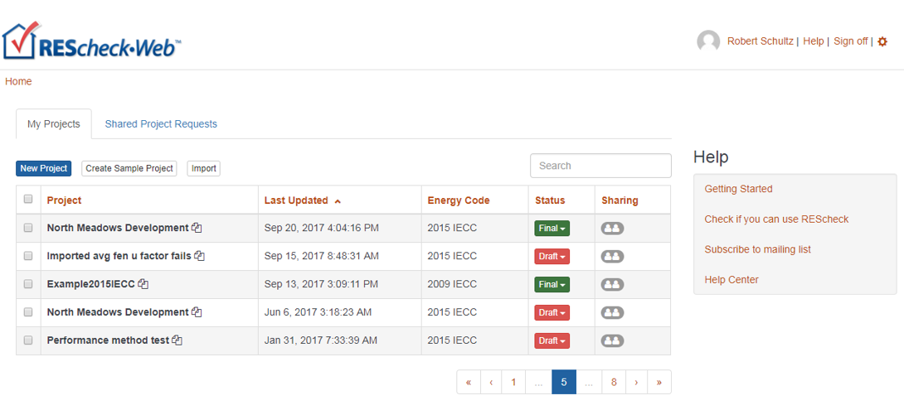
Home: My Projects (aka Project Dashboard)
Notes:
“Home” (aka Project Dashboard) is new and gives users advanced project management capabilities.
Standard table features exists:
Sort columns in ascending/descending order by alternately clicking on column header.
Modify projects status descriptor to identify projects that are final.
Send out sharing privileges with co-workers.
Bulk process deletion operations.
Specify “My Profile” and “My Settings” features.
Use the “Create Sample Project” button to create an example project to review and study as a tutorial aid.
Right-mouse-click on Project name to see other options specific to projects.

Slide 46
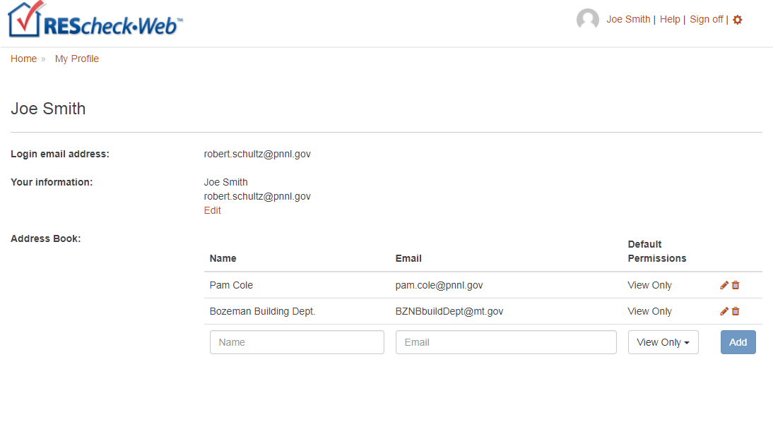
My Profile
Notes:
Add co-workers to your Address Book that you wish to sharing projects with.
Your personal information will accompany share invitation emails.

Slide 47
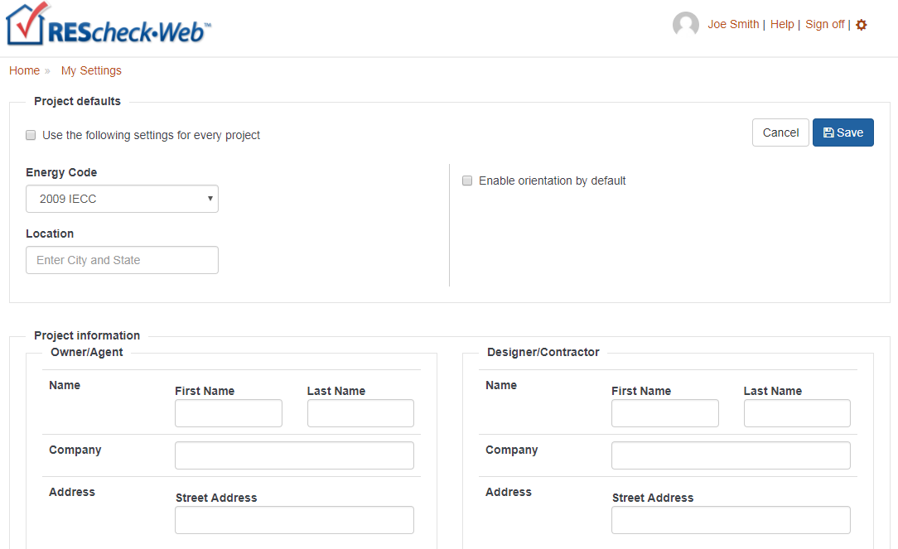
My Settings
Notes:
My Settings can be used to set default properties to invoke for each new project you create.
Toggle the default project settings on/off to temporarily disable use of defaults.

Slide 48
REScheckWeb Project Sharing

Slide 49


Sharing Projects: Shared Project Invitation
Notes:
Example of a project share email invitation.

Slide 50

Sharing Projects: Email Invitation
Shared project recipient will receive email with invitation to accept the “share”
Notes:
Example of a project share email invitation.

Slide 51

Sharing Projects: Shared Projects
Notes:
Example of project sharing types.

Slide 52

Project Tab: New Project
Notes:
New projects will open in “edit” mode by default.
Existing (previously saved projects) will open in “read-only” mode. Click Edit to allow editing to occur.

Slide 53

Project Location Specification
Notes:
Project location can be specified by typing in a zipcode, city name, county name, and/or state.
In most inputs, a drop-down list will be displayed and populated according to previously entered content while type ahead keystrokes can be matched with those inputs.

Slide 54


Envelope Viewing Option (cont)
Notes:
Multiple viewing options are available including fully collapsing (hiding) category tables, expanding them in part or in fully expanded mode.
This allows for personalizing your display to accommodate data entry and review.

Slide 55

Envelope Full View Example
Notes:
Fully expanded view

Slide 56

Envelope Tab (edit mode)
Notes:
Edit mode displays the time remaining before inactivity will automatically terminate a project edit session.
This is done to limit projects from being left in a locked state unintentionally.
Note the actionable icons on the left side of the assembly row. These include Show/Hide (if child assemblies are specified) icon, edit, copy, and delete. These are only exposed and available while in edit mode.

Slide 57


Envelope Add Wall Example
Notes:
This illustrates how to add an assembly. In this case an above-grade exterior wall is added by clicking the Add button in the Walls category table. The drop-down list from clicking Add will include Wall, Window, and Door. When wall is selected the screen “Add Wall Assembly” is displayed.
The type of wall assembly selected on the left hand side of the screen determine what inputs are presented on the right hand side of the screen.

Slide 58

Envelope Glazing Requirements
Notes:
Example of the Glazing Requirements screen that is displayed when clicking on the hypertext item in the background having the same name.
The requirements displayed are dependent on the energy code and location of the project as well as the set of windows/skylights that are specified.

Slide 59

Basement Wall Screen
Notes:
This is an example of an assembly that has help text and a diagram to assist in construction details specification.

Slide 60

Envelope Show Assembly Details
Notes:
The icon at the far right of each assembly row is “Show more details” feature. It displays all data that were specified in the assembly dialog including those that may not fit well within the assembly row columns.

Slide 61

Compliance Tab (edit mode)
Notes:
Compliance tab shows the compliance results in detail and couples those with the mandatory requirements that must also be satisfied.

Slide 62


Reports
Notes:
Reports are created by clicking on the Report button on the Compliance tab. The report consists of three sections that can be processed as necessary. Once the report process is complete, a dialog informs the user what the assigned name is and if the document is final. If is final then the REScheckWeb breadcrumb is updated to reflect that as is the Status flag for this project on the project dashboard.

Slide 63


Case Study
Jones Residence
Notes:
This case study is based on a location where the mandatory solar heat gain requirement applies. This is to show the orientation and trade off features for overhangs that can be used in RESCheck.

Slide 64
Building Envelope
Conditioned Basement
Conditioned Main Floor
Building Section
Notes:
The conditioned area or building envelope is the first thing that needs to be defined for REScheck inputs.
The highlighted areas on the plans and building section show the areas of the house that are conditioned.

Slide 65
Ceiling Area
Ceiling Area - 2415 sf
Notes:
The ceiling area in this residence corresponds with the main floor area because the ceilings are flat. If this plan contained vaulted areas, the ceiling area would need to be adjusted for the larger ceiling area created by the vault.

Slide 66
Exterior Wall Areas
3’ knee walls (between 9’&12’ sections) – 153 sf
  West – 69 sf
  East – 84 sf
12’ Exterior Walls – 689 sf
  North – 221 sf
  South – 234 sf
  East – 52 sf
  West – 182 sf
9’ Ceilings
12’ Ceilings
9’ Exterior Walls – 2180 sf
  North – 690 sf
  South – 600 sf
  East – 440 sf
  West – 450 sf
9’ Ceilings
Notes:
Exterior Walls:
The area of the exterior walls depend on the ceiling height of the space that the wall encloses. The highlighted sections on the main floor plan show the ceiling heights in various areas of the residence. The perimeter length of the exterior wall enclosing the space is multiplied by the wall height for the given area. This wall height includes the depth of the rim joist.
The knee walls between the 9’ ceiling and 12’ ceiling sections also enclose the conditioned space.

Slide 67


Knee Wall Insulation
No, No… Never cut the batts too short

Slide 68
Basement Walls – below grade
>50% below grade = below grade concrete basement wall
Notes:
The “side” basement walls are assumed to be more than 50% below grade so the entire wall is considered a “below grade basement wall (solid masonry)”.

Slide 69


Ways to Insulate Basement Walls
Exterior Rigid Foam
Interior Studs w/batts

Slide 70
Basement Wall Areas
Above Grade Bsmt Walls (exterior wood) = 837 sf (93’ x 9’)
(entered as wood frame wall. not a basement wall)
Below Grade Bsmt Walls = 1044 sf
Side basement walls = 360 sf
    West Wall – 144 sf
    East Wall – 216 sf
Back basement wall = 684 sf (76’x9’)
Above Grade
Bsmt Walls (exterior wood) – 837 sf
(93 ln. ft. x 9’ height)
144 sf
684 sf
216 sf
Notes:
Basement Walls:
The “walkout” side of the basement is an exterior wood wall with windows and doors and is entered as “wood frame wall – 16” o.c.”. The perimeter length of this wall is 93’. This length multiplied by the basement wall height of 9’ equals 837 square feet.
The “side” basement walls are assumed to be more than 50% below grade so the entire wall is considered a “below grade basement wall (solid masonry)”. The perimeter length of these side walls equals 40 feet (360 s.f.).
The “back” basement wall is totally below grade and is considered a “below grade basement wall”. The length of the back wall is 76 feet (684 s.f.).
The area of all the below grade basement walls is 1044 square feet (116’ x 9’).

Slide 71


Basement Walls
Split the “back” below grade basement wall in two below-grade assemblies in distinguish the area adjacent to the crawlspace from the area adjacent to the garage.
Notes:
Screen shots of the below grade basement wall REScheck inputs are shown.

Slide 72
Basement Walls
“side” below-grade basement walls
Notes:
Screen shots of the below grade basement wall REScheck inputs are shown.
The side basement walls are assumed to be 4.5’ below grade. This assumption is based on the average of the front of the wall that is totally above grade and the back section which is 9’ below grade.

Slide 73
Floor Area
Crawlspace Area – 783 sf
Notes:
The area of the floor above the crawlspace is entered as a “floor” in REScheck. The floor is insulated between the floor joists.
If the crawlspace wall had been insulated rather than the floor above the crawlspace, then a crawlspace wall assembly would be specified in place of a floor assembly.

Slide 74

Crawlspace Wall Insulation
Example of an Insulated crawlspace wall =
- no foundation vents to the exterior
+ mechanically vented/conditioned
This case study does NOT have a conditioned crawlspace
Notes:
Installing insulation on the inside surface of the foundation stemwall is common practice in many cold locations in the country. This practice eliminates the need to install insulation in the raised floor over the crawlspace. There are a few criteria that must be met in order to use this insulation method:
The crawlspace may not have ventilation openings that communicate directly with outside air
The crawlspace must be mechanically ventilated or supplied with conditioned air
The crawlspace floor must be covered with an approved vapor retarder material.
The IRC allows the construction of unventilated crawlspaces. To meet the requirements the crawlspace walls must be insulated to the R-value specified in the energy code. The crawlspace must either be provided with conditioned air or with mechanical ventilation. The code does not specify the quantity of conditioned air to supply the crawlspace.
If mechanical ventilation is selected, the crawlspace must be ventilated at 1 CFM per 50 square feet. The ground surface must also be covered with an approved vapor retarder material. To eliminate moisture from the crawlspace the sill plate and perimeter joist must be sealed. Also, while not a code requirement, all joints in the vapor retarder should be overlapped and taped. This includes the connection between the vapor retarder and crawlspace wall.
The code requires the crawl space wall insulation to extend from the top of the wall to the inside finished grade (if the inside grade is less than 12 inches (305 mm) below the outside finished grade or the vertical wall insulation stops less than 12).

Slide 75

Crawlspace Walls in REScheck

Slide 76
Slab Perimeter
Slab Perimeter – 93 linear feet
Line represents the slab edge to be calculated in linear feet
Notes:
The “front edge” of the basement exterior wall (above grade) is entered as a “slab” in REScheck. The perimeter edge measures 93 feet.

Slide 77




Slabs in REScheck

Slide 78
Insulation Levels
Roof/Ceiling
Walls (above and below grade)
Floor over vented crawl space
Slab-on-grade
Notes:
Building Sections are used to clarify insulation locations and levels for REScheck inputs.

Slide 79
Window/ Door Area
Glass Doors <50% glass - 40 sf; U-factor = 0.50
North – 40 sf
Opaque Doors - 40 sf; U-factor = 0.50
South – 40 sf
Window Area - 533 sf
North – 369 sf
South – 149 sf
West – 15 sf
U-factor = 0.35
U-factor = 0.27
SHGC = .25
South
North
West
East
Notes:
Window and door areas are listed to simplify REScheck inputs.

Slide 80

Case Study – Building Envelope Assemblies

Slide 81





U.S. DOE: BECP Resources
Compliance software
Technical support
Code notes
Publications
Resource guides
Training materials www.energycodes.gov

Slide 82
THANK YOU!
Bob Schultz
robert.schultz@pnnl.gov
Building Energy Codes Program
www.energycodes.gov
BECP help desk
http://www.energycodes.gov/resource-center/help-desk

