Slide 1
COMcheck Basics
bob schultz
2019 Department of Energy National Energy Codes Conference
Building Energy Codes Program
May 28, 2019
Notes:
PNNL develops and supports the CheckTools suite of software
Residential projects – REScheck
Commercial projects - COMcheck
Why do we do this?
Compliance: Provide technical assistance to states to implement building energy codes including increasing and verifying compliance to ensure consumer benefits (42 USC 6833), develop software to support a streamlined compliance process, provide objective information resources and technical guidance to states and localities to increase code compliance.

Slide 2





CheckTools Current Use Scenario
Demonstrate Compliance
Collect Data
Check Compliance
Plan Review
Review Software Input
Review Mandatory Requirements
Field Inspection
Verify compliance of inspection checklist items
Prepare Input
Generate Compliance Report
Check Compliance Results
Approve compliance
Paper/PDF
Paper/PDF
Builder
Architect Designer
Plan Reviewer
Field Inspector
BECP Tools used only during “Demonstrate Compliance” Stage

Slide 3

COMcheck Compliance Methods
Building System
Compliance Options
Envelope
Prescriptive Option
HVAC
Energy Code Compliance
Mandatory
Provisions
Trade Off Option
SWH
Power
Energy Cost Budget: Performance Simulation
Lighting
Other

Slide 4
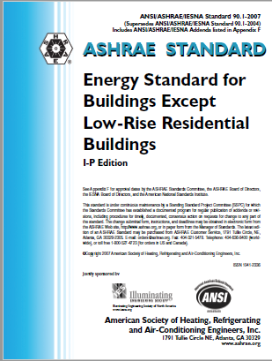
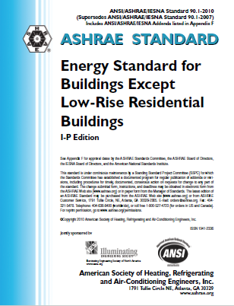
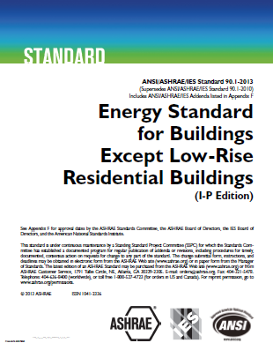
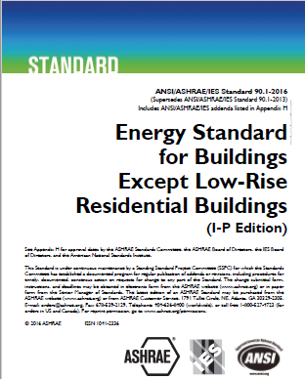




COMcheck Commercial Energy Codes
ASHRAE 90.1 (Pre-2013) Normative Appendix C Methodology for Building Envelope Trade-Off Option
  90.1-2007/2010
  2009/2012 IECC
ASHRAE 90.1-2013/2016 Appendix C has limited performance method (EnergyPlus)
2015/2018 IECC Component Performance Alternative (hybrid Total UA method)

Slide 5
Envelope Trade-Off Methods (cont.)
90.1-2007/2010 and 2009/2012 IECC : Normative Appendix C Methodology for Building Envelope Trade-Off Option
Building energy cost factor computed using regression equations
90.1-2007/2010: Window/wall and skylight/roof ratio limitations enforced but tradable
2009/2012 IECC: Window/wall and skylight/roof ratio limitations enforced as hard limit
90.1-2013/2016 Appendix C Envelope Trade-Off Methodology
Envelope components are assigned to isolated thermal zones based on
  Building Envelope Area types (BEAT) play influential role
  Space conditioning categories (SCC)
  Window/wall and skylight/roof ratio limitations enforced but tradable
2015/2018 Component Performance Method Criteria
Envelope assemblies must pass on ‘hybrid’ Total UA based criteria
Window/wall and skylight/roof ratio limitations enforced but tradable
SHGC prescriptive requirement enforced

Slide 6
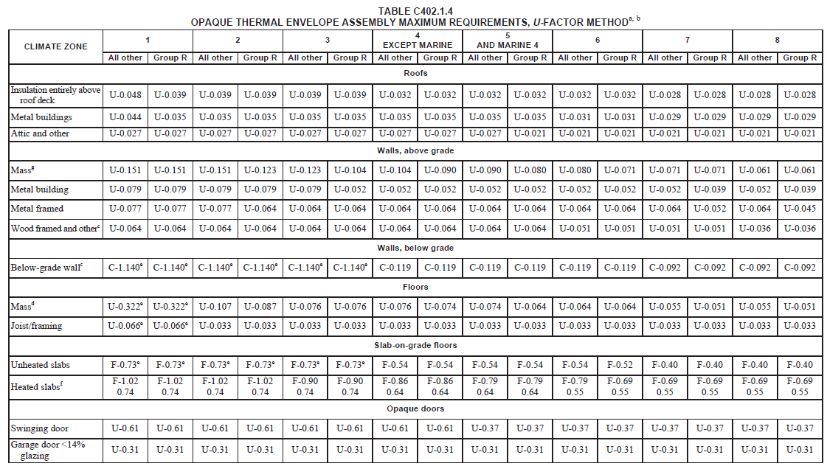
IECC Envelope Opaque Assembly Requirements
(Source: 2018 IECC)
Notes:
Note that these categories are mostly similar to 90.1 excepting Opaque Doors.

Slide 7
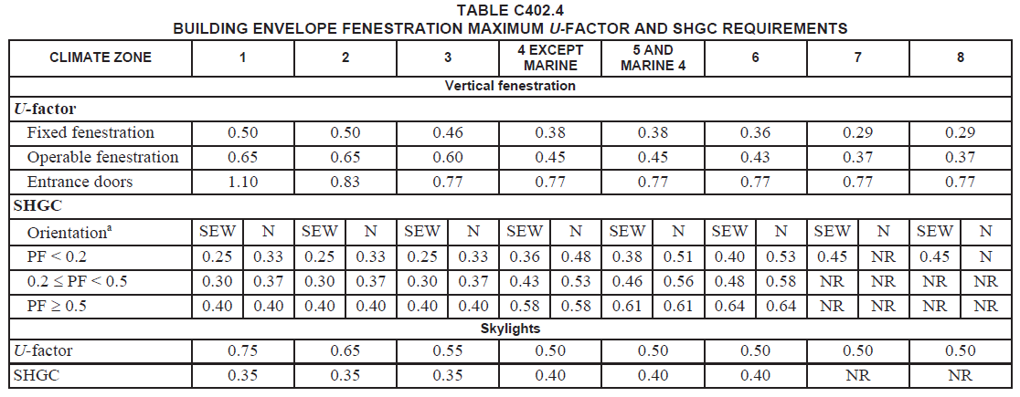
IECC Envelope Fenestration Requirements
(Source: 2018 IECC)
Notes:
Note that 2018 IECC requires SHGC to be met prescriptively, not by area-weighted averaging method.

Slide 8
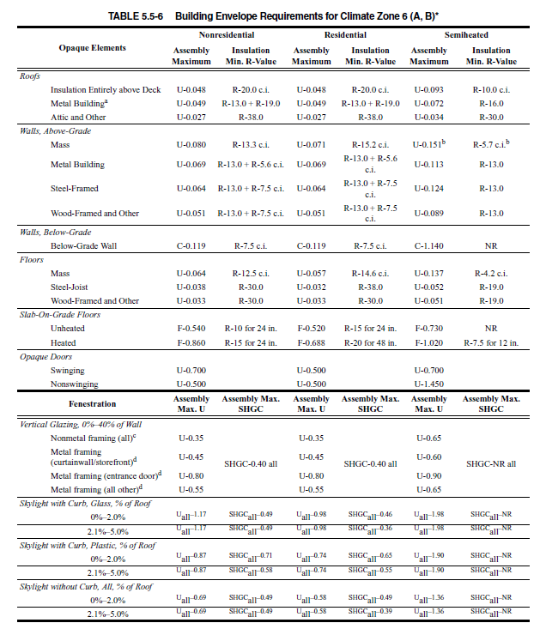
90.1 Envelope Requirements
Source: 90.1-2010

Slide 9
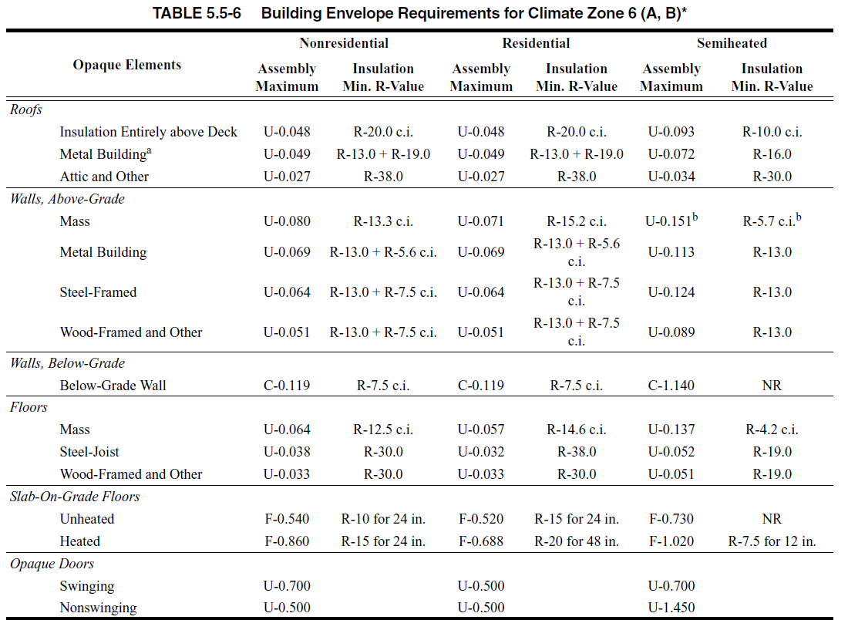
90.1 Envelope Opaque Assembly Requirements
Source: 90.1-2010
Notes:
Note the U-factor requirements are what COMcheck uses.

Slide 10

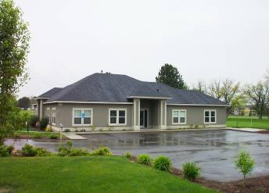
Project Types
New Construction:
  Trade-off compliance method
  Prescriptive – Oregon only
Addition
  Trade-off compliance method
  Prescriptive – Oregon only
Alteration
  Prescriptive compliance
Notes:
The Trade-off compliance approach is used for New Construction and Addition. The prescriptive compliance option is used for Alteration.

Slide 11


Lighting Compliance Methods
Mandatory requirements: Controls, Switching, Daylighting
Interior/Exterior lighting power requirements
  Complies if total connected power <= lighting power allowance
Proposed Wattage
Allowed Wattage
≤
Allowed Wattage

Slide 12
Mechanical/Service Hot Water Compliance
Efficiency requirements
Economizer requirements
Fan Power Limitation
Mandatory requirements
No compliance metric available
Allowed Wattage
Allowed Wattage

Slide 13
COMcheck Project Specification Steps
Project
Building Envelope Components
Lighting
Mechanical
Requirements Reports

Slide 14
Info You’ll Need
Energy Code
Builder and project location
Area take-offs for envelope assemblies
Insulation R-values, fenestration performance data
Lighting fixture details
Heating and cooling system details
Service water heating details

Slide 15
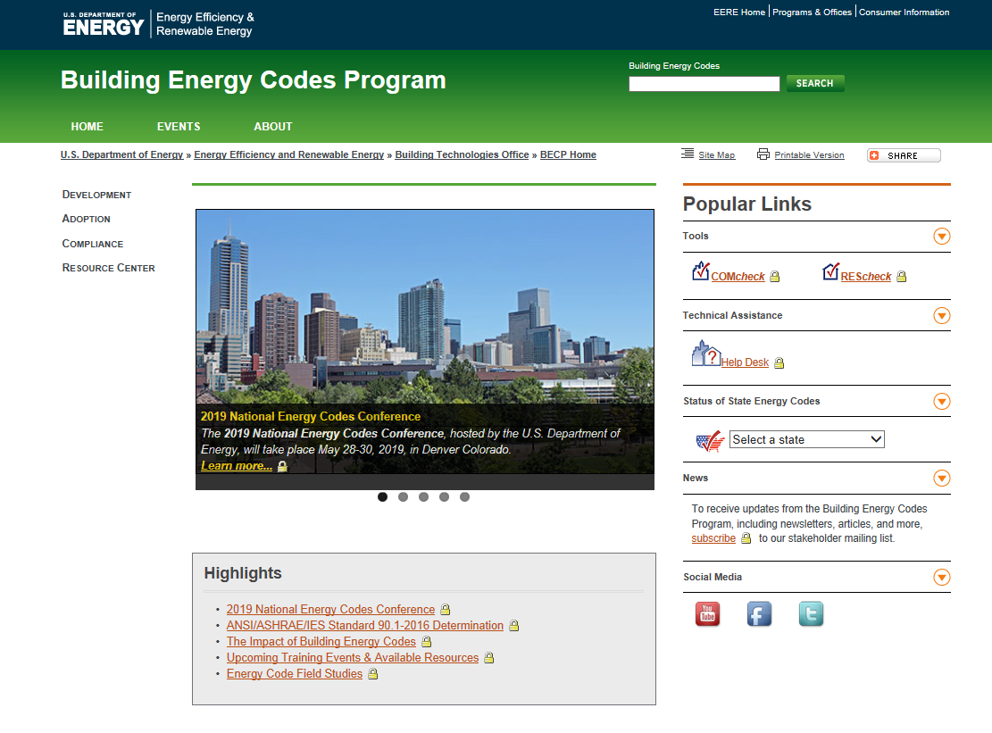
www.energycodes.gov

Slide 16
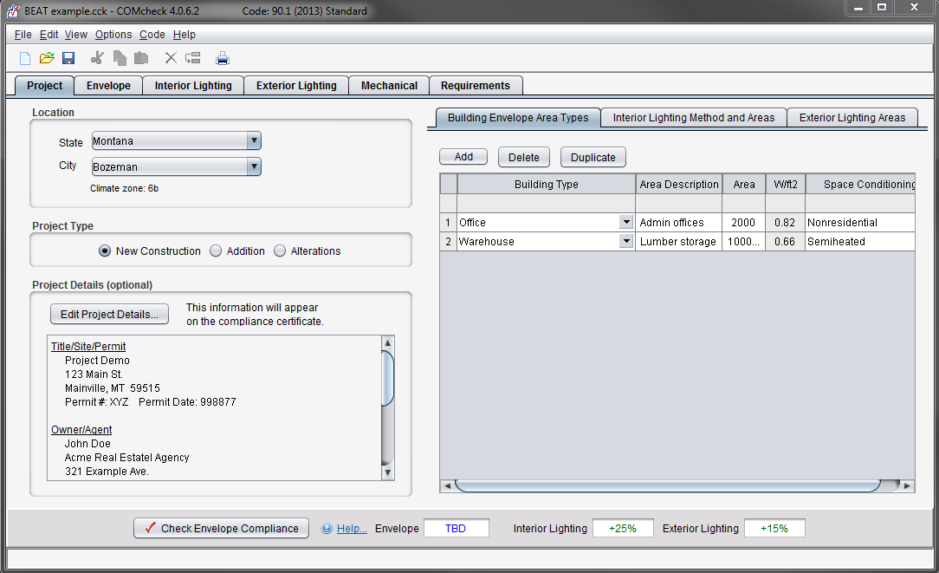
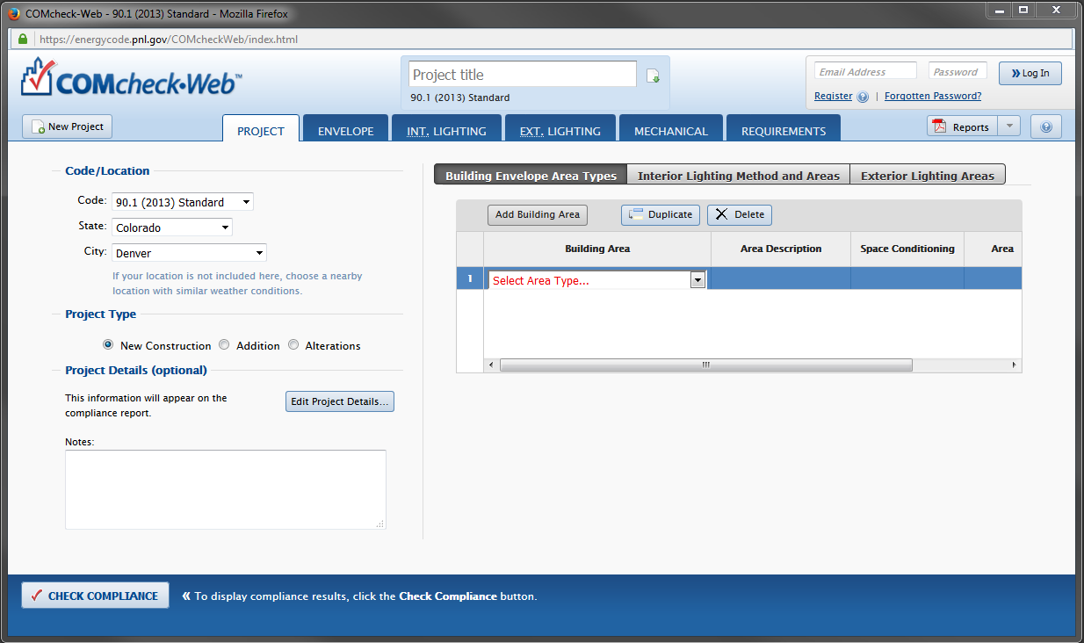
COMcheck
“Desktop”
Web

Slide 17
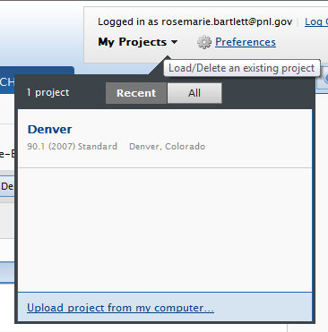

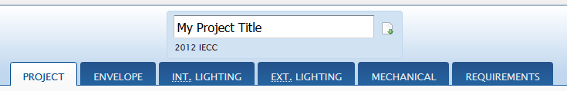
Desktop/Web Data Exchange
Can exchange files between desktop and web
  Log in to web
  My Projects
Upload from desktop to web account
Download from web account to desktop

Slide 18
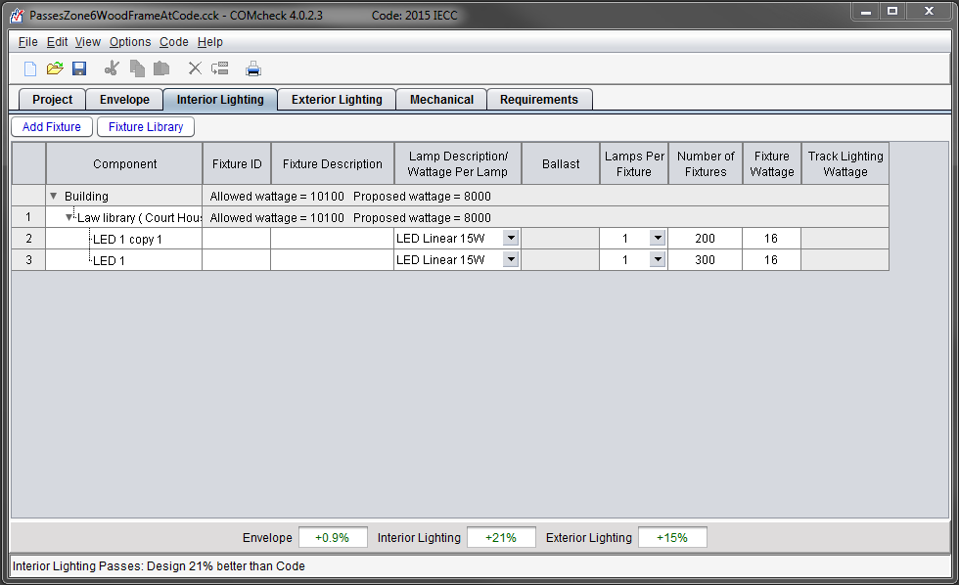
COMcheck Basics: Color cues and feedback
Red
Blue
Green
Compliance bar
Status bar

Slide 19
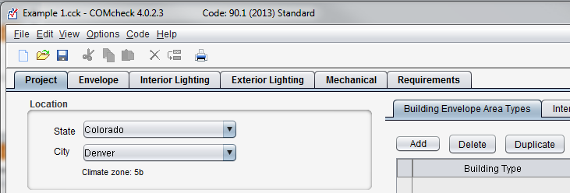
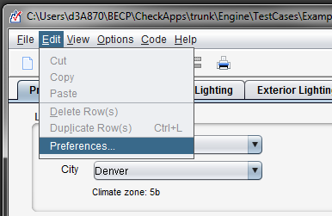
COMcheck Basics: Menus and Toolbars
General
File options
Version update check
Project
Code/location
Envelope
Applicant
Project details
Reports
Signatures
Upload usage data
Email reports

Slide 20
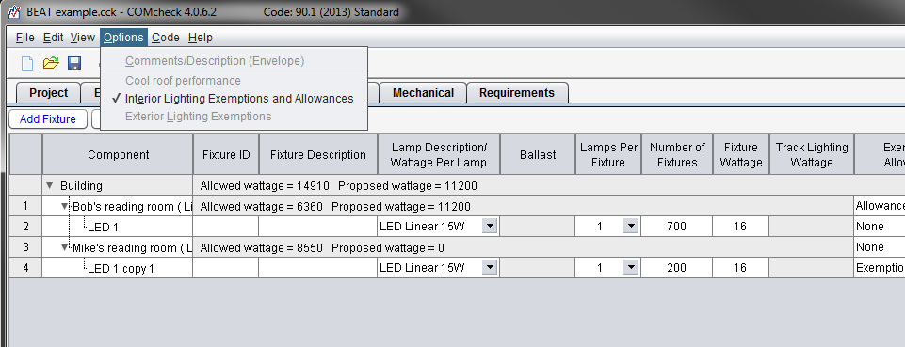
COMcheck Basics: Options Menu
Options menu is tab dependent and code dependent
Exemptions/Allowances
Comments

Slide 21
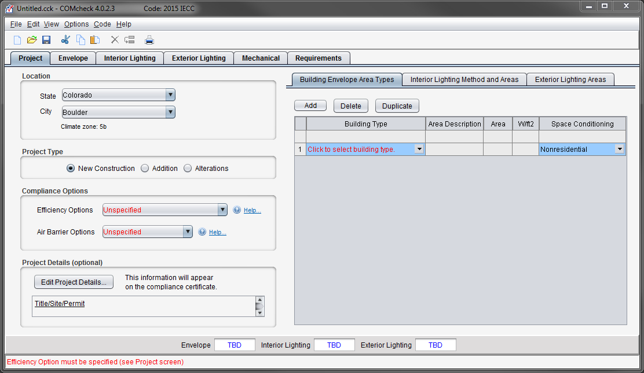
Project Screen

Slide 22
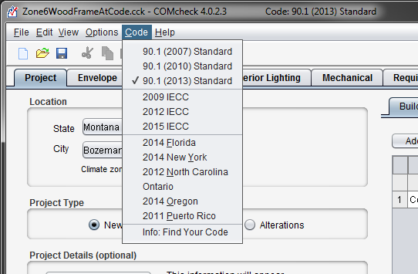
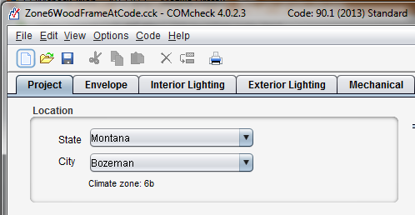
Project: Code and Location
Appropriate Code
Location

Slide 23

Project: Project Type
New Construction
Addition
Alteration
Notes:
The Trade-off compliance approach is used for New Construction and Addition. The prescriptive compliance option is used for Alteration.

Slide 24
Project: Alteration project type explained
Projects involve changes to or replacement of
  Existing building components that are part of building envelope
  Lighting, heating, ventilating, air conditioning, and water-heating equipment
Specify only those envelope components, lighting fixtures, or mechanical systems/equipment that will exist upon completion of the project.
Alteration detail dialogs
  Specify exemptions if applicable
  Additional qualifications may be required (e.g., Window/wall ratio)
Compliance shown as Pass/Fail for Envelope and Lighting

Slide 25
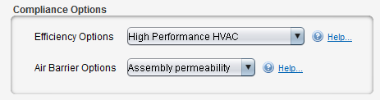
Compliance Options (IECC only)
Efficiency Options
  High performance power (2012/2015/2018)
  Reduced lighting power (2012/2015/2018)
  On-site renewable energy (2012/2015/2018)
  High performance SWH (2015/2018)
  Enhanced interior lighting controls (2015/2018)
  Dedicated outdoor air system (2015/2018)
  Enhanced Envelope Performance (2018)
  Reduced Air Infiltration (2018)
Air Barrier Options (IECC 2012+, climate zone dependent)
  Air barrier permeability
  Assembly permeability
  Air leakage test

Slide 26
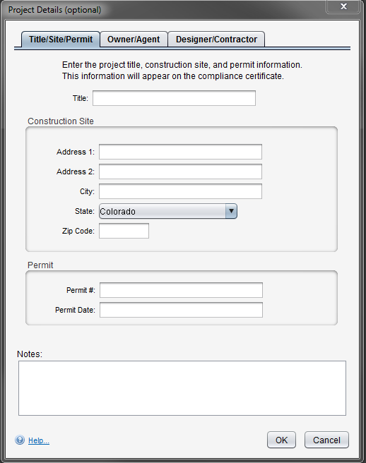
Project: Project Details
Optional
Sections
  Title/Site/Permit
  Owner/Agent
  Designer/Contractor
Included on report

Slide 27
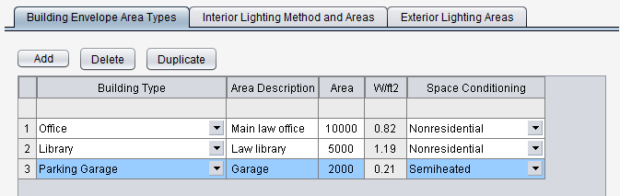
Project: Building Envelope Area Types
Primarily impacts envelope compliance
Whole building types that describe the envelope (separating conditioned and unconditioned spaces)
Space conditioning type
  Nonresidential
  Residential
  Semiheated (no mechanical cooling) – 90.1 only
Notes:
Building Envelope Area Types enable envelope assemblies to be assigned to a specific space conditioning type so specific requirements for that assembly can be applied and, for codes computing energy performance, internal loads of the building classification can be defaulted.

Slide 28
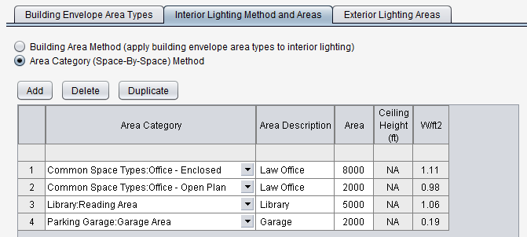
Project: Interior Lighting Method and Area Types
Method determines lighting power density and allowances
Area category allows for more detailed space representation
Notes:
Building Envelope Area Types or Area Categories will appear in Interior Lighting input table. Fixtures will be specified and assigned to one of these types.

Slide 29
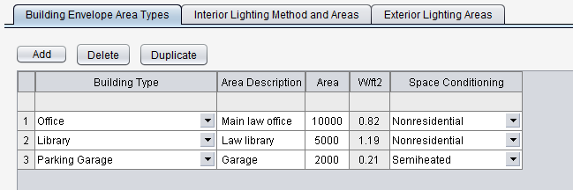
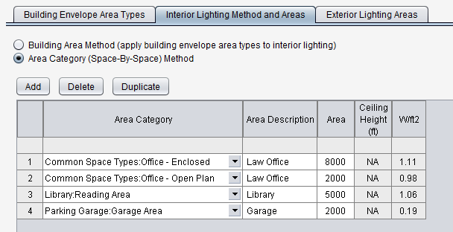
Interior Lighting: Methods
Selected method determines lighting power densities in interior lighting and exterior lighting screens
  based on code, method, and applications selected on the Project screen

Slide 30
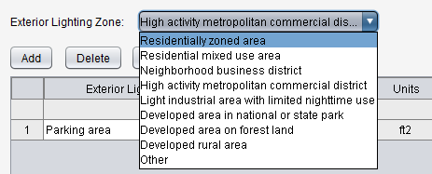
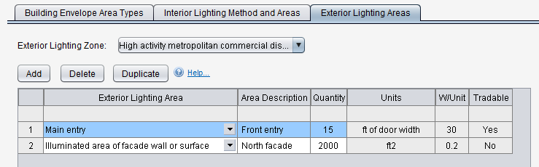
Project: Exterior Lighting Area Types
Zone and area type determine:
  Lighting power density
  Units
  Tradability
Notes:
The new feature enables envelope assemblies to be assigned to a specific space conditioning type so specific requirements for that assembly can be applied and so internal loads of the building can be assigned by space conditioning.

Slide 31
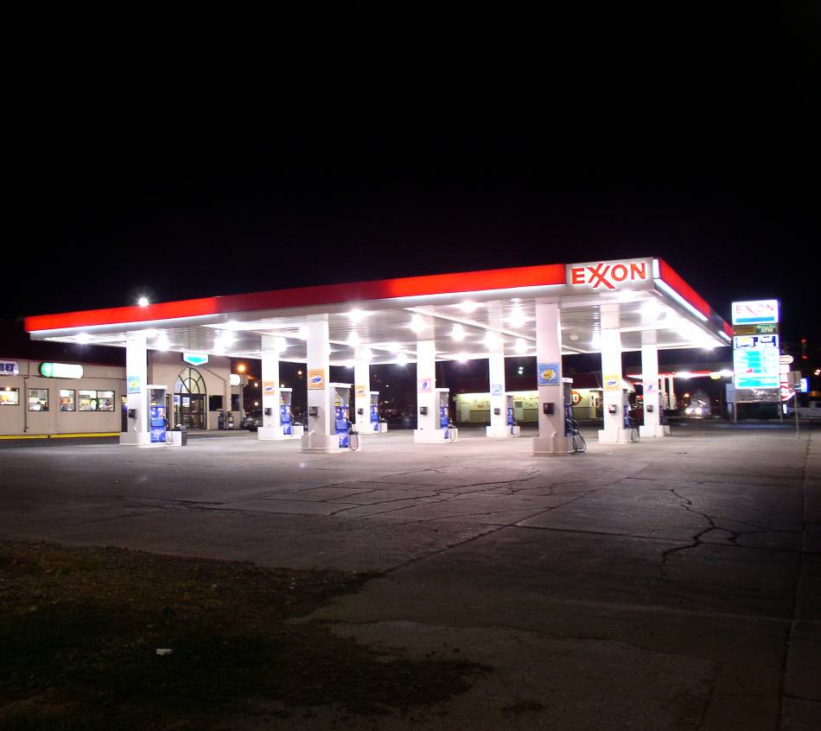
Exterior Lighting: Tradable Applications
Tradable areas allow ‘unused’ allowable power to be traded between other tradable area (e.g., driveways and entry ways)
Generally based on length or area of application then summed
Notes:
Tradable – for example, wattage allowed for parking lot lighting can be “traded” and used for canopy lighting.

Slide 32
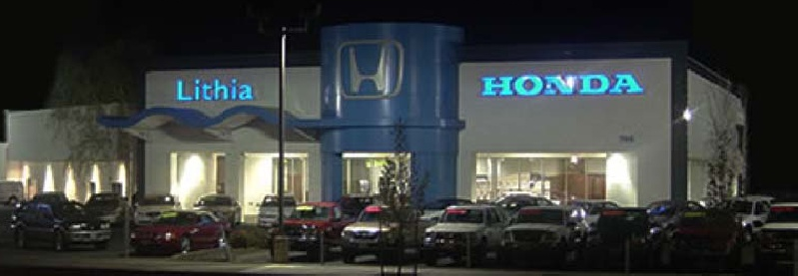
Exterior Lighting: Non-Tradable Applications
  Non-tradable areas/applications are “use it or lose it” (e.g., building façade lighting, ATM stations)
Notes:
Nontradable – these applications have more specific security or task illuminance needs such as ATM machines, drive-up windows, emergency services

Slide 33
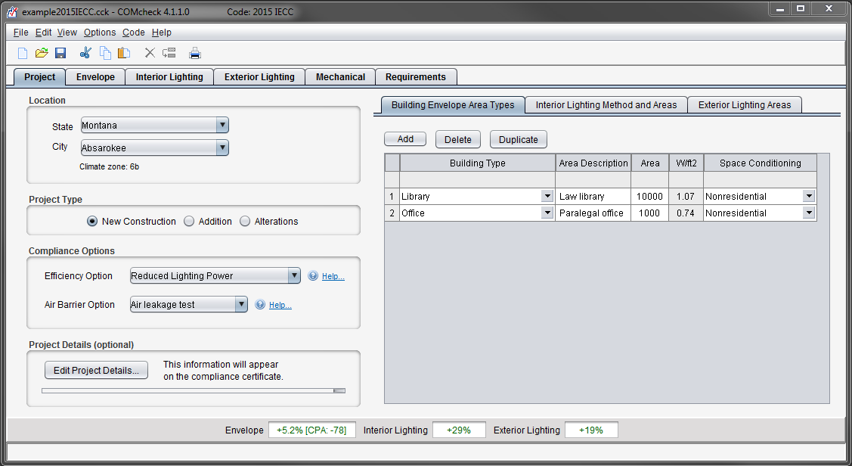
Project: Summary and Example
Notes:
Envelope assemblies to be assigned to a specific space conditioning type so specific requirements for that assembly can be applied and, if energy performance is to be computed, internal loads will be specific to the building classification.

Slide 34
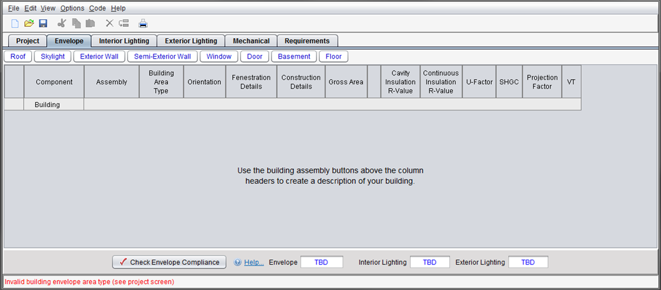
Envelope: Introduction
Cavity Insulation R-value – insulation placed between structural members
Continuous Insulation R-value – ‘continuous’ insulation across the structure (e.g., rigid insulation)

Slide 35
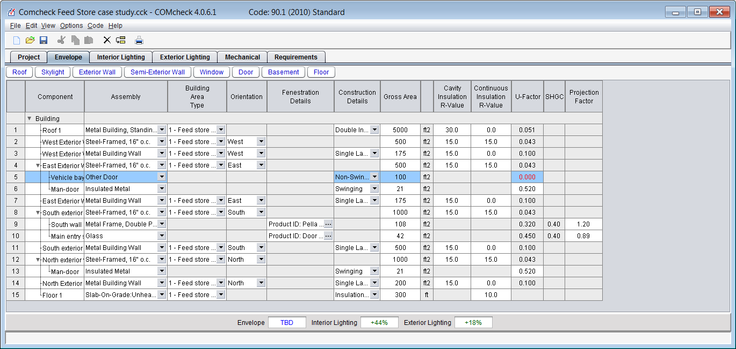
Envelope: Opaque Assemblies
After you’ve entered building components, look at compliance result
  Look for fields with red text
  If TBD, look for missing data

Slide 36
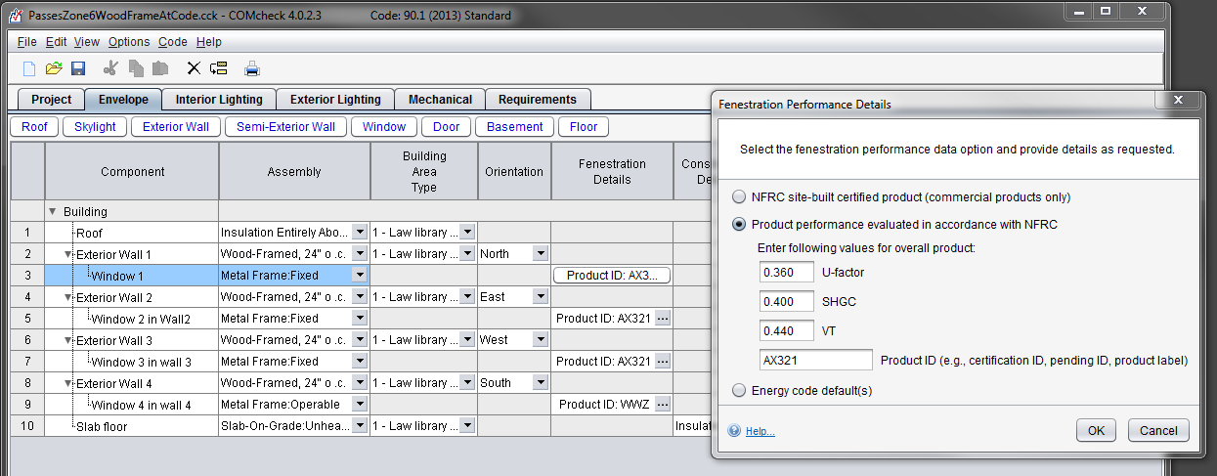
Envelope: Fenestration
NFRC site-built certified product
Performance evaluated (per NFRC guidelines)
Energy code defaults

Slide 37
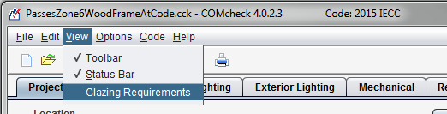
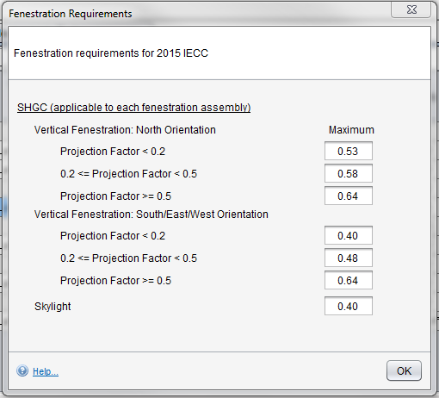
Envelope: 2015/2018 IECC Fenestration Requirements
Menu View->Glazing Requirements
Notes:
Demonstrates how to access glazing requirements.

Slide 38
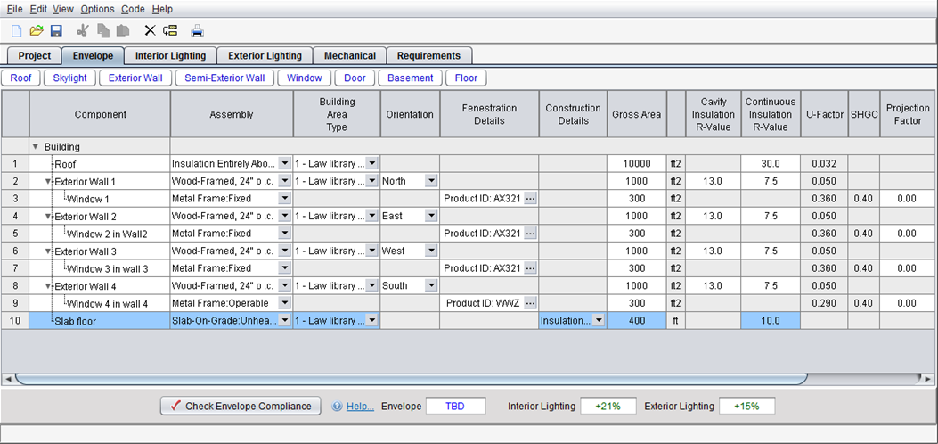
Envelope: Summary
Don’t have to use every assembly type
Can group “like” components
Gross area (except slab-on-grade)
Use “Other” assembly as needed

Slide 39
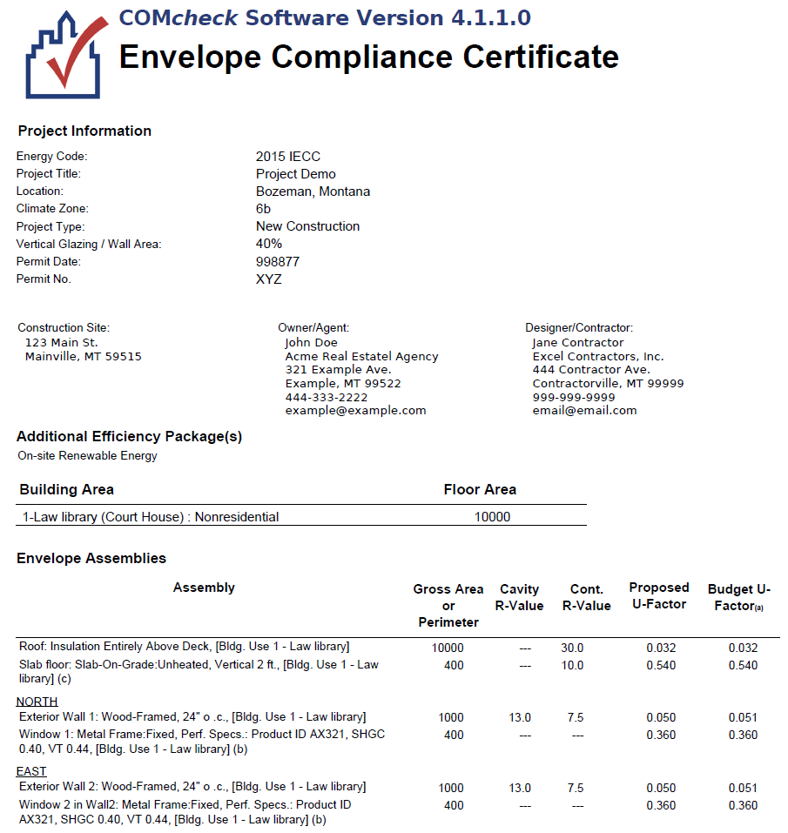
Diagnostic Data on Envelope Report
Notes:
Refer to Envelope Compliance Certificate to obtain important diagnostic details.

Slide 40
Lighting Compliance
Mandatory Requirements (Interior and Exterior)
Interior Lighting Power Limits
Exterior Lighting Power Limits
+
+
Tradable
Total Connected Power
Interior Lighting Power Allowance
<
Exemptions
Controls
Non-Tradable
Switching
Exemptions
Whole Building
Efficiency
Exterior Lighting Power Allowance
OR
Total Connected Power
<
Space-by-Space
Additional Allowances

Slide 41
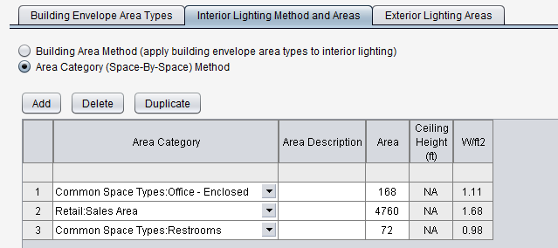
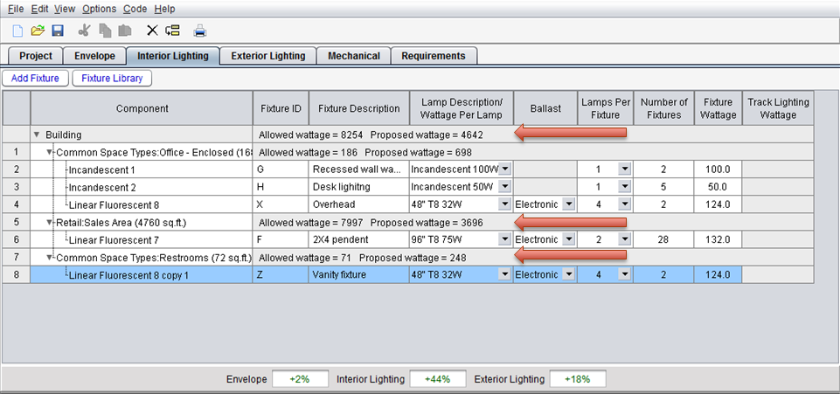
Interior Lighting: Spaces and Fixtures
Select space then Add Fixture button or Fixture Library
Fixture library preserves frequently used fixtures for future use
Allowed/Proposed wattage balance maintained
Notes:
Only applicable to the desktop version as of March 2013

Slide 42
Lighting Fixture Categories
Linear fluorescent
Compact fluorescent
HID
Incandescent
Halogen
Track lighting
LED
Induction
Notes:
Induction lighting is a fluorescent type bulb without the metal electrical contacts used to conduct electricity from the fixture to the light-emitting gas inside the bulb. Induction is the process of transmitting energy via an electro-magnetic field. The light emitting gas inside the bulbs is excited, or energized when located within a sufficiently strong EMF, or electro-magnetic field, which is induced by passing alternating current through a coil, or inductor. This means that electricity-conducting metal contacts are unnecessary on the bulb, and the bulb will experience longer life.
The lamps are capable of saving 40% over fluorescents, and some models boast a life expectancy of up to 100,000 hours.

Slide 43
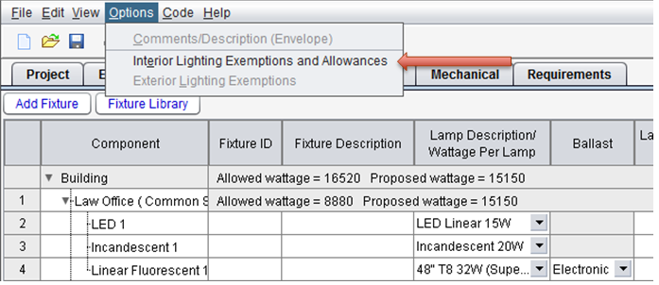
Lighting: Exemptions and Allowances
Options menu
Exemptions
  Power for exempt fixtures is omitted from the proposed wattage
Allowances
  Allowed wattage for building increased by allowable amount

Slide 44
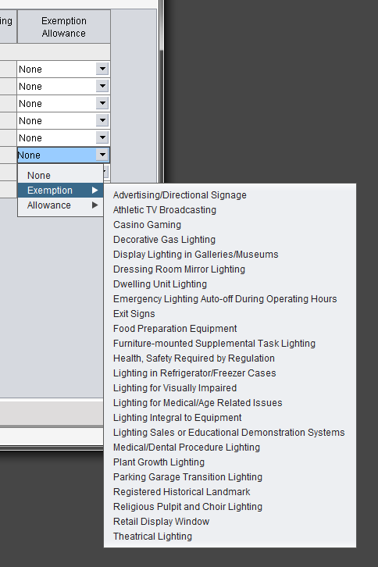
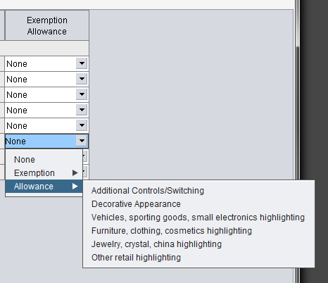
Lighting: Exemptions and Allowances (cont)

Slide 45
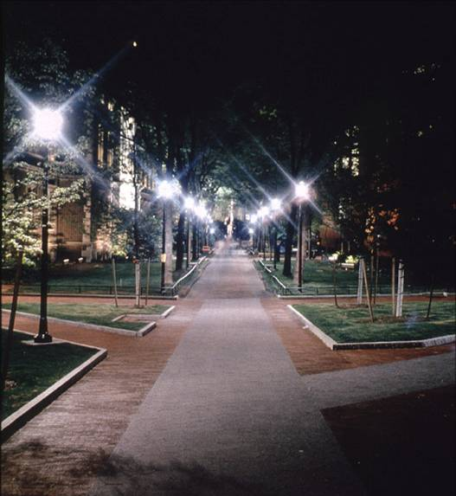
Exterior Lighting
Inputs will be based on code selected
Mandatory requirements
Exemptions
≤
Total Connected Power
Ext. Ltg. Power Allowance

Slide 46
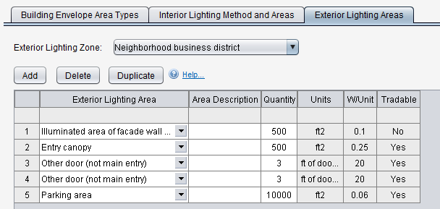
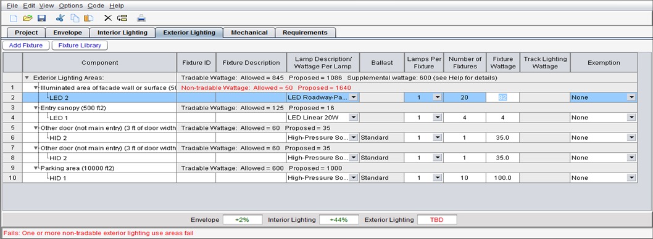
Exterior Lighting: Example
Lighting applications entered similar to interior lighting
Pay attention to tradable versus non-tradable criteria.

Slide 47
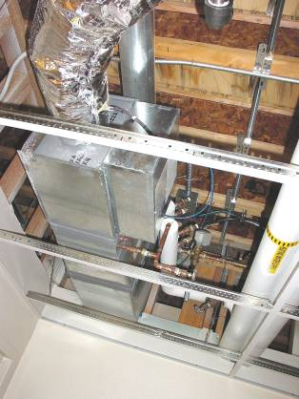
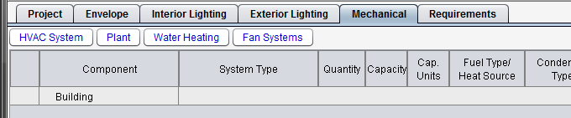
Mechanical Systems
Limited means to determine compliance
Enter characteristics of
  HVAC system
  Plant
  Water heating
Characteristics you select determine which requirements apply
Notes:
Mechanical works differently because most of the mechanical requirements are mandatory.
The characteristics you enter enable the software to exclude large numbers of requirements that don’t apply to your systems.
HVAC system refers to secondary HVAC systems, including controls, fans, terminal boxes, radiators, coils, and package HVAC equipment, not primary HVAC system components such as boilers, chillers, cooling towers, and pumps. The characteristics you select determine which requirements apply. Some of the inputs are interdependent.
Plant refers to primary HVAC components, such as boilers, chillers, cooling towers, and pumps.
Water heating – the selection (or deselection) of the checkboxes in this section determines which water heating requirements apply to your building.

Slide 48
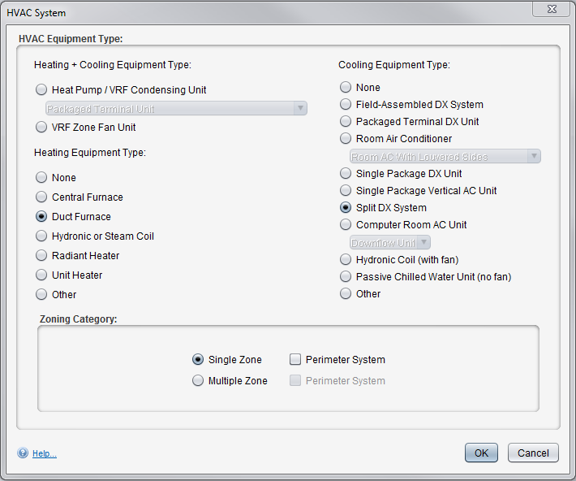

Mechanical Systems
Example of a typical duct furnace and split system
Notes:
Mechanical works differently because most of the mechanical requirements are mandatory.
The characteristics you enter enable the software to exclude large numbers of requirements that don’t apply to your systems.
HVAC system refers to secondary HVAC systems, including controls, fans, terminal boxes, radiators, coils, and package HVAC equipment, not primary HVAC system components such as boilers, chillers, cooling towers, and pumps. The characteristics you select determine which requirements apply. Some of the inputs are interdependent.
Plant refers to primary HVAC components, such as boilers, chillers, cooling towers, and pumps.
Water heating – the selection (or deselection) of the checkboxes in this section determines which water heating requirements apply to your building.

Slide 49

Mechanical: Fan Systems
Determines Fan Power Limitations compliance for each fan system
Motor nameplate HP and brake HP
  Brake HP includes pressure drop credits as applicable
Notes:
Applicable only to the desktop version as of March 2013

Slide 50

Requirements Tab – Goals
Ensure user is aware of applicable mandatory requirements and addresses each in the software
Provide better documentation for code officials

Slide 51
Requirements Tab – How it Works
For each requirement, the user
  Chooses a “compliance option”
    Requirement will be Met
    Exempt or Exceptions
    Requirement is Not Applicable or Requirement Does Not Apply
  Notes how compliance for applicable requirements are documented
This information is shown on the report in the “Comments/ Assumptions” column of the Inspection Checklist

Slide 52
Reports
File View / Print Report
Choices, choose any or all
  Envelope Compliance Certificate
  Interior Lighting Compliance Certificate
  Exterior Lighting Compliance Certificate
  Mechanical Compliance Certificate
First pages are the Compliance Certificate
Follow-on pages are the Inspection Checklists by phase of inspection
  Plan Review
  Footing/Foundation
  Rough-in
  Final

Slide 53

Report – Compliance Certificate

Slide 54


Reports – Compliance Certificate (cont)
Verify energy code, location, and construction type specifications

Slide 55


Reports – Compliance Certificate (cont)
Verify area, insulation R-values, and U-factors consistent with plans
Verify Compliance Statement is Signed

Slide 56



Reports – Inspection Checklist

Slide 57
www.energycodes.gov

Slide 58

COMcheck Page

Slide 59





U.S. DOE: BECP Resources
Compliance software
Technical support
Code notes
Publications
Resource guides
Training materials www.energycodes.gov

Slide 60
THANK YOU!
Building Energy Codes Program
www.energycodes.gov
BECP help desk
http://www.energycodes.gov/resource-center/help-desk

