Slide 1
Energy Codes 101
Rose Bartlett
bob schultz
2019 Department of Energy National Energy Codes Conference
Building Energy Codes Program
May 28, 2019
Notes:
PNNL develops and supports the CheckTools suite of software
Residential projects – REScheck
Commercial projects - COMcheck
Why do we do this?
Compliance: Provide technical assistance to states to implement building energy codes including increasing and verifying compliance to ensure consumer benefits (42 USC 6833), develop software to support a streamlined compliance process, provide objective information resources and technical guidance to states and localities to increase code compliance.

Slide 2

Code Benefits
Cumulative 2010-2040
Reduced energy consumption
Reduced CO₂ emissions
12.82 quads primary energy
841 MMT
Rising cost savings
$126B
www.energycodes.gov/sites/default/files/documents/Impacts_Of_Model_Energy_Codes.pdf
Notes:
Building energy codes set minimum efficiency boundaries that bring about vital, tangible benefits.

Slide 3
Major Players
ASHRAE (American Society of Heating, Refrigerating and Air-Conditioning Engineers)
ICC (International Code Council)
Jurisdictions
From DOE’s perspective, the model / baseline codes are
  ASHRAE 90.1 for Commercial
  ICC IECC for Residential

Slide 4
DOE’s Role
DOE is directed by statute to participate in industry processes to
  Develop model building energy codes
  Issue determinations as to whether updated codes result in energy savings
  Provide technical assistance to states to implement and comply with the codes
For specific statutory language, visit
  https://www.energycodes.gov/about/statutory-requirements

Slide 5

DOE’s Support
Code development and adoption
  Research
  Technical analyses
  Supporting industry processes which review and update model codes
Implementation and compliance
  Customized technical analyses
  Software tools
  Education and training materials
  Technical support through a help desk

Slide 6
DOE Determinations
DOE is required by law (the Energy Conservation and Production Act, as amended (ECPA)) to issue a determination as to whether
    the latest edition of ASHRAE Standard 90.1 (for commercial and multi-family high-rise residential buildings) or
    the latest version of the International Energy Conservation Code (for low-rise residential buildings)
  will improve energy efficiency compared to the previous edition of the corresponding standard or code.
  DOE has one year to publish a determination in the Federal Register after each new edition of the standard/code is published

Slide 7


Building Energy Codes
ASHRAE Standard 90.1
International Energy
Conservation Code
State and Locally
Adopted Codes
Notes:
When people speak in general about Building Energy Codes, they may be referring to:
ASHRAE Standard 90.1 Standards
The International Energy Conservations Code, or IECC
State and locally adopted codes.

Slide 8
IECC
Two sets of provisions
  Commercial
  Residential (three stories or less in height above grade)
Each set of provisions is treated separately
References 90.1 as an alternate approach for
commercial
  Must be used in its entirety

Slide 9

What Do Building Energy Codes and Standards Cover?
For both residential and commercial:
  Building Envelope
  Mechanical
  Service Water Heating
  Lighting
  Electrical Power
Notes:
Building energy codes are minimum requirements for energy-efficient design and construction for new and renovated residential and commercial buildings. Using them doesn’t necessarily equal (what some refer to as) “green” building. Building energy codes are a solid baseline of requirements—but they do set the standard by which “above-code” efforts are defined.
So, what specific parts of buildings do they cover?
Simply put, they apply to a building’s envelope (the materials that make up its outer shell) as well as its systems and built-in equipment. These will be described in more detail later in this presentation.
The life cycle of a building is decades or even centuries long. As minimum requirements in these vital areas, when codes are improved, future generations will receive more efficient and less costly living and working environments.

Slide 10
Residential vs. Commercial
Residential codes are typically less complex than commercial
Commercial buildings usually have more systems
  More requirements for lighting, including daylighting and controls
  Detailed control requirements for mechanical systems
  Etc.

Slide 11




Energy Codes & Standards History – Ancient
Residential Codes
86 MEC
93 MEC
98 IECC
77 MCEC
83 MEC
89 MEC
92 MEC
95 MEC
00 IECC
90-
1975
90A-
1980
90.1-
1989
Codified 90.1-1989
Commercial Standards
Federal
10 CFR 435 (FEDCOM)
10 CFR 435 Subpart E (COSTSAFR)
FEDRES
Notes:
11
Legend: boxes highlighted in yellow are residential only; boxes highlighted in maroon are commercial only
The 92 MEC allowed 90.1-1989 for commercial.
The 93 MEC specifically references 90.1-1989.
The 95 MEC changes the ASHRAE reference to the 1993 codified version.
In 1998, the change is made to the IECC, and a new commercial chapter is added as a simplified approach limited to low-rise commercial buildings with “simple” mechanical systems.
90.1-1999 is a complete revision to the previous version and is written in mandatory, enforceable language.
The 2000 IECC commercial chapter was broadened to include ALL commercial buildings.
The 2001 IECC changes the ASHRAE reference to 90.1-1999.
90.1-2001 includes addenda
2003 IECC changes the ASHRAE reference to 90.1-2001.
90-1975 “Energy Conservation in New Building Design” was the first to comprehensively address the design and construction of new buildings from an energy standpoint.
The 83, 86, and 89 MEC are based largely on 90A-1980.
90.2-1993 is a complete revision of 90A-1980 for low-rise residential buildings.
The 2000 IECC added a residential prescriptive compliance approach.
90.2-2001 revises 90.2-1993 and includes a number of addenda.

Slide 12
Energy Codes & Standards History – Modern
Residential Codes
2012
IECC
2015
IECC
2003
IECC
2006
IECC
2009
IECC
2018
IECC
90.1-
1999
90.1-
2001
90.1-
2004
90.1-
2007
90.1-
2010
90.1-
2013
90.1-
2016
Commercial Standards
Federal
10 CFR 433 – Commercial and High-Rise Multi-Family Residential (all versions of Standard 90.1 starting with 2004)
10 CFR 434
10 CFR 435 Subpart A – Low Rise Residential (all versions of the IECC starting with 2004)
Notes:
12
Legend: boxes highlighted in yellow are residential only; boxes highlighted in maroon are commercial only
Note that 10 CFR 435 started with the 2004 Supplement to the 2003 IECC. The 2004 is not a typo. Note also that the slide does not show linkage between the IECC or Standard 90.1 and the Federal standards as the connection is much more complex that can be shown in this slide.
The 92 MEC allowed 90.1-1989 for commercial.
The 93 MEC specifically references 90.1-1989.
The 95 MEC changes the ASHRAE reference to the 1993 codified version.
In 1998, the change is made to the IECC, and a new commercial chapter is added as a simplified approach limited to low-rise commercial buildings with “simple” mechanical systems.
90.1-1999 is a complete revision to the previous version and is written in mandatory, enforceable language.
The 2000 IECC commercial chapter was broadened to include ALL commercial buildings.
The 2001 IECC changes the ASHRAE reference to 90.1-1999.
90.1-2001 includes addenda
2003 IECC changes the ASHRAE reference to 90.1-2001.
90-1975 “Energy Conservation in New Building Design” was the first to comprehensively address the design and construction of new buildings from an energy standpoint.
The 83, 86, and 89 MEC are based largely on 90A-1980.
90.2-1993 is a complete revision of 90A-1980 for low-rise residential buildings.
The 2000 IECC added a residential prescriptive compliance approach.
90.2-2001 revises 90.2-1993 and includes a number of addenda.

Slide 13
Three Main Aspects
Development
Adoption
Compliance

Slide 14
Code Development
ASHRAE 90.1
  Uses the American National Standards Institute (ANSI) consensus process
  90.1 project committee and subcommittees
  All interested parties can participate
  Final vote of the project committee
    Includes members from a balance of all interests
ICC IECC
  Uses a government consensus process
    All interested parties can participate
    Final vote is online governmental consensus vote
  https://www.iccsafe.org/codes-tech-support/code-development-process/

Slide 15

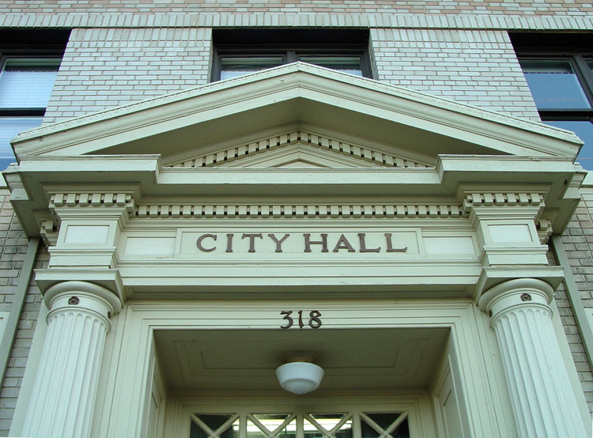
Energy Code Adoption
Can occur at the state or
local level in one of two ways:
directly through legislative
action (state level)
by regulatory action through
state or local agencies.
https://cdn-web.iccsafe.org/wp-content/uploads/Code-Adoption-Process-by-State-NOV.pdf
Notes:
Once building energy codes are developed, they are merely books on the shelf until governing bodies adopt (and sometimes adapt) them into laws.
Adoption of energy codes can occur in one of two ways:
Directly through legislative action
By regulatory action through agencies authorized by the legislative body to oversee the development and adoption of codes.
When adoption is accomplished through legislation, a committee may be appointed to provide recommendations and/or draft the legislation.
When adoption occurs through a regulatory process, states and local governments often appoint an advisory body comprising representatives of the design, building construction, and enforcement communities. This advisory panel recommends revisions that should be considered for adoption. In basing their recommendations on model energy codes, the advisory panel considers modifications to the model codes to account for local preferences and construction practices. The panel also may serve as a source of information during the adoption process. Their recommendations then enter a public review process.

Slide 16
Adoption Date vs. Effective Date
Usually these dates are different
Sometimes a grace period is allowed where the predecessor code can be used
  Because buildings may be in different stages of design or construction
  Stakeholders need time to learn the new code
  Manufacturers may need time to provide products
Effective date is sometime tied to publication date of a model energy code.

Slide 17
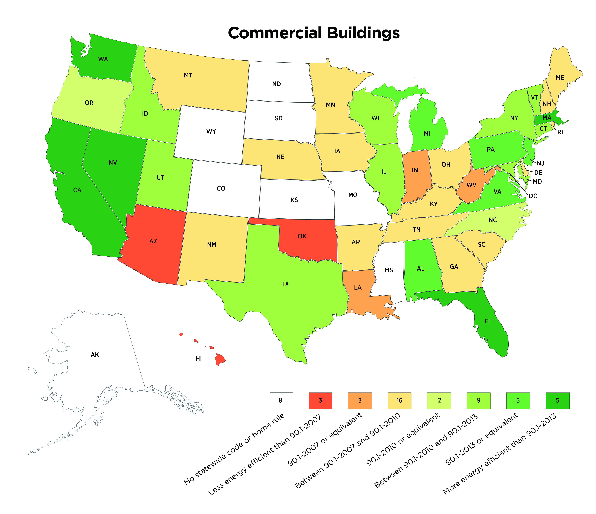
Current State Adoption Status - Commercial

Slide 18
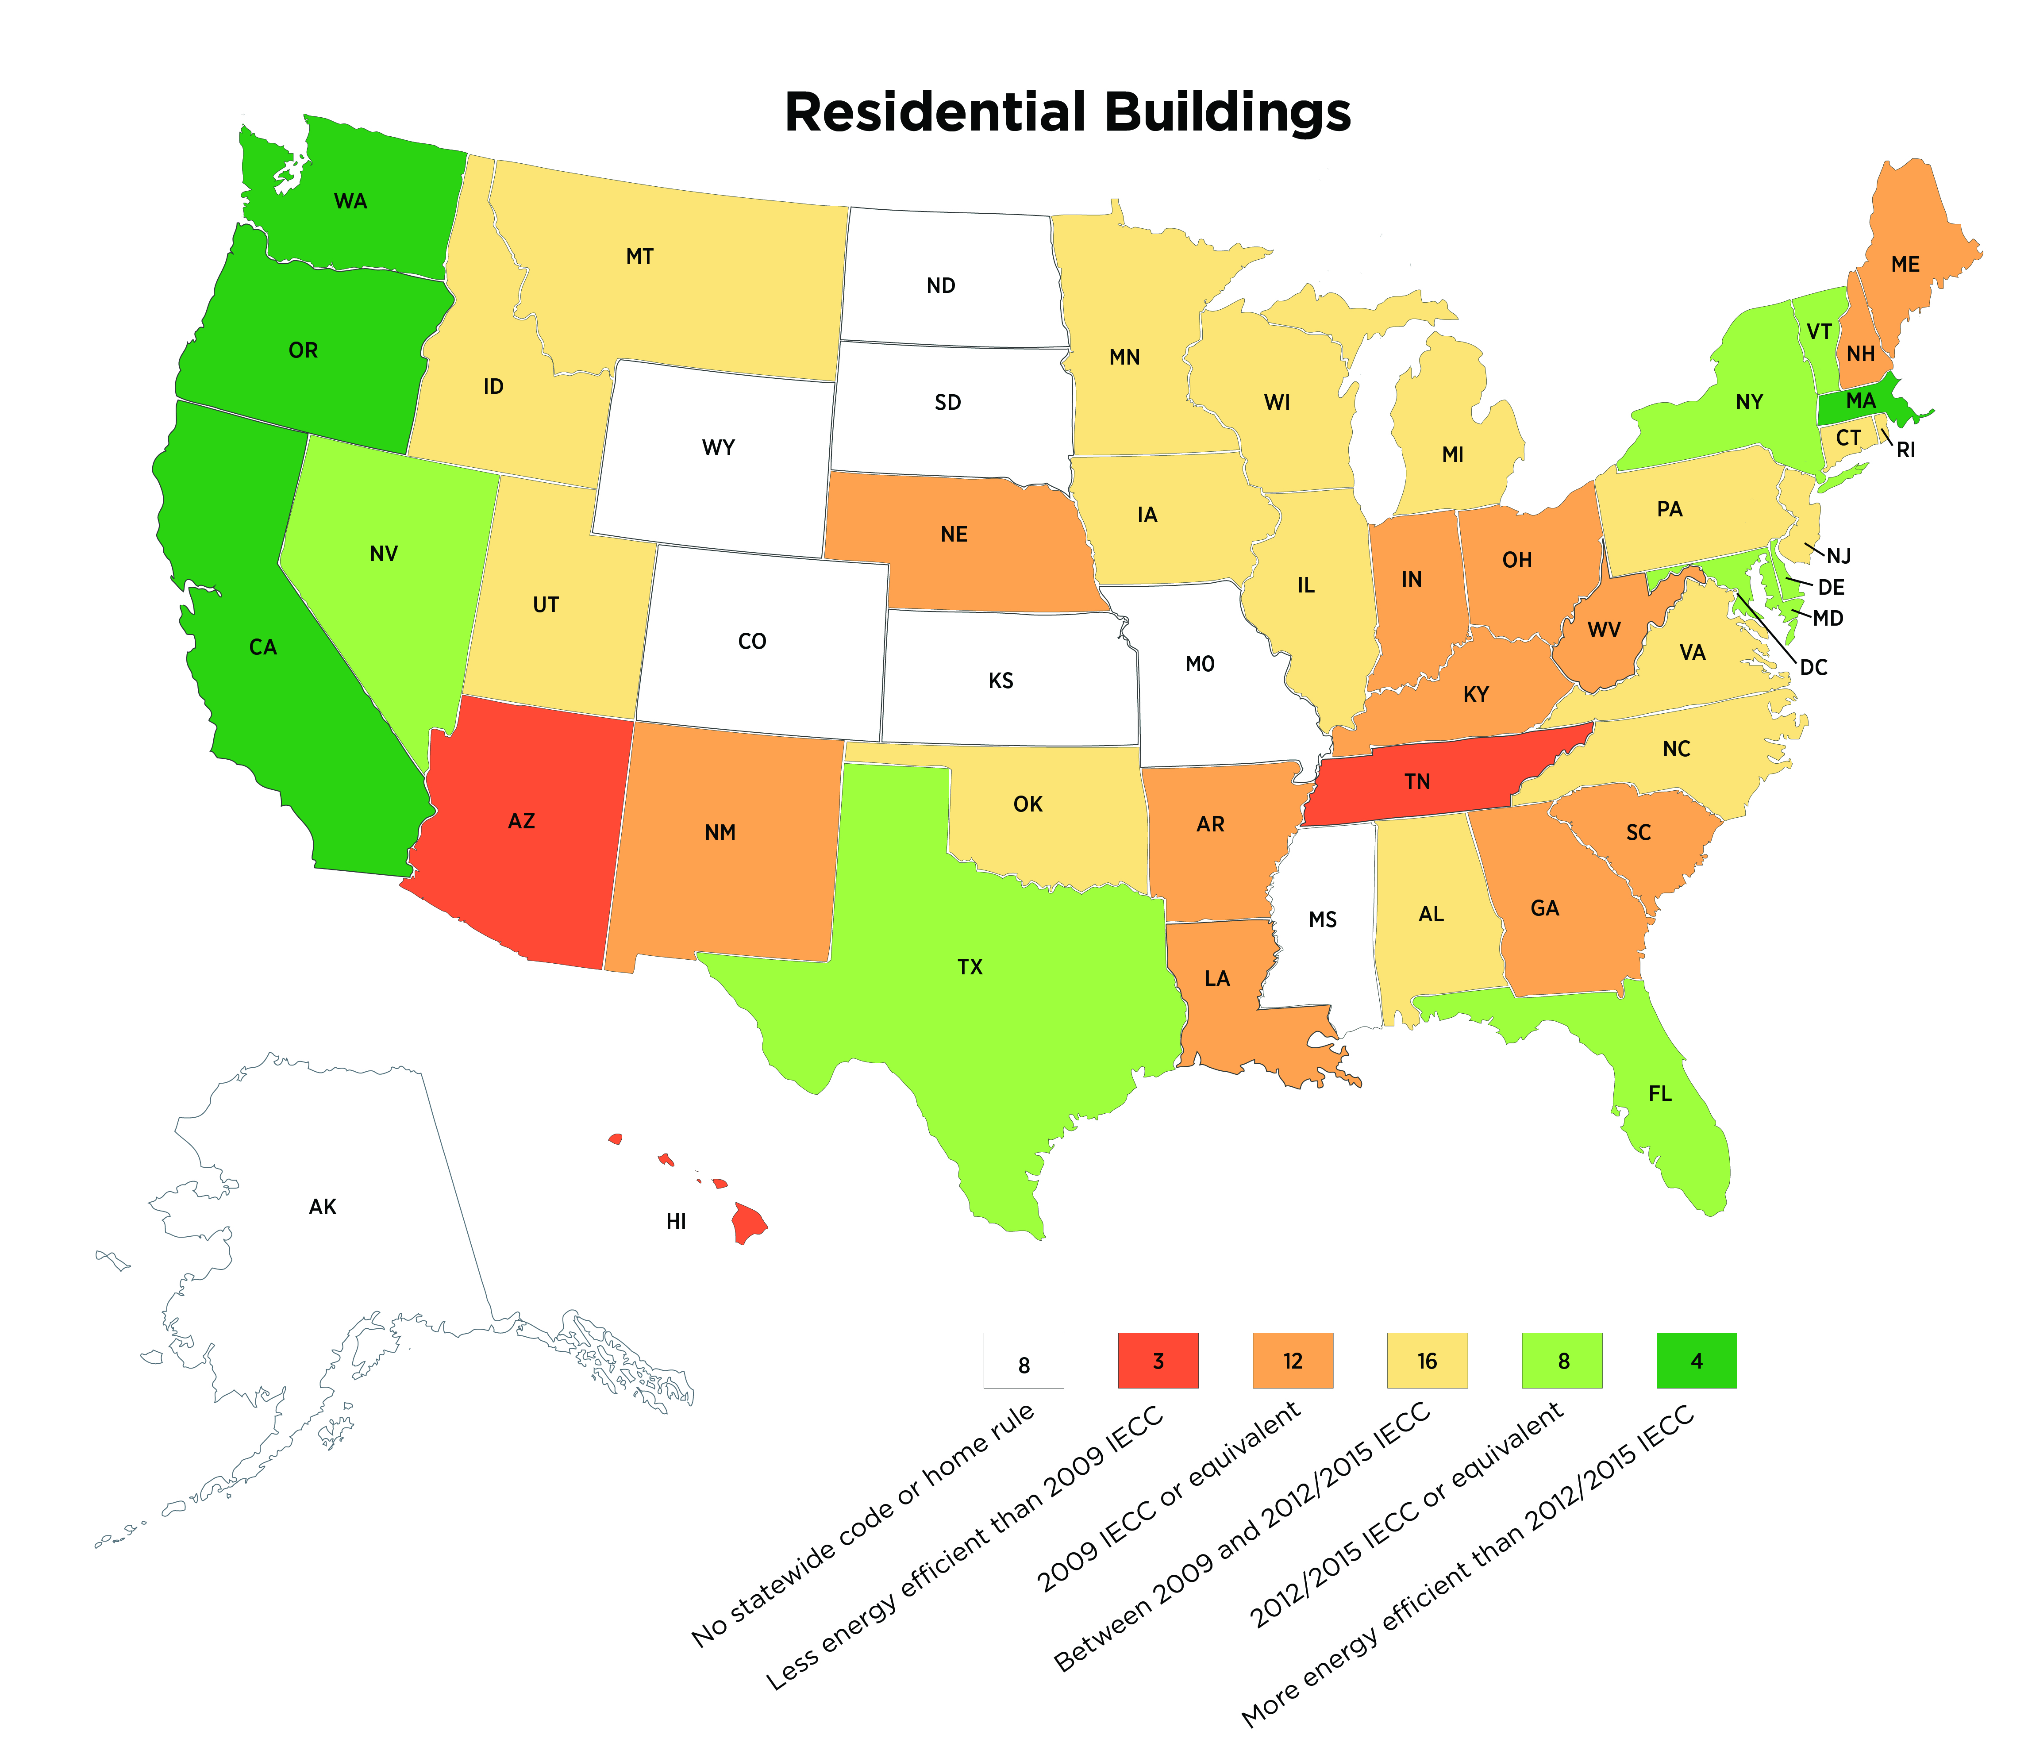
Current State Adoption Status - Residential

Slide 19

Energy Code Enforcement and Compliance
Enforcement, or making sure that a building is in compliance
with an energy code, is the last step in the building process.
Notes:
In this training, we’ve followed the basic life cycle of building energy codes, from their very inception in public forums to their adoption by jurisdictions and application in the building industry. The final stage—implementation by designers and the building industry, and enforcement by the adopters —is absolutely vital.
After all, if energy codes don’t truly guide on-the-ground practices, their corresponding energy savings and environmental benefits are not realized.
‘Enforcement’ simply means ‘making sure that a building is in compliance with an energy code’ and is the last step in the building process.
The responsibility to enforce building energy codes falls upon states or jurisdictions, and the responsibility to comply with the building energy code falls on developers, designers, and contractors. Education and communication regarding energy codes are vital to the effective delivery of both enforcement and compliance.
Let’s examine the basics of energy code enforcement strategies.

Slide 20
Energy Code Compliance
The key to realizing the full benefits associated with building energy codes is through compliance verification.
Materials and tools to help the building industry achieve, document and verify compliance with energy codes.
Methodologies and tools (and funding) to help state and local jurisdictions measure and report energy code compliance.
  http://www.energycodes.gov/compliance

Slide 21


REScheck™
DOE’s residential compliance software
Desktop Software Tools
Web-Based Tools
No-cost, easy-to-use software
that will demonstrate compliance.
https://www.energycodes.gov/software-and-web-tools
Notes:
DOE’s easy-to-use code residential compliance software, REScheck, along with associated training and support resources, is available for download at no cost at www.energycodes.gov/
Software programs such as REScheck™ and COMcheck™ are helpful tools for end-users of codes to determine whether a building or renovation is in compliance. The user inputs building component areas, efficiencies, and other specifications to generate a compliance report. The software allows flexibility and trade-offs between components. For example, a designer may choose to include a greater glass area on a particular wall for a view corridor, and compensate by increasing insulation levels elsewhere.

Slide 22


COMcheck™
DOE’s commercial compliance software
Desktop Software Tools
Web-Based Tools
No-cost, easy-to-use software
that will demonstrate compliance.
https://www.energycodes.gov/software-and-web-tools
Notes:
DOE’s easy-to-use code commercial compliance software, COMcheck, along with associated training and support resources, is also available for download at no cost at www.energycodes.gov/

Slide 23
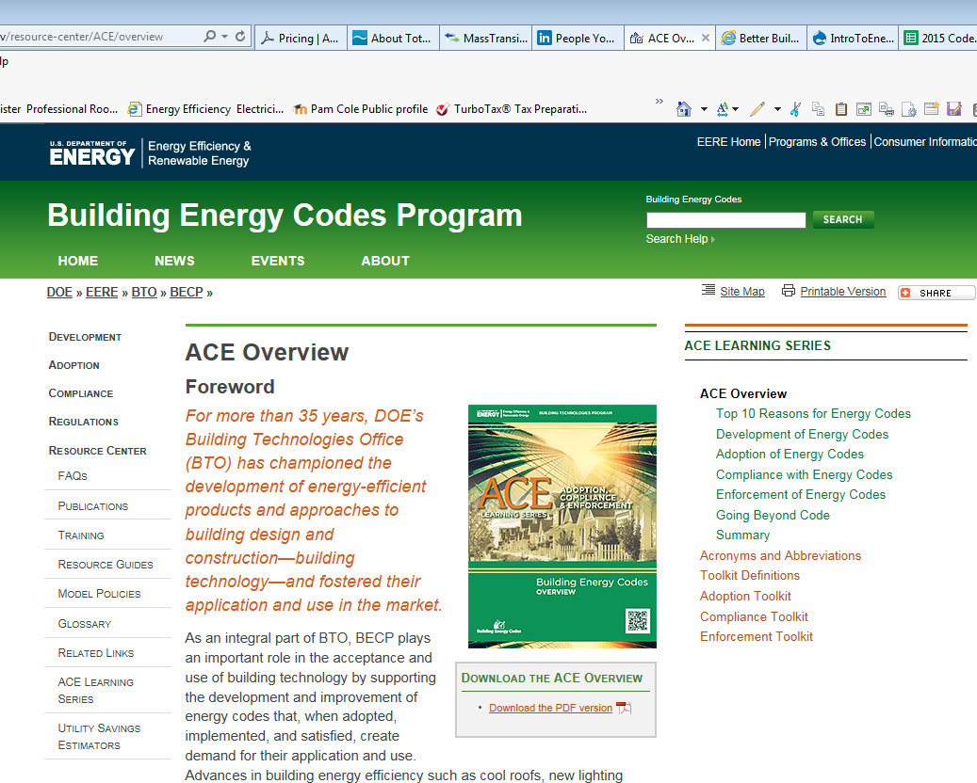
Energy Codes Website
Additional resources, including:
ACE Learning Series
Software Compliance tools
Code Notes
Technical Assistance to Users
Training Materials
www.energycodes.gov
PNNL-SA-72577
Notes:
Thank you for learning the basics of building energy codes!
Please don’t hesitate to present this information to interested parties. For more resources, continue to visit BECP’s website at www.energycodes.gov.

Slide 24
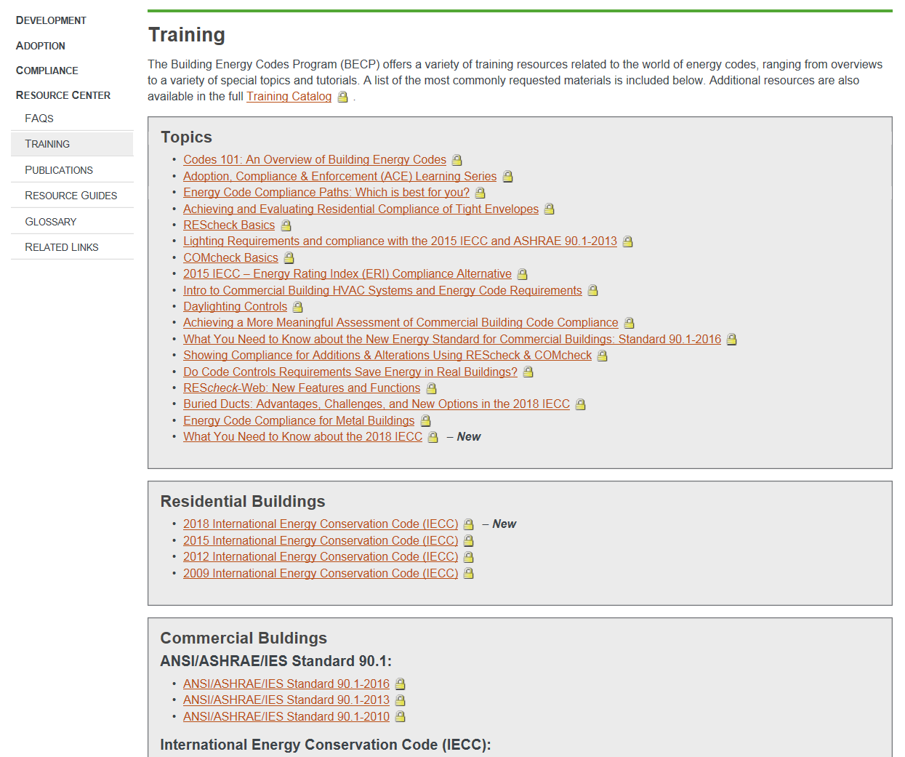
Energy Codes Website: Training materials

Slide 25
THANK YOU!
Rose Bartlett
rose.bartlett@pnnl.gov
Bob Schultz
robert.schultz@pnnl.gov
Building Energy Codes Program
www.energycodes.gov
PNNL-SA-143542

