Slide 1
REScheck Basics
bob schultz
2019 Department of Energy National Energy Codes Conference
Building Energy Codes Program
May 28, 2019
PNNL-SA-143556
Notes:
PNNL develops and supports the CheckTools suite of software
Residential projects – REScheck
Commercial projects - COMcheck
Why do we do this?
Compliance: Provide technical assistance to states to implement building energy codes including increasing and verifying compliance to ensure consumer benefits (42 USC 6833), develop software to support a streamlined compliance process, provide objective information resources and technical guidance to states and localities to increase code compliance.

Slide 2





CheckTools Current Use Scenario
Demonstrate Compliance
Collect Data
Check Compliance
Plan Review
Review Software Input
Review Mandatory Requirements
Field Inspection
Verify compliance of inspection checklist items
Prepare Input
Generate Compliance Report
Check Compliance Results
Approve compliance
Paper/PDF
Paper/PDF
Builder
Architect Designer
Plan Reviewer
Field Inspector
BECP Tools used only during “Demonstrate Compliance” Stage

Slide 3
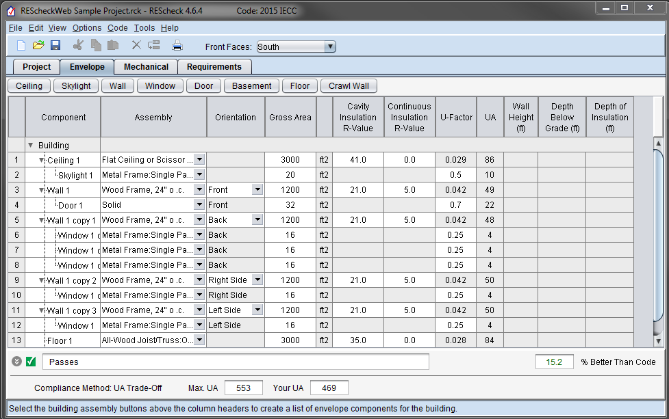
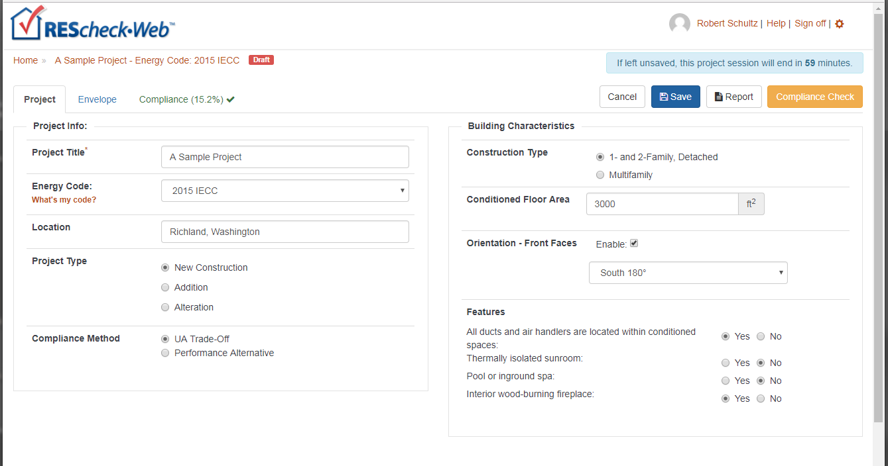
REScheck
“Desktop”
Web

Slide 4
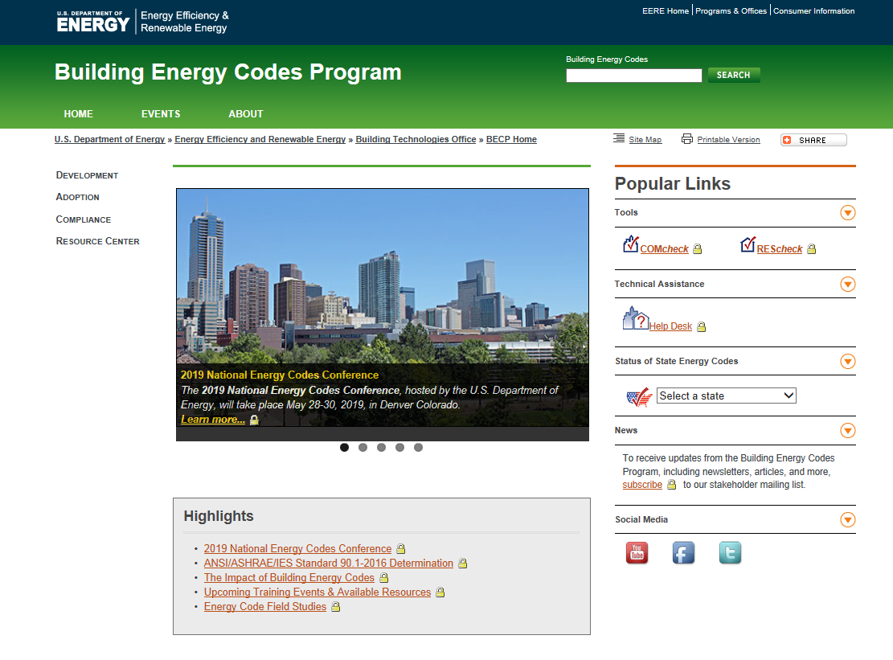
www.energycodes.gov

Slide 5
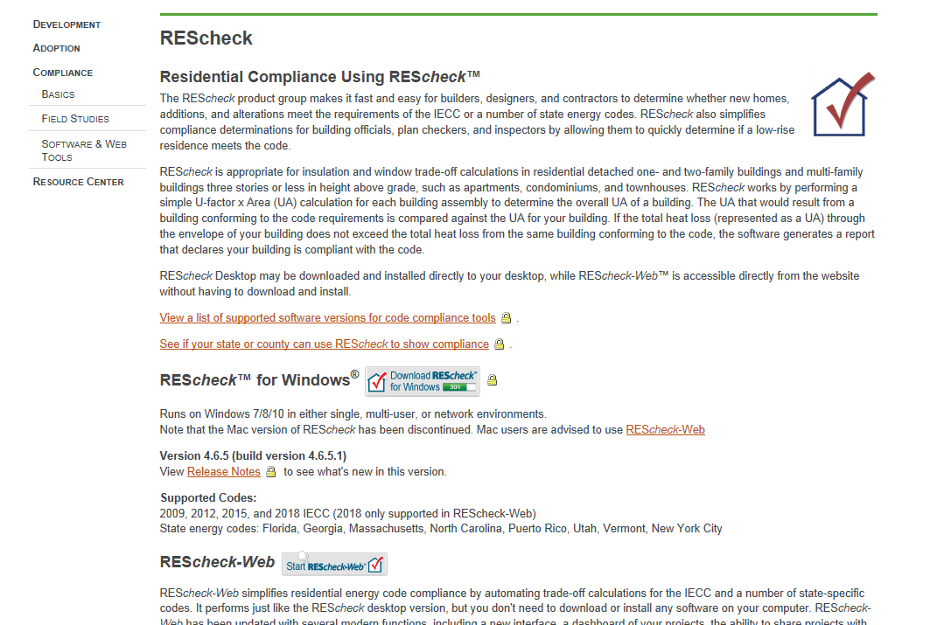
REScheck Page
https://www.energycodes.gov/rescheck

Slide 6




REScheck Supported Energy Codes

Slide 7
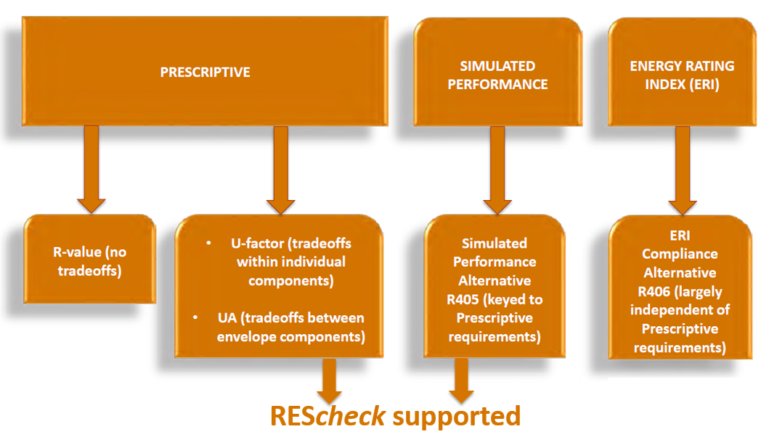
Energy Code Compliance
Notes:
REScheck also supports a limited performance alternative: Envelope trade-offs only.

Slide 8
REScheck Supported Compliance Methods
Total UA
  Considers thermal conductance of envelope assemblies
  “Trades-off” UA from above-code assemblies to below-code assemblies
  UA = U-factor x Area for each building assembly
  Sum UA for Proposed Building compared to SUM UA for Code (Budget) Building
Performance alternative
  Considers the whole building energy performance
  Based on simulated performance of your building compared to an equivalent code building
  Requires additional inputs (over UA approach): building orientation, minimum of four walls having unique orientations, and a minimum of one roof and floor
  Envelope trade-off only, no mechanical equipment trade-off

Slide 9
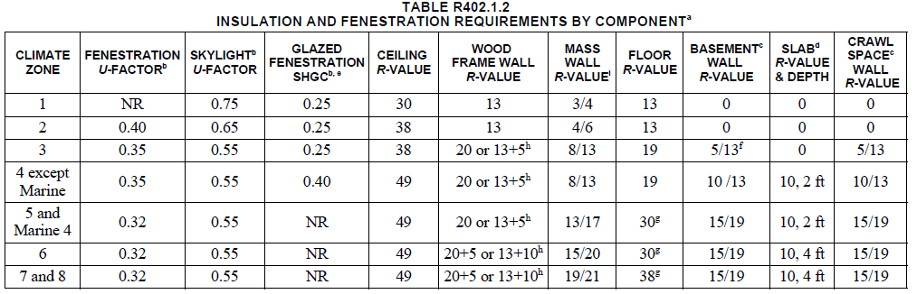
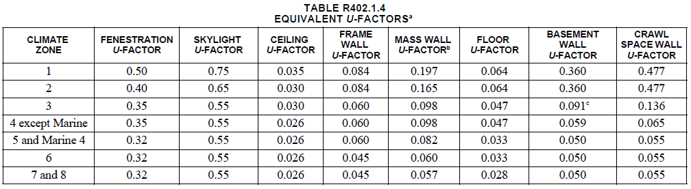
Energy Code Envelope Assembly Requirements
Notes:
Energy code offers two sets of requirements. REScheck applies the U-factor set of requirements for both Total UA and Prescriptive compliance methods.

Slide 10
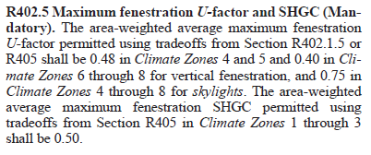
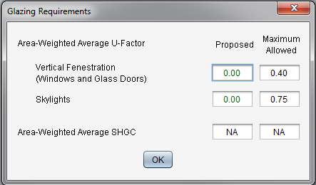
Envelope Mandatory Requirements
(Source: 2018 IECC)
Notes:
Mandatory requirements exist that serve as a “back-stop” to trade-off of fenestration. These requirements will be found in the body of the energy code section as shown here.

Slide 11
Walkthrough REScheck Steps
Select the appropriate code
Enter project information
Enter building components
Enter mechanical equipment (optional)
Review Mandatory Requirements
Reports
View/print/save

Slide 12
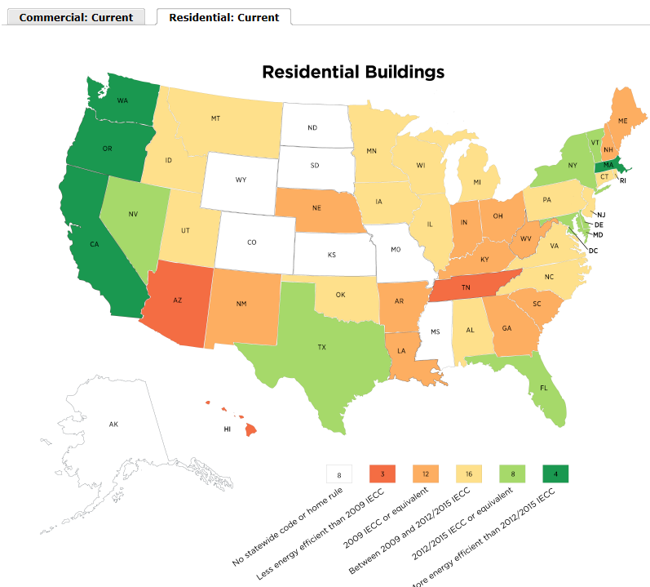
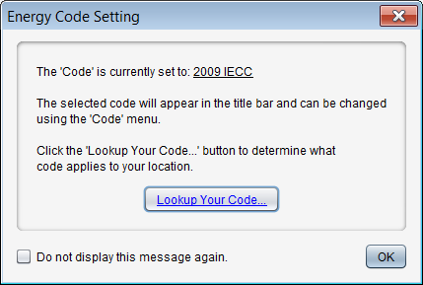
Select the Appropriate Code
Applicable to your state/ jurisdiction (Code menu)

Slide 13
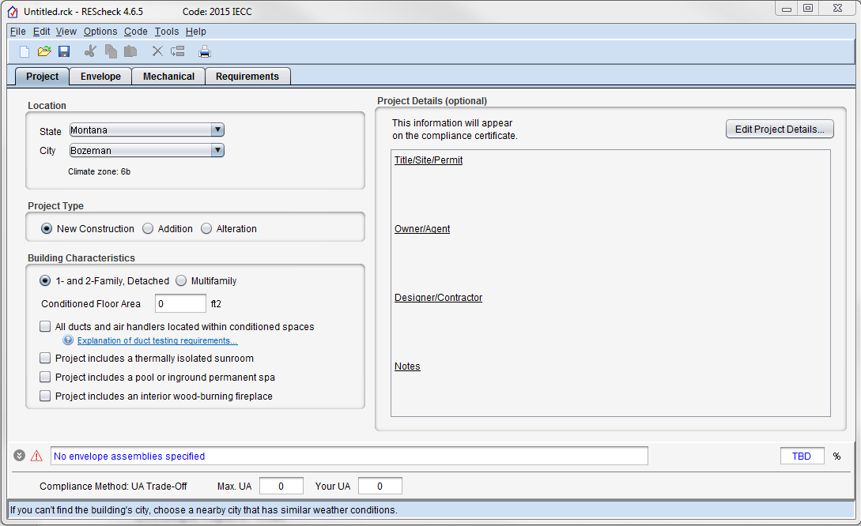
Energy Code, Location, Project Type, Compliance Method
Notes:
Location of project determines climate zone.
Project type and compliance method determines what method is used for determining compliance.
2015/2018 IECC Alternation projects require prescriptive path method be used.
Trade-off compliance approach is used for New Construction and Addition.

Slide 14
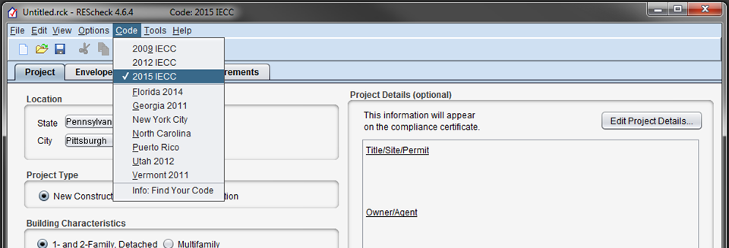
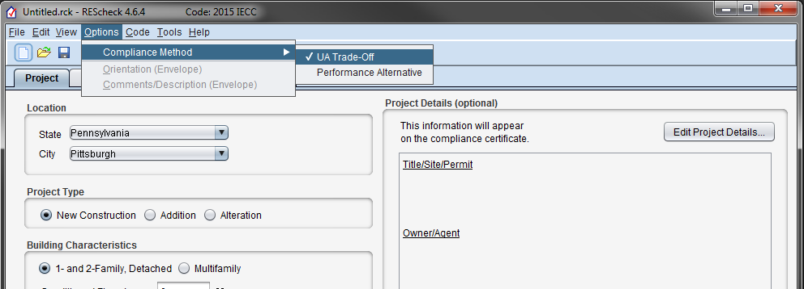
Energy Code and Compliance Method
Notes:
Select Energy Code and Compliance Method from the menu Code and Options, respectively.
Last used selections will be used next time you start REScheck.

Slide 15
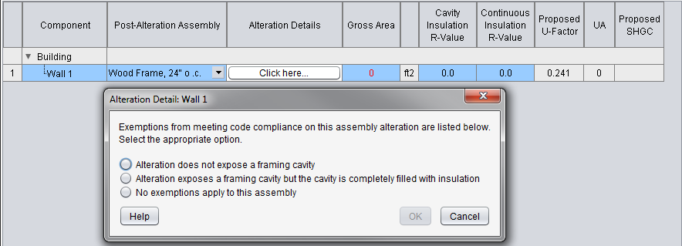
Project Tab: Project Type
Select New Construction, Addition or Alteration on Project screen
  Additions
  User choice:
    Addition only
    Addition plus existing home
  Alterations
    Only include those assemblies being altered
    Exemptions may apply (“Alteration Details”)
Notes:
New = Addition is now separated from Alteration

Slide 16
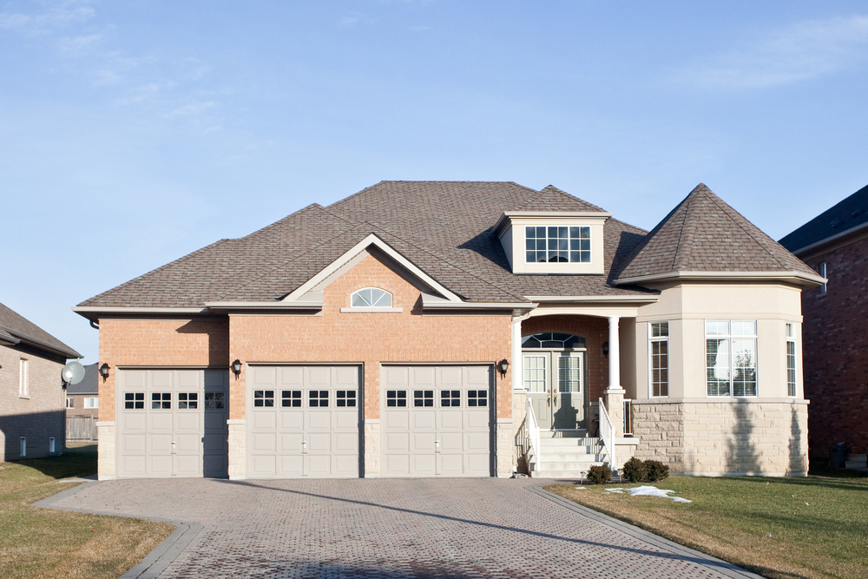
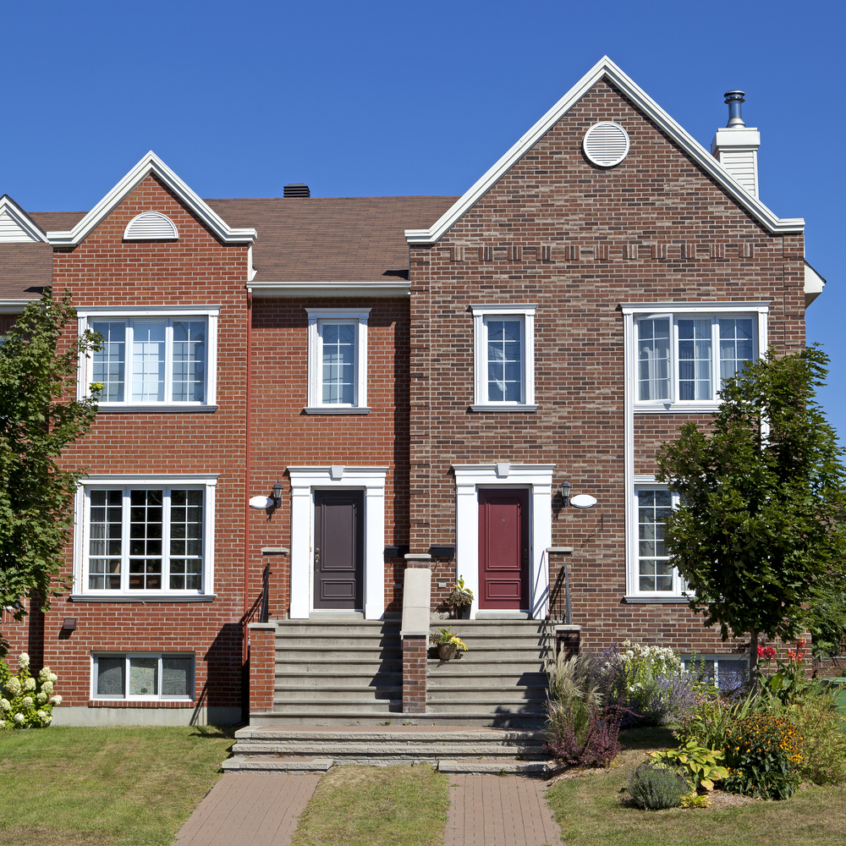

Building Characteristics
1- and 2-Family, Detached
Multifamily

Slide 17

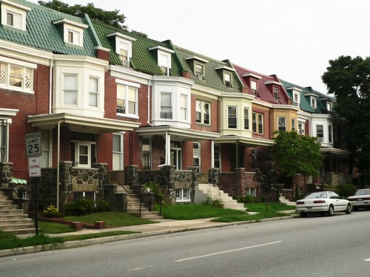
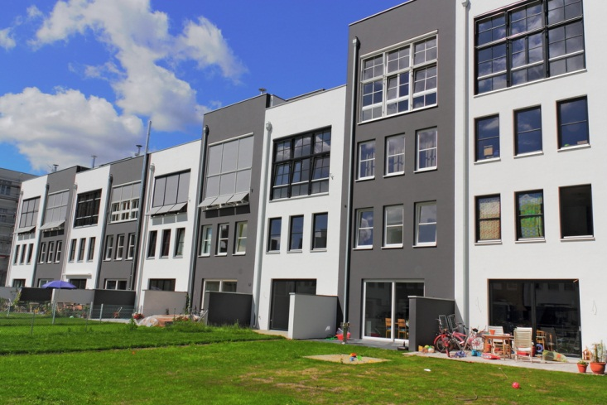
Building Characteristics: Multifamily
Multifamily if
  All multifamily buildings three stories or less in height above grade and
  Contain three or more attached dwelling units
  Examples
    Apartments
    Condominiums
    Townhouses
    Dormitories
    Rowhouses
Notes:
Multifamily buildings can be considered as a whole or separate reports can be generated for each dwelling unit. If compliance is being shown for an individual unit, typically you would not include the shared components that do NOT separate conditioned space from unconditioned space. Where individual units are identical, one report may be submitted as representative of the others. Contact the authority having jurisdiction to determine which approach to take.

Slide 18
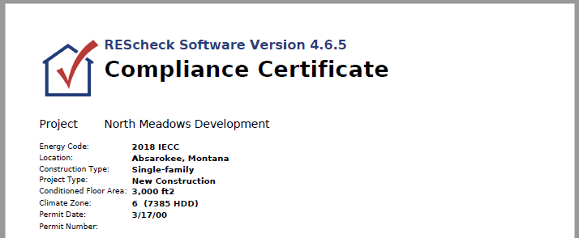
Diagnostic Data on Compliance Certificate
Notes:
Refer to Compliance Certificate report to find important diagnostic details.

Slide 19
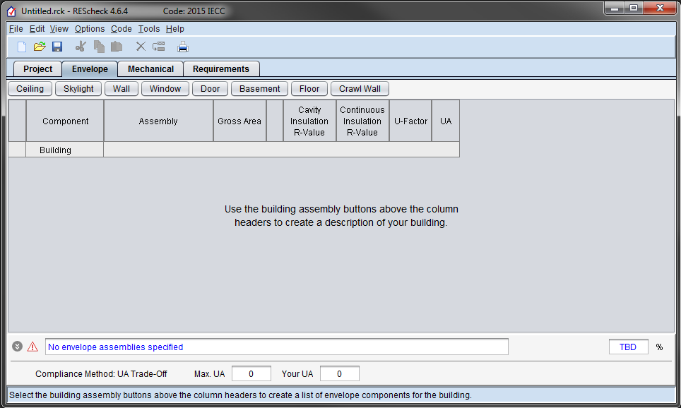
Envelope Tab

Slide 20
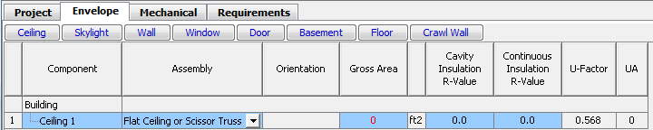
Color Clues
Red
Green
Blue
Notes:
Colors – red usually indicates missing information, errors, or failing compliance;
Colors –green on the screen means a passing condition, in help it means a glossary term;
Colors –blue refers to a lack of data (blue TBD in compliance bar means not enough data has been entered to render a compliance result

Slide 21
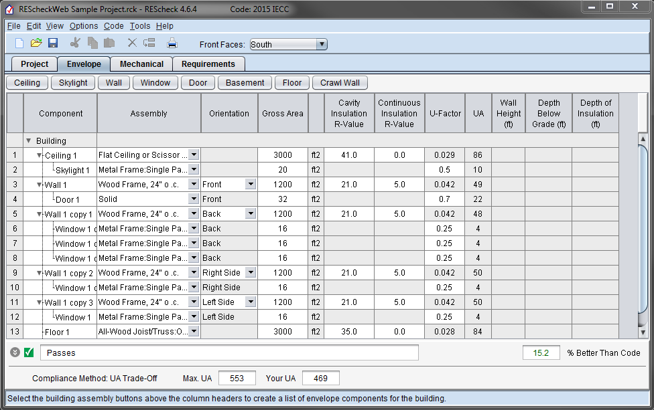
Screen Information
Compliance Bar
Status Bar
Notes:
Status bar explains what type of information goes into the active screen and/or active cell.
Compliance bar shows the compliance results.

Slide 22
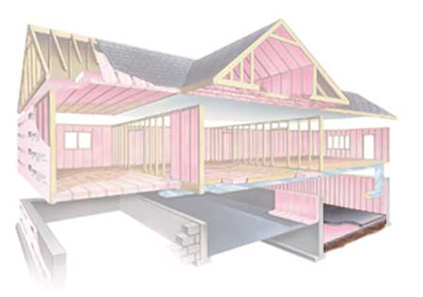
What is the Building Thermal Envelope?
Notes:
Consists of ceiling, walls (above grade and below grade), fenestration, foundation

Slide 23

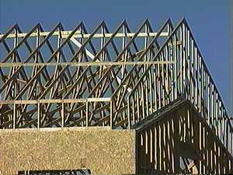
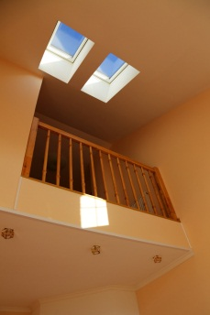
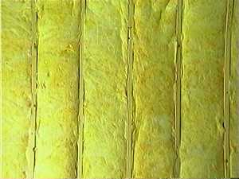
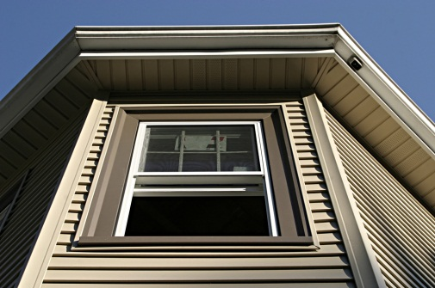

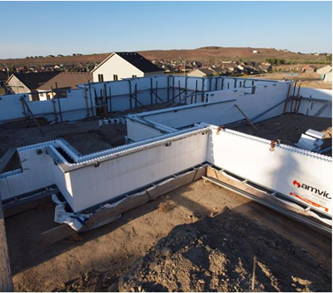
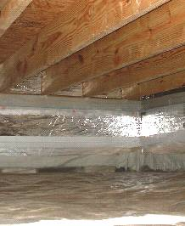
Entering Building Components
Enter only applicable
building components

Slide 24
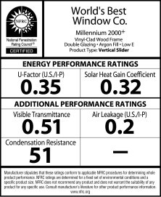
Fenestration: U-Factors and SHGCs

Slide 25
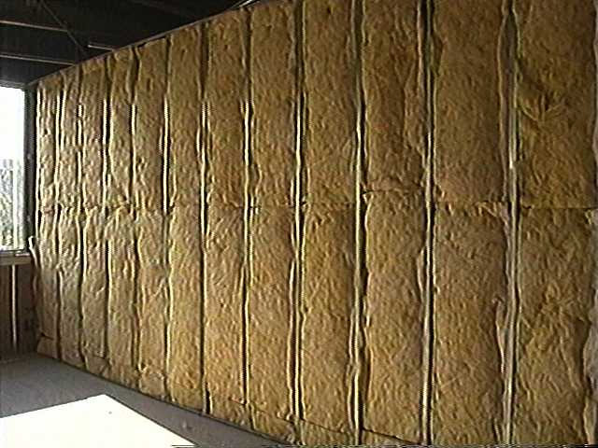
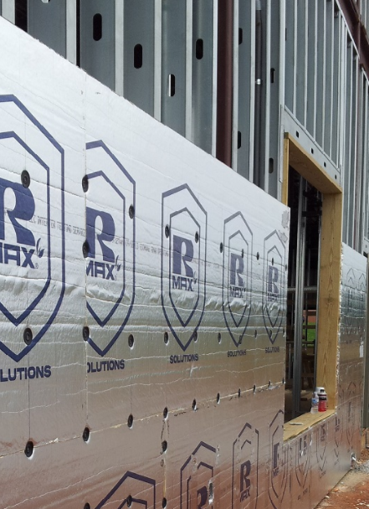
Cavity vs. Continuous
Cavity R-value – used for insulation placed between structural members
Continuous R-value – used for insulation that is continuous across the structure (e.g., rigid insulation)

Slide 26
Foundations – what button to use
Basement
Basement is conditioned
Floor
Separates conditioned from
unconditioned space
Crawl Wall
Crawl space is not vented to the outside and floor above is NOT insulated
Notes:
Slab-on-grade is a type of floor. Slabs require input of perimeter of the slab component in linear feet. Slabs include all slab edges that are part of the building envelope and are less than 12” below grade. Edges of slab floors over 12” below grade (such as basement floors) aren’t subject to code requirements and shouldn’t be entered into the software.

Slide 27
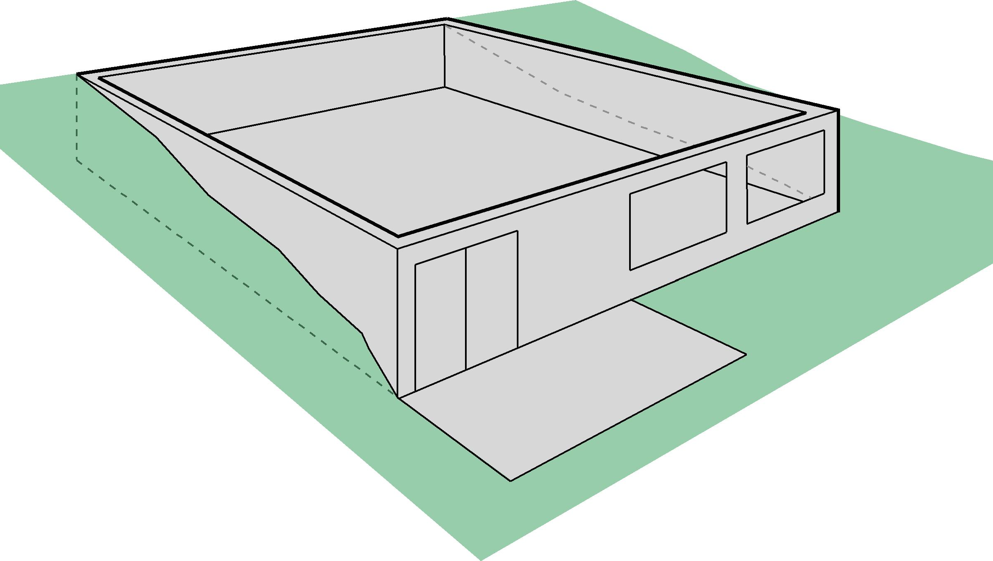
What’s a Basement Wall?
Basement Wall –
>50% below grade
Below grade
Basement wall
Below grade
Basement wall
Exterior Wall –
<50% below grade

Slide 28
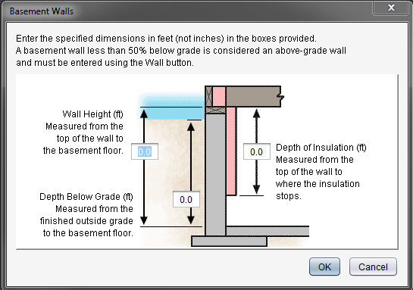
Basement Wall
Wall Height: If not uniform, provide an average height
Depth Below Grade: If sloped or uneven, provide an average depth below grade
Depth of Insulation
  Requirements are for full depth of basement wall (to 10 ft); REScheck allows trade offs
  If you enter insulation depth of 0, program assumes no insulation, regardless of values in the insulation fields
Continuous Insulation: Software assumes it’s exterior rigid
Cavity Insulation: Software assumes you’re furring out on the interior

Slide 29
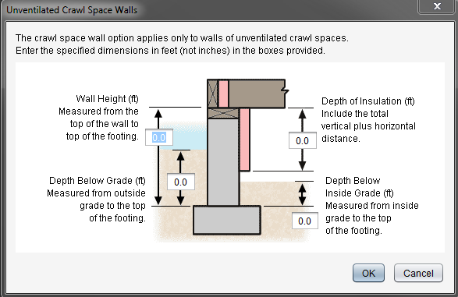
Crawl Wall

Slide 30
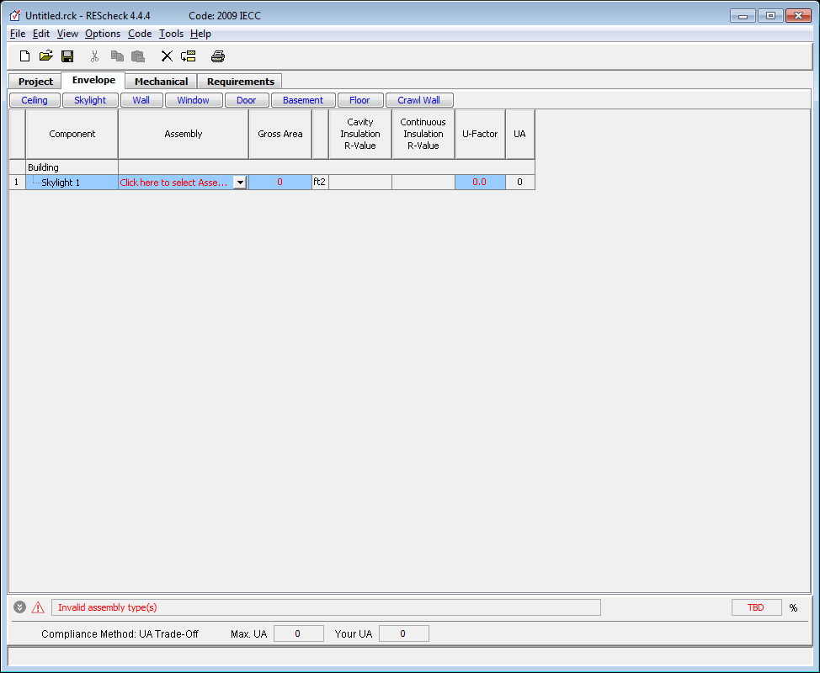
Envelope Helpful Hints
Don’t have to use every button
Can group “like” components
Gross area (except slab-on-grade)
  Gross wall area to include peripheral edges of floors (area of band joist and subfloor between floors)
Use “Other” assembly as needed
Notes:
Use of “other” requires a U-factor of the entire assembly, not just the insulation R-value. Documentation of the calculated assembly U-factor must be provided to the local jurisdiction.

Slide 31
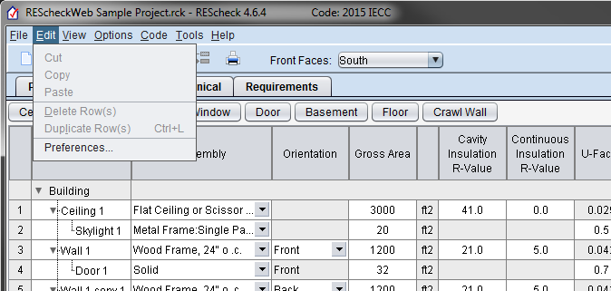
Preferences
General
File options
Version update check
Project
Code/location
Envelope
Applicant
Project details
Reports
Signatures
Upload usage data
Email reports
Notes:
Will demo this slide in realtime.

Slide 32

Compliance Failing – Helpful Hints
Review building plans to ensure all components are entered correctly
Confirm takeoffs (areas) are correct
Confirm insulation values
  Double check cavity vs. continuous entries
Confirm fenestration values
  Double check ratings on windows and doors (U-factor and SHGC)
Compare proposed U-factors with required U-factors
Evaluate UA data

Slide 33
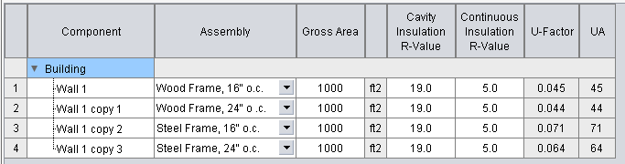
Evaluate Assembly Performance
Notes:
Consider the proposed and required U-factor for envelope assemblies. Note that requirement U-factor is “generalized” to covered a variety of standard construction types.

Slide 34
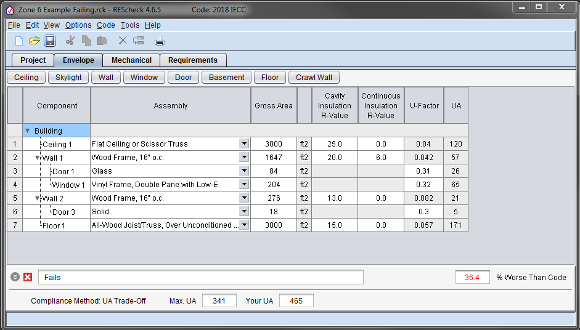
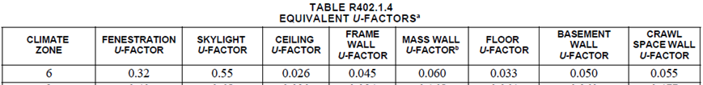
Evaluate Assembly Performance (cont)
Notes:
Look for “heavy hitters” by reviewing “UA” column. This metric incorporates the weight of the U-factor with the area of the assembly.

Slide 35
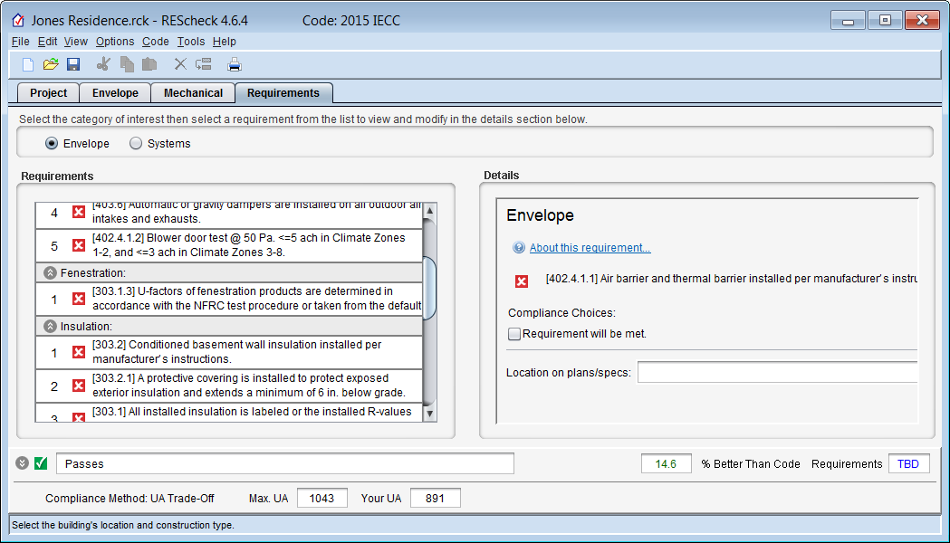
Requirements Tab
Mandatory requirements
  Air leakage
  Building mechanical systems and equipment
  Service water heating
  Duct construction, insulation, testing
For each requirement, the user
  Chooses a “compliance option”
    Requirement will be Met
    Exempt or Exceptions
    Requirement is Not Applicable
  Notes how compliance for applicable requirements are documented
This information is shown on the report in the “Comments/ Assumptions” column of the Inspection Checklist

Slide 36
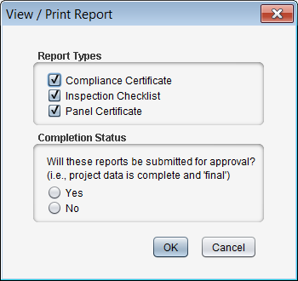
Reports
File View / Print Report
Choices, choose any or all
  Compliance Certificate
  Inspection Checklist
  Panel Certificate

Slide 37
Reports
Implement Requirements tab
Inspection checklists set up by phase of construction
  Plan Review
  Footing/Foundation
  Rough-in
  Final

Slide 38
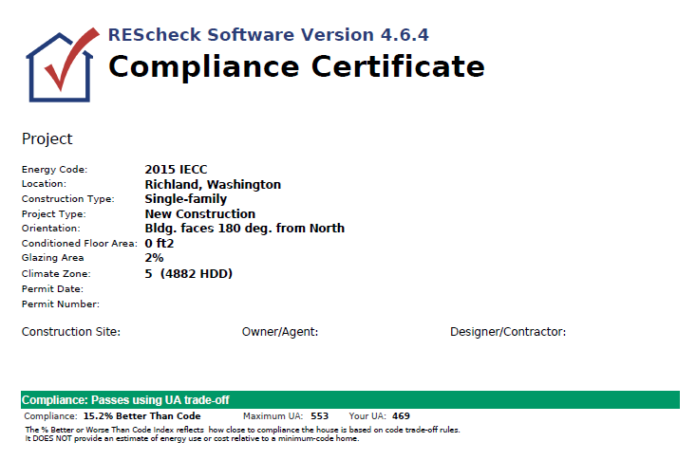
Reports – Sample Compliance Certificate, con’t
Verify energy code, location, construction type, and conditioned floor area

Slide 39
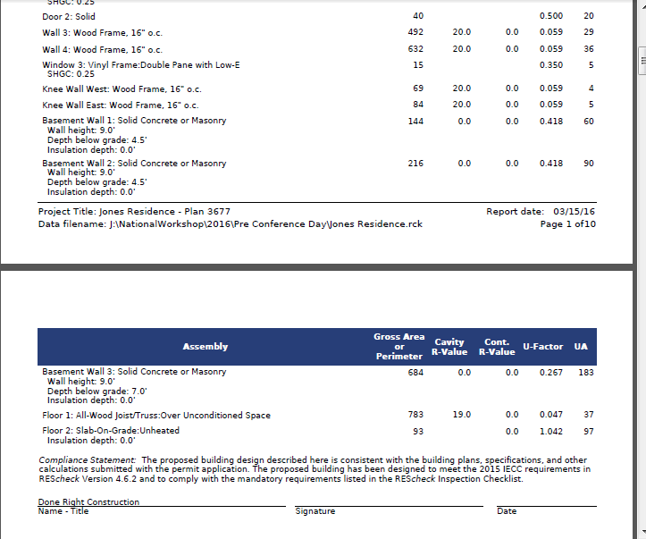
Reports – Sample Compliance Certificate, con’t
Verify Values are Consistent with Plans
Verify Compliance Statement is Signed

Slide 40
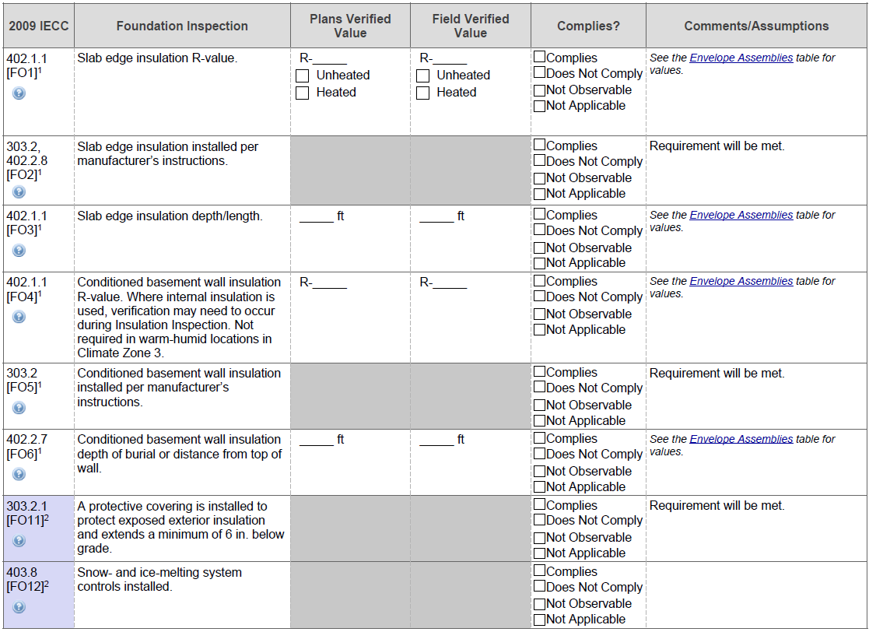
Envelope Sample Inspection Checklist
Notes:
Foundation Inspection

Slide 41
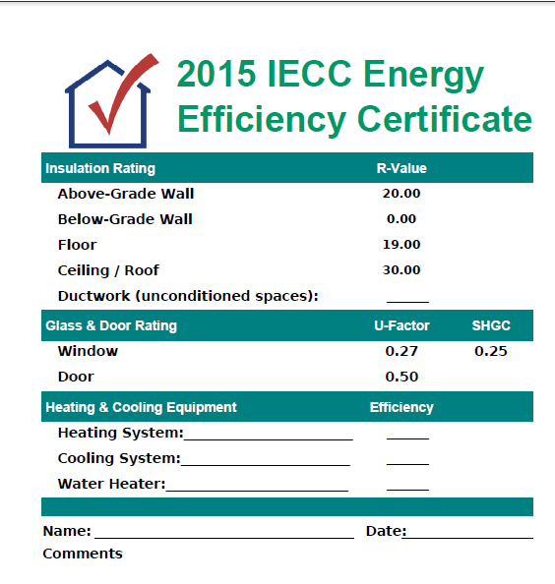
Panel Certificate

Slide 42
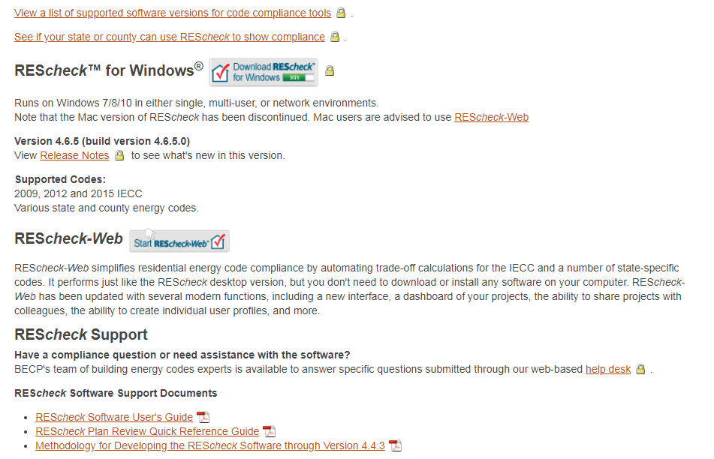
REScheck-Web
https://www.energycodes.gov/rescheck:
Notes:
Users will be required to register from now on.
Once registration is complete, log in credentials can be saved depending on browser and company policy.
All previously saved REScheckWeb projects will be available in the new REScheckWeb.

Slide 43
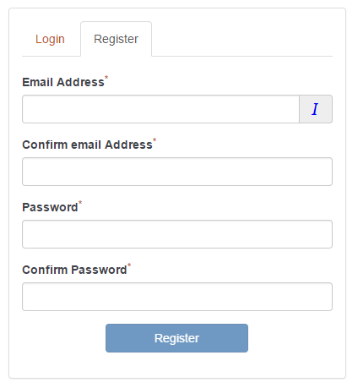
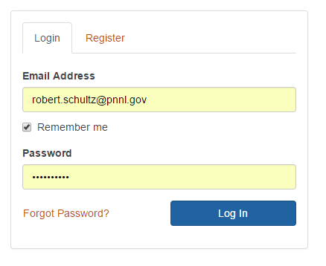
REScheck-Web: Registration and Account Log-In
Notes:
Users will be required to register from now on.
Once registration is complete, log in credentials can be saved depending on browser and company policy.
All previously saved REScheckWeb projects will be available in the new REScheckWeb.

Slide 44

Home: My Projects (aka Project Dashboard)
Notes:
“Home” (aka Project Dashboard) is new and gives users advanced project management capabilities.
Standard table features exists:
Sort columns in ascending/descending order by alternately clicking on column header.
Modify projects status descriptor to identify projects that are final.
Send out sharing privileges with co-workers.
Bulk process deletion operations.
Specify “My Profile” and “My Settings” features.
Use the “Create Sample Project” button to create an example project to review and study as a tutorial aid.
Right-mouse-click on Project name to see other options specific to projects.

Slide 45

My Profile
Notes:
Add co-workers to your Address Book that you wish to sharing projects with.
Your personal information will accompany share invitation emails.

Slide 46

My Settings
Notes:
My Settings can be used to set default properties to invoke for each new project you create.
Toggle the default project settings on/off to temporarily disable use of defaults.

Slide 47


REScheckWeb Project Sharing

Slide 48


Sharing Projects: Shared Project Invitation
Notes:
Example of a project share email invitation.

Slide 49

Sharing Projects: Email Invitation
Shared project recipient will receive email with invitation to accept the “share”
Notes:
Example of a project share email invitation.

Slide 50

Sharing Projects: Shared Projects
Notes:
Example of project sharing types.

Slide 51

Project Tab: New Project
Notes:
New projects will open in “edit” mode by default.
Existing (previously saved projects) will open in “read-only” mode. Click Edit to allow editing to occur.

Slide 52

Project Location Specification
Notes:
Project location can be specified by typing in a zipcode, city name, county name, and/or state.
In most inputs, a drop-down list will be displayed and populated according to previously entered content while type ahead keystrokes can be matched with those inputs.

Slide 53


Envelope Viewing Option (cont)
Notes:
Multiple viewing options are available including fully collapsing (hiding) category tables, expanding them in part or in fully expanded mode.
This allows for personalizing your display to accommodate data entry and review.

Slide 54

Envelope Full View Example
Notes:
Fully expanded view

Slide 55

Envelope Tab (edit mode)
Notes:
Edit mode displays the time remaining before inactivity will automatically terminate a project edit session.
This is done to limit projects from being left in a locked state unintentionally.
Note the actionable icons on the left side of the assembly row. These include Show/Hide (if child assemblies are specified) icon, edit, copy, and delete. These are only exposed and available while in edit mode.

Slide 56


Envelope Add Wall Example
Notes:
This illustrates how to add an assembly. In this case an above-grade exterior wall is added by clicking the Add button in the Walls category table. The drop-down list from clicking Add will include Wall, Window, and Door. When wall is selected the screen “Add Wall Assembly” is displayed.
The type of wall assembly selected on the left hand side of the screen determine what inputs are presented on the right hand side of the screen.

Slide 57

Envelope Glazing Requirements
Notes:
Example of the Glazing Requirements screen that is displayed when clicking on the hypertext item in the background having the same name.
The requirements displayed are dependent on the energy code and location of the project as well as the set of windows/skylights that are specified.

Slide 58

Basement Wall Screen
Notes:
This is an example of an assembly that has help text and a diagram to assist in construction details specification.

Slide 59

Envelope Show Assembly Details
Notes:
The icon at the far right of each assembly row is “Show more details” feature. It displays all data that were specified in the assembly dialog including those that may not fit well within the assembly row columns.

Slide 60

Compliance Tab (edit mode)
Notes:
Compliance tab shows the compliance results in detail and couples those with the mandatory requirements that must also be satisfied.

Slide 61


Reports
Notes:
Reports are created by clicking on the Report button on the Compliance tab. The report consists of three sections that can be processed as necessary. Once the report process is complete, a dialog informs the user what the assigned name is and if the document is final. If is final then the REScheckWeb breadcrumb is updated to reflect that as is the Status flag for this project on the project dashboard.

Slide 62





U.S. DOE: BECP Resources
Compliance software
Technical support
Code notes
Publications
Resource guides
Training materials www.energycodes.gov

Slide 63
THANK YOU!
Bob Schultz
robert.schultz@pnnl.gov
Building Energy Codes Program
www.energycodes.gov
BECP help desk
http://www.energycodes.gov/resource-center/help-desk

