Slide 1
ANSI/ASHRAE/IES
Standard 90.1-2019: Envelope
Prepared by Pacific Northwest National Laboratory for the
U.S. Department of Energy
May 2020– PNNL-SA-153209

Slide 2
Acknowledgements
PNNL and DOE would like to thank ASHRAE Standing Standard Project Committee 90.1 for their contributions to the development of this presentation and their technical review of the content.

Slide 3
OVERVIEW OF CHANGES TO 90.1-2019

Slide 4
Overview
Clean up type changes
  References
  Definitions
Criteria changes
Text re-arrangement type changes

Slide 5
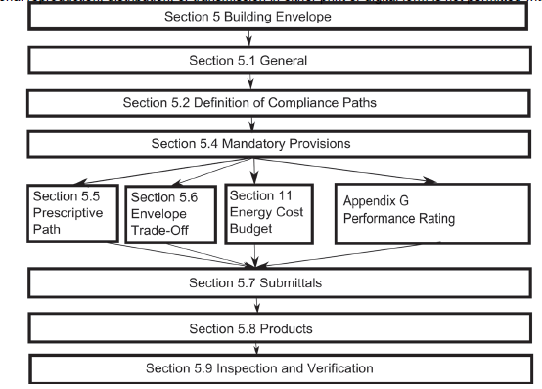
Compliance
Prescriptive Path
Envelope Trade Off
Energy Cost Budget
Performance Rating Method
Compliance with Sections 5.7, 5.8, & 5.9 is also required for all projects

Slide 6
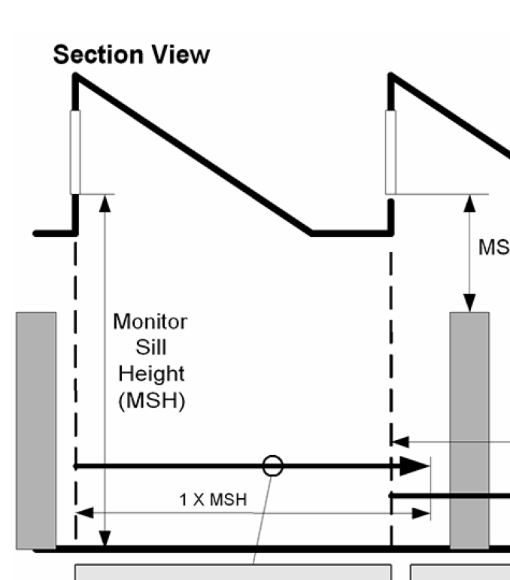
References and Definitions
Cool Roof Rating Standard from
  CRRC -1 TO CRRC S100
Added clarification in the definitions for ‘operable’ rooftop monitors
Clarifications to the Definition of ‘door’ to help sort out confusion with revolving doors, garage doors, sectional garage doors, non-swinging doors, and glass doors

Slide 7
Criteria Changes
Section Re-organization and Alignment
The parts of Section 5 covering
Submittals,
Products, and
Inspection and Verification
All underwent a general realignment so they are consistent with the same parts of Sections 6-10.

Slide 8
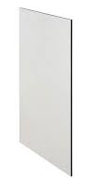
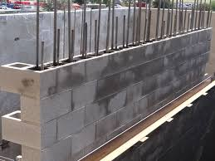
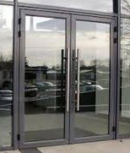
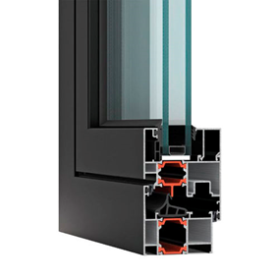

Text Clarifications
Air-leakage
Language describing air-leakage requirements for materials, assemblies and the whole building was updated
  Materials: 0.004 cfm/ft²
  Assemblies: 0.04 cfm/ft²
  Fenestration: 0.06 – 0.3 cfm/ft²
  Doors:
  1.0 – 1.3 cfm/ft²
  Whole Building: 0.4 cfm/ft²
Section 5.8.3.1
Section 5.4.3.1
Notes:
Not sure what this slide is trying to say

Slide 9
Criteria Changes
Commissioning
Mandatory commissioning (Cx) requirements are now better organized and consistently addressed in Standard 90.1, including for the building envelope.
Section 4.2.5 Verification, Testing, and Commissioning outlines the general requirements while Sections 5-10 each have specific requirements under the heading Verification. Testing, Commissioning, and Inspections
Section 5.9 Verification. Testing, Commissioning, and Inspections
  5.9.1 – Verification and Testing
  5.9.2 – Commissioning (New part of Section 5.9)
  5.9.3 – Inspections
Notes:
Might note that envelope Cx requirements haven’t changed but new requirements were added for many of the other sections of the Standard.

Slide 10
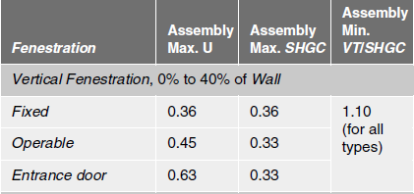
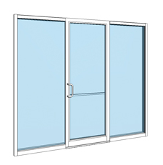
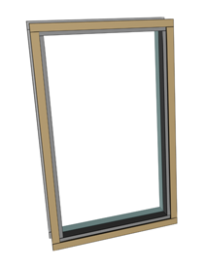
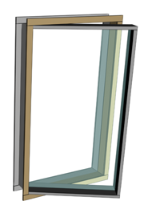
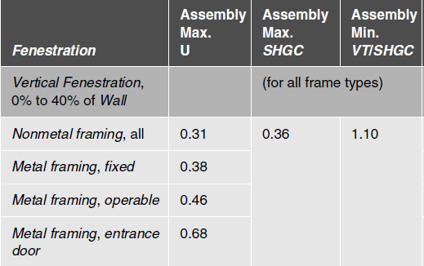

Criteria Changes
Fenestration
  Fenestration performance requirements are now based on fenestration type not on frame material.

Slide 11
Criteria Changes
Fenestration Example
SHGC Change for a Fixed, Metal Framed Window
SHGC | 0 | 1 | 2 | 3 | 4 | 5 | 6 | 7 | 8
2016 | 0.22 | 0.25 | 0.25 | 0.25 | 0.36 | 0.38 | 0.40 | 0.45 | 0.45
2019 | 0.22 | 0.23 | 0.25 | 0.25 | 0.36 | 0.36 | 0.38 | 0.40 | 0.40
Example of stringency improvements – note this comparison is based on both a window type and frame material
U-Factor Change for a Fixed, Metal Framed Window
U-factor | 0 | 1 | 2 | 3 | 4 | 5 | 6 | 7 | 8
2016 | 0.50 | 0.57 | 0.54 | 0.45 | 0.38 | 0.38 | 0.36 | 0.33 | 0.29
2019 | 0.50 | 0.50 | 0.45 | 0.42 | 0.36 | 0.36 | 0.34 | 0.29 | 0.26

Slide 12
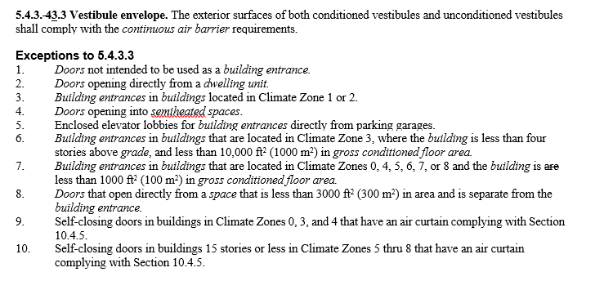
Criteria Changes
Air Curtains
Air curtains allowed in lieu of vestibules for some building entrances
Requirements
ANSI/AMCA 220 Compliant
Design Jet Velocity of 6.6 ft/s
Angle to door < 20 deg
Commissioned
Automatic controls

Slide 13
DETAILED INFORMATION
CHANGES TO 90.1-2019 SHOWN IN RED

Slide 14
Compliance Paths
Building Envelope
Building System
Compliance Requirements
Envelope
Prescriptive Path
Submittal Requirements
HVAC
Envelope Trade Off
Energy Code Compliance
Mandatory
Provisions
(required for each compliance path)
Information and Installation Requirements
SWH
Energy Cost Budget
Power
Verification, Testing, Inspection & Commissioning
Lighting
Simplified
Other
Performance Rating Method
Notes:
Under “Compliance Paths”, Simplified is not available for Envelope
Prescriptive Option = no trade offs; 8 criteria sets (certain rules to being able to use this option)
Trade Off Option = trade offs permitted among envelope components; area take offs must be calculated; COMcheck
ECB = trade offs can be made between envelope, lighting, and/or mechanical (building as a whole)
Performance Rating Method = Appendix G

Slide 15
Section 5
Building Envelope Overview 5.1 – 5.4
Section 5.1 General
  Scope
  Space-Conditioning Categories
  Envelope Alterations
  Climate
Section 5.2 Definition of Compliance Paths
Section 5.3 Simplified Building (Not Used)
Section 5.4 Mandatory Provisions
  Insulation
  Fenestration and Doors
  Air Leakage (continuous air barriers; loading dock weatherseals; vestibules and revolving doors)

Slide 16
Section 5
Building Envelope Overview (cont’d)
Prescriptive Building Envelope Compliance Path (Section 5.5)
Exterior Building Envelope
Semiexterior Building Envelope
Opaque Areas
Fenestration
Building Envelope Trade-Off Option (Section 5.6)
Submittals (Section 5.7)
Product Information and Installation Requirements (Section 5.8)
Verification, Testing, Commissioning, and Inspection (Section 5.9)
Notes:
It would be good to note why things are red down here.

Slide 17
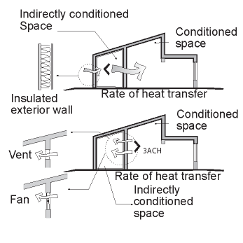
Section 5 – 5.1.2
Space Conditioning Categories & Basis
Space classifications used to determine Building Envelope Requirements
Conditioned space
    Cooled Space - any enclosed space served by a system with sensible cooling output capacity larger than 3.4 Btu/h∙ft2
    Heated Space - an enclosed space with a heating system output capacity larger than specified below
    Indirectly conditioned space – see image.
Semiheated space
    Enclosed space with a heating system capacity ≥ 3.4 Btu/h.ft² but is not a conditioned space
Unconditioned space
    Any enclosed space that is not a conditioned or semiheated space. Attics, crawlspaces and parking garages are not considered enclosed spaces.
Heating Output, Btu/h∙ft² | Climate Zone
>5 | 0, 1, 2
>9 | 3A, 3B
>7 | 3C
>10 | 4A, 4B
>8 | 4C
>12 | 5
>14 | 6
>16 | 7
>19 | 8
    Heated Space Capacity Criteria
    Example of Indirectly Conditioned Spaces
    User’s Manual – 90.1-2013
Notes:
By SPACE, not BUILDING
Words in italic have a definition in Section 3 Definitions

Slide 18
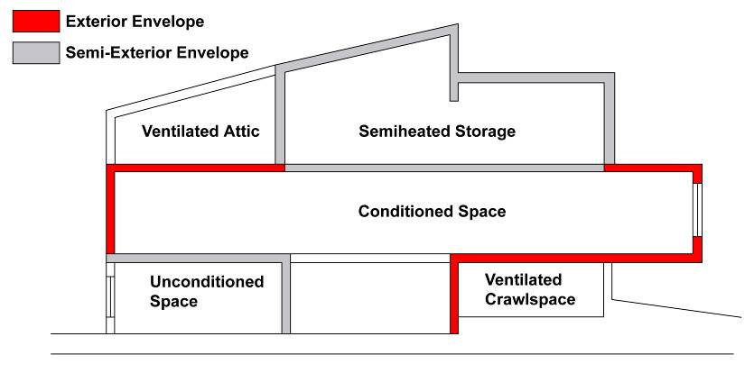
Section 5
Building Envelope
Notes:
The gray areas represent the semi-exterior envelope, and the red areas represent exterior envelope.
Semi-exterior envelope is defined under “building envelope” in Section 3: the elements of a building that separate conditioned space from unconditioned space or that enclose semiheated spaces through which thermal energy may be transferred to or from the exterior, or to or from unconditioned spaces, or to or from conditioned spaces.
Note that “unconditioned spaces” such as the ventilated attic or the ventilated crawlspace do not have any envelope requirements between these spaces and the exterior BUT there are requirements for the envelope between these spaces and any conditioned or “semi-conditioned” spaces. The presence of unconditioned spaces or “semi-conditioned” spaces greatly complicates the definition of the building envelope.
IECC does not have definition for semiheated = conditioned
Note: technically, it’s possible the unconditioned space in this example could be indirectly conditioned

Slide 19
Section 5 – 5.1.2
Space Conditioning Categories & Basis
Spaces are assumed to be conditioned space and comply with requirements of conditioned space at time of construction regardless of whether the mechanical or electrical equipment is included in the building permit application or installed at that time
Exceptions:
    Space is designated as semiheated or unconditioned and
    Approved as such by the building official
Notes:
Semiheated is heated, but not to comfort levels like conditioned space.
Additional information in the User’s Manual
Must be approved by building official and must be labeled on plans

Slide 20
Section 5
Envelope Alteration Exceptions
  Allowed if they don’t increase energy usage of building
Installation of storm windows or glazing panels with low-emissivity coating
Replacement of glazing in existing sash and frame provided U-factor and SHGC < than previous glass
Alterations to envelope cavities provided they are insulated to full depth with a nominal R-3.0 per in.
Wall and floor alterations where no new cavities are created
Roof recovering
Removal and replacement of roof membranes
Replacement of existing doors that separate conditioned space from exterior do not require a vestibule provided existing vestibule is not removed
Replacement of existing fenestration, provided area of replacement is no more than 25% of total fenestration area provided U-factor and SHGC < than previous fenestration
Notes:
Altered portions of buildings must comply with section 5 for insulation, air leakage, and fenestration. Alterations listed here don’t have to comply if they don’t increase energy use of building.
Roof membranes – if the roof is stripped down to the level of sheathing or insulation, then the roof must be insulated to the Standard (unless there is insulation below the sheathing).
Replacing exterior doors doesn’t trigger requirement for vestibule or revolving door, however, if a vestibule or revolving door exists, it can’t be removed.
Use COMcheck for alterations

Slide 21
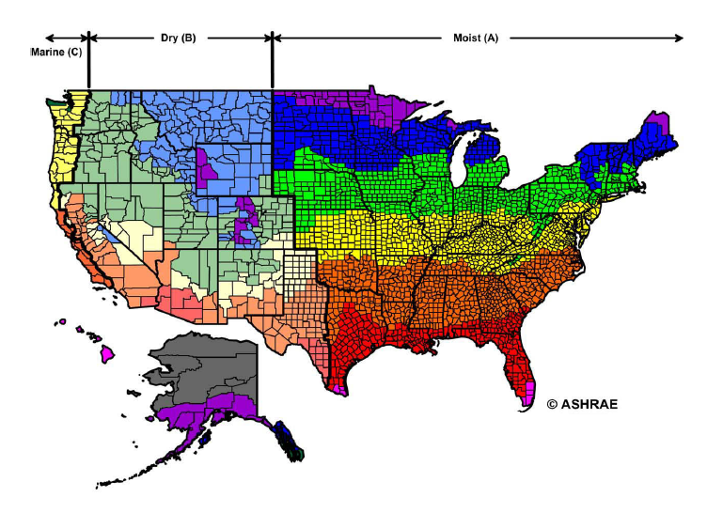
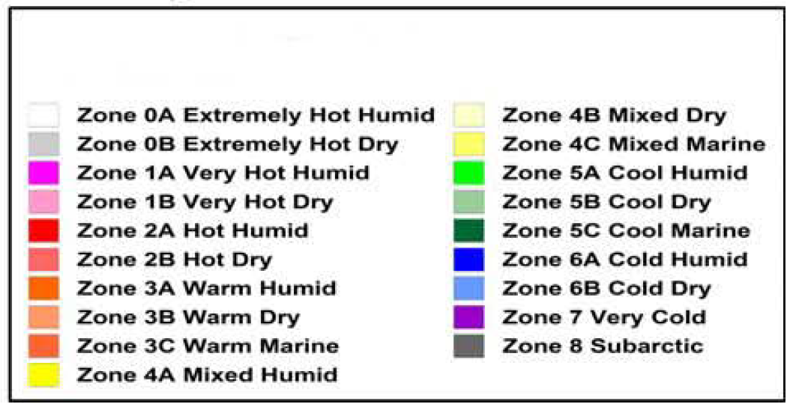
Section 5 – 5.1.4
Climate – Climate Zones
United States Locations – ASHRAE 90.1-2019 Table Annex1-1
Canadian Locations – ASHRAE 90.1-2019 Table Annex 1-2
International Locations – ASHRAE 90.1-2019 Table Annex 1-3
Notes:
Extensively changed in 90.1-2016:
More accurately represents recent climate, better data
Aligns with ASHRAE Standard 169-2013
Retains same climate zone definitions (based on HDDs)
Some U.S. counties have shifted zones
Reflects weather over the most recent 30 years
Adds new Climate Zone 0 (extremely hot)
Approximately 10% of U.S. counties reassigned to a different climate zone with a majority reassigned to a warmer climate zone
United States Locations. 90.1 includes an Annex that contains an extraction from Standard 169, Table B-1
Exception:
If there are recorded historical climatic data available for a construction site, they may be used to determine compliance if approved by the building official.

Slide 22
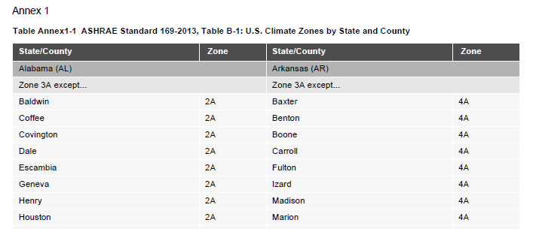
Section 5 – 5.1.4
Climate
United States Locations – Use ASHRAE Standard 169 Table B-1
Notes:
United States Locations. 90.1 includes an Annex that contains an extraction from Standard 169, Table B-1
Exception:
If there are recorded historical climatic data available for a construction site, they may be used to determine compliance if approved by the building official.

Slide 23
Compliance Paths
Building Envelope
Building System
Compliance Requirements
Envelope
Prescriptive Path
Submittal Requirements
HVAC
Envelope Trade Off
Energy Code Compliance
Mandatory
Provisions
(required for each compliance path)
Information and Installation Requirements
SWH
Energy Cost Budget
Power
Verification, Testing, Inspection & Commissioning
Lighting
Simplified
Other
Performance Rating Method
Notes:
Compliance. For the appropriate climate, space-conditioning category, and class of construction, the building envelope to comply with
5.1 General
5.4 Mandatory
5.7 Submittals
5.8 Product Information
AND
Either 5.5 Prescriptive if
The vertical fenestration area does not exceed 40% of the gross wall area for each space-conditioning category and
The skylight fenestration area does not exceed 3% of the gross roof area for each space-conditioning category, or
5.6 Building Envelope Trade-Off Options
Mandatory requirements will be discussed next.

Slide 24
Section 5 – 5.4
Mandatory Provisions
Insulation (Section 5.4.1 refers to 5.8.1. through 5.8.1.10)
Labeling (Section 5.8.1.1)
Manufacturers’ Installation Instructions (Section 5.8.1.2)
Loose-Fill Insulation Limitation (Section 5.8.1.3)
Baffles (Section 5.8.1.4)
Substantial Contact (Section 5.8.1.5)
Recessed Equipment (Section 5.8.1.6)
Insulation Protection (Section 5.8.1.7)
Location of Roof Insulation (Section 5.8.1.8)
Extent of Insulation (Section 5.8.1.9)
Joints in Rigid Insulation (Section 5.8.1.10)
Insulation Installation Documentation (Section 5.8.1.11)
Notes:
All mandatory provisions must be satisfied regardless of which compliance path (prescriptive, building envelope trade-off, or energy cost budget) is used.
The amount of insulation required is specified in the prescriptive Section (5.5) or will be determined through the envelope trade-off option (5.6). The insulation requirements for labeling, contact, protection, staggering of rigid insulation, and so on, are specified in Section 5.8. Section 5.8 is referenced in Section 5.4.1 and is part of the mandatory requirements. Note also that Section 5.7 Submittals is “mandatory” as well.

Slide 25
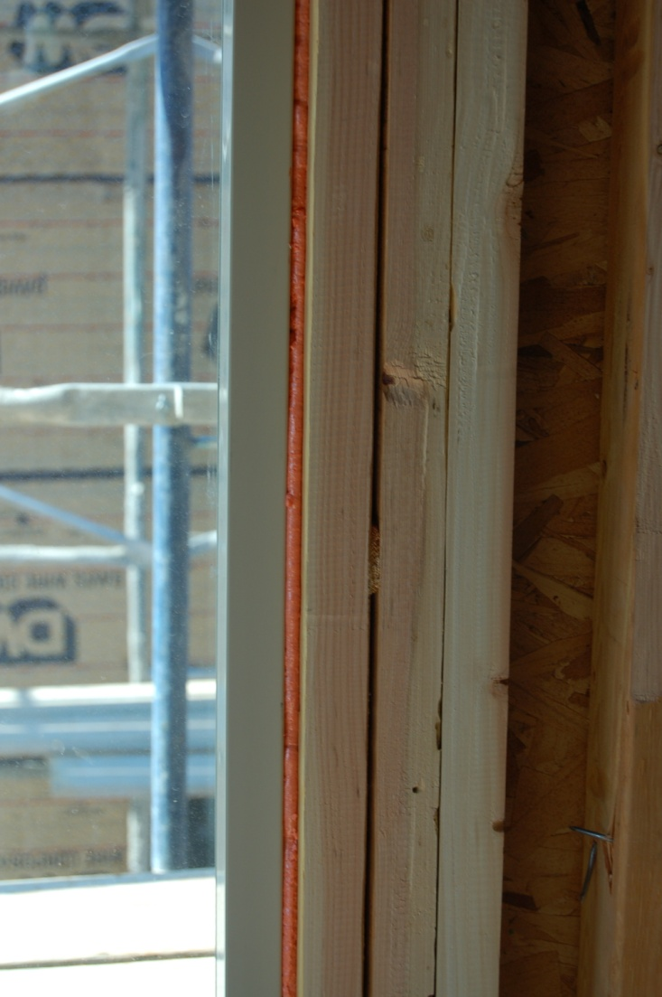
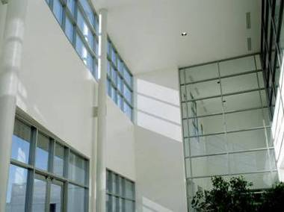
Section 5 – 5.4
Mandatory Provisions
Fenestration and Doors (Section 5.4.2 that refers to 5.8.2)
Air Leakage (Section 5.4.3)
Photo courtesy of Ken Baker, K energy
Notes:
Requirements are described in detail in subsequent slides.

Slide 26
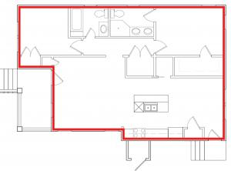
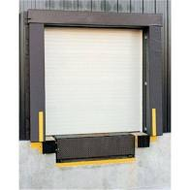
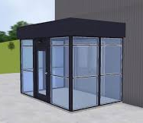
Section 5 – 5.4.3
Air Leakage
Mandatory air-leakage requirements exist for
Loading dock weather seals
Vestibules and revolving doors
Continuous air barriers
Notes:
Goal is to not let uncontrolled air leak into or out of the building.

Slide 27
Section 5 – 5.4.3.1
Air Leakage – Continuous Air Barrier
Continuous air barrier required in all buildings covered by the Standard except:
  Semiheated spaces in climate zones 0-6
  Single wythe concrete masonry buildings in climate zone 2B
Measured whole building air-leakage rate not to exceed 0.40 cfm/ft² (at a pressure differ. of 0.3 in. of water)
Normalized by above and below-grade building envelope area of both conditioned space and semiheated spaces.
Testing conducted per ASTM E779 or ASTM E1827 by independent 3rd party
Notes:
Single wythe in CZ 2B is a result of the public review process, and the subcommittee believes that only CZ 2B is cost effective and fits the need where these walls are the most common.
90.1-2019 modified language to state that the exterior building envelope and the semiexterior building envelope must have a continuous air barrier.

Slide 28
Section 5 – 5.4.3.1.1
Whole-Building Air Leakage – Exceptions
Buildings > 50,000 sf (exception)
All Buildings
  May comply using partial testing if:
  Test entire floor area of all stories with; any space under a roof, a building entrance or a loading dock.
  Test representative above-grade wall sections totaling at least 25% of wall area enclosing remaining conditioned space, cannot include areas tested under (a)
  Comply by testing entire building
Building complies if measured air leakage rate is less than 0.40 cfm/ft² at 0.30 in. of water
If measured air leakage rate is greater than 0.40 cfm/ft² but less than 0.60 cfm/ft²
  Perform diagnostic evaluation (smoke tracer, infrared imaging, etc.) and seal identified leaks
  Perform visual inspection of air barrier and seal identified leaks
  Submit report to code official and building owner identifying corrective actions taken to seal leaks
3. Testing not required when meeting

Slide 29
Section 5 – 5.4.3.1.1
Whole-Building Air Leakage
When a building has both conditioned space and semiheated space, compliance can be demonstrated using one of two methods
  Separately for each space condition type
    Air-leakage of conditioned space normalized by exterior building envelope area
    Air-leakage of semiheated space normalized by area of semiexterior building envelope
  Both space conditioning types together,
    Air-leakage rate for both space types normalized by sum of exterior building envelope area and semiexterior building envelope area minus semiexterior building envelope area separating conditioned and semiheated spaces
Option 1: Air-leakage calculated separately for each space.
Semiheated Storage air-leakage normalized only using its semiexterior envelope area
Conditioned space air-leakage normalized using the exterior envelope area

Slide 30
Section 5 – 5.4.3.1.1
Whole-Building Air Leakage
When a building has both conditioned space and semiheated space, compliance can be demonstrated using one of two methods
  Separately for each space condition type
    Air-leakage of conditioned space normalized by exterior building envelope area
    Air-leakage of semiheated space normalized by area of semiexterior building envelope
  Both space conditioning types together,
    Air-leakage rate for both space types normalized by sum of exterior building envelope area and semiexterior building envelope area minus semiexterior building envelope area separating conditioned and semiheated spaces
Option 2:
Air-leakage calculated for both spaces together,
normalized based on total envelope area (red + grey) minus the area of exterior envelope between the spaces.

Slide 31
Section 5 – 5.4.3.1.2
Continuous Air Barrier Design and Installation
Continuous air barrier compliance requires:
Component and component positions in envelope assemblies to be clearly identified on construction documents
Joints, interconnections, and penetrations to be detailed on construction documents
Extension over all surfaces of the building envelope and identified as continuous on construction documents
A design that resists positive and negative pressures from wind, stack effect, and mechanical ventilation and allow for anticipated movements
The following areas to be wrapped, sealed, caulked, gasketed, or taped in an approved manner
  Joints around fenestration and door frames
  Junctions between all wall, floor and roof assembly transitions including building corners
  Penetrations through roofs, walls, and floors
  Building assemblies used as ducts or plenums
  Joints, seams, connections between planes, and other changes in air barrier materials

Slide 32
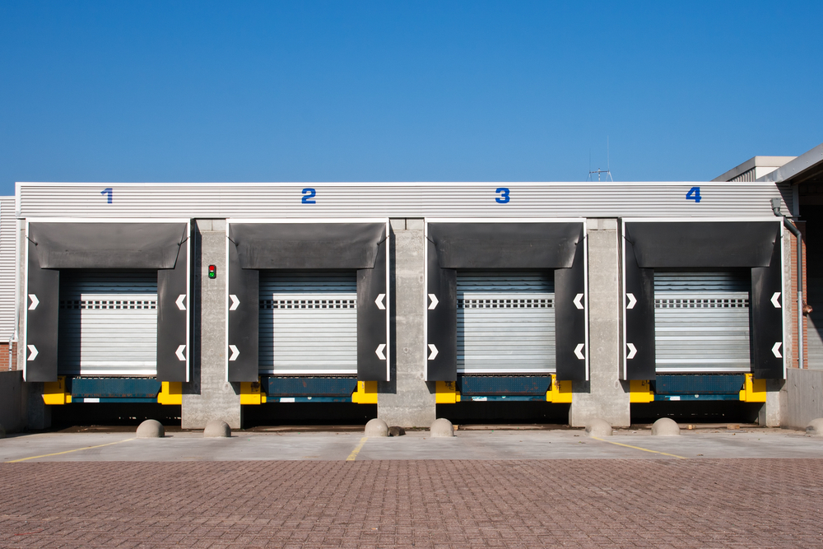
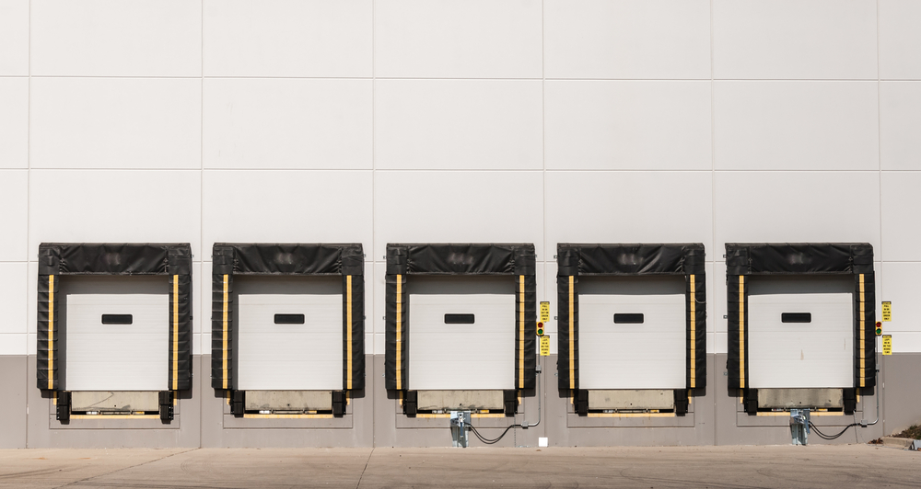
Section 5 – 5.4.3.2
Air Leakage – Loading Dock Weatherseals
In climate zones 0 and 4-8
Cargo doors and loading dock doors equipped with weatherseals
  To restrict infiltration when vehicles are parked in the loading dock/doorway
Notes:
Climate dependent requirements shown in green font
Usually consists of a vinyl-wrapped compressible foam block that’s mounted around the perimeter of the door and forms a seal between the truck and the dock when the truck is parked at the dock.
Typically offered by manufacturers as an option

Slide 33
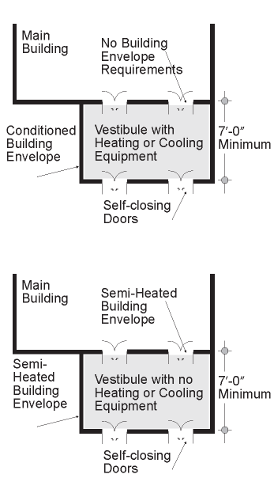
Section 5 – 5.4.3.3
Air Leakage – Vestibules and Revolving Doors
Building entrances must have an enclosed vestibule with self-closing devices, revolving doors or a combination of the two
Vestibules and revolving doors
Cannot have interior and exterior doors open at the same time
Distance between interior and exterior doors, minimum 7 ft when closed
Floor area < 50 ft² or 2% of the conditioned area of that building level
Conditioned vestibule must comply with conditioned building envelope
Unconditioned vestibule must comply with semi-heated building envelope
Notes:
Climate dependent requirements shown in green font
building entrance: any doorway, set of doors, turnstile, vestibule, or other form of portal that is ordinarily used to gain access to the building by its users and occupants.
Conditioned Vestibules – exterior envelope to meet requirements for a conditioned space.
Unconditioned Vestibules – interior and exterior envelope to meet requirements for a semiheated space.
Big difference between IECC and 90.1 requirements is number of stories specified in 90.1

Slide 34
Section 5
Air Leakage – Vestibules Exceptions
Exceptions to Vestibule Requirements
Non-entrance doors or doors opening from dwelling unit
Building entrances with revolving doors
All building entrances in climate zones 1 and 2 OR in buildings < 4 stories and < 10,000 ft² in gross conditioned floor area in climate zone 3 OR in buildings
< 1000 ft² in gross conditioned floor area in climate zones 0 and 4-8
All doors that open from spaces < 3000 ft² and separate from building entrance
Self-closing doors in climate zones 0, 3, and 4 OR in buildings < = 15 stories in climate zones 5-8 that have air curtains complying with 10.4.5
Notes:
Climate dependent requirements shown in green font
Not required < 4 stories because stack effect is smaller and stack effect (along with wind effects) is one of the main drivers of infiltration. Also, low-rise buildings are generally smaller and there is less traffic through the door. However, large, low-rise buildings have more foot traffic so they are not exempt.
Doesn’t include hot and humid climates even though they could use vestibules too (less temperature gradient usually between indoor and outdoor temperatures).
If meet one, exempt from all? Yes.

Slide 35
Section 5 – 5.4.3.3
Air Leakage – Vestibules
Vestibules opening into large conditioned spaces (large retail) shall have a minimum distance between the interior and exterior doors of not less than 16 ft.
Applies when vestibules:
open into a space >= 40,000 ft² of gross conditioned floor area at the same building level.
have doors equipped with automatic, electrically driven, self-closing devices on doors going both in and out.
Notes:
Sometimes, vestibules may have a unit heater to heat the space but not all the way to comfort conditions. Such a vestibule would be considered a semiheated space.

Slide 36
Compliance Paths
Building Envelope
Building System
Compliance Requirements
Envelope
Prescriptive Path
Submittal Requirements
HVAC
Energy Code Compliance
Envelope Trade Off
Mandatory
Provisions
(required for each compliance path)
Information and Installation Requirements
SWH
Energy Cost Budget
Power
Verification, Testing, Inspection & Commissioning
Lighting
Simplified
Other
Performance Rating Method
Notes:
The following section details the prescriptive envelope requirements.

Slide 37
Section 5 – 5.5
Prescriptive Building Envelope Option
Each envelope component must separately meet designated space conditioning requirements:
(Nonresidential, Residential, and/or Semiheated)
Opaque Areas (5.5.3)
Fenestration (5.5.4)
WWR ≤ 40% of gross wall area
Skylight-roof ratio ≤ 3% of roof area
Prescriptive requirements for each component specified by climate zone and space conditioning category (Tables 5.5-0 through 5.5-8)
Insulation levels for roofs, walls, floors and doors
Fenestration criteria for windows, glazed doors and skylights
Notes:
Mentioed this part al

Slide 38
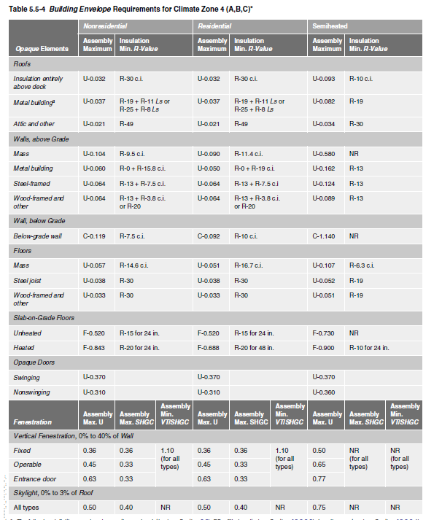
Section 5 – 5.5
Prescriptive Building Envelope Option
Notes:
Defining characteristic of nonresidential is that no one is sleeping there at night and whether it is a dwelling unit (cook, eat, wash, sleep).
Unconditioned spaces are enclosed spaces within a building that are not conditioned or semiheated; must be completely enclosed by walls, roofs, floors, and/or other envelope components and space must qualify as a cooled space, heated space, or an indirectly conditioned space.
Indirectly heated spaces don’t have heating or cooling directly (ex: storage room adjacent to conditioned space)
Nonresidential examples: retail, offices (not continuously conditioned)
Residential examples: dwelling units, hotel/motel guest rooms, dormitories (more or less continuously conditioned)
Semiheated example: warehouse (building official must approve semiheated spaces)

Slide 39
Section 5 – 5.5.3
Opaque Areas
Compliance
Meet or exceed minimum R-values in table
  Only R-value of insulation, not to include air films, etc.
  OR
Meet maximum U-factor, C-factor, or F-factor for the entire assembly (typical construction assemblies described in Appendix A)
  OR
Perform area-weighted average U-factor, C-factor, or F-factor
  Only if there are multiple assemblies within a single class of construction for a single space-conditioning category
Notes:
C-factor (thermal conductance) = time rate of steady-state heat flow through unit area of a material or construction, induced by a unit temperature difference between the body surfaces. Units of C-factor are Btu/h-ft2-F. Note that C-factor doesn’t include soil or air films.
F-factor – the perimeter heat loss factor for slab-on-grade floors, expressed in Btu/h-ft-F
Rule #3 indicates that area-weighted averages across multiple classes of construction or multiple space-conditioning categories are not allowed.

Slide 40
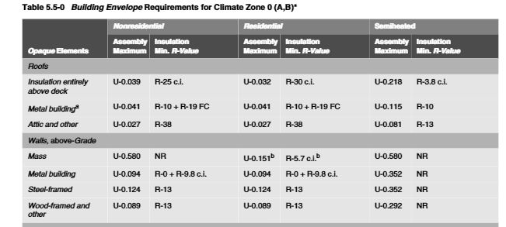
Section 5 – 5.5.1
Opaque
Opaque Elements | Nonresidential |  | Residential |  | Semiheated
 | Assembly Maximum | Insulation Min. R-Value | Assembly Maximum | Insulation Min. R-Value | Assembly Maximum | Insulation Min. R-Value
Roofs Insulation Entirely above Deck Metal Building Attic and Other | U-0.039 U-0.041 U-0.027 | R-25 c.i. R-10 + 19 FC R-38 | U-0.032 U-0.041 U-0.027 | R-30 c.i. R-10 + 19 FC R-38 | U-0.218 U-0.115 U-0.081 | R-3.8 c.i. R-10 R-13
FC = filled cavity
Reference Table 5.5-0 on page 58 in 90.1-2019
Notes:
There is a table for each climate zone. Requirements are separated by Nonresidential, Residential, and Semiheated columns. Both U-factor and R-value requirements are given. Requirements for residential spaces are a little more stringent than nonresidential because residential spaces are assumed to have continuous heating and cooling.
PRESENTERS: All of the tables are provided; use only the tables representing climate zones applicable to your training sessions.
“ci” stands for continuous insulation (uninterrupted by framing members). “ci” applies to all Insulation Entirely Above Deck and to most of mass walls, mass floors, and below-grade walls.
“fc” = filled cavity

Slide 41
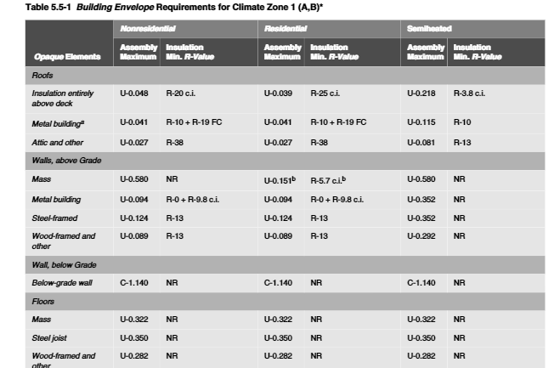
Section 5 – 5.5.1
Opaque
Opaque Elements | Nonresidential |  | Residential |  | Semiheated
 | Assembly Maximum | Insulation Min. R-Value | Assembly Maximum | Insulation Min. R-Value | Assembly Maximum | Insulation Min. R-Value
Roofs Insulation Entirely above Deck Metal Building Attic and Other | U-0.048 U-0.041 U-0.027 | R-20 c.i. R-10 + 19 FC R-38 | U-0.039 U-0.041 U-0.027 | R-25 c.i. R-10 + 19 FC R-38 | U-0.218 U-0.115 U-0.081 | R-3.8 c.i. R-10 R-13
FC = filled cavity
Reference Table 5.5-1 on page 59 in 90.1-2019
Notes:
There is a table for each climate zone. Requirements are separated by Nonresidential, Residential, and Semiheated columns. Both U-factor and R-value requirements are given. Requirements for residential spaces are a little more stringent than nonresidential because residential spaces are assumed to have continuous heating and cooling.
PRESENTERS: All of the tables are provided; use only the tables representing climate zones applicable to your training sessions.
“ci” stands for continuous insulation (uninterrupted by framing members). “ci” applies to all Insulation Entirely Above Deck and to most of mass walls, mass floors, and below-grade walls.
“fc” = filled cavity

Slide 42
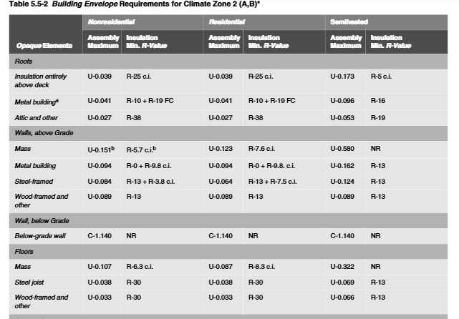
Section 5 – 5.5.1
Opaque
Opaque Elements | Nonresidential |  | Residential |  | Semiheated
 | Assembly Maximum | Insulation Min. R-Value | Assembly Maximum | Insulation Min. R-Value | Assembly Maximum | Insulation Min. R-Value
Roofs Insulation Entirely above Deck Metal Building Attic and Other | U-0.039 U-0.041 U-0.027 | R-25 c.i. R-10+R-19 FC R-38 | U-0.039 U-0.041 U-0.027 | R-25 c.i. R-10+R-19 FC R-38 | U-0.173 U-0.096 U-0.053 | R-5 c.i. R-16 R-19
Reference Table 5.5-2 on page 60 in 90.1-2019
Notes:
PRESENTERS: All of the tables are provided; use only the tables representing climate zones applicable to your training sessions.

Slide 43
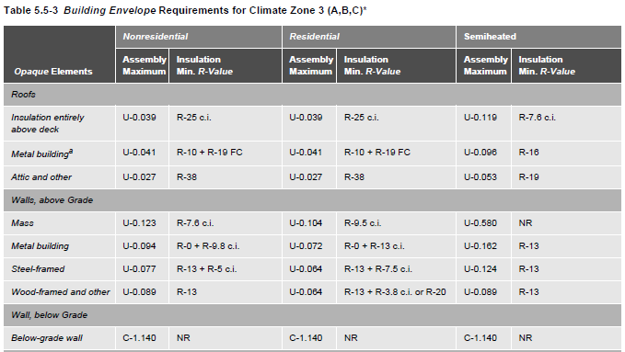
Section 5 – 5.5.1
Opaque
Opaque Elements | Nonresidential |  | Residential |  | Semiheated
 | Assembly Maximum | Insulation Min. R-Value | Assembly Maximum | Insulation Min. R-Value | Assembly Maximum | Insulation Min. R-Value
Roofs Insulation Entirely above Deck Metal Building Attic and Other | U-0.039 U-0.041 U-0.027 | R-25 c.i. R-10+R-19 FC R-38 | U-0.039 U-0.041 U-0.027 | R-25 c.i. R-10+R-19 FC R-38 | U-0.119 U-0.096 U-0.053 | R-7.6 c.i. R-16 R-19
Reference Table 5.5-3 on page 61 in 90.1-2019
Notes:
PRESENTERS: All of the tables are provided; use only the tables representing climate zones applicable to your training sessions.

Slide 44
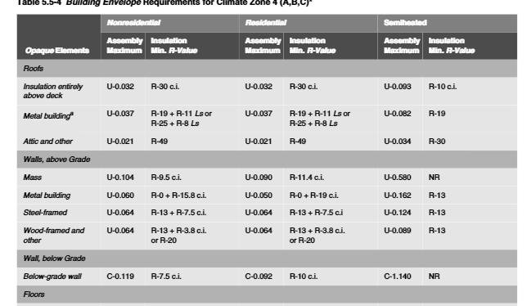
Section 5 – 5.5.1
Opaque
Opaque Elements | Nonresidential |  | Residential |  | Semiheated
 | Assembly Maximum | Insulation Min. R-Value | Assembly Maximum | Insulation Min. R-Value | Assembly Maximum | Insulation Min. R-Value
Roofs Insulation Entirely above Deck Metal Building Attic and Other | U-0.032 U-0.037 U-0.021 | R-30 c.i. R-19+R-11 Ls or R-25+R-8 Ls R-49 | U-0.032 U-0.037 U-0.021 | R-30 c.i. R-19+R-11 Ls or R-25+R-8 Ls R-49 | U-0.093 U-0.082 U-0.034 | R-10 c.i. R-19 R-30
Reference Table 5.5-4 on page 62 in 90.1-2019
Notes:
PRESENTERS: All of the tables are provided; use only the tables representing climate zones applicable to your training sessions.

Slide 45
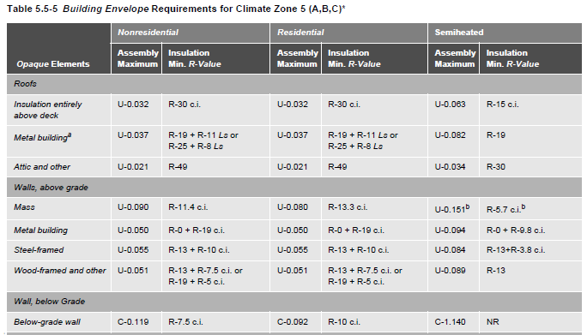
Section 5 – 5.5.1
Opaque
Opaque Elements | Nonresidential |  | Residential |  | Semiheated
 | Assembly Maximum | Insulation Min. R-Value | Assembly Maximum | Insulation Min. R-Value | Assembly Maximum | Insulation Min. R-Value
Roofs Insulation Entirely above Deck Metal Building Attic and Other | U-0.032 U-0.037 U-0.021 | R-30 c.i. R-19+R-11 Ls or R-25+R-8 Ls R-49 | U-0.032 U-0.037 U-0.021 | R-30 c.i. R-19+R-11 Ls or R-25+R-8 Ls R-49 | U-0.063 U-0.082 U-0.034 | R-15 c.i. R-19 R-30
Reference Table 5.5-5 on page 63 in 90.1-2019
Notes:
PRESENTERS: All of the tables are provided; use only the tables representing climate zones applicable to your training sessions.

Slide 46
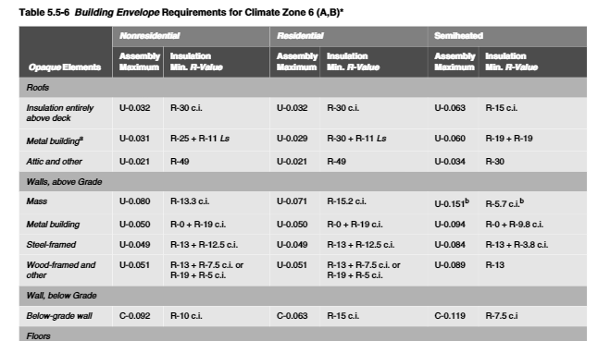
Section 5 – 5.5.1
Opaque
Opaque Elements | Nonresidential |  | Residential |  | Semiheated
 | Assembly Maximum | Insulation Min. R-Value | Assembly Maximum | Insulation Min. R-Value | Assembly Maximum | Insulation Min. R-Value
Roofs Insulation Entirely above Deck Metal Building Attic and Other | U-0.032 U-0.031 U-0.021 | R-30 c.i. R-25+R-11 Ls R-49 | U-0.032 U-0.029 U-0.021 | R-30 c.i. R-30+R-11 Ls R-49 | U-0.063 U-0.060 U-0.034 | R-15 c.i. R-19+R-19 R-30
Reference Table 5.5-6 on page 64 in 90.1-2019
Notes:
PRESENTERS: All of the tables are provided; use only the tables representing climate zones applicable to your training sessions.

Slide 47
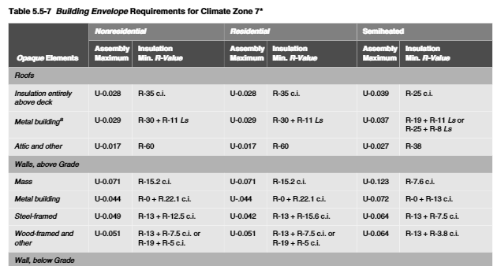
Section 5 – 5.5.1
Opaque
Opaque Elements | Nonresidential |  | Residential |  | Semiheated
 | Assembly Maximum | Insulation Min. R-Value | Assembly Maximum | Insulation Min. R-Value | Assembly Maximum | Insulation Min. R-Value
Roofs Insulation Entirely above Deck Metal Building Attic and Other | U-0.028 U-0.029 U-0.017 | R-35 c.i. R-30+R-11 Ls R-60 | U-0.028 U-0.029 U-0.017 | R-35 c.i. R-30+R-11 Ls R-60 | U-0.039 U-0.037 U-0.027 | R-25 c.i. R-19+R-11 Ls or R-25+R-8 Ls R-38
Reference Table 5.5-7 on page 65 in 90.1-2019
Notes:
PRESENTERS: All of the tables are provided; use only the tables representing climate zones applicable to your training sessions.

Slide 48
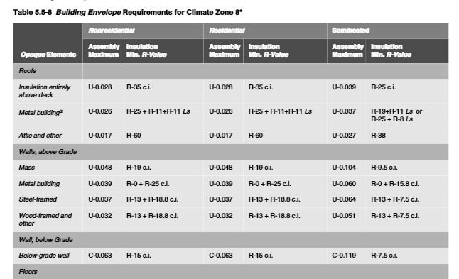
Section 5 – 5.5.1
Opaque
Opaque Elements | Nonresidential |  | Residential |  | Semiheated
 | Assembly Maximum | Insulation Min. R-Value | Assembly Maximum | Insulation Min. R-Value | Assembly Maximum | Insulation Min. R-Value
Roofs Insulation Entirely above Deck Metal Building Attic and Other | U-0.028 U-0.026 U-0.017 | R-35 c.i. R-25+R-11+ R-11 Ls R-60 | U-0.028 U-0.026 U-0.017 | R-35 c.i. R-25+R-11+ R-11 Ls R-60 | U-0.039 U-0.037 U-0.027 | R-25 c.i. R-19+R-11 Ls or R-25+R-8 Ls R-38
Reference Table 5.5-8 on page 66 in 90.1-2019
Notes:
PRESENTERS: All of the tables are provided; use only the tables representing climate zones applicable to your training sessions.

Slide 49
Section 5 – 5.5.3.1
Roof Insulation
Meet or exceed minimum R-value in table for climate zone
Skylight curbs insulated to level of roofs with insulation entirely above deck or R-5, whichever is less
Notes:
Some interruptions are inevitable and permitted up to 1%. Interruptions are typically required to provide structural supports for mechanical or other roof-mounted equipment.

Slide 50
Section 5 – 5.5.3.1
Roof Insulation (cont’d)
Three types of roofs are defined
Roofs with insulation entirely above deck
  R-value is for continuous insulation
  Exception: mechanical equipment framing and pads ≤ 1% of roof area
Metal building roofs
  First value is for insulation
      draped over purlins and then compressed by metal spanning members or
      hung between purlins provided a minimum 1” thermal break exists between purlins and metal spanning members
  Second value is for double-layer installations with insulation installed parallel to the purlins
    Attics and other roofs
  R-value is for insulation installed both inside and outside the roof or entirely inside the roof cavity
Notes:
Double-layer – continuous insulation – it is assumed that the insulation boards are installed below the purlins and are uninterrupted by framing members. Insulation exposed to the conditioned space or semiheated space shall have a facing and all insulation seams shall be continuously sealed to provide a continuous air barrier.
Attics and Other Roofs – all roofs that aren’t metal building roofs or don’t have insulation installed above the structural deck.
For attics – the Standard permits the insulation depth to be reduced near the eaves since this was accounted for in developing the requirements.
Single-rafter roofs – when insulation required by the Standard has a thickness too large to fit in the cavity, it’s only necessary to install insulation at a depth that will fill the cavity and still leave an inch or so for ventilation.

Slide 51
Section 5 – 5.8.1
Insulation Installation
Insulation must be installed such that:
The rated R-value is clearly identified by an identification mark applied by manufacturer to each piece of building envelope insulation
  Exception - provide documentation and one of the following:
    Batts/blankets – rated R-value, length, width, thickness
    Boardstock – rated R-value, length, width, thickness of boards in the package
    Loose-fill – minimum settled thickness, initial installed thickness, max. net coverage area, number of bags/1000 sf and minimum weight per sf at R-values of 13, 19, 30, 38,and 49; package to state minimum net weight of insulation in the package
    Spray-applied polyurethane foam – R-value of insulation at 1 in. thickness and additional inch increments up to max. thickness allowed
Per manufacturer’s installation instructions in a way that achieves the rated R-value
No open-blown or poured loose-fill insulation when ceiling slope is > 3/12
If eave air vents are installed, provide baffling to deflect incoming air above the surface of the insulation
  Metal buildings Exception - if roof and wall insulation is compressed between roof or wall skin and the structure

Slide 52
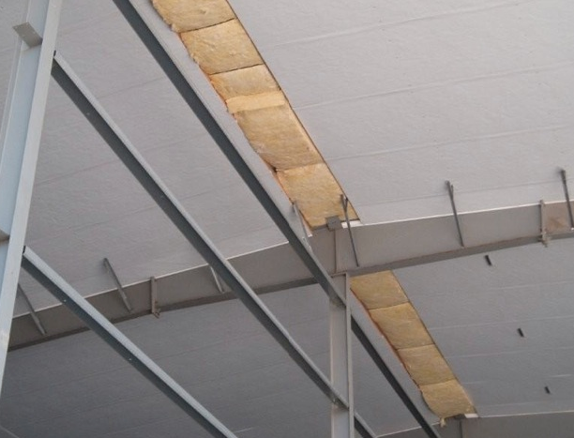
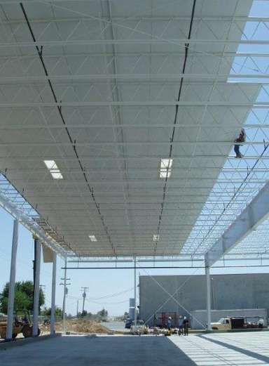
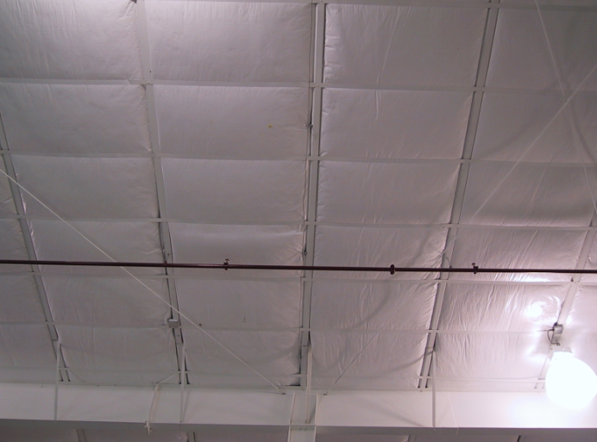
Section 5
Roof Insulation Examples
Photos courtesy of MBMA
Notes:
Verify that the installed insulation R-value meets or exceeds the R-value shown on the plans or energy code compliance documentation.
Applies if only time you can check insulation before final roof covering is installed (e.g., roof deck).

Slide 53
Section 5 – 5.5.3.1.1
High Albedo Roofs
High Albedo Roofs Required in climate zones 0-3
Minimum three-year aged solar reflectance of 0.55 and minimum three-year aged thermal emittance of 0.75 (tested in accordance with CRRC S100)
OR
Minimum Solar Reflectance Index of 64, based on
Three-year aged solar reflectance
Three-year aged thermal emittance
  Tested in accordance with CRRC S100
  OR
Increase roof insulation levels in Table 5.5.3.1.1
Notes:
Qualifying products shall be tested and labeled by the Cool Roof Rating Council.
Solar Reflectance Index must be as calculated by the ASTM E1980 procedure.
Cool roof can be achieved by applying a coating to the roof’s outside surface or using a material that has both a high reflectance (light color) and a high emittance.

Slide 54
Section 5 – 5.5.3.1
High Albedo Roofs – Exceptions
Situations when High Albedo Roofs are not required:
Ballasted roofs with minimum stone ballast of 17 lb/ft² or 23 lb/ft² pavers
Vegetated roof systems containing minimum thickness of 2.5 in. of growing medium that covers minimum of 75% of roof area with durable plantings
Roofs, where a minimum of 75% of the roof area is:
  shaded during peak sun angle on June 21 by permanent features of the building
  covered by on-site solar energy systems (ie: PV arrays) OR
  permitted to be interpolated using a combination of 1 and 2 above
Steep-sloped roofs
Low-sloped metal building roofs in climate zones 2-3
Roofs over: ventilated attics, semiheated spaces, or conditioned spaces that aren’t cooled spaces
Asphaltic membranes in climate zones 2-3
Notes:
Qualifying products shall be tested and labeled by a nationally recognized accreditation organization, such as the Cool Roof Rating Council CRRC.
Cool roof can be achieved by applying a coating to the roof’s outside surface or using a material that has both a high reflectance (light color) and a high emittance.

Slide 55
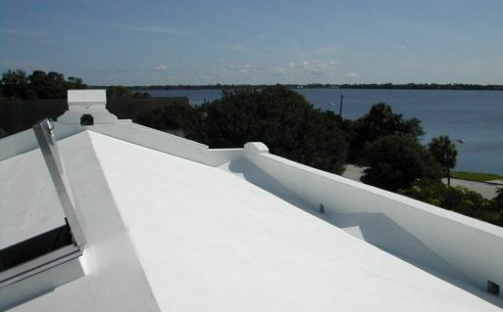
Section 5
High Albedo Roof – Example

Slide 56
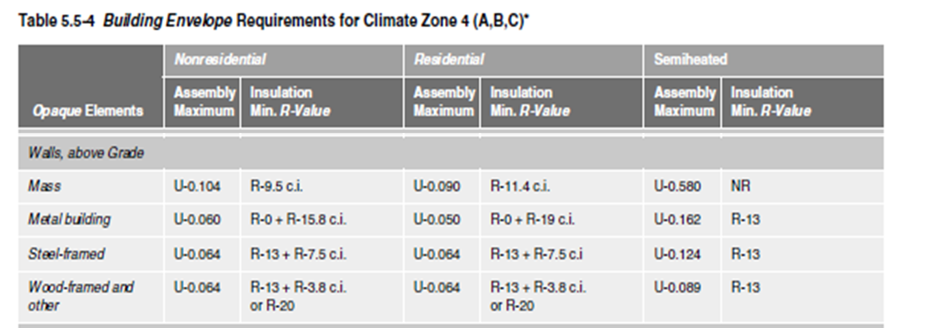
Section 5 – 5.5.3.2
Above-Grade Wall Insulation
Meet or exceed R-value specified for climate zone in appropriate table
When wall consists of both above-grade and below-grade portion, entire wall to be insulated on either exterior or interior or be integral
If insulated on interior: above-grade wall insulation requirements apply
If insulated on exterior or integral: below-grade wall portion to be insulated to the below-grade wall requirements and above-grade to above-grade wall requirements
Notes:
A mass wall is a heavyweight wall, with a heat capacity larger than 5 Btu/ft2-F.
Comply with R-value criteria or U-factor requirement for the overall assembly, including thermal bridges.
If insulated on the interior, the wall is insulated to the above-grade wall requirements.
If insulated on the exterior or integral, the below-grade wall portion is insulated to the below-grade wall requirements, and the above-grade wall portion shall be insulated to the above-grade wall requirements.
Exception example – perlite-filled cores on concrete block; applies only when the concrete masonry units are ungrouted or partly grouted.
Sub-bullets under “Mass Walls” come from Appendix A. Exception itself is unchanged, but language was moved from the Appendix to Section 5 in 90.1-2013.

Slide 57
Section 5 – 5.5.3.2
Above-Grade Wall Insulation (cont’d)
Above-grade East and West walls in climate zone 0 shall meet one of the following:
  A. Minimum of 75% of the opaque wall area to have a minimum SRI 29
    glass spandrel areas a minimum solar reflectance of 29% determined in accordance with NFRC 300 or ISO 9050 is permitted
    Each wall is allowed to be considered separately
  Minimum of 30% of the above-grade wall area be shaded
    Can demonstrate using shade-providing plants, manmade structures, existing buildings, hillsides, permanent building projections, on-site renewable energy systems, or combination
    Shade coverage calculated at 10 a.m. for east walls and 3 p.m. for west walls on summer solstice
The building is allowed to be rotated up to 45 degrees to the nearest cardinal orientation for compliance calculation purposes

Slide 58
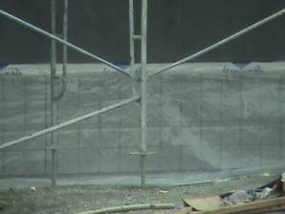
Section 5 – 5.5.3.2
Above-Grade Wall Insulation (cont’d)
Four types of above-grade walls
Mass walls,
Metal Building walls,
Steel Framed walls,
Non-metal walls.
Mass walls
    heat capacity (HC) determined from Table A3.1-2 or A3.1-3
    Rated R-value is for continuous insulation or when uninterrupted by framing other than metal clips no closer than 24 in. o.c. horizontally and 16 in. o.c. vertically
  Exception
      Requirement of U-0.151

Slide 59
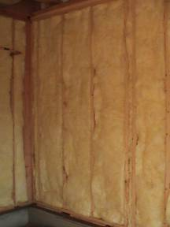
Section 5
Above-Grade Wall Insulation (cont’d)
  Metal building wall R-value
    for insulation compressed between metal wall panels and the steel structure
  Steel-framed wall R-value
    for uncompressed insulation installed in the cavity between steel studs; also acceptable to be continuous insulation uninterrupted by studs
  Wood-framed and other R-value
    for uncompressed insulation installed in the cavity between wood studs; also acceptable to be continuous insulation uninterrupted by studs

Slide 60
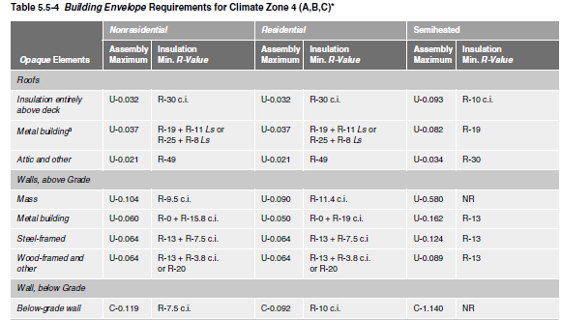
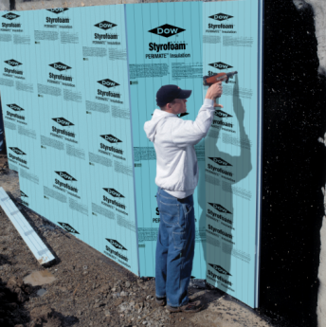
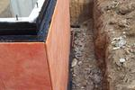
Section 5 – 5.5.3.3
Below-Grade Wall Insulation
Meet or exceed values in appropriate table for climate zone
R-value is for continuous insulation and the maximum assembly C-factor is for framed assemblies with cavity insulation.
Photo courtesy of Dow Building Solutions
Notes:
C-factor includes all layers in the construction assembly but excludes exterior air film and soil effect.
Continuous insulation can be either on the outside or inside.

Slide 61
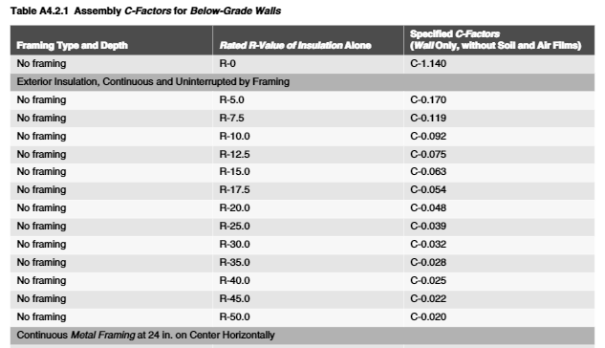
Section 5 – 5.5.3.3
Below-Grade Wall Insulation
Framing Type and Depth | Rated R-Value of Insulation Alone | Specified C-Factors (Wall Only, without Soil and Air Films)
No Framing | R-0 | C-1.140
Exterior Insulation, Continuous and Uninterrupted by Framing
No Framing No Framing No Framing | R-5.0 R-7.5 R-10.0 | C-0.170 C-0.119 C-0.092
Notes:
C-factors for below-grade walls are taken from Table A4.2.1; excerpt shown above

Slide 62
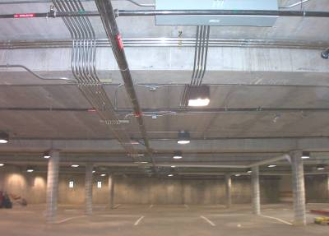
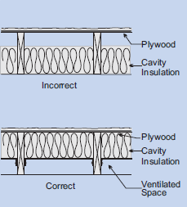
Section 5 – 5.5.3.4
Floor Insulation
Exterior floors over unconditioned space must meet or exceed insulation values in appropriate table for climate zone
The 3 classes of exterior floor are:
Mass floors
  R-value is for continuous insulation
  If framing is used, compliance is based on maximum assembly U-factor
  Steel-joist floors
  R-value is for uncompressed insulation or spray-on insulation, but is also acceptable for continuous insulation
  Wood-framed and others
  R-value is for uncompressed insulation, but is also acceptable for continuous insulation
Notes:
Waffle slab floors – floor is insulated either on interior above the slab or on all exposed surfaces of the waffle
Insulation in floor cavity must be in contact with inside surface.

Slide 63
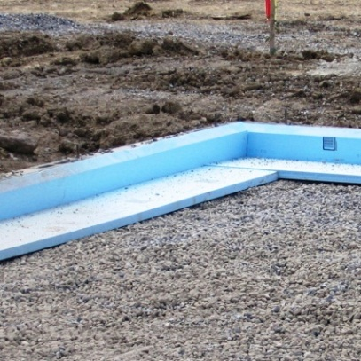

Section 5 – 5.5.3.5
Slab-on-Grade Floor Insulation
Table describes the rated R-value of insulation to be installed around the perimeter of the slab-on-grade floor to the distance specified or comply with F-factor requirement based on Appendix A.
Installing Insulation:
  Inside foundation wall – extend downward from top of slab a minimum distance specified or to the top of the footing, whichever is less
  Outside foundation wall – extend from top of the slab or downward to at least the
  bottom of the slab and then horizontally to a minimum distance specified
  In all climate zones, the horizontal insulation extending outside of the foundation to be covered by pavement or by soil a minimum of 10 in. thick
  Exception: monolithic slab-on-grade floor, insulation to extend from the top of the slab-on-grade to the bottom of the footing.
Notes:
For unheated slabs, insulation is required from climate zones 3 and up.

Slide 64

Section 5 – 5.5.3.6
Opaque Doors
U-factor not greater than specified for climate zone in appropriate table
Notes:
Table 5.5-4 (partial table)

Slide 65
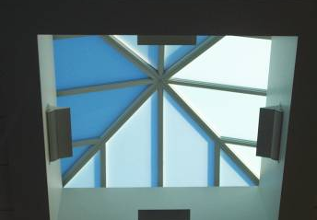
Section 5 – 5.5.4
Fenestration
Criteria apply to fenestration, including windows, glass doors, glass block, plastic panels, and skylights
specified by fenestration type and by climate zone
Compliance with values in Tables 5.5-0 through 5.5-8
  U-factor not greater than specified
  SHGC not greater than specified
  Meet or exceed minimum VT/SHGC
  Use NFRC ratings or default values in Appendix A
Exceptions:
  Area weighting allowed within same class of construction and space-conditioning categories
  Vertical fenestration can only be area-weighted across a single space conditioning category (ie: conditioned vs unconditioned spaces)

Slide 66
Section 5 – 5.5.4.2
Fenestration Area
Total vertical fenestration area to be smaller than specified values in Tables 5.5-0 through 5.5-8 (40% for all climate zones)
  Including both fixed and operable vertical fenestration
  Exception: street-level vertical fenestration (5.5.4.4.1)
  Total skylight area smaller than specified in Tables 5.5-0 through 5.5-8 (3% of roof area for all climate zones)
    Permitted to be no greater than 6% of gross roof area provided criteria in exception 1 to skylight SHGC requirements are met (5.5.4.4.2) and daylight area under skylights is more than or equal to half the floor area of the space
Notes:
Buildings with vertical fenestration > 40% must use the Trade-Off Method or ECB.
For both windows and skylights, there is a maximum U-factor and a maximum SHGC.
= vertical if slope is greater than or equal to 60 degrees from horizontal.
= skylight if slope is less than 60 degrees from horizontal.
Ex: clerestories, roof monitors = vertical

Slide 67
Section 5 – 5.5.4.2.3
Minimum Skylight Fenestration Area
Minimum skylight area must be provided in enclosed spaces that are ≥ 2,500 ft² with ceiling height > 15 ft and the following use type:
Office
Lobby
Atrium
Concourse
Corridor
Storage (incl. nonrefrigerated warehouse)
Gymnasium/fitness/exercise area
Playing area
Gymnasium seating area
Convention exhibit/event space
Courtroom
Automotive service
Fire station engine room
Manufacturing
Corridor/transition and bay areas
Retail
Library reading and stack areas
Distribution/sorting area
Transportation
Baggage and seating areas
Workshop
Notes:
Requirements for skylights in large spaces

Slide 68
Section 5 – 5.5.4.2.3
Minimum Skylight Fenestration Area
When spaces require skylights, the skylight area must daylight a minimum of half the floor area be designed to provide either:
A minimum ratio of 3% of skylight area to daylight area with a skylight VLT at least 0.40, or
a minimum skylight effective aperture of at least 1%
Minimum skylight areas are not required
For enclosed spaces in climate zones 6-8
For enclosed spaces under shaded roofs (beam sunlight blocked for more than 1500 daytime hours between 8 a.m. and 4 p.m.)
For daylight area under rooftop monitors are > 50% of floor area
When documented that 90% of skylight area is shaded on June 21 (Northern Hemisphere)/December 21 (Southern Hemisphere) at noon by permanent features
When total space area minus the primary and secondary sidelighted area(s) is < 2,500 ft and where lighting is controlled according to sidelighting requirements of Section 9.4.1

Slide 69
Section 5 – 5.5.4.3 and 5.8.2.3
Fenestration U-Factor
Fenestration U-factor shall not be greater than specified in Tables 5.5-0 through 5.5-8
  Exception:
  U-factor for skylights allowed to be increased no greater than
    0.90 Btu/h•ft² °F in climate zone 0-3
    0.75 Btu/h•ft² °F in climate zone 4-8
    Provided they have a measured haze value >90%, skylight VT> 90% and lighting under the skylight has multilevel photocontrols per Section 9.4.1.1 (f)
Fenestration and Door U-Factors shall be calculated accordance with NFRC 100 and Skylight U-Factors shall be based on a slope of 20° above the horizontal
Exceptions
  U-Factors from Appendix A are used; A8.1 for skylights, A8.2 for vertical fenestration, and A7 for opaque doors
  ANSI/DASMA 105 acceptable for sectional garage doors and metal coiling doors
Notes:
NFRC’s certification program shifted the basis for skylight ratings to a 20 degree slope in 2001.

Slide 70
Section 5 – 5.5.4.4
Fenestration SHGC
Vertical fenestration (5.5.4.4.1)
  SHGC values < Assembly Maximum SHGC in Tables 5.5-0 to 5.5-
Exceptions
For south, east, or west-oriented vertical fenestration only, the SHGC in the proposed building can be reduced by using the multipliers in Table 5.5.4.4.1 for fenestration shaded by permanent projections that will last as long as the building itself
For south, east, or west-oriented vertical fenestration shaded by partially opaque permanent projections that will last as long as the building itself, can reduce the PF by multiplying by values in Table 5.5.4.4.1
Street-level exception only applies when using the prescriptive compliance option
Dynamic glazing cannot be area-weighted with other fenestration and minimum SHGC of dynamic glazing shall be used to show compliance for dynamic glazing
North-oriented vertical fenestration allowed to have SHGC equal to or less than the area-weighted average SHGC of the south, east, and west-oriented vertical fenestration before any reductions made for permanent projections in Exception 1 and 2 of Section 5.5.4.4.1
Notes:
Street-level fenestration if:
Street side of the street-level story is < 20 ft in height
Fenestration has a continuous overhang with weighted average PF > 0.5 and
Street-level fenestration area is < 75% of the gross wall area.

Slide 71


Information – Overhangs
Standard 90.1 credits permanent overhangs by adjustment to SHGC
Size of overhang is determined by projection factor
Projection Factor Ratio
Calculating Projection Factor Ratio
Notes:
Conventional overhangs are solid, however, the Standard also offers credit for louvered overhangs and overhangs made of transparent or translucent materials such as tinted or fretted glass.
Credit is offered for louvered overhangs only when the louvers are angled and spaced such that no direct sunlight passes through the louvers at solar noon on the summer solstice (June 21 in the northern hemisphere).

Slide 72
Section 5 – 5.8.2.4
Solar Heat Gain Coefficient (SHGC)
Fenestration SHGC shall be determined in accordance with NFRC 200
Exceptions
  Shading Coefficient (SC) x 0.86 is acceptable for overall fenestration area (NFRC 300)
  SHGC of center-of-glass is acceptable (NFRC 300) for overall fenestration area
  SHGC from A8.1 for skylights is an acceptable alternative for determining compliance
  SHGC from A8.2 for vertical fenestration is an acceptable alternative for determining compliance
Notes:
The glazing’s effectiveness in rejecting solar heat gain
SHGC must be determined in accordance with NFRC 200 and product must be labeled and certified by manufacturer.

Slide 73
Section 5 – 5.5.4.4.2
Skylight SHGC
Skylights
  SHGC values < Table value for appropriate total skylight area
Exceptions
1. If skylights
Have a glazing material or diffuser with measured haze value > 90% when tested according to ASTM D1003, and
Have a skylight VT > 0.40, and
Have all general lighting in daylight area under skylights controlled by multilevel photocontrols per Section 9.4.1.1 (f)
2. Dynamic Glazing
Minimum SHGC is used to demonstrate compliance
Considered separately from other vertical fenestration
Area-weighted averaging with other vertical fenestration that isn’t dynamic glazing isn’t allowed

Slide 74


Section 5 – 5.5.4.5
Fenestration Orientation
Two options to comply for vertical fenestration:
N
Option 1 – Area Method
East & West fenestration areas are each less than 25% of building total
For climate zones 0 - 8
A_{W} ≤ (A_{T})/4 and A_{E} ≤ (A_{t})/4
Option 2 – SHGC Weighted Method
East & West area weighted SHGC is each less than average area weighted SHGC.
For climate zones 0 – 3
A_{W} x SHGC_{W} ≤ (A_{T} x SHGC_{C})/4 and
A_{E} x SHGC_{E} ≤ (A_{T} x SHGC_{C})/4
For climate zones 4 – 8
A_{W} x SHGC_{W} ≤ (A_{T} x SHGC_{C})/5 and
A_{E} x SHGC_{E} ≤ (A_{T} x SHGC_{C})/5
No!
N
Yes!
Where,
A_{W} and SHGC_{W} = west-oriented vertical fenestration area and SHGC
A_{E} and SHGC_{E} = east-oriented vertical fenestration area and SHGC
A_{T} = total vertical fenestration area
SHGC_{C} = SHGC criteria in Tables 5.5-0 through 5.5-8
Exceptions
Complies with Exception 3 of Section 5.5.4.4.1
Buildings with shade on 75% of the west and east
Alterations and additions that don’t increase vertical fenestration area
Buildings where west- and east-oriented vertical fenestration area < 20% of gross wall area for each of those facades and SHGC on those facades < 90% of SHGC_{c}
Buildings in climate zone 8
Notes:
SHGC trade-off new in 2013 edition. Allows more flexibility in complying prescriptively.
SHGC of east- and west-oriented fenestration used in formula can include effect of overhangs.
Exception for 75% shading applies when shading provided from permanent projections, existing buildings, existing permanent infrastructure, or topography at 9am and 3pm on June 21

Slide 75
Section 5 – 5.5.4.6
Visible Transmittance/SHGC Ratio
When automatic daylighting controls are required per 9.4.1.1 (e) or (f), fenestration in all climate zones shall have a VT/SHGC ratio that is no less than 1.1.
Exceptions
Use of light-to-solar-gain ratio (LSG)
  Fenestration can have a LSG ratio of not less than 1.25 if center-of-glass SHGC and VT determined per NFRC 300 and NFRC 301 by independent lab
Fenestration not covered in scope of NFRC 200
In enclosed spaces where:
  daylight area under rooftop monitors is > 50% of floor area and
  skylights comply with 5.5.4.2.3 and
  sidelighting effective aperture is ≥ 0.15
Dynamic glazing
  VT/SHGC ratio and LSG determined using maximum VT and maximum SHGC
  Considered separately from other fenestration; cannot include dynamic glazing with other fenestration for area-weighted averaging

Slide 76
Compliance Paths
Building Envelope
Building System
Compliance Requirements
Envelope
Prescriptive Path
Submittal Requirements
HVAC
Envelope Trade Off
Energy Code Compliance
Mandatory
Provisions
(required for each compliance path)
Information and Installation Requirements
SWH
Energy Cost Budget
Power
Verification, Testing, Inspection & Commissioning
Lighting
Simplified
Other
Performance Rating Method
Notes:
The following section details the envelope trade-off option.
Building Envelope Trade-Off Option cannot be used to make trade offs between the building envelope and the lighting or mechanical systems
All mandatory provisions must be satisfied regardless of which compliance path (prescriptive, building envelope trade-off, or energy cost budget) is used.

Slide 77
Section 5 – 5.6.1
Building Envelope Trade-Off Option “Rules”
Proposed design must comply with Sections 5.1, 5.4, 5.7, 5.8, and 5.9
Proposed envelope performance factor (EPF) of proposed design is less than or equal to the proposed envelope performance factor of the base design
All building envelope components shown on drawings or installed in existing buildings to be included in proposed building design
Fenestration and opaque envelope types and area used in simulation model to be consistent with design documents
Don’t need to separately describe any envelope assembly covering < 5% of total area of that assembly
  as long as it’s similar to an assembly being modeled
  if not separately described, add the area of that assembly to an assembly with same orientation and thermal properties

Slide 78

Section 5 – 5.6.1.2
Trade-Offs Limited to Building Permit
Limitations of the Envelope Trade-off Approach
If the building permit application applies to less than the whole building, then all parameters relating to unmodified existing conditions or future building components shall be identical when calculating the proposed EPF and base EPF.
Any future components must meet prescriptive requirements of Section 5.5

Slide 79
Compliance Paths
Building Envelope
Building System
Compliance Requirements
Envelope
Prescriptive Path
Submittal Requirements
HVAC
Energy Code Compliance
Envelope Trade Off
Mandatory
Provisions
(required for each compliance path)
Information and Installation Requirements
SWH
Energy Cost Budget
Power
Verification, Testing, Inspection & Commissioning
Lighting
Simplified
Other
Performance Rating Method
Notes:
The following section details the envelope trade-off option.
Building Envelope Trade-Off Option cannot be used to make trade offs between the building envelope and the lighting or mechanical systems
All mandatory provisions must be satisfied regardless of which compliance path (prescriptive, building envelope trade-off, or energy cost budget) is used.

Slide 80
Section 5 – 5.7
Submittals
Compliance documentation and supplemental information per 4.2.2
Permit Application Documentation shall include:
  Type and rated R-value of each insulation product
  Opaque door schedule showing U-factors
  Fenestration schedule showing manufacturer, model number, orientation, area, U-factor, SHGC, and VT
  air barrier details.
  Clear labeling of space conditioning categories on permit drawings
  Clear labeling of daylight areas on permit drawings including
    Primary sidelighted areas
    Secondary sidelighted areas
    Daylight area under skylights
    Daylight areas under roof monitor
  Completion Requirements including record documents and Owner Manuals

Slide 81
Compliance Paths
Building Envelope
Building System
Compliance Requirements
Envelope
Prescriptive Path
Submittal Requirements
HVAC
Energy Code Compliance
Envelope Trade Off
Mandatory
Provisions
(required for each compliance path)
Information and Installation Requirements
SWH
Energy Cost Budget
Power
Verification, Testing, Inspection & Commissioning
Lighting
Simplified
Other
Performance Rating Method
Notes:
The following section details the envelope trade-off option.
Building Envelope Trade-Off Option cannot be used to make trade offs between the building envelope and the lighting or mechanical systems
All mandatory provisions must be satisfied regardless of which compliance path (prescriptive, building envelope trade-off, or energy cost budget) is used.

Slide 82
Section 5 – 5.8
Product Information and Installation Requirements
Building Envelope Assemblies must meet all of the information and Installation requirements in Section 5.8.
Labeling of Building Envelope Insulation (Section 5.8.1.1)
Manufacturers’ Installation Instructions (Section 5.8.1.2)
Loose-Fill Insulation Limitation (Section 5.8.1.3)
Baffles (Section 5.8.1.4)
Substantial Contact (Section 5.8.1.5)
Recessed Equipment (Section 5.8.1.6)
Insulation Protection (Section 5.8.1.7)
Location of Roof Insulation (Section 5.8.1.8)
Extent of Insulation (Section 5.8.1.9)
Joints in Rigid Insulation (Section 5.8.1.10)
Insulation Installation Documentation (Section 5.8.1.11)
Notes:
Labeling of Building Envelope Insulation - The rated R-value to be clearly identified
Exception: If no identification mark, need a signed and dated certification for the installed insulation listing the type of insulation, the manufacturer, the rated R-value, and, where appropriate, the initial installed thickness, the settled thickness, and the coverage area.
Manufacturers’ Installation Instructions - Insulation to be installed in accordance with manufacturers’ recommendations and in such a manner as to achieve rated R-value of insulation.
Exception: Where metal building roof and metal building wall insulation is compressed between the roof or wall skin and the structure.
Loose-fill Insulation Limitation - Open-blown or poured loose-fill insulation not used in attic roof spaces when the slope of the ceiling is >3/12.
Baffles - When eave vents are installed baffles provided to deflect the incoming air above the surface of the insulation.

Slide 83

Section 5 – 5.8.1.5
Insulation – Substantial Contact
Install insulation in a permanent manner in substantial contact with inside surface
Flexible batt insulation in floor cavities must be supported in a
permanent manner by supports no more than 24 in. on center (o.c.)
Notes:
There is an exception for assemblies that use reflective materials and rely on an air gap next to the interior surface.

Slide 84
Section 5 – 5.8.1.6
Recessed Equipment
Recessed equipment should not affect insulation thickness
  Lighting fixtures
  HVAC equipment (includes wall heaters, ducts, and plenums)
  Other
Except when
  Total combined area affected (include necessary clearances) is
  < 1% of opaque area of the assembly, OR
  Entire roof, wall, or floor is covered with insulation to the full depth required, OR
  Effects of reduced insulation are included in area-weighted calculations and compressed insulation values from Table A9.4.3
In all cases, air leakage to be limited through or around recessed equipment to the conditioned space in accordance with Section 5.4.3 (Air leakage)
Notes:
Penetration to the roof/ceiling area
Even with these exceptions, the infiltration barrier must be maintained – this generally prohibits drop-in ceilings from being used as the exterior envelope element.
Examples of recessed equipment:
Lighting fixtures
Wall heaters
HVAC ducts
Diffusers
VAV boxes
Electrical panels
Exception examples:
Lighting fixtures can penetrate insulated ceiling if area of opening is <1% of total ceiling area.
Could be achieved if Type IC lighting fixtures are used and additional insulation is placed on top of them.
In all cases, air leakage through or around the recessed equipment to the conditioned space is limited in accordance with Section 5.4.3 (Air Leakage).

Slide 85

Section 5 – 5.8.1.7
Insulation Protection
Insulation Protection
  Cover exterior insulation to protect from
    Sunlight
    Moisture
    Landscaping operations
    Equipment maintenance
    Wind
  Ensure access to attics and mechanical rooms without damaging or compressing insulation
  Any insulation materials in ground contact shall have a water absorption rate ≤ 0.3% (ASTM C272)
Example
Notes:
Rigid insulation used at the slab perimeter shall be covered.
If equipment is installed in attics, access must be provided in a way that won’t cause compression or damage to the insulation. This may mean using walking boards, access panels, and other techniques.
Foundation vents to not interfere with the insulation.

Slide 86


Section 5 – 5.8.1.8
Location of Roof Insulation
Roof Insulation
  Not installed on a suspended ceiling with removable ceiling panels
  Non-compliant
Notes:
Prohibited because the insulation’s continuity is likely to be disturbed by maintenance workers.
Also, suspended ceilings don’t meet the infiltration requirements unless they’re properly sealed.
If not totally sealed not part of your thermal envelope

Slide 87
Section 5 – 5.8
Additional Requirements
Section 5 – 5.8.1.9 Extent of Insulation
Insulation should extend over the full component area to the required insulation rating R-value, U-factor, C-factor or F-factor
Section 5 – 5.8.1.10 Joints in Rigid Insulation
Where two or more layers of rigid insulation board are used in a construction assembly the edge joints between each layer of boards to be staggered

Slide 88
Section 5 – 5.8.3.1
Air Leakage – Testing, Acceptable Materials, and Assemblies
Air leakage requirements for materials, assemblies, fenestration and doors is now in Section 5.8.3.1
  Materials: 0.004 cfm/ft²
  Assemblies: 0.04 cfm/ft²
  Fenestration: 0.06 – 0.3 cfm/ft²
  Doors:
  1.0 – 1.3 cfm/ft²
Notes:
Not sure what this slide is trying to say

Slide 89

Section 5 – 5.8.3.1
Air Leakage – Testing, Acceptable Materials, and Assemblies
Material air-leakage compliance – new table in Section 5.8
The following materials meet the requirements of Table 5.8.3.1:
1. Plywood, minimum 3/8 in.
2. Oriented strand board, minimum 3/8 in.
3. Extruded polystyrene insulation board, minimum 1/2 in.
4. Foil-faced polyisocyanurate insulation board, minimum 1/2 in.
5. Exterior gypsum sheathing or interior gypsum board, minimum 1/2 in.
6. Cement board, minimum 1/2 in.
7. Built-up roofing membrane
8. Modified bituminous roof membrane
9. Single-ply roof membrane
10. A Portland cement/sand parge, stucco, or gypsum plaster, minimum 1/2 in. thick
11. Cast-in-place and precast concrete
12. Sheet metal
13. Closed-cell 2 lb/ft3 nominal density spray polyurethane foam, minimum 1 in.

Slide 90
Section 5 – 5.8.3.1
Air Leakage – Testing, Acceptable Materials, and Assemblies
Assembly air-leakage compliance – new table in Section 5.8
The following assemblies meet the requirements of Table 5.8.3.1:
  Fully grouted concrete masonry walls
  Concrete masonry walls painted to fill the pores
  Shale or clay masonry units assembled as a solid wall (without weeps, with nominal width of 4in. or more, and with Type S mortar)

Slide 91

Section 5 – 5.8.3.2
Air Leakage – Fenestration and Doors

Slide 92
Compliance Paths
Building Envelope
Building System
Compliance Requirements
Envelope
Prescriptive Path
Submittal Requirements
HVAC
Energy Code Compliance
Envelope Trade Off
Mandatory
Provisions
(required for each compliance path)
Information and Installation Requirements
SWH
Energy Cost Budget
Power
Verification, Testing, Inspection & Commissioning
Lighting
Simplified
Other
Performance Rating Method

Slide 93
Section 5 – 5.9
Verification, Testing, Commissioning, and Inspection
Verification of:
Building envelope performance
Design and installation of continuous air barrier
  Design review to assess compliance with Sections 5.4.3 and 5.8.3.2
  Periodic field inspection during construction to view assemblies while still accessible, confirm repairs and verify compliance with Sections 5.4.1.2 and 5.8.3
  Reporting in compliance with Section 4.2.5.1.2
Commissioning
Energy performance of building envelope
Required Inspections:
Fenestration and doors
  Air leakage testing conducted by independent third party, when applicable
  Operation of door and operating mechanism for conformance with the manufacturer’s instructions
  Seals or gaskets installed per manufacturer’s instructions
Loading dock weatherseals to ensure proper installation and condition

Slide 94
Section 5 – 5.9
Verification, Testing, Commissioning, and Inspection (cont’d)
Opaque building envelope air tightness
  Opaque roof, above-grade walls, and below-grade walls, and floors subject to the following inspections:
    Use of compliant materials and assemblies per Section 5.8.3.1
    Integration with adjoining fenestration and continuous air barrier elements
Fenestration Commissioning items
  Skylights size and location in relation to designed primary sidelighted area and secondary lighted area below
  Roof monitor size and location in relation to designed primary sidelighted area and secondary lighted area below
  Dynamic glazing with SHGC and U-factor per Section 5.5.4.4.1 and 5.5.4.4.2 and testing of the operation of conformance per manufacturer’s instructions
  Permanent fenestration projections installation and performance per Section 5.5.4.4.1 and construction documents

Slide 95

Section 4 – 4.2.5
Verification, Testing, and Commissioning
Referenced 5.9 testing and commissioning refers to 4.2.5
New in 2019: Central FPT & Commissioning requirements

Slide 96
Section 4 – 4.2.5
Verification, Testing, and Commissioning
Referenced 5.9 testing and commissioning refers to 4.2.5
4.2.5 Verification, Testing, and Commissioning
4.2.5.1 Verification and Testing (V&T)
  V&T provider qualifications
  V&T requirements in construction documents
  Functional Performance Testing (FPT) & Verification Documentation
4.2.5.2 Commissioning (Cx) (unless Excepted)
  Cx provider qualifications
  Cx plan, design review, requirements in construction documents
  Preliminary and Final Cx report includes FPT & verification

Slide 97
Section 4 – 4.2.5.2
Exceptions to Commissioning
Where to FPT & Cx requirements apply
 | Simple buildings (<10k conditioned ft², warehouse, or Simple HVAC path < 25k ft²) | Complex Buildings < 25,000 ft² | All Buildings ≥ 50,000 ft² Except Warehouse
Verification, FPT | Required | Required | Required
Pre- & Design phase Cx | NR | Required | Required
Construction Phase Cx | NR | Required | Required
80% of US buildings are exempt from commissioning requirements
Verification and functional performance testing (FPT) required throughout
Pre- & design-phase Cx saves energy and cost by catching issues early
90.1 Cx requirements only apply to 90.1 standard requirements
Verification that the design substantially meets 90.1 included

