Slide 1
ANSI/ASHRAE/IES Standard 90.1-2019: Power and Lighting
Prepared by Pacific Northwest National Laboratory for the U.S. Department of Energy
May 2020 – PNNL-SA-153216

Slide 2
Acknowledgements
PNNL and DOE would like to thank ASHRAE Standing Standard Project Committee 90.1 for their contributions to the development of this presentation and their technical review of the content.

Slide 3
OVERVIEW OF CHANGES TO 90.1-2019

Slide 4
Summary of Changes
Updated:
Lighting model for LPD calculations
LPD allowances (9.5.1, 9.6.1)
Interior and exterior lighting wattage (9.1.4)
Parking garage lighting control requirements (9.4.1.2)
Special applications lighting and controls (9.4.1.2)
Daylighting control requirements (9.4.1.1)
Daylighting zones [3.2, 9.4.1.1(e)]
LPDs for non-typical exterior areas (9.4.2)
New:
Simplified lighting method for select buildings up to 25,000 ft² (9.3)

Slide 5
Summary of Changes Lighting Model
90.1 lighting methodology used to develop LPAs was evaluated and model reconstructed
Now more representative of real-world conditions
Updated IES recommendations, room cavity ratios, light loss factors, and efficacy values
Additional surface reflectance categories added
Features a 100% LED baseline

Slide 6
Summary of Changes
Simplified Building Method Compliance Path
Intended for contractors who design or renovate office, school, and retail buildings up to 25,000 ft²
Single interior and exterior LPD targets cover the entire building; LPAs are lower than other methods
Requirements occupancy sensor lighting control in most spaces, with some exemptions where life safety concerns apply
All power from all lights must be counted towards the Interior Lighting Power Allowance – NO EXEMPTIONS
Notes:
The building area method is the easiest to use but has limitations as discussed above.

Slide 7
Interior Lighting Power Allowances Space-by-Space Method
Average LPD reduction from 2016: 5%
Space-by-space values are primary
Building area method LPDs values flow from the space-by-space
Space-by-Space Method – Lighting Power Densities (w/sq. ft.)
Space Type | 90.1 2016 | 90.1 2019
Office, open plan | 0.81 | 0.61
Guest room | 0.77 | 0.41
Lobby, hotel | 1.06 | 0.51
Parking area, interior | 0.14 | 0.15
Retail sales Area | 1.22 | 1.05
Classroom/lecture/training | 0.92 | 0.71
Warehouse, med. To bulky items | 0.35 | 0.33
LOOK HERE
Addendum BB

Slide 8
Interior Lighting Power Allowances Building Area Method
Average LPD reduction from 2016: 5%
BAM values flow from the space-by-space values
Building Area Method – Lighting Power Densities (w/sq. ft.)
Building Type | 90.1 2016 | 90.1 2019
Office | 0.79 | 0.64
Hotel/Motel | 0.75 | 0.56
Manufacturing Facility | 0.90 | 0.82
Parking Garage | 0.15 | 0.18
Retail | 1.06 | 0.84
School/University | 0.81 | 0.72
Warehouse | 0.48 | 0.45
Addendum CG

Slide 9
New Compliance Method for Lighting in Simple Buildings
Intended for contractors who design or renovate office, school, and retail buildings up to 25,000 sq. ft.
Single interior and exterior LPD targets that cover the entire building, LPAs are lower than other methods
Requires occupancy sensor lighting control in most spaces with some exemption where life safety concerns apply
All power from all lights must be counted towards the Interior Lighting Power Allowance ILPA No Exemptions
Addendum BG

Slide 10
New Compliance Method for Lighting in Simple Buildings
Addendum BG

Slide 11
New Compliance Method for Lighting in Simple Buildings
Addendum BG

Slide 12
Interior and Exterior Lighting Wattage
Replaced luminaire with lighting equipment
Changed the term ballast to be ballast/driver
Section now clearly split into 5 categories:
Line voltage lighting equipment
Line voltage lighting equipment with remote ballast/driver
Track/plug-in busway
Low-voltage track
DC low voltage lighting systems with flexible cabling for plug-in connection of lighting equipment and remote power supply (e.g., PoE lighting)
NEW
Wattage of a DC low voltage lighting system that employs flexible cabling for plug-in connection of the lighting equipment and a remote power supply shall be the labeled maximum wattage of the system power supply
For systems that also provide power to equipment other than lighting, the wattage shall be the labeled maximum wattage of the system power supply reduced by the wattage of the non-lighting equipment connected to the system
Addendum AH

Slide 13
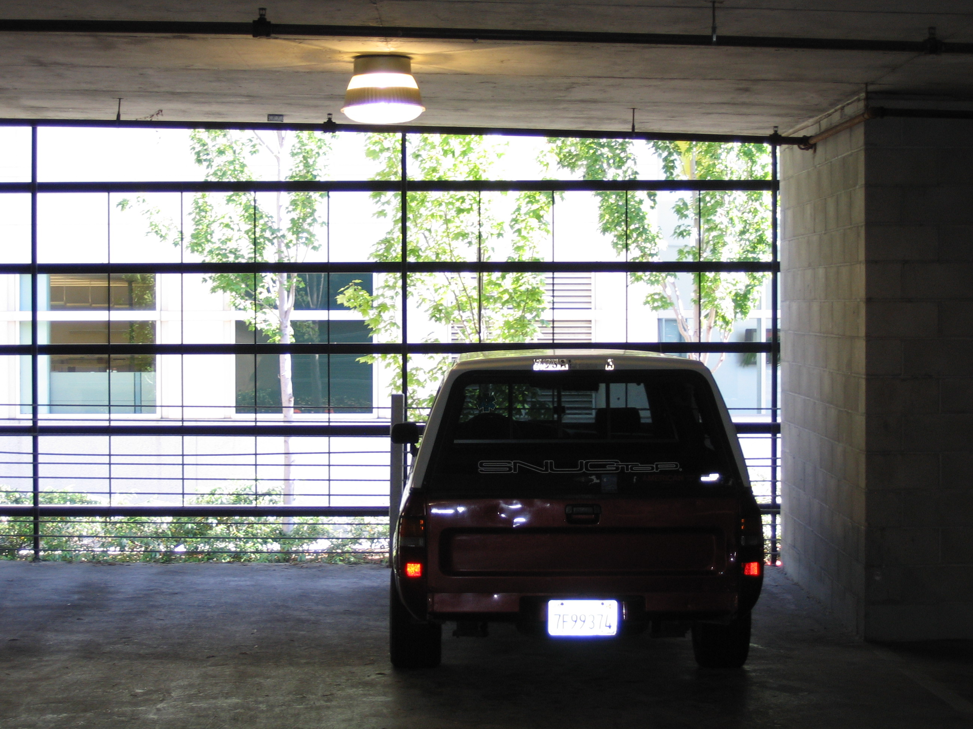
Parking Garage Lighting Control Requirements
Increased the stringency of setback in parking garages – % reduction & time period
Updated control requirements for transition lighting
Continuous daylight dimming down to 50% required for luminaires within 20 ft. of wall openings
Parking Garages
 | 90.1 2016 | 90.1 2019
Time | 20 | 10
Reduction | 30% | 50%
NEW
NEW exemptions for permanent architectural screens or architectural elements that obstruct more than 50% of the opening and where the top of and existing adjacent structures or natural objects is at least twice as high above the openings as its horizontal distance from the opening.
Addendum CV

Slide 14
Special Applications Lighting and Controls
Clarified the lighting control requirements for lighting applications not specifically covered in Table 9.6.1 and aligned them to the mandatory control provisions in 9.4.1
Item # | Equipment/Application | In Addition to and controlled Separately from General Lighting | Required Controls
1 | Lighting that is integral to equipment, medical equipment or instrumentation and is installed by its manufacturer. | YES | No control requirements
2 | Lighting specifically designed for use only during medical or dental procedures | YES | 9.4.1.1(a) - Local control
8 | Lighting integral to both open and glass-enclosed refrigerator and freezer cases. | YES | 9.4.1.1(h) - Automatic full OFF or 9.4.1.1(i) - Scheduled shutoff
9 | Casino gaming areas. | NO
10 | Lighting in retail display windows, provided the display area is enclosed by ceiling-height partitions. | YES | 9.4.1.1(a) - Local control and 9.4.1.1(i) - Scheduled shutoff
Addendum AQ

Slide 15
Daylighting Control Requirements
NEW: Continuous daylight dimming required for all spaces
Step dimming (control points) eliminated from requirements
Calibration for automatic daylight responsive controls for sidelighting no longer requires the physical presence of a person at the sensor while processing
Low setting for the photocontrol to reduce electric lighting power in response to available daylight using continuous dimming set to ‘20% or less or off’
When an automatic partial OFF control has reduced the lighting power to the unoccupied setpoint, the daylight responsive control shall adjust the electric light in response to available daylight, but it shall not allow the lighting power to be above the unoccupied setpoint
NEW
continuous dimming: a lighting control strategy that varies the light output of a lighting system over a continuous range from full light output to a minimum light output in imperceptible steps without flickering.
Addendum CW
Notes:
Can try to you reduce text of the bullets?

Slide 16
Daylighting Zones
NEW: Added definition for daylight area under skylights in multi-story space
Added two figures for clarity
Added an exemption for primary sidelighted areas adjacent to vertical fenestration that have external projections and no vertical fenestration above the external projection and projection factor >1.0 for north-oriented projections or where the external projection has a projection factor > 1.5 for all other orientations
NEW
daylight area under skylights in multistory spaces: the daylight area under skylights in multi-story spaces shall include floor areas directly beneath the skylight and portions of the uppermost floor adjacent to the multistory space that meet the criteria for a daylight area under skylights, where CH is the ceiling height of the uppermost floor
Addendum CH
Notes:
Can try to you reduce text of the bullets?

Slide 17
Daylighting for Sidelighting Requirements
Modified the sidelighting requirements to clarify that the setback distance is a horizontal measurement
Added natural objects as obstructions in addition to existing adjacent structures
Removed an error that inadvertently set an exact measurement for an obstruction (instead of saying at least twice as high above the windows as its horizontal distance away from the windows)
Addendum CY

Slide 18
Selecting LPDs for Non-Typical Exterior Areas
Clarified how to select an LPD for an exterior area not already listed in Table 9.4.2-2 by moving the language from 9.4.2 to a new explanatory row at the end of Table 9.4.2-2
Interior LPDs from Table 9.6.1 are referenced and an appropriate reduction is applied to recognize the reduced power and illumination needs in exterior applications
Addendum T
Notes:
Suggest some text edits

Slide 19
DETAILED INFORMATION
CHANGES TO 90.1-2019 SHOWN IN RED

Slide 20
Compliance Paths Power
Building System
Compliance Requirements
Envelope
Prescriptive Path
Submittal Requirements
HVAC
Energy Code Compliance
Simplified
Mandatory
Provisions
(required for each compliance path)
Information and Installation Requirements
SWH
Trade Off Option
Power
Energy Cost Budget
Verification, Testing, Inspection & Commissioning
Lighting
Other
Performance Rating Method
Notes:
Grayed out options under Compliance Options do not exist for this chapter. For Power, there are only Mandatory Provisions and the option to use the Energy Cost Budget Method or Appendix G.
Power section is only in 90.1, not IECC.

Slide 21
Section 8 Power – Scope
New Buildings
Additions
Alterations
Mandatory Provisions
Voltage drop
Automatic receptacle control
Electrical Energy Monitoring
Low-Voltage Dry Type Distribution Transformers
Submittals
Notes:
Section 8 covers voltage drop and completion requirements (both of these requirements are mandatory).

Slide 22
Section 8 – 8.1.2 – 8.1.4 New Buildings, Additions, and Alterations to Existing Buildings
Equipment installed in new buildings or additions to existing buildings must comply
Alterations to equipment or systems must comply with requirements applicable to those specific portions of the building and systems being altered
New equipment installed as a direct replacement of existing equipment must comply with requirements for that equipment
Exception - Compliance not required for relocation or reuse of existing equipment at the same site

Slide 23
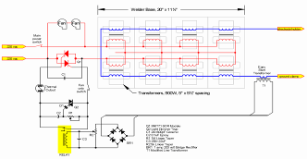
Section 8 – 8.4.1 Voltage Drop
Two types of conductors
Feeder conductors
Connect service equipment to the branch circuit breaker panels
Branch circuit conductors
Run from the final circuit breaker to the outlet or load
Feeder conductors and branch circuits combined to be sized for a maximum of 5% voltage drop total

Slide 24
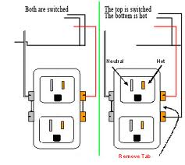
Section 8 – 8.4.2 Automatic Receptacle Control
Automatically controlled
≥ 50% of all 125 volt 15- and 20-amp receptacles in:
Private offices
Conference rooms
Rooms used primarily for printing and/or copying functions
Break rooms
Classrooms
Individual workstations
≥ 25% of branch circuit feeders installed for modular furniture not shown on construction documents

Slide 25
Section 8 – 8.4.2 Automatic Receptacle Control (cont’d)
Automatic control devices must function on:
Time-of-day controller provided to control ≤ 5,000 ft² and not more than one floor (occupant able to manually override up to 2 hours) OR
Occupant sensor(s) to turn off receptacles within 20 minutes of occupant leaving the space, OR
Automated signal from another control or alarm that turns receptacles off within 20 minutes after determining the area is unoccupied
Controlled receptacles must be
visually marked to differentiate from uncontrolled receptacles
uniformly distributed throughout the space
Plug-in type devices may not be used to comply with this requirement
Exceptions
Receptacles designated for equipment requiring 24 hr/day 365 days/yr operation
Spaces where automatic lighting shutoff would cause security or safety concerns

Slide 26
Section 8 – 8.4.3 Electrical Energy Monitoring
Measurement devices in new building to monitor electrical energy use for each of these separately:
Total electrical energy
HVAC systems
Interior lighting
Exterior lighting
Receptacle circuits
For buildings with multiple tenants, the above must be separately monitored for total building and for each tenant (excluding shared systems)
Exception:
up to 10% of each separate load (other than total) can be from other electrical loads

Slide 27
Section 8 – 8.4.3 Electrical Energy Monitoring – Recording and Reporting
Energy use must be automatically recorded a minimum of every 15 minutes
Use must be reported at least hourly, daily, monthly, and annually
Data for tenants must be made available to that tenant
The system must be capable of retaining data for at least 36 months

Slide 28
Section 8 – 8.4.4 Low Voltage Dry-Type Distribution Transformers
Comply with the Energy Policy Act of 2005
If not included in scope of EPAct 2005, then no requirements
Exceptions
If meet EPAct 2005 exclusions based on 10 CFR 431
Special purpose applications
Not likely in general purpose applications
Have multiple voltage taps where highest tap is ≥ 20% more than lowest tap
Some specific products are listed
Notes:
Products that meet the exception criteria and are exempt from 8.1.2 include these types of transformers: drive, rectifier, auto-transformer, uninterruptible power system, impedance, regulating, sealed and nonventilating, machine tool, welding, grounding, or testing.

Slide 29
Section 8 – 8.6.1 Computer Room Systems
Power distribution systems and equipment only serving a computer room with IT equipment load > 10 kW to comply with Standard 90.4 (Energy Standard for Data Centers)
Notes:
Products that meet the exception criteria and are exempt from 8.1.2 include these types of transformers: drive, rectifier, auto-transformer, uninterruptible power system, impedance, regulating, sealed and nonventilating, machine tool, welding, grounding, or testing.

Slide 30
Compliance Paths Power
Building System
Compliance Requirements
Envelope
Prescriptive Path
Submittal Requirements
HVAC
Energy Code Compliance
Simplified
Mandatory
Provisions
(required for each compliance path)
Information and Installation Requirements
SWH
Trade Off Option
Power
Energy Cost Budget
Verification, Testing, Inspection & Commissioning
Lighting
Other
Performance Rating Method
Notes:
Grayed out options under Compliance Options do not exist for this chapter. For Power, there are only Mandatory Provisions and the option to use the Energy Cost Budget Method or Appendix G.
Power section is only in 90.1, not IECC.

Slide 31
Section 8 – 8.7 Power Submittals
Owner gets information about the building’s electrical system
Record drawings of actual installation within 30 days
Single-line diagram of electrical distribution system
Floor plans showing location and areas served for all distribution
Manuals
Submittal data stating equipment rating
O&M manuals for equipment
Qualified service agency contact
Complete narrative of system as it’s normally intended to operate

Slide 32
Compliance Paths Power
Building System
Compliance Requirements
Envelope
Prescriptive Path
Submittal Requirements
HVAC
Energy Code Compliance
Simplified
Mandatory
Provisions
(required for each compliance path)
Information and Installation Requirements
SWH
Trade Off Option
Power
Energy Cost Budget
Verification, Testing, Inspection & Commissioning
Lighting
Other
Performance Rating Method
Notes:
Grayed out options under Compliance Options do not exist for this chapter. For Power, there are only Mandatory Provisions and the option to use the Energy Cost Budget Method or Appendix G.
Power section is only in 90.1, not IECC.

Slide 33
Section 8 – 8.9 Verification, Testing, and Commissioning
Verification and Testing
Verify and test per 4.2.5.1 that control elements are configured and operating per 8.4.2 and 8.4.3
automatic receptacles controls
energy monitoring
Verification and Functional Performance Testing (FPT) documentation per 4.2.5.1
Commissioning
energy performance of the power systems per 4.2.5.2
Reporting per 4.2.5.2.2

Slide 34
Compliance Paths Lighting
Building System
Compliance Requirements
Envelope
Prescriptive Path
Submittal Requirements
HVAC
Energy Code Compliance
Simplified
Mandatory
Provisions
(required for each compliance path)
Information and Installation Requirements
SWH
Trade Off Option
Power
Energy Cost Budget
Verification, Testing, Inspection & Commissioning
Lighting
Other
Performance Rating Method
Notes:
Grayed out options under Compliance Options do not exist for this chapter.

Slide 35
Basic Lighting Requirements
Mandatory Requirements (Interior and Exterior)
Interior Lighting Power Limits
Exterior Lighting Power Limits
+
+
Tradable
Total Connected Power
Interior Lighting Power Allowance
<
Exemptions
Controls
Non-Tradable
Switching
Exemptions
Building Area
Efficiency
OR
Exterior Lighting Power Allowance
Total Connected Power
<
Space-by-Space
Additional Allowances
+
Simplified Method
Notes:
Interior lighting requirements are divided into a set of mandatory requirements, provisions that must be complied with regardless of the quantity of lighting that is installed, and two methods for determining the allowed wattage for the building.
The Prescriptive approach contains a look up table to determine allowed wattage for each occupancy type and is divided into two categories.
The Building Area approach can be used for a single occupancy building or separate business entities within a building.
The Space-by-Space approach is used flexibility and for non-standard building types or space configurations.

Slide 36
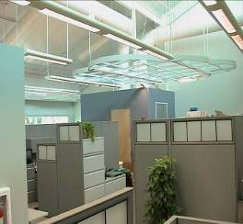
Section 9 Lighting
General Application (Section 9.1)
Scope
Lighting Alterations
Installed Lighting Power
Interior and Exterior Luminaire Wattage
Compliance Paths (Section 9.2)
Mandatory Provisions (Section 9.4)
Lighting control
Exterior lighting power
Dwelling units
Building Area Method Compliance Path (Section 9.5)
Alternative Compliance Path: Space-by-Space Method (Section 9.6)

Slide 37
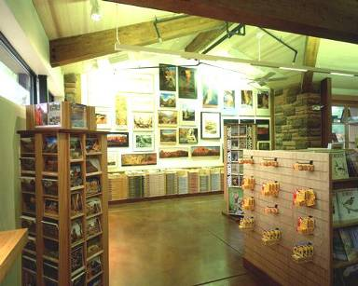
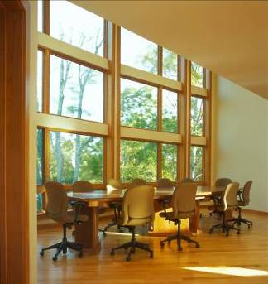
Section 9 Lighting General Scope
Interior spaces of buildings
Exterior lighting powered through building
Exceptions
Emergency lighting
Lighting required by life safety statute
Decorative gas lighting
Notes:
This section applies to the following: interior spaces of buildings
exterior building features, including facades, illuminated roofs, architectural features, entrances, exits, loading docks, and illuminated canopies
exterior building grounds lighting provided through the building’s electrical service

Slide 38
Section 9 Lighting General – Alterations
Applies to these retrofits:
where luminaires are added, replaced, or removed
Replacement of lamp plus ballast in luminaires
Requires BOTH interior and exterior alterations to comply with Lighting Power Density (LPD) limits and basic after hours automatic shutoff requirements
Exception
Spaces where alterations involve < 20% of connected lighting load and the LPD for the space is not increased
Alterations that only involve replacement of lamps plus ballasts/drivers or only involve one-for-one luminaire replacement to only comply with LPD requirement and Section 9.4.1.1(h) and 9.4.1.1(i)
Routine maintenance or repair situations

Slide 39
Section 9 Interior Lighting Power
Installed interior lighting power must be ≤ lighting power allowance
Installed interior lighting power calculation method
Calculation requirements
Lots of exemptions
Power allowance calculation methods
Building area compliance path
Alternative Compliance Path: Space-by-space method

Slide 40
Section 9 – 9.1.3 Installed Lighting Power Calculation Requirements – INTERIOR and EXTERIOR
These requirements apply to both interior and exterior
Installed Lighting Power shall include all power used by the luminaires, including lamps, ballasts/drivers, transformers, and controls
Exception: where two independent lighting systems exist in the same space or area and are controlled to prevent simultaneous operation, only the system with the highest total wattage must be included
Luminaire Wattage for various systems shall be determined in accordance with details in Section 9.1.4

Slide 41
Section 9 – 9.1.4 Luminaire Wattage Calculation Requirements
These requirements apply to both interior and exterior
Wattage of lighting equipment connected to line voltage = manufacturers’ labeled max. wattage
Luminaires with ballasts/drivers or transformers = total input wattage of all components. For luminaires with factory adjustable ballast factors (not user changeable), apply the ballast factor to be used in the space)
Line voltage track = actual wattage with a min. 30 W per foot OR wattage limit of system’s circuit breaker OR wattage limit of other permanent-current-limiting device(s) on the system
Low voltage track = transformer wattage
DC low-voltage with flexible cabling for plug-in connection and remote power supply = labeled maximum wattage of power supply minus wattage of connected non-lighting equipment
All others as specified on equipment

Slide 42
Section 9 Installed Interior Lighting Power Calculation Exemptions
Lighting that does not have to be included in the installed lighting power calculation:
Theatrical, stage, broadcast studio, film, and video production
Medical and dental procedures
Exhibit displays for museums, monuments, and galleries
Integral to equipment, medical equipment or instrumentation installed by manufacturer
Integral to both open and glass-enclosed refrigerator and freezer cases
Retail display windows, provided the display is enclosed by ceiling-height partitions
Food warming and food preparation equipment
Interior spaces specifically designated as registered interior historic landmarks
Integral part of advertising or directional signage
Exit signs
Sale or lighting educational demonstration systems
Lighting in sporting activity areas for television broadcasting
Casino gaming areas
Furniture-mounted supplemental task lighting
For use in areas specifically designed for life support of nonhuman life forms
Mirror lighting in dressing rooms
Accent lighting in religious pulpit and choir areas
Parking garage transition lighting
Photographic processes
Notes:
Table 9.2.3.1 provides details about required controls

Slide 43
Section 9.3 Simplified Building Method Compliance Path
Includes requirements for:
interior lighting (Section 9.3.1)
exterior lighting (Section 9.3.2)
(wattage allowances calculated and complied with separately)
Allowed if at least 80% of floor area is office, retail, or school
Can be used for new buildings or tenant improvements < 25,000 ft²

Slide 44
Section 9.3 Simplified Building Method Compliance Path
Notes:
Table for School Buildings; similar tables for Retail and Office

Slide 45
Section 9 Building Area Method of Calculating Interior Lighting Power Allowance
Can be used for entire building or separate building type occupancies
Advantages
Fewer calculations
Limitations
Limited building area type selection - use reasonably equivalent type
Insensitive to specific space functions and room configurations
Generally more restrictive that space-by-space method
Calculation Process
Determine gross lighted area for each building type area using:
Exterior faces of exterior walls
Centerline of interior walls
Calculate the area power allowance by multiplying the gross lighted area by the applicable building type allowance from Table 9.5.1
Sum all the allowances (if more than one building type area)
Notes:
The building area method is the easiest to use but has limitations as discussed above.

Slide 46
Section 9 – Table 9.5.1 Building Types
Part of Table 9.5.1 shown below.
Complete table in the Standard has 32 different building types
Building Type
Lighting Power Density (W/ft²)
Automotive Facility
0.75
Convention Center
0.64
Court House
0.79
Dining: Bar Lounge/Leisure
0.80
Dining: Cafeteria/Fast Food
0.76
Dining: Family
0.71
Dormitory
0.53
Exercise Center
0.72
Notes:
A partial view of the Building Area table.

Slide 47
Section 9 – 9.6.1 Space-by-Space Method of Calculating Interior Lighting Power Allowance
Applies to any building configuration by calculating allowances for individual spaces
Advantages
More flexible than building area method
More accurately accounts for actual room lighting power needs
Provides additional allowances for:
Difficult room configurations
Decorative and retail needs
Use of advanced controls not already required in the standard
Limitations
More calculations needed (individual spaces)
Calculation Process
Determine the gross lighted area of each space type
include balconies and mezzanines
Use centerline of walls between spaces
Calculate the space power allowance by multiplying the space type area by the applicable allowance from Table 9.6.1
Sum all the allowances

Slide 48
Section 9 – 9.6.1 Space-by-Space Method of Calculating Subspaces
If a physical space has multiple functions such that more than one space type from Table 9.6.1 applies
Break the space into smaller subspaces
Use the centerline of interior walls and dividing line between subspaces to determine subspace areas
Calculate the allowance separately for each subspace
Exception
Subspaces with areas less than 20% of the original space and less than 1000 ft² do not need to be broken out separately
Notes:
Multi-occupancy building – if both space-by-space and building area methods are used, trade-offs are not permitted between the two building occupancies; each building occupancy must comply separately.
For each space enclosed by partitions 80% or greater than ceiling height, determine the gross interior floor area by measuring to the center of the partition wall. Include the floor area of balconies or other projections. Retail spaces do not have to comply with the 80% partition height requirements.
The interior lighting power allowance is the sum of lighting power allowances of all spaces. Trade-offs among spaces are permitted provided that the total installed interior lighting power does not exceed the interior lighting power allowance.

Slide 49
Section 9 – Table 9.6.1 Space-by-Space Allowances
Small part of Table 9.6.1 shown below
Notes:
Partial look at Table 9.6.1.

Slide 50
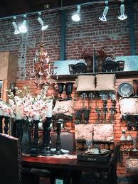
Section 9 – 9.6.2 – 9.6.3 Additional Interior Lighting Power
Decorative and Retail display highlighting
An increase in the lighting power allowance is allowed for specific decorative and retail applications when using the space-by-space method.
Applications must be automatically controlled, separately from the general lighting, to be turned off during non-business hours. The additional allowances can only be used for the additional lighting equipment – and not general lighting
Decorative luminaires in addition to the general lighting = 0.75 W/ft²
Retail display lighting = varies by retail type
Advanced Controls
An increase in the allowance is also allowed for the use of specified advanced controls that are installed in addition to those already required
Notes:
Retail display lighting covered on the next slide.
Decorative lighting is use-it-or-lose-it and can only be applied up to the amount of decorative lighting wattage installed.
Additional power is allowed only if the specified lighting is installed and automatically controlled, separately from the general lighting, to be turned off during nonbusiness hours. This additional power can be used only for the specified luminaires and not used for any other purpose.

Slide 51
Section 9 – 9.6.2 Additional Retail Display Lighting Allowance
Additional Interior Lighting Power Allowance = 1000 watts +
(Retail Area 1 x 0.45 W/ft²) +
(Retail Area 2 x 0.45 W/ft²) +
(Retail Area 3 x 1.05 W/ft²) +
(Retail Area 4 x 1.88 W/ft²),
Where:
Retail Area 1 = the floor area for all products not listed in Retail Area 2, 3 or 4
Retail Area 2 = the floor area used for the sale of vehicles, sporting goods and small electronics
Retail Area 3 = the floor area used for the sale of furniture, clothing, cosmetics and artwork
Retail Area 4 = the floor area used for the sale of jewelry, crystal, and china.
Other merchandise categories not listed may be included in Retail Areas 2 through 4, provided that justification documenting the need for additional lighting power based on visual inspection, contrast, or other critical display is approved by the authority having jurisdiction.
Notes:
Retail highlighting allowance is use-it-or-lose-it.
This additional display lighting must be separately circuited, switched, and automatically controlled.
Additional allowance depends on type of retail display area.
Doesn’t apply to entire store – only sales floor area.

Slide 52
Section 9 – 9.6.3 Advanced Controls Incentive
If all mandatory control requirements are met for a space AND advanced controls are installed in that space, THEN additional limited lighting power is allowed:
Additional power can be used anywhere in the building
Additional Interior Lighting Power Allowance is calculated as
Lighting Power Under Control x Control Factor
Notes:
Table 9.6.3 is used; only a partial table is shown.

Slide 53
Room Geometry Adjustment – 9.6.4
Room Cavity Ratio Adjustment for relief in unusual space configurations
Used only when applying the space by space method
Calculate the Room Cavity Ratio (RCR) for the empty room:
RCR = 2.5 x Room Cavity Height x room perimeter length room area
(Room Cavity Height = Luminaire mounting height – Workplane height)
If RCR is greater than the RCR threshold for that space type from Table 9.6.1, a 20% increase is allowed
For corridor/transition spaces, a 20% adjustment is allowed when less than 8 feet wide, regardless of the RCR

Slide 54
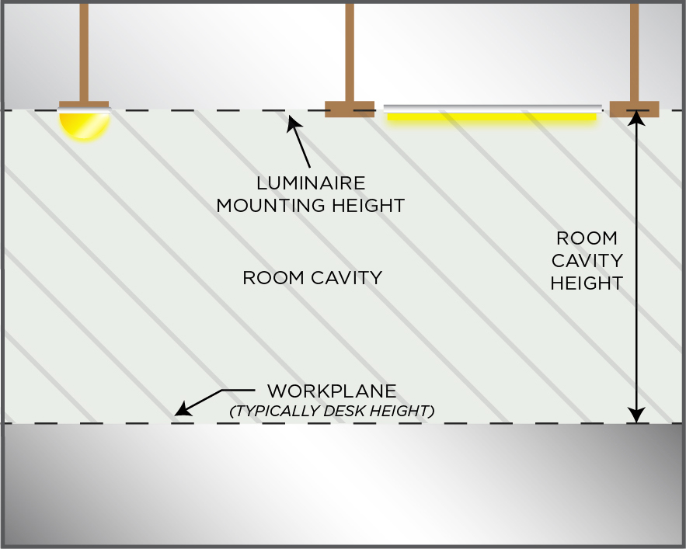
Room Geometry Adjustment

Slide 55
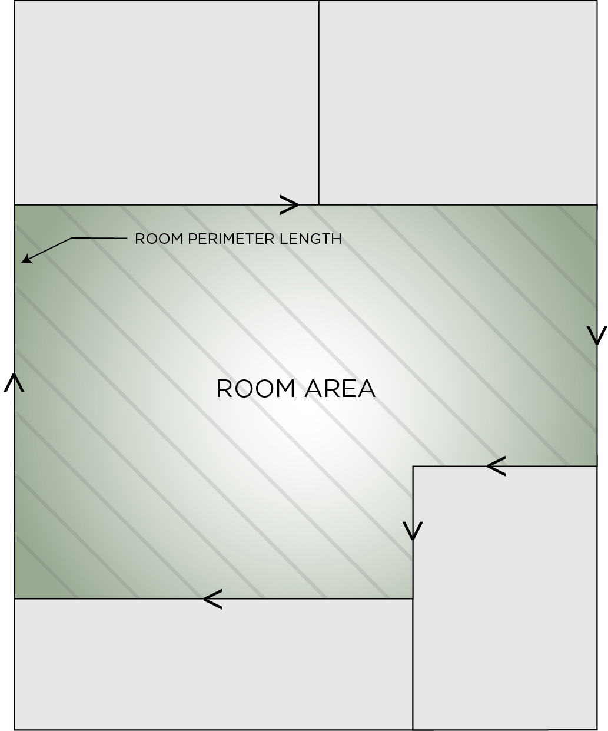
Room Geometry Adjustment

Slide 56
Section 9.4.1.1 Interior Lighting Controls
For each space type, apply the lighting control functions listed
If using the Space-by-Space method for LPD requirements, use same space type for control requirements. For space types not listed, use a reasonable equivalent
“REQ” = mandatory
“ADD1” = at least one of these must be implemented
“ADD2” = at least one of these must be implemented

Slide 57
Section 9.4.1.1 Control Functions
Local control
Restricted to manual ON
Restricted to partial automatic ON
Bilevel lighting control
Automatic daylight responsive controls for sidelighting
Automatic daylight responsive controls for toplighting
Automatic partial OFF (full OFF complies)
Automatic full OFF
Scheduled shutoff
Scheduled OFF during nonbusiness hours

Slide 58
Section 9 – 9.4.1.1 (a) Local Control
At least one control that controls all the lighting in the space
In spaces ≤ 10,000 ft², each control serves 2,500 ft² maximum and in spaces > 10,000 ft², serves 10,000 ft² maximum

Slide 59
Section 9 – 9.4.1.1 (b) Restricted to Manual ON
No lighting automatically turned on
Exception
Where manual ON would endanger safety or security
Typically, users are allowed to choose to implement this control or Partial On

Slide 60
Section 9 – 9.4.1.1 (c) Restricted to Partial ON
< 50% of general lighting power allowed to be automatically turned on, and none of remaining lighting automatically turned on
Exception
Lighting in open-plan offices allowed to turn on automatically to > 50% if control zone is ≤ 600 ft²
Typically, users are allowed to choose to implement this control or Manual On

Slide 61
Section 9 – 9.4.1.1 (d) Bilevel Lighting Control
General lighting to provide at least one intermediate step in lighting power or continuous dimming in addition to full ON and full OFF
To have at least one control step between 30% and 70% (inclusive) of full lighting power in addition to all off

Slide 62
Section 9 – 9.4.1.1 (e) Automatic Daylight Responsive Controls for Sidelighting
Apply photocontrols if the combined input power of all general lighting completely or partially within:
primary sidelighted areas is ≥ 150 W
primary and secondary sidelighted areas is ≥ 300 W
general lighting in secondary sidelighted area controlled independently of general lighting in primary sidelighted area
Control system must have following characteristics
Calibration adjustment located ≤ 11ft above finished floor (no person needed at sensor while processing)
Reduce electric lighting in response to available daylight using continuous dimming to ≤ 20% and off
When automatic partial OFF control has reduced to unoccupied set point, daylight responsive control to adjust electric light in response to available daylight (but not above unoccupied set point)

Slide 63
Section 9 – 9.4.1.1 (e) Automatic Daylight Responsive Controls for Sidelighting (cont’d)
Exceptions
Primary sidelighted areas where top of any existing adjacent structure is at least twice as high above the windows as its horizontal distance away from the windows
Sidelighted areas where total glazing area is < 20 ft²
Retail spaces
Primary sidelighted areas adjacent to vertical fenestration with external projections and no vertical fenestration above projections, where projection has projection factor (PF)
> 1.0 if north oriented or
> 1.5 for all other orientations

Slide 64
Section 9 – 9.4.1.4 Daylight Zone Definition – Primary Sidelighted Area
© 2019, ASHRAE, ANSI/ASHRAE/IES Standard 90.1-2019, Figure 3.2-4
Notes:
Primary sidelighted area: the total primary sidelighted area is the combined primary sidelighted area without double counting overlapping areas. The floor area for each primary sidelighted area is directly adjacent to vertical glazing below the ceiling with an area equal to the product of the primary sidelighted area width and the primary sidelighted area depth.
The primary sidelighted area width is the width of the vertical fenestration plus, on each side, the smaller of:
1. One half of the vertical fenestration head height (where head height is the distance from the floor to the top of the glazing) or
2. the distance to any 5 ft or higher opaque vertical obstruction.
The primary sidelighted area depth is the horizontal distance perpendicular to the vertical fenestration which is the smaller of:
1. one vertical fenestration head height or
2. the distance to any 5 ft or higher opaque vertical obstruction.

Slide 65
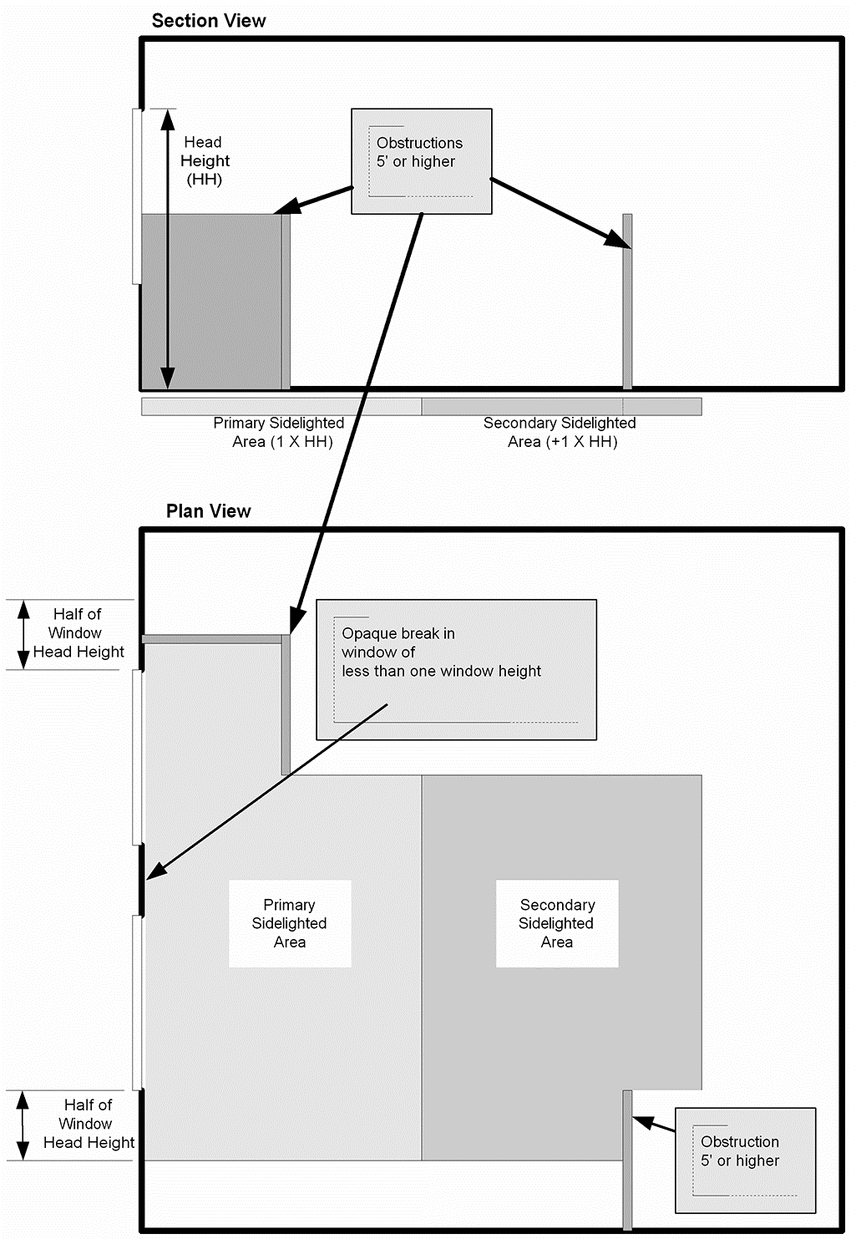
Section 9 – 9.4.1.4 Daylight Zone Definition – Secondary Sidelighted Area
© 2019, ASHRAE, ANSI/ASHRAE/IES Standard 90.1-2019, Figure 3.2-5
Notes:
Secondary sidelighted area: the total secondary sidelighted area is the combined secondary sidelighted area within a space. Each secondary sidelighted area is directly adjacent to a primary sidelighted area.
The secondary sidelighted area width is the width of the vertical fenestration plus, on each side, the smaller of:
1. One half of the vertical fenestration head height or
2. the distance to any 5 ft or higher vertical obstruction.
The secondary sidelighted area depth is the horizontal distance perpendicular to the vertical fenestration, which begins at the edge of the primary sidelighted area depth and ends at the smaller of:
1. one vertical fenestration head height (head height is the distance from the floor to the top of the glazing), or
2. the distance to any 5 ft or higher opaque vertical obstruction.

Slide 66
Section 9 – 9.4.1.4 Daylight Zone Definition – Project Factor
© 2019, ASHRAE, ANSI/ASHRAE/IES Standard 90.1-2019, Figure 3.2-6
Notes:
Secondary sidelighted area: the total secondary sidelighted area is the combined secondary sidelighted area within a space. Each secondary sidelighted area is directly adjacent to a primary sidelighted area.
The secondary sidelighted area width is the width of the vertical fenestration plus, on each side, the smaller of:
1. One half of the vertical fenestration head height or
2. the distance to any 5 ft or higher vertical obstruction.
The secondary sidelighted area depth is the horizontal distance perpendicular to the vertical fenestration, which begins at the edge of the primary sidelighted area depth and ends at the smaller of:
1. one vertical fenestration head height (head height is the distance from the floor to the top of the glazing), or
2. the distance to any 5 ft or higher opaque vertical obstruction.

Slide 67
Section 9 – 9.4.1.1 (f) Automatic Daylight Responsive Controls for Toplighting (cont’d)
Apply photocontrols if the combined input power of all general lighting completely or partially under daylight areas under skylights and daylight areas under roof monitors is ≥ 150 W. Photocontrols must:
Calibration adjustment located ≤ 11ft above finished floor (no person needed at sensor while processing)
Reduce electric lighting in response to available daylight using continuous dimming to ≤ 20% and off
When automatic partial OFF control has reduced to unoccupied set point, daylight responsive control to adjust electric light in response to available daylight (but not above unoccupied set point)
Control overlapping toplighted and sidelighted daylight areas together with general lighting in the daylight area under skylights or daylight areas under roof monitors

Slide 68
Section 9 – 9.4.1.1 (f) Automatic Daylight Responsive Controls for Toplighting
Exceptions
Daylight area under skylights where documented that existing adjacent structures or natural objects block direct sunlight fore > 1500 daytime hours per year between 8am and 4pm
Daylight area under skylights where overall skylight effective aperture for enclosed space is < 0.006
In each space within buildings in Climate Zone 8 where input power of general lighting within daylight areas is < 200 W

Slide 69
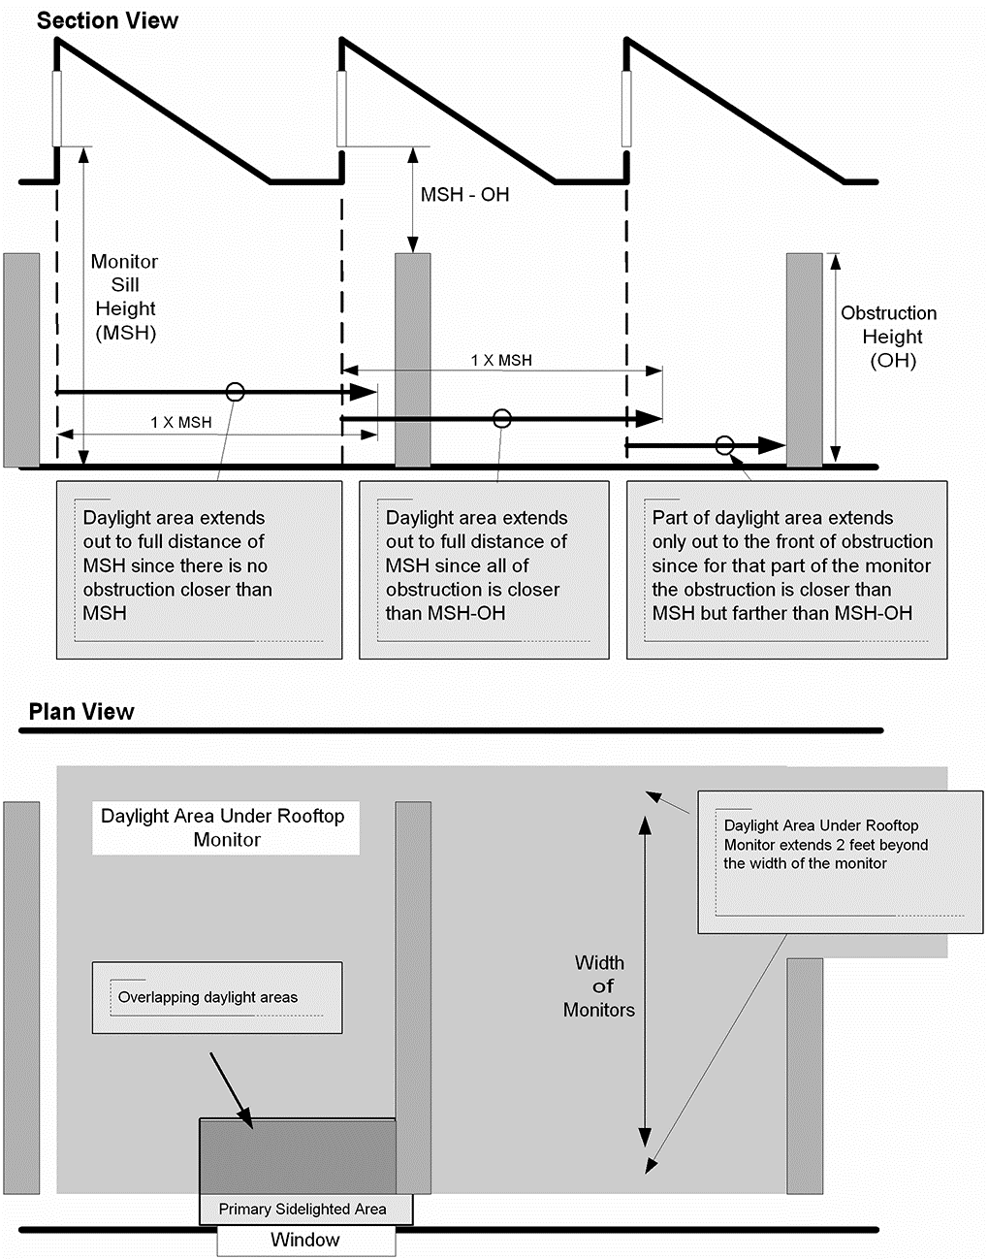
Section 9 – 9.4.1.1 (f) Daylight Zone Definition: Under Rooftop Monitors
© 2019, ASHRAE, ANSI/ASHRAE/IES Standard 90.1-2019, Figure 3.2-1
Notes:
The daylight area under rooftop monitors is the combined daylight area under each rooftop monitor without double counting over-lapping areas. The daylight area under each rooftop monitor is the product of the width of the vertical glazing above the ceiling level and the smallest of the
following horizontal distances inward from the bottom edge of the glazing, (See Figure 3.2-1):
1. the monitor sill height, MSH, (the vertical distance from the floor to the bottom edge of the monitor glazing), or
2. the distance to the edge of any primary sidelighted area or
3. the distance to the front face of any vertical obstruction where any part of the obstruction is farther away than the difference between the
height of the obstruction and the monitor sill height (MSH-OH).

Slide 70
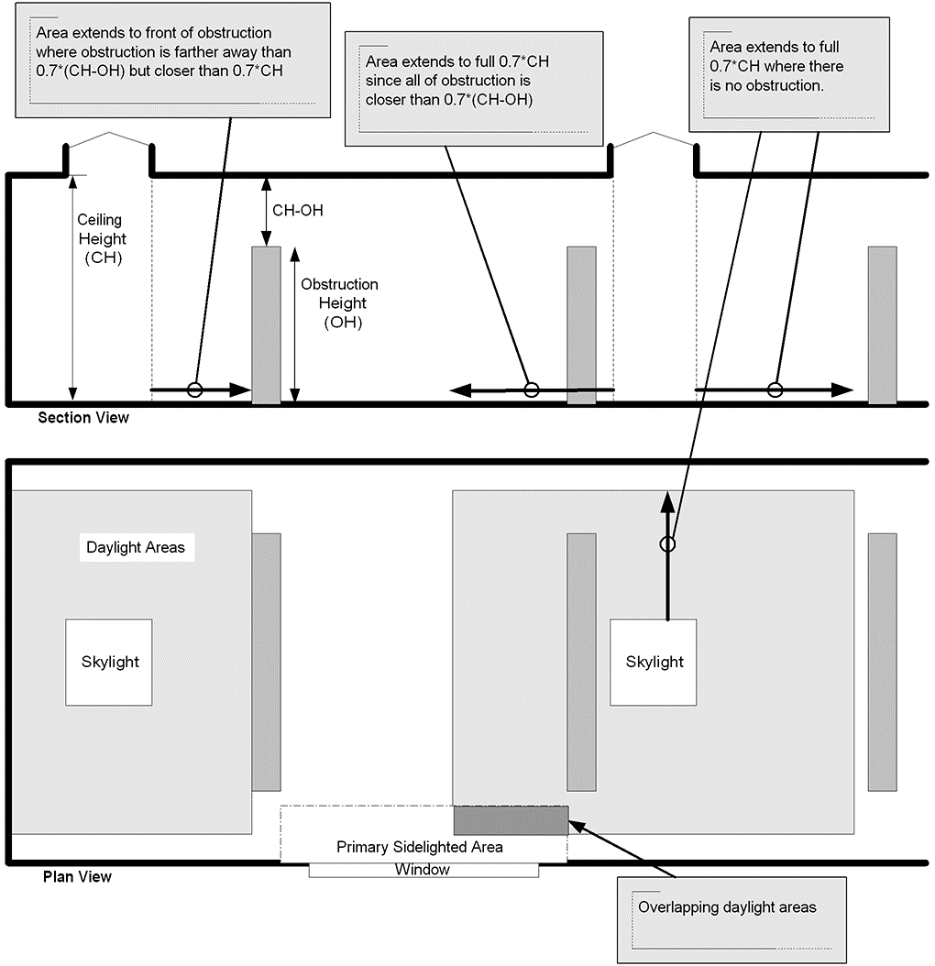
Section 9 – 9.4.1.1 Daylight Zone Definition: Under Skylights
© 2019, ASHRAE, ANSI/ASHRAE/IES Standard 90.1-2019, Figure 3..2-2
Notes:
The daylight area under skylights is the combined daylight area under each skylight without double counting overlapping areas. The daylight
area under each skylight is bounded by the opening beneath the skylight, plus horizontally in each direction, the smallest of (See Figure 3.2-2):
1. 70% of the ceiling height (0.7 × CH), or
2. the distance to the nearest face of any opaque vertical obstruction where any part of the obstruction is farther away than 70% of the distance between the
top of the obstruction and the ceiling (0.7 × [CH–OH]), where CH = the height of the ceiling at the lowest edge of the skylight, and OH = the height to the top of the obstruction.

Slide 71
Section 9 – 9.4.1.1 (f) Daylight Zone Definition: Under Skylights
© 2019, ASHRAE, ANSI/ASHRAE/IES Standard 90.1-2019, Figure 3..2-3

Slide 72
Section 9 – 9.4.1.1 (g) Automatic Partial OFF (Full OFF Complies)
Automatically reduce general lighting power by at least 50% within 20 minutes of all occupants leaving the space
Exceptions
Space has LPD < 0.80 W/ft²
Space is lighted by High-Intensity Discharge technology
General lighting power in space is automatically reduced by ≥ 30% within 20 minutes of all occupants leaving the space
Lighting load ≤ 0.02 W/ft² multiplied by gross lighted area of the building

Slide 73
Section 9 – 9.4.1.1 (h) Automatic Full OFF
All lighting automatically shut off within 20 minutes of all occupants leaving the space
Control device to control < 5,000 ft²
Exceptions
Shop and lab classrooms
Areas where auto shutoff causes safety or security concerns
Lighting for 24/7 operation
Lighting load < 0.02 W/ft² multiplied by the gross lighted floor area
Typically, users are allowed to choose to implement this control or Scheduled Shutoff

Slide 74
Section 9 – 9.4.1.1 (i) Scheduled Shutoff
Control lights on a scheduled basis (automatic time switch)
Time-of-day controller or
Signal from another control or alarm
Controller or system provide independent control sequences that
Controls ≤ 25,000 ft²
Not more than one floor
Accounts for weekend and holidays
Manual override control
< 2 hours during scheduled off
Control ≤ 5,000 ft²
Exceptions
Lighting for 24/7 operation
Patient care spaces
Areas where auto shutoff causes safety or security concerns
Lighting load ≤ 0.02 W/ft² multiplied by gross lighted area of the building
Typically, users are allowed to choose to implement this control or Automatic Full Off
Notes:
Intent:
Eliminate after hours lighting waste
Casinos (exception)
Areas with safety – always an issue

Slide 75
Section 9 – 9.4.1.1 (j) Scheduled OFF During Nonbusiness Hours
Lights scheduled off at end of business hours using either
Time-of-day control automatically turns lighting off as programmed OR
Signal from another automatic control or alarm/security system
Any manual, override control to not turn lighting on > 2 hours during scheduled off

Slide 76
Section 9 – 9.4.1.2 Parking Garage Lighting Control
Automatic lighting shutoff per 9.4.1.1(i)
Must reduce lighting power by minimum of 50% when no activity is detected for 10 minutes within a lighting zone ≤ 3,600 ft²
Parking garage daylight transition lighting exempt per Section 9.2.3.1 to be separately controlled to automatically reduce lighting to no more than general light level from sunset to sunrise
Automatically reduce power through continuous dimming in response to daylight for luminaires within 20 ft of any perimeter wall openings totaling at least 24 ft²
Exceptions
Parking garage daylight transition lighting exempt per 9.2.3.1
Where permanent screens or architectural elements obstruct > 50% of opening
Where top of any existing adjacent structure or natural object is at least twice as high above the openings as its horizontal distance from opening
Notes:
Graphics on next two slides illustrate these requirements

Slide 77
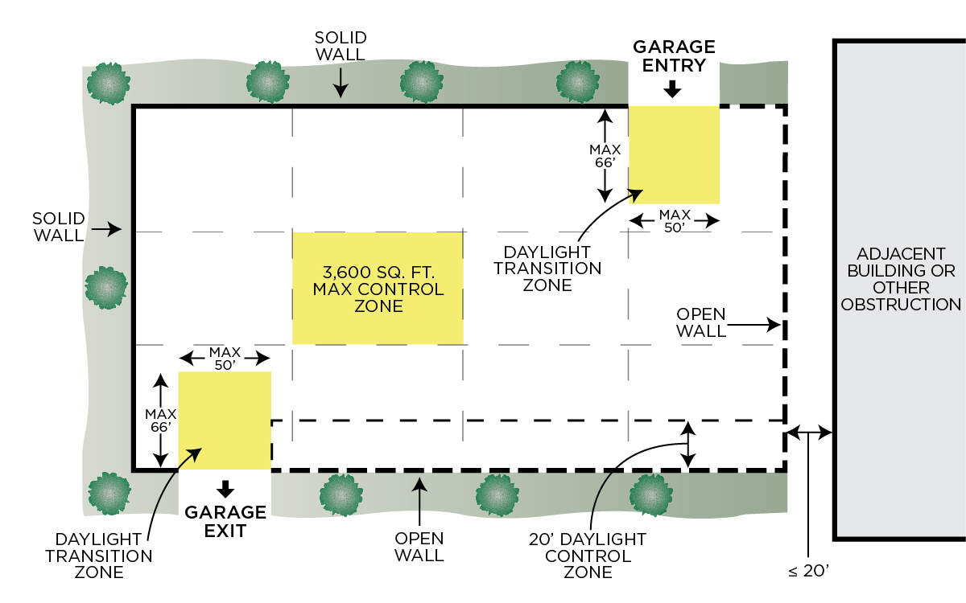
Section 9 – 9.4.1.2 Parking Garage Lighting Control

Slide 78
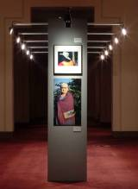
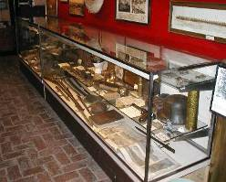
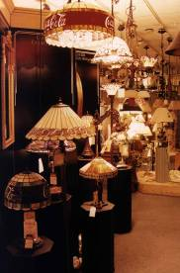
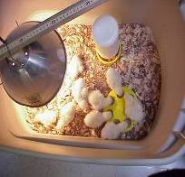
Section 9 – 9.4.1.3 Control of Special Applications
Special applications separately controlled from general lighting
Display or accent lighting
Case lighting
Demonstration lighting
Notes:
Intent:
Provide opportunity to turn off special application lighting

Slide 79
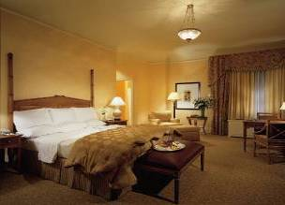
Section 9 – 9.4.1.3 Control of Special Applications
Guestroom lighting and switched receptacles to be turned off within 20 minutes of occupants leaving the space
Exception: where captive key systems used
Bathrooms controlled to automatically turn off lighting within 30 minutes of occupants leaving space
Exception: night lighting not > 5W
Supplemental task lighting controlled by
Controller integral to the luminaires OR
Local control independent of general lighting control (and per 9.4.1.1(h) and (i)

Slide 80
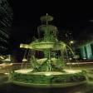
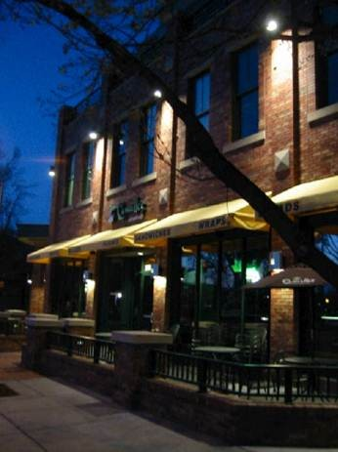
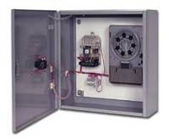
Section 9 – 9.4.1.4 Mandatory Exterior Lighting Control
Lighting must turn off when there is sufficient daylight
Building façade and landscape lighting must be shut off between
midnight or business closing (whichever is later) and
6am or business opening (whichever comes first) OR
times established by AHJ
Power for other lighting and lighting for signage to be automatically reduced by at least 50%
From midnight or within 1 hour of end of business operations (whichever is later) and until 6am or business opening (whichever is earlier) OR
During any period when no activity has been detected for a time no longer than 15 minutes
Luminaires serving outdoor parking areas with rated input wattage > 78 W and mounting height of ≤ 24 ft above ground
Lights must automatically reduce power of each luminaire by > 50% when no activity is detected in the area for 15 minutes or less
Limited to 1500 W of lighting controlled together
Exceptions
Covered vehicle entrances
Exits from buildings or parking structures
(where required for safety, security, or eye adaptation)
Lighting integral to signage and installed by manufacturer

Slide 81
Section 9.4.2 Exterior Lighting Power
Exterior Building Lighting Power must meet prescribed power limits.
The total exterior lighting power allowance is the sum of the base site allowance plus individual lighting power densities (LPD) for the applicable “lighting power zone”
Trade-offs are allowed only among “Tradable Surfaces” applications
Some exemptions apply
Notes:
Building grounds lighting – unless controlled by a motion sensor or qualifies for one of the exceptions under Section 9.1.1 or 9.4.5.
Pedestrian walkways, gardens, other landscape areas associated with a building.
Eliminates the use all incandescent and mercury vapor discharge sources over 100W.

Slide 82
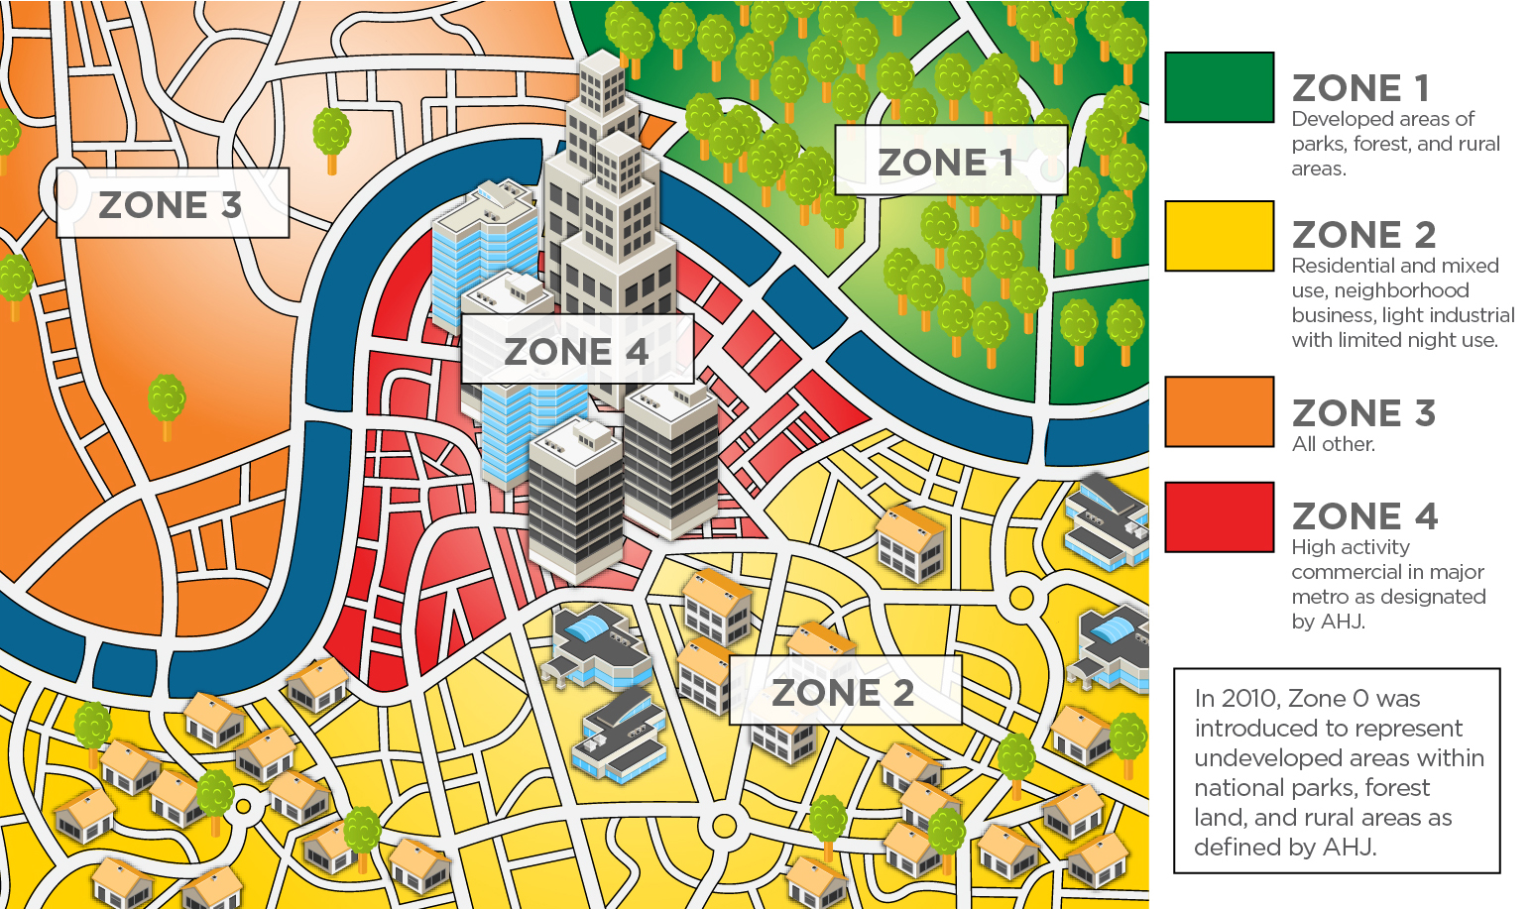
Exterior Lighting Power Zones

Slide 83
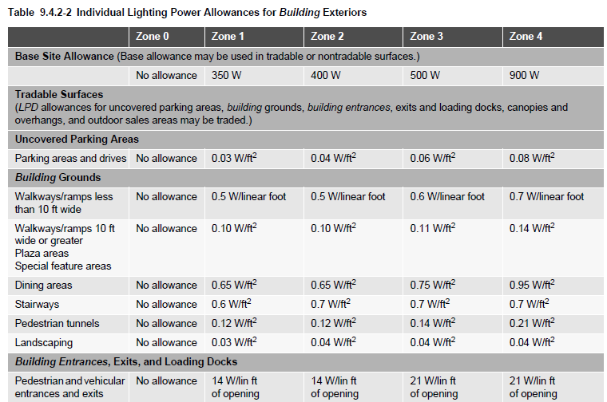
Section 9 Tradable Exterior LPDs
Exterior applications are divided into 2 categories:
Tradable: allowed wattage may be traded among these applications
Non-Tradable: allowed wattage cannot be traded between surfaces or with other exterior lighting
Notes:
These are the more common applications in most building exteriors.
Tradable means if you don’t use all the wattage you’re allowed for a parking lot, you could apply some of that to another tradable application, like a canopy, for example.

Slide 84
Section 9 – 9.4.2 Exterior Lighting Power Exemptions
The following are exempt when equipped with separate controls:
lighting that is integral to signage and installed by its manufacturer;
lighting for athletic playing areas;
lighting for industrial production, material handling, transportation sites, and associated storage areas;
theme elements in theme/amusement parks;
lighting used to highlight features of public monuments, public art displays, and registered historic landmark structures or buildings;
lighting for water features;
specialized signal, directional, and marker lighting associated with transportation;
lighting that is integral to equipment or instrumentation and is installed by its manufacturer;
lighting for theatrical purposes, including performance, stage, film, and video production;
temporary lighting;
lighting for hazardous locations;
lighting for swimming pools;
searchlights.
Notes:
The key is these are exempt but must have separate controls.

Slide 85
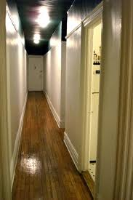
Section 9 – 9.4.3 Dwelling Units
Dwelling units (apartment, condo, living space, etc.) must be built so that at least 75 percent of the permanently installed lighting fixtures utilize lamps with an efficacy of at least 55 lm/W, or have a total luminaire (fixture) efficacy of at least 45 lm/W
Exceptions:
Lighting that is controlled with dimmers or automatic control devices
Hotel/motel guest rooms [those requirements covered in Table 9.6.1 and Section 9.4.1.3(b)]
Applies to 4 story above grade multi-family (3 story and below not in scope of 90.1)
Other common spaces in the building must follow standard 90.1 Requirements.
Notes:
No other provisions of Section 9 apply to dwelling units.

Slide 86
Compliance Paths Lighting
Building System
Compliance Requirements
Envelope
Prescriptive Path
Submittal Requirements
HVAC
Energy Code Compliance
Simplified
Mandatory
Provisions
(required for each compliance path)
Information and Installation Requirements
SWH
Trade Off Option
Power
Energy Cost Budget
Verification, Testing, Inspection & Commissioning
Lighting
Other
Performance Rating Method
Notes:
Grayed out options under Compliance Options do not exist for this chapter.

Slide 87
Section 9 – 9.7 Submittals
Record drawings, to include for each piece of lighting equipment:
Location
Luminaire identifier
Control
Circuiting
Operation and maintenance manuals
Daylighting documentation
Identify all general lighting located within daylight areas under skylights, daylight areas under roof monitors as well as primary sidelighted areas and secondary sidelighted areas

Slide 88
Compliance Paths Lighting
Building System
Compliance Requirements
Envelope
Prescriptive Path
Submittal Requirements
HVAC
Energy Code Compliance
Simplified
Mandatory
Provisions
(required for each compliance path)
Information and Installation Requirements
SWH
Trade Off Option
Power
Energy Cost Budget
Verification, Testing, Inspection & Commissioning
Lighting
Other
Performance Rating Method
Notes:
Grayed out options under Compliance Options do not exist for this chapter.

Slide 89
Section 9 – 9.9 Verification, Testing, and Commissioning
Functional testing (calibrated/adjusted/programmed) of lighting control devices and systems required within 90 days of occupancy
Must be performed by individuals NOT involved in design, manufacture, or installation
For occupancy sensors:
Certify location and aiming per manufacturer recommendation
Test all sensors if project ≤ 7
If > 7 sensors, test for each unique combination of sensor type and space geometry and verify
Status indicator
Lights turn off or down to permitted level within required time
Auto-on – lights turn on to permitted level when someone enters the space
Manual on – lights turn on only when manually activated
Lights aren’t incorrectly turned on by movement in nearby areas or by HVAC operation

Slide 90
Section 9 – 9.9 Verification, Testing, and Commissioning (cont’d)
For automatic time switches:
Confirm programmed schedules
Document schedules for owner
Verify correct time and date are set
Verify any battery backup is installed and energized
Verify override time limit set to ≤ 2 hours
Simulate occupied condition and verify and document:
Lights turn on and off with respective switches
Switch only operates lights in enclosed space where switch is located
Simulate unoccupied condition and verify and document:
All nonexempt lights turn off
Manual override only operates lighting where it is located
For daylighting controls
Properly located, field-calibrated, and set to have appropriate setpoints and threshold light levels
Daylight controlled lighting loads adjust to correct levels with available daylight
Location where calibration adjustments are made is readily accessible only to authorized personnel

Slide 91
Section 4 – 4.2.5 Verification, Testing, and Commissioning
Referenced 9.9 testing and commissioning refers to 4.2.5
New in 2019: Central FPT & Commissioning requirements

Slide 92
Section 4 – 4.2.5 Verification, Testing, and Commissioning
Referenced 9.9 testing and commissioning refers to 4.2.5
4.2.5 Verification, Testing, and Commissioning
4.2.5.1 Verification and Testing (V&T)
V&T provider qualifications
V&T requirements in construction documents
Functional Performance Testing (FPT) & Verification Documentation
4.2.5.2 Commissioning (Cx) (unless Excepted)
Cx provider qualifications
Cx plan, design review, requirements in construction documents
Preliminary and Final Cx report includes FPT & verification

Slide 93
Section 4 – 4.2.5.2 Exceptions to Commissioning
Where to FPT & Cx requirements apply
 | Simple buildings (<10k conditioned ft², warehouse, or Simple HVAC path < 25k ft²) | Complex Buildings < 25,000 ft² | All Buildings ≥ 50,000 ft² Except Warehouse
Verification, FPT | Required | Required | Required
Pre- & Design phase Cx | NR | Required | Required
Construction Phase Cx | NR | Required | Required
80% of US buildings are exempt from commissioning requirements
Verification and functional performance testing (FPT) required throughout
Pre- & design-phase Cx saves energy and cost by catching issues early
90.1 Cx requirements only apply to 90.1 standard requirements
Verification that the design substantially meets 90.1 included

