Slide 1


OVERVIEW
Drake H. Erbe
Chair, SSPC 90.1

Slide 2
OBJECTIVES
It is the overall goal of each version of Standard 90.1 to create a consensus standard that saves energy and is technically feasible and cost effective.
It is also the goal to continue to improve clarity, understanding and compliance of the standard
Continued viability and relevance is also a goal and requires thinking strategically as well as delivering a standard every 3 years

Slide 3
RESULTS
More than 100 addenda were processed by the committee and 88 approved by the ASHRAE and IES Boards of Directors and are included in this edition.
This version of the standard has had changes that affect all sections for standardization and are below:
  Submittal documentation requirements have been outlined clearly most notably in Section 5 Envelope
  Compliance paths are clarified especially for additions and alterations in Section 4 Administration and Enforcement
  Throughout the standard unused definitions and references were removed
  There are multiple clarifications and attention to definitions throughout the standard for ease of use and application

Slide 4
RESULTS (CONT.)
One additional result for all sections should be highlighted and will be further explained in the presentation. Commissioning has been greatly enhanced in Section 4 with further requirements in each section. Also, an informative appendix has been added with additional guidance and information on this important inclusion into the standard.
On viability and strategic direction, two initiatives have already started and have been out for Public Review
  A very focused effort on widening Title, Purpose and Scope to include “site”
  The inclusion of renewables into the standard

Slide 5

OVERVIEW OF ENVELOPE CHANGES
Leonard Sciarra, AIA
SSPC 90.1 Envelope Subcommittee Chair

Slide 6
OVERVIEW
Clean up type changes
  References
  Definitions
Criteria changes
Text re-arrangement type changes

Slide 7
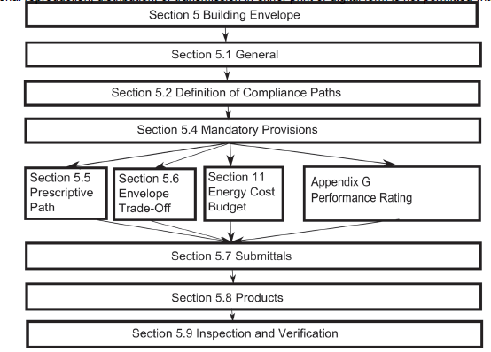
COMPLIANCE
4 Compliance options still remain
Notice reinforcement of compliance with 5.7, 5.8, & 5.9

Slide 8
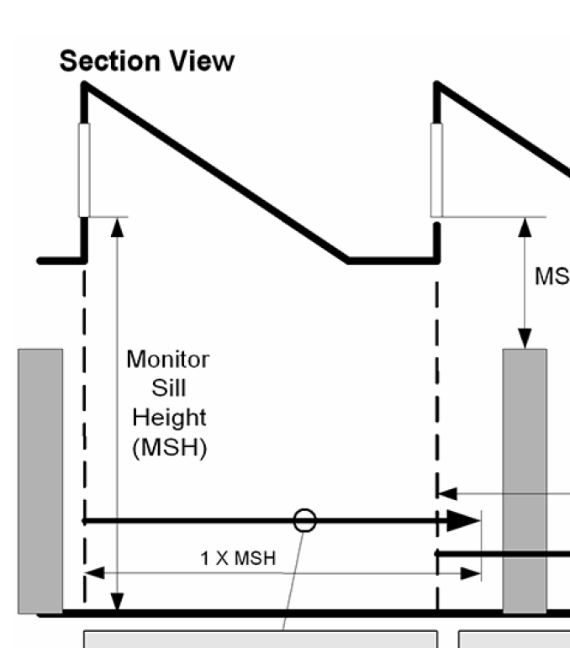
REFERENCES & DEFINITIONS
Cool Roof Rating Standard from
  CRRC -1 TO CRRC S100
Added clarification in the definitions for ‘operable’ rooftop monitors
Clarifications to the Definition of ‘door’ to help sort out confusion with revolving doors, garage doors, sectional garage doors, non-swinging doors, and glass doors.

Slide 9
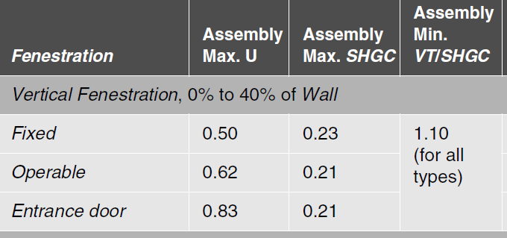
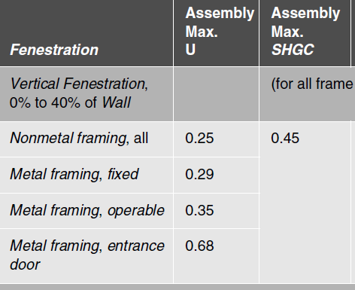
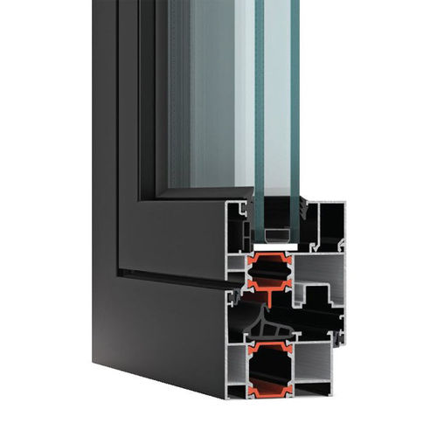
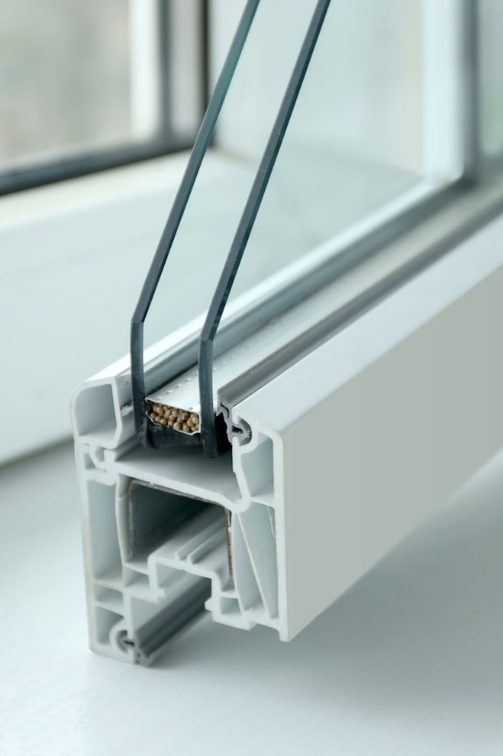
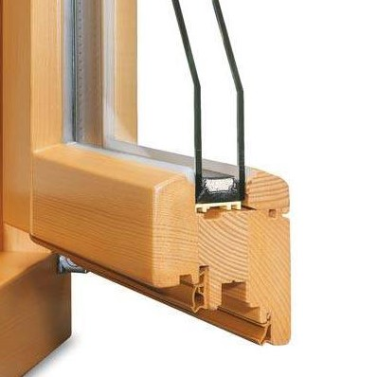
CRITERIA CHANGES
Fenestration
  Fenestration is now based on type not on Material

Slide 10
CRITERIA CHANGES
Changes for Metal Framing - fixed
SHGC | 0 | 1 | 2 | 3 | 4 | 5 | 6 | 7 | 8
2016 | 0.22 | 0.25 | 0.25 | 0.25 | 0.36 | 0.38 | 0.40 | 0.45 | 0.45
2019 | 0.22 | 0.23 | 0.25 | 0.25 | 0.36 | 0.36 | 0.38 | 0.40 | 0.40
Example of stringency improvements – note this will depend on the frame material
Changes for Metal Framing - fixed
U-factor | 0 | 1 | 2 | 3 | 4 | 5 | 6 | 7 | 8
2016 | 0.50 | 0.57 | 0.54 | 0.45 | 0.38 | 0.38 | 0.36 | 0.33 | 0.29
2019 | 0.50 | 0.50 | 0.45 | 0.42 | 0.36 | 0.36 | 0.34 | 0.29 | 0.26

Slide 11
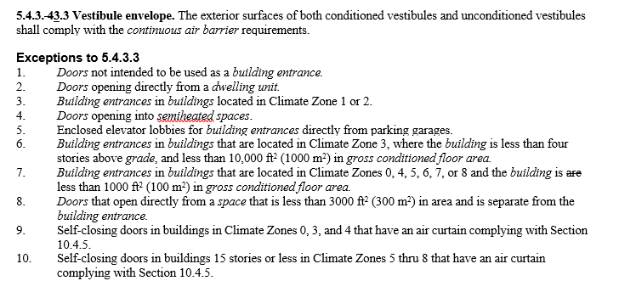
CRITERIA CHANGES
Air Curtains
  Now allowed for some building entrances
  ANSI/AMCA 220
  Jet Velocity of 6.6 ft/s
  Angle to door < 20 deg
  Commissioned
  Automatic controls

Slide 12
TEXT RE-ARRANGEMENTS
Air Leakage
  Whole Building testing to 0.40 cfm/ft² is the criteria with exceptions:
    Portions of buildings
    Allowance for up to 0.60 cfm/ft²
    Compliance by inspection and verification
      Material and Assembly compliance
  5.7-submittals
  5.8-products
  5.9-verification testing and compliance
Air Leakage
  Materials – 0.004 cfm/ft²
  Assemblies – 0.04 cfm/ft²
  Buildings – 0.40 cfm/ft²
    With exception up to 0.06 cfm/ft²

Slide 13
TEXT RE-ARRANGEMENTS
5.9 Verification. Testing, Commissioning, and Inspections
  5.9.1 – verification
  5.9.2 – commissioning
  5.9.3 – inspections
Section expanded and reformatted to coordinate with overall commissioning requirements

