Slide 1
COMcheck Basics
2021 Department of Energy National Energy Codes Conference
Building Energy Codes Program
V. Robert Salcido
Senior Research Engineer
Notes:
PNNL develops and supports the CheckTools suite of software – Gate keeper and Key Master
Residential projects – REScheck
Commercial projects - COMcheck
Why do we do this?
Compliance: Provide technical assistance to states to implement building energy codes including increasing and verifying compliance to ensure consumer benefits (42 USC 6833), develop software to support a streamlined compliance process, provide objective information resources and technical guidance to states and localities to increase code compliance.

Slide 2





COMcheck Current Use Scenario
Demonstrate Compliance
Collect Data
Check Compliance
Plan Review
Review Software Input
Review Mandatory Requirements
Field Inspection
Verify compliance of inspection checklist items
Prepare Input
Generate Compliance Report
Check Compliance Results
Approve compliance
Paper/PDF
Paper/PDF
Builder
Architect Designer
Plan Reviewer
Field Inspector
BECP Tools used only during “Demonstrate Compliance” Stage
Building Energy Codes Program
Notes:
Where COMcheck fits into the whole design and build process

Slide 3

COMcheck Compliance Methods
Building System
Compliance Options
Envelope
Prescriptive Option
HVAC
Energy Code Compliance
Mandatory
Provisions
Trade Off Option
SWH
Power
Energy Cost Budget: Performance Simulation
Lighting
Other
Building Energy Codes Program
Notes:
COMcheck as part of compliance, reviewing mandatory requirements, envelope efficiency, hvac efficiency and SHW efficiency. Entries determine the mandatory requirements.

Slide 4
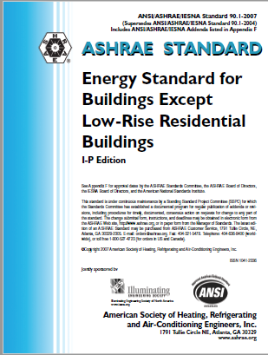
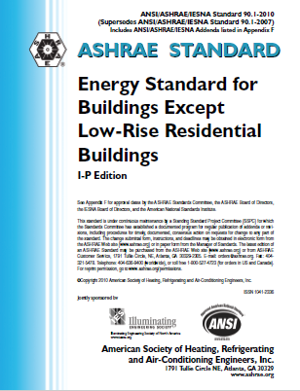
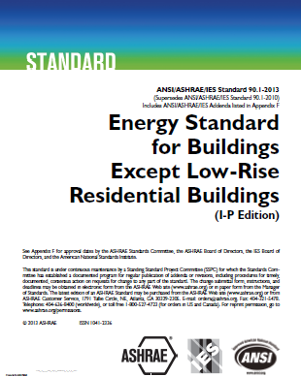
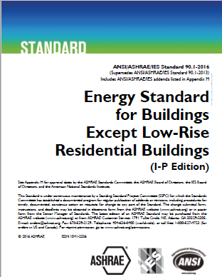
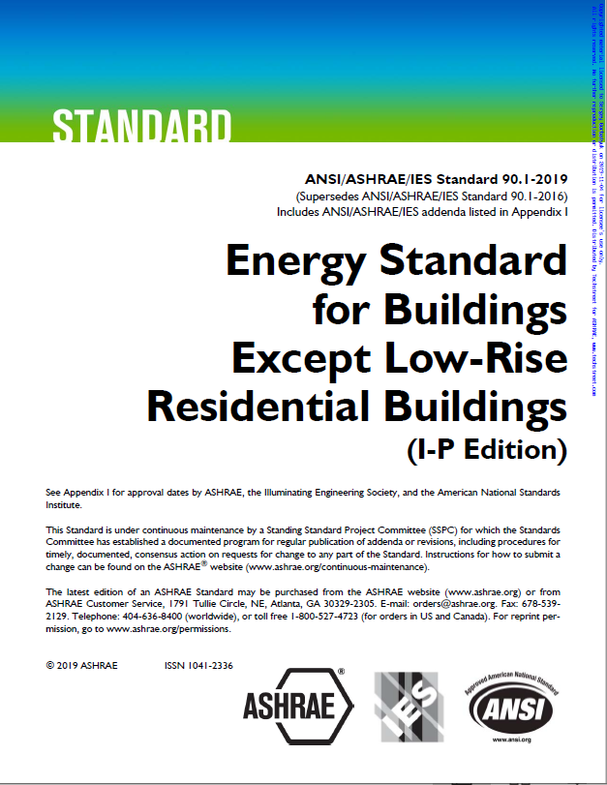





COMcheck Commercial Energy Codes
ASHRAE 90.1 (Pre-2013) Normative Appendix C Methodology for Building Envelope Trade-Off Option
  90.1-2007/2010
  2009/2012 IECC
ASHRAE 90.1-2013/2016/2019 Appendix C has limited performance method (EnergyPlus)
2015/2018/2021 IECC (Fall 2021) Component Performance Alternative (hybrid Total UA method)
Building Energy Codes Program
Notes:
Based on the energy code, , COMcheck will use differing compliance options as specified in the energy codes

Slide 5
Envelope Trade-Off Methods
90.1-2007/2010 and 2009/2012 IECC: Normative Appendix C Methodology for Building Envelope Trade-Off Option
Building energy cost factor computed using regression equations
90.1-2007/2010: Window/wall and skylight/roof ratio limitations enforced but tradable
2009/2012 IECC: Window/wall and skylight/roof ratio limitations enforced as hard limit
90.1-2013/2016/2019 Appendix C Envelope Trade-Off Methodology
Envelope components are assigned to isolated thermal zones based on
  Building Envelope Area Types (BEAT) play influential role
  Space conditioning categories (SCC)
  Window/wall and skylight/roof ratio limitations enforced but tradable
2015/2018/2021 IECC Component Performance Method Criteria
Envelope assemblies must pass on ‘hybrid’ Total UA based criteria
Window/wall and skylight/roof ratio limitations enforced but tradable
SHGC prescriptive requirement enforced
Building Energy Codes Program
Notes:
Enforced but tradeable – can trade with more efficient envelope components in reference home.
Enforced as a hard limit – cannot go over these limits but can use 90.1 if you can

Slide 6
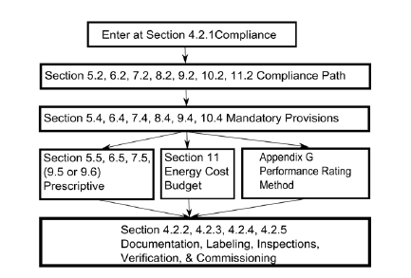


ASHRAE Standard 90.1 Section 11 and Appendix G Compliance Documentation
ASHRAE Standard 90.1 Performance Based Compliance Form
https://www.energycodes.gov/ashrae-standard-901-performance-based-compliance-form
Building Energy Codes Program
Notes:
Documentation for the prescriptive path involves filling out Comcheck.
Previously there was no equivalent to Comcheck, however, now with funding from the DOE a compliance form was developed in order to document compliance for performance based submittals.

Slide 7
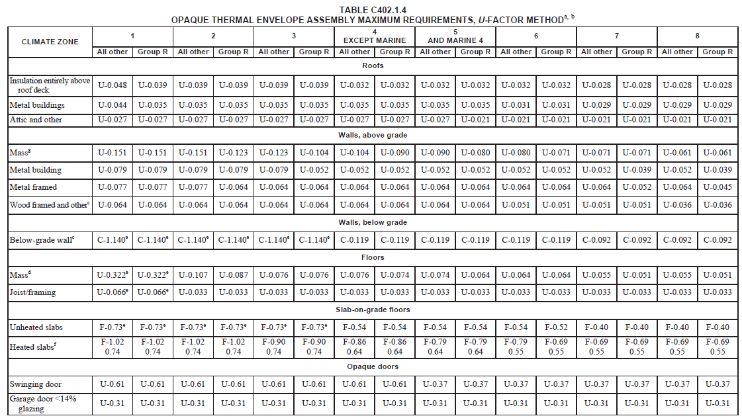
IECC Envelope Opaque Assembly Requirements
Building Energy Codes Program
Notes:
Note that these categories are mostly similar to 90.1 excepting Opaque Doors.

Slide 8
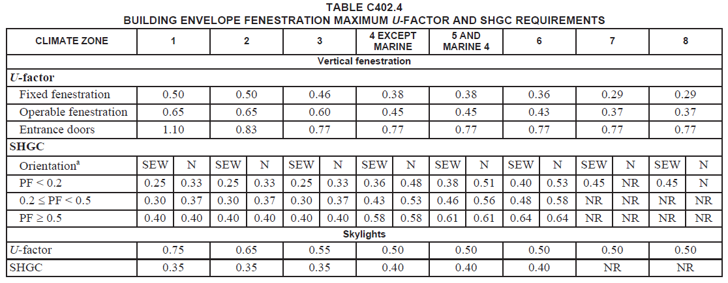
IECC Envelope Fenestration Requirements
(Source: 2018 IECC)
Building Energy Codes Program
Notes:
Note that 2018 IECC requires SHGC to be met prescriptively, not by area-weighted averaging method.

Slide 9
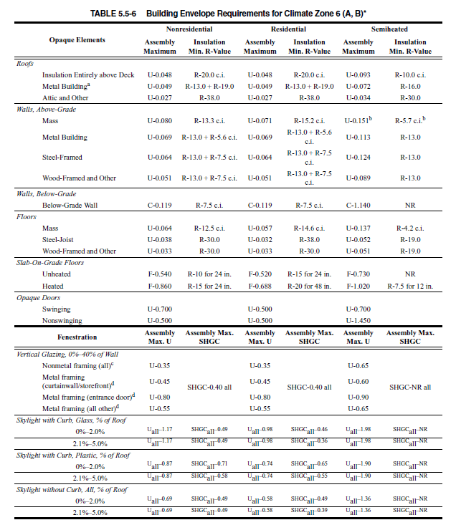
90.1 Envelope Requirements
Source: 90.1-2010
Building Energy Codes Program

Slide 10
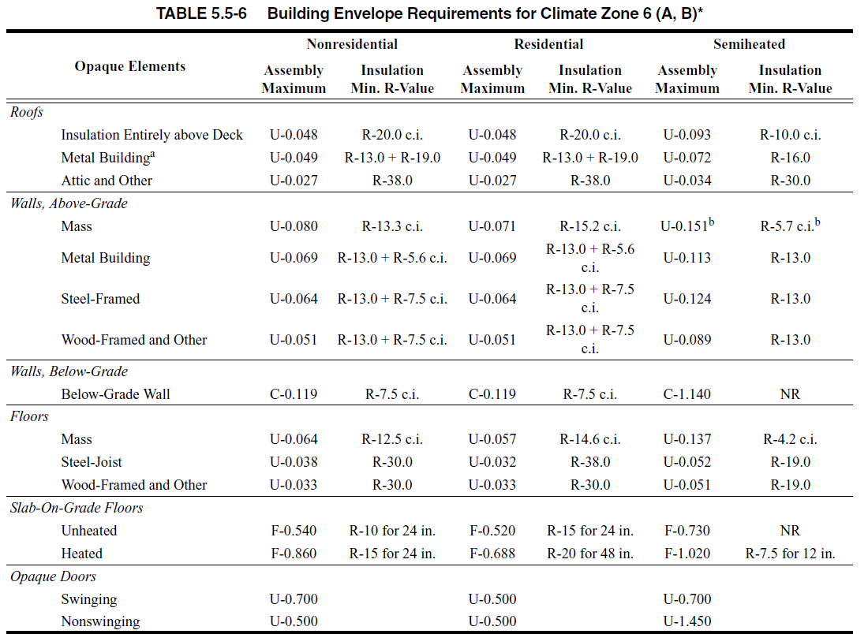
90.1 Envelope Opaque Assembly Requirements
Source: 90.1-2010
Building Energy Codes Program
Notes:
Note the U-factor requirements are what COMcheck uses.

Slide 11

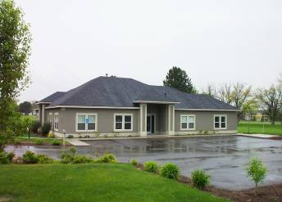
Project Types
New Construction:
  Trade-off compliance method
  Prescriptive – Oregon only
Addition
  Trade-off compliance method
  Prescriptive – Oregon only
Alteration
  Prescriptive compliance
Building Energy Codes Program
Notes:
The Trade-off compliance approach is used for New Construction and Addition. The prescriptive compliance option is used for Alteration.

Slide 12


Lighting Compliance Methods
Mandatory requirements: Controls, Switching, Daylighting
Interior/Exterior lighting power requirements
  Complies if total connected power <= lighting power allowance
Proposed Wattage
Allowed Wattage
≤
Building Energy Codes Program

Slide 13
Mechanical/Service Hot Water Compliance
Efficiency requirements
Economizer requirements
Fan Power Limitation
Mandatory requirements
No compliance metric available
Proposed Wattage
Building Energy Codes Program

Slide 14
COMcheck Project Specification Steps
Project
Building Envelope Components
Lighting
Mechanical
Requirements Reports
Proposed Wattage
Building Energy Codes Program
Notes:
How we design the software

Slide 15
Info You’ll Need
Energy Code
Builder and project location
Area take-offs for envelope assemblies
Insulation R-values, fenestration performance data
Interior/Exterior lighting fixture details
Heating and cooling system details
Service water heating details
Proposed Wattage
Building Energy Codes Program

Slide 16
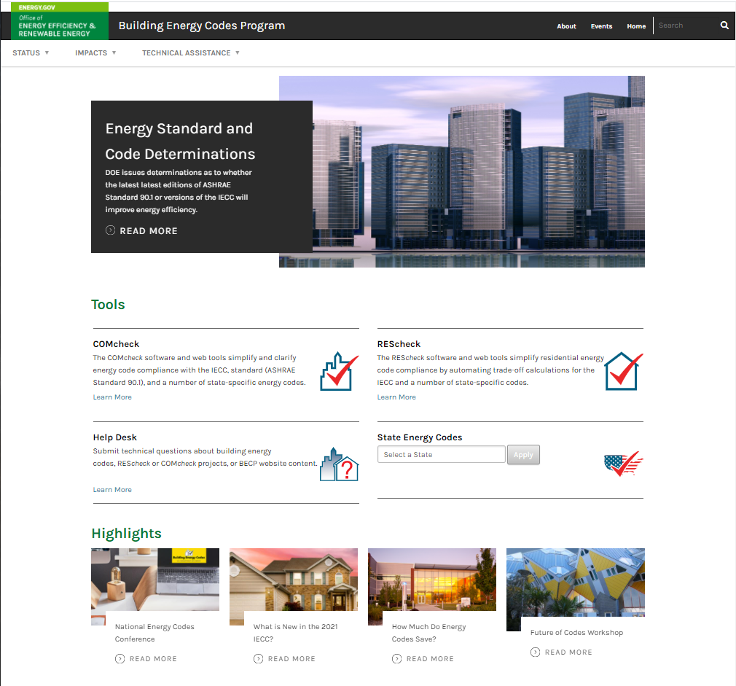
www.energycodes.gov
Building Energy Codes Program

Slide 17
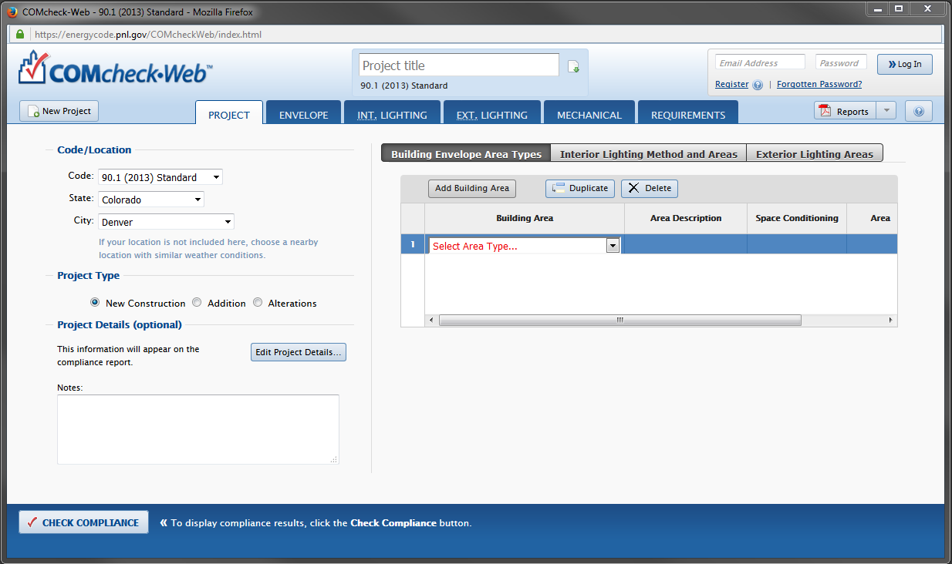
COMcheck
Building Energy Codes Program
Notes:
Desktop is being phased out, and a new version of COMcheck-Web will be out later this year. Discuss the design of the software – mention flow and format

Slide 18
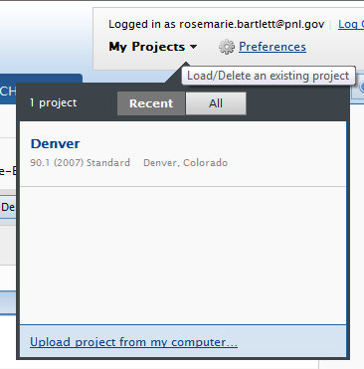

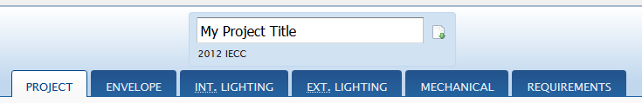
Desktop/Web Data Exchange
Can exchange files between desktop and web
  Log in to web
  My Projects
Upload from desktop to web account
Download from web account to desktop
Building Energy Codes Program

Slide 19
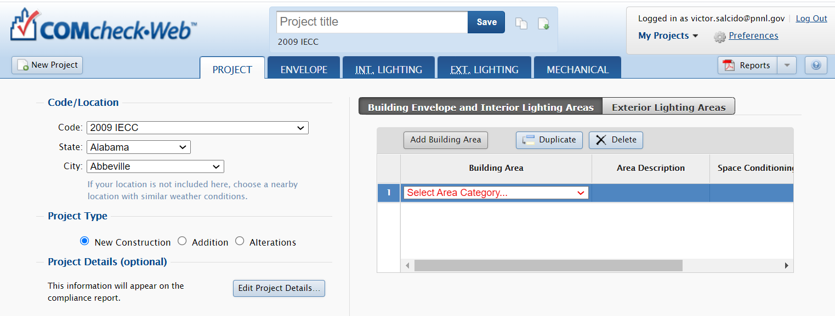
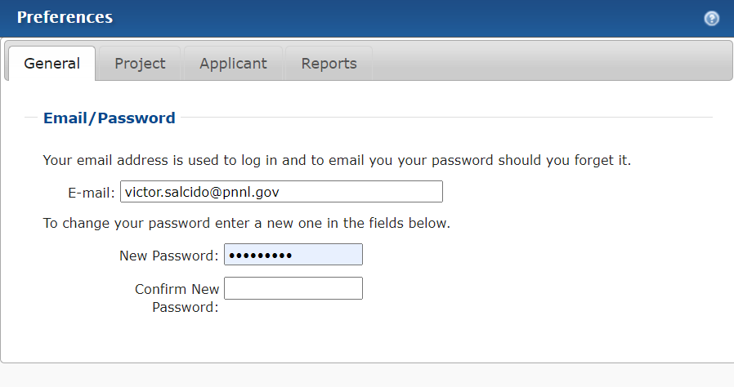
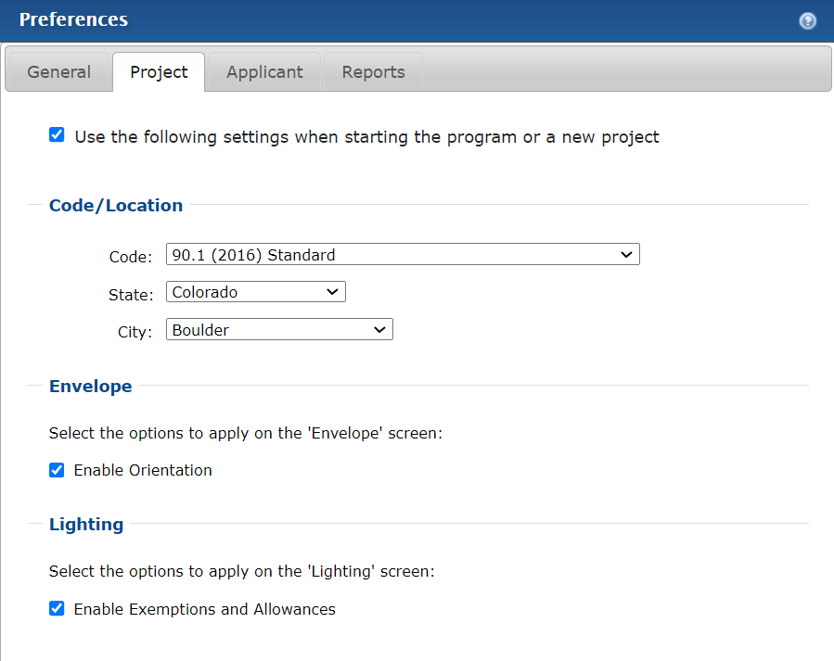
COMcheck Basics: Preferences
Building Energy Codes Program

Slide 20
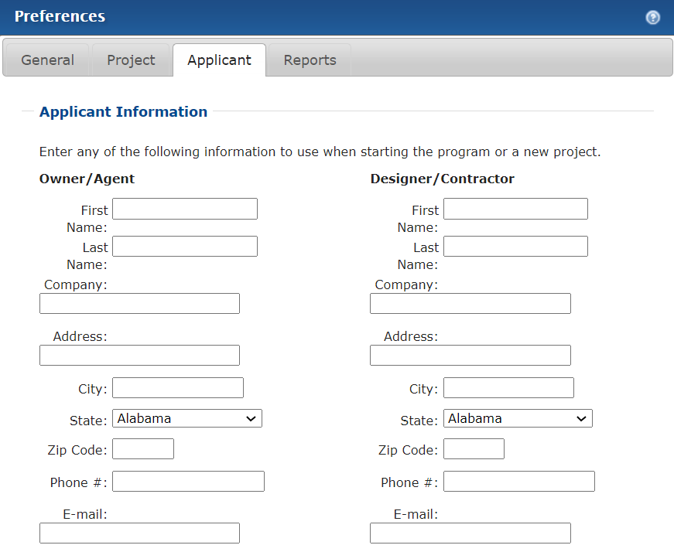
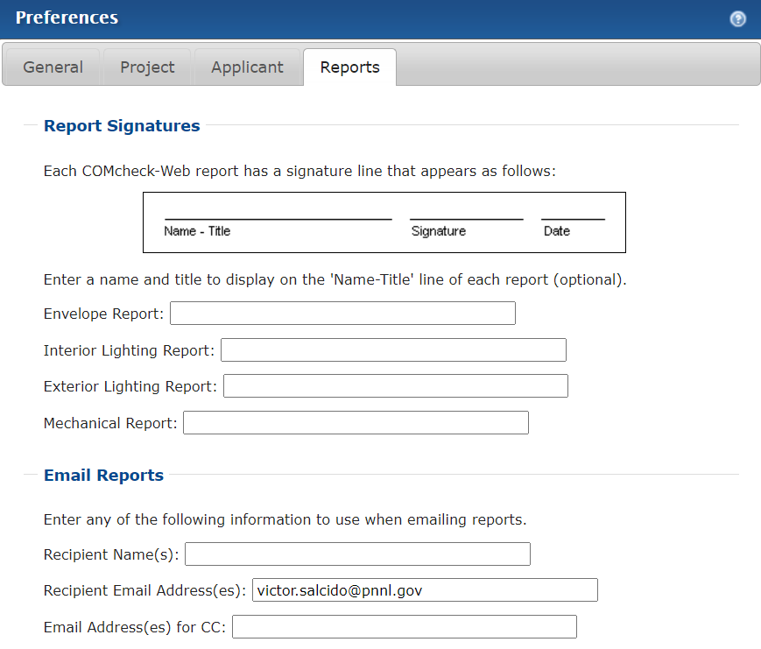
COMcheck Basics: Preferences (cont)
Building Energy Codes Program

Slide 21
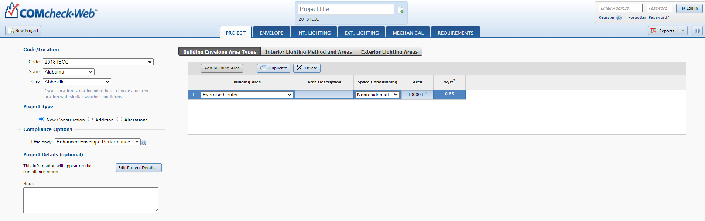
Project Screen
Select Code and Location
Building Energy Codes Program
Notes:
If unsure of applicable code to select, consult your local building department

Slide 22

Project: Project Type
New Construction
Addition
Alteration
Building Energy Codes Program
Notes:
The Trade-off compliance approach is used for New Construction and Addition. The prescriptive compliance option is used for Alteration.

Slide 23
Project: Alteration Project Type Explained
Projects involve changes to or replacement of
  Existing building components that are part of building envelope
  Lighting, heating, ventilating, air conditioning, and water-heating equipment
Specify only those envelope components, lighting fixtures, or mechanical systems/equipment that will exist upon completion of the project.
Alteration detail dialogs
  Specify exemptions if applicable
  Additional qualifications may be required (e.g., Window/wall ratio)
Compliance shown as Pass/Fail for Envelope and Lighting
Building Energy Codes Program

Slide 24
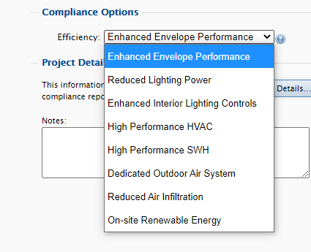
Compliance Options (IECC only)
Efficiency Options
  High performance power (2012/2015/2018)
  Reduced lighting power (2012/2015/2018)
  On-site renewable energy (2012/2015/2018)
  High performance SWH (2015/2018)
  Enhanced interior lighting controls (2015/2018)
  Dedicated outdoor air system (2015/2018)
  Enhanced Envelope Performance (2018)
  Reduced Air Infiltration (2018)
Air Barrier Options (IECC 2012+, climate zone dependent)
  Air barrier permeability
  Assembly permeability
  Air leakage test
Additional Efficiency Requirements (2021 IECC)
  Added efficiency credit requirements based on occupancy type
  Fall 2021
Building Energy Codes Program

Slide 25
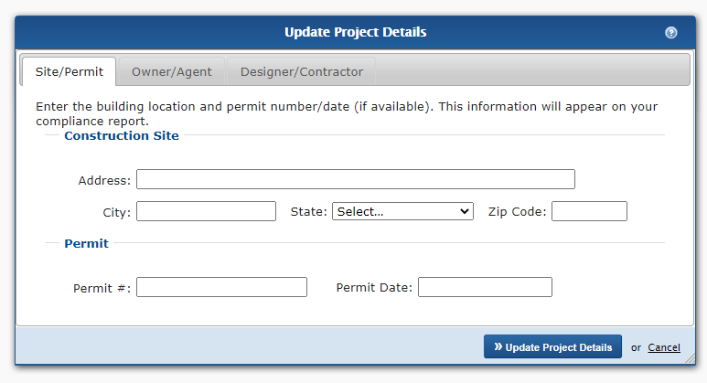
Project: Project Details
Optional
Sections
  Site/Permit
  Owner/Agent
  Designer/Contractor
Included on report
Building Energy Codes Program

Slide 26
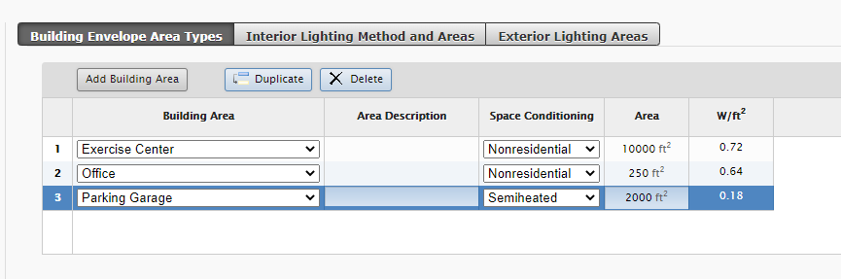
Project: Building Envelope Area Types
Primarily impacts envelope compliance
Whole building types that describe the envelope (separating conditioned and unconditioned spaces)
Space conditioning type
  Nonresidential
  Residential
  Semiheated (no mechanical cooling) – 90.1 only
Building Energy Codes Program
Notes:
Building Envelope Area Types enable envelope assemblies to be assigned to a specific space conditioning type so specific requirements for that assembly can be applied and, for codes computing energy performance, internal loads of the building classification can be defaulted.

Slide 27
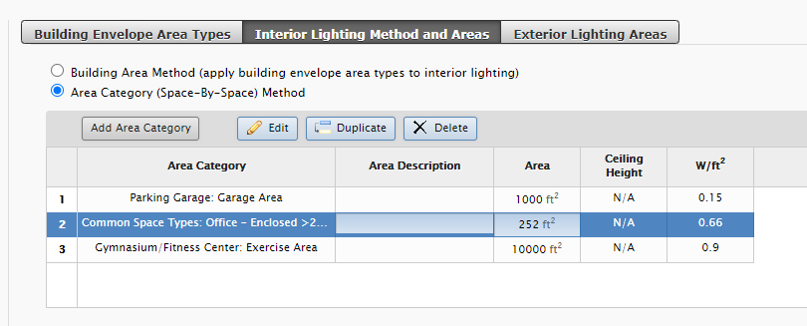
Project: Interior Lighting Method and Area Types
Method determines lighting power density and allowances
Area category allows for more detailed space representation
Building Energy Codes Program
Notes:
Building Envelope Area Types or Area Categories will appear in Interior Lighting input table. Fixtures will be specified and assigned to one of these types.

Slide 28
Interior Lighting: Methods
Selected method determines lighting power densities in interior lighting and exterior lighting screens
  based on code, method, and applications selected on the Project screen
Building Energy Codes Program

Slide 29
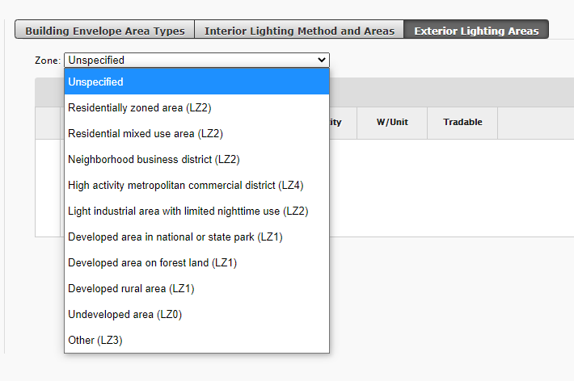
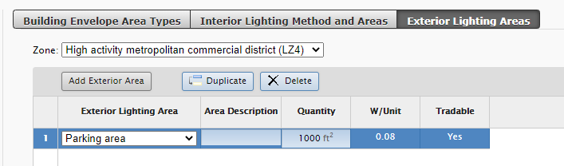
Project: Exterior Lighting Area Types
Zone and area type determine:
  Lighting power density
  Units
  Tradability
Building Energy Codes Program
Notes:
The new feature enables envelope assemblies to be assigned to a specific space conditioning type so specific requirements for that assembly can be applied and so internal loads of the building can be assigned by space conditioning.

Slide 30
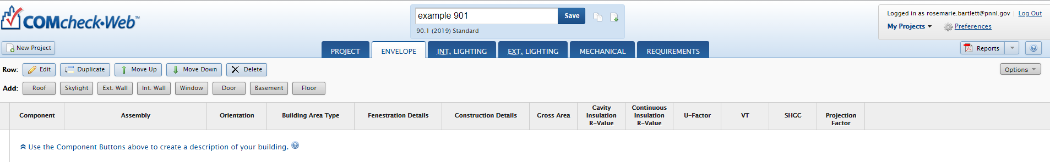
Envelope: Introduction
Cavity Insulation R-value – insulation placed between structural members
Continuous Insulation R-value – ‘continuous’ insulation across the structure (e.g., rigid insulation)
Building Energy Codes Program
Notes:
When you get to this page – remember that you will be asked for insulation in two types, cavity and continuous

Slide 31
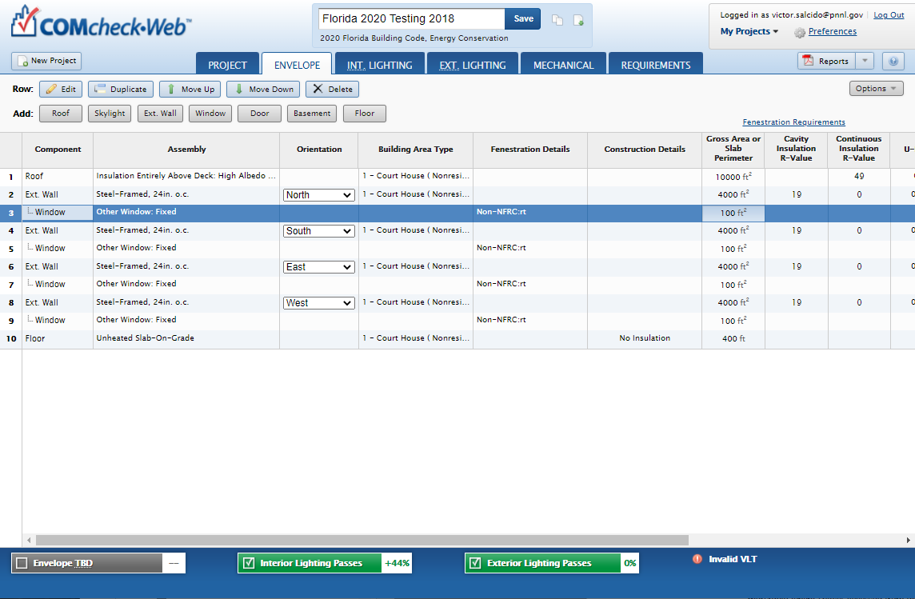
Envelope: Opaque Assemblies
After you’ve entered building components, look at compliance result
  Look for fields with red text
  If TBD, look for missing data
Building Energy Codes Program

Slide 32
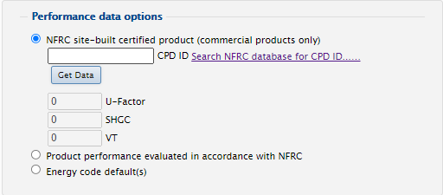
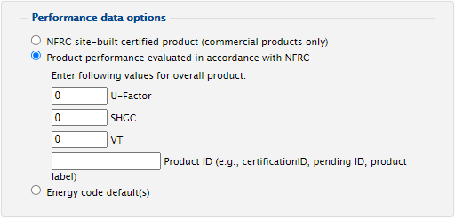
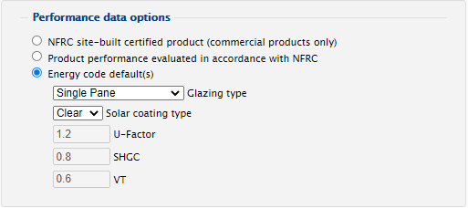
Envelope: Fenestration
NFRC site-built certified product
Performance evaluated (per NFRC guidelines)
Energy code defaults
Building Energy Codes Program
Notes:
Energy Code Defaults do not set to minimum required values

Slide 33
Envelope: Summary
Don’t have to use every assembly type
Can group “like” components
Gross area (except slab-on-grade)
Use “Other” assembly as needed
Building Energy Codes Program

Slide 34
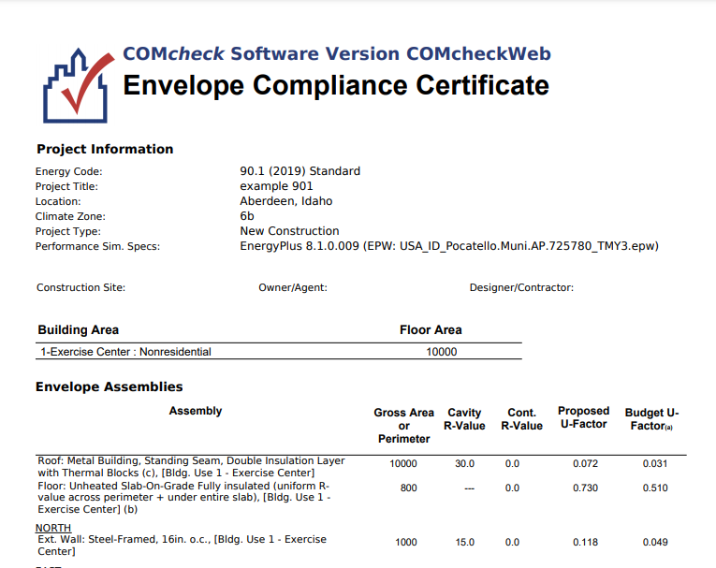
Diagnostic Data on Envelope Report
Building Energy Codes Program
Notes:
Refer to Envelope Compliance Certificate to obtain important diagnostic details.

Slide 35
Lighting Compliance
Mandatory Requirements (Interior and Exterior)
Interior Lighting Power Limits
Exterior Lighting Power Limits
+
+
Tradable
Total Connected Power
<
Interior Lighting Power Allowance
Controls
Exemptions
Non-Tradable
Switching
Efficiency
Exemptions
Whole Building
OR
Total Connected Power
<
Exterior Lighting Power Allowance
Space-by-Space
Additional Allowances
Building Energy Codes Program
Notes:
Focus on allowed and total wattage in bold. This is total compliance but just address these lighting power this. Are additional checklist requirements for controls but not fully robust

Slide 36
Lighting Fixture Categories
Linear fluorescent
Compact fluorescent
HID
Incandescent
Halogen
Track lighting
LED
Induction
Building Energy Codes Program
Notes:
Induction lighting is a fluorescent type bulb without the metal electrical contacts used to conduct electricity from the fixture to the light-emitting gas inside the bulb. Induction is the process of transmitting energy via an electro-magnetic field. The light emitting gas inside the bulbs is excited, or energized when located within a sufficiently strong EMF, or electro-magnetic field, which is induced by passing alternating current through a coil, or inductor. This means that electricity-conducting metal contacts are unnecessary on the bulb, and the bulb will experience longer life.
The lamps are capable of saving 40% over fluorescents, and some models boast a life expectancy of up to 100,000 hours.
We offer these basic categories

Slide 37
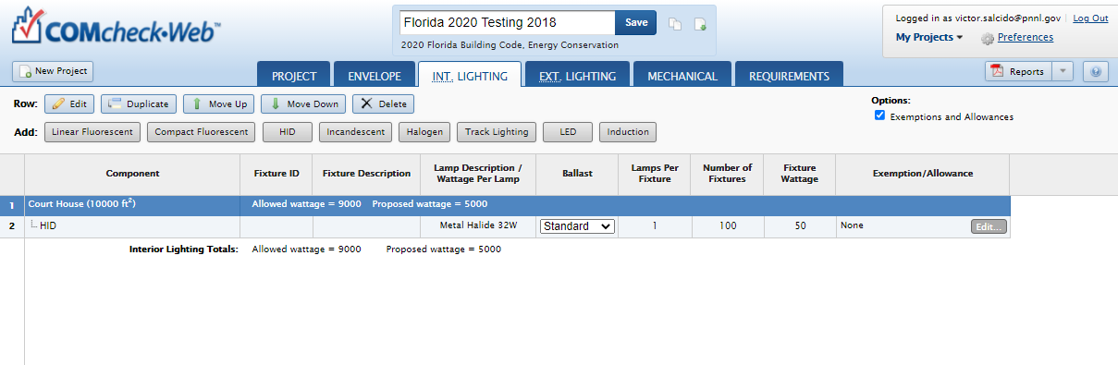
Lighting: Exemptions and Allowances
Options checkbox – top right of screen
Exemptions
  Power for exempt fixtures is omitted from the proposed wattage
Allowances
  Allowed wattage for building increased by allowable amount
Building Energy Codes Program

Slide 38
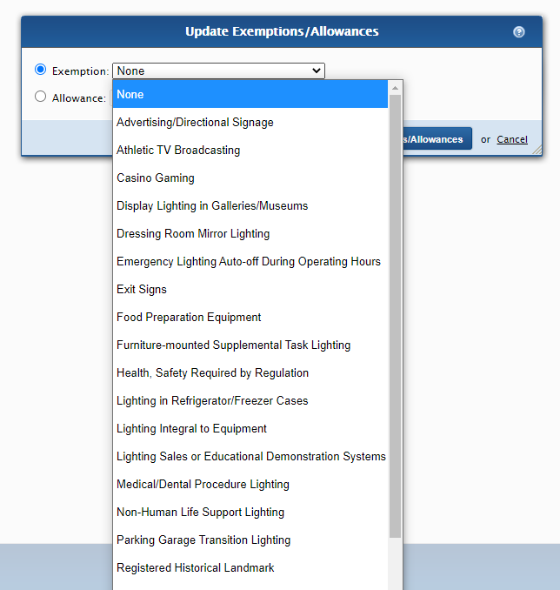
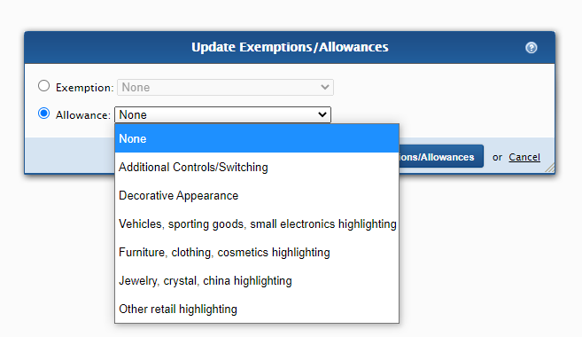
Lighting: Exemptions and Allowances (cont)
Building Energy Codes Program
Notes:
These are code specific exemptions/allowances. May see different based on code

Slide 39
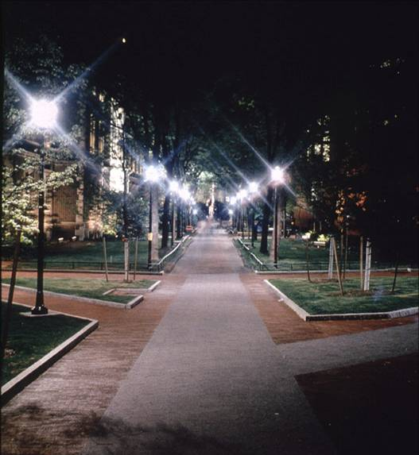
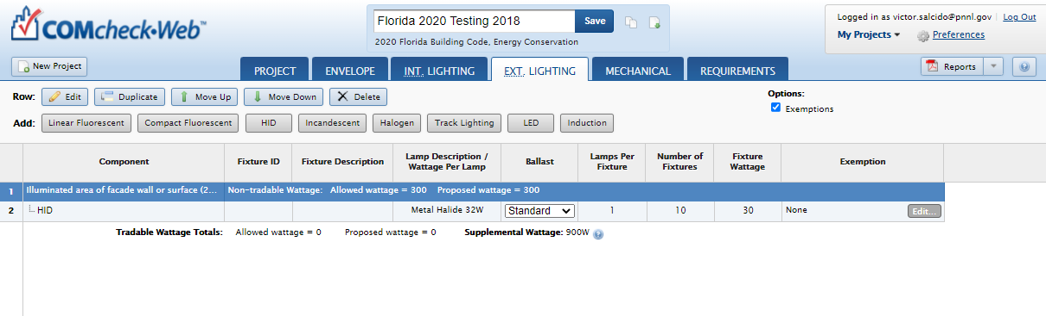
Exterior Lighting
Inputs will be based on code selected
Mandatory requirements
Exemptions
≤
Total Connected Power
Ext. Ltg. Power Allowance
Building Energy Codes Program

Slide 40
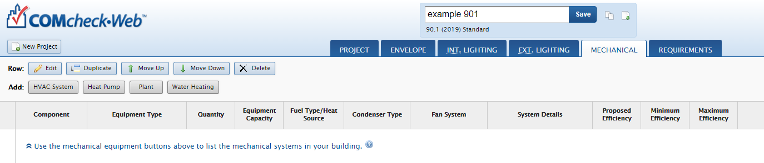
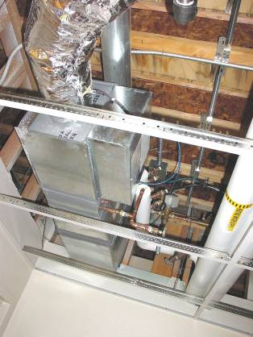
Mechanical Systems
Limited means to determine compliance
Enter characteristics of
  HVAC or Heat Pump system
  Plant
  Water heating
Characteristics you select determine which requirements apply
Building Energy Codes Program
Notes:
System Details –
HVAC - zoning category (single, multi, perimeter), and multiple zone details (distribution type, terminal type and reheat)
Also economizer requirements, chiller types, boiler types, hot water system details.

Slide 41
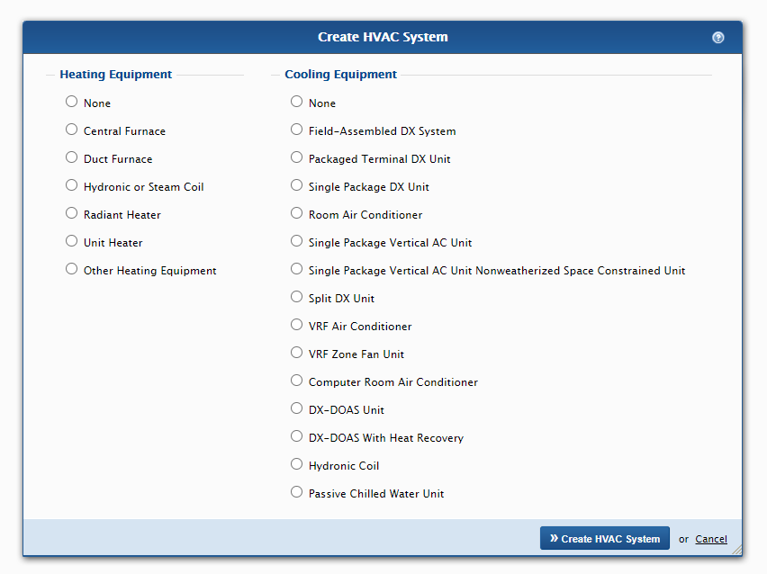
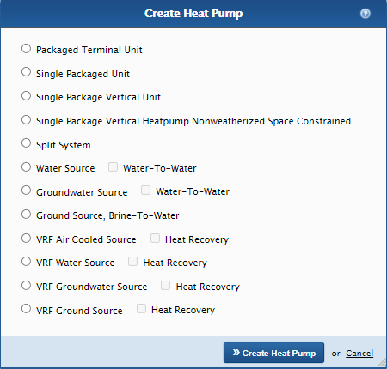
Mechanical Systems
Building Energy Codes Program

Slide 42
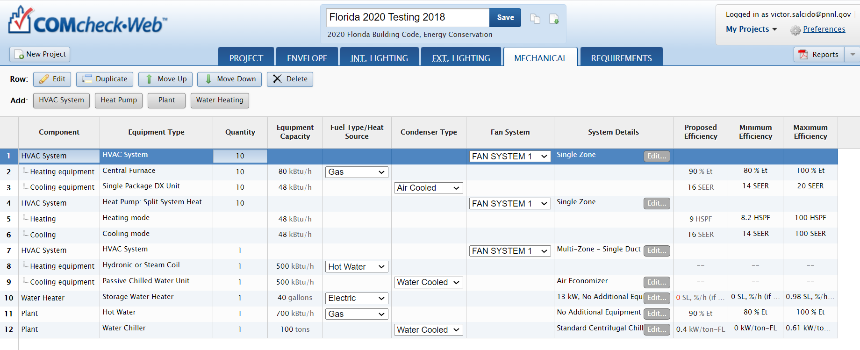
Mechanical Systems
Building Energy Codes Program

Slide 43
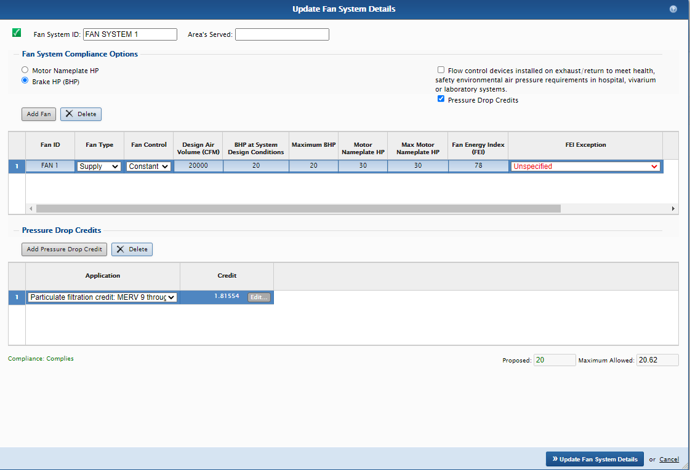
Mechanical Fan Systems
Determines Fan Power Limitations compliance for each fan system
Motor nameplate HP and brake HP
  Brake HP includes pressure drop credits as applicable
Building Energy Codes Program

Slide 44
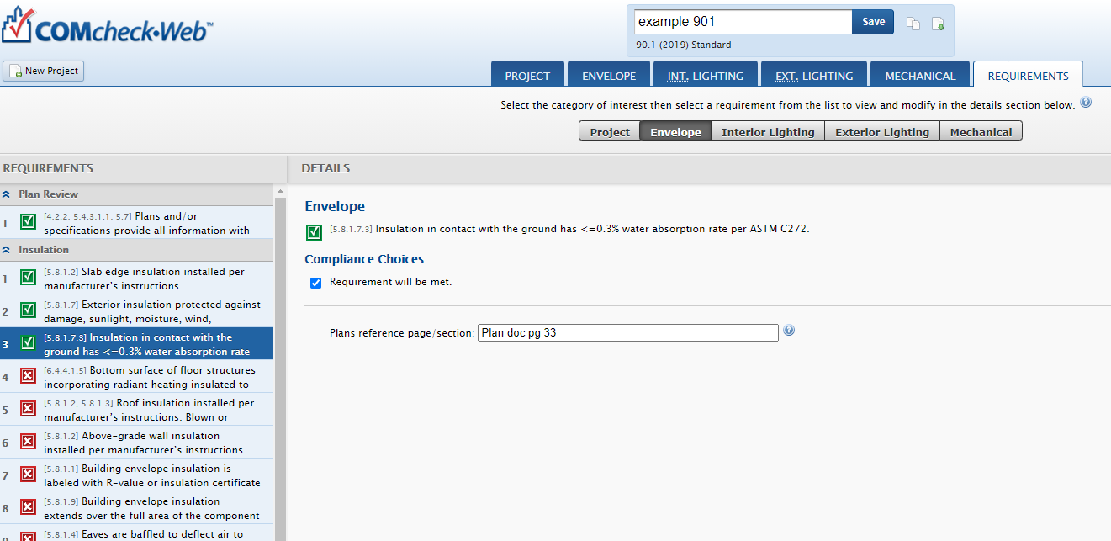
Requirements Tab - Goals
Ensure user is aware of applicable mandatory requirements and addresses each in the software
Provide better documentation for code officials
Building Energy Codes Program

Slide 45
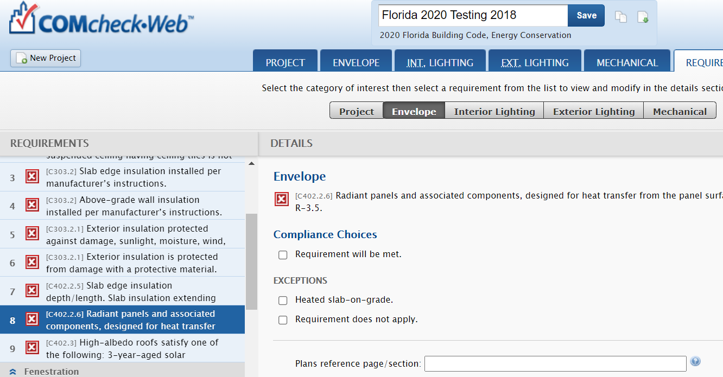
Requirements Tab – How it Works
For each requirement, the user
  Chooses a “compliance option”
    Requirement will be Met
    Exempt or Exceptions
    Requirement is Not Applicable or Requirement Does Not Apply
  Notes how compliance for applicable requirements are documented
This information is shown on the report in the “Comments/ Assumptions” column of the Inspection Checklist
Building Energy Codes Program

Slide 46
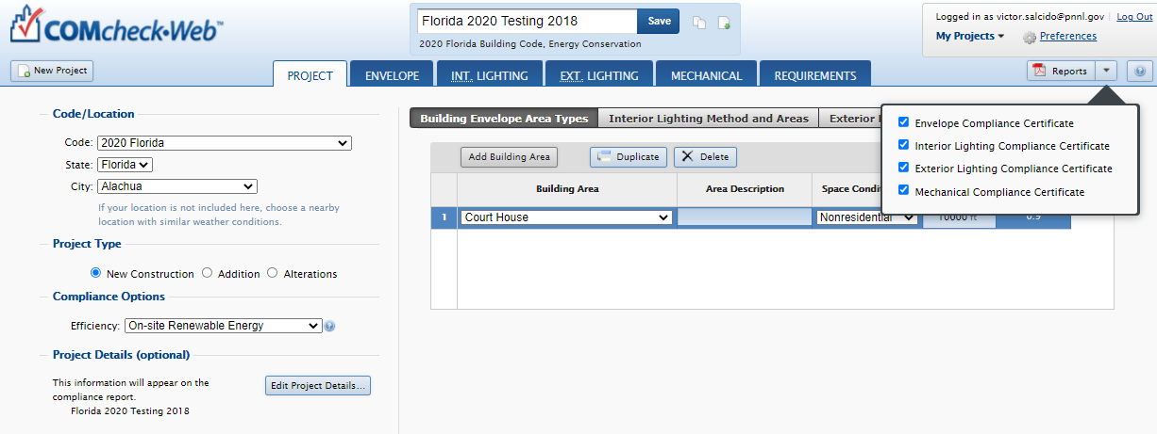
Reports
Click on Reports – top right of screen
Choices, choose any or all
  Envelope Compliance Certificate
  Interior Lighting Compliance Certificate
  Exterior Lighting Compliance Certificate
  Mechanical Compliance Certificate
First pages are the Compliance Certificate
Follow-on pages are the Inspection Checklists by phase of inspection
  Plan Review
  Footing/Foundation
  Rough-in
  Final
Building Energy Codes Program

Slide 47
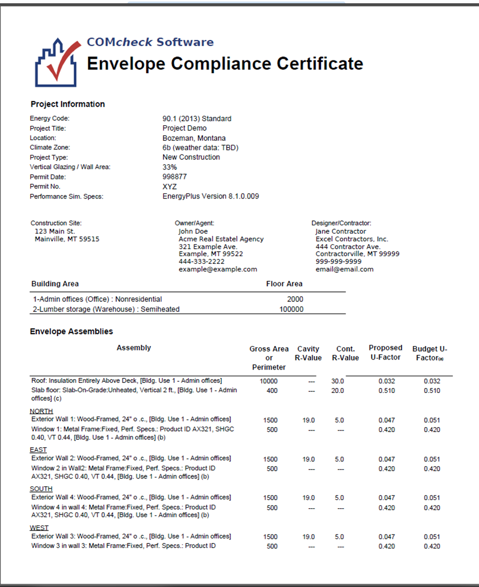
Reports – Compliance Certificate
Building Energy Codes Program

Slide 48
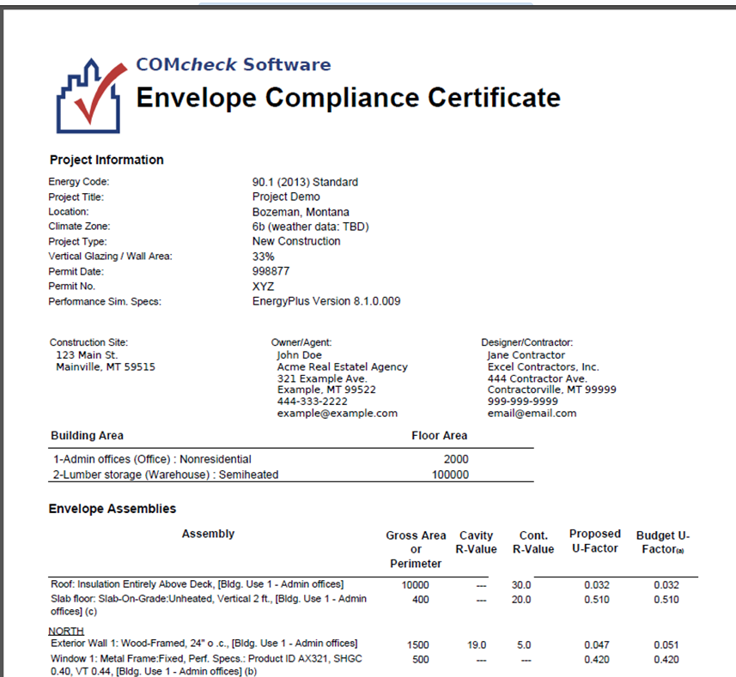
Reports – Compliance Certificate (cont)
Verify energy code, location, and construction type specifications
Building Energy Codes Program

Slide 49
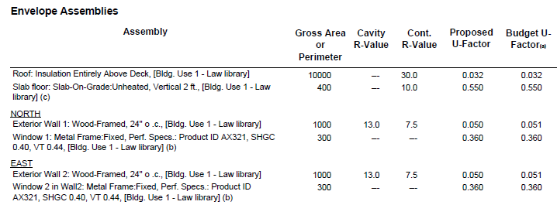

Reports – Compliance Certificate (cont)
Verify area, insulation R-values, and U-factors consistent with plans
Verify Compliance Statement is Signed
Building Energy Codes Program

Slide 50




Reports – Inspection Checklist
Building Energy Codes Program
Notes:
Plan Review
Foundation Review
Framing
Final Inspection
Color code those more important items
Organization is different in report than in the interface. Any suggestions are welcome

Slide 51





U.S. DOE: BECP Resources
Compliance software
Technical support
Code notes
Publications
Resource guides
Training materials www.energycodes.gov
Building Energy Codes Program
Notes:
Plan Review
Foundation Review
Framing
Final Inspection
Color code those more important items
Organization is different in report than in the interface. Any suggestions are welcome

Slide 52



COMcheck – Next Generation (Anticipated Fall 2021)
Building Energy Codes Program

Slide 53

COMcheck – Project Page
Building Energy Codes Program

Slide 54

COMcheck – Project Page
Building Energy Codes Program

Slide 55

COMcheck Upgrade – Envelope
Building Energy Codes Program

Slide 56

COMcheck Upgrade – Envelope
New Project
Building Energy Codes Program

Slide 57

COMcheck Upgrade – Batch Operations
Building Energy Codes Program

Slide 58

COMcheck Upgrade – Mechanical
Building Energy Codes Program

Slide 59





COMcheck Upgrade – Mechanical
Building Energy Codes Program

Slide 60

COMcheck Upgrade – Mechanical
Building Energy Codes Program

Slide 61

If you want AIA LUs or a Certificate of Attendance for self-reporting to ICC or RESNET, WRITE DOWN THIS LINK:
www.energycodes.gov/necc/2021_credit_request
NOTE: This link will only be active until Monday, July 26

Slide 62
THANK YOU!!!
Building Energy Codes Program
www.energycodes.gov
BECP help desk
http://www.energycodes.gov/resource-center/help-desk
Building Energy Codes Program
Notes:
Send out note – always improving software for the future and would love your feedback on any features or operations

Slide 63
Notes:
Send out note – always improving software for the future and would love your feedback on any features or operations

