Slide 1
Energy Codes 101
Rosemarie Bartlett
PNNL-SA-163891
Notes:
This presentation is truly a “101” course, intended for anyone not familiar with the basics of the building energy codes world. We will NOT be covering any code requirements during this short presentation, however, webinars were held last fall providing an overview of what’s in the latest codes. You can check those out on www.energycodes.gov.

Slide 2
Code Benefits
Cumulative 2010-2040
Reduced energy consumption
Reduced CO₂ emissions
13.5 quads primary energy
900 MMT
Rising cost savings
$138B
www.energycodes.gov/sites/default/files/documents/Impacts_Of_Model_Energy_Codes.pdf
Building Energy Codes Program
Notes:
So, what are the benefits/impacts of building energy codes?
The U.S. Department of Energy (DOE) Building Energy Codes Program (BECP) periodically evaluates national and state-level impacts associated with energy codes in residential and commercial buildings. Pacific Northwest National Laboratory (PNNL), funded by DOE, conducted an assessment of the prospective impacts of national model building energy codes from 2010 through 2040.
DOE has conducted an interim and limited update to its 2016 study to evaluate potential building code updates using the 2016 methodology and data. This interim update includes estimated savings resulting from more recent updates to the model energy codes, including the Standard 90.1-2016 and 2019 editions, as well as the 2018 and 2021 International Energy Conservation Code (IECC). DOE intends to release a fully updated report in 2022 that is anticipated to include the recent code updates, as well as additional enhancements to the study methodology, and re-casting the estimated savings and impacts over a 30-year analysis period (e.g., through the year 2050).

Slide 3
Major Players
ASHRAE
ICC (International Code Council)
Jurisdictions
From DOE’s perspective – the model / baseline codes are
ASHRAE 90.1 for Commercial
ICC IECC for Residential
Notes:
There are many players in the building energy codes world. Here are a few we call “major” players.

Slide 4
DOE’s Role
DOE is directed by statute to participate in industry processes to
Develop model building energy codes
Issue determinations as to whether updated codes result in energy savings
Provide technical assistance to states to implement and comply with the codes
For specific statutory language, visit
https://www.energycodes.gov/statutory-requirements
Notes:
Energy codes have been around in one form or another since the 1970s and became part of official federal policy in 1992 with the amendment of the Energy Conservation and Product Act (ECPA)
DOE’s Building Energy Codes Program was created in response to Congressional direction in ECPA to promote energy efficiency in buildings through energy codes. ECPA explicitly references the model codes as ASHRAE 90.1 for commercial and IECC for residential.

Slide 5
DOE’s Support
Code development and adoption
Research
Technical analyses
Supporting industry processes which review and update model codes
Implementation
Customized technical analyses
Software tools
Education and training materials
Technical support through a help desk
Notes:
Customized technical analyses can include, for example, analyzing proposed state or local code amendments to estimate impact. BECP has funds set aside to provide technical assistance to states and local governments – the technical assistance is NOT in the form of funding for states and locals but rather through technical analyses, development of specific resources, etc.
The REScheck and COMcheck software tools are free for users to demonstrate compliance with the model codes and some state and local codes. In addition, BECP offers technical support on the tools and other basic energy code questions through a help desk accessible from energycodes.gov. The help desk averages about 2000 to 2500 inquiries per year.

Slide 6
DOE Determinations
DOE is required by law [the Energy Conservation and Production Act, as amended (ECPA)] to issue a determination as to whether the latest editions of
ASHRAE Standard 90.1 (for commercial and multi-family high-rise residential buildings) and
ICC’s International Energy Conservation Code (for low-rise residential buildings)
will improve energy efficiency compared to the previous edition
DOE has 1 year to publish a determination in the Federal Register after each new edition of the standard/code is published
Notes:
DOE conducts and posts the technical analyses that assess Standard 90.1 compared to the previous edition and IECC compared to the previous edition and estimates the anticipated energy consumption of buildings required to meet the updated editions.
For commercial code- Upon publication of an affirmative determination, States are required to certify that they have reviewed the provisions of their commercial building code regarding energy efficiency, and, as necessary, updated their codes to meet or exceed the updated edition of Standard 90.1.
For residential code - Upon publication of an affirmative determination, States are required to certify that they have reviewed the provisions of their residential building code regarding energy efficiency and made a determination as to whether it is appropriate for them to revise their code to meet or exceed the updated edition of the IECC.
State certifications must be submitted within two years from the date a final determination is published in the Federal Register.

Slide 7
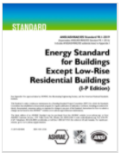
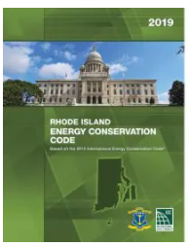
“Building Energy Codes”
When speaking in general about “building energy codes”, people may be referring to:
ASHRAE Standard 90.1
IECC
State and locally adopted codes

Slide 8
IECC
Two sets of provisions
Commercial
Residential (three stories or less in height above grade)
Each set of provisions is treated separately
References 90.1 as an alternate approach for commercial
Must be used in its entirety
Different publication schedule
e.g., 2021 IECC refers to 90.1-2019

Slide 9
What Do Building Energy Codes and Standards Cover?
For both residential and commercial:
Building Envelope
Mechanical
Service Water Heating
Lighting
Electrical Power
Notes:
Building energy codes are minimum requirements for energy-efficient design and construction for new and renovated residential and commercial buildings. Using them doesn’t necessarily equal (what some refer to as) “green” building. Building energy codes are a solid baseline of requirements—but they do set the standard by which “above-code” efforts are defined.
So, what specific parts of buildings do they cover?
Simply put, they apply to a building’s envelope (the materials that make up its outer shell) as well as its systems and built-in equipment. These will be described in more detail later in this presentation.
The life cycle of a building is decades or even centuries long. As minimum requirements in these vital areas, when codes are improved, future generations will receive more efficient and less costly living and working environments.

Slide 10
Residential vs. Commercial
Residential codes are typically less complex than commercial
Commercial buildings usually have more systems
More requirements for lighting, including daylighting and controls
Detailed control requirements for mechanical systems
…and more

Slide 11
Three Main Aspects
Development
Adoption
Compliance

Slide 12
Code Development
ASHRAE 90.1
Uses the American National Standards Institute (ANSI) consensus process
90.1 project committee and subcommittees
All interested parties can participate
Final vote of the project committee
Includes members from a balance of all interests
ICC IECC
Historically
Used a government consensus process
All interested parties could participate
Final vote was online governmental consensus vote
New framework starting in 2021
See www.ICCsafe.org/energy for details

Slide 13
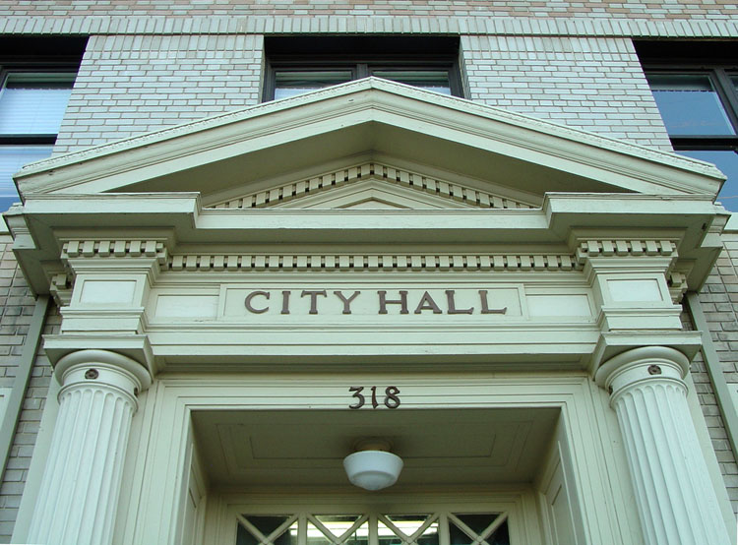
Energy Code Adoption
Can occur at the state or local level in one of two ways:
directly through legislative action (state level)
by regulatory action through state or local agencies.
https://cdn-web.iccsafe.org/wp-content/uploads/Code-Adoption-Process-by-State-June-2019.pdf
Notes:
Once building energy codes are developed, they are merely books on the shelf until governing bodies adopt (and sometimes adapt) them into laws.
Adoption of energy codes can occur in one of two ways:
Directly through legislative action
By regulatory action through agencies authorized by the legislative body to oversee the development and adoption of codes.
When adoption is accomplished through legislation, a committee may be appointed to provide recommendations and/or draft the legislation.
When adoption occurs through a regulatory process, states and local governments often appoint an advisory body comprising representatives of the design, building construction, and enforcement communities. This advisory panel recommends revisions that should be considered for adoption. In basing their recommendations on model energy codes, the advisory panel considers modifications to the model codes to account for local preferences and construction practices. The panel also may serve as a source of information during the adoption process. Their recommendations then enter a public review process.

Slide 14
Adoption Date vs. Effective Date
Usually, these dates are different
Sometimes a grace period is allowed where the predecessor code be used
Because buildings may be in different stages of design or construction
Stakeholders may need time to learn the new code
Manufacturers may need time to provide products
Effective date is sometimes tied to publication date of a model energy code

Slide 15
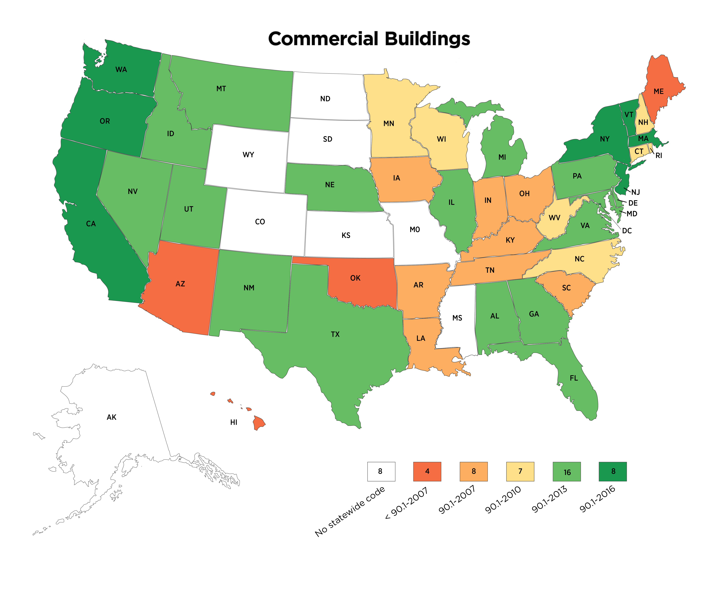
Current State Adoption Status – Commercial*
*As of June 30, 2021, and as analyzed by PNNL
Notes:
PNNL conducts an analysis every quarter of states that have codes with effective dates in that quarter. Prior to 2016, BECP maps noted whatever base code states had adopted, but this was problematic. States sometimes amend the base codes – and sometimes rather extensively. Therefore, simply listing the base code could be misleading. For example, a state that adopted the 2018 IECC but included amendments that effectively rendered the code to be equivalent to the energy savings level of the 2009 IECC.
Prior to 2016, the BECP map would have listed that state’s code as the 2018 IECC. Since 2016, energy code adoption is assessed based on a quantitative analysis of energy savings impacts within a given state and would list that state’s code as the 2009 IECC.
Explanations of the analysis are available at energycodes.gov.

Slide 16
Current State Adoption Status – Residential
*As of June 30, 2021, and as analyzed by PNNL

