Slide 1
REScheck Basics
2021 Department of Energy National Energy Codes Conference
Building Energy Codes Program
V. Robert Salcido
Senior Research Engineer
Notes:
PNNL develops and supports the CheckTools suite of software- Gate Keepers and Key Masters
Residential projects – REScheck
Commercial projects - COMcheck
Why do we do this?
Compliance: Provide technical assistance to states to implement building energy codes including increasing and verifying compliance to ensure consumer benefits (42 USC 6833), develop software to support a streamlined compliance process, provide objective information resources and technical guidance to states and localities to increase code compliance.

Slide 2





REScheck Current Use Scenario
Demonstrate Compliance
Collect Data
Check Compliance
Plan Review
Review Software Input
Review Mandatory Requirements
Field Inspection
Verify compliance of inspection checklist items
Prepare Input
Generate Compliance Report
Check Compliance Results
Approve compliance
Paper/PDF
Paper/PDF
Builder
Architect Designer
Plan Reviewer
Field Inspector
BECP Tools used only during “Demonstrate Compliance” Stage
Building Energy Codes Program
Notes:
Where REScheck fits into the whole design and build process

Slide 3

www.energycodes.gov
Building Energy Codes Program
Notes:
This is the website where you can find the REScheck software. Both web and desktop. This workshop will focus on the web as the desktop will be phased out.

Slide 4
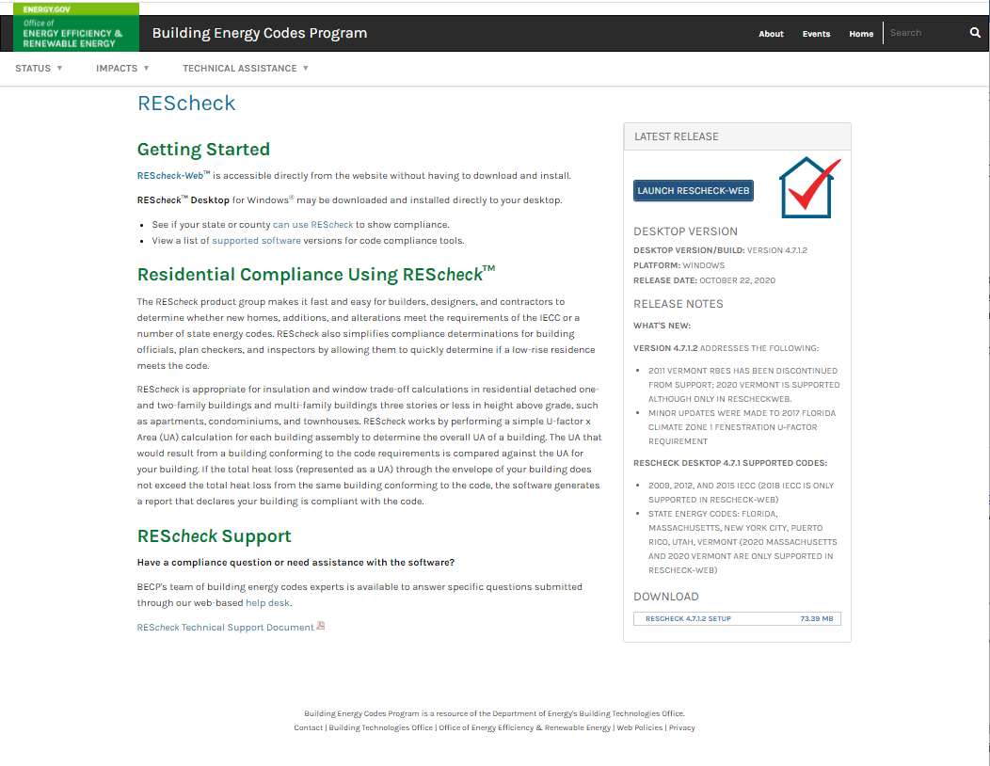
REScheck Page
https://www.energycodes.gov/rescheck
Building Energy Codes Program
Notes:
Links directly to REScheck web and REScheck desktop

Slide 5





REScheck Currently Supported Energy Codes
Building Energy Codes Program
Notes:
Codes that REScheck supports. There are state amended codes that have been implemented that meet the DOE requirements for inclusion into REScheck.

Slide 6
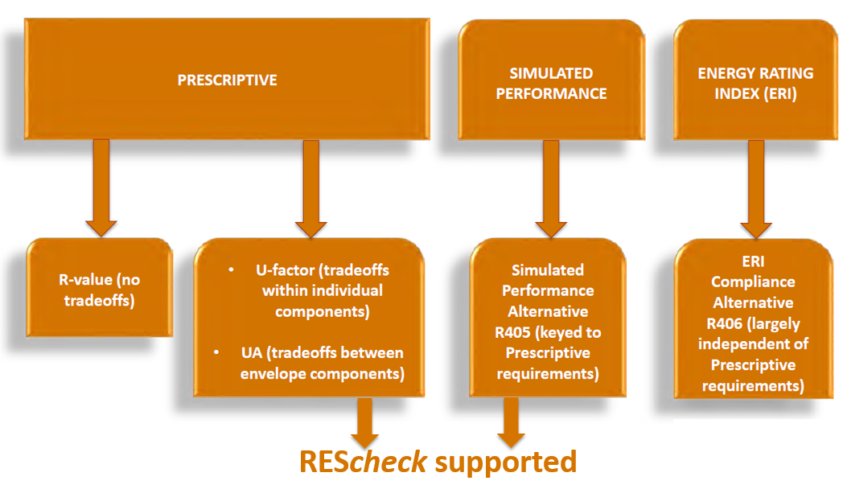
Residential Energy Code Compliance
Building Energy Codes Program
Notes:
REScheck also supports a limited performance alternative: Envelope trade-offs only.

Slide 7
REScheck Supported Compliance Methods
Total UA
  Considers thermal conductance of envelope assemblies
  “Trades-off” UA from above-code assemblies to below-code assemblies
  UA = U-factor x Area for each building assembly
  Sum UA for Proposed Building compared to SUM UA for Code (Budget) Building
Performance Alternative
  Considers the whole building energy performance
  Based on simulated performance of your building compared to an equivalent code building
  Requires additional inputs (over UA approach): building orientation, minimum of four walls having unique orientations, and a minimum of one roof and floor
  Envelope trade-off only, no mechanical equipment trade-off
Building Energy Codes Program
Notes:
Total UA – measure of the effectiveness of the thermal envelope. Considers the thermal conductance of envelope assemblies and the effect of thermal bridging.
Performance Alternative – limited in scope and only tradeoffs with envelope allowed. No tradeoffs with infiltration, mechanical, L&A or ducts can be conducted.

Slide 8
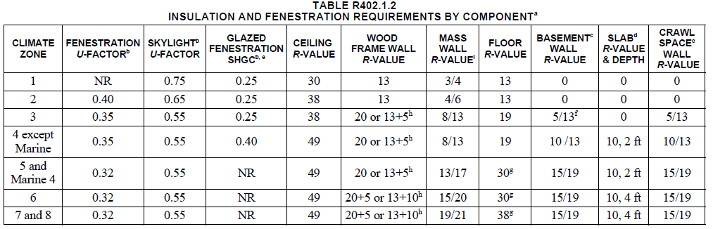
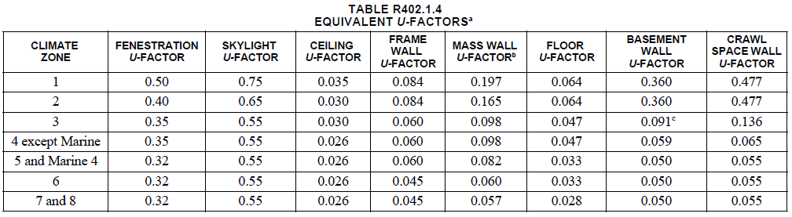
Energy Code Envelope Assembly Requirements
Building Energy Codes Program
Notes:
Energy code offers two sets of requirements. REScheck applies the U-factor set of requirements for both Total UA and Prescriptive compliance methods.

Slide 9
Walkthrough REScheck Steps
Register for Account
Log In
Select the appropriate code
Enter project information
Enter building components
Enter mechanical equipment (optional)
Review Mandatory Requirements
Reports
View/print/save
Building Energy Codes Program

Slide 10
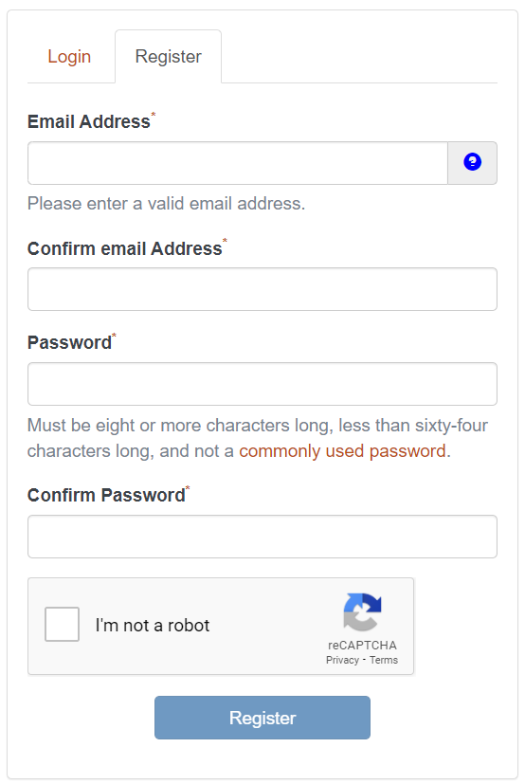
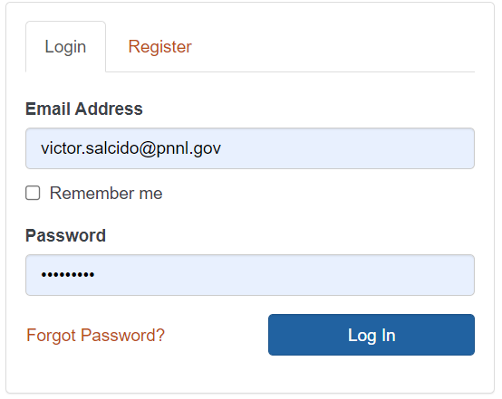
REScheck-Web: Registration and Account Log-In
Building Energy Codes Program
Notes:
Users will be required to register from now on.
Once registration is complete, log in credentials can be saved depending on browser and company policy.

Slide 11
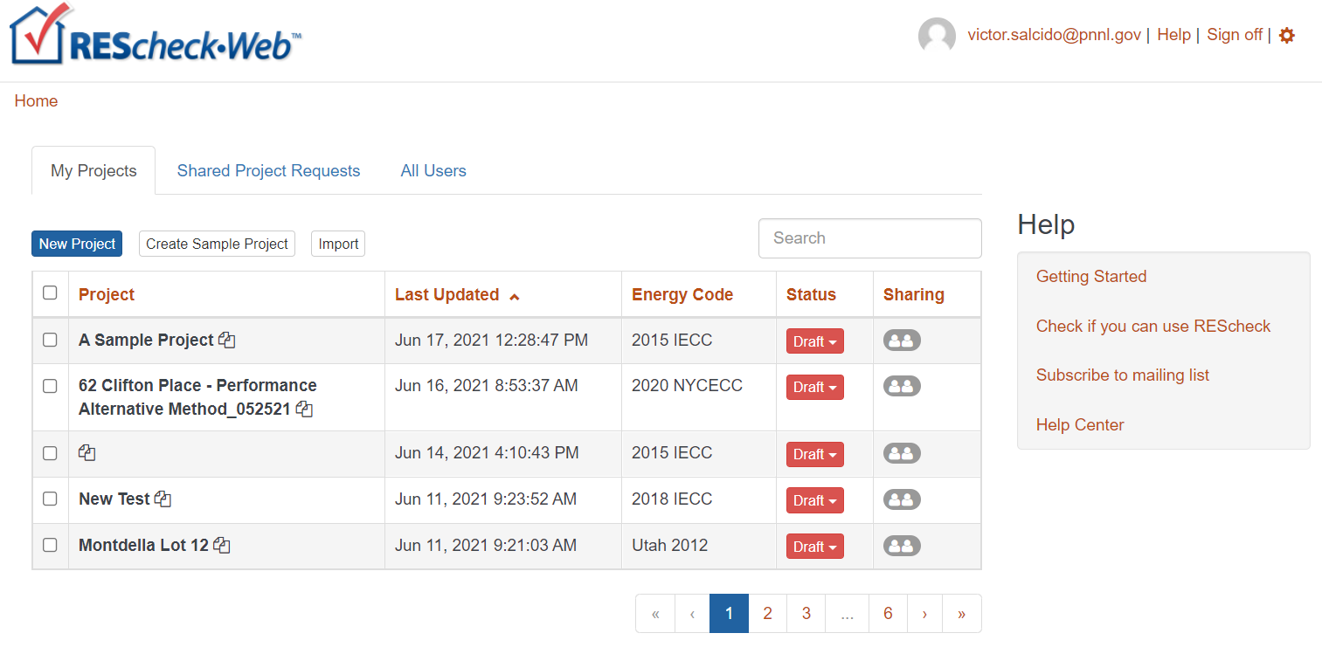
Home: My Projects (aka Project Dashboard)
Building Energy Codes Program
Notes:
“Home” (aka Project Dashboard) gives users advanced project management capabilities.
Standard table features exists:
Sort columns in ascending/descending order by alternately clicking on column header.
Modify projects status descriptor to identify projects that are final.
Send out sharing privileges with co-workers.
Bulk process deletion operations.
Specify “My Profile” and “My Settings” features.
Use the “Create Sample Project” button to create an example project to review and study as a tutorial aid.
Right-mouse-click on Project name to see other options specific to projects.

Slide 12
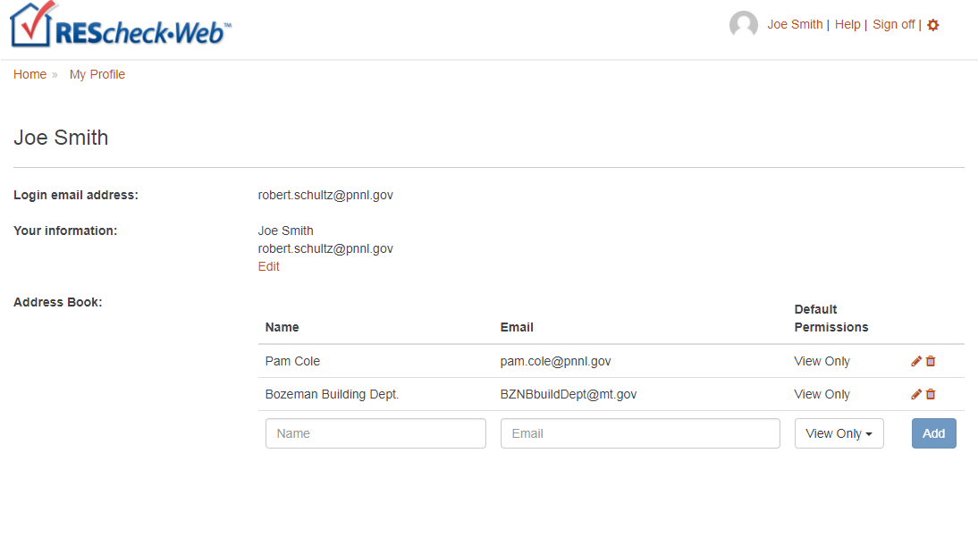
My Profile
Building Energy Codes Program
Notes:
Add co-workers to your Address Book that you wish to sharing projects with.
Your personal information will accompany share invitation emails.

Slide 13
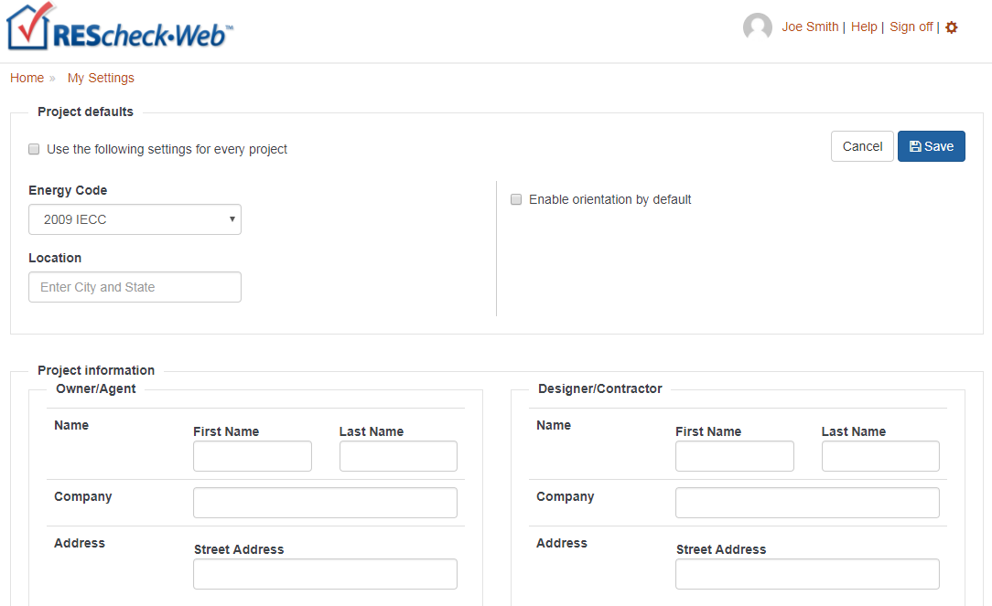
My Settings
Building Energy Codes Program
Notes:
My Settings can be used to set default properties to invoke for each new project you create.
Toggle the default project settings on/off to temporarily disable use of defaults.

Slide 14
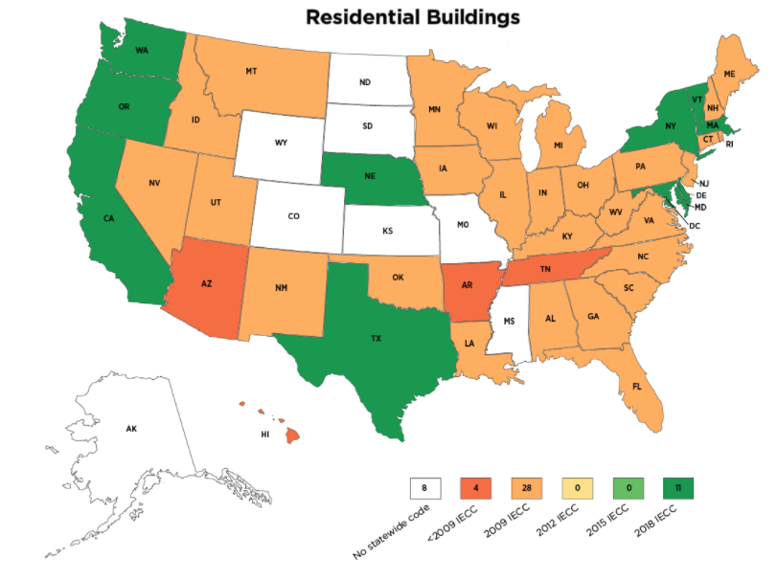
Select the Appropriate Code
Applicable to your state/ jurisdiction (Code menu)
Building Energy Codes Program
Notes:
Adoption is assessed based on a quantitative analysis of energy savings impacts within a given state. This provides a greater level of accuracy and replaces the previous approach, which was comprised of a simpler qualitative review of state code titles and provisions. However, this may mean that the code shown on the map is not necessarily the code the local building department may want used for compliance. Users need to ask the local building department what code to select from the Code menu to be sure.

Slide 15
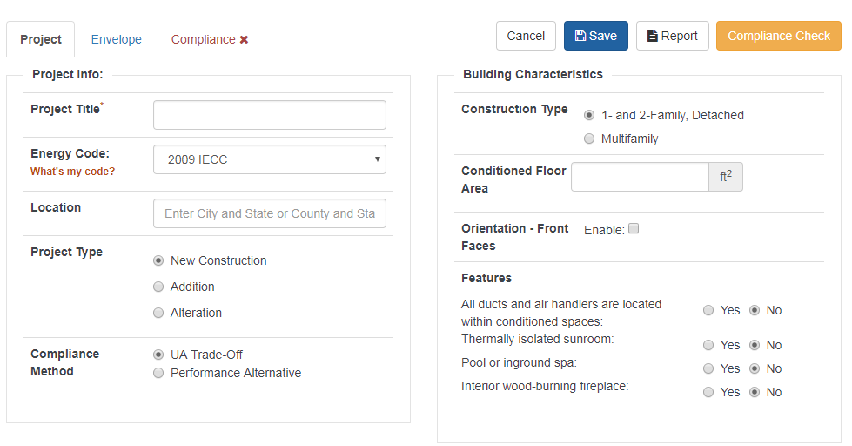
Project Tab: New Project
Building Energy Codes Program
Notes:
New projects will open in “edit” mode by default.
Existing (previously saved projects) will open in “read-only” mode. Click Edit to allow editing to occur.
REScheck designed flow to move from the top left to bottom right. Flow should be to move left to right and top to bottom

Slide 16
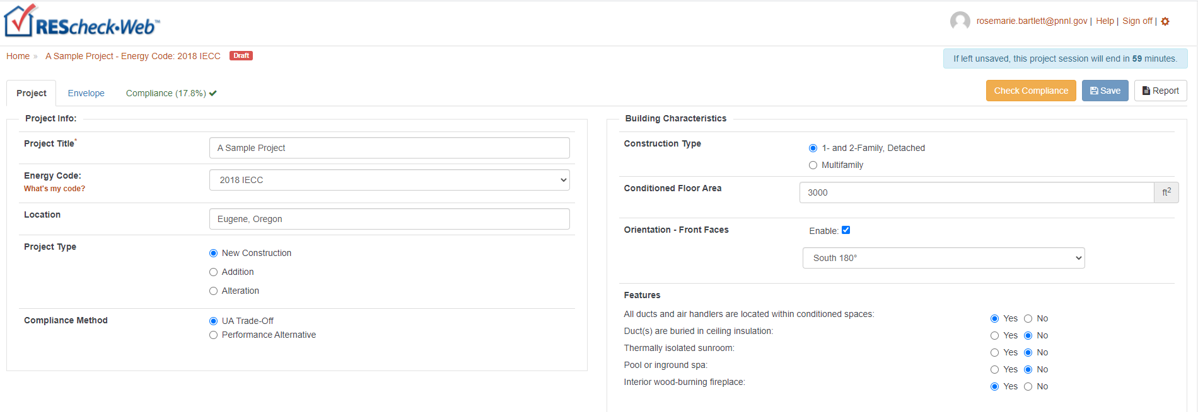
Energy Code, Location, Project Type, Compliance Method
Building Energy Codes Program
Notes:
Location of project determines climate zone.
Project type and compliance method determines what method is used for determining compliance.
2015/2018 IECC Alternation projects require prescriptive path method be used.
Trade-off compliance approach is used for New Construction and Addition.

Slide 17
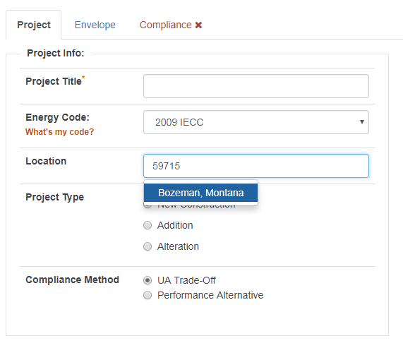
Project Location Specification
Building Energy Codes Program
Notes:
Project location can be specified by typing in a zipcode, city name, county name, and/or state.
In most inputs, a drop-down list will be displayed and populated according to previously entered content while type ahead keystrokes can be matched with those inputs.

Slide 18
Project Tab: Project Type
Select New Construction, Addition or Alteration on Project screen
  Additions
  User choice:
    Addition only
    Addition plus existing home
  Alterations
    Only include those assemblies being altered
    Exemptions may apply (“Alteration Details”)
Building Energy Codes Program

Slide 19
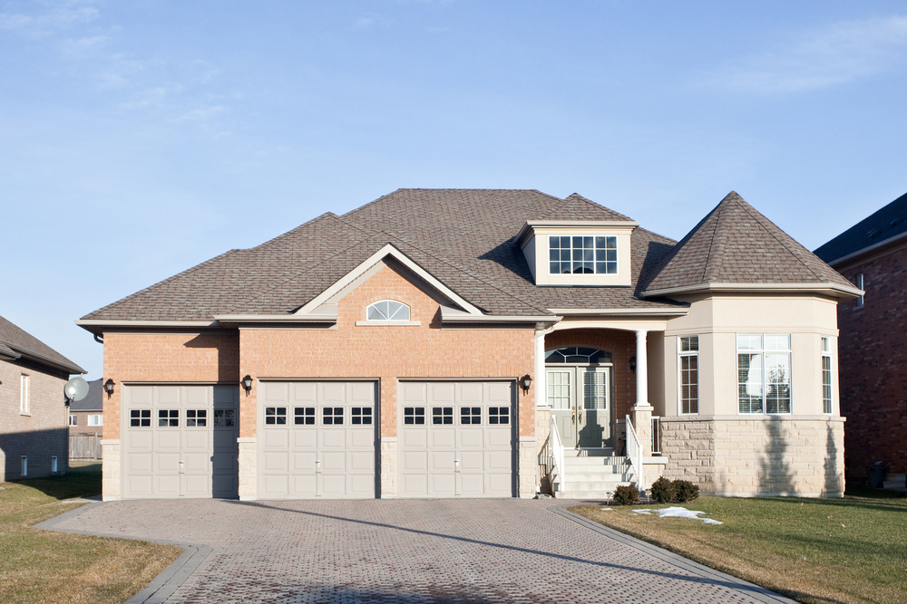
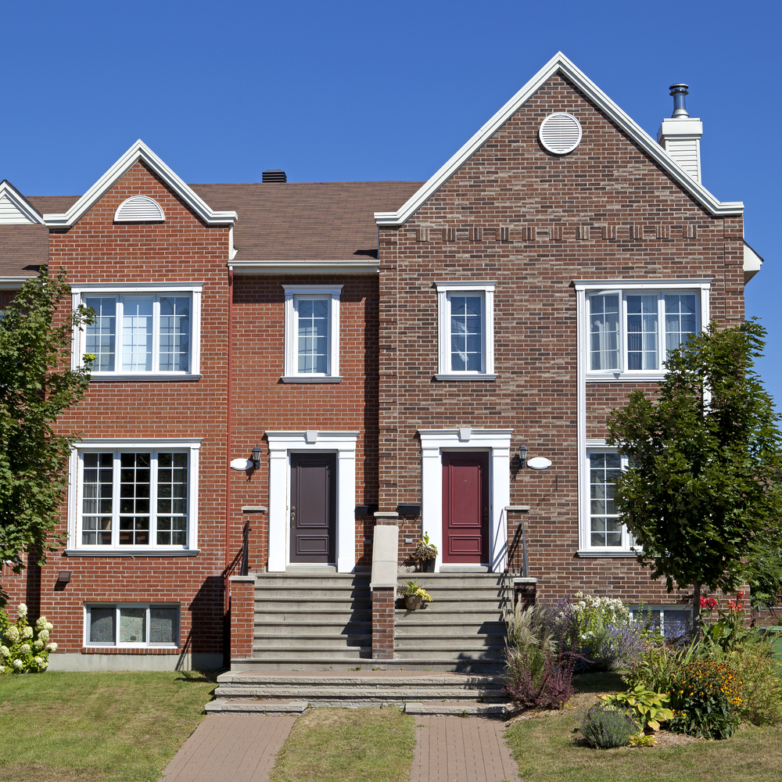
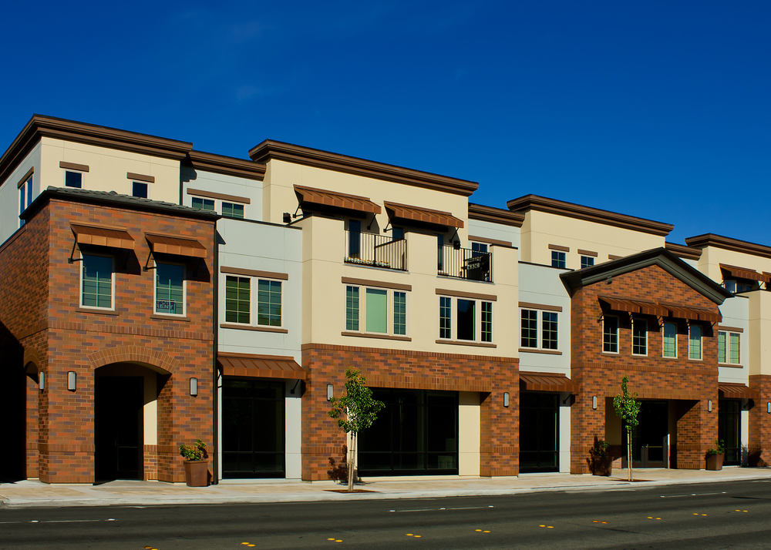
Building Characteristics
1- and 2-Family, Detached
Low-rise Multifamily
Building Energy Codes Program

Slide 20

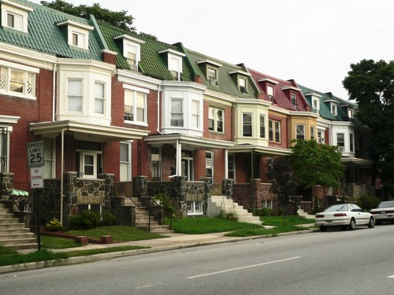

Building Characteristics: Multifamily
Multifamily if
  All multifamily buildings three stories or less in height above grade and
  Contain three or more attached dwelling units
  Examples
    Apartments
    Condominiums
    Townhouses
    Dormitories
    Rowhouses
Building Energy Codes Program
Notes:
Multifamily buildings can be considered as a whole or separate reports can be generated for each dwelling unit. If compliance is being shown for an individual unit, typically you would not include the shared components that do NOT separate conditioned space from unconditioned space. Where individual units are identical, one report may be submitted as representative of the others. Contact the authority having jurisdiction to determine which approach to take.

Slide 21
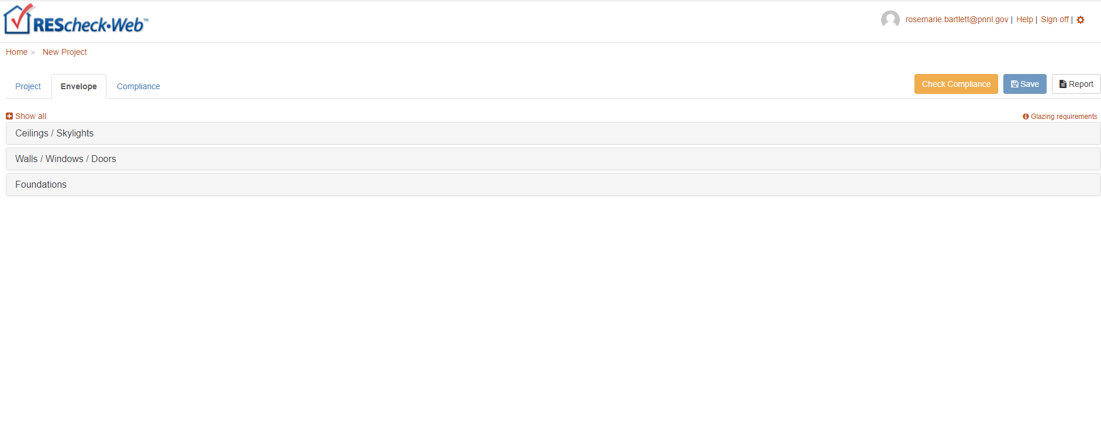
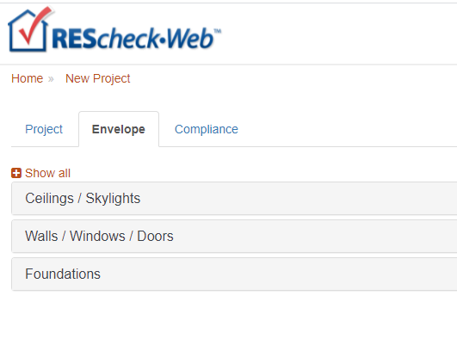
Envelope Tab
Building Energy Codes Program

Slide 22
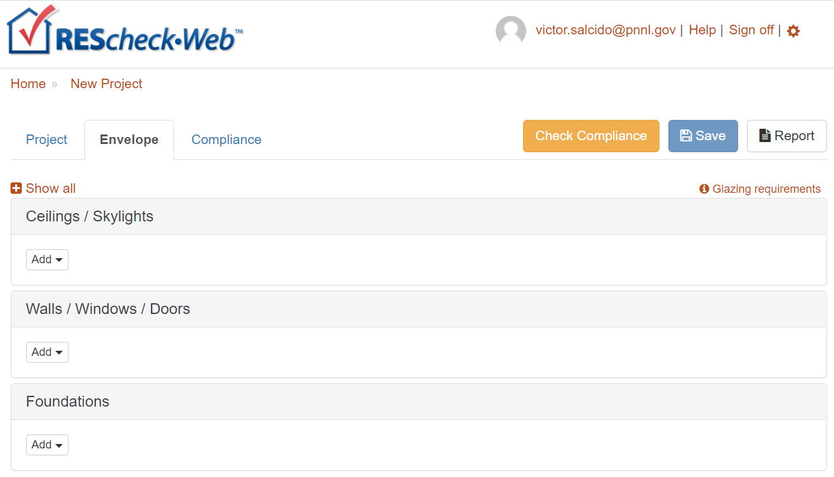
Envelope Helpful Hints
Don’t have to use every button
Can group “like” components
Gross area (except slab-on-grade)
  Gross wall area to include peripheral edges of floors (area of band joist and subfloor between floors)
Use “Other” assembly as needed
Building Energy Codes Program
Notes:
Use of “other” requires a U-factor of the entire assembly, not just the insulation R-value. Documentation of the calculated assembly U-factor must be provided to the local jurisdiction.

Slide 23
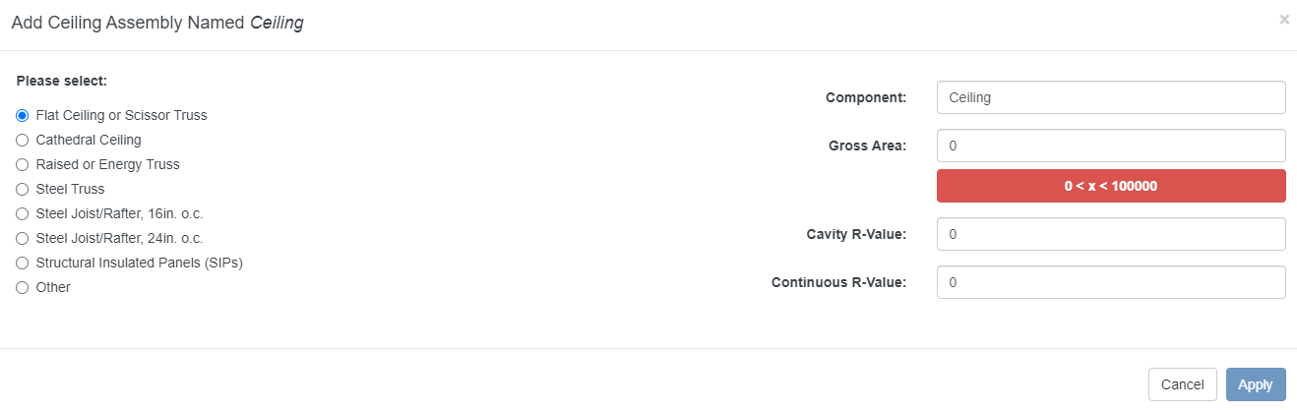
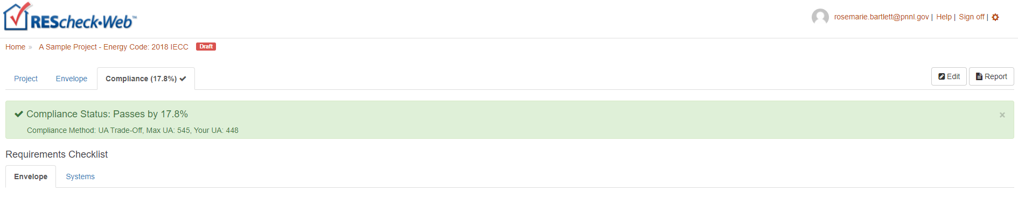
Color Cues
Red
Green
Building Energy Codes Program
Notes:
Colors – red usually indicates missing information, errors, or failing compliance;
Colors –green on the screen means a passing condition, in help it means a glossary term;

Slide 24
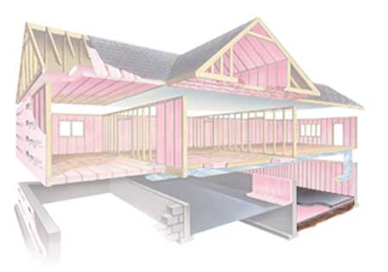
What is the Building Thermal Envelope?
Building Energy Codes Program
Notes:
Consists of ceiling, walls (above grade and below grade), fenestration, foundation

Slide 25

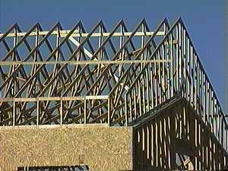
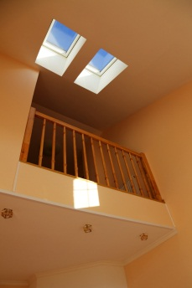
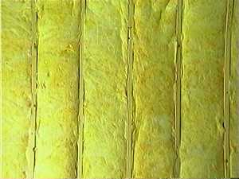
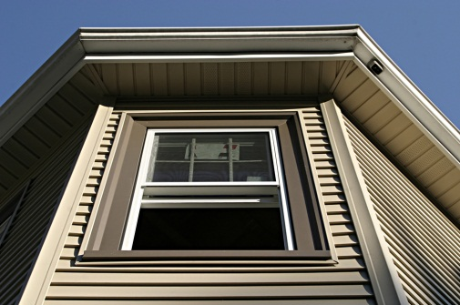
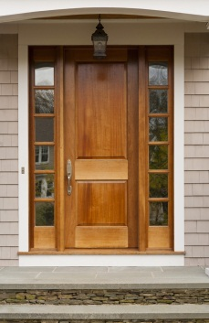
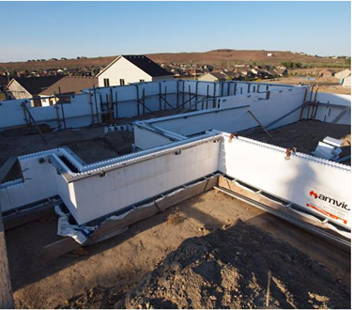
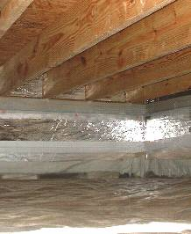
Entering Building Components
Enter only applicable
building components
Building Energy Codes Program

Slide 26
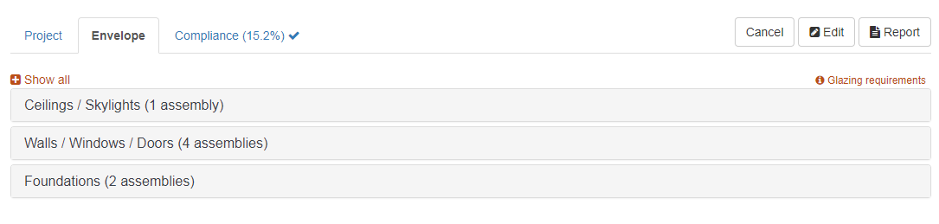
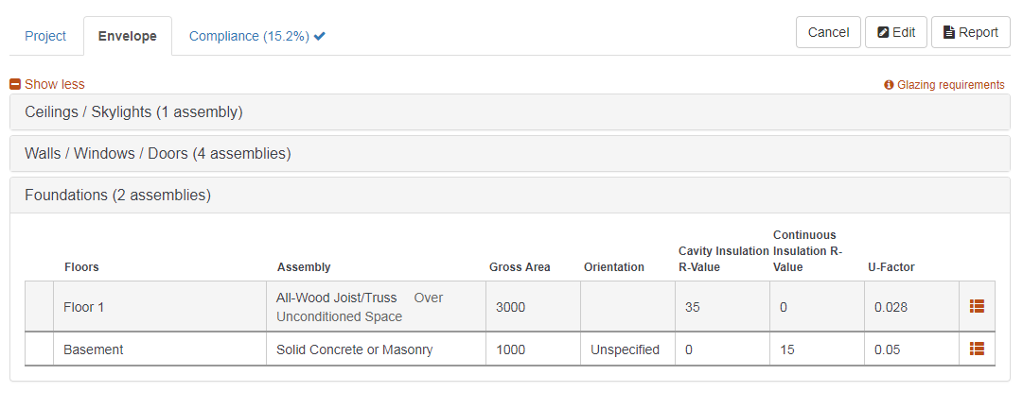
Envelope Tab
Building Energy Codes Program
Notes:
Multiple viewing options are available including fully collapsing (hiding) category tables, expanding them in part or in fully expanded mode.
This allows for personalizing your display to accommodate data entry and review.

Slide 27
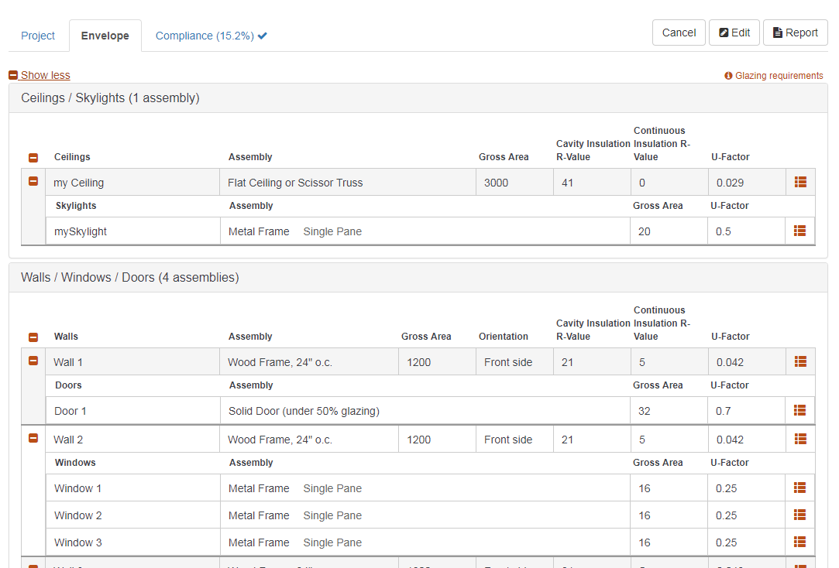
Envelope Full View Example
Building Energy Codes Program
Notes:
Fully expanded view

Slide 28
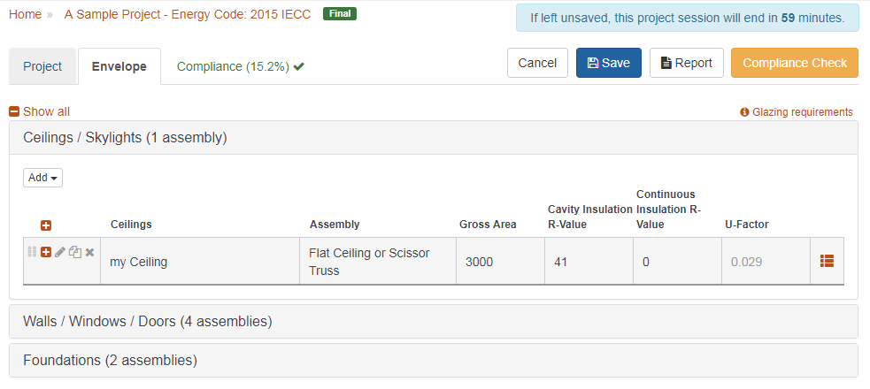
Envelope Tab (edit mode)
Building Energy Codes Program
Notes:
Edit mode displays the time remaining before inactivity will automatically terminate a project edit session.
This is done to limit projects from being left in a locked state unintentionally.

Slide 29
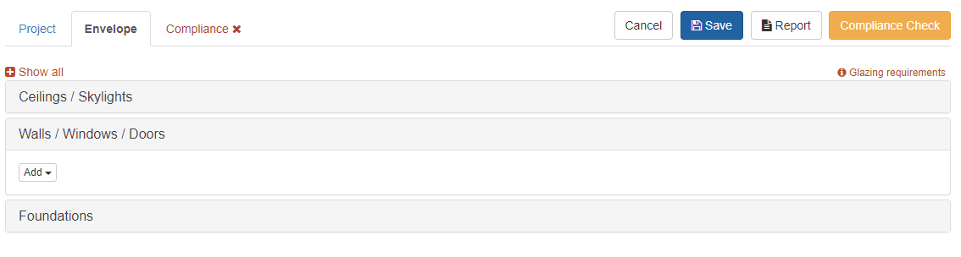
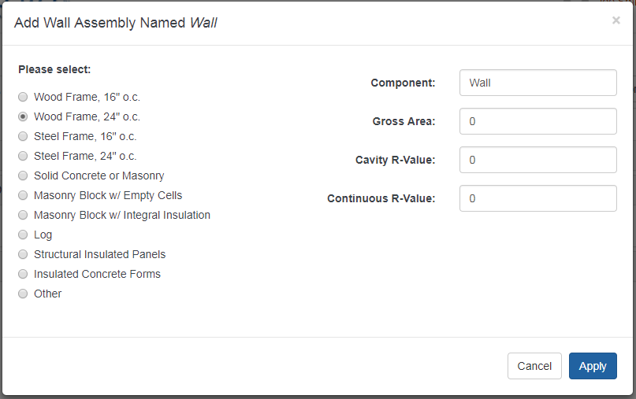
Envelope Add Wall Example
Building Energy Codes Program
Notes:
This illustrates how to add an assembly. In this case an above-grade exterior wall is added by clicking the Add button in the Walls category table. The drop-down list from clicking Add will include Wall, Window, and Door. When wall is selected the screen “Add Wall Assembly” is displayed.
The type of wall assembly selected on the left hand side of the screen determine what inputs are presented on the right hand side of the screen.

Slide 30
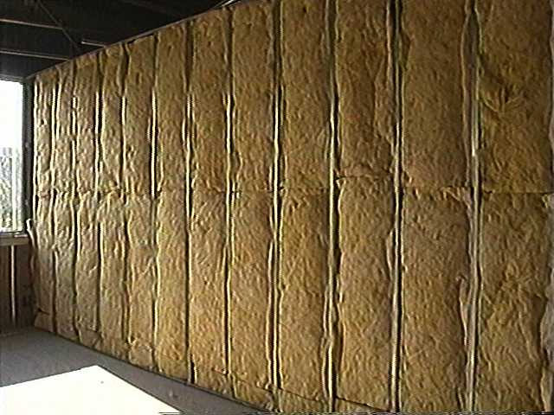
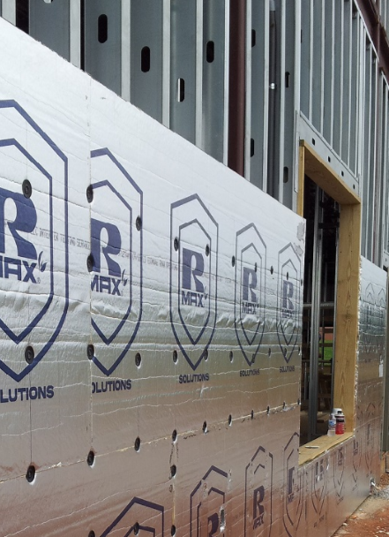
Cavity vs. Continuous
Cavity R-value – used for insulation placed between structural members
Continuous R-value – used for insulation that is continuous across the structure (e.g., rigid insulation)
Building Energy Codes Program

Slide 31
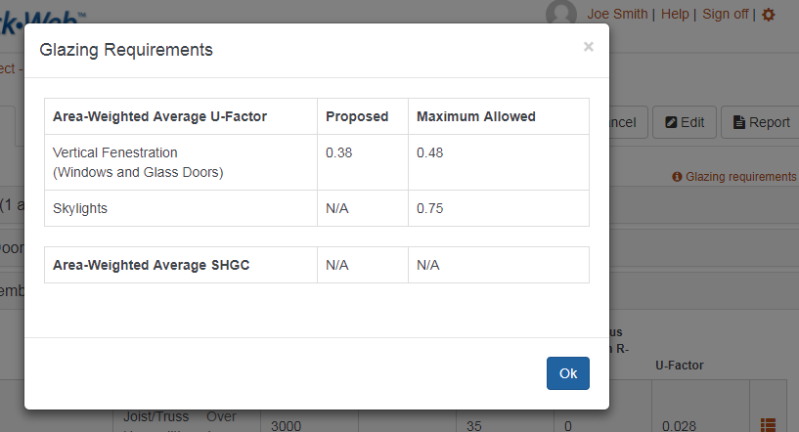
Envelope Glazing Requirements
Building Energy Codes Program
Notes:
Example of the Glazing Requirements screen that is displayed when clicking on the hypertext item in the background having the same name.
The requirements displayed are dependent on the energy code and location of the project as well as the set of windows/skylights that are specified.

Slide 32
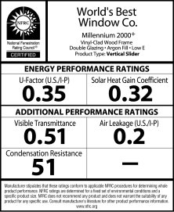
Fenestration: U-Factors and SHGCs
Building Energy Codes Program

Slide 33
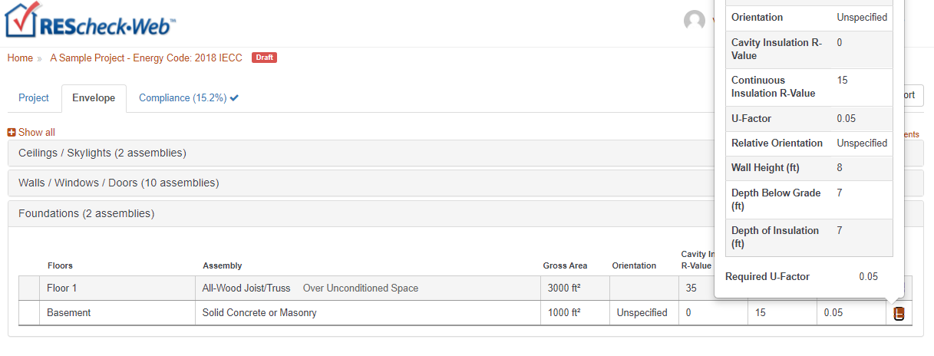
Envelope Show Assembly Details
Building Energy Codes Program
Notes:
The icon at the far right of each assembly row is “Show more details” feature. It displays all data that were specified in the assembly dialog including those that may not fit well within the assembly row columns.

Slide 34
Foundations – what button to use
Basement
Basement is conditioned
Floor
Separates conditioned from
ambient or unconditioned space
Crawl Wall
Crawl space is not vented to the outside and floor above is NOT insulated
Building Energy Codes Program
Notes:
Slab-on-grade is a type of floor. Slabs require input of perimeter of the slab component in linear feet. Slabs include all slab edges that are part of the building envelope and are less than 12” below grade. Edges of slab floors over 12” below grade (such as basement floors) aren’t subject to code requirements and shouldn’t be entered into the software.

Slide 35
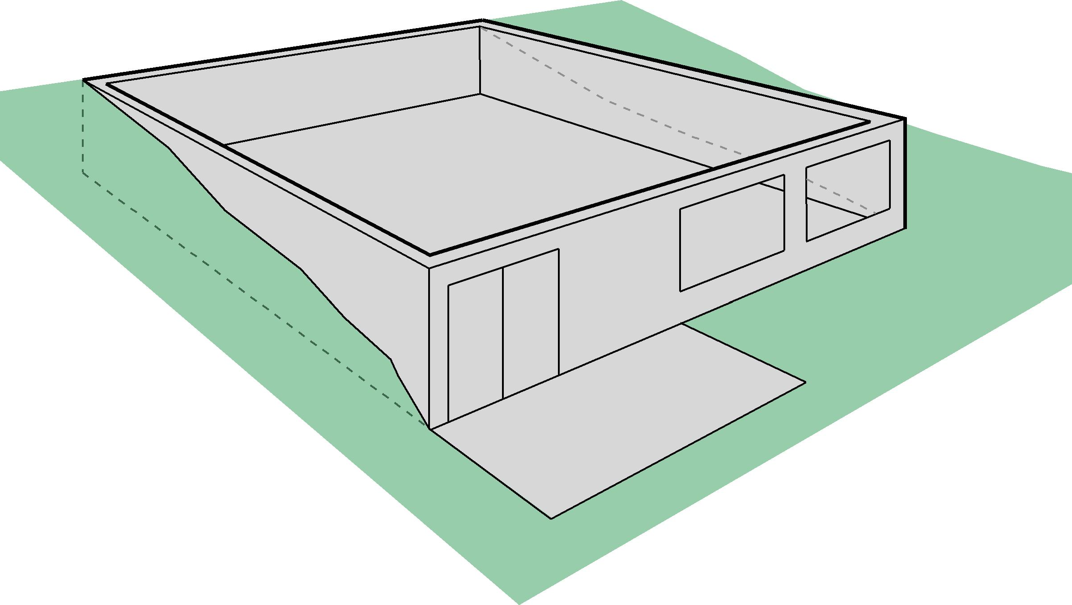
What’s a Basement Wall?
Basement Wall –
>50% below grade
Below grade
Basement wall
Below grade
Basement wall
Exterior Wall –
<50% below grade
Building Energy Codes Program
Notes:
Reminder – all foundation wall could be of same construction, walkout portion of this basement will be considered an above grade wall and subject to those requirements.

Slide 36
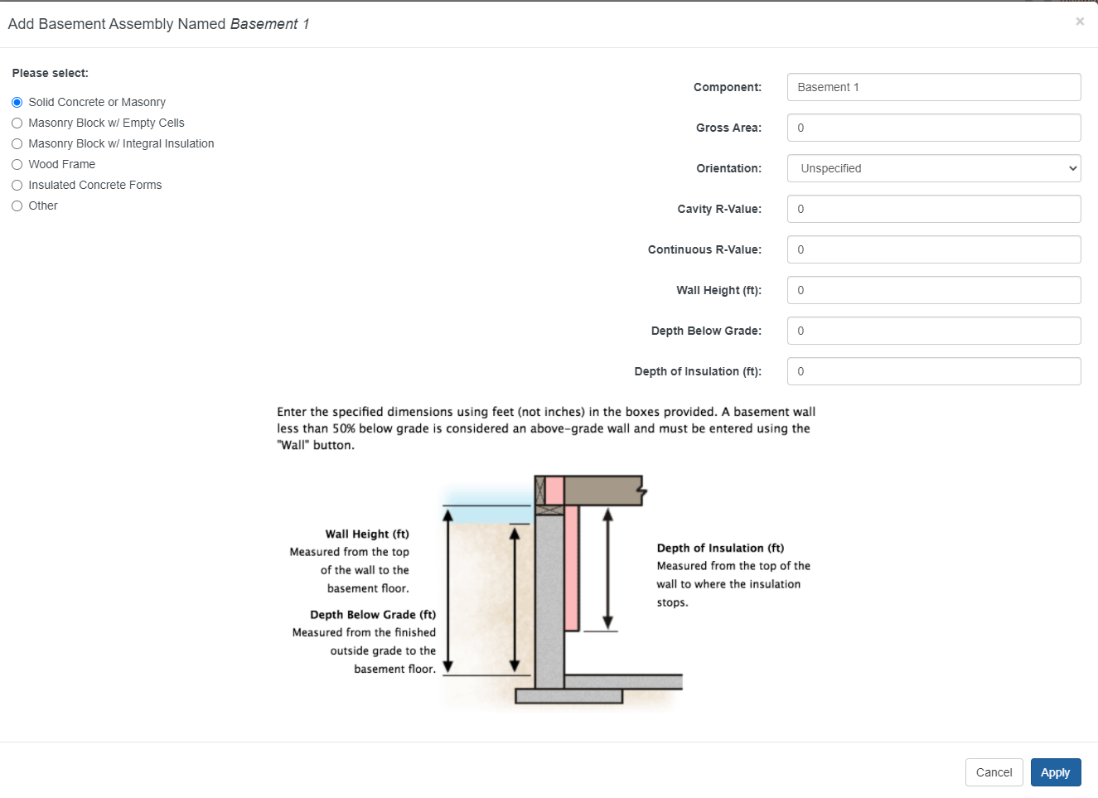
Basement Wall
Wall Height: If not uniform, provide an average height
Depth Below Grade: If sloped or uneven, provide an average depth below grade
Depth of Insulation
  Requirements are for full depth of basement wall (to 10 ft); REScheck allows trade offs
  If you enter insulation depth of 0, program assumes no insulation, regardless of values in the insulation fields
Continuous Insulation: Software assumes it’s exterior rigid
Cavity Insulation: Software assumes you’re furring out on the interior
Building Energy Codes Program

Slide 37
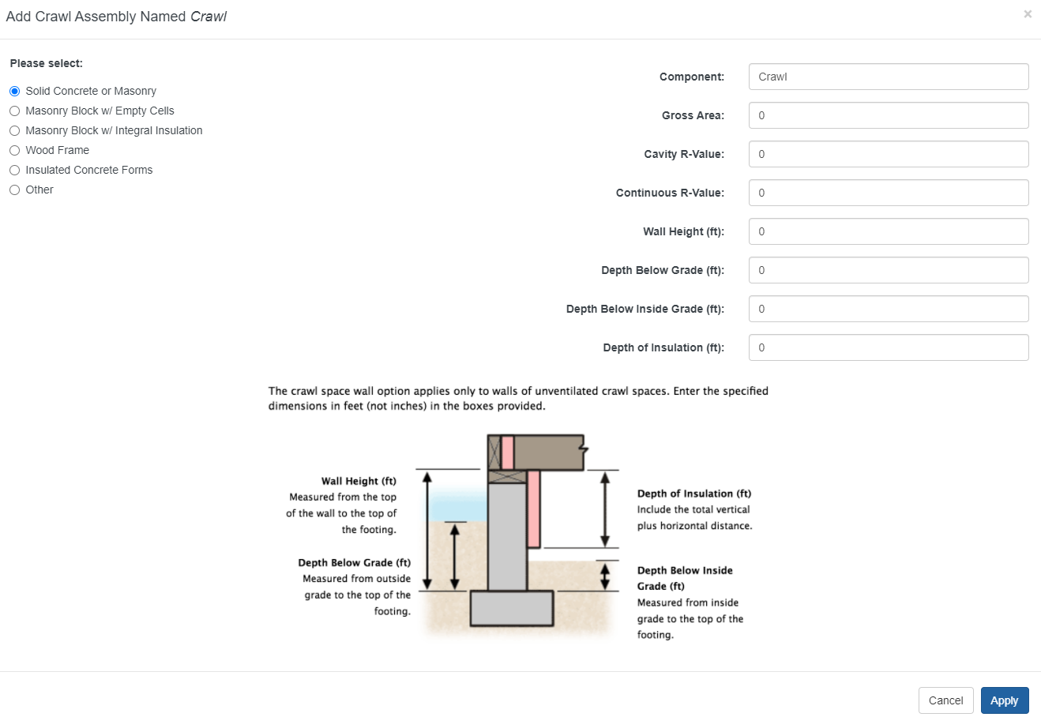
Crawl Wall
Building Energy Codes Program

Slide 38
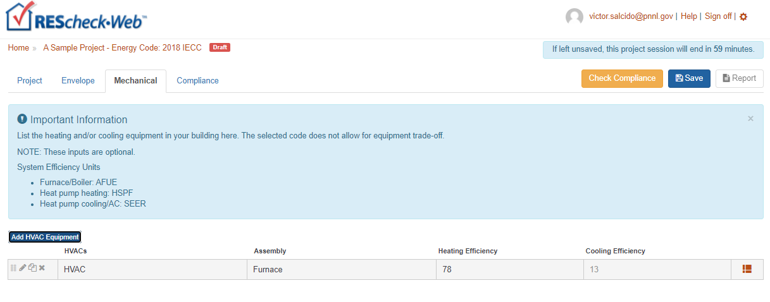
Mechanical Tab – Performance Alternative Only
Building Energy Codes Program

Slide 39
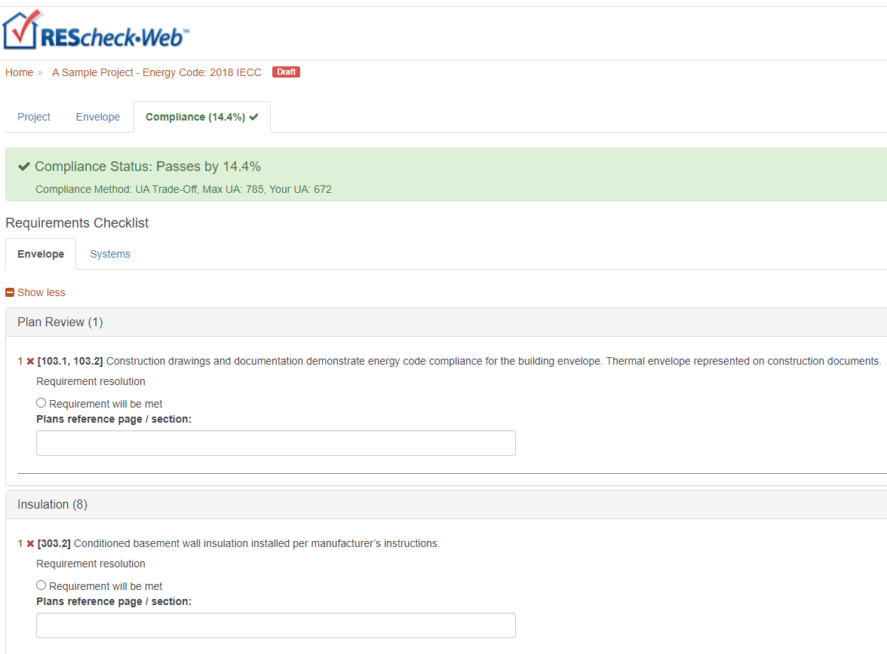
Compliance Tab
Mandatory requirements
  Air leakage
  Building mechanical systems and equipment
  Service water heating
  Duct construction, insulation, testing
For each requirement, the user
  Chooses an applicable “compliance option”
    Requirement will be met
    Exempt or Exceptions
    Requirement is Not Applicable
  Notes how compliance for applicable requirements are documented
This information is shown on the report in the “Comments/ Assumptions” column of the Inspection Checklist
Building Energy Codes Program

Slide 40
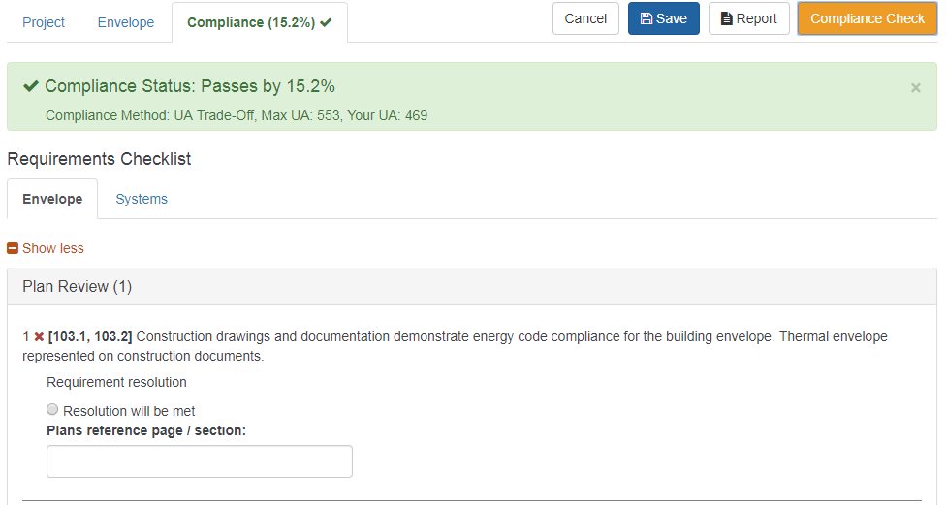
Compliance Tab (edit mode)
Building Energy Codes Program
Notes:
Compliance tab shows the compliance results in detail and couples those with the mandatory requirements that must also be satisfied.

Slide 41

Compliance Failing – Helpful Hints
Review building plans to ensure all components are entered correctly
Confirm takeoffs (areas) are correct
Confirm insulation values
  Double check cavity vs. continuous entries
Confirm fenestration values
  Double check ratings on windows and doors (U-factor and SHGC)
Compare proposed U-factors with required U-factors
Evaluate UA data
Building Energy Codes Program

Slide 42
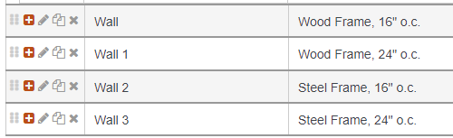
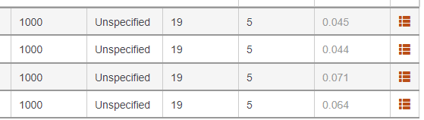
Evaluate Assembly Performance
Building Energy Codes Program
Notes:
Consider the proposed and required U-factor for envelope assemblies. Note that requirement U-factor is “generalized” to covered a variety of standard construction types.

Slide 43
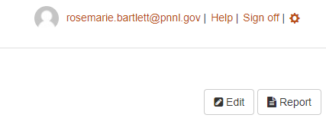

Reports
Choices, choose any or all
  Compliance Certificate
  Inspection Checklist
  Panel Certificate
Building Energy Codes Program

Slide 44
Reports
Requirements
Inspection checklists set up by phase of construction
  Plan Review
  Footing/Foundation
  Rough-in
  Final
Building Energy Codes Program

Slide 45


Reports
Building Energy Codes Program
Notes:
Reports are created by clicking on the Report button on the Compliance tab. The report consists of three sections that can be processed as necessary. Once the report process is complete, a dialog informs the user what the assigned name is and if the document is final. If is final then the REScheckWeb breadcrumb is updated to reflect that as is the Status flag for this project on the project dashboard.

Slide 46

Reports – Sample Compliance Certificate
Verify energy code, location, construction type, and conditioned floor area
Building Energy Codes Program
Notes:
Both users and code officials should do this step

Slide 47

Evaluate Assembly Performance (cont)
Building Energy Codes Program
Notes:
Look for “heavy hitters” by reviewing draft report. This metric incorporates the weight of the U-factor with the area of the assembly.

Slide 48
Reports – Sample Compliance Certificate, cont
Building Energy Codes Program

Slide 49

Reports – Sample Compliance Certificate, cont
Verify Compliance Statement is Signed
Verify Values are Consistent with Plans
Building Energy Codes Program
Notes:
For code officials

Slide 50

Envelope Sample Inspection Checklist
Building Energy Codes Program
Notes:
Foundation Inspection

Slide 51

Panel Certificate
Building Energy Codes Program

Slide 52


REScheck-Web Project Sharing
Building Energy Codes Program

Slide 53


Sharing Projects: Shared Project Invitation
Building Energy Codes Program
Notes:
Example of a project share email invitation.

Slide 54

Sharing Projects: Email Invitation
Shared project recipient will receive email with invitation to accept the “share”
Building Energy Codes Program
Notes:
Example of a project share email invitation.

Slide 55

Sharing Projects: Shared Projects
Building Energy Codes Program
Notes:
Example of project sharing types.

Slide 56





U.S. DOE: BECP Resources
Compliance software
Technical support
Code notes
Publications
Resource guides
Training materials www.energycodes.gov
Building Energy Codes Program

Slide 57

If you want AIA LUs or a Certificate of Attendance for self-reporting to ICC or RESNET, WRITE DOWN THIS LINK:
www.energycodes.gov/necc/2021_credit_request
NOTE: This link will only be active until Monday, July 26

Slide 58
THANK YOU!!!
V. Robert Salcido
victor.salcido@pnnl.gov
Building Energy Codes Program
www.energycodes.gov
BECP help desk
http://www.energycodes.gov/resource-center/help-desk
Building Energy Codes Program
Notes:
Send out note – always improving software for the future and would love your feedback on any features or operations

