Slide 1
2021 IECC Commercial Electrical Power and Lighting Systems
PNNL-SA-170332
Notes:
1

Slide 2
Why Care About IECC?
Energy codes and standards set minimum efficiency requirements for new and renovated buildings, assuring reductions in energy use and emissions over the life of the building. Energy codes are a subset of building codes, which establish baseline requirements and govern building construction.
Code buildings are more comfortable and cost-effective to operate, assuring energy, economic and environmental benefits.

Slide 3
What’s Covered Under Electrical Power and Lighting Systems Requirements?
Mandatory Interior Lighting requirements
Required Controls
Wattage/Efficiency Limits
Interior Lighting Power Allowances (watts/ft²)
Exterior Lighting Controls
Required Controls
Lamp Efficiency
Exterior Lighting Power Allowances (watts/ft²)
Dwelling Electric Meters
Electrical Transformers and Motors
Vertical and Horizontal Transportation Systems and Equipment

Slide 4
General Section C405.1
Sleeping units to comply with C405.2.4 and either C405.1.1 or C405.3
A minimum of 90 percent of the lamps in permanently installed lighting fixtures serving dwelling units (excluding kitchen appliance lighting) to be provided by lamps with efficacy of not less than 65 lm/W or luminaires with an efficacy not less than 45 lm/W or comply with C405.2.4 and C405.3

Slide 5
High-Efficacy Lamps - Definition
Compact fluorescent lamps, LED lamps, T8 or smaller diameter linear fluorescent lamps, or other lamps with efficacy not less than 65 lumens/watt or luminaires with an efficacy of not less than 45 lumens/watt

Slide 6
Lighting Power Compliance Calculation
Sum the wattage of all proposed connected lighting power
This must include all lighting that is part of the design for the space including:
Overhead lighting
Task lighting
Decorative lighting
Compare values; proposed wattage must be less than or equal to allowed wattage
Notes:
Must include all lighting that is part of the design. If individual task lighting is part of the design it must be included. One example of lighting that would NOT have to be included is if the tenant purchases furniture with under shelf task lighting that wasn’t part of the original design.
The calculation includes the lamp plus ballast values.
Total connected interior lighting power. The total connected interior lighting power (watts) should be determined in accordance with Equation 4-9

Slide 7
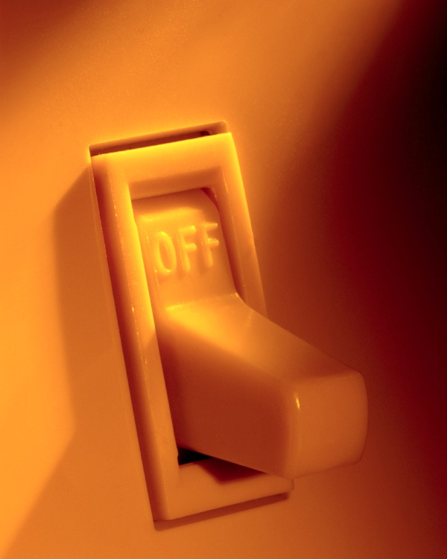
Lighting Controls Section C405.2
Lighting systems required to be provided with controls as specified for:
Occupant sensor controls – C405.2.1
Time-switch controls – C405.2.2
Light-reduction controls – C405.2.3
Daylight-responsive controls – C405.2.4
Specific application controls – C405.2.5
Manual controls – C405.2.6
Exterior lighting controls – C405.2.7
Notes:
Intent is to allow occupants to control unneeded lighting.

Slide 8
Occupant Sensor Controls Sections C405.2.1
Occupancy sensors are required in:
Classrooms/lecture/training rooms
Conference/meeting/multipurpose rooms
Copy/print rooms
Lounges/breakrooms
Enclosed offices
Open plan office areas
Restrooms
Storage rooms
Locker rooms
Corridors
Other spaces ≤ 300 ft² enclosed by floor-to-ceiling height partitions
Warehouse storage areas

Slide 9
Occupant Sensor Controls Sections C405.2.1.1
Occupancy sensor function (other than for warehouses – C405.2.1.2 and open plan office areas – C405.2.1.4):
Automatically turn lights off within 20 minutes after occupants have left space
Either manual-on or controlled to automatically turn on lighting to not more than 50% power
Incorporate a manual control to allow occupants to turn off lights
Exemptions:
Full auto-on controls with no manual controls allowed in
Corridors
Interior parking areas
Stairways
Restrooms
Locker rooms
Lobbies
Library stacks
Areas where manual-on operation would endanger safety or security of room or occupants

Slide 10
Occupant Sensor Controls Section C405.2.1.2 – Warehouse Storage Areas
Aisleways and open areas
Automatically reduce lighting power by ≤ 50% within 20 minutes of areas becoming unoccupied
Control lighting in each aisleway independently
Lights not turned off by occupant sensors to be turned off by time-switch control per C405.2.2.1
Provide manual control to allow occupants to turn off lights

Slide 11
Occupant Sensor Controls Section C405.2.1.3 – Open Plan Office Areas
Spaces less than 300 ft² to comply with C405.2.1.1
All other spaces to comply with:
General lighting controlled separately in zones with floor areas not greater than 600 ft²
General lighting can automatically turn on upon occupancy. General lighting in unoccupied zones within open plan office space can turn on to not more than 20% of full power or remain unaffected
Automatically turn off general lighting in all control zones within 20 minutes after occupants have left (except where general lighting is turned off by time-switch control)
General lighting power in each control zone to turn off or uniformly reduce to unoccupied setpoint of not more than 20% of full power within 20 minutes after occupants leave the control zone

Slide 12
Occupant Sensor Controls Section C405.2.1.4 – Corridors
Occupant sensor controls in corridors to uniformly reduce lighting power to not more than 50% of full power within 20 minutes of all occupants leaving the space
Exception
Corridors with less than 2 footcandles of illumination on the floor at the darkest point with all lights on

Slide 13
Time-switch Controls Section C405.2.2
Each area of the building that is NOT provided with occupant sensor control must have a time-switch control to turn lights off automatically
Exceptions where a manual control can provide the light reduction and time-switch control is not required:
Luminaires required to have specific application controls per C405.2.4
Spaces where patient care is directly provided
Spaces where an automatic shutoff would endanger occupant safety or security
Lighting intended for continuous operation
Shop and laboratory classrooms

Slide 14
Time-switch Control Functions Section C405.2.2.1
Must include an override switching device with the following:
Automatically turn off lights when space scheduled to be unoccupied
Minimum 7-day clock
Capable of being set for 7 different day types/week
Incorporate holiday “shutoff” feature to turn all controlled lighting loads for ≥ 24 hours and resume to normally scheduled operations
Program backup capabilities to prevent loss of program and time setting for ≥ 10 hours if power is interrupted
Override switch should include:
Manual control
Control lighting to remain on for < 2 hours
Control lighting for an area < 5,000 ft²

Slide 15
Time-switch Control Functions Section C405.2.2.1 – Cont’d.
Exceptions:
Mall concourses
Auditoriums
Sales areas
Manufacturing facilities
Sports arenas
Time limit permitted to be > 2 hours provided switch is a captive key device
Override switch not limited to an area 5,000 ft² provided area is < 20,000 ft²
If area has a manual control:
spaces with 1 luminaire with rated power < 100 watts
spaces that use < 0.6 watts/ft²
corridors, lobbies, electrical rooms and or mechanical rooms

Slide 16
Light-reduction Controls Section C405.2.3
General lighting without occupant sensor controls to be provided with light-reduction controls per C405.2.3.1
Exceptions
Luminaires controlled by daylight responsive controls per C405.2.4
Luminaires controlled by special application controls per C405.2.5
If manual control, these spaces aren’t required to have light-reduction control:
Spaces with only one luminaire with rated power < 60 watts
Spaces using < 0.45 watts/ft²
Corridors, lobbies, electrical rooms and/or mechanical rooms
Notes:
Intent is to allow occupants to moderate light levels to save energy.

Slide 17
Light-reduction Controls Section C405.2.3.1
Light Reduction Controls must allow the occupant to reduce connected lighting load
By not less than 50%
In a reasonably uniform illumination pattern with intermediate step in addition to full on or off, or with continuous dimming control
Notes:
Intent is to allow occupants to moderate light levels to save energy.

Slide 18
Light-reduction Control Options
Continuous dimming of all luminaires from full output to < 20% full power
Switching all luminaires to reduced output of not less than 30% and not more than 70% of full power
Switching alternate luminaires or alternate rows of luminaires to achieve reduced output of not less than 30% and not more than 70% of full power

Slide 19
Daylight-responsive Controls Section C405.2.4
Definition: A device or system that provides automatic control of electric light levels based on the amount of daylight in a space
Required to control lighting in spaces with
> 150 watts of general lighting within primary sidelit daylight zones
> 300 watts of general lighting within sidelit daylight zones
> 150 watts of general lighting within toplit daylight zones
Exceptions:
Spaces in health care facilities where patient care is directly provided
Sidelight daylight zones on 1st floor above grade in Group A-2 and Group M occupancies
New buildings where total connected lighting power isn’t greater than adjusted interior lighting power allowance per Equation 4-9
Notes:
General lighting does not include lighting that is required to have specific application control in accordance with Section C405.2.4

Slide 20
Daylight-responsive Control Functions Section C405.2.4.1
Toplit zones shall be controlled independently of lights in sidelit zones
Lights in primary sidelit daylight zones to be controlled independently of those in secondary sidelit daylight zone
Controls shall be configured so that they can be calibrated from within the space by authorized personnel
Calibration mechanisms shall be in a location with ready access
Dim lights continuously from full light output to 15% of full light output or lower
Controls configured to completely shut off all controlled lights
When occupant sensor controls have reduced lighting to unoccupied setpoint, controls to continue to adjust electric light levels in response to available daylight, but configured to not increase the lighting power above specified unoccupied setpoint
Sidelit zones facing different cardinal orientations (within 45 degrees of due north, east, south, west) controlled independently of each other

Slide 21
Daylight-responsive Control Functions Section C405.2.4.1 – Cont’d.
Exceptions:
< 150 watts in each space within primary sidelit daylight zone is permitted to be controlled together with lighting in a primary daylight zone facing a different cardinal orientation
< 150 watts in each space within secondary sidelit daylight zone is permitted to be controlled together with lighting in a secondary daylight zone facing a different cardinal orientation

Slide 22
Sidelit Daylight Zone Section C405.2.4.2
Definition: floor area adjacent to vertical fenestration that complies with all of the following:
Fenestration located in a wall:
Sidelit daylight zone shall extend laterally to the nearest full-height wall OR
< 1.0 x height from the floor to the top of the fenestration, and longitudinally from the edge of the fenestration to the nearest full-height wall, or up to 0.5 times the height from the floor to the top of the fenestration, whichever is less
Fenestration located in a rooftop monitor:
Sidelit daylight zone to extend laterally to the nearest obstruction that is taller than 0.7 times the ceiling height, or up to 1.0 times the height from the floor to the bottom of the fenestration, whichever is less, and longitudinally from edge of the fenestration to the nearest obstruction that is taller than 0.7 times the ceiling height, or up to 0.25 times the height from the floor to the bottom of the fenestration, whichever is less
Secondary sidelit daylight zone is directly adjacent to the primary sidelit daylight zone
Extend laterally to 2.0 times the height from the floor to the top of the fenestration or to the nearest full height wall, whichever is less, and longitudinally from the edge of the fenestration to the nearest full height wall, or up to 2 ft, whichever is less. The area of secondary sidelit zones to not be considered in the calculation of the daylight zones.

Slide 23
Sidelit Daylight Zone Section C405.2.4.2 – Cont’d.
Area of fenestration > 24 ft²
Distance from fenestration to any building or geological information that would block access to daylight is > than one half height from bottom of fenestration to top of building or geologic information
The visible transmittance of fenestration > 0.20
Projection factor for any overhanging shaded projection is not greater than
1.0 for fenestration oriented 45 degrees or less from true north
1.5 for all other orientations

Slide 24
Toplit Daylight Zone Section C405.2.4.3
Definition: the floor area underneath a roof fenestration assembly that complies with all of the following:
Zone shall extend laterally and longitudinally beyond the edge of the roof fenestration assembly to the nearest obstruction that is (taller) > 0.7 x the ceiling height, > 0.7 x the ceiling height, whichever is less
Where located in rooftop monitor, toplit zone to extend laterally to nearest obstruction taller than 0.7 x the ceiling height, or up to 1.0 times the height from floor to bottom of fenestration, whichever is less, and longitudinally from the edge of the fenestration to the nearest obstruction taller than 0.7 x ceiling height, or up to 0.25 times the height from the floor to bottom of fenestration, whichever is less
No building or geological formation blocks different sunlight from hitting the roof fenestration assembly at the peak solar angle on the summer solstice
Where located in existing buildings, visible transmittance of the roof fenestration assembly times the area of the rough opening of the roof fenestration assembly divided by area of daylight zone > 0.008

Slide 25
Atriums Section C405.2.4.4
Daylight zones in atrium spaces
At top floor surrounding atrium space and floor of atrium space (not on intermediate floors)

Slide 26
Specific Application Controls Section C405.2.5
These types to be controlled by occupant sensor or time-switch control, and a manual control provided to control separately from general lighting
Luminaires for which additional lighting power is claimed per C405.3.2.2.1
Display and accent lighting
Display case lighting
Supplemental task lighting, including permanently installed under-shelf or under-cabinet lighting
Equipment for sale or educational demonstrations
Display lighting for exhibits in galleries, museums and monuments – in addition to general lighting
Sleeping units
Master control device capable of automatically switching off all installed luminaires and switched receptacles within 20 minutes of occupants leaving the room
Exceptions: lighting and switch receptacles controlled by captive key systems and spaces where patient care is provided
Permanently installed luminaires within dwelling units to have controls complying with C405.2.1.1 or C405.2.3.1
Nonvisual applications, plant growth and food warming shall be controlled via time-switch control
Task lighting for medical and dental purposes in addition to general lighting to be provided a manual control

Slide 27
Manual Controls Section C405.2.6
In a location where
occupants have ready access
controlled lights are visible (or identify the area served by the lights and indicate status)

Slide 28
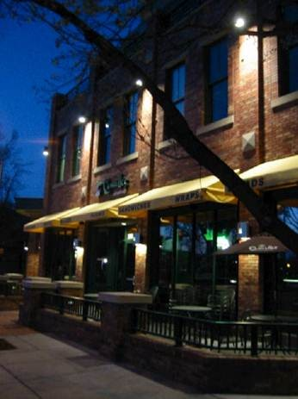
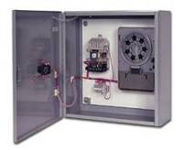
Exterior Lighting Control Requirements Section C405.2.7
Exterior lighting systems provided with controls complying with C405.2.7.1 through C405.2.7.4
Exceptions: Covered vehicle entrances or exits from buildings and parking structures where required for safety, security or eye adaptation; and lighting controlled from within dwelling units

Slide 29
Daylight Shutoff Section C405.2.7.1
Lighting to be automatically off if sufficient daylight is present satisfying needs in the space

Slide 30
Building Façade and Landscape Lighting Section C405.2.7.2
Lighting for building façade and landscape automatically off from not later than 1 hour after business closing to not earlier than 1 hour before opening

Slide 31
Lighting Setback Section C405.2.7.3
Building façade or landscape NOT covered in Section C405.2.7.2 shall have controls configured to automatically reduce connected lighting power > 50%
no later than midnight to not earlier than 6 am
from not later than 1 hour after business closing to not earlier than 1 hour before opening
any period where activity has not been detected for at least 15 minutes
Outdoor parking areas with rated input wattage of > 78 W and mounting height of 24 feet or less above ground
Controlled so lighting is reduced by at least 50% after 15 minutes of inactivity
Not more than 1500 W to be controlled together

Slide 32
Exterior Time-Switch Control Function Section C405.2.7.4
All time switch controls
have a clock capable of being programmed for not fewer than 7 days
capable of being set for 7 different day types per week
incorporate automatic holiday setback feature
be able to retain programming and the time setting during loss of power for a period of > 10 hours

Slide 33
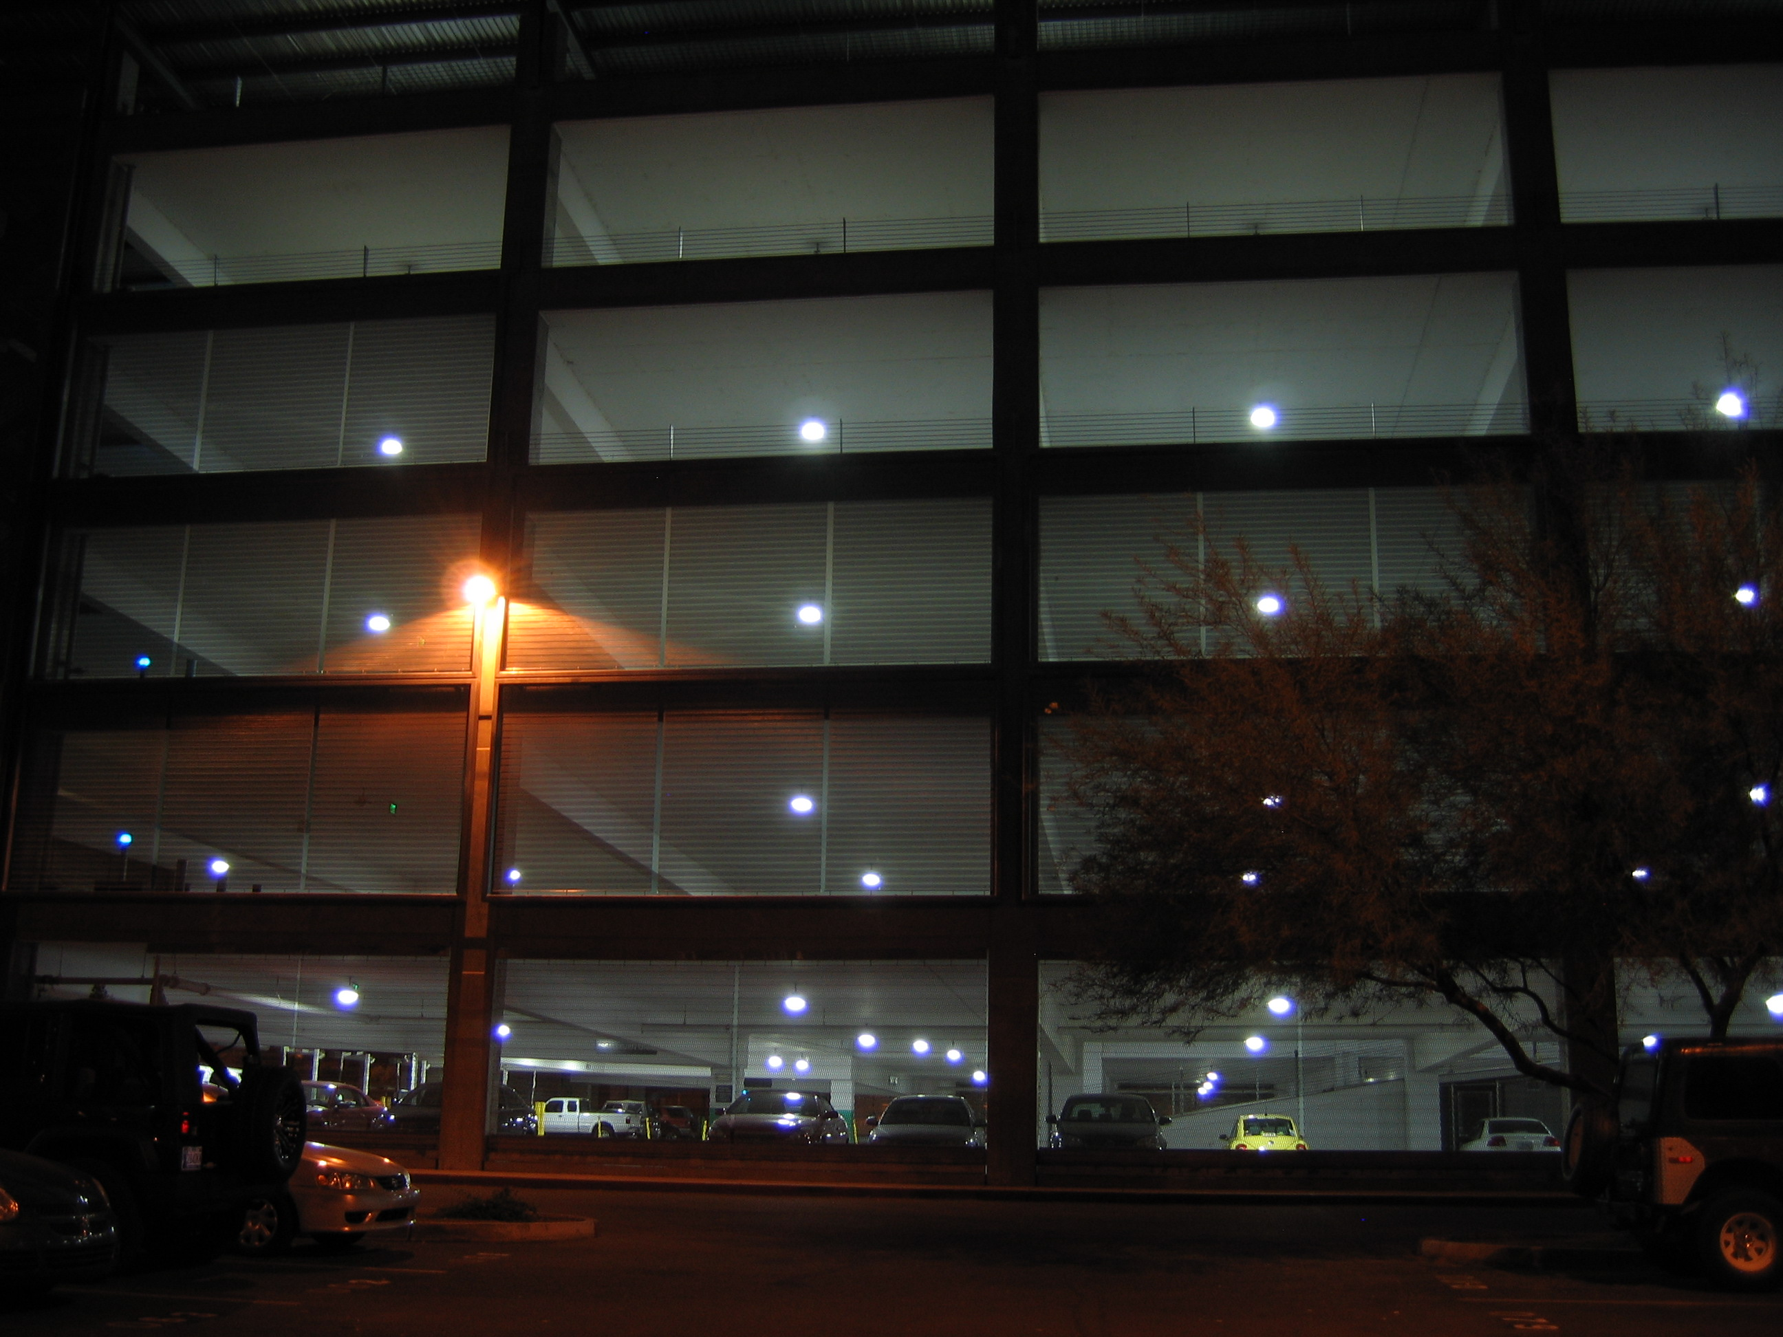
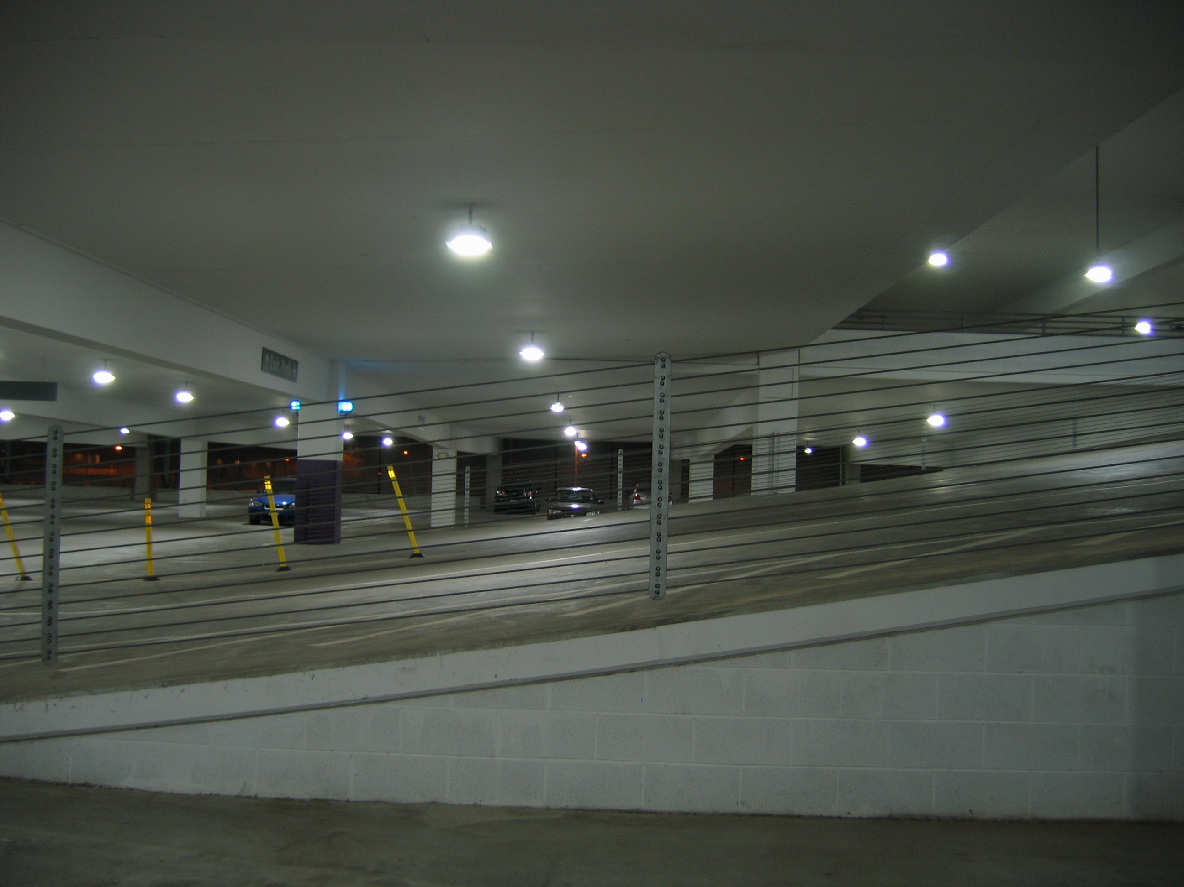
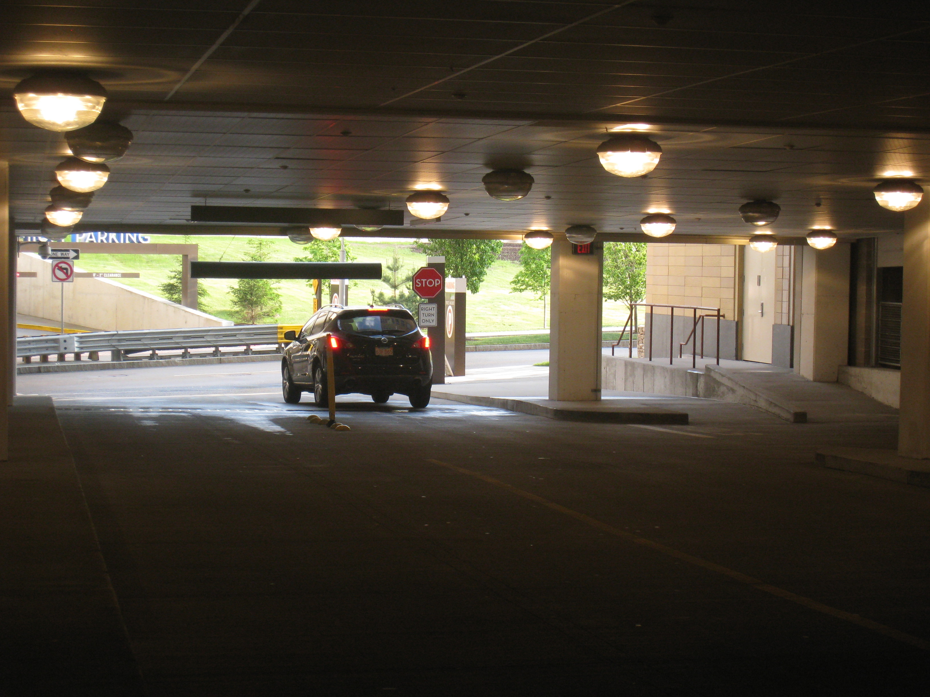
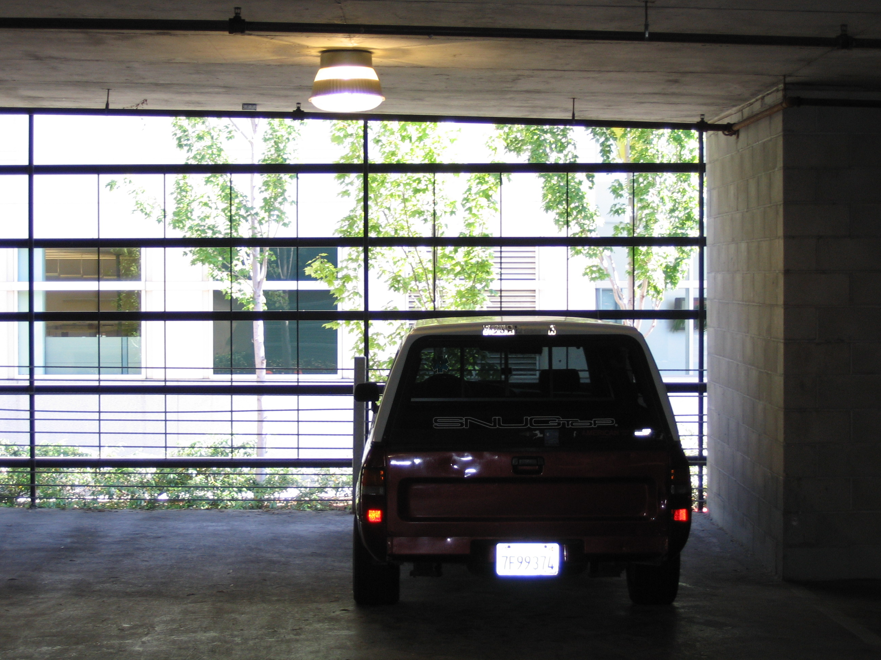
Parking Garage Lighting Control Section C405.2.8
Multiple control requirements required for parking garage lighting
Automatic time-switch
Automatically reduce lighting by 30% when no activity in a lighting zone for 20 minutes, zone must be < 3600 ft²
In daylight transition zone at entrances and exits, lighting to be separately controlled that reduces lighting at night
Lighting within 30 ft of perimeter opening or fenestration to reduce in response to daylight by at least 50%

Slide 34
Proposed Connected Lighting Calculation Section C405.3.1
Proposed lighting wattage must be calculated in accordance with Equation 4-10
TCLP = [LVL + BLL + LED + TRK + OTHER]
TCLP = total connected lighting power (watts)
LVL = labeled wattage of luminaires connected directly to building power
BLL = wattage of the ballast or transformer
LED = wattage of LEDs with either integral or remote drivers
TRK = wattage of lighting tracks, cable conductors, rail conductors, and plug-in busways specified wattage of the luminaires but not less than 8 W per linear foot OR the wattage limit of other permanent current-limiting devices on the system OR wattage limit of the transformer
OTHER = the wattage of all other luminaires and lighting sources not covered previously and associated with interior lighting verified by data supplied by the manufacturer or other approved sources
Notes:
Screw lamp holders = typical Edison based – this is whatever the factory labeling says is the maximum wattage; not simple wattage of a bulb – must be the max that could be installed in the fixture
If you have other types, it’s the manufacturer’s rated wattage of the lamp plus ballast.

Slide 35
Exemptions to Proposed Interior Lighting Power Calculation Section C405.3.1
Television broadcast lighting for playing areas in sports arenas
Emergency lighting automatically off during normal business operation
Lighting for occupants with special needs (visual impairment and other medical and age-related issues)
Casino gaming areas
Mirror lighting in dressing rooms
Task lighting for medical and dental purposes (in addition to general lighting and controlled independently)
Display lighting for exhibits in galleries, museums and monuments (in addition to general lighting and controlled independently)
Theatrical, stage, film, and video production
Used for photographic processes
Integral to equipment or instrumentation installed by manufacturer
Plant growth or maintenance
Advertising or directional signage
Food warming
Lighting equipment that is for sale
Lighting demonstration equipment in lighting education facilities
Approved because of safety considerations
In retail display windows when the display is enclosed by ceiling-height partitions
Furniture-mounted supplemental task lighting controlled by automatic shutoff
Exit signs
Antimicrobial lighting used for sole purpose of disinfecting a space
Notes:
These types of lighting do not have to be counted. These are considered to be IN ADDITION TO general lighting.
Background on antimicrobial lighting:
Light on low end of visual spectrum (≈ 405 – 420 nm) or UV-C
This lighting can inhibit the growth of microbes
Typical spaces include medical facilities, gyms, locker rooms, kitchens, restrooms, and places where general health may be a concern

Slide 36
Lighting Power Compliance Calculation
Sum the wattage of all proposed connected lighting power
This must include all lighting that is part of the design for the space including:
Overhead lighting
Task lighting
Decorative lighting
Compare values; proposed wattage must be less than or equal to allowed wattage
Notes:
Must include all lighting that is part of the design. If individual task lighting is part of the design it must be included. One example of lighting that would NOT have to be included is if the tenant purchases furniture with under shelf task lighting that wasn’t part of the original design.
The calculation includes the lamp plus ballast values.
Total connected interior lighting power. The total connected interior lighting power (watts) should be determined in accordance with Equation 4-9

Slide 37
Interior Lighting Power Allowance Section C405.3.2
Two methods to determine entire building allowance:
Building Area Method
Floor area for each building area type x value for the area
Each building area type to be treated as a separate area
Space-by-Space Method
Floor area of each space x value for the area
Then sum the allowances for all the spaces
Tradeoffs among spaces are allowed
If unfinished spaces, LPA for them is total connected power for those spaces or 0.2 W/ft², whichever is less
If only portions of a building – must use Space-by-Space
If buildings with unfinished spaces – must use Space-by-Space
Notes:
The total interior lighting power (watts) equals the sum of all areas interior lighting powers in the building covered within the permit.
2021 IECC changes address core and shell buildings

Slide 38
Building Area Method Table C405.3.2(1)
Building Area Type | LPD (w/ft²)
Automotive facility | 0.75
Convention center | 0.64
Courthouse | 0.79
Dining: bar lounge/leisure | 0.80
Dining: cafeteria/fast food | 0.76
Dining: family | 0.71
Dormitory | 0.53
Exercise center | 0.72
Fire station | 0.56
Gymnasium | 0.76
(partial table)
Notes:
Table C405.4.2(1)

Slide 39
Space-By-Space Method Table C405.3.2(2)
Space Type | LPD (w/ft²)
Food Preparation Area | 1.09
Guestroom | 0.41
Laboratory
In or as a classroom | 1.11
Otherwise | 1.33
Laundry / washing area | 0.53
Loading dock, interior | 0.88
Lobby
For an elevator | 0.65
Visually impaired facility | 1.69
In a hotel | 0.51
(partial table)

Slide 40
Additional Interior Lighting Power Section C405.3.2.2.1
Additional Interior Lighting Power Allowance = 1000 watts +
(Retail Area 1 x 0.45 W/ft2) +
(Retail Area 2 x 0.45 W/ft2) +
(Retail Area 3 x 1.05 W/ft2) +
(Retail Area 4 x 1.87 W/ft2),
Where:
Retail Area 1 = the floor area for all products not listed in Retail Area 2, 3 or 4.
Retail Area 2 = the floor area used for the sale of vehicles, sporting goods and small electronics.
Retail Area 3 = the floor area used for the sale of furniture, clothing, cosmetics and artwork.
Retail Area 4 = the floor area used for the sale of jewelry, crystal, and china.
Notes:
Where using the space-by-space method, an increase is permitted only where specified lighting is installed and automatically controlled separately from general lighting
Specific accommodation has been made for retail merchandise highlighting starting in the 2015 IECC. These are IN ADDITION TO general lighting.
Floor area is the specific area to highlight merchandise. For example, track lighting installed to highlight a wall display of shoes – would qualify. Overhead, general lighting not specifically aimed at the wall of shoes would not qualify.

Slide 41
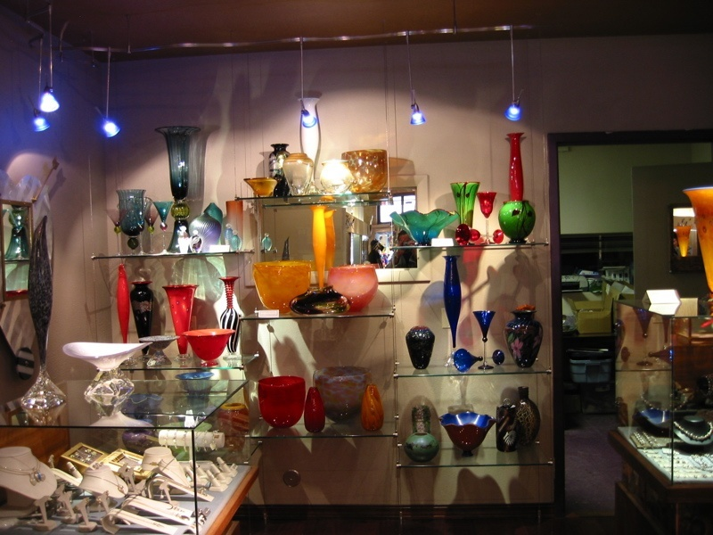
Additional Interior Lighting Power Section C405.3.2.2.1
Exception:
Other merchandise categories are permitted to be included in Retail Areas 2 through 4 above, provided that justification documenting the need for additional lighting power based on visual inspection, contrast, or other critical display is approved by the code official
For spaces which lighting is specified to be installed in addition to general lighting or purpose of decorative appearance or for highlighting art or exhibits, provided that the add’l lighting power is < 0.9 W/ft2 in lobbies and < 0.75 W/ft2 in other spaces
Photo courtesy of Ken Baker, K energy

Slide 42
Dwelling Electrical Meter Section C405.6
Separate metering required for each dwelling unit
Notes:
Specific requirement for buildings with individual dwelling unit to have separate electrical meters.
Intent: Occupant understanding of actual energy use can promote effective energy use!

Slide 43
Electrical Transformers Section C405.7
Low-voltage dry-type distribution electric transformers must meet minimum efficiency requirements of Table C405.7 when tested and rated in accordance with test procedure 10 CFR 431
Efficiency to be verified through certification under an approved certification program or when program does not exist, ratings shall be supported by data furnished by transformer manufacturer

Slide 44
Electrical Transformers Section C405.7 – Cont’d.
Exceptions:
If meet EPAct 2005 exclusions based on 10 CFR 431
Special purpose applications
Not likely in general purpose applications
Have multiple voltage taps where highest tap is ≥ 20% more than lowest tap
Some specific products are listed

Slide 45
Electric Motors Section C405.8
Electric motors must meet minimum efficiency requirements of Tables C405.8(1) through C405.8(4) when tested and rated in accordance with test procedure 10 CFR 431
Efficiency to be verified through certification under an approved certification program or when program does not exist, ratings shall be supported by data furnished by motor manufacturer

Slide 46
Vertical and Horizontal Transportation System and Equipment Section C405.9.1 – Elevator Cabs
The sum of lumens divided by the sum of the watts > 35 lumens/W (not including signal and displays)
Ventilation fans without their own air-conditioning system shall not consume < 0.33 watts/cfm at the max. rated speed of the fan
Controls shall be provided that will de-energize ventilation fans and lighting systems when the elevator is stopped, unoccupied and with its doors closed for > 15 minutes

Slide 47
Vertical and Horizontal Transportation System and Equipment Section C405.9.2 – Escalators and Moving Walks
Must comply with ASME A17.1/CSA B44
Automatic controls configured to reduce speed to minimum permitted speed as permitted in accordance with ASME A17.1/CSA B44 or applicable local code
Exception: variable voltage drive systems that reduce operating voltage in response to light loading conditions is an alternative to reduced speed function
Energy Recovery
Escalators to be designed to recover
electrical energy when resisting overspeed in down direction
on average, more power than is consumed by the power recovery feature of its motor controller system

Slide 48
Additional Efficiency Credit Requirements Section C406
New buildings need 10 credits from Tables C406.1(1) – (5)
Table selected based on use group of the building and credit calculations
Where building contains multiple use groups, credits from each use group to be weighted by floor area of each group to determine weighted average building credit
Credits from tables or calculation to be achieved where building complies with one ore more of the following
More efficient HVAC performance
Reduced lighting power
Enhanced lighting controls
On-site supply of renewable energy
Provision of dedicated outdoor air system for certain HVAC equipment
High-efficiency service water heating
Enhanced envelope performance
Reduced air infiltration
Where not required by C405.12, include energy monitoring system
Where not required by C403.2.3, include fault detection and diagnostics system
Efficient kitchen equipment
Notes:
Old extra efficiency options in C406 were based on “pick one” approach
New extra efficiency made several changes
Assigned “credits” to each item by climate zone and building type
General goal was to equalize savings achieved
10 credit requirement represents about 2.5% total building energy cost savings
Modifications to existing credits
HVAC split to heating and cooling separately with 5% and 10% efficiency improvements
Lighting allows added credits above 15% LPD reduction
Credits for sleeping/dwelling unit lighting efficacy

Slide 49
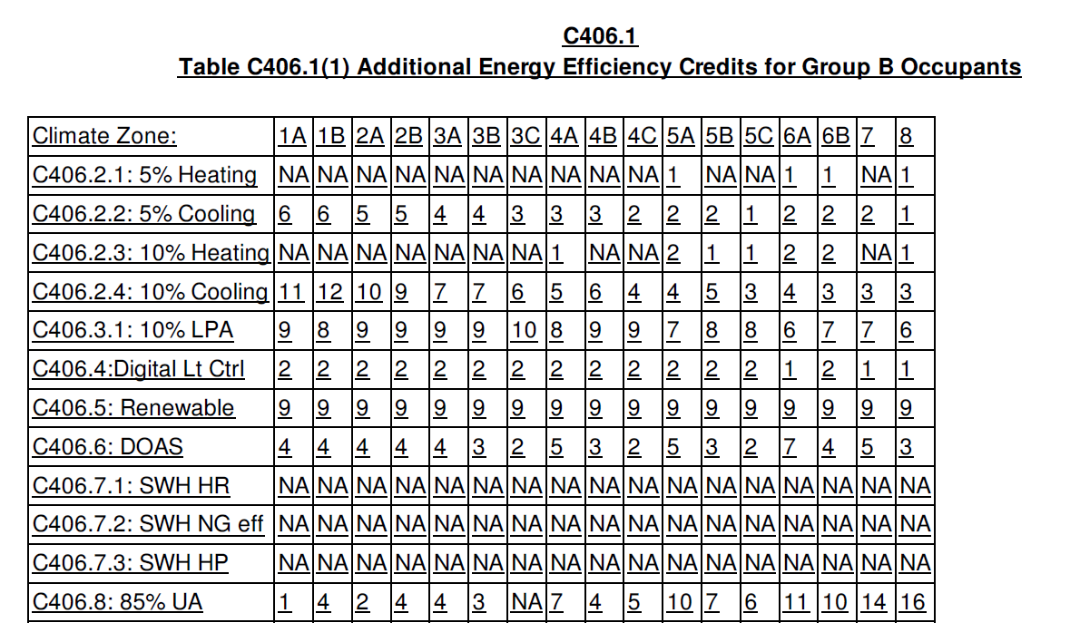
Energy Credit Table Example
Most credits table based, some are formulas
Separate tables:
Office (Group B)
Multifamily (R) & Institutional (I)
Schools (E)
Retail (M)
Other than above
Uniform Target
10 credits = 2.5% cost savings
Tenant infill
5 Credits
Tables expanded with added credits

Slide 50
Additional Efficiency Credit Requirements Section C406
More efficient HVAC performance per C403.3.2 tables
Variable refrigerant flow systems listed in energy efficiency provisions of 90.1 per C406.21, C406.2.2, C406.2.3 or C406.24 shall also meet applicable requirements of C403
Heating – selected from C406.2.1 or C406.2.3; Cooling – selected from C406.2.2, C406.2.4, or C406.2.5. Selected credits to include a heating or cooling energy efficiency credit or both.
Equipment not listed in tables and variable refrigerant flow systems in energy efficiency provisions of 90.1 to be limited to 10% of total building system capacity
5% heating efficiency improvement
5% cooling efficiency improvement
10% heating efficiency improvement
10% cooling efficiency improvement
More than 10% cooling efficiency improvement
Reduced lighting power by more than 10%
Reduced lighting power by more than 10%
Reduced lighting power by more than 15%
Lamp efficacy

Slide 51
Additional Efficiency Credit Requirements Section C406
Enhanced digital lighting controls per C406.4, controls located and operated in accordance with C405.2.1 – C405.2.3:
Luminaires capable of continuous dimming
Luminaires capable of being addressed individually OR a controlled group of < 4 luminaires
< 8 luminaires controlled together in a daylight zone
Fixtures controlled through digital control system that includes the following function:
Control reconfiguration based on digital addressability
Load shedding
Occupancy sensors capable of being reconfigured through the digital control system
Construction documents including submittal of Sequence of Operations including specs outlining each function of the fixture requirements above
Functional testing of controls comply with C408

Slide 52
Additional Efficiency Credit Requirements Section C406
Tenant Spaces
Comply with sufficient options from Tables C406.1(1)-(5) to achieve a minimum number of 5 credits (selected from C406.2, C406.3, C406.6, C406.7 or C406.10)
Where the entire building complies using credits from C406.5, C406.8 or C406.9, tenant spaces are deemed to comply
Exception
Previously occupied tenant spaces that comply with this code per C501

Slide 53
Functional Testing of Lighting Controls Section C408.3.1
Prior to passing final inspection, registered design professional or approved agency to provide evidence that lighting control systems have been tested to ensure that control hardware and software are calibrated, adjusted, programmed and in proper working order per construction documents and manufacturer’s installation instructions
Notes:
Independent refers to independent from the design or construction of the project

Slide 54
Occupant Sensor Controls Section C408.3.1.1
Certify location and aiming per manufacturer recommendation
Test all sensors if project ≤ 7
If > 7 sensors, test for each unique combination of sensor type and space geometry
Where multiples of each unique combination of sensor type and space geometry are provided > 10%, but in no case < 1 of each combination shall be tested unless the code official or design professional requires a higher percentage to be tested
Where >30% of tested controls fail, all remaining identical combinations must be tested
Verify the following:
Status indicator, verify correct operation
Lights turn off or down to permitted level within required time
Auto-on – lights turn on to permitted level when someone enters the space
Manual on – lights turn on only when manually activated
Lights aren’t incorrectly turned on by movement in nearby areas or by HVAC operation

Slide 55
Time-switch Controls Section C408.3.1.2
Confirm programmed schedules
Document schedules for owner
Verify correct time and date are set
Verify any battery backup is installed and energized
Verify override time limit set to ≤ 2 hours
Simulate occupied condition and verify and document:
Lights turn on and off with respective switches
Switch only operates lights in enclosed space where switch is located
Simulate unoccupied condition and verify and document:
All nonexempt lights turn off
Manual override only operates lighting where it is located
Additional testing as specified by the registered design professional

Slide 56
Daylight Responsive Controls Section C408.3.1.3
For daylight responsive controls
Properly located, field-calibrated, and set to have appropriate setpoints and threshold light levels
Daylight controlled lighting loads adjust to correct levels with available daylight
Authorized personnel have ready access to calibration adjustment equipment

Slide 57
Documentation Requirements Section C408.3.2
Construction documents specify that documents in this section be provided to building owner or owner’s authorized agent within 90 days of date of receipt of certificate of occupancy

Slide 58
Existing Buildings Section C502.3.6 Lighting Power and Systems
New lighting systems installed as part of an addition to comply with C405
Total interior lighting power to comply C405.3.2
Stand alone addition
Addition + existing building as a single building
Total exterior lighting power to comply C405.5.2
Stand alone addition
Addition + existing building as a single building
Repairs – C504.2
Repairs exempt where only the bulb, ballast or both within the existing luminaires in a space are replaced, provided that the replacement does not increase the installed interior lighting power

