Slide 1
2021 IECC Commercial Mechanical Requirements
PNNL-SA-170333
Notes:
1

Slide 2
Why Care About IECC?
Energy codes and standards set minimum efficiency requirements for new and renovated buildings, assuring reductions in energy use and emissions over the life of the building. Energy codes are a subset of building codes, which establish baseline requirements and govern building construction.
Code buildings are more comfortable and cost-effective to operate, assuring energy, economic and environmental benefits.

Slide 3
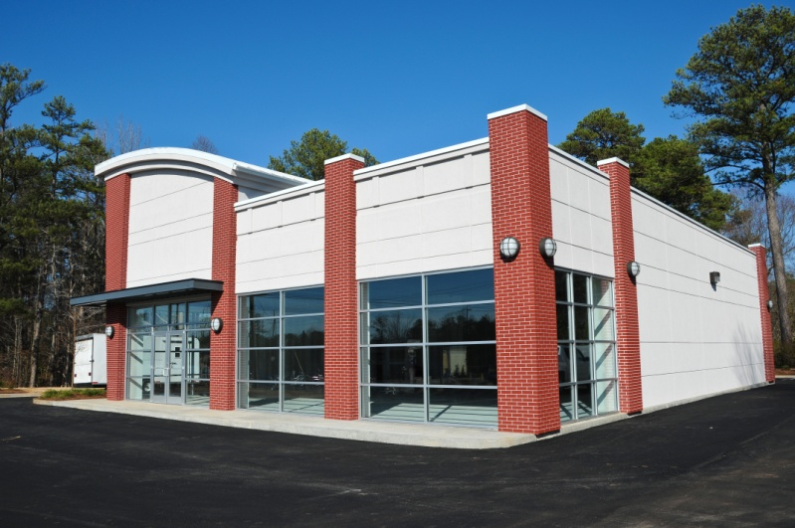
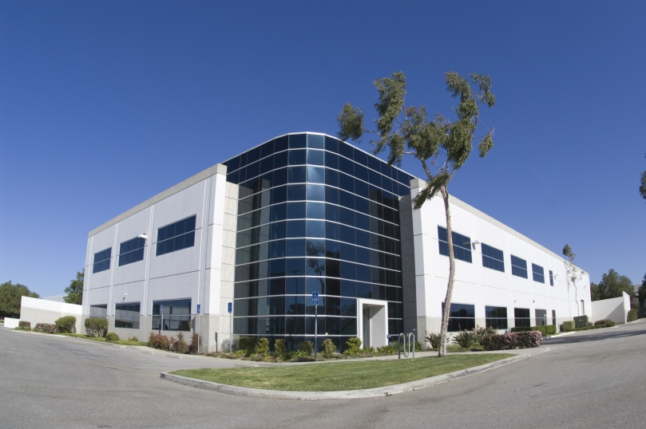
Does My Project Need to Comply with the IECC?
All Buildings Other Than:
One- and two-family residential three stories or less in height
R-2, R-3, R-4 three stories or less in height
Notes:
R-2 is occupancies containing more than 2 dwelling units where the occupants are primarily permanent in nature, including apartments, boarding houses, dormitories, etc. (but not hotels/motels).
R-3 includes one- and two-family dwellings.
R-4 includes residential care and assisted living facilities.

Slide 4
Referenced Codes and Standards Section C108.1
Codes and standards listed in Chapter 6 are considered part of the requirements of this code to the “prescribed extent of each such reference and as further regulated in Sections C108.1.1 and C108.1.2”
Conflicts, C108.1.1 – where differences occur between this code and the referenced codes and standards, provisions of this code apply
Provisions in reference codes and standards, C108.1.2 – “where the extent of the reference to a referenced code or standard includes subject matter that is within the scope of this code, the provisions of this code, as applicable, shall take precedence over the provisions in the referenced code or standard”
Notes:
The year of the standard is also provided
ASHRAE 90.1-2019 at the time of the publishing of the code is applicable (subsequent amendments through the 90.1 continuous maintenance process are not applicable)

Slide 5
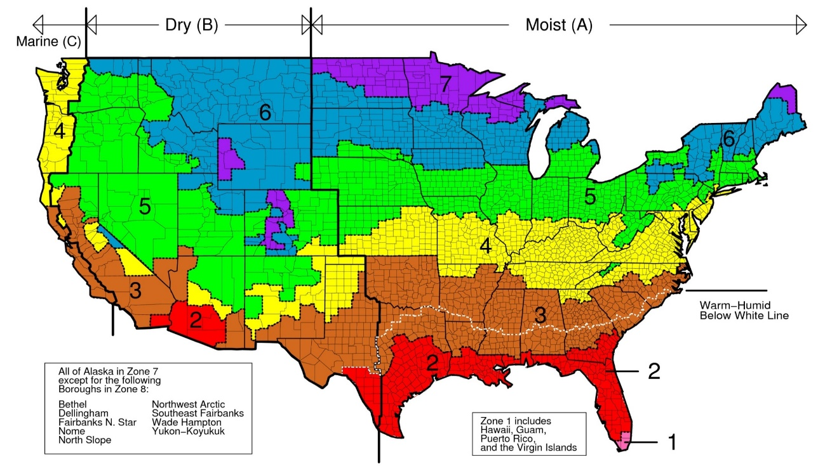
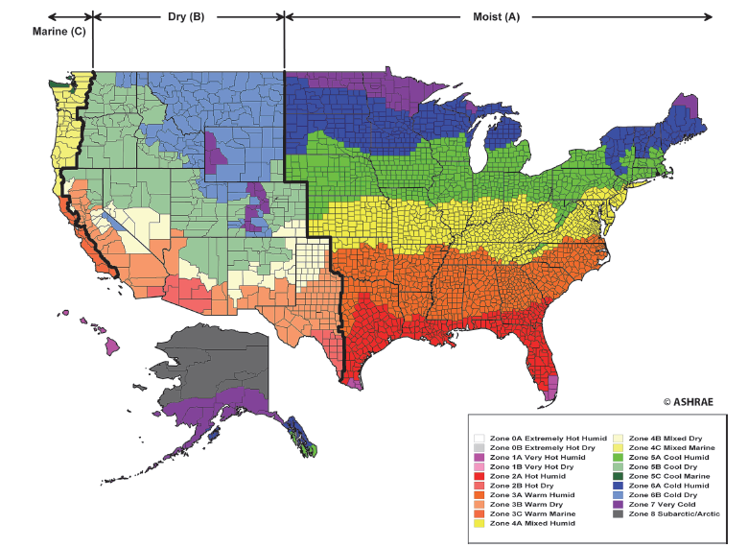
ASHRAE Standard 169-2013 reassigned counties to climate zones based on new climatic data
Climate Zones
Climate Zones for 2018 IECC
Climate Zones for 2021 IECC

Slide 6
Building Mechanical Systems
Systems and equipment serving the building heating, cooling, and ventilation need to comply with C403.2 and Sections C403.3 and C403.14 based on the equipment and systems provided
Large diameter fans to comply with C403.9
Walk-in coolers, walk-in freezers, refrigerated warehouse coolers and refrigerated warehouse freezers shall comply with Section 403.11
Heating systems outside the building envelope shall comply with C403.13

Slide 7
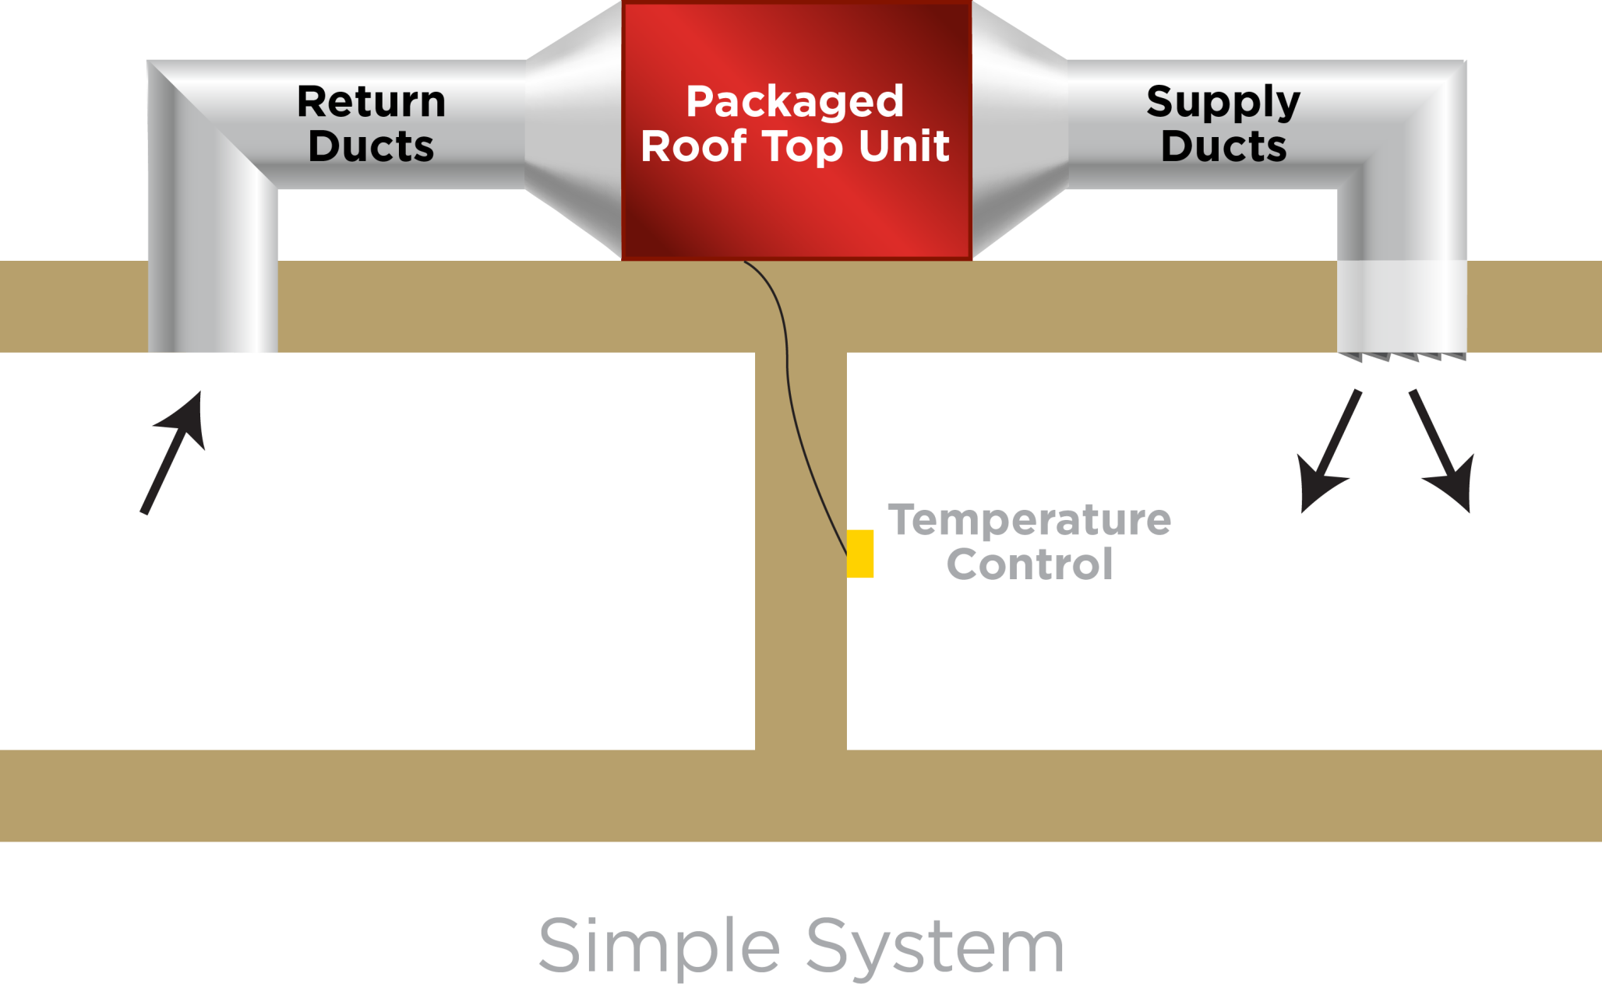
Single Zone Systems
Notes:
The wording simple and complex were removed in 2015, but the concept remains the same, and this slide and the next slide remain to help the presenter introduce HVAC systems.

Slide 8
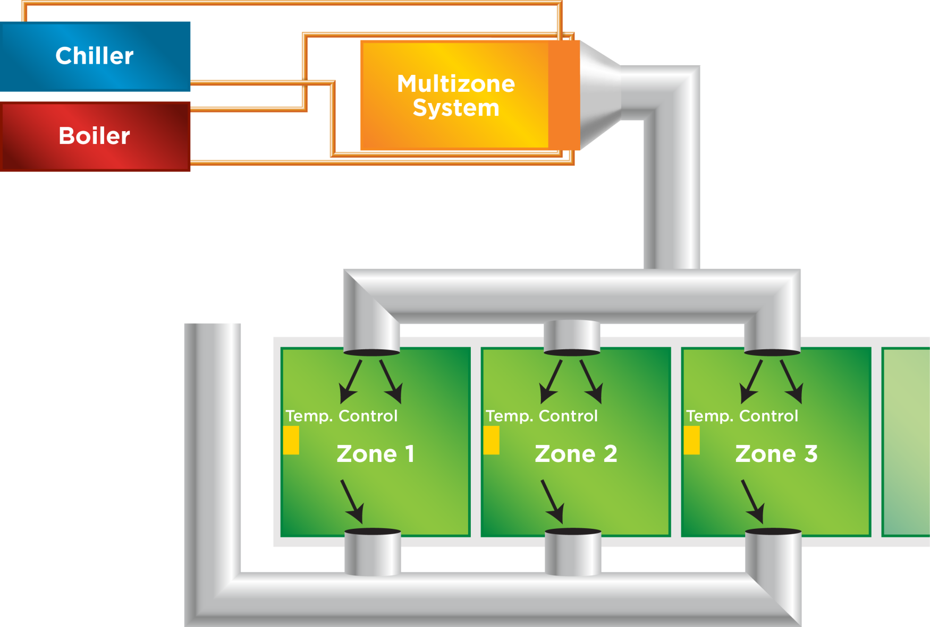
Multiple Zone Systems

Slide 9
Section C403 Organization
Mechanical sections:
C403.1: General (Loads)
C403.2: System Design
C403.3: Equipment Efficiencies & Specs
C403.4: HVAC Controls
C403.5: Economizers
C403.6: Multi-zone/VAV
C403.7: Vent & Exhaust
C403.8: Fan Eff. & Cntrl.
C403.9: Large-Diameter Ceiling Fans
C403.10: Heat Rejection
C403.11: Refrigeration
C403.12: Construction
C403.13: Outside Bldg.
C403.14: Operable Opening Interlocking Controls
Notes:
For 2018 IECC, there was a major reorganization of the mechanical section (C403)
Rather than separate mandatory (C403.2) and prescriptive requirements by section group:
Similar requirements were brought together
Mandatory requirements were indicated (Mandatory) for each section. Sections without the “Mandatory” designation are prescriptive.

Slide 10
Overview
HVAC Load Calculations
Equipment and System Sizing
HVAC Equipment Performance Requirements
HVAC System Controls
Guestroom HVAC Controls
Hot Water Boiler Outdoor Temp. Set-back Control
Ventilation & Vent. Control
Energy Recovery Ventilation Systems
Kitchen Exhaust Systems
Duct and Plenum Insulation and Sealing
Piping Insulation
HVAC System Commissioning and Completion
Air System Design and Control
Heating Outside a Building
Refrigeration Equipment Performance
Walk-in Coolers and Freezers, Refrigerated Warehouse Coolers and Freezers
Site-built walk-in Coolers and Walk-in Freezers

Slide 11
HVAC Load Calculations Section C403.1.1
Heating and cooling load sizing calculations required
ASHRAE/ACCA Standard 183 OR
Other approved computation procedures – defined in Chapter 3
Interior design conditions
Specified by Section C302 of the IECC
≤ 72ºF for heating load
≥ 75ºF for cooling load
Loads reduced from energy recovery systems utilized in the HVAC system shall be accounted for in accordance with the ASHRAE HVAC Systems and Equipment Handbook
Notes:
Handbook can be purchased from ASHRAE

Slide 12
Zone Isolation Section C403.2.1
Divided into isolation areas:
HVAC systems serving zones > 25,000 ft² in floor area OR
Span > one floor and are designed to operate or be occupied nonsimultaneously
Isolation areas:
Isolation devices and controls configured to automatically shut off the supply of conditioned air and outdoor air to and exhaust air from the isolation area
Controlled independently by a device meeting C403.4.2.2
Central systems and plants provided with controls and devices that will allow system and equipment operation for any length of time while serving the smallest isolation area served by system or plant

Slide 13
Zone Isolation Section C403.2.1 – Cont’d
Exceptions:
Exhaust air and outdoor air connections to isolation areas where the fan system to which they connect is < 5,000 cfm
Exhaust airflow from a single isolation area of < 10% of the design airflow of the exhaust system to which it connects
Isolation areas intended to operate continuously or intended to be inoperative only when all other isolation areas in a zone are inoperative

Slide 14
Ventilation Section C403.2.2
Natural and mechanical ventilation to be provided in accordance with Chapter 4 of the IMC
If mechanical – system to provide the capability to reduce outdoor air supply to minimum required by IMC Chapter 4

Slide 15
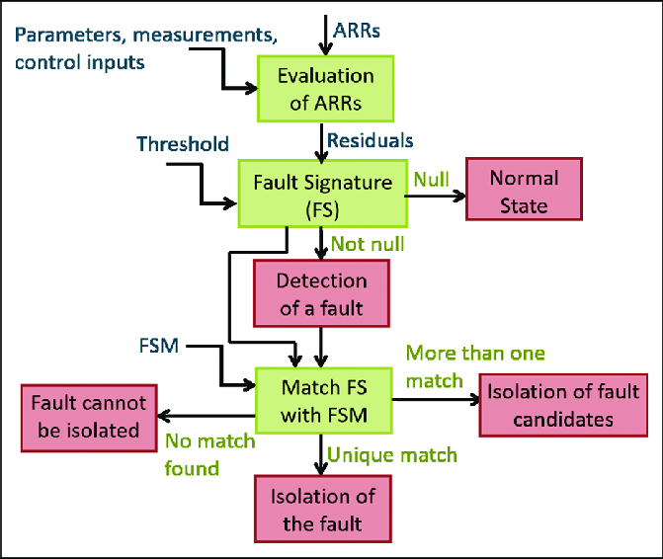
Fault Detection and Diagnostics (FDD) Section C403.2.3
HVAC controls fault detection & diagnostic
Required on buildings 100,000 square feet and larger
Include permanently installed sensors and devices to monitor the HVAC system's performance;
Sample the HVAC system's performance at least once per 15 minutes;
Automatically identify and report HVAC system faults;
Automatically notify authorized personnel of identified HVAC system faults;
Automatically provide prioritized recommendations for repair of identified faults based on analysis of data collected from the sampling of HVAC system performance; and
Be capable of transmitting the prioritized fault repair recommendations to remotely located authorized personnel.

Slide 16
Equipment and System Sizing Section C403.3.1
Output capacity of heating and cooling equipment to not be greater than that of the smallest available equipment size that exceeds the loads calculated
Exceptions:
Standby Equipment with Required Controls
Multiple Units with Combined Capacities Exceeding Loads
Sequencing Controls Required
Notes:
A single piece of equipment providing both heating and cooling must satisfy this provision for one function with the capacity for the other function as small as possible, within available equipment options.

Slide 17
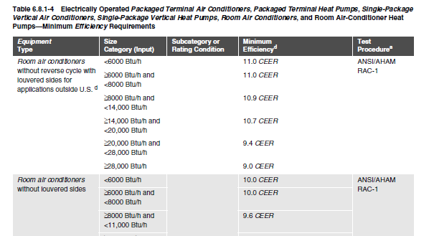
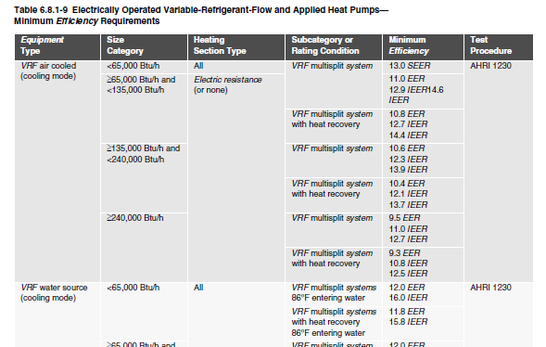
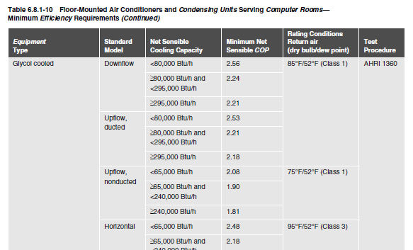
HVAC Equipment Performance Section C403.3.2
Applies to all equipment used in heating and cooling of buildings
Where components from different manufacturers are used
calculations and supporting data demonstrating combined efficiency meets requirements
Must comply with all listed efficiencies
Notes:
There are several tables based on type of equipment. The efficiency to be verified through certification under an approved certification program or, if no certification program exists, the equipment efficiency ratings shall be supported by data furnished by the manufacturer. Where multiple rating conditions or performance requirements are provided, the equipment shall satisfy all stated requirements.
2021 IECC added new tables for:
DOAS units
Water source heat pumps
Variable refrigerant flow cooling and heat pumps
Heat pump and heat reclaim chiller packages
Ceiling mounted computer room air conditioners
Commercial refrigerators and freezers
HVAC equipment efficiency was updated in 2021 IECC to match ASHRAE tables directly

Slide 18
Table C403.3.2(2) Efficiency Requirements
(partial table; similar to other efficiency tables not shown)
EQUIPMENT TYPE | SIZE CATEGORY | HEATING SECTION TYPE | SUBCATEGORY OR RATING CONDITION | MINIMUM EFFICIENCY | TEST PROCEDURE
Air conditioners, air cooled | < 65,000 Btu/h | All | Split system, three phase and applications outside US single phase | 13.0 SEER before 1/1/2023 13.4 SEER2 after 1/1/2023 | AHRI 210/240-2017 before 1/1/2023 AHRI 210/240-2023 after 1/1/2023
 |  |  | Single-package, three phase and applications outside US single phase | 14.0 SEER before 1/1/2023 13.4 SEER2 after 1/1/2023
Space constrained, air cooled | ≤ 30,000 Btu/h | All | Split system, three phase and applications outside US single phase | 12.0 SEER before 1/1/2023 11.7 SEER2 after 1/1/2023
 |  |  | Single-package, three phase and applications outside US single phase | 12.0 SEER before 1/1/2023 11.7 SEER2 after 1/1/2023
Small duct, high velocity, air cooled | < 65,000 Btu/h | All | Split system, three phase and applications outside US single phase | 12.0 SEER before 1/1/2023 12.1 SEER2 after 1/1/2023
Notes:
This is only part of Table C403.3.2(2) to give an idea of the information contained in the table.

Slide 19
Water-Cooled Centrifugal Chilling Packages Section C403.3.2.1
Equipment not designed for operation at AHRI Standard 550/590 test conditions of 44°F leaving and 54°F entering chilled-water temperature and 85°F entering and 93°F leaving condenser water temperature
To have maximum full-load kW/ton and NPLV ratings adjusted using Equations 4-6 and 4-7
The FLadj and PLVadj values are only applicable for centrifugal chillers meeting all of these full-load design ranges
Evaporator leaving temperature ≥ 36°F
Condenser leaving temperature ≤ 115°F
20°F < LIFT < 80°F

Slide 20
Positive Displacement (Air- and Water-Cooled Chilling Packages) Section C403.3.2.2
Equipment with a leaving fluid temperature > 32°F and water-cooled positive displacement chilling packages with a condenser leaving fluid temperature < 115°F to meet requirements of tables in C403.3.2
when tested or certified with water at standard rating conditions, in accordance with the referenced test procedure

Slide 21
Hot Gas Bypass Section C403.3.3
Cooling systems can’t use unless system designed with
multiple steps of unloading OR
Continuous capacity modulation
Capacity limited per Table C403.3.3 as limited by Section C403.5.1
Rated Capacity | Maximum Hot Gas Bypass Capacity (% of total capacity)
≤ 240,000 Btu/h | 50%
> 240,000 Btu/h | 25%
Notes:
In hot gas bypass systems, hot gas from the compressor discharge is injected into the compressor suction to false load the compressor so it will operate stably at its lowest stage of unloading. This can be the result in increased energy usage at low loads, so it can only be used in certain circumstances.

Slide 22
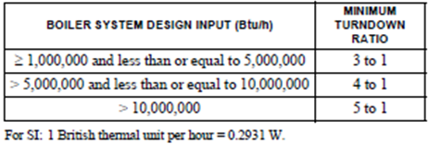
Boiler Turndown Section C403.3.4
Boiler systems with design input ≥ 1,000,000 Btu/h to comply with turndown ratio specified in Table C403.3.4
System turndown requirement must be met through the use of
multiple single input boilers OR
> 1 modulating boilers OR
combination of single input and modulating boilers

Slide 23
Thermostatic Controls Section C403.4.1
Control required for each system
if zoned for each zone
Exceptions: Independent perimeter systems that are designed to offset only building envelope heat losses or gains or both serving one or more perimeter zones also served by an interior system provided:
The perimeter system includes at least one thermostatic control zone for each building exposure having exterior walls facing only one orientation (within +/- 45 degrees) (0.8 rad) for more than 50 contiguous feet (15.2 m); and
The perimeter system heating and cooling supply is controlled by a thermostat(s) located within the zone(s) served by the system.
Notes:
If humidification/dehumidification, at least one control device provided for each humidity control system.

Slide 24
Heat Pump Supplementary Heat Section C403.4.1.1
Heat pump systems
Controls to limit supplemental heat to only those times of these applies:
Vapor compression cycle can’t provide necessary heating to satisfy thermostat
Heat pump is in defrost mode
Vapor compression cycle malfunctions
Thermostat malfunctions

Slide 25
Deadband Section C403.4.1.2
Thermostats must have at least a 5°F deadband between operation of heating and cooling
Exception:
Thermostats requiring manual change over between heating and cooling
Occupancies or applications requiring precision in indoor temperature control as approved by code official
Notes:
The deadband means that the system will not be on and will not be using energy when the temperature is in that deadband. This also helps reduce the possibility of simultaneous heating and cooling.

Slide 26
Set Point Overlap Restriction Section C403.4.1.3
Where separate thermostatic control devices for heating and cooling in a zone:
Limit switch
Mechanical stop OR
Direct digital control system with software programming shall be configured to prevent heating set point from exceeding cooling set point to maintain deadband

Slide 27
Heated or Cooled Vestibules Section C403.4.1.4
Heating system for heated vestibules and air curtains with integral heating
Controls configured to shut off heat when outdoor air temperature is > 45°F
Heating and cooling systems controlled by thermostat in vestibule configured to limit heating to < 60°F and cooling to >85°F
Exception: control of heating or cooling provided by
site-recovered energy or
transfer air that would otherwise be exhausted

Slide 28
Hot Water Boiler Outdoor Temp. Set-back Control Section C403.4.1.5
Hot water boilers that supply heat to the building through one or two-pipe heating systems to have an outdoor setback control that lowers the boiler water temperature based on the outdoor temperature

Slide 29
Off-Hour Controls Section C403.4.2
Automatic time clock or programmable system
Exceptions:
Zones operated continually
Zones with full HVAC load demand <6,800 Btu/h and has a shut off switch located with ready access
Thermostatic setback capabilities (C403.4.2.1)
Capability to maintain zone temps down to 55ºF or up to 85ºF
Automatic setback and shutdown (C403.4.2.2)
Seven different daily schedules/week
Retain programming ≥ 10 hrs with loss of power AND
Manual override up to 2 hours OR
Manual timer configured to operate up to 2 hours OR
Occupancy sensor
Notes:
Each zone shall be provided with thermostatic setback controls that are controlled by either an automatic time clock or programmable control system.
Thermostatic setback capabilities.
Thermostatic setback controls shall have the capability to set back or temporarily operate the system to maintain zone temperatures down to 55°F (13°C) or up to 85°F (29°C).
Automatic setback and shutdown capabilities.
Automatic time clock or programmable controls shall be capable of starting and stopping the system for seven different daily schedules per week and retaining their programming and time setting during a loss of power for at least 10 hours. Additionally, the controls shall have a manual override that allows temporary operation of the system for up to 2 hours; a manually operated timer capable of being adjusted to operate the system for up to 2 hours; or an occupancy sensor.

Slide 30
Automatic Start Capabilities Section C403.4.2.3
Automatic start controls for each HVAC system
Configured to automatically adjust daily start time to bring each space to desired occupied temperature immediately prior to scheduled occupancy
Automatic stop controls
End of day system turns off and “coasts” up to temperature shift of +/- 2°F
Notes:
This allows the building to “warm up” or “cool down” in time for occupancy without requiring the occupants to override the setbacks or face a cold or hot building when they arrive.

Slide 31
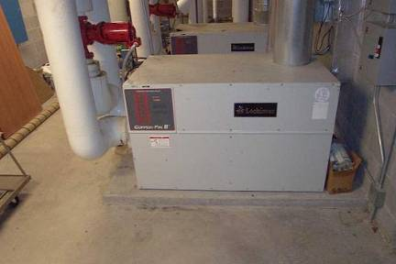
Hydronic System Controls Section C403.4.3
Limit reheat/recool of fluids
Multiple boiler heating plants must include automatic controls configured to sequence operation of the boilers
Single boilers > 500,000 Btu/h input design capacity must include multi-staged or modulating burner

Slide 32
Hydronic Systems Section C403.4.3
3-Pipe System – not allowed (C403.4.3.1)
Can’t use a common return
2-Pipe Changeover System (C403.4.3.2)
Dead band between changeover ≥ 15ºF outside temperature
Diagram Courtesy of Ken Baker
Notes:
Two-pipe changeover systems use a common distribution system to alternately supply heated or chilled water to fan-coils and air-handlers. One pipe in and one pipe out. Changeover happens at specified times of the year.
To be designed to allow a dead band between changeover from one mode to the other of at least 15°F (8.3°C) outside air temperatures; be designed to and provided with controls that will allow operation in one mode for at least 4 hours before changing over to the other mode; and be provided with controls that allow heating and cooling supply temperatures at the changeover point to be no more than 30°F (16.7°C) apart.

Slide 33
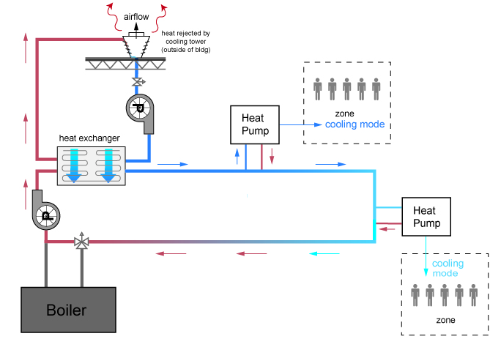
Hydronic Water Loop Heat Pump Systems Section C403.4.3.1
Temperature dead band configured to at least 20ºF (C403.4.2.3.1)
Exception:
Where system loop temp optimization controller is installed and can determine the most efficient operating temp based on real time conditions of demand and capacity
Example:
Heat rejection off below 75ºF loop temperature.
Boiler off above 55ºF loop temperature
75ºF - 55ºF =
20ºF dead band
Diagram Courtesy of Ken Baker
Notes:
Ex: water loop through building and heat pumps are placed around and use water loop as a heat source for heating and a heat sink for cooling.
Requirements are meant to limit the unnecessary use of the central heating and cooling sources and increase heat recovery in the system.

Slide 34
Hydronic Water Loop Heat Pump Systems Section C403.4.3.3.2
Heat rejection equipment in Climate Zones 3 - 8
Closed-circuit cooling tower used directly in heat pump loop
Install either automatic valve to bypass flow of water around tower, except for minimal freeze protection flow OR lower leakage positive closure dampers to be provided
Open-circuit tower used directly in heat pump loop
Install automatic valve to bypass all heat pump water flow around tower
Open- or closed-circuit tower used in conjunction with separate heat exchanger to isolate cooling tower from heat pump loop
Heat loss controlled by shutting down the circulation pump on cooling tower loop
Exception: Where it can be demonstrated that a heat pump system will be required to reject heat throughout the year
Notes:
Exception: Where it can be demonstrated that a heat pump system will be required to reject heat throughout the year.
If an open-circuit tower is used directly in the heat pump loop, an automatic valve must be installed to bypass all heat pump water flow around the tower.
If an open-circuit tower is used in conjunction with a separate heat exchanger to isolate the tower from the heat pump loop, then heat loss must be controlled by shutting down the circulation pump on the cooling tower loop.

Slide 35
Hydronic Water Loop Heat Pump Systems Section C403.4.3.3.3
Two position shutoff valve
Required on each hydronic heat pump where total system pump power > 10 hp

Slide 36
Hydronic System Part Load Control Section C403.4.4
System ≥ 300,000 Btu/h heating or cooling must include
Temperature reset and variable flow
Configured automatic resets for supply water temperature by at least 25% of design supply-to-return temperature differences and
Automatic vary fluid flow if a combined motor capacity ≥ 2 hp with ≥ 3 control valves or other devices:
Must reduce system design flow rate by > 50% by
designed valves or pumps that modulate flow:
Modulating valves or VSD on pumps,
Valves that step open and close OR
Sequencing pumps or valves turn on and of as function of load
Notes:
The “or” in 2012 has changed to an “and” for 2015

Slide 37
Hydronic System Part Load Control Section C403.4.4 – Cont’d
Automatic vary pump flow on heating-water systems, chilled-water systems and heat rejection loops serving cooled unitary air conditioners
Where pumps operate continuously or based on a time schedule, pumps with nominal output hp of ≥ 2hp to have a variable speed drive
Where pumps have automatic direct digital control configured to operate pumps only when zone heating or cooling is required, a variable speed drive to be provided for pumps with motors having the same or greater nominal output power per Table C403.4.4 based on climate zone and system served
Where a variable speed drive is required per above bullet, pump motor power input to be not more than 30% of design wattage at 50% of design water flow. Pump flow rate to be controlled to maintain one control valve nearly wide open Or to satisfy the minimum differential pressure.

Slide 38
Hydronic System Part Load Control Section C403.4.4 – Cont’d
Exceptions:
Supply-water temp. reset for chilled-water systems supplied by off-site district chilled water or chilled water from ice storage systems
Variable pump flow not required on
dedicated coil circulation pumps for freeze protection
dedicated equipment circulation pumps where configured in primary/secondary design to provide the minimum flow requirements of the equipment manufacturer for proper operation of equipment
Variable speed drives not required on heating water pumps where more than 50% of annual heat is generated by electric boiler

Slide 39
Pump Isolation Section C403.4.5
Multiple chiller chilled water plants
Capable and configured to reduce flow through the chiller automatically when chiller is shut down
Chillers piped in series considered one chiller
Multiple boiler plants
Capable and configured to reduce flow through the boiler system automatically when boiler is shut down
What to look for:
Separate pumps for each boiler or chiller with check valves, OR
A variable flow pump with isolation valves for each boiler or chiller
Notes:
Essentially requires that flow through chillers (or boilers), when piped in parallel, must be shutoff when the chillers (or boilers) are inactive.
When a chilled-water plant includes more than one chiller, provisions shall be made so that the flow in the chiller plant can be automatically reduced, correspondingly, when a chiller is shut down.
When a boiler plant includes more than one boiler, provisions shall be made so that the flow in the boiler plant can be automatically reduced, correspondingly, when a boiler is shut down.

Slide 40
Economizers Section C403.5
Air or water economizers shall be provided for the following cooling systems:
Chilled water systems with total cooling capacity less capacity provided by air economizers per Table C403.5.1
Individual fan systems with cooling capacity ≥ 54 kBtu/h in buildings other than Group R occupancy
Total supply capacity of all fan-cooling units not provided with economizers to be not > 20% of total supply capacity of all fan-cooling units in the building or 30 kBtu/h, whichever is greater, unless otherwise excepted
Individual fan systems with cooling capacity ≥ 270 kBtu/h in buildings of Group R occupancy
Total supply capacity of all fan-cooling units not provided with economizers to be not > 20% of the total supply capacity of all fan-cooling units in the building or 1,500,000 Btu/h, whichever is greater, unless otherwise excepted
Notes:
Economizers. Supply air economizers shall be provided on each cooling system as shown in Table C403.3.1(1).

Slide 41
Economizers – Table C403.5(1) Section C403.5
Climate Zones (Cooling) | Total Chilled-Water System Capacity < Capacity of Cooling Units with Air Economizers
 | Local Water-cooled Chilled-water Systems | Air-cooled Chilled-water Systems or District Chilled-water Systems
0A, 1A | No economizer requirement | No economizer requirement
0B, 1B, 2A, 2B | 960,000 Btu/h | 1,250,000 Btu/h
3A, 3B, 3C, 4A, 4B, 4C | 720,000 Btu/h | 940,000 Btu/h
5A, 5B, 5C, 6A, 6B, 7, 8 | 1,320,000 Btu/h | 1,720,000 Btu/h
Example: Hotel with guest room chilled water fan coil units totaling 1,500 MBH of cooling capacity in climate zone 5A
Central water economizer or individual fan coil air economizers required if a water-cooled chiller
No economizer requirement if all air-cooled chillers or district chilled water source outside of building

Slide 42
Economizer Exceptions Section C403.5
Exceptions: (economizers not required)
Individual fan systems not served by chilled water in Climate Zones 0A, 0B, 1A, and 1B
Where > 25% of air designed to be supplied by the system is to spaces that are designed to be humidified > 35°F dew-point temperature to satisfy process needs
Systems expected to operate < 20 hours/week
Systems serving supermarket areas with open refrigerated casework systems
Where cooling efficiency meets of exceeds efficiency requirements in Table C403.5(2)
Systems that include a heat recovery system in accordance with Section C403.10.5
VRF systems installed with a dedicated outdoor air system

Slide 43
Economizers – Table C403.5(2) Section C403.5
Trade-off high cooling efficiency for economizer
Table C403.5(2)
CLIMATE ZONES | COOLING EQUIPMENT PERFORMANCE IMPROVEMENT (EER OR IPLV)
2A, 2B | 10% Efficiency Improvement
3A, 3B | 15% Efficiency Improvement
4A, 4B | 20% Efficiency Improvement

Slide 44
Integrated Economizer Control Section C403.5.1
Systems to be integrated with the mechanical cooling system and be configured to provide partial cooling even where additional mechanical cooling is required to provide the remainder of the cooling load
Controls shall not be capable of creating a false load in the mechanical cooling systems by limiting or disabling the economizer or any other means, such as hot gas bypass, except at the lowest stage of mechanical cooling

Slide 45
Integrated Economizer Control Section C403.5.1 – Cont’d
Units that include an air economizer to comply with the following:
Unit controls are configured so the mechanical cooling capacity control interlocked with the air economizer controls such that the outdoor air damper is at the 100% open position when mechanical cooling is on and the outdoor air damper does not begin to close to prevent coil freezing due to minimum compressor run time until the leaving air temp. < 45°F
Direct expansion (DX) units that control >75,000 Btu/h of rated capacity of the capacity of the mechanical cooling directly based on occupied space temp. shall have not fewer than two stages of mechanical cooling capacity
Other DX units including those that control space temp. by modulating the airflow to the space be in accordance with Table C403.5.1

Slide 46
Heating System Impact Section C403.5.2
HVAC system design and economizer controls shall be such that economizer operation does not increase building heating energy use during normal operations
Exception: Economizers on variable air volume (VAV) systems that cause zone level heating to increase due to a reduction in supply air temperature

Slide 47
Air Economizers – Design Capacity Section C403.5.3.1
Configured to modulate outdoor air and return air dampers to provide up to 100% of design supply air quantity as outdoor air for cooling

Slide 48
Air Economizers – Control Signal Section C403.5.3.2
Economizer dampers to be configured to sequence with mechanical cooling equipment and not be controlled by only mixed air temperature
Exception:
Can use mixed air temperature limit control for systems controlled from space temperature
Example: single-zone systems

Slide 49
Air Economizers – High-Limit Shutoff Section C403.5.3.3
Air economizers to be configured to automatically reduce outdoor air intake to design minimum outdoor air quantity when outdoor air intake will no longer reduce cooling energy usage
High-limit shutoff control types to be chosen from Table C403.5.3.3 for specific climates
Specifications for high-limit shutoff control type settings per Table C403.5.3.3

Slide 50
Air Economizers – Relief of Excess Outdoor Air Section C403.5.3.4
Systems to be capable of relieving excess outdoor air during air economizer operation to prevent over-pressurizing the building
Relief air outlet to be located to avoid recirculation into the building

Slide 51
Air Economizers – Dampers Section C403.5.3.5
Dampers used in economizers to comply with Section C403.7.7 (Shut Off Dampers)
Return
Exhaust/relief
Outdoor air

Slide 52
Water-side Economizers – Design Capacity Section C403.5.4.1
Configured to cool supply air by indirect evaporation and provide up to 100% of expected system cooling load at outdoor air temperatures ≤ 50ºF dry bulb/45ºF wet bulb
Exceptions:
Systems primarily serving computer rooms in which 100% of expected system cooling load at 40ºF dry bulb/35ºF wet bulb is met with evaporative water economizers
Systems primarily serving computer rooms with dry cooler water economizers which satisfy 100% of the expected system cooling load at 35ºF dry bulb
Systems where dehumidification requirements cannot be met using outdoor air temps of 50ºF dry bulb/45ºF web bulb and where 100% of expected system cooling load at 45ºF dry bulb/40ºF wet bulb is met with evaporative water economizers

Slide 53
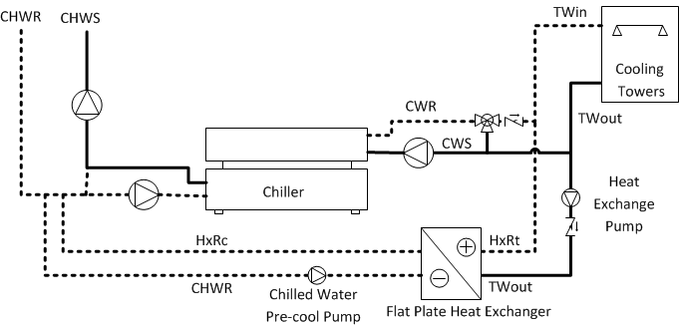
Water-side Economizers – Maximum Pressure Drop Section C403.5.4.2
Precooling coil and water-to-water heat exchangers used as part of a water economizer system to have either a:
water side pressure drop < 15 feet of water OR
secondary loop created so that the coil or heat exchanger pressure drop is not seen by the circulating pumps when the system is in normal cooling (non-economizer) mode
Notes:
Unlike airside economizers, water economizers have parasitic energy losses that reduce the cooling energy savings. One of these losses comes from possible increases in pumping energy. This requirement attempts to limit those losses. The diagram shows the second option, a secondary loop with a separate pump on the chilled water side.
Save pumping energy

Slide 54
Economizer Fault Detection and Diagnostics Section C403.5.5
Air cooled unitary direct-expansion units (listed in Tables in C403.3.2) and variable refrigerant flow (VRF) units that are equipped with an economizer per C403.5 to C403.5.4 to include a fault detection and diagnostics (FDD) system complying with the following:
Temperature sensors permanently installed to monitor system operation
Outside air
Supply air
Return air
Temperature sensors have an accuracy of +2°F over the range of 40°F - 80°F
Refrigerant pressure sensors, where used, have an accuracy of +3% of full scale

Slide 55
Economizer Fault Detection and Diagnostics Section C403.5.5 – Cont’d
Unit controller configured to provide system status by indicated the following:
Free cooling available
Economizer enabled
Compressor enabled
Heating enabled
Mixed air low limit cycle active
Current value of each sensor
Unit controller capable of manually initiating each operating mode so that the operation of compressors, economizers, fans and heating system can be independently tested and verified

Slide 56
Economizer Fault Detection and Diagnostics Section C403.5.5 – Cont’d
Unit configured to report faults to a fault management application accessible by day-to-day operating or service personnel, or annunciated locally on zone thermostats
The FDD system configured to detect the following faults:
Air temperature sensor failure/fault
Not economizing when the unit should be economizing
Economizing when the unit should not be economizing
Damper not modulating
Excess outdoor air

Slide 57
VAV & Multiple-zone Systems Section C403.6.1
Supply air systems serving multiple-zones shall be VAV systems with zone controls to reduce reheated air to one of the following:
20% of zone peak supply for DDC (30% others)
DDC with 20% air in deadband, first stage heating at 20%, second stage heating up to 50% zone airflow
Airflow required to meet IMC ventilation requirements
A higher rate shown to use less energy through system OA reduction
Airflow required for accreditation standards
Exceptions:
Zones or supply air systems where not less than 75% of the energy for reheating or for providing warm air in mixing systems is provided from a site-recovered energy source.
Systems that prevent reheating, recooling, mixing or simultaneous supply of air that has been previously cooled (mechanically or economizer) and heated air.

Slide 58
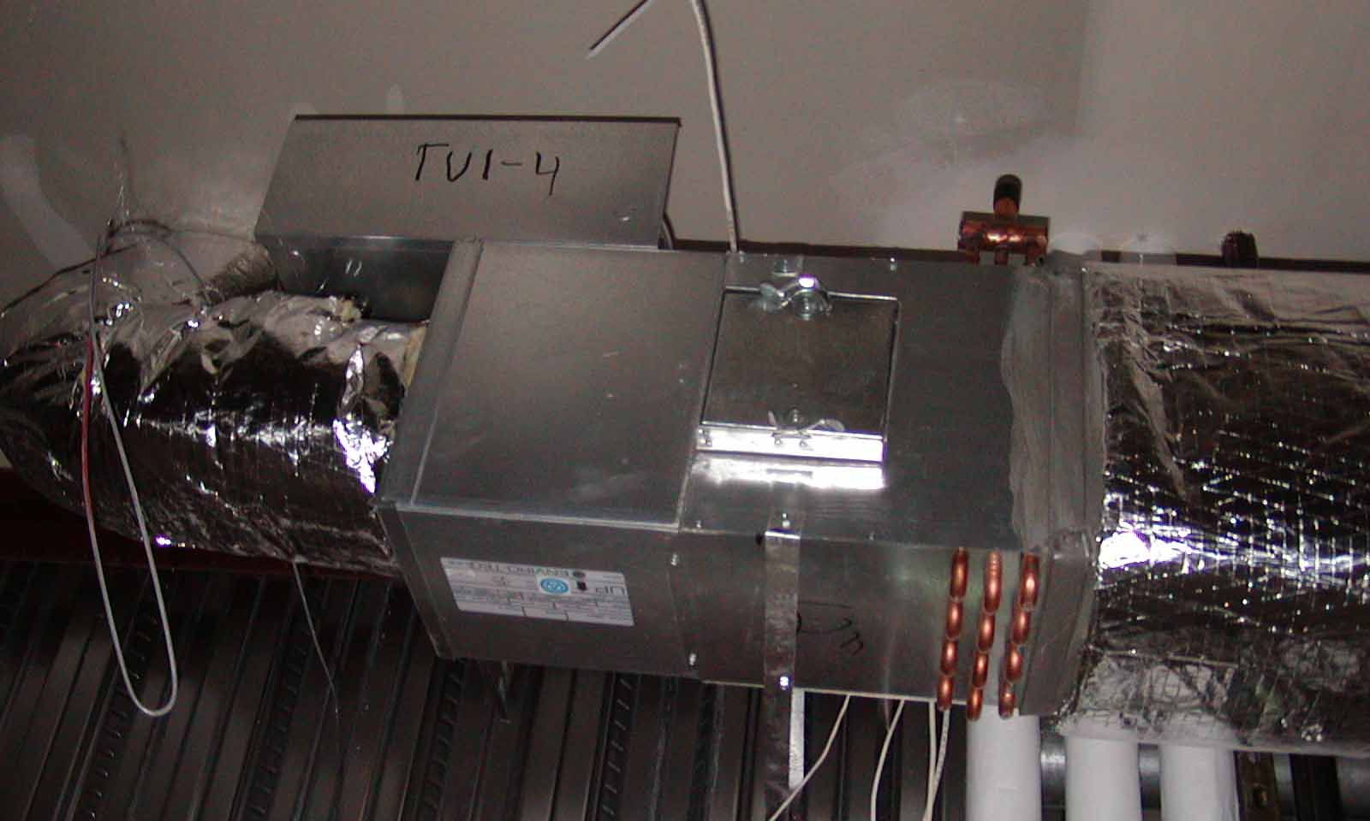
Single Duct VAV Systems, Terminal Devices Section C403.6.2
Single duct VAV systems to use terminal devices capable of and configured to reduce the supply of primary supply air before reheating or recooling takes place

Slide 59
Dual Duct and Mixing VAV Systems, Terminal Devices Section C403.6.3
Systems with one warm air duct and one cool air duct to use terminal devices configured to reduce flow from one duct to a minimum before mixing of air from the other duct takes place
Notes:
These systems are considered older technology

Slide 60
Single Fan Dual Duct and Mixing VAV Systems, Economizers Section C403.6.4
Individual dual duct or mixing reheating and cooling systems with a single fan and with total capacities > 90,000 Btu/h (7.5 tons) should not have economizers
Notes:
Not very common

Slide 61
Supply-Air Temperature Reset Controls Section C403.6.5
Multiple zone HVAC systems to have controls capable of and configured to automatically reset supply-air temperature in response to building loads or outdoor air temperature
Controls to be configured to reset supply air temperature at least 25% of difference between design supply-air temperature and design room air temperature
Controls that adjust reset based on zone humidity allowed in CZ 0B, 1B, 2B, 3B, 3C and 4-8
HVAC zones expected to experience relatively constant loads to have maximum airflow designed to accommodate fully reset supply-air temperature
Exceptions:
Systems that prevent reheating, recooling or mixing of heated and cooled supply air
75% of energy for reheating is from site-recovered or site solar energy sources
Systems in CZ 0A, 1A and 3A with < 3,000 cfm design outside air
Systems in CZ 2A with < 10,000 cfm design outside air
Systems in CZ 0A, 1A, 2A and 3A with no less than 80% outside air and employing exhaust air energy recovery per C403.7.4

Slide 62
Dehumidification Control Interaction Section C403.6.5.1
In warm moist climate zones (0A to 3A)
System design to allow supply-air temperature reset while dehumidification is provided
Lock out economizer during dehumidification
Notes:
Usually requires separate outdoor air cooling coil or return air bypass

Slide 63
Multiple-zone VAV System Ventilation Optimization Control Section C403.6.6
Multiple-zone VAV systems with direct digital control of individual zone boxes reporting to central control panel
Automatic controls configured to reduce outdoor air intake flow below design rates in response to changes in system ventilation efficiency (Ev) as defined by IMC
Exceptions:
VAV systems with zonal transfer fans that recirculate air from other zones without directly mixing it with outdoor air, dual-duct dual-fan VAV systems, and VAV systems with fan-powered terminal units
Systems where total design exhaust airflow is > 70% of total design outdoor air intake flow requirements
Notes:
The provision doesn’t require a central panel. It only applies when one is present.

Slide 64
Parallel Fan-Powered VAV Zone Control Section C403.6.7
Parallel fan-powered VAV zone terminal units shall be configured to operate as follows:
Turn off the terminal fan except when space heating is required or where required for ventilation.
Turn on the terminal fan as the first stage of heating before the heating coil is activated.
During heating for warmup or setback temperature control, either:
Operate the terminal fan and heating coil without primary air.
Reverse the terminal damper logic and provide heating from the central air handler by primary air.

Slide 65
Setpoints for Direct Digital Control Section C403.6.8
Systems with direct digital control of individual reporting to the central control panel
Static pressure set point to be reset based on the zone requiring the most pressure (i.e., the set point is reset lower until one zone damper is nearly wide open)
Direct digital controls capable of monitoring zone damper positions or have an alternative method of indication the need for static pressure configured to provide all of the following:
Automatically detecting any zone that excessively drives the reset logic
Generating an alarm to the system operational location
Allowing an operator to readily remove > 1 zones from the reset algorithm

Slide 66
Static Pressure Sensor Location Section C403.6.9
Sensors used to control VAV fans
Placed so that the controller setpoint is ≤ 1.2 inches w.c.
Sensors installed downstream of major duct splits
At least one sensor to be located on each major branch so that static pressure can be maintained in each branch

Slide 67
Demand Controlled Ventilation Section C403.7.1
DCV must be provided for all single-zone systems required to comply with C403.5-C403.5.3 and spaces > 500 ft² and the average occupant load ≥ 15 people/1000 ft² of floor area (per IMC table 403.3.1.1) where the HVAC system has:
An air-side economizer, or
Automatic modulating control of the outdoor air damper, or
A design outdoor airflow > 3,000 cfm
Demand control ventilation (DCV): a ventilation system capability that provides for the automatic reduction of outdoor air intake below design rates when the actual occupancy of spaces served by the system is less than design occupancy.
Notes:
Now includes retail sales areas

Slide 68
Demand Controlled Ventilation Section C403.7.1 – Cont’d
Exceptions:
Systems with energy recovery per C403.7.4.2
Multiple zone systems without direct digital control of single zones communicating with central control panel
Multiple zone systems with design outdoor airflow < 750 cfm
Spaces where > 75% of space design outdoor airflow is required for makeup air exhausted from space or transfer air that is required for makeup air that is exhausted from other spaces
Spaces with one or more of the following occupancy classifications per IMC Table 403.3.1.1:
Correctional cells
Education laboratories
Barber
Beauty and nail salons
Bowling alley seating areas

Slide 69
Enclosed Parking Garage Ventilation Controls Section C403.7.2
Garages for storing or handling automobiles operating under their own power shall employ carbon monoxide detects applied in conjunction with nitrogen dioxide detectors and automatic controls configured to stage fans or modulate fan average airflow rates to < 50% of design capacity, or intermittently operate fans < 20% of occupied time or as required to maintain acceptable contaminant levels in accordance with IMC provisions
Failure of these devices shall cause the exhaust fans to operate continuously at design airflow
Exceptions:
Garages with total exhaust capacity < 8,000 cfm with ventilation systems that do not utilize heating or mechanical cooling
Garages that have garage area to ventilation system motor nameplate power ratio >1,125 cfm/hp and do not utilize heating or mechanical cooling

Slide 70
Ventilation Air Heating Control Section C403.7.3
Units providing ventilation air to multiple zones and operating in conjunction with zone heating and cooling systems to not use heating or heat recovery to warm supply air to a temperature > 60ºF when representative building loads or outdoor air temperatures indicate majority of zones require cooling.
Things to look for:
Applies to DOAS systems with or without heating or cooling capability
HRV or ERV systems will require bypass of flat plate exchangers or speed control of heat wheels
“Neutral air” control is not allowed

Slide 71
Energy Recovery Systems Section C403.7.4.1
Nontransient (e.g., apartment) dwelling units to be provided with outdoor air energy recovery ventilation systems with an enthalpy recovery ratio (ERR) 50% cooling / 60% heating
Exceptions
Climate Zone 3C
Smaller (<500 ft²) apartments exempt in Climate Zones 0, 1, 2, 3, 4C, 5C
ERR requirements at heating design condition in Climate Zones 0, 1, 2
ERR requirements at cooling design condition in Climate Zones 4, 5, 6, 7 and 8

Slide 72
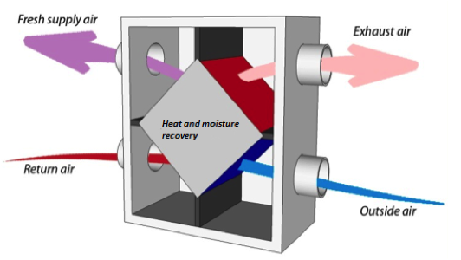
Energy Recovery Ventilation Systems Section C403.7.4.2
Applies to fan systems serving other than nontransient space with supply airflow rates > values in Tables C403.7.4(1-2)
Note that prior 0 cfm values in tables have been increased
ERR must be ≥ 50%
When an air economizer is required
include a bypass or controls that permit operation of economizer per C403.5
Energy recovery ventilation (ERV) systems: employ air-to-air heat exchangers to recover energy from exhaust air for the purpose of preheating, precooling, humidifying or dehumidifying outdoor ventilation air prior to supplying the air to a space, either directly or as part of an HVAC system.
Notes:
Have an energy recovery system that provides a change in the enthalpy of the outdoor air supply of 50 percent or more of the difference between the outdoor air and return air at design conditions. Provide for bypassing or controlling the energy recovery system to permit cooling with outdoor air where cooling with outdoor air is required.

Slide 73
Energy Recovery Ventilation Systems Section C403.7.4.2 – Cont’d
Exceptions:
Where energy recovery ventilation systems prohibited by the IMC
Lab fume hood system with at least one of the following:
VAV hood exhaust and room supply systems configured to reduce exhaust and makeup air volume to ≤ 50% of design values
Direct makeup (auxiliary) air supply equal to at least 75% of exhaust rate, heated no warmer than 2ºF below room setpoint, cooled to no cooler than 3ºF above room setpoint, with no humidification added, and no simultaneous heating and cooling use for dehumidification control
Systems serving uncooled spaces and heated to < 60ºF
Where > 60% of outdoor heating energy is from site-recovered or site solar energy
Enthalpy recovery ratio at heating design condition in Climate Zones 1-2
Enthalpy recovery ratio at cooling design condition in Climate Zones 3C, 4C, 5B, 5C, 6B, 7, and 8
Systems requiring dehumidification that employ energy recovery in series with the cooling coil
Where largest source of air exhausted at a single location at building exterior is < 75% of design outside air flow rate
Systems expected to operate < 20 hours/week at outdoor air % covered by Table C403.7.4.2(1)
Systems exhausting toxic, flammable, paint or corrosive fumes or dust
Commercial kitchen hoods used for collecting and removing grease vapors and smoke

Slide 74
Kitchen Exhaust Systems Section C403.7.5
Replacement air introduced directly into the exhaust hood cavity shall not be > 10% of the hood exhaust airflow rate
Conditioned supply air delivered to any space shall not exceed the greater of the following:
Ventilation rate required to meet the space heating or cooling load
Hood exhaust flow minus the available transfer air from adjacent space where available transfer air is considered to be that portion of outdoor ventilation air not required to satisfy other exhaust needs, such as restrooms, and not required to maintain pressurization of adjacent spaces

Slide 75
Kitchen Exhaust Systems Section C403.7.5 – Cont’d
Total kitchen hood exhaust flow rate >5,000 cfm, each hood be a factory built commercial exhaust hood listed by nationally recognized testing laboratory in compliance with UL 710
Each hood shall have a maximum exhaust rate as specified in Table C403.7.5
Where a single hood, or hood section, is installed over appliances with different duty ratings, the maximum allowable flow rate for the hood or hood section shall be based on the requirements for the highest appliance duty rating under the hood or hood section
Exception: where at least 75% of the replacement air is transfer air that would otherwise be exhausted

Slide 76
Kitchen Exhaust Systems Section C403.7.5 – Cont’d
Each kitchen exhaust hood shall comply with one of the following:
Not < 50% of all replacement air shall be transfer air that would otherwise be exhausted
Demand ventilation systems on not < 75% of the exhaust air that are configured to provide not less than 50% reduction in exhaust and replacement air system airflow rates including controls necessary to modulate airflow in response to appliance operation and maintain full capture and containment of smoke, effluent and combustion products during cooking and idle
Listed energy recovery devices with a sensible heat recovery effectiveness not <40% on not <50% of the total exhaust airflow

Slide 77
Automatic Control of HVAC Systems Serving Guestrooms Section C403.7.6
In Group R-1 buildings with > 50 guestrooms, each guestroom to be provided with controls complying with C403.7.6.1 and C403.7.6.2
For these systems room occupancy sensing can be either:
Occupant sensors, or
Card key controls
For these systems unrented rooms can be determined either:
With a signal from a networked reservation, or
After 16 hours of continuous vacancy

Slide 78
Automatic Control of HVAC Systems Serving Guestrooms Section C403.7.6.1 - Temperature Setpoint Controls
Capable of and configured to
Automatically raise cooling setpoint and lower heating setpoint by not less than 4ºF from occupant setpoint within 30 minutes after occupants leave (vacant)
Automatically raise cooling setpoint to not lower than 80ºF and lower heating setpoint to not higher than 60ºF when guestroom is unrented and is unoccupied more than 30 minutes (unrented)
Not precluded
Networked control systems capable of returning thermostat setpoints to default occupied setpoints 60 minutes prior to time a guestroom is scheduled to be occupied
Cooling capable of limiting relative humidity with a setpoint not lower than 65% relative humidity during unoccupied periods
When occupied, HVAC setpoint to return to occupied setpoints once occupancy is sensed

Slide 79
Automatic Control of HVAC Systems Serving Guestrooms Section C403.7.6.2 - Ventilation Controls
Capable of and configured to
Automatically turn off ventilation and exhaust fans within 20 minutes of occupants leaving OR
Isolation devices provided to each guestroom capable of automatically shutting off supply of outdoor air to and exhaust air from guestroom
Exception: Guestroom ventilation systems not precluded from having an automatic daily pre-occupancy purge cycle that provides daily outdoor air ventilation during unrented periods at design ventilation rate for 60 minutes, or at a rate and duration equivalent to one air change

Slide 80
Shutoff Dampers Section C403.7.7
Outdoor air intake and exhaust openings and stairway and shaft vents provided with Class I motorized dampers
Dampers with air leakage rate < 4 cfm ft² of damper surface at 1.0 inch water gauge (249 Pa) and labeled and approved in accordance with AMCA 500D
Outdoor air intake and exhaust dampers with automatic controls configured to close the systems or spaces served when not in use or during unoccupied period warm-up and setback operation
Unless systems served require outdoor or exhaust air per IMC OR
Dampers are opened to provide intentional economizer cooling
Notes:
Motorized dampers are more expensive than gravity dampers and are only required where they are most impactful (e.g., taller buildings).

Slide 81
Shutoff Dampers Section C403.7.7 – Cont’d
Stairway and shaft vent dampers installed with automatic controls configured to open up on activation of any fire alarm initiating device of the building’s fire alarm system or the interruption of power to the damper
Exceptions non-motorized gravity dampers permitted :
in buildings < 3 stories
for buildings of any height located in Climate Zones 1-3
outside air intake or exhaust airflows of 300 cfm (0.14m³/s) or less

Slide 82
Shutoff Dampers Section C403.7.7 – Cont’d
Gravity motorized dampers shall have an air leakage rate:
< 20 cfm/ft² where > 24 inches in either dimension
40 cfm/ft² where < 24 inches in either dimension
Air leakage rate determined at 1.0 inch water gauge (249 Pa) when tested in accordance with AMCA 500D
Dampers labeled by an approved agency

Slide 83
Allowable Fan Horsepower Section C403.8.1
Table C403.8.1(2) Fan Power Limitation Pressure Drop Adjustment
Applies when all fans in a system exceed a total of 5 hp motor nameplate for all fans operating at design conditions.
Nameplate method
Brake hp (BHP) method
BHP option includes adjustment “adders” and “deducts” for certain devices
Single-zone variable air volume systems shall comply with the constant volume fan power limitation
DEVICE | ADJUSTMENT
Credits
Return air or exhaust systems required by code or accreditation standards to be fully ducted, or systems required to maintain air pressure differentials between adjacent rooms | 0.5 in w.c. (2.15 in w.c. for laboratory and vivarium systems)
Return and exhaust air flow control devices | 0.5 in w.c.
Exhaust filters, scrubbers, or other exhaust treatment. | The pressure drop of device calculated at fan system design condition.
Particulate Filtration Credit: MERV 9 thru 12 | 0.5 in w.c.
(Partial table)
Notes:
Table changed from 2009 IECC.

Slide 84
Allowable Fan Horsepower Section C403.8.1 – Cont’d
Exceptions:
Hospital, vivarium, and laboratory systems using flow control devices on exhaust and/or return for health and safety or environmental control permitted to use variable fan power limitation
Individual exhaust fans with motor nameplate ≤ 1 hp

Slide 85
Motor Nameplate Horsepower Section C403.8.2
Selected fan motor to be no larger than first available motor size greater than bhp
Fan bhp on design documents
Fans < 6 bhp, where first available motor larger than bhp has nameplate rating within 50% of bhp, next larger nameplate motor size may be selected
Example: 5.2 Bhp; next size of 7.5 is within 1.5 * Bhp (7.8)
so may upsize to 10 HP, or next size after 7.5 HP
Fans ≥ 6 bhp, where first available motor larger than bhp has nameplate rating within 30% of bhp, next larger nameplate motor size may be selected
Exceptions
Fans equipped with electronic speed control devices to vary fan airflow as function of load
Fans with a fan nameplate electrical input power < 0.89 kW
Systems complying with C403.8.1 fan system motor nameplate hp
Fans with motor nameplate hp < 1 hp
bhp = brake horsepower

Slide 86
Fan Efficiency Section C403.8.3
Have a fan efficiency index (FEI) of not less than 1.00 as determined in accordance with AMCA 208 by an approved independent testing laboratory or labeled by the manufacturer
For variable-air-volume system – FEI of not less than 0.95
FEI for fan arrays calculated per AMCA 208 Annex C
Exceptions:
Fans that are not embedded fans with motor nameplate hp of < 1.0hp or with nameplate electrical input power < 0.89 kW
Embedded fans with motor nameplate hp of 5hp or less, or with fan system electrical input of 4.1kW or less
Multiple fans in a series or parallel that have a combined motor nameplate horsepower < 5hp and are operated as the functional equivalent of a single fan

Slide 87
Fan Efficiency Section C403.8.3 – Cont’d
Exceptions (cont’d)
Fans that are part of the equipment covered in Section C403.3.2
Fans included in an equipment package certified by an approved agency for air or energy performance
Ceiling fans, defined as nonportable devices suspended from a ceiling or overhead structure for circulating air via rotation of the blades
Fans used for moving gases at temperatures above 425 degrees F
Fans used for operation in explosive atmospheres
Reversible fans used for tunnel ventilation
Fans outside the scope of AMCA 208
Fans that are intended to operate only during emergency conditions

Slide 88
Fractional hp Fan Motors Section C403.8.4
Motors for fan ≥ 1/12 hp and < 1 hp shall be electronically commutated motors OR have a minimum motor efficiency of 70% rated in accordance with DOE 10 CFR 431
Motors must have the means to adjust motor speed for either balancing or remote control
The use of belt-driven fans with sheave adjustments for airflow balancing instead of a varying motor speed is permitted
Exceptions:
Motors in the airstream within fan coils and terminal units that only provide heating to the space served
Motors in space-conditioning equipment that comply with Section C403.3.2 or C403.8.1 through C403.8.3
Motors that comply with Section C405.7

Slide 89
Fan Airflow Control Section C403.8.6.1
Each cooling system listed in Table C403.8.6.1
(DX ≥65 MBH capacity & chilled water or evaporative with fan ≥ ¼ hp)
to be designed to vary the indoor fan airflow as a function of load and comply with the following:
Direct expansion (DX) and chilled water cooling units that control capacity of mechanical cooling directly based on space temp to have not fewer than 2 stages of fan control
Low or minimum speed < 66% full speed
fan to draw < 40% of fan power at full fan speed
Used during period of low cooling load and ventilation-only operation
Other units including DX cooling and chilled water that control the space temp. by modulating the airflow to the space have modulation fan control (usually a variable speed drive)
Minimum speed < 50% of full speed
Fan to draw < 30% of fan power at full fan speed
Low or minimum speed used during period of low cooling load and ventilation-only operation

Slide 90
Fan Airflow Control Section C403.8.6.1 – Cont’d
Units that include an airside economizer in accordance with Section C403.5 to have not fewer than two speeds of fan control during economizer operation
Exceptions:
Modulating fan control is not required for chilled water and evaporative cooling units with fan motors < 1 hp where the units are not used to provide ventilation air and the indoor fan cycles with the load
Where the volume of outdoor air required to comply with the ventilation requirements of IMC at low speed exceeds the air that would be delivered at the speed defined in Section C403.8.6
Minimum speed to be selected to provide the required ventilation air

Slide 91
Large-diameter Ceiling Fans Section C403.9
Tested and labels per AMCA 230

Slide 92
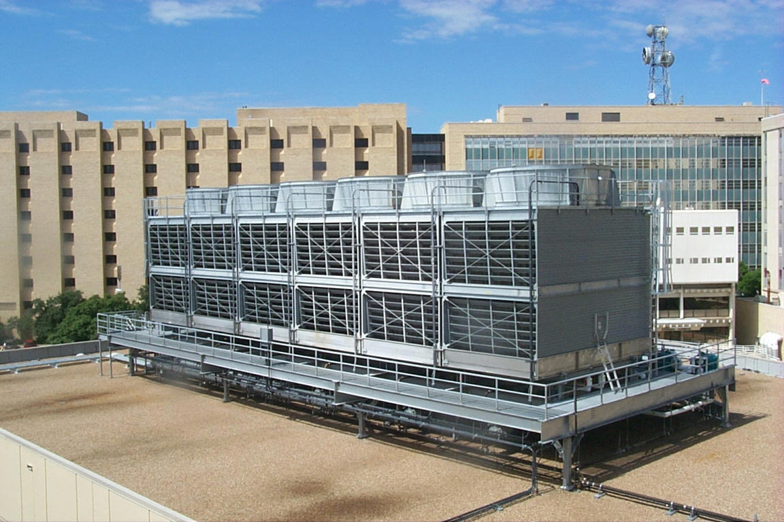
Heat Rejection Equipment Section C403.10
Each tower fan powered by a motor ≥ 7.5 hp must include variable speed or two speed fan
Have controls to automatically change the fan speed to control the leaving fluid temperature or condensing temperature/pressure of the heat rejection device
Exception:
Heat rejection devices where energy usage is included in the ratings in accordance with Tables C403.3.2(6) and C403.3.2(7)
Notes:
Each fan powered by a motor of 7.5 hp (5.6 kW) or larger to have the capability to operate that fan at two-thirds of full speed or less, and shall have controls that automatically change the fan speed to control the leaving fluid temperature or condensing temperature/pressure of the heat rejection device.

Slide 93
Heat Rejection Equipment Section C403.10 – General
Air-cooled condensers, dry coolers, open-circuit cooling towers, closes-circuit cooling towers, and evaporative condensers used for comfort cooling applications must comply with Section C403.9
Exception: heat rejection devices where energy usage is included in the equipment efficiency ratings listed in Tables C403.3.2(6) and C403.3.2(7)

Slide 94
Heat Rejection Equipment Section C403.10.1 – Fan Speed Control
Fan motors > 5hp must have
Controls that automatically modulate fan speed to control the leaving fluid temp. or condensing temp./pressure of the heat rejection device
Fan motor power input to be not more than 30% of design wattage or 50% of design airflow
Exception:
Condenser fans serving multiple refrigerant or fluid cooling circuits
Condenser fans serving flooded condensers

Slide 95
Heat Rejection Equipment Section C403.10.2 – Multiple-cell
Multiple-cell heat rejection equipment with variable speed fan drives to be controlled in both manners:
Operate the maximum number of fans allowed that comply with manufacturer’s requirements for all system components
So all fans can operate at the same fan speed required for the instantaneous cooling duty, as opposed to staged (on/off) operation
Minimum fan speed must be the minimum allowable speed of the fan drive system in accordance with manufacturer’s recommendations

Slide 96
Heat Rejection Equipment Section C403.10.3 – Limitation on Centrifugal Fan Open-circuit Cooling Towers
Centrifugal fan open-circuit cooling towers with combined rated capacity > 1,100 gpm at 95ºF condenser water return, 85ºF condenser water supply, 75ºF outdoor air wet-bulb temperature must meet the energy efficiency requirement for axial fan open-circuit cooling towers listed in Table C403.3.2(8)
Exception:
Centrifugal open-circuit cooling towers that are designed with inlet or discharge ducts or require external sound attenuation

Slide 97
Heat Rejection Equipment Section C403.10.4 – Tower Flow Turndown
Open-circuit cooling towers used on water-cooled chiller system that are configured with multiple or variable-speed condenser water pumps
Designed that all open circuit cooling tower cells can be run in parallel with the larger of
the flow that is produced by the smallest pump at its minimum expected flow rate OR
50% of the design flow for the cell

Slide 98
Heat Recovery for Service Hot Water Heating Section C403.10.5
Condenser heat recovery required for heating/reheating of SWH provided:
Facility operates 24 hours/day
Total installed heat capacity of the heat rejection of water-cooled systems >6,000,000 Btu/hr
Design SWH load >1,000,000 Btu/hr
Capacity to provide the smaller of
60% of peak heat rejection load at design conditions OR
Preheating to raise peak SWH to 85ºF
Exceptions:
Recovered heat is used for space heating or when 60% of SWH is heated by renewables or site recovered energy sources
Notes:
Concept: If there is waste heat in the building, it is to be used for potable water.
Exceptions: 1. Facilities that employ condenser heat recovery for space heating or reheat purposes with a heat recovery design exceeding 30% of the peak water-cooled condenser load at design conditions. 2. Facilities that provide 60% of their service water heating from site solar or site recovered energy or from other sources.

Slide 99
Refrigeration Equipment Performance Section C403.11
Performance determined per C403.11.1 and C403.11.2 for commercial refrigerators, freezers, refrigerator-freezers, walk-in coolers, walk-in freezers and refrigeration equipment
Energy use shall be verified through certification under an approved certification program or where a certification program does not exist, the energy use shall be supported by data furnished by the equipment manufacturer
Exception
Walk-in coolers and walk-in freezers regulated under Federal law per Subpart R of DOE 10 CFR 431

Slide 100
Commercial Refrigerators, Refrigerator-Freezers and Refrigeration Section C403.11.1
Equipment defined in DOE 10 CFR Part 431.62 to have energy use in kWh/day not greater than values in Table C403.11.1 when tested and rated per AHRI Standard 1200

Slide 101
Walk-in Coolers and Walk-in Freezers Section C403.11.2
As defined in DOE 10 CFR 431.302 to meet requirements of Tables C403.11.2.1(1)-(3)
Exception: Walk-in process cooling refrigeration systems
Performance standards to meet Tables C403.11.2.1(1)-(3)

Slide 102
Refrigeration Systems Section C403.11.3
Display cases, walk-in coolers or walk-in freezers served by remote compressors and remote condensers not located in a condensing unit must comply with Sections C403.11.3.1 and C403.11.3.2
Exception: Systems where the working fluid in the refrigeration cycle goes through both subcritical and supercritical states (transcritical) or that use ammonia refrigerant

Slide 103
Condensers Serving Refrigeration Systems Section C403.11.3.1
Fan-Powered Condensers
Design saturated condensing temperatures for air-cooled condenser not to exceed
design dry-bulb temp. plus 10ºF for low-temp. refrigeration systems
Design dry-bulb temp. plus 15ºF for medium temp. refrigeration systems where saturated condensing temp. for blend refrigerants should be determined using the average of liquid vapor temps. as converted from the condenser drain pressure
Condenser fan motors < 1 hp use electronically commutated motors, permanent split-capacitor-type motors or 3-phase motors

Slide 104
Condensers Serving Refrigeration Systems Section C403.11.3.1 – Cont’d
Air-cooled condensers, evaporatively cooled condensers, air- or water-cooled fluid coolers or cooling towers must reduce fan motor demand ≤ 30% of design wattage at 50% of design air volume, and incorporate one of the following continuous variable speed fan control approaches:
Control for air-cooled condensers must use variable setpoint control logic to reset the condensing temp. setpoint in response to ambient dry-bulb temp.
Control for evaporatively cooled condensers must use variable setpoint control logic to reset the condensing temp. setpoint in response to ambient wet-bulb temp.
Multiple fan condensers to be controlled in unison
Minimum condensing temp. setpoint ≤ 70ºF

Slide 105
Compressor Systems Section C403.11.3.2
Compressors and multiple-compressor system suction groups must include control systems that use floating suction pressure control logic to reset the target suction pressure temp. based on the temp. requirements of the attached refrigeration display cases or walk-ins:
Exception: controls are not required for:
Single-compressor system that do not have variable capacity capability
Suction groups that have:
a design saturated suction temp. of > 30ºF,
comprise the high stage of a two-stage or cascade system OR
primarily serve chillers for secondary cooling fluids

Slide 106
Compressor Systems Section C403.11.3.2 – Cont’d
Liquid subcooling must be provided for all low-temp. compressor systems with a design cooling capacity > 100,000 Btu/hr with a design-saturated suction temp. < -10ºF
Sub-cooled liquid temp. to be controlled at max. temp. setpoint of 50ºF at the exit of the subcooler using either compressor economizer ports or a separate compressor suction group operating at a saturated suction temp. >18ºF
Insulation for liquid lines with a fluid operating temp. < 60ºF must comply with Table C403.11.3
Compressors that incorporate internal or external crankcase heaters must provide a means to cycle the heaters off during compressor operation

Slide 107
Duct and Plenum Insulation & Sealing Section C403.12.1
Insulation required for supply and return ducts and plenums
Located in unconditioned space:
minimum R-6
Duct located outside the building; duct or plenum within building envelope assembly shall be separated from building exterior or unconditioned or exempt spaces:
minimum R-8, Climate Zones 0-4
minimum R-12, Climate Zones 5-8
Underground ducts (beneath buildings) insulated as required by this section or have equivalent thermal distribution efficiency
Underground ducts utilizing thermal distribution efficiency method to be listed and labeled with R-value equivalency
Exceptions:
When located within equipment
When design temperature difference between interior and exterior of the duct or plenum doesn’t exceed 15ºF
Notes:
When located within a building envelope assembly, the duct or plenum shall be separated from the building exterior or unconditioned or exempt spaces by a minimum of R-8 insulation.
Separation from an unconditioned space has a higher requirement than a duct in an unconditioned space because the ductwork insulation is taking the place of the envelope insulation.
All ducts, air handlers and filter boxes shall be sealed. Joints and seams shall comply with Section 603.9 of the International Mechanical Code.
Duct Construction: ductwork shall be constructed and erected in accordance with IMC

Slide 108
Low & Medium Pressure Duct Systems Sections C403.12.2.1 and C403.12.2.2
C403.12.2.1 Low Pressure: Ducts designed to operate at static pressures ≤ 2 in. w.g.
Securely fastened and sealed
Exception: Locking-type longitudinal joints and seams, other than the snap-lock and button-lock types, need not be sealed as specified in this section.
C402.12.2.2 Medium Pressure: Ducts designed to operate at static pressures > 2 in. w.g. but < 3 in. w.g.
Insulated and sealed in accordance with Section C403.12.1
Notes:
Low-pressure duct systems. All longitudinal and transverse joints, seams and connections of supply and return ducts operating at a static pressure less than or equal to 2 inches w.g. (500 Pa) shall be securely fastened and sealed with welds, gaskets, mastics (adhesives), mastic-plus-embedded-fabric systems or tapes installed in accordance with the manufacturer’s installation instructions. Pressure classifications specific to the duct system shall be clearly indicated on the construction documents in accordance with the International Mechanical Code.
Exception:
Locking-type longitudinal joints and seams other than the snap-lock and button-lock types need not be sealed as specified in this section
Medium-pressure duct systems. Insulated and sealed in accordance with Section C403.2.9.
In both cases, pressure classifications specific to the duct system shall be clearly indicated on the construction documents in accordance with the International Mechanical Code.

Slide 109
High Pressure Duct Systems Section C403.12.2.3
Ducts and plenums designed to operate at static pressures > 3 in. w.g. to be
insulated and sealed
be leak tested in accordance with SMACNA HVAC Air Duct Leakage Test Manual with the following result
Air leakage rate (CL) ≤ 4.0
CL = F/P^{0.65}
Where:
F = leakage rate cfm per 100 sf of duct surface area
P = the static pressure of the test
Must document test of ≥ 25% of the duct area and meet the requirements

Slide 110
Piping Insulation Section C403.12.3
All piping serving heating or cooling system must be insulated in accordance with Table C403.12.3
Minimum Pipe Insulation
(thickness in inches)
(Partial table)
11.3.1: Piping insulation exposed to weather shall be protected from sun or moisture damage
Notes:
Table Footnotes:
a. For piping smaller than 11/2 inch (38 mm) and located in partitions within conditioned spaces, reduction of these thicknesses by 1 inch (25 mm) shall be permitted (before thickness adjustment required in footnote b) but not to a thickness less than 1 inch (25 mm).
b. For insulation outside the stated conductivity range, the minimum thickness (T) shall be determined as follows:
T = r{(1 + t/r)K/k – 1}
where:
T = minimum insulation thickness,
r = actual outside radius of pipe,
t = insulation thickness listed in the table for applicable fluid temperature and pipe size,
K = conductivity of alternate material at mean rating temperature indicated for the applicable fluid temperature (Btu × in/h × ft2 × °F) and
k = the upper value of the conductivity range listed in the table for the applicable fluid temperature.
c. For direct-buried heating and hot water system piping, reduction of these thicknesses by 11/2 inches (38 mm) shall be permitted (before thickness adjustment
required in footnote b but not to thicknesses less than 1 inch (25 mm).

Slide 111
Piping Insulation Section C403.12.3 – Cont’d
Exceptions to pipe insulation requirements:
Piping internal to HVAC equipment (including fan coil units) factory installed and tested
Piping for fluid in temperature range
60 °F< temp < 105°F
Piping for fluid not heated or cooled by electricity or fossil fuels
Strainers, control valves, and balancing valves associated with piping ≤ 1” in diameter
Direct buried piping for fluids ≤ 60°F
In radiant heating systems, sections of piping intended by design to radiate heat

Slide 112
Heating Outside a Building Section C403.13.1
Systems are to be radiant systems
Controlled by an occupancy sensing device or timer switch
So system is automatically deenergized when no occupants are present
Notes:
Examples may be heating loading docks, hotel taxi waiting areas, or patios in restaurants. This is one of the few examples in the code where a specific technology (i.e., radiant heating) is required. Typically the code only mentions performance requirements.

Slide 113
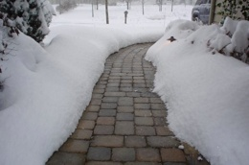
Snow Melt Systems Section C403.13.2
Snow- and ice-melting systems, supplied through energy service to the building, shall include
automatic controls configured to shut off the system when the pavement temperature is above 50°F (10°C) and no precipitation is falling
an automatic or manual control configured to shut off when the outdoor temperature is above 40°F (4°C)
Photo courtesy of Ken Baker, K energy

Slide 114
Freeze Protection System Section C403.13.3
Systems such as heat tracing of outdoor piping and heat exchangers, including self-regulated heat tracing to include:
Automatic controls configured to shut off the system when outdoor air temperatures are > 40°F (4°C) OR
When conditions of the protected fluid will prevent freezing

Slide 115
Operable Opening Interlocking Controls Section C403.14
Heating and cooling systems to have controls that will interlock to the set temperatures of 90F cooling and 55F heating when conditions of C402.5.8 exist
Controls configure to shut off systems entirely when outdoor temperatures are below 90F or above 55F

Slide 116
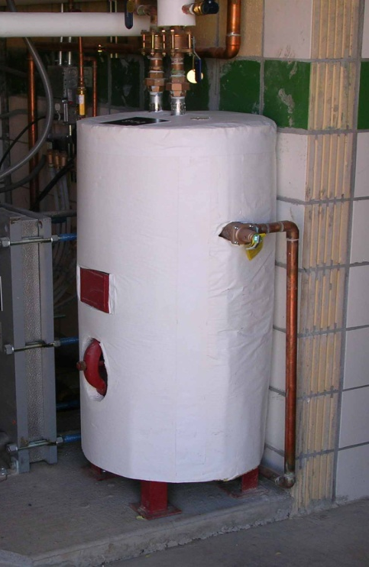
Service Water Heating Section C404
Table C404.2 Minimum Performance of Water-Heating Equipment
Water Heater Types Covered
Electric Storage
Gas and Oil Storage
Instantaneous Water Heaters – Gas and Oil
Hot water boilers – gas and oil
Pool heaters
Unfired storage tanks
Heat Traps (C404.3)
Piping Insulation (C404.4)
Heated Water Supply Piping(C404.5)
Circulation & Temperature Maintenance (C404.6)
Drain Heat Recovery(C404.7)
Pools and Spas (C404.8)
Portable Spas (C404.9)
All service water heating items are mandatory

Slide 117
Service Water-heating Equipment Performance Section C404.2
Water-heating equipment and hot water storage tanks must meet Table C404.2
Efficiency verified through data furnished by manufacturer of equipment or through certification under an approved certification program
Water-heating equipment intended to be used to provide space heating must meet Table C404.2

Slide 118
High Input-rated SWH Systems Section C404.2.1
Gas-fired equipment installed in new buildings
Single piece serves entire building with input rating ≥ 1,000,000 Btu/h
Thermal efficiency ≥90%
Multiple pieces with combined input rating ≥ 1,000,000 Btu/h
Combined input-capacity-weighted-average thermal efficiency ≥92%
Exceptions:
25% of annual SWH requirement is provided by on-site renewable energy or site-recovered energy
Input rating of water heaters installed in individual dwelling units
Individual units with input rating ≤ 100,000 Btu/h not considered part of building SWH equipment

Slide 119
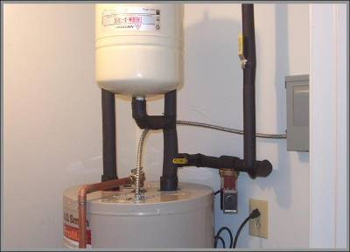
Heat Traps Section C404.3
Storage tank-type water heaters and hot water storage tanks that have vertical water pipes connecting to inlet and outlet to be provided integral heat traps at those inlets and outlets or have pipe-configured heat traps in piping connected to those inlets and outlets
Tank inlets and outlets associated with solar water heating system circulation loops not required to have heat traps

Slide 120
Insulation of Piping Section C404.4
Piping from water heater to termination of heated water fixture supply pipe (all recirculation piping) to be insulated per Table C403.12.3
Both inlet and outlet piping of storage water heater or heated water storage tank
Piping to a heat trap or first 8 ft. of piping, whichever is less
Piping that is heat traced per Table C403.12.3 or heat trace manufacturer instructions
Tubular piping insulation installed in accordance with insulation manufacturer’s instructions
Insulation to be continuous
Except where piping passes through a framing member
Minimum insulation thickness not to supersede any greater insulation thickness requirements necessary for the protection of piping from freezing temps. or personnel against external surface temps. on the insulation

Slide 121
Insulation of Piping Section C404.4 – Cont’d
Exceptions to SHW piping insulation:
Tubing from the connection at the termination of the fixture supply piping to a plumbing fixture or plumbing appliance
Valves, pumps, strainers and threaded unions in piping that is ≤1” in nominal diameter
Piping from user-controlled shower and bath mixing valves to the water outlets
Cold-water piping of demand recirculation water system
Tubing form hot drinking-water heating unit to the water outlet
Piping at locations where a vertical support of the piping is installed
Piping surrounded by building insulation with a thermal resistance ≥ R-3

Slide 122
Heated Water Supply Piping Section C404.5
For piping from the nearest source of heated water (from the water heater or from the recirculation or trace heated loop) to fixture requires either maximum pipe length (C404.5.1) or maximum pipe volume (C404.5.2) and has maximum flow rated by size
Flow rate through ¼” piping should be ≤ 0.5 gpm
Flow rate through 5/16” piping should be ≤ 1.0 gpm
Flow rate through 3/8” piping should be ≤ 1.5 gpm
Intent is to reduce wasting previously-heated water that has cooled in pipes that do not require insulation
Notes:
The take-offs to the fixtures are not part of a recirculation loop

Slide 123
Maximum Allowable Pipe Length Method Section C404.5.1
Maximum allowed piping length from nearest source of heated water to termination of the fixture supply pipe:
Where piping contains more than one size, the largest size of pipe within the piping shall be used for determining the max. allowable length of piping in Table C404.5.1
Public lavatory faucet, use “Public Lavatory faucets” column in Table C404.5.1
All other plumbing fixtures and plumbing appliances use “Other fixtures and appliances” column in Table C404.5.1
Notes:
Employee-only toilets are considered public lavatories when not a single-user toilet accessed through a private office

Slide 124
Maximum Allowable Pipe Volume Method Section C404.5.2
Water heaters, circulating water systems, and heat trace temp. maintenance systems to be considered sources of heated water
Volume from the nearest source of heated water to the termination of the fixture supply pipe as follows:
Public lavatory facet: ≤ 2 ounces
Other plumbing fixtures or plumbing appliances: ≤ 0.5 gallon

Slide 125
Water Volume Determination Section C404.5.2.1
Volume to be the sum of the internal volumes of pipe, fittings, valves, meters and manifolds between the nearest source of heated water and the termination of the fixture supply pipe
Volume determined from the “Volume” column in Table
Volume contained with fixture shutoff valves, within flexible water supply connectors to a fixture fitting and within a fixture fitting should not be included in the water volume determination
Heated water supplied by recirculating system or heat-traced piping, the volume should include the portion of the fitting on the branch pipe that supplies water to the fixture

Slide 126
Heated-water Circulating and Temperature Maintenance Sys. Section C404.6
Circulation Systems
Controlled pump(s) required
Demand control required (see C404.7)
Gravity and thermosyphon not allowed
Heat Trace Systems
Energy input adjusted to maintain temperature
Timed or demand automatic controls
Controls for Hot Water Storage Tank Pumps
Automatic controls limit pump operation to no more than 5 minutes after heater operation
Automatic controls, temperature sensors and pumps shall be in a location with access
Manual controls shall be in a location with ready access
Notes:
Add notes for each section

Slide 127
Demand Recirculation Controls Section C404.6.1.1
Systems with >1 recirculation pumps that pump water from a heated-water supply pipe back to the heated-water source through a cold-water supply pipe must be a demand recirculation water system
Demand recirculation water systems to have controls that:
Start pump upon receiving a signal from the action of a user of a fixture or sensing the presence of a user of a fixture, or sensing the flow of hot or tempered water to a fixture fitting or appliance

Slide 128
Drain Water Heat Recovery Units Section C404.7
Must comply with CSA B55.2
Potable water-side pressure loss < 10 psi at maximum design flow
Group R occupancies, units must meet efficiency in accordance with CSA B55.1
Note that this provision does not require the use of drain water heat recovery units; it just specifies their performance if used

Slide 129
Energy Consumption of Pools and Permanent Spas Section C404.8
Heaters (C404.8.1)
Readily accessible on-off switch, that is an integral part of heater, mounted on the exterior of heater or external to within 3 feet of heater in a location with ready access
Switch should not change the setting of the heater thermostat
Switches to be in addition to a circuit breaker for the power to the heater
Natural gas or LPG fired pool heaters will not have continuously burning pilot lights
Time switches or other control method (C404.8.2)
Automatic controls required to control heaters and pumps on a preset schedule
Exceptions:
Where public health standards require 24 hour operation
Where pumps are required to operate solar and waste heat recovery pool heating systems
Note: heaters, pumps and motors with built-in timers meet this requirement
Notes:
Pool heater - added LPG

Slide 130
Covers Section C404.8.3
Outdoor heated pools and outdoor permanent spas required to have a cover
Cover must be vapor-retardant
Or other approved vapor-retardant means
Exception:
Pools deriving > 75% of operating season (of not fewer than 3 calendar months) energy for heating from from heat pump or on-site renewable energy system

Slide 131
Additional Efficiency Credit Requirements Section C406
New buildings need 10 credits from Tables C406.1(1) – (5)
Table selected based on use group of the building and credit calculations
Where building contains multiple use groups, credits from each use group to be weighted by floor area of each group to determine weighted average building credit
Credits from tables or calculation to be achieved where building complies with one ore more of the following
More efficient HVAC performance
Reduced lighting power
Enhanced lighting controls
On-site supply of renewable energy
Provision of dedicated outdoor air system for certain HVAC equipment
High-efficiency service water heating
Enhanced envelope performance
Reduced air infiltration
Where not required by C405.12, include energy monitoring system
Where not required by C403.2.3, include fault detection and diagnostics system
Efficient kitchen equipment
Notes:
Old extra efficiency options in C406 were based on “pick one” approach
New extra efficiency made several changes
Assigned “credits” to each item by climate zone and building type
General goal was to equalize savings achieved
10 credit requirement represents about 2.5% total building energy cost savings
Modifications to existing credits
HVAC split to heating and cooling separately with 5% and 10% efficiency improvements
Lighting allows added credits above 15% LPD reduction
Credits for sleeping/dwelling unit lighting efficacy

Slide 132
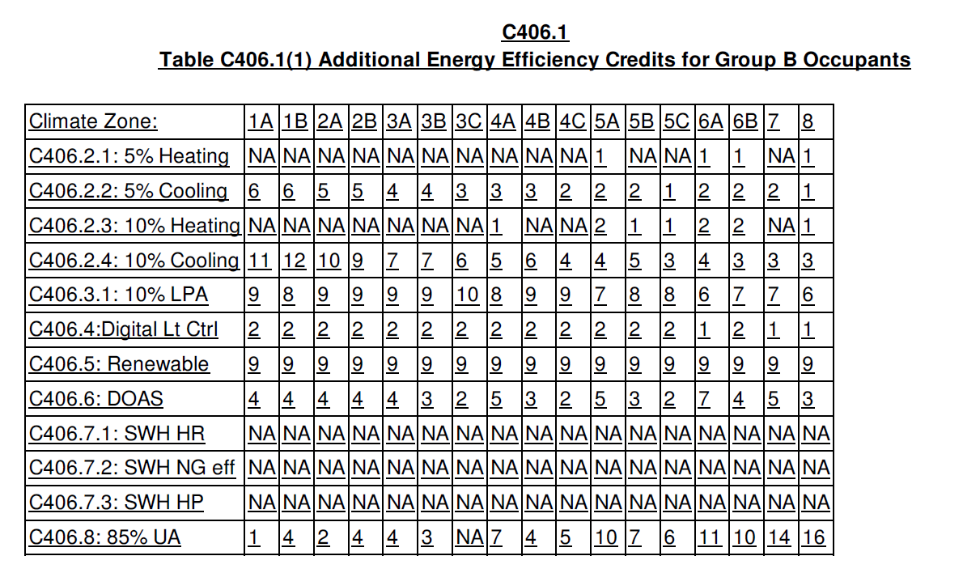
Energy Credit Table Example
Most credits table based, some are formulas
Separate tables:
Office (Group B)
Multifamily (R) & Institutional (I)
Schools (E)
Retail (M)
Other than above
Uniform Target
10 credits = 2.5% cost savings
Tenant infill
5 Credits
Tables expanded with added credits

Slide 133
Additional Efficiency Credit Requirements Section C406
More efficient HVAC performance per C403.3.2 tables
Variable refrigerant flow systems listed in energy efficiency provisions of 90.1 per C406.21, C406.2.2, C406.2.3 or C406.24 shall also meet applicable requirements of C403
Heating – selected from C406.2.1 or C406.2.3; Cooling – selected from C406.2.2, C406.2.4, or C406.2.5. Selected credits to include a heating or cooling energy efficiency credit or both.
Equipment not listed in tables and variable refrigerant flow systems in energy efficiency provisions of 90.1 to be limited to 10% of total building system capacity
5% heating efficiency improvement
5% cooling efficiency improvement
10% heating efficiency improvement
10% cooling efficiency improvement
More than 10% cooling efficiency improvement
Reduced lighting power by more than 10%
Reduced lighting power by more than 10%
Reduced lighting power by more than 15%
Lamp efficacy

Slide 134
Additional Efficiency Credit Requirements Section C406
Enhanced digital lighting controls per C406.4, controls located and operated in accordance with C405.2.1 – C405.2.3:
Luminaires capable of continuous dimming
Luminaires capable of being addressed individually OR a controlled group of < 4 luminaires
< 8 luminaires controlled together in a daylight zone
Fixtures controlled through digital control system that includes the following function:
Control reconfiguration based on digital addressability
Load shedding
Occupancy sensors capable of being reconfigured through the digital control system
Construction documents including submittal of Sequence of Operations including specs outlining each function of the fixture requirements above
Functional testing of controls comply with C408

Slide 135
Additional Efficiency Credit Requirements Section C406
On-site renewable energy per C406.5
Basic renewable credit
Total minimum ratings to
Provide ≥ 0.86 Btu or ≥ 0.25 watts per ft² of conditioned floor area OR
Provide ≥ 2% of energy used for mechanical and SWH equipment and lighting
Enhanced renewable credit
Total minimum ratings exceed rating in C406.5.1
Additional energy efficiency credits determined by calculation
Dedicated outdoor air system per C406.6
Be equipped with an independent ventilation system designed to provide <100% outdoor air to each occupied space
Ventilation system capable of total energy recovery
HVAC system include supply-air temperature controls that automatically reset the supply-air temp. in response to building loads or outdoor air temperatures
Controls reset the supply-air temp. at least 25% of the difference between design supply-air temp. and design room-air temp.

Slide 136
Additional Efficiency Credit Requirements Section C406
Reduced energy use in SWH per C406.7
Buildings with the following types qualify for credits:
Group R-1: Boarding houses, hotels, or motels
Group I-2: Hospitals, psychiatric hospitals, and nursing homes
Group A-2: Restaurants and banquet halls or buildings containing food preparation areas
Group F: Laundries
Group R-2
Group A-3: Health clubs and spas
Group E: Schools with full-service kitchens or locker rooms with showers
Buildings showing a service hot water load of >10% of total building energy loads as shown with an energy analysis per C407

Slide 137
Additional Efficiency Credit Requirements Section C406
Recovered or renewable water heating:
Building SWH system has >1 of the following sized to provide > 30% of building’s annual hot water requirements or sized to provide 70% of building’s annual hot water requirements if building complies with C403.10.5
Waste heat recovery from service hot water, heat recover chillers, building equipment, process, equipment, or combined heat and power system
On-site renewable energy water-heating systems
Efficient fossil fuel water heater
Combined input-capacity weighted-average equipment rating of all fossil fuel water-heating equipment > 95% Et or 0.95 EF
This option receives only half the listed credits for buildings required to comply with C404.2.1
Heat pump water heater
Where electric resistance water heaters are allowed, all SHW system heating requirements to be met using heat pump technology with combined input-capacity weighted-average EF 0f 3.0
Air-source heat pump water heaters to not draw conditioned air from within the building, except exhaust air that would otherwise be exhausted to exterior
Enhanced Envelope Performance
Total UA of building thermal envelope as designed to be not less than 15% below total UA of building thermal envelope per Section C402.1.5

Slide 138
Additional Efficiency Credit Requirements Section C406
Reduced Air Infiltration
Air infiltration verified by whole-building pressurization test
Per ASTM E779 or ASTM E1827
By independent third party
Measured air-leakage rate not to exceed 0.25 cfm/ft² under pressure differential of 0.3 inches w.c. (75 Pa), with calculated surface area the sum of above- and below-grade building envelope
Submit report to code official and building owner
Including: tested surface area, floor area, air by volume, stories above grade, and leakage rates
Exception: Buildings over 250,000 ft² of conditioned floor area don’t need testing on whole building, can test representative above-grade sections. Tested areas to total not less than 25% of conditioned floor area and tested per C406.9

Slide 139
Additional Efficiency Credit Requirements Section C406
Energy monitoring – buildings equipped to measure, monitor, record and report energy consumption data
Electrical energy metering – For all electrical energy supplied to building and associated site – meters or other measurement devices to be provided to collect energy consumption data for each end-use category required by C406.10.2.
End-use metering categories – Per Table C406.10.2
Meters to have capability to collect energy consumption data for whole building or each separately metered portion of the building
Where multiple meters are used to measure any end-use category, data acquisition system to total all of the energy used by that category
< 5% of measured load for each end-use category in Table 4016.10.2 permitted to be from a load not within the category
Exceptions
HVAC and water-heating equipment serving only an individual dwelling unit
End-use metering not required for fire pumps, stairwell pressurization fans or any system operating only during testing or emergency

Slide 140
Additional Efficiency Credit Requirements Section C406
Meters – configured to automatically communicate energy consumption data to data acquisition system
Source meters – allowed to be any digital-type meter
Lighting, HVAC or other building systems that can monitor their energy consumption are permitted instead of meters
Current sensors permitted provided they have a tested accuracy of +/- 2%
Required metering systems and equipment to have capability to provide at least hourly data that is fully integrated into the data acquisition system and graphical energy report per C4016.10.4 and C406.10.5
Data acquisition system – have capability to store data for a minimum of 36 months
Have capability to store real-time energy consumption data and provide hourly, daily, monthly and yearly logged data for each end-use category required by C406.10.2
Graphical energy report – permanent and readily accessible reporting mechanism to be provided in that building (accessible to building operation and management personnel)
Capability to graphically provide energy consumption for each end-use category required by C406.10.2 at least every hour,d ay, month and year for previous 36 months

Slide 141
Additional Efficiency Credit Requirements Section C406
Fault detection and diagnostics system – installed to monitor HVAC system performance and automatically identify faults. Must do all of the following:
Including permanently installed sensors and devices to monitor HVAC system performance
Sample HVAC system performance at least once every 15 minutes
Automatically identify and report HVAC system faults
Automatically notify authorized personnel of identified HVAC system faults
Automatically provide prioritized recommendations for repair of identified faults based on analysis of data collected from sampling of the HVAC system performance
Be capable of transmitting the prioritized fault repair recommendations to remotely located authorized personnel
Efficient kitchen equipment – Group A-2 or facilities that include commercial kitchen with at least one gas or electric fryer, all fryers, dishwashers, steam cookers and ovens to comply with the following:
Achieve performance levels in Tables C406.12(1)-(4) rated per applicable test procedures
Be installed prior to issuance of Certificate of Occupancy
Have associated performance levels listed on construction documents submitted for permitting
Credits for efficient kitchen equipment independent of climate zone and determined based on equation

Slide 142
Maintenance Information and System Commissioning Section C408.1.1
Building operations and maintenance information
Documents provided to owner and consist of
Manufacturers’ information
Specifications and recommendations
Programming procedures and data points
Narratives
And other means of illustrating how the building, equipment and systems are intended to be installed, maintained and operated
Required regular maintenance actions for equipment and systems to be clearly stated on a readily visible label
Label to include title or publication number for the operation and maintenance manual for that particular model and type of product

Slide 143
Mechanical Systems and SWH Commissioning and Completion Section C408.2
Prior to passing final mechanical and plumbing inspection
Registered design professional or approved agency to provide evidence of commissioning and completion
Construction document notes to clearly indicate provisions for commissioning and completion requirements
Permitted to refer to specifications
Copies of all documents to be provided to the owner and made available to code official upon request

Slide 144
Mechanical Systems Commissioning and Completion Requirements Section C408.2 Exceptions
These systems are exempt from commissioning requirements
In buildings where total mechanical equipment capacity is < 480,000 Btu/h (40 tons) cooling capacity and < 600,000 Btu/h combined service water heating and space-heating capacity
Included in Section C403.3 that serve individual dwelling units and sleeping units

Slide 145
Commissioning Plan Section C408.2.1
Developed by registered design professional or approved agency and include:
Narrative description of activities to be accomplished during each phase of commissioning
Including personnel who will do each activity
Listing of specific equipment, appliances or systems to be tested and description of tests to be performed
Functions to be tested, including, but not limited to calibrations and economizer controls
Conditions under which test will be performed
At a minimum, testing will affirm winter and summer design conditions and full outside air conditions
Measurable criteria for performance

Slide 146
Systems Adjusting and Balancing Section C408.2.2
HVAC systems balanced per generally accepted engineering standards
Air and water flow rates measured and adjusted to deliver final flow rates within tolerances in product specifications
Test and balance activities to include air system and hydronic system balancing

Slide 147
Air Systems Balancing Section C408.2.2.1
Each supply air outlet and zone terminal device equipped with means for air balancing per Chapter 6 of the IMC
No discharge dampers used for air-system balancing on constant volume fans and variable volume fans with motors ≥ 10 hp
Air systems balanced in a manner to first minimize throttling losses, then, for fans with system power > 1hp, fan speed adjusted to meet design flow conditions
Exception – fans with motors ≤ 1hp are not required to have a means for air balancing
Notes:
Note that Section 608.1 of the IMC requires testing and balancing even if commissioning is not required

Slide 148
Hydronic Systems Balancing Section C408.2.2.2
Individual hydronic heating and cooling coils equipped with means for balancing and measuring flow
Hydronic systems proportionately balanced in a manner to first minimize throttling losses, then pump impeller to be trimmed or pump speed to be adjusted to meet design flow conditions
Each hydronic system to have either capability to measure pressure across the pump, or test ports at each side of each pump
Exceptions with a means for balancing or measuring flow:
Pumps with pump motors ≤ 5hp
Where throttling results in ≤ 5% of nameplate hp draw above that required if the impeller were trimmed

Slide 149
Functional Performance Testing - Equipment Section C408.2.3.1
To demonstrate the installation and operation of components, systems, and system-to-system interfacing relationships in accordance with approved plans and specifications, such that operation, function, and maintenance serviceability for each of the commissioned systems is confirmed
Testing to include all modes and sequence of operation, including under full-load, part-load and the following emergency conditions:
All modes as described in the sequence of operation
Redundant or automatic back-up mode
Performance of alarms, and
Mode of operation upon a lost off power and restoration of power
Exception – unitary or packaged HVAC equipment listed in C403.3.2 that don’t require supply air economizers

Slide 150
Functional Performance Testing – Controls & Economizers Sections C408.2.3.2 & C408.2.3.3
HVAC and SWH control systems to be tested to document that control devices, components, equipment, and systems are calibrated, adjusted and operate in accordance with approved plans and specifications
Sequences of operation to be functionally tested to document they operate in accordance with approved plans and specifications
Air economizers to undergo a functional test to determine they operate in accordance with manufacturer’s specifications

Slide 151
Preliminary Commissioning Report Section C408.2.4
Registered design professional or approved agency to complete, certify, and submit to the building owner or owner’s authorized agent
Report to be organized with mechanical and service hot water findings in separate sections to allow independent review. Report shall include Commissioning Compliance Checklist (Figure C408.2.4) and be identified as “Preliminary Commissioning Report” and will identify:
Itemization of deficiencies found during testing that haven’t been corrected at the time of report preparation
Deferred tests that can’t be performed at the time of report preparation due to climatic conditions
Climatic conditions required for performance of deferred tests
Results of functional performance tests
Functional performance test procedures used during commissioning process, including measurable criteria for test acceptance
Notes:
Organization is to allow mechanical and plumbing inspectors easy separate review of the report

Slide 152
Preliminary Commissioning Report – Acceptance and Copy of Report Sections C408.2.4.1, C408.2.4.2
Buildings or portions of buildings can’t pass final mechanical inspection until code official has received the Preliminary Commissioning Report from the building owner or owner’s authorized agent

Slide 153
Documentation Requirements Section C408.2.5
Construction documents to specify that documents described in C408.2.5 be provided to building owner or owner’s authorized agent within 90 days of receipt of certificate of occupancy
C408.2.5.1 System balancing report per Section C408.2.2
descriptions of the activities and
measurements completed
C408.2.5.2 Final commissioning report with
Functional test results
Disposition of deficiencies found during testing
Functional performance test procedures
Exception – deferred tests which can’t be performed at time of report preparation due to climatic conditions

