Slide 1






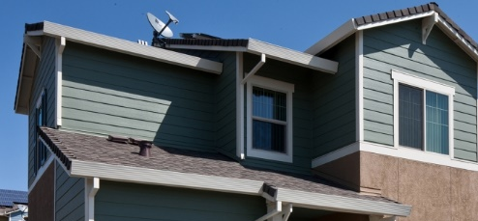
Building Energy Codes 101
April 2023

Slide 2





What are Building Energy Codes?
Building energy codes and standards set efficiency requirements for new and renovated buildings, enabling reductions in energy use and emissions over the building life.
States or local governments can choose to adopt one of the national model energy codes, a modified version of the model code, or develop their own state-specific code.
Energy codes are part of the broader set of building codes, including fire, electrical, structural, and plumbing.
Energy codes are different than appliance and equipment standards. However, there is some overlap between the two.

Slide 3






From 2010-2040, model energy codes are projected to save
  $138 billion
  energy cost savings
  900 MMT
  of CO² emissions
  13.5 quads
  primary energy
These savings equate to the annual emissions of
195 million passenger vehicles
227 coal power plants
108 million homes
Notes:
Source: https://www.energycodes.gov/impact-analysis
Building energy codes govern up to 80% of a building's energy load and increase energy efficiency and yield significant savings for the U.S. economy.
It is estimated that by 2035, 75% of the building stock in the U. S. will be new or renovated.
Building energy codes present a unique opportunity to assure savings through efficient building design, technologies, and construction practices
For perspective, the primary energy consumption of the entire U.S. commercial and residential sectors in 2020 was estimated at 38 quads.

Slide 4
Benefits of Building Energy Codes
The latest model energy codes are over 30% more efficient than many state codes.
Building Owners
Buildings constructed to the latest standards are more comfortable, cost-effective, and resilient.
Homeowners and Occupants
Homes have lower utility bills, are more comfortable and resilient, and have lower environmental impact.
Construction industry
Only buildings built to the latest codes represent the latest technologies and construction standards.
Building officials
The public is protected and benefits when buildings are constructed to the latest codes and building standards.
Utilities
Cost-benefit data is accessible for attribution of savings to efficiency programs
State & Local governments
Codes help achieve reductions in energy demand and GHG emissions
Who benefits from energy codes?
Notes:
Source: https://www.energy.gov/eere/buildings/articles/building-energy-codes-fact-sheet
https://www.energycodes.gov/why-building-energy-codes

Slide 5
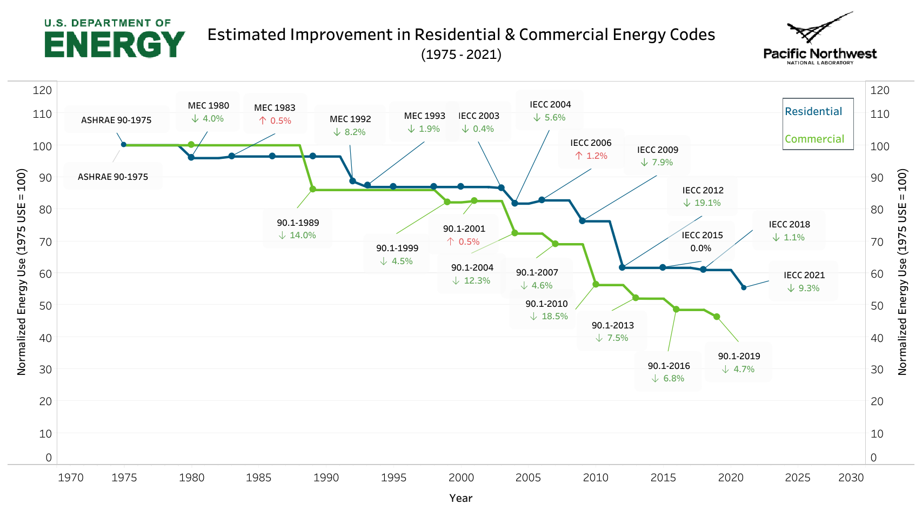
Background and Historical Context
Building energy codes have reduced building energy use for over 40 years

Slide 6



Types of Model Building Energy Codes
National model energy codes are developed by ASHRAE and ICC.
DOE develops & submits code change proposals that strive to make cost-effective, energy efficient upgrades.
ASHRAE Standard 90.1
Commercial Model Code
Application: Commercial buildings and multifamily buildings 4-stories or greater
Development: Every three years approved addenda to the current edition are aggregated and incorporated into a new edition of Standard 90.1.
  International Energy Conservation Code (IECC) Residential Model Code
Application: All residential buildings 3-stories or less
Development: The IECC is revised every three years through the ICC’s standard development process.
Notes:
https://www.energycodes.gov/codes-101
https://www.energycodes.gov/stretch-codes

Slide 7



Key Stakeholders
Implementation
States & Local Governments
Non-profits
Code Officials
Builders
Designers
Trade Associations
Utilities
ASHRAE & ICC
Development
Adoption
7

Slide 8

Energy Code Adoption
How it Works
Most codes are adopted at the state level, though, in about 10 states they are adopted by local jurisdictions.
State adoption can occur directly by legislative action, or through regulatory agencies authorized by the legislature.
Once adopted, the code becomes law within the particular state or local jurisdiction.
Code Development
Code is Adopted
Effective Date
Compliance

Slide 9



Energy Code Compliance
How it Works
All new and renovated existing buildings are required to achieve compliance with the state/local energy code.
Education and training supports code compliance among design and construction professionals, particularly after a new code is adopted.
Enforcement is almost always done by building permit office staff at the local level who typically review plans first to ensure they are compliant and then conduct field inspections to verify that the plans are followed during construction.

Slide 10
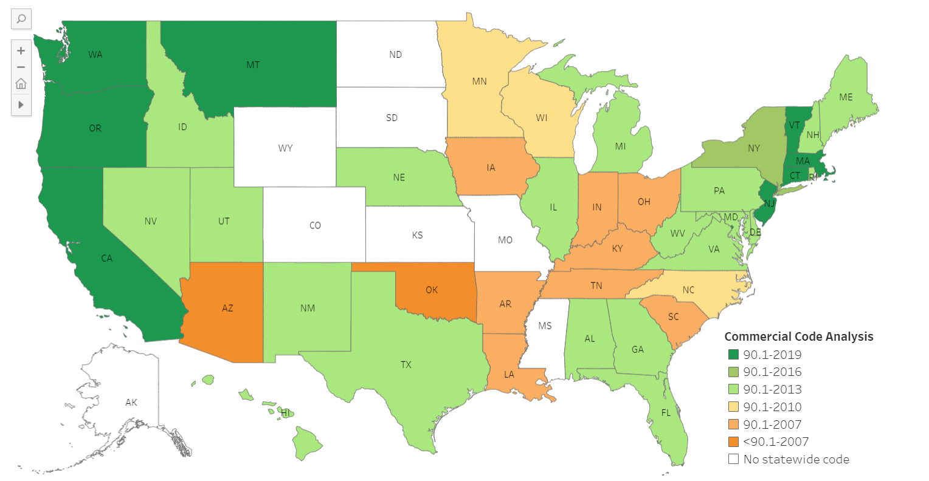
Current State Adoption Status: Commercial

Slide 11
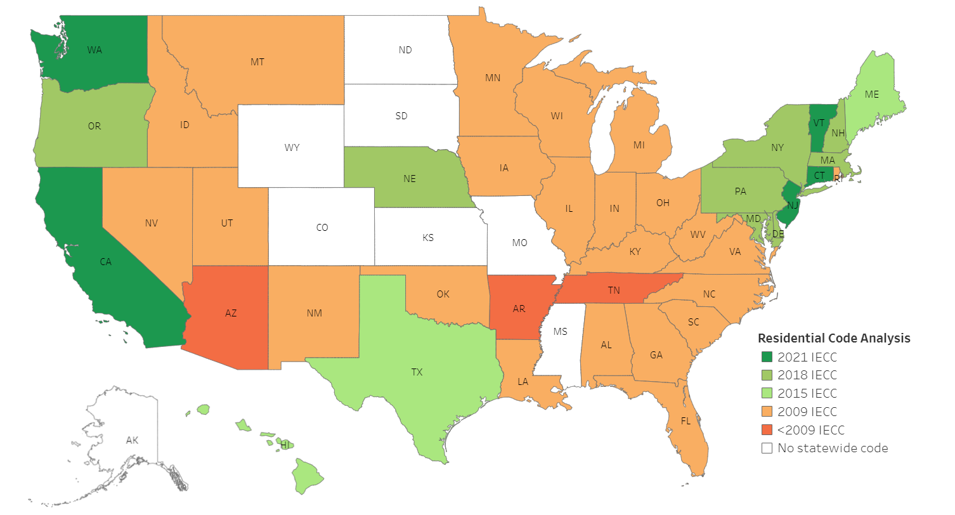
Current State Adoption Status: Residential

Slide 12
Stretch Codes
A stretch code is a locally mandated code or alternative compliance path that is more aggressive than base code, resulting in buildings that achieve higher energy savings.
DOE and PNNL are developing a series of technical briefs which can be incorporated as “plug-ins” to building energy codes. Many of these align with existing EERE programs and initiatives.
EV charging
Simplified HVAC system performance
Energy credits
Electric readiness
Grid-interactive efficient buildings
Plug-ins are available for adoption by state and local governments, as well as for incorporation into future model codes (editions of the IECC and Standard 90.1).
Notes:
https://newbuildings.org/code_policy/utility-programs-stretch-codes/stretch-codes/
https://www.energycodes.gov/stretch-codes

Slide 13
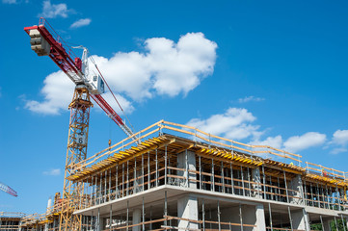


Building Energy Codes Program
To support building energy code development, adoption, implementation and enforcement processes to achieve the maximum practicable, cost-effective improvements in energy efficiency and decarbonization while providing safe, healthy buildings for occupants.
The Building Energy Codes Program is directed to:
  Participate in industry processes to develop model building energy codes
  Issue determinations as to whether updated codes result in energy savings
  Promulgate standards for federal buildings
  Provide technical assistance to states to implement their energy codes
Mission
Directive
Notes:
https://www.energycodes.gov/about

Slide 14



What is DOE’s Role in Energy Codes?
Development
Adoption
Implementation
Review technical and economic feasibility of model codes
Provide technical assistance to state & local governments
Provide tools to simplify & clarify compliance
Conduct assessments to determine if new codes save energy
Partner with others who provide support for state and local code advancement and implementation
Provide free education, training & resources
Develop methods for determining energy & cost savings
Participate in industry processes to review & update model codes
Convene stakeholder forums & develop next-gen standards
14

Slide 15
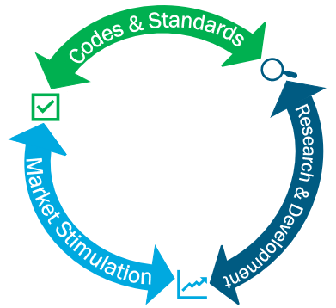









How does BECP support the mission of BTO and EERE?
Increasing Energy Efficiency & Building Decarbonization
Developing advanced codes & standards built on cost-effective technologies
Leading By Example
Updating federal standards to ensure they’re aligned with the latest design and construction practices
Realizing the Benefits of Codes
Supporting states and local governments to implement updated energy codes
Developing Workforce
Helping the design and construction industry embrace the latest building codes & standards
Ensuring Environmental Justice
Exploring how building energy codes can enable more equitable outcomes

Slide 16









DOE’s Technical Assistance
BECP offers a comprehensive collection of information, resources, and technical assistance to answer questions and address issues related to energy codes.
Stakeholders
Analysis of energy savings and cost impacts associated with code adoption
Comparative analysis of future code options
Potential modification of model code language
Customized educational materials
Web-based or in-person training programs
Compliance resources and software tools
State & Local Governments
Energy Efficiency Organizations
Code Development Bodies
Building Design And Construction Representatives
The Code Enforcement Community
Notes:
https://www.energycodes.gov/technical-assistance

Slide 17




DOE’s Building Code Tools & Resources
Compliance
Code
Analysis
State & Local
Energy Codes
Innovative
Approaches
Direct Technical Assistance
RESCheck & COM Check
Compliance Field Studies
Training Courses
Code Impacts & Cost-Effectiveness Reports
Prototype Models
State Energy Code Portal
Stretch Code Modules
BECP Help Desk
Building Performance Standards
State Pages
State Fact Sheets
Program Resources Guide
Notes:
https://www.energycodes.gov/sites/default/files/2022-12/20221202_BECP_Resources.pdf

Slide 18

Thank you
Contacts
Chris Perry
Christopher.Perry@ee.doe.gov
Ian Blanding
Ian.Blanding@ee.doe.gov
Building Energy Codes Program
https://www.energycodes.gov/
BECP Help Desk
https://www.energycodes.gov/technical-assistance/help-desk

