Slide 1
Building Performance Standards
Billierae Engelman
US Department of Energy
2024 National Energy Codes Conference

Slide 2
Roadmap
Intro to Building Performance Standards (BPS)
US Policy Landscape
Federal Support for BPS

Slide 3





Building Performance Standard 101
Metric Selection
EUI, GHGI, and more
State & local policies regulating existing building energy/emissions use through mandated performance requirements over lifecycle of building.
Covered Buildings
Building sqft, use type
Compliance Timeline
One long-term target
interim step-down targets
Alternative Compliance Pathways
Flexibility for equitable implementation (e.g., audit requirements, timeline extensions, etc.)
Notes:
Covered buildings+metric selection+timeline of compliance=meeting performance target
BPS introduce a shift from prescriptive, discrete retrofit activities to a holistic whole-building approach to energy and GHG performance over the life of the building.
Building owners can meet performance target (or agreed-upon alternative compliance pathway) through any number of building retrofit and operations activities.

Slide 4
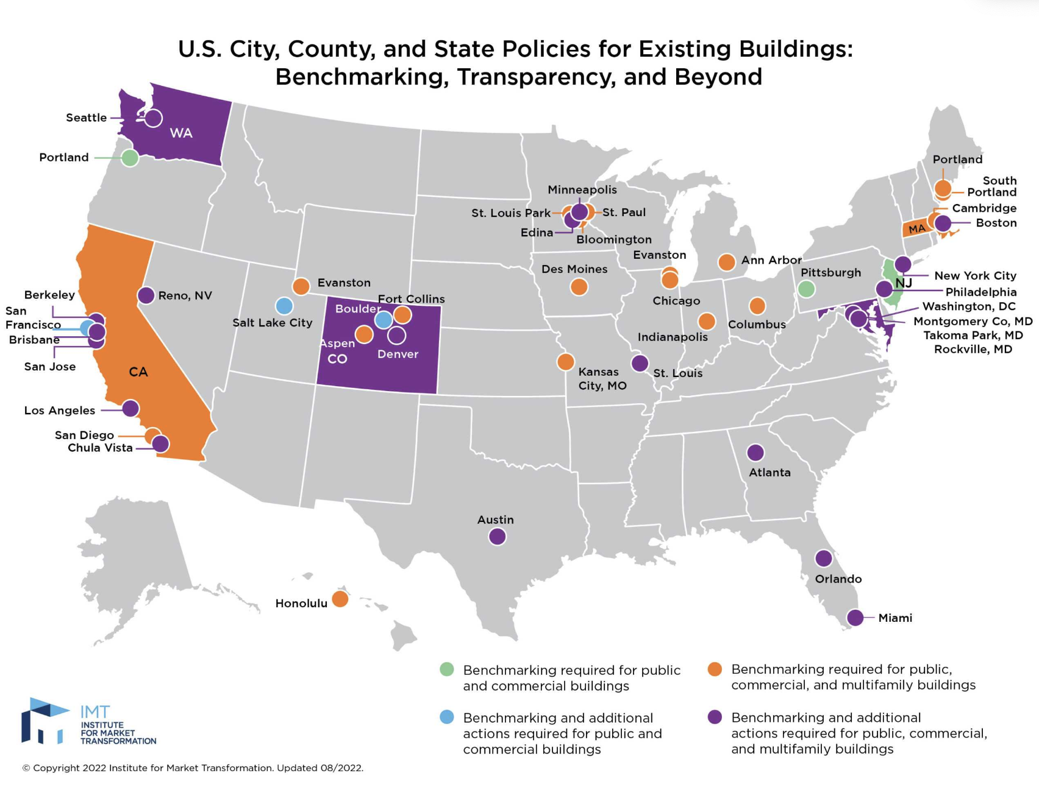
How We Got Here
Benchmarking
Disclosure and labeling
Audits and retrocommissioning
Standardized building data

Slide 5

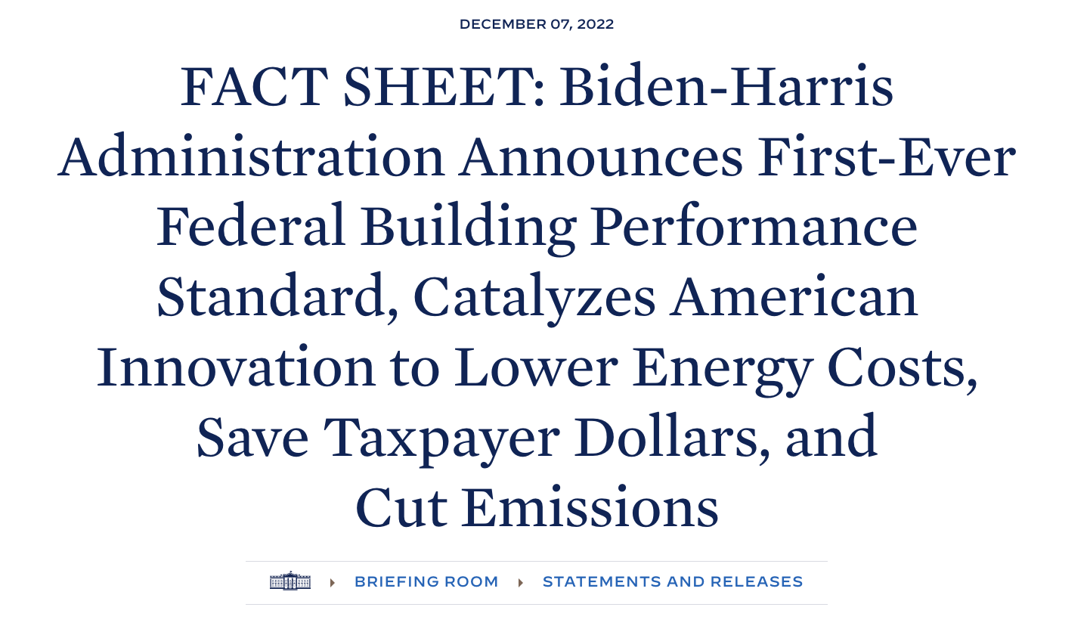


BPS Policy Momentum
January 2022 – President Biden launched the National BPS Coalition with 33 state and local governments publicly committed to passing BPS by Earth Day, 2024.
December 2022 - President Biden launched the Federal Building Performance Standard to cut energy use in federally owned portfolios by 2030.
Source: FACT SHEET: Biden-Harris Administration Launches Coalition of States and Local Governments to Strengthen Building Performance Standards | The White House
FACT SHEET: Biden-Harris Administration Announces First-Ever Federal Building Performance Standard, Catalyzes American Innovation to Lower Energy Costs, Save Taxpayer Dollars, and Cut Emissions | The White House

Slide 6
Current Landscape
14 policies adopted,
40+ considering
BPS covering all federally owned/leased buildings
Federal support for BPS through TA, funding, resources
Notes:
Covering more than 25% of

Slide 7

Metric Selection
Range of Metrics
Jurisdiction Goals and Abilities
Site EUI
Energy Star score
GHG intensity, etc.
Energy/climate/building policy goals
Regulatory authority
Complexity
Single or Dual Metrics
Range of complexity
building-level control
Dependent on policy design
building stock diversity
Notes:
Boston regulates GHG emissions with BPS as Massachusetts retains sole authority to regulate building energy
Washington, DC uses Energy Star score except for those building types where score is not available. Chose an equivalent metric of weather-normalized source EUI
Denver chose site EUI and electrification to align with policy goals driving energy efficiency and electrification of equipment

Slide 8

Covered Buildings Selection
Jurisdictions select which buildings are in or out of BPS policies:
Typology (offices, warehouses, agriculture, multifamily, etc.)
Size threshold (10,000-50,000+ sqft starting thresholds)
Ownership (municipal/public, private, cooperative, leased vs owned, etc)

Slide 9

Alternative Compliance Pathways
Adjustments
  Timeline
  Target
Exemptions
  Use type
  Ownership
Planning
  Building Performance Improvement Plans
Enforcement
  Penalties

Slide 10
Target-setting Approaches
Sector-Level Goals
Benchmarking Data
Published Sources
Modeled Performance
Requires understanding existing building stock performance
Targets by type depend on how buildings are represented in the data
ASHRAE Standard 100 and ENERGY STAR National Median EUIs can be used directly for target-setting
Multiple approaches are being explored, including prototype building and urban-level modeling
Targets can be set based on the top performers in the stock
Top-down approach may not account for the feasibility of retrofits needed to meet targets
Notes:
Taking in detail of their policy model, available data on building stock, future grid emission factors, and we output SAVINGS, both cumulative and as a pathway.
Jurisdictions have their own ideas on policy framework, motivations, constraints. But they don’t know what data they have, what the impacts will be. Target Setting itself.
Reference ASHRAE guide

Slide 11
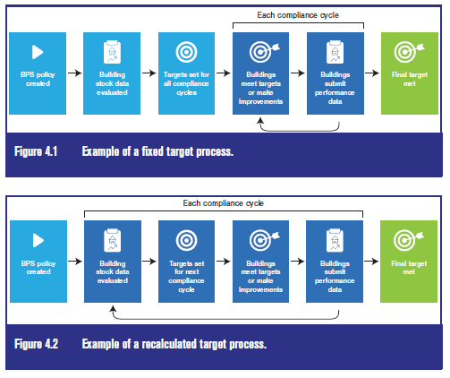
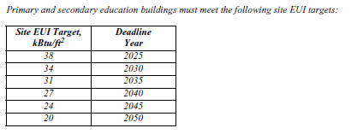
Compliance Cycles
Target Methods
  Fixed targets reaching end-goal
  Recalculated targets changed per compliance cycle
Compliance Timelines
  Often based on building type
  Flexibility based on circumstances
Source: DOE & ASHRAE BPS Technical Resource Guide
Example target and compliance timeline
Source: DOE & ASHRAE BPS Technical Resource Guide

Slide 12

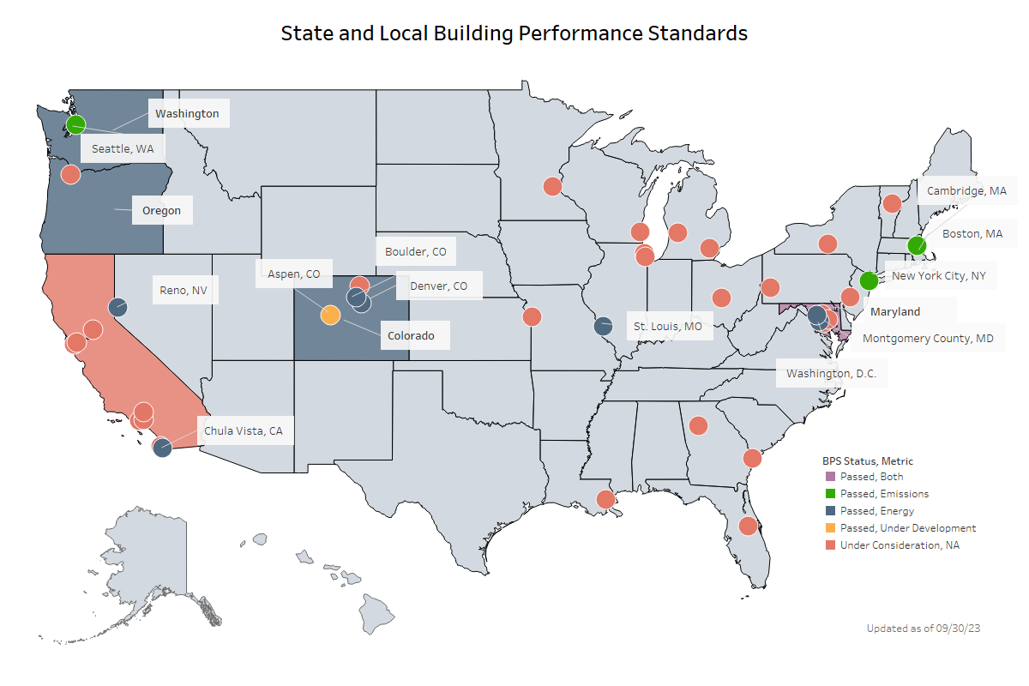
DOE & EPA Building Performance Standards Technical Assistance Network
Technical Assistance Network support includes:
  Technical analysis – Building stock, energy & emissions impacts, economic impacts
  Compliance pathways tools & support
  Performance target-setting and savings trajectories
  Program design & administrative structure support, including data tools implementation
  Stakeholder engagement best practices & equitable policy design support
  And more!
To request Technical Assistance or to learn more about BPS, visit energycodes.gov/BPS
Source: DOE Building Performance Standards Technical Assistance Program
Notes:
14 policies passed to date, more under consideration
46+ jurisdictions have joined national BPS Coalition
Commitments covering more than 25% of nation’s building stock and counting!
The BPS TA Network is open to all members of the National BPS Coalition and any other cities, states, and jurisdictions working on or interested in a BPS or similar policy prompting improvements in a building.

Slide 13
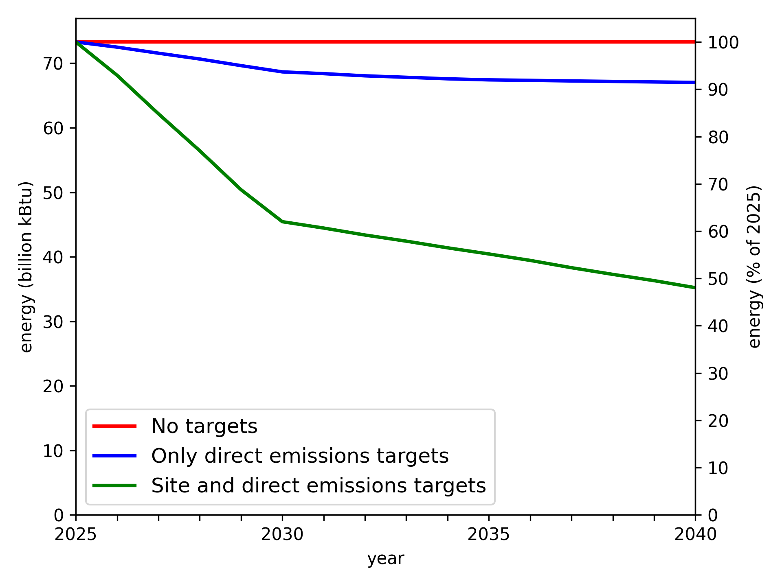
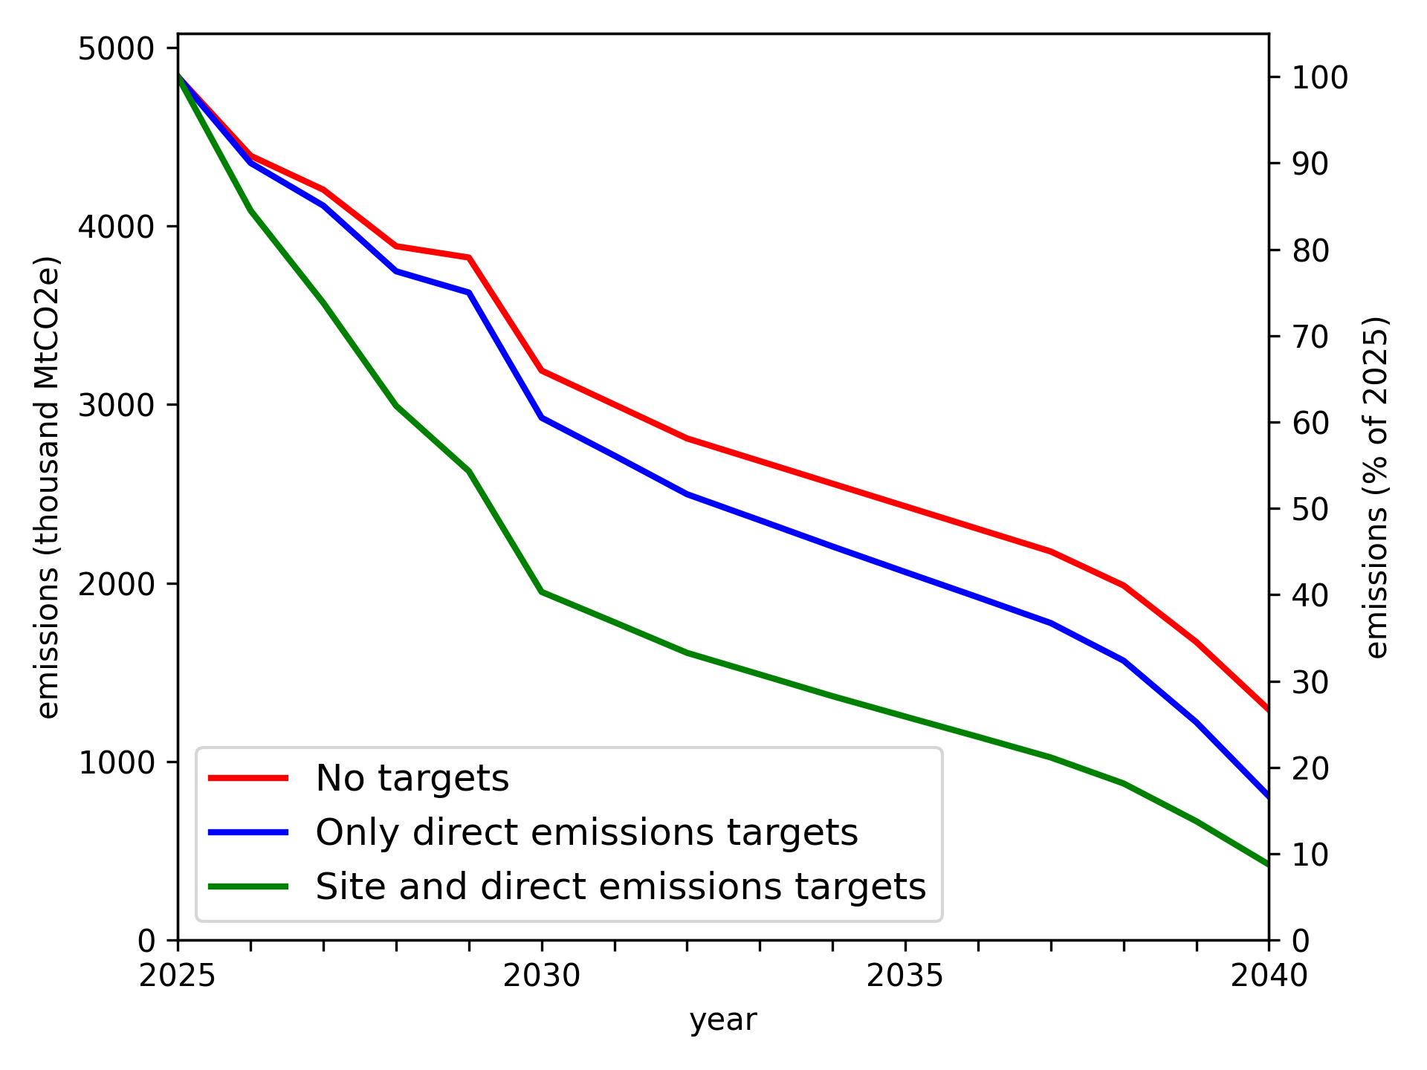
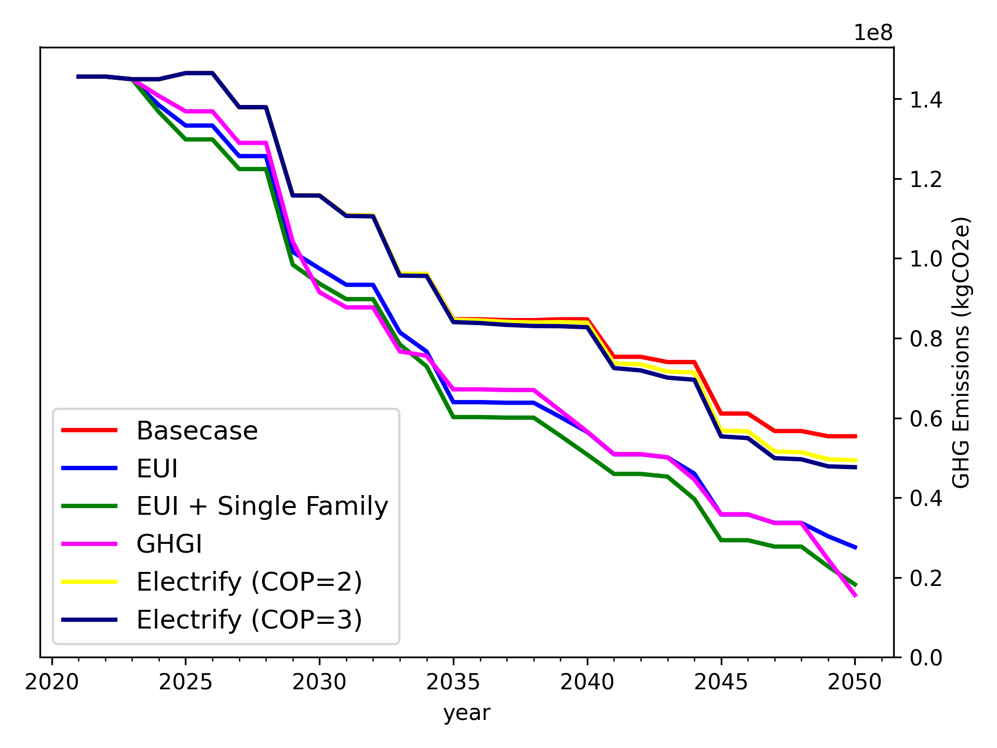
Example TA – Baseline & Scenario Planning
Baselining - Building Stock
  Leverage all existing data, regardless of format or quality
  Fill the gap of unknown energy+GHG data for existing buildings
  Support jurisdictions at any phase of policy development
Scenarios - Impact Analysis
  Model policy-driven scenarios for energy/GHG reduction for any jurisdiction, tailored to their policy framework
  Support policy standardization without sacrificing accuracy of scenario simulation

Slide 14


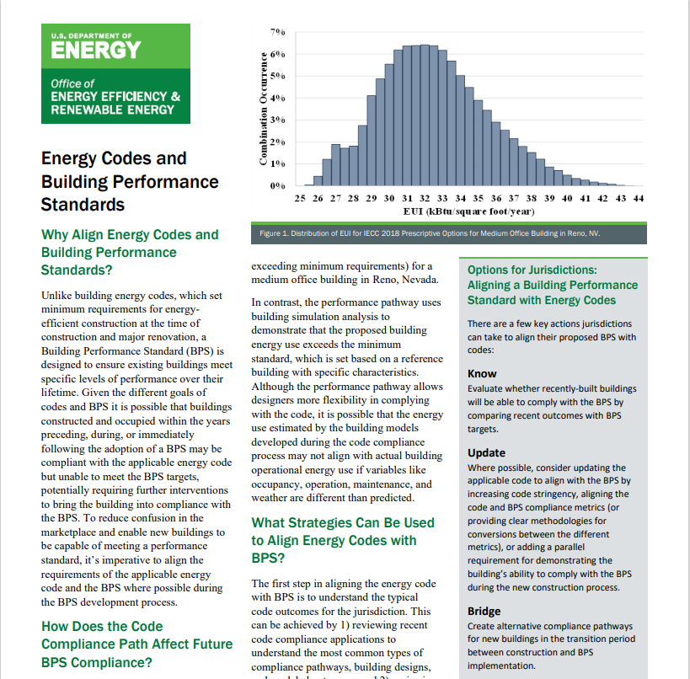


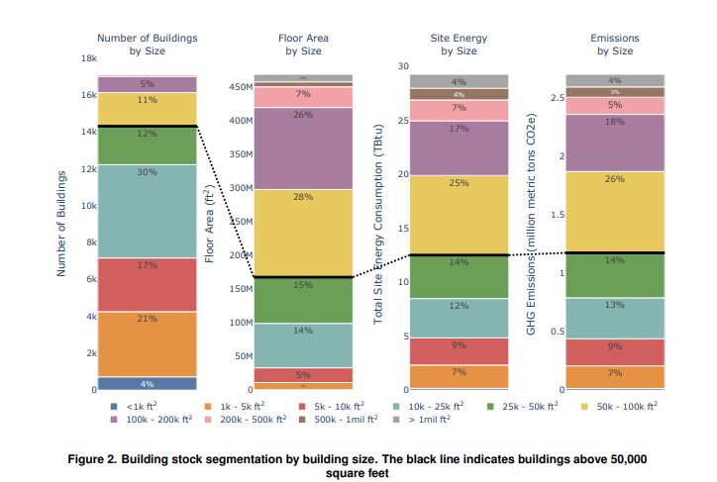
Guidance documentation for stakeholders engaged with BPS design and implementation
Visit energycodes.gov/BPS/Resources for more!

Slide 15






  ENERGY STAR Portfolio Manager - enables the reporting of a building’s energy and water use, square footage, and operational details in a consistent format.
  SEED – central database for tracking building related information
BPS Implementation Support – Software Tools
Clear, accessible, standardized building energy & asset data ecosystem designed to result in action.
  Audit Template – standard format for asset-based building data collection & persistency
Visit energycodes.gov/BPS/Implementation for more!
  UBID – unique building identifier based on geospatial location supporting data use

Slide 16
Data Collection, Management, & Standardization
Users
Data Management Tool: Review, Aggregation, QA/QC, Analysis
Ordinance or BPS Admin
Building Owners/ Auditors/Energy Managers
CRM
BuildingSync XML
Data Collection Tools
EPA ENERGY STAR Portfolio Manager
3rd party platforms
Standardization

Slide 17
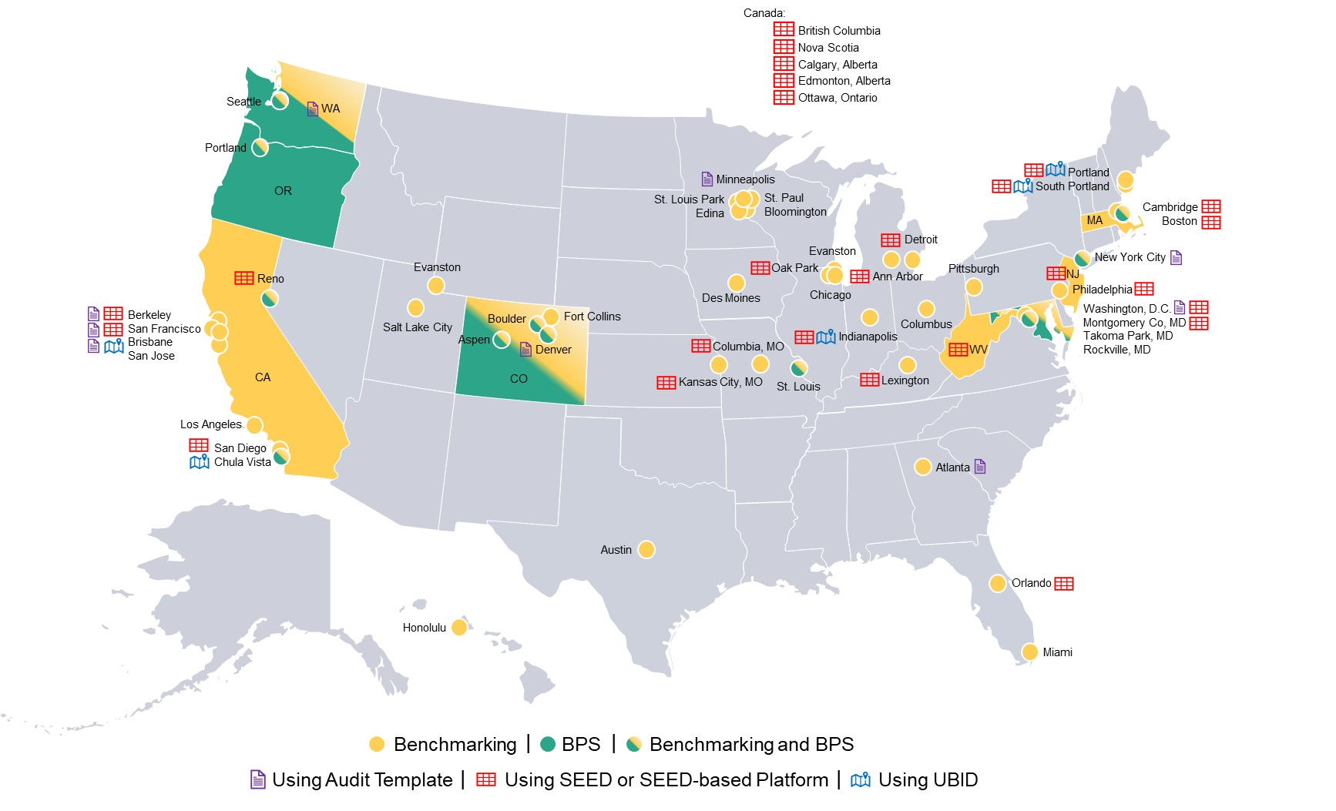
Tool Adoption (as of Sept 2023)
Current (Known) Adoption
8
Audit Template
5
UBID
24
SEED or SEED- Based

Slide 18
Bipartisan Infrastructure Law Funding Section 40511 (RECI)
Title: Cost-effective Codes Implementation for
Efficiency and Resilience
Funding: $225M through FY26
To date, 27 projects awarded across
26 states & District of Columbia
Biden-Harris Administration Announces $90 Million To Support Resilient and Efficient Building Energy Codes and Save American Families Money | Department of Energy

Slide 19









RECI2 - Areas of Interest and Targeted Outcomes
> RECI2 includes one overarching topic area with nine AOIs
Key Areas of Interest
Targeted Outcomes
State and Local Code Adoption
Develop next-generation workforce
Facilitate energy code updates
Improve energy code compliance
Advance new and innovative polices and tools
Increase equity in code-related policies and planning
High Impact State and Local Govs
Rural Communities
Tribal Nations
Workforce Development
Innovative Approaches
Implementation and Compliance
Utility Data
Equity, Energy and Environmental Justice
Partnerships

Slide 20
IRA Codes FOA: Overview
Section 50131 of the Inflation Reduction Act provides funding $1 billion:
To adopt:
  a building energy code (or codes) for residential buildings that meets or exceeds the 2021 International Energy Conservation Code, or achieves equivalent or greater energy savings
  a building energy code (or codes) for commercial buildings that meets or exceeds the ANSI/ASHRAE/IES Standard 90.1-2019, or achieves equivalent or greater energy savings
  a building energy code (or codes) for residential and commercial buildings that meets or exceeds the zero energy provisions in the 2021 International Energy Conservation Code or an equivalent stretch code
To implement a plan for the jurisdiction to achieve full compliance with any building energy code adopted […] which shall include active training and enforcement programs and measurement of the rate of compliance each year
LMC
ZEC

Slide 21
IRA Codes FOA: Deadlines
Full Applications for Round 1 (Must have submitted concept paper) | April 30, 2024 (5pm ET)
Concept Papers Round #2 | May 31, 2024 (5 pm ET)
Second Round Full Application | Late Summer 2024
Third Round (pending funding availability): | Spring 2025
More Info: energy.gov/scep/technical-assistance-adoption-building-energy-codes

Slide 22
Thank you!
Billierae Engelman
Billierae.Engelman@ee.doe.gov
Energycodes.gov/BPS

